Slide 1

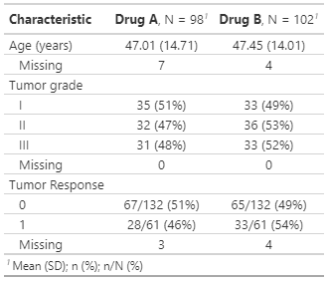
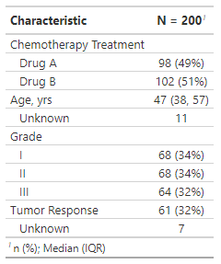
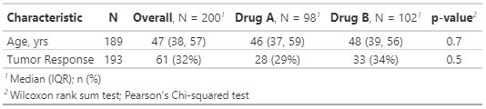
gt summary
Core Table Functions
Publication-ready analytical
and summary tables with R
Cheat Sheet
tbl_summary()
tbl_regression()
tbl_survfit()
Calculates descriptive stats for continuous, categorical, and dichotomous variables.
Turns a regression model object into a customized, formatted table.
Turns a survfit object into a customized table with time-to-event estimates.
tbl_summary()(using tidyverse syntax to summarize specific columns of a dataset with flexible customization options
(See vignette!)
Basic code
Customized code
Customized table
trial %>% select(trt,age,grade,response))%>% tbl_summary()
trial %>%
select(trt, age, grade, response) %>%
tbl_summary(
by = trt,
label = list(age ~ "Age (years)”,
grade ~ “Tumor grade"),
percent = "row"
digits = list(age ~ 2),
statistic = list(age ~ "{mean} ({sd})",
response ~ "{n}/{N} ({p}%)"),
type = list(response ~ "categorical"),
missing = "always",
missing_text = "Missing",
)
Basic table
tbl_svysummary()
for survey objects(
Same functionality as tbl_summary(), but takes a survey object as input, and accounts for survey weights and design.
More info at: http://www.danieldsjoberg.com/gtsummary/reference/tbl_svysummary.html
For more info on customization arguments and options, visit http://www.danieldsjoberg.com/gtsummary/reference/tbl_summary.html
Customization options
Helper functions useful extensions to tbl_summary()
Argument Input Effect on table
by | Column to crosstabulate by | Summary statistics will be calculated separately for each level of the variable
label | Formula list of variable labels | Changes text of variable name in table
statistic | Formula list of summary statistic type for each variable | Changes summary statistics displayed for specified variables in table
digits | Formula list of number of decimal places to display | Changes number of rounded decimal places in table for specified continuous variables
type | Formula list specifying variable types | Changes variable type for specified variables, affecting which summary statistics are displayed
value | Formula list of value to display for dichotomous variables | Changes the value displayed for dichotomous type variables
missing | “no”, “ifany”, “always” | Changes whether missing observations are reported
missing_text | String to display for count of missing observations | Changes the name of the missing data level for appropriate variables
sort | Formula list of type of sorting to perform (“frequency” or “alphanumeric”) | Changes the type of sorting for categorical variables
percent | “column”, “row”, or “cell” | Changes how percentage statistics are calculated and displayed
Extended code
Extended table
trial %>%
select(trt, age,
response) %>%
tbl_summary(
by = trt,
missing= "no“
) %>%
add_n() %>%
add_overall() %>%
add_p()
add_n()
add_overall()
See also:
add_q()
bold_p()
bold_labels()
add_stat()
Adds a column with the total number of non-missing observations
Adds a column with overall summary statistics
add_p()
Adds column of p-values generated by testing for differences between groups. Takes arguments below.
Argument Default Input Effect on table
test | Continuous: “Kruskal test”; Categorical, expected cell counts ≥5: “chisq.test.no.correct“; Categorical, expected cell counts < 5: “fisher.test” | Formula list specifying statistical test to perform for each variable: "t.test“, “aov“, "wilcox.test“, "kruskal.test“, "chisq.test“ and "lme4“; custom tests possible too | Changes p-value in table based on specified statistical test
pvalue_fun | style_pvalue() | Function to round and format p-values | Changes format of p-values in table
For more info, visit http://www.danieldsjoberg.com/gtsummary/reference/index.html
CC BY SA Esther Drill • drille@mskcc.org • Learn more at gtsummary • package version 1.5.2 • Updated: 2022-04

Slide 2
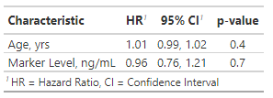
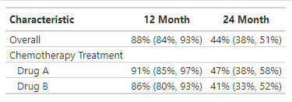
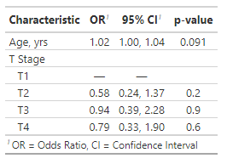
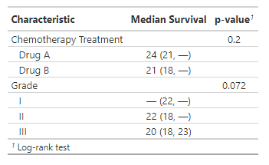
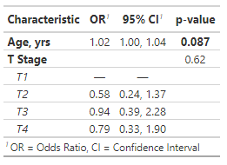
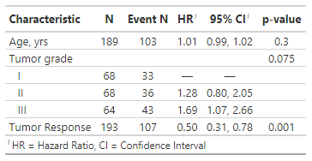
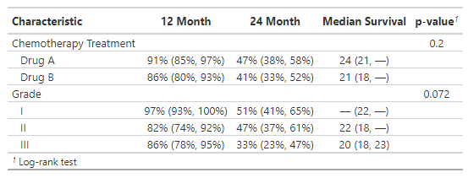
tbl_regression()(Present regression model object in publication-ready table
tbl_survfit()(Present survfit object with custom estimates In publication-ready table
cox model: basic code
Build model of interest
Use tbl_regression() to present results
tbl_regression() supports most commonly used regression models, and uses broom::tidy(x) to perform initial tidying.
For more info:
http://www.danieldsjoberg.com/gtsummary/reference/tbl_regression.html
library(survival)
tbl_survfit(
list(
survfit(Surv(ttdeath, death) ~ 1, trial),
survfit(Surv(ttdeath, death) ~ trt, trial)
),
times = c(12, 24),
label_header = "**{time} Month**"
)
Options for defining model:
x=explicit survfit model (or list of models) from dataframe
x=dataframe and designate y=Surv object and include=covariates in model
library(survival)
cox1 = coxph(Surv(ttdeath, death) ~ age + marker,
data = trial)
tbl_regression(cox1, exponentiate = TRUE)
cox model: basic table
Options for output:
time-specific survival estimates using times=times of interest
quantile (e.g. median) survival times using probs=quantile of interest
glm model: basic table
For more info: http://www.danieldsjoberg.com/gtsummary/reference/tbl_survfit.html
glm model: basic code
m1 <- glm(response ~ age + stage, data = trial,
family = binomial)
tbl_regression(m1, exponentiate = TRUE)
library(survival)
tbl_survfit(
trial,
y = Surv(ttdeath, death),
include = c(trt, grade),
probs = 0.5,
label_header = "**Median Survival**"
) %>% add_p()
glm model: custom table
glm model: custom code using
helper functions
m1 %>%
tbl_regression(exponentiate = TRUE) %>%
add_global_p() %>%
bold_p(t = 0.10) %>%
bold_labels() %>%
italicize_levels()
tbl_merge(), tbl_stack()
combine tables by row or column
Helper functions
t2 = tbl_survfit(
trial,
y = Surv(ttdeath, death),
include = c(trt, grade),
probs = 0.5,
label_header = "**Median Survival**"
) %>% add_p()
tbl_uvregression() displays multiple univariate regression models at once
t1 = tbl_survfit(
list(survfit(Surv(ttdeath, death) ~ trt + grade, trial),
times = c(12, 24),
label_header = "**{time} Month**"
)
cox univariate models: code
cox univariate models: table
library(survival)
tbl_uvregression(
trial %>% select(ttdeath, death, age,
grade, response),
method = coxph,
y = Surv(ttdeath, death),
exponentiate = TRUE,
label = list(grade ~ "Tumor grade")
) %>%
add_global_p()
add_n(location = "level") %>%
add_nevent(location = "level")
tbl_merge(list(t1,t2), tab_spanner = FALSE)
Requires “method” parameter specifying model type. Can estimate univariate regression models holding either outcome (“y”) or covariate (“x”) constant, or both (see “formula” parameter). For more info about “formula” and other parameters, see:
https://www.danieldsjoberg.com/gtsummary/reference/tbl_uvregression.html
tbl_merge combines columns, tbl_stack() combines rows. For more info, see
https://www.danieldsjoberg.com/gtsummary/reference/
CC BY SA Esther Drill • drille@mskcc.org • Learn more at gtsummary • package version 1.5.2 • Updated: 2022-04

