Slide 1
Action 5 - Steelhead
Annual Loss Threshold – 1% of JPE
JPE based on hatchery steelhead
Sacramento River – Coleman, Nimbus, Feather
San Joaquin River – Mokelumne
Normal hatchery practices
Based on historical survival from release sites to Delta entry
May modify survival estimates based on year-specific conditions

Slide 2
Hatchery JPE process
Σ
Hatchery Release
Survival Estimate
Juvenile Production Estimate

Slide 3
Survival Estimates
Water Body | Survival Estimate | Source
Sacramento River | 0.205 – 0.433 | Sandstrom et al. (2020)
Feather River | 0.09 – 0.45 | Kurth (2013) – just an abstract
American River | 0.62 – 0.83 | Brodsky et al. (2020)
Mokelumne River | 0.25 – 0.33 | Del Real et al. (2012)

Slide 4
Survival Estimates Assuming survival and water year type are positively correlated
Water Year Type | Coleman National Fish Hatchery | Feather River Fish Hatchery | Nimbus Fish Hatchery | Mokelumne Fish Hatchery
Critical | 0.21 | 0.9 | 0.62 | 0.25
Dry | 0.27 | 0.18 | 0.67 | 0.27
Below Normal | 0.32 | 0.27 | 0.72 | 0.29
Above Normal | 0.38 | 0.36 | 0.78 | 0.31
Wet | 0.43 | 0.45 | 0.83 | 0.33

Slide 5
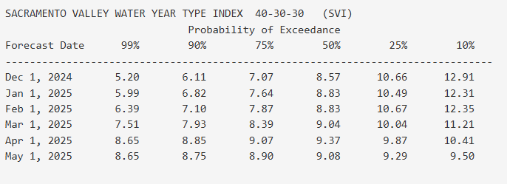
Dynamic Water Year Type
Coleman Fish

Slide 6
Dynamic Water Year Type
State Hatchery Fish

Slide 7
Dynamic Water Year Type
If water year type not available for month, either use previous month water year type or average survival estimates
State Hatchery Fish

Slide 8
Dynamic JPE
Hatchery Release
Cross reference WY type
Grab Survival Estimate
Add to running JPE total

Slide 9
Dynamic JPE
Hatchery Release
Cross reference WY type
Grab Survival Estimate
Add to running JPE total
Full JPE

Slide 10
WY2026 Forecasted Sac WY type = Below Normal
645k
29%
187k
Coleman Fish

Slide 11
WY2026 Forecasted Sac WY type = Below Normal
645k
29%
187k
Coleman Fish
233K
72%
167k
Nimbus Fish

Slide 12
WY2026 Forecasted Sac WY type = Below Normal
645k
29%
187k
Coleman Fish
Total JPE = ~355k
Threshold (1%) = 3551.3
233K
72%
167k
Nimbus Fish

Slide 13
Hatchery release information
CDFW providing spreadsheet on FTP site
SacPAS is now on all hatchery distribution lists
Can parse hatchery release notification PDFs
Already has most of the data from previous years
Can make this scrapable for our assessment code

Slide 14
Improvements for the future
Ongoing genetic analysis
Provide insight into proportional hatchery salvage
Reanalyze existing data
Use modern Bayesian framework to get better survival estimates to delta
Additional telemetry studies
Red Bluff is conducting new study on Coleman steelhead releases

