Slide 1
War Of Kings: A Chess Game Catalogue
By: Brian Porter
Major: Bachelor Of Science in Computer Science (Cybersecurity Minor)
Advised by: Dr. Hayes
Expected Date of Graduation: May 2021
Senior Project Defense(CSCI 499)

Slide 2
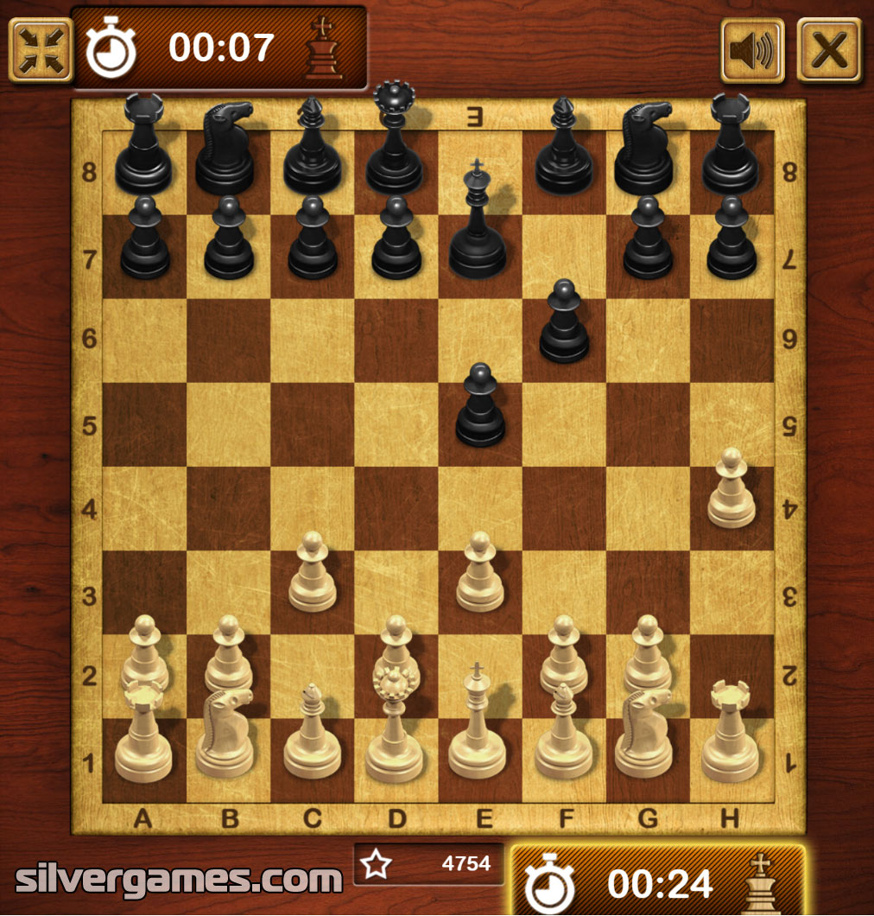
Problem Statement And Purpose
What is chess
One of the oldest and most popular board games in the world.
Played by two people with two colors
Turn based combat where players try to capture each other pieces in an attempt to force each other into an unavoidable capture position
What is the problem?
There aren’t many examples of digital chess
Many interesting forms of chess simply do not exist on any digital media
Ex: Alice Chess, Millennium Chess, Kubikschach, Raumschach, etc…
Only a few chess games with online multiplayer support and mobile support
https://www.britannica.com/topic/chess

Slide 3
Requirements Overview..
What do I want to do?
Make a game that holds many formats of chess
Is available to the average person
Has many options for controls
Has online and offline support
Can be played by mobile users

Slide 4
Research and Background
Unreal Engine Blueprints
Visual Scripting Language
Based on C++ and can generate C++ code from Blueprints
Chess formats:
2-Player, 3-Player, 4-Player, Alice, Millennium
Main Menu, Pause Menu, HUDS:
Unreal Engine Widgets and Buttons
Android Mobile Support
Gamepad and Touch Controls
Android Setup
Networking
Hosting Games
Joining Games
Creating New Players

Slide 5
Hardware and Software Requirements
Preface:
Anything that can run Unreal Engine on its own can run War Of Kings
Windows:
4 GB Ram, most GPU and CPU are acceptable.
Android:
Testing Still Ongoing:
Tests ran with 1GB of Ram
Likely need around 500MB or less until online networking support is complete.

Slide 6
Why I chose Unreal Engine Blueprints
Compile Times
Computer Performance with Unreal Engine
Learning New Language/Challenging Myself
Unchanged Game Performance

Slide 7
Program Description
https://youtu.be/Z0TU96TISpw

Slide 8
Test Plan Requirements
Separated Between five different variants of Chess and 2 modes of playability which are local and online multiplayer.
Tests Include:
Mobile controller support- 2 stick for movement and direction and touch input to select pieces
Windows controller- using mouse to select pieces and drag to look around.
Players can select a piece that belongs to their army
Players can select a new place for the piece
Players are not allowed to make invalid moves(putting pieces outside board, putting pieces in allied occupied spot, etc..)
Players Can Promote Pawns to different pieces when pawns go to specific location
Players can host or join a game
Players have a Hud to show information about game and ability to exit game using pause menu
Etc…

Slide 9
Test Plan Results
Player Controller for Windows and Mobile for all formats
Main Menu buttons
Pause Menu buttons
Player HUDs mostly work
All Boards Mapped to grids and pieces placed
All except 3-Player Board can select pieces
Special Move tests for boards are in progress
Checkmate and Stalemate for boards are in partial testing and implementation

Slide 10
Challenges Overcome
Main Menu Level Selection and Button Actions
Special Board Formats(3-Player Board Shape, etc..)
Mobile Input Controls
Camera and Player Movement
Creation of Boards
Selecting Pieces
Change Player Turn

Slide 11
Current Challenges
Time
My own ambition
Networking remains incomplete
Mobile Support remains incomplete
Checkmate function and Stalemate function are incomplete for some variants
Special Moves Incomplete

Slide 12
Future Planning
Fix to allow players to connect to listener server(In Progress)
Fix to allow players to play on Android(In Progress)
Change to player controllers for when a piece is selected, board cells are highlighted to show potential moves.
Adding more chess variants to the game.
Add themes(option) to boards
And more…

Slide 13
Mistakes I Have Made
Choosing too many chess formats to work on at one time
Not focusing on one chess format to work on at a time and working on one section for multiple formats
Being too indecisive about changing projects requirements
Making mistakes and forgetting certain rules for certain chess formats
Not giving myself enough time to test smaller aspects of the game

Slide 14
What Have I Learned?
Unreal Engine Blueprints
Functions, Widgets, Variables, And Space Coordinate System
Player Controllers, Game states, Game Modes, Level Blueprints
Strengths and Weaknesses of Unreal Engine Blueprints

Slide 15
Credits
https://github.com/BDP18/WarOfKingsProj

