Slide 1


ByteMentor ZHAW AI Assistant

Slide 2
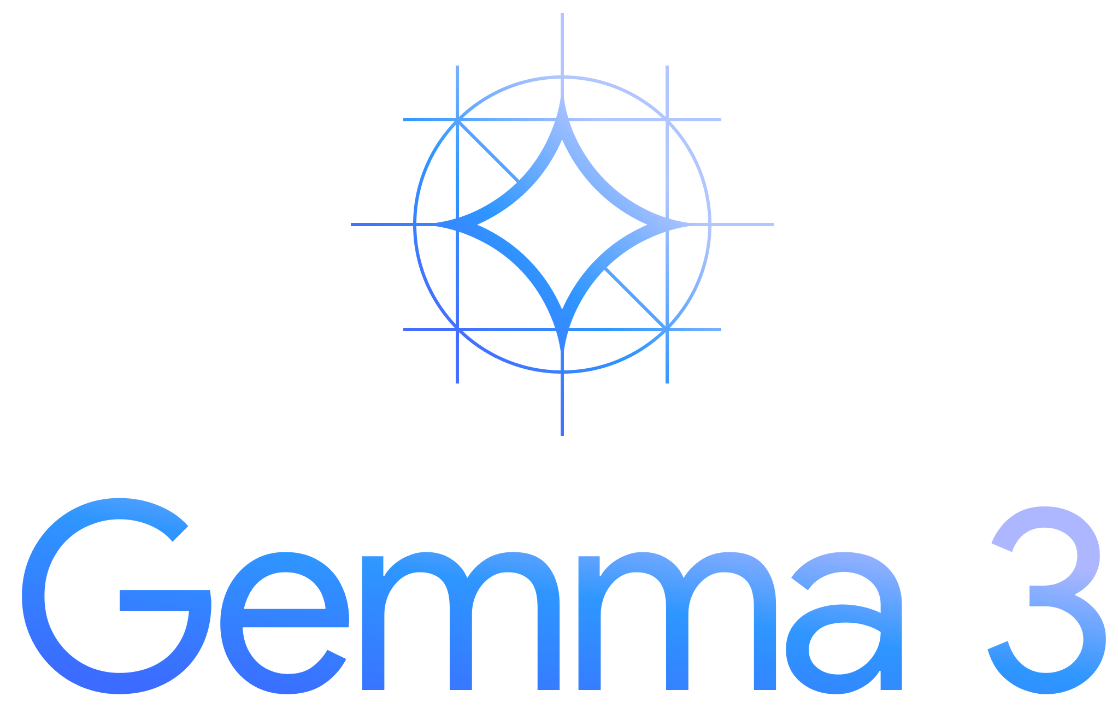


ByteMentor - Model
Gemma 3:1b (open sourced, lightweight)
English, Text Input/Output
Fine-tune model
Unsloth (Python Lib, Nividia GPU)
Hugging Face (Transformers)
2

Slide 3
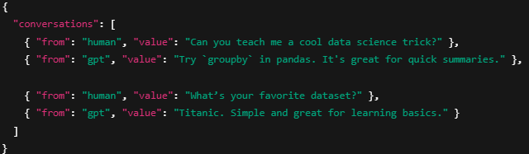
ByteMentor - Data
Pipeline Now
Text extraction ~ 1000 ZHAW Documents
Translation ~ 70% from «de» to «en»
Save to MongoDB
Pipeline Planned
Transformation into Q&A Fomat
3

Slide 4
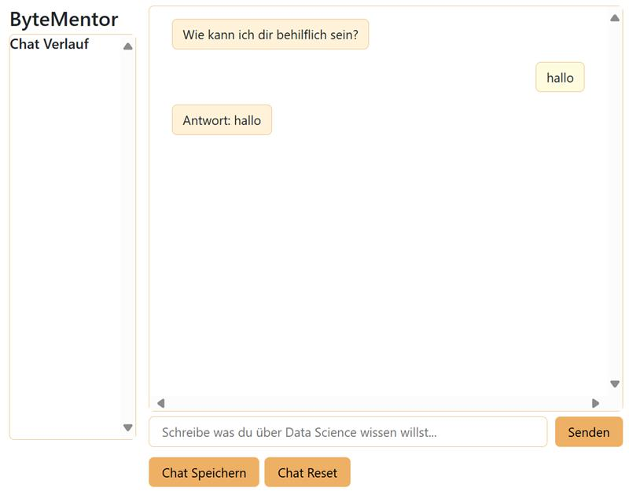
ByteMentor - Web App
Now:
Frontend (chat, chat-history, input)
Planned;
Frontend (UI/UX improvment)
Backend(API Endpoints, Performance optimization)
4

