Slide 1


ByteMentor ZHAW AI Assistant
Azevedo Katharina, Tomic Nikola, Schwarz Damian

Slide 2

ByteMentor - Entstehung
Problemstellung
LLMs sind nicht auf ZHAW-Daten trainiert.
Motivation
Interesse an LLMS, und Datapipelines
Ziel: App mit nutzen für uns
Release: Google DeepMind Gemma 3 (klein, stark, open-weight)
2

Slide 3
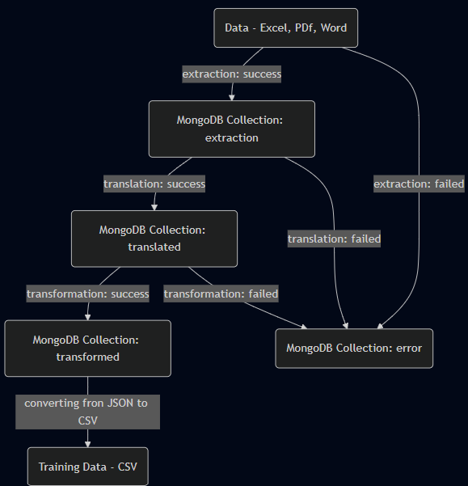
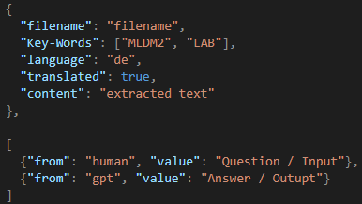
Daten – Pipeline
2
Notes:
Extrahieren: 1 Stunde
Übersetzen: 7 Stunden
Transformieren: 49 Stunden

Slide 4
Daten – Ressourcen und Zahlen
MongoDB – pymongo
Text extrahieren: PyPDF 2, python-pptx, python-docx
Übersetzen: Argostranslate (Open-Source, offline, NN, python)
Problem: Input -> aufteilen in Sätze
Transformieren: Ollama(gemma-3), langchain_community
Promt: (Kurz, Format, ZHAW Modul)
Kennzahlen
Extrahiert: 831 | 1 Stunde
Übersetzung: 580 | 69.8% | 7 Stunden
Transformation: 35’221 paare | 49 Stunden | 5.008 sec/request
2

Slide 5

Model - System Design
Model: google/gemma-2b-it , Hugging Face
Training in Python
Transformers, torch, trl
Lokales fine-tuning mit CUDA
LORA
2

Slide 6
Model - Training
1. Schneller Test: rate01-50
Learning Rate: 0.1
Training Steps: 50
2. Kleine learning-rate und wenig steps: rate2e-4-500
Learning Rate: 0.0002
Training Steps: 500
3. Hohe learning-rate und viele steps: rate2-2-10’000 (runtime: 48h)
Learning Rate: 0.02
Training Steps: 10’000
2

Slide 7

Model – Evaluation aller Models
Frage: What is the core concept of Explorative_Datenanalyse, focusing on data discovery?
Antwort: Explorative_Datenanalyse involves uncovering insights through data exploration, focusing on understanding patterns.
rate01-50:555
What is the core concept of Explorative_Datenanalyse, focusing on data discovery?
**Explorative_Datenanalyse** is a research area that focuses on the **discovery of patterns and relationships** in **unstructured and semi-structured data**. This involves a **multi-step process** that includes data cleaning, data transformation, data exploration, and data mining. …
rate2e-4-500:
What is the core concept of Explorative_Datenanalyse, focusing on data discovery?
**Explorative_Datenanalyse** is a data science approach that focuses on **uncovering and understanding data** through a **creative and iterative process**. It emphasizes the **discovery of patterns and relationships** in data, rather than just analyzing pre-defined variables or hypotheses…..
rate2-2-10’000:
What is the core concept of Explorative_Datenanalyse, focusing on data discovery?
2

Slide 8
Web App - System Design
Backend:
Python - Flask
Endpunkte: /correct, /askmodel
Frontend:
Vite
ReactJS (hooks, components, types)
Features: Chat-Input, Chat-Window, Chat-History
2

Slide 9
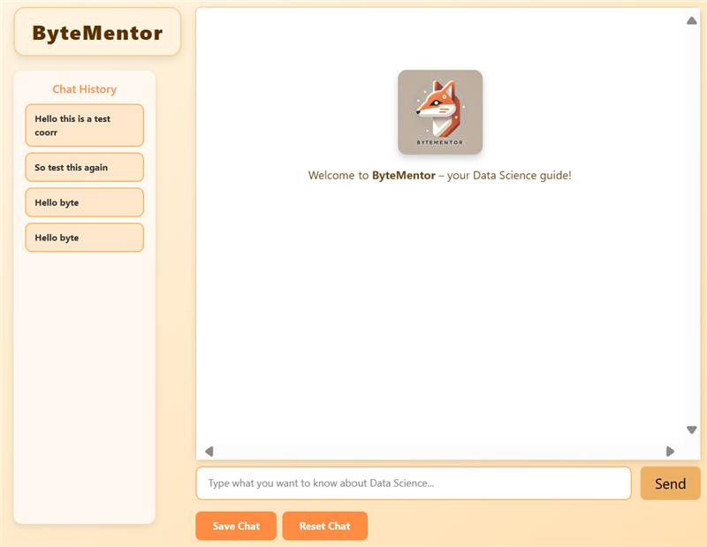
Web App - Demo
Live Demo
2

