Slide 1



QKD-E91 Protocol
Artur Ekert
1991
By:
Nawaf Abdulrahman Alharkan
Abdulaziz Salem Altamimi
Bader Khaled Alotaibi
October 12th, 2023

Slide 2
01
Solutions Tools

Slide 3



Solutions Tools
We used Qiskit which is an open-source software development kit for working with quantum computers at the level of circuits, and algorithms, using Python.
We also used Composer, which is an IBM quantum tool that allows you to build, visualize, and run circuits.
3

Slide 4
Fundamentals Of Quantum
02

Slide 5
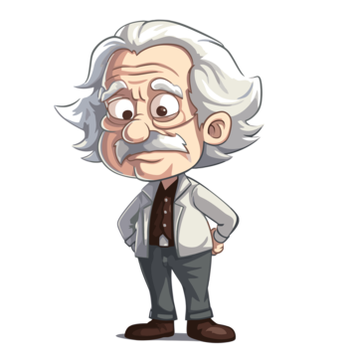
Entanglement
Entanglement is an important aspect of quantum computing. But what exactly is it?
Entanglement is when multiple objects, (such as a pair of electrons or photons) share a single quantum state, changing the state of one of the qubits will instantaneously change the state of the other one in a predictable way. This happens even if they are separated by very long distances.
Nobody really knows quite how or why entanglement works. It even baffled Einstein, who famously described it as “spooky action at a distance.”
5

Slide 6

Entanglement
The concept of entanglement may seem strange and abstract, information is processed using bits that can take on either a value of 0 or 1. In quantum computing, information is processed using quantum bits, or qubits, which can exist in a superposition of both 0 and 1 states at the same time.
This allows quantum computers to perform certain calculations much faster than classical computers.
6

Slide 7
03
Protocol-E91

Slide 8
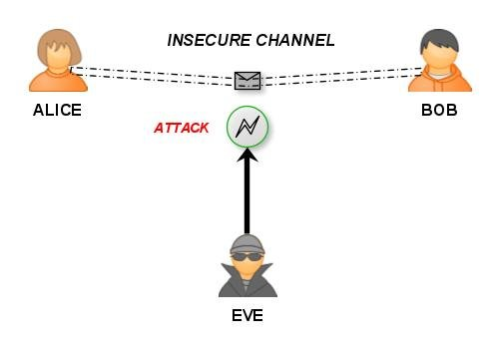
Protocol-E91
If we use a classical channel between two users, the chance of an eavesdropper is very high and even if there is encryption, the encryption will be easily broken.
8

Slide 9
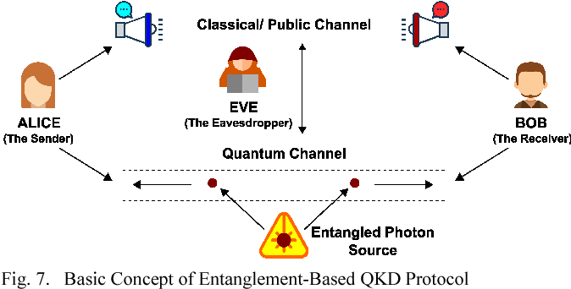
Protocol-E91
So here comes the use of quantum channel through entanglement, which is nearly impossible to break, once the quantum particles (Photons) are generated and reach Alice and Bob no one can eavesdrop on the channel, but they can disturb it, but no chance they can have the result or outcome.
9

Slide 10
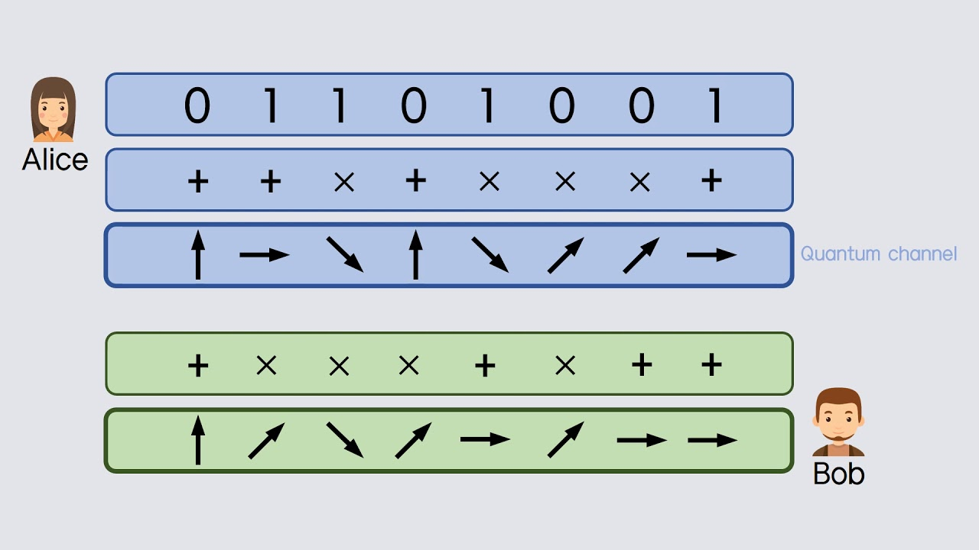
Protocol-E91
Source that emits pairs of particles in a single state.
Each particle gets entangled.
Fly towards two users(Alice & Bob).
Each of them uses random gates (filters) to change the value.
They use classical channel to tell each other which gates they use.
Through the similar gates used, they extract the key from it.
10

Slide 11
Protocol-E91
Please wait while we run the demo…
11

Slide 12
04
Conclusion

Slide 13

Conclusion
Quantum Cryptography is a new revolution in the world of secure communication and as the research continues, the day is not very far when we will be successfully using it for highly secure communication.
E91 offers the advantage of information-theoretic security, meaning it is secure against any eavesdropper. However, it requires a higher level of experimental control and is more challenging to implement in practice.
13

Slide 14
THANK YOU !

Slide 15

Any questions?

Slide 16

References
http://www.physics.drexel.edu/~bob/Entanglement/Ekert_keydistribution.pdf
https://medium.com/@qcgiitr/fundamentals-of-quantum-key-distribution-bb84-b92-e91-protocols-e1373b683ead
https://www.youtube.com/@ArturEkert
16

