Slide 1
Interactive Visualizations
with R and Shiny

Slide 2
What is shiny?
Under the hood
My first shiny app
Inputs & Outputs
CONTROLLING THE FLOW
Observers & reactives

Slide 3
What is shiny?
An R package
A framework
Web server linked with R
User interface
Communication
State management

Slide 4


What is shiny? An R package
Available on CRAN & GitHub:
https://cran.r-project.org/package=shiny
https://github.com/rstudio/shiny
Maintained by (of fame)
https://shiny.posit.co/

Slide 5
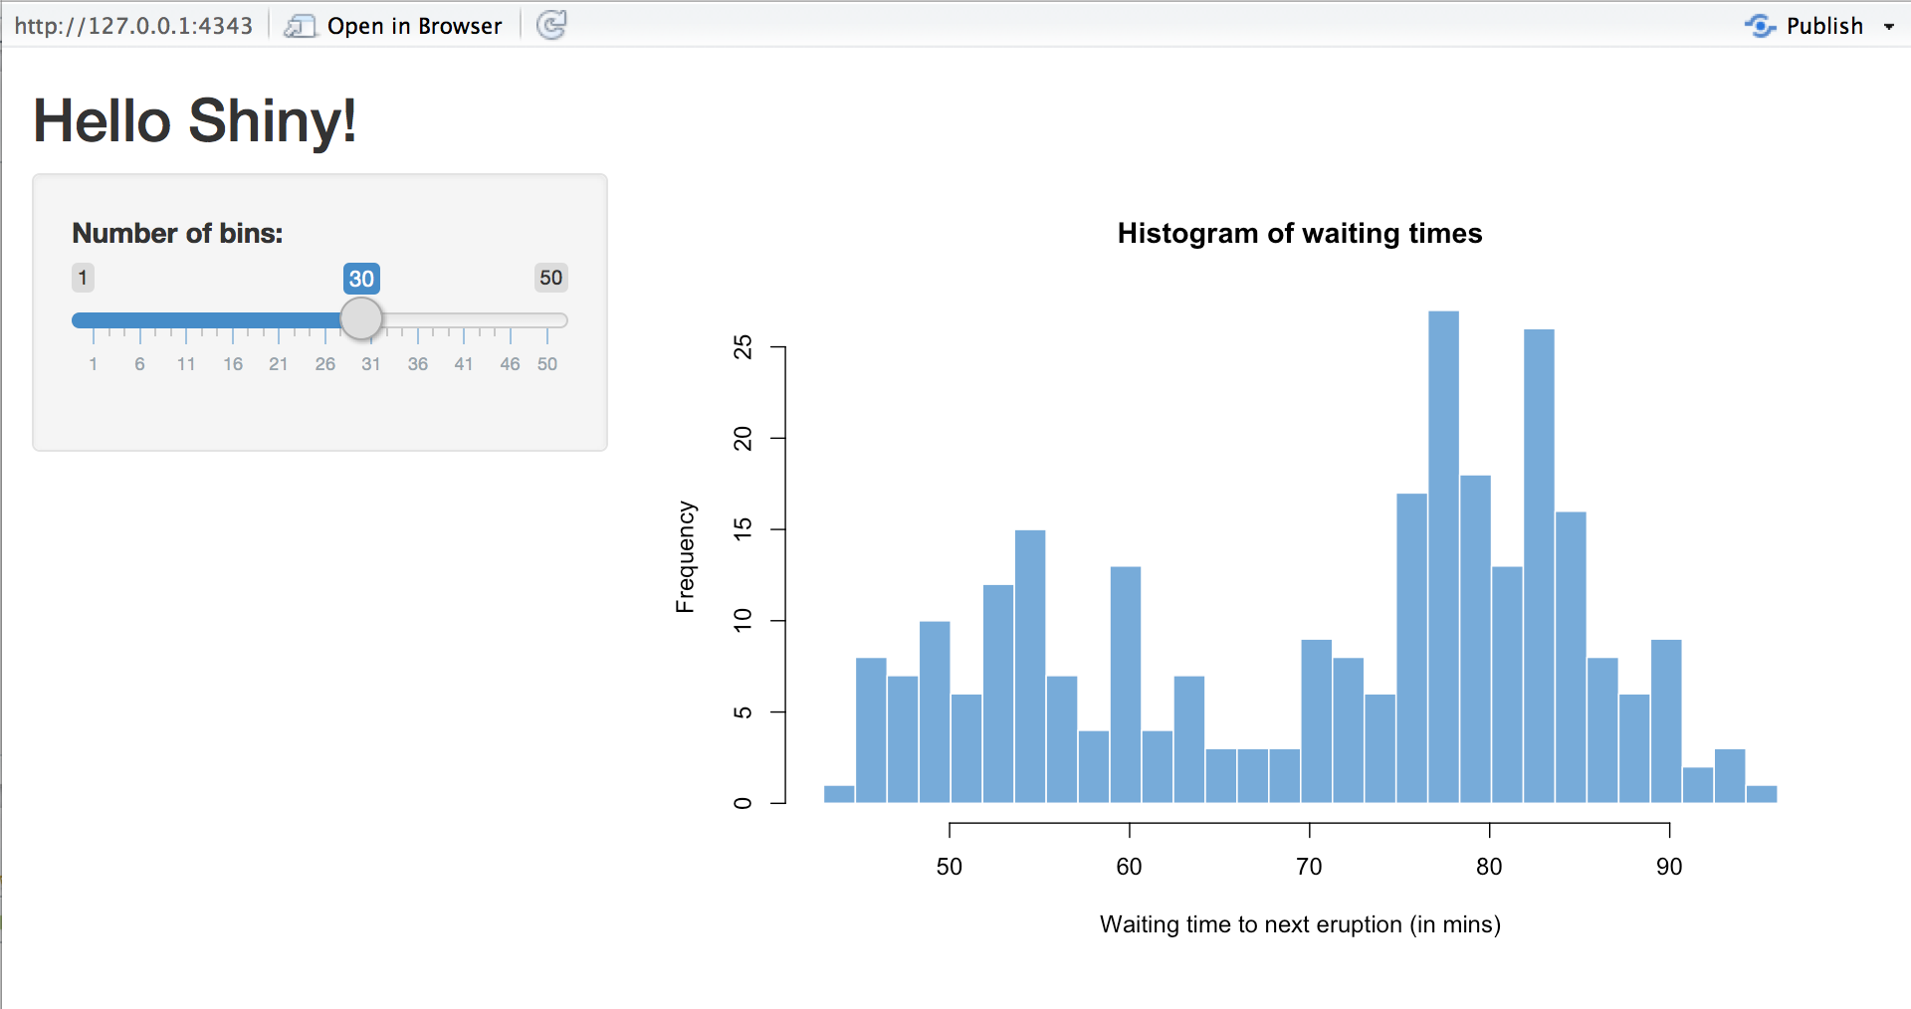

What is shiny? A FRAMEWORK
Shiny apps are hosted by a computer running R
https://pix4free.org/assets/library/2021-01-12/originals/laptop_notepad_pen_cafe_coffee.jpg

Slide 6
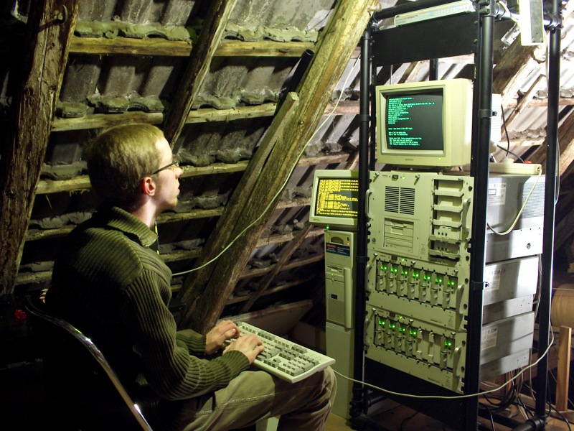
What is shiny? A FRAMEWORK
Shiny apps are hosted by a computer running R
https://www.flickr.com/photos/rudolf_schuba/153225000

Slide 7
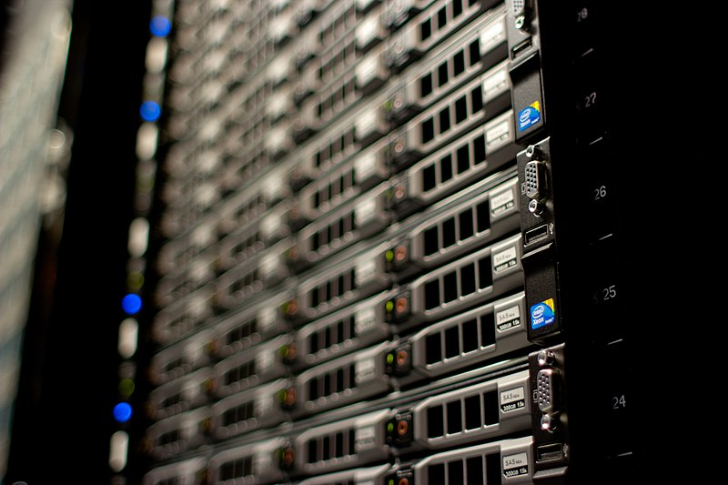
What is shiny? A FRAMEWORK
Shiny apps are hosted by a computer running R
http://www.mojimade.com/cloud-caf-stickers
https://commons.wikimedia.org/wiki/File:Wikimedia_Foundation_Servers-8055_17.jpg

Slide 8



What is shiny? A FRAMEWORK
http://www.mojimade.com/cloud-caf-stickers
https://commons.wikimedia.org/wiki/File:Wikimedia_Foundation_Servers-8055_17.jpg

Slide 9


What is shiny? A FRAMEWORK
http://www.mojimade.com/cloud-caf-stickers
https://commons.wikimedia.org/wiki/File:Wikimedia_Foundation_Servers-8055_17.jpg

Slide 10

What is shiny? A FRAMEWORK
http://www.mojimade.com/cloud-caf-stickers
https://commons.wikimedia.org/wiki/File:Wikimedia_Foundation_Servers-8055_17.jpg

Slide 11
What is shiny? A FRAMEWORK
http://www.mojimade.com/cloud-caf-stickers
https://commons.wikimedia.org/wiki/File:Wikimedia_Foundation_Servers-8055_17.jpg

Slide 12

What is shiny? A FRAMEWORK
http://www.mojimade.com/cloud-caf-stickers
https://commons.wikimedia.org/wiki/File:Wikimedia_Foundation_Servers-8055_17.jpg

Slide 13
What is shiny? A FRAMEWORK
http://www.mojimade.com/cloud-caf-stickers
https://commons.wikimedia.org/wiki/File:Wikimedia_Foundation_Servers-8055_17.jpg
UI.R
Server.R

Slide 14
What is Shiny? User Interface & server
UI.R
Layout
Inputs
Text fields, buttons, etc.
File uploads
Mouse clicks, drags, etc.
Outputs
Text
Tables, figures, media, etc.
File downloads
Server.R
Handle data and logic
React to changes
Observe inputs
Update outputs
Trigger side effects
Maintain state
Data, inputs, outputs
Dynamic/intermediate data

Slide 15
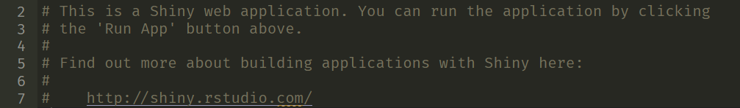
Hello, world! MY first shiny app
Create a Shiny App
File -> new file -> Shiny Web App
Choose a Single File app
Open app.R (if it wasn’t already)

Slide 16
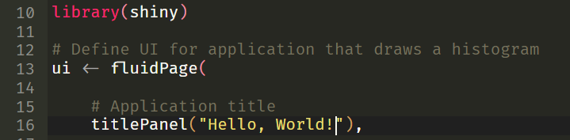
Hello, world! MY first shiny app
Change the title to “Hello, World!”
This is traditional, other titles are not acceptable.

Slide 17
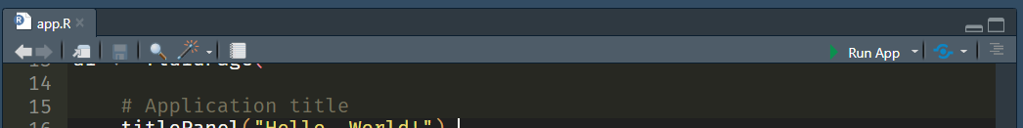

Hello, world! MY first shiny app
Run your app
Congratulations!
You’ve made your first shiny app.

Slide 18

Hello, world! MY first shiny app
Change lines 51-52 to:
Restart the app
Change the input, see the output update.

Slide 19
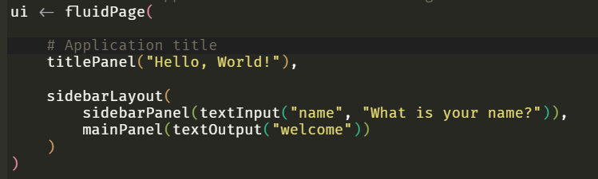
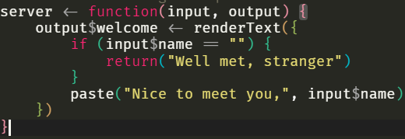
Hello, world! my first shiny app
UI
- sliderInput(“bins”, …)
+ textInput(“name”, …)
- plotOutput(“distPlot”)
+ textOutput(“welcome”)
Server
- renderPlot(“distPlot”, …)
+ renderText(“welcome”, …)

Slide 20
Hello, world! Make it yours
Cheat sheets are your friend Help > Cheat Sheets > Web applications with Shiny
Keep it simple
Stick to a basic use case – you can add complexity later
Load any data you need
UI
Add/change inputs & outputs
[xxx]Input(..), [xxx]Output(..)
Change layout, labels, texts
Server
Create an output for your analysis/visualization
render[xxx](..)

