Slide 1
Interactive Visualizations
with R and Shiny

Slide 2
What is shiny?
Under the hood
My first shiny app
Inputs & Outputs
CONTROLLING THE FLOW
Observers & reactives
Notes:
Quick intro to what shiny does and how it does it
Group “hello world” minimal app
Practical, work on your own app, I may highlight some concepts with examples

Slide 3
What is shiny?
An R package
A framework
Web server linked with R
User interface
Communication
State management

Slide 4


What is shiny? An R package
Available on CRAN & GitHub:
https://cran.r-project.org/package=shiny
https://github.com/rstudio/shiny
Maintained by (of fame)
https://shiny.posit.co/

Slide 5

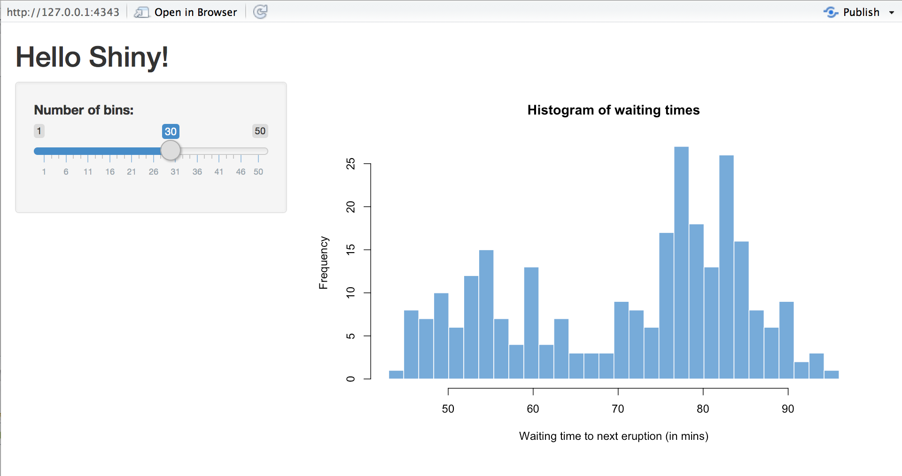

What is shiny? A FRAMEWORK
Shiny apps are hosted by a computer running R
https://pix4free.org/assets/library/2021-01-12/originals/laptop_notepad_pen_cafe_coffee.jpg
Notes:
Shiny is a WEBSERVER. You don’t interact directly with it like a normal script, you open the app in a browser and it connects to the server. The server can be your own laptop, or a server somewhere else.

Slide 6
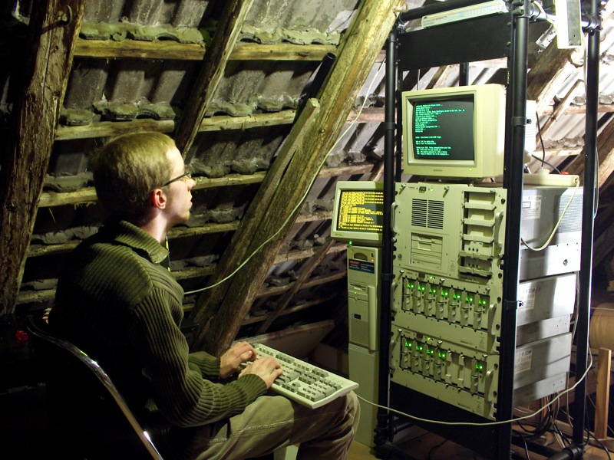
What is shiny? A FRAMEWORK
Shiny apps are hosted by a computer running R
https://www.flickr.com/photos/rudolf_schuba/153225000
Notes:
If you’re like me it could be an old server in your attic (though I don’t have to be there for it to work – remember, it’s a webserver)

Slide 7
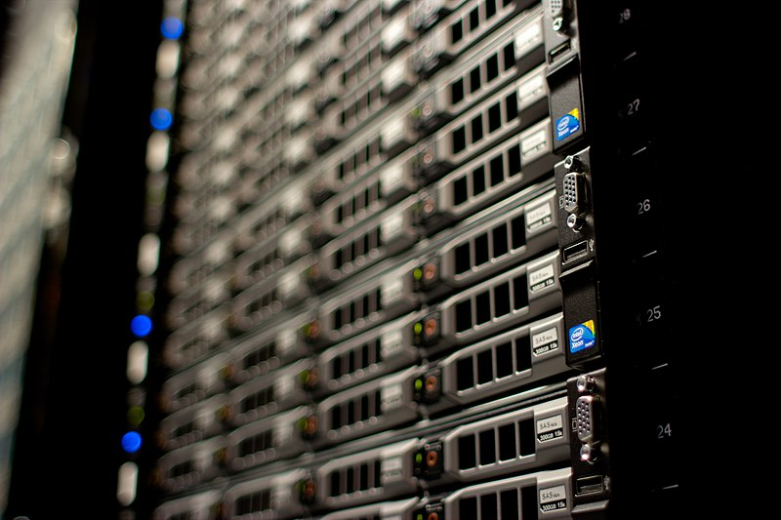
What is shiny? A FRAMEWORK
Shiny apps are hosted by a computer running R
http://www.mojimade.com/cloud-caf-stickers
https://commons.wikimedia.org/wiki/File:Wikimedia_Foundation_Servers-8055_17.jpg
Notes:
Or, more likely, it’s in “the cloud” somewhere.
Keep in mind that the cloud just means someone else’s computer, so be careful with sensitive data!

Slide 8



What is shiny? A FRAMEWORK
http://www.mojimade.com/cloud-caf-stickers
https://commons.wikimedia.org/wiki/File:Wikimedia_Foundation_Servers-8055_17.jpg
Notes:
The user interface uses common web tech, i.e. html, css, javascript.

Slide 9


What is shiny? A FRAMEWORK
http://www.mojimade.com/cloud-caf-stickers
https://commons.wikimedia.org/wiki/File:Wikimedia_Foundation_Servers-8055_17.jpg
Notes:
If you want to be specific, it uses bootstrap and react.

Slide 10

What is shiny? A FRAMEWORK
http://www.mojimade.com/cloud-caf-stickers
https://commons.wikimedia.org/wiki/File:Wikimedia_Foundation_Servers-8055_17.jpg
Notes:
But the good news is that most of the time, we don’t have to deal with any of that – shiny does it for us.

Slide 11
What is shiny? A FRAMEWORK
http://www.mojimade.com/cloud-caf-stickers
https://commons.wikimedia.org/wiki/File:Wikimedia_Foundation_Servers-8055_17.jpg
Notes:
Shiny also handles all the communication between the user interface and the server

Slide 12
What is shiny? A FRAMEWORK
http://www.mojimade.com/cloud-caf-stickers
https://commons.wikimedia.org/wiki/File:Wikimedia_Foundation_Servers-8055_17.jpg
Notes:
And on the server, we use “normal” R code in combination with shiny functions.

Slide 13
What is shiny? A FRAMEWORK
http://www.mojimade.com/cloud-caf-stickers
https://commons.wikimedia.org/wiki/File:Wikimedia_Foundation_Servers-8055_17.jpg
UI.R
Server.R
Notes:
As the user interface and the server code are two separate components, we typically save them as separate R files

Slide 14
What is shiny? A FRAMEWORK
http://www.mojimade.com/cloud-caf-stickers
https://commons.wikimedia.org/wiki/File:Wikimedia_Foundation_Servers-8055_17.jpg
ui
server()
app.R
Notes:
Or, especially in smaller apps, we combine a ui object and server function in a single app.R file.

Slide 15
What is Shiny? User Interface & server
UI.R
Layout
Inputs
Text fields, buttons, etc.
File uploads
Mouse clicks, drags, etc.
Outputs
Text
Tables, figures, media, etc.
File downloads
Server.R
Handle data, logic, and state
React to changes
Observe inputs
Update outputs
Trigger side effects
Maintain state
Data, inputs, outputs
Dynamic/intermediate data
Notes:
Ui and server have different responsibilities
UI is largely static, defining a list of inputs and outputs, and how they are shown
Server is a function that handles data, logic and state.

Slide 16
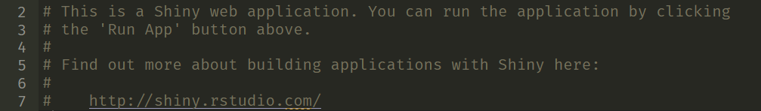
Hello, world! MY first shiny app
Create a Shiny App
File -> new file -> Shiny Web App
Choose a Single File app
Open app.R (if it wasn’t already)

Slide 17
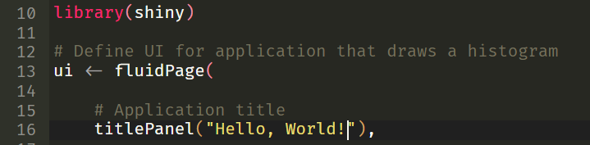
Hello, world! MY first shiny app
Change the title to “Hello, World!”
This is traditional, other titles are not acceptable.

Slide 18
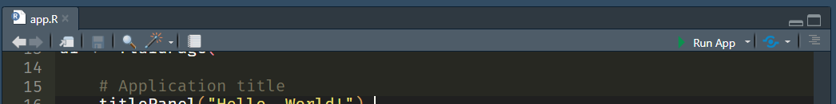

Hello, world! MY first shiny app
Run your app
Congratulations!
You’ve made your first shiny app.

Slide 19

Hello, world! MY first shiny app
Change lines 51-52 to:
Restart the app
Change the input, see the output update.

Slide 20
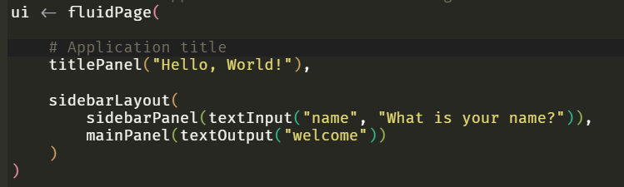
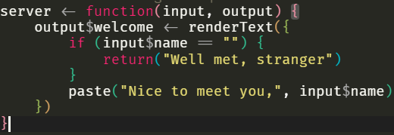
Hello, world! my first shiny app
UI
- sliderInput(“bins”, …)
+ textInput(“name”, …)
- plotOutput(“distPlot”)
+ textOutput(“welcome”)
Server
- renderPlot(“distPlot”, …)
+ renderText(“welcome”, …)
Notes:
Let’s take the example app and create a simple interactive greeter app.

Slide 21
Hello, world! Make it yours
Cheat sheets are your friend Help > Cheat Sheets > Web applications with Shiny
Keep it simple
Stick to a basic use case – you can add complexity later
Load any data you need
UI
Add/change inputs & outputs
Change layout, labels, texts
Server
Create output(s) for your analysis/visualization

Slide 22
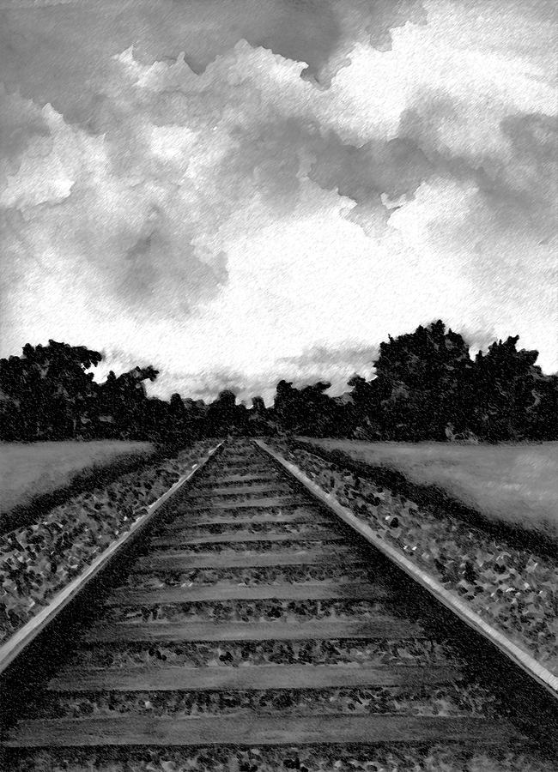
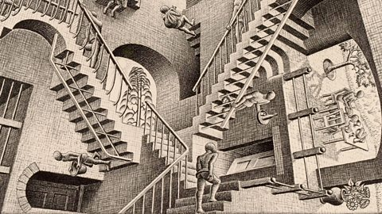
apps are not scripts REACTIVITY
Linear script vs. interactive flow
Cause and effect
if name changes, update greeting
explicit vs. implicit dependencies
Notes:
Implicit dependencies occur when you use reactive values (e.g. inputs) to create outputs. This makes sure that everything works, but in some cases it can lead to inefficiencies, and degrade the user experience.
We can define _explicit_ dependencies to take control of when and how updates happen. This gives us much more control, but also makes it possible to create bigger problems. Great power, great responsibility.

Slide 23
apps are not scripts meta-PROGRAMMING
Known static variables vs. unknown dynamic variables
Inputs are variables where the value is the target variable name
“non-standard evaluation”
ggplot(aes(x = age, y = bmi))
ggplot(aes(
x = input$predictor,
y = bmi
)) + …
ggplot(aes(
x = .data[[input$predictor]],
y = bmi
)) + …
Notes:
What happens if you, for example, want to let the user decide which variable in your model to plot? This is a common scenario, but the way tidyverse functions use non-standard evaluation (or, more accurately, _black magic_) means that the naïve method won’t work. We have to use .data and .env objects to use variable value names.
This is just one example of where this kind of meta-programming occurs, but there are many more examples. See e.g., letting the user select predictors in the model-fitting examples.

