Slide 1

Input, ouput, and plots
Hong Qin

Slide 2
Convert and read excel files
Convert EXCEL files to *.csv files.
In R:
tb = read.csv( “mydata.csv”);
tb = read.csv( “Carlson2.csv”);

Slide 3
Exercises
Convert the Carlson yeast growth data from EXCEL to CSV, and input into R
tb = read.csv("Carlson_Yeast.csv");

Slide 4
Plot the growth curve
# a simple plot
plot( tb$Amount ~ tb$Hours );
plot(Amount ~ Hours, data=tb );
# a better plot
plot( tb$Amount ~ tb$Hours, ylab="Amount", xlab="Hours", type="b", main="Carlson growth curve");

Slide 5
Now, try a different data set.
tb2 = read.csv( "Carlson2.csv" );
##first try, not pretty
plot( tb2$Amount ~ tb2$Hours,
ylab="Amount",xlab="Hours",type="l",
main="growth comparison");
lines( tb2$Amount2 ~ tb2$Hours );
##now, let's add colors
plot( tb2$Amount ~ tb2$Hours,
ylab="Amount",xlab="Hours",type="l",
main="growth comparison", col="blue");
lines( tb2$Amount2 ~ tb2$Hours, col="red" );
##add legends
legend(2,500,c("wt","mutant"), col=c("blue","red"), lwd=c(1,1) )

Slide 6
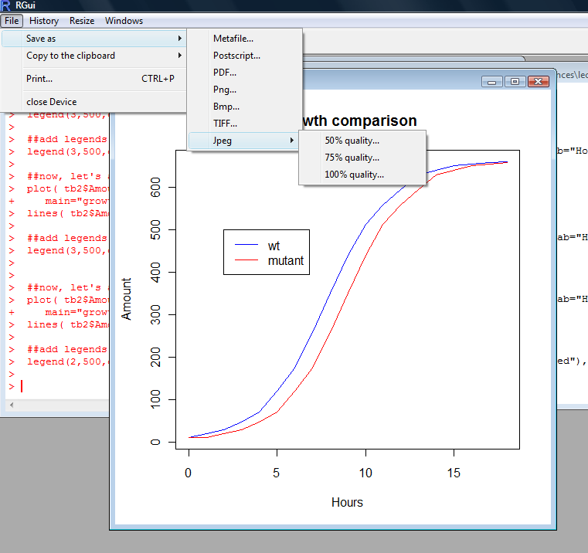
Save the figure in R

Slide 7
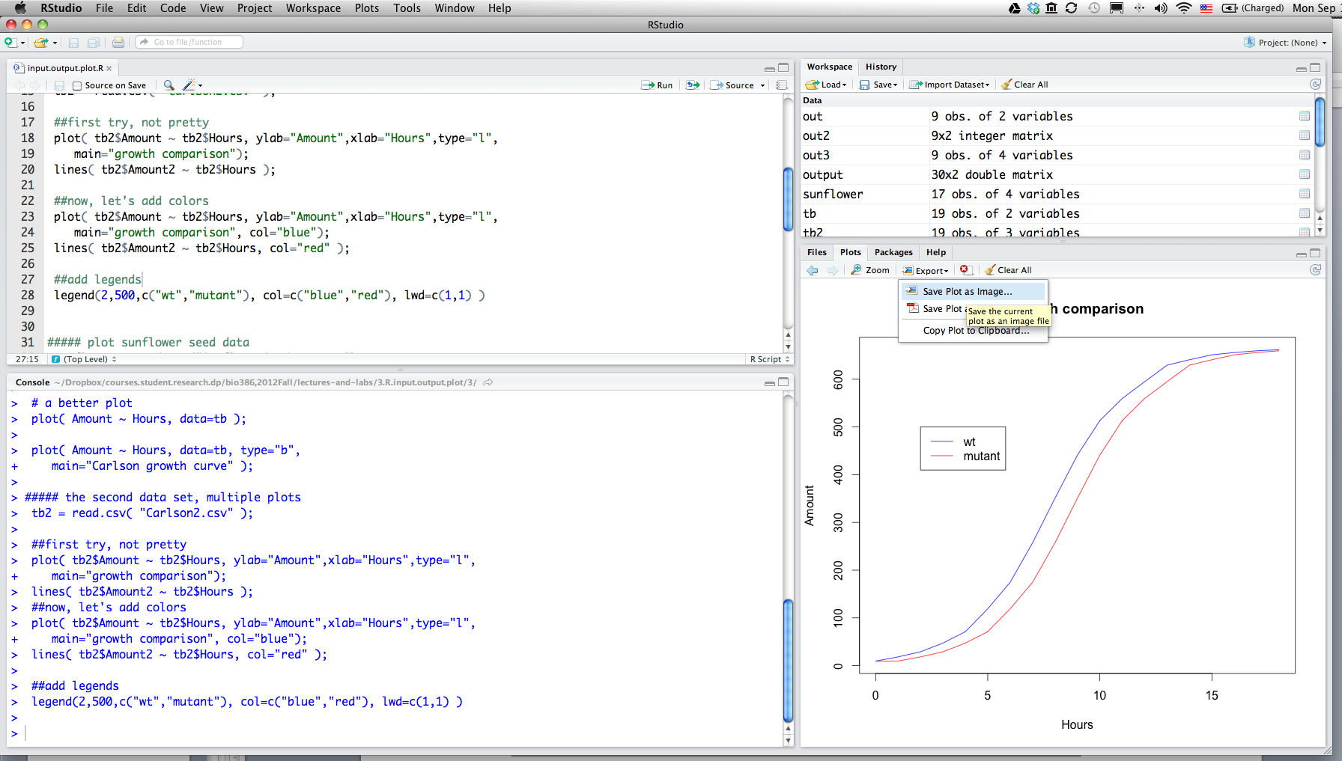

Save figure in Rstudio

Slide 8
Self-exercise
Convert the first sheet of “SunflowerSeedData.xls” to a csv file.
Input into R
Generate a plot and save to a jpeg file.
Notes:
20 minutes

Slide 9
Output to csv files
write.csv(data, “mydata.csv”);
write.csv(data, “mydata.csv”, row.names=F);

Slide 10
Homework
Write a function to calculate factorial.
Use a loop to calculate the factorial from 1 to 20.
Output your results to a csv file, named “lastname.hw3.csv”.

Slide 11
Hw hits
Use a loop to calculate factorials.
Generate a table using cbind()

