Slide 1
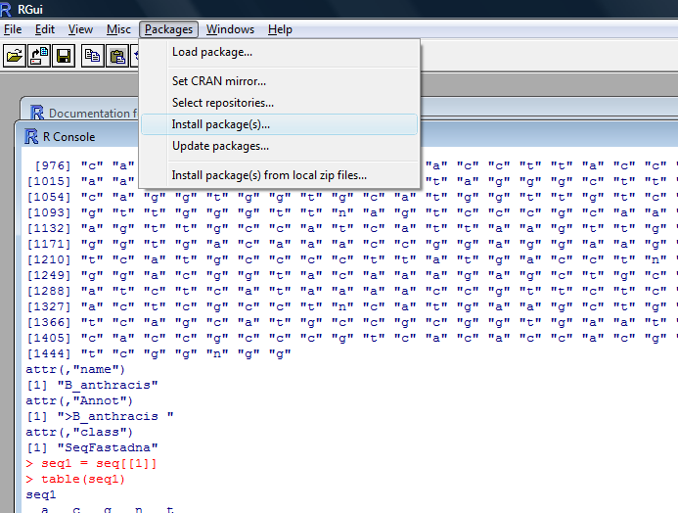
Packages
>
> [1] 3

Slide 2
Packages
#### packages
#install packages
install.packages("ape");
install.packages("seqinr");
#load packages
library(ape);
library(seqinr);
#what's in the package?
help(package=ape);
help(package=seqinr);
#you should also read the manual of the packages

Slide 3
Use the package
#### a simple example
library(seqinr);
# read in some bacterial 16s rDNA sequences
seqs = read.fasta( "http://www.bioinformatics.org/ctls/download/data/16srDNA.fasta",
seqtype="DNA");
str(seqs);
# look at the first sequence
seq1 = seqs[[1]]
table( seq1 ); #nucleotide composition
GC(seq1); # GC content

Slide 4
Use the package
# a loop for all sequences
num = 1:length(seqs);
gc = 1:length(seqs);
out = data.frame( cbind( num, gc ) );
for( i in 1:length(seqs) ) {
out$gc[i] = GC( seqs[[i]] );
}
out;
write.csv(out, "gc.csv", row.names=F) # output the results
The *csv files can be opened by EXCEL.

Slide 5
Exercise
Try to calculate the gene length for each gene, and add a new output csv file.
For a single gene, the length is obtained:
length(singleSeq)

