Slide 1

Introduction to R through a case study
Hong Qin
Notes:
Part of materials are based on Ken Rice and Thomas Lumley’s lecture on R

Slide 2
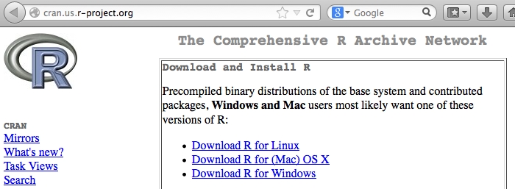
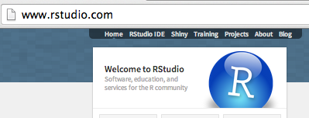
Install R and RStudio
R
  www.r-project.org
Rstudio (a nice GUI IDE for R)
  www.rstudio.com
  Free Desktop version.
YouTube
  How to download and install R and Rstudio .

Slide 3
GitHub
Register for an account.
Download a desktop client of GitHub.

Slide 4
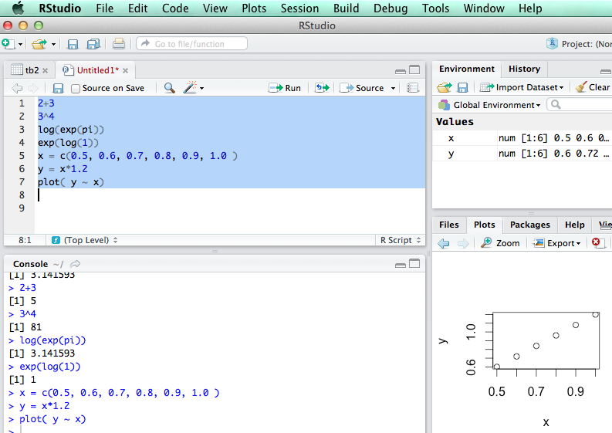
R is an interpretive language

Slide 5
R markdown file
Code chunk (blocks)
Comment chunks (blocks).
Run selected lines
Run selected chunks (next chunks).

Slide 6
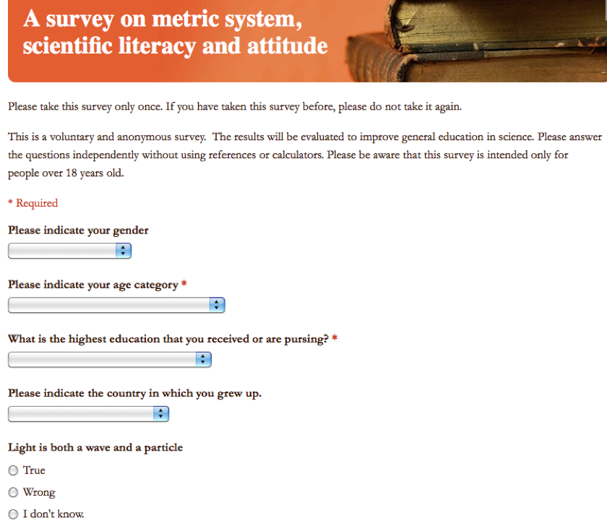
Learning R using an example
R Code: ‘metric.R’
Link to the online Survey

Slide 7
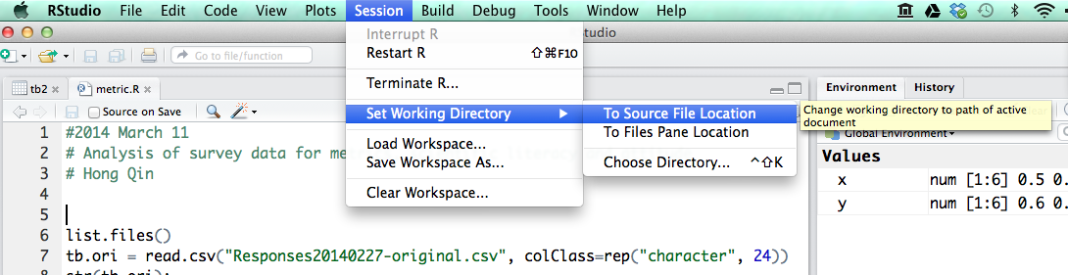
Load data into R
First, change working directory
Then, read.csv()

Slide 8
Explore the data
str()
head()
View()
Change long names to short names.

Slide 9
Table is a dataframe
A dataframe is like a spreadsheet in Excel.
tb[ 1:4, 2:7] #1-4 rows, 2-7 columns
tb$age #pick a column of a dataframe.

Slide 10
Brackets and parentheses
# barackets are often for variable-access
x[i,j]
y[1];
z[[1]];
# parentheses are often for functions
t.test(x,y)
If (x <0 ) { x = -x; }
#curly parentheses are for other things

Slide 11
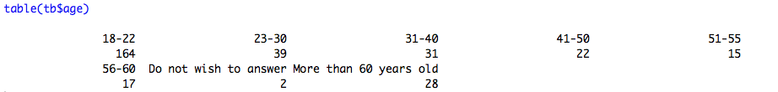


Explore the data

Slide 12
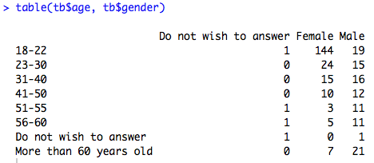
Explore the data

Slide 13
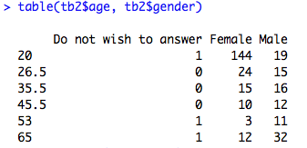
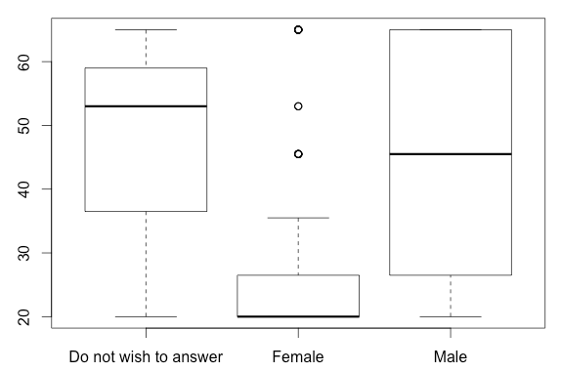

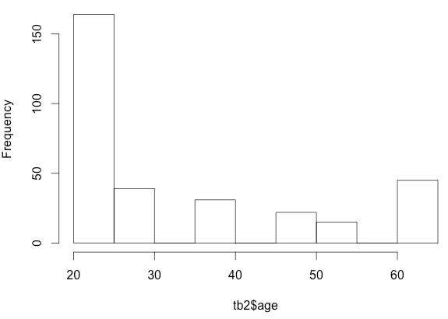
Plotting the data

Slide 14
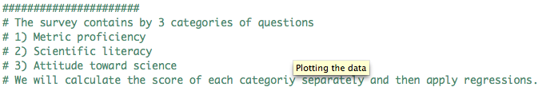
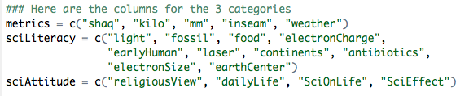
Three categories of questions

Slide 15
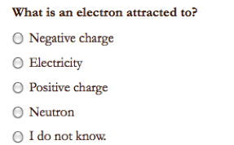
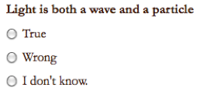
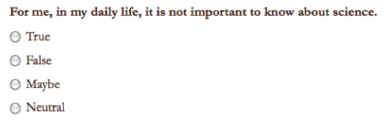
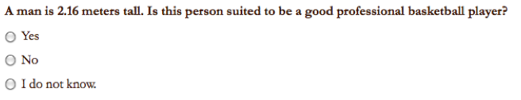
Sample Questions

Slide 19
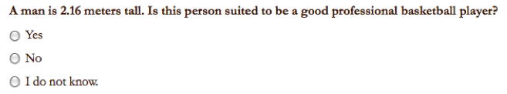
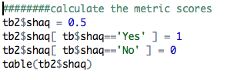

Convert answers to numerical scores

Slide 20
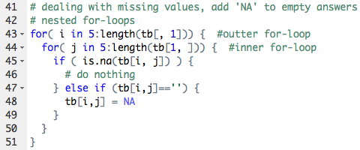
Loops in R

Slide 21

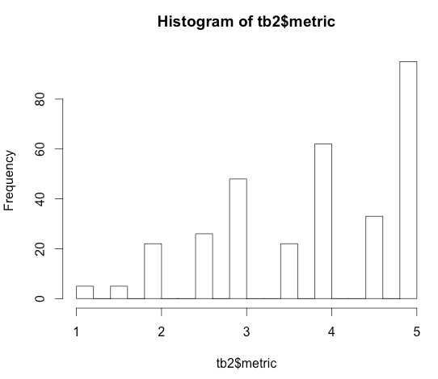

Score for Metric Proficiency

Slide 22
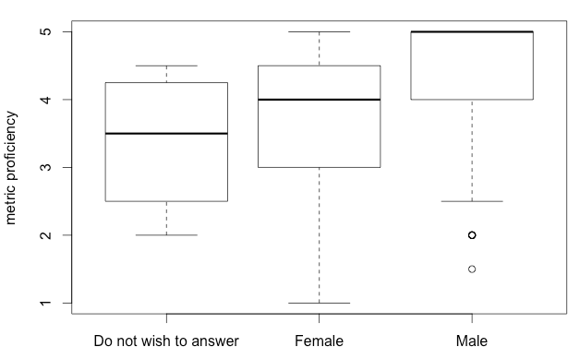
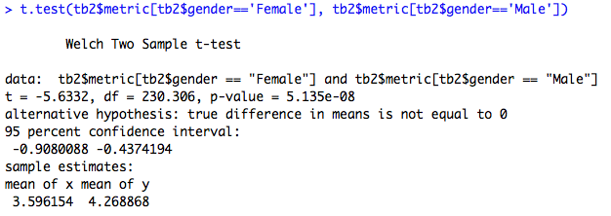
Do females tend to be less proficient in metric usage?

Slide 23
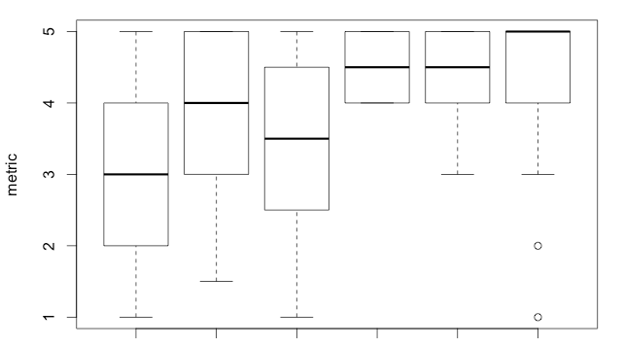
Education is a confounding factor.
BA BS HS MD MS PhD

Slide 24
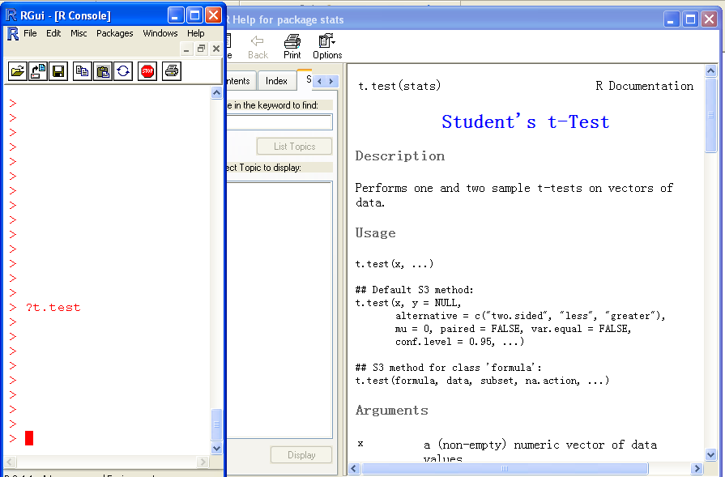
Help!

Slide 25
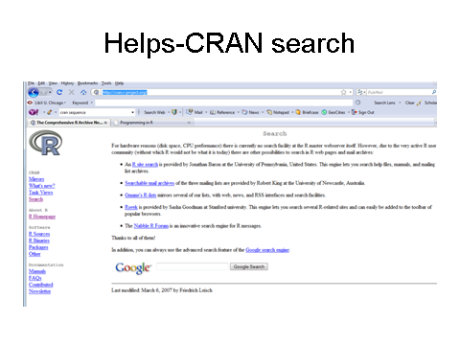
The R card

Slide 26
Assignment
Use the 2014 survey data for student assignment.

Slide 27
Todo
Add linear regression demo.

