Slide 1

Introduction to R through a case study
Hong Qin
Notes:
Part of materials are based on Ken Rice and Thomas Lumley’s lecture on R

Slide 2
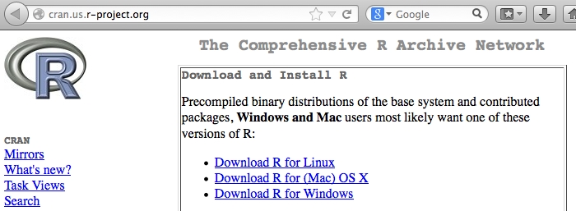
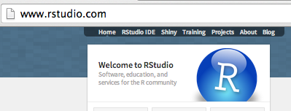
Install R and RStudio
R
  www.r-project.org
Rstudio (a nice GUI IDE for R)
  www.rstudio.com
YouTube
  How to download and install R and Rstudio .

Slide 3
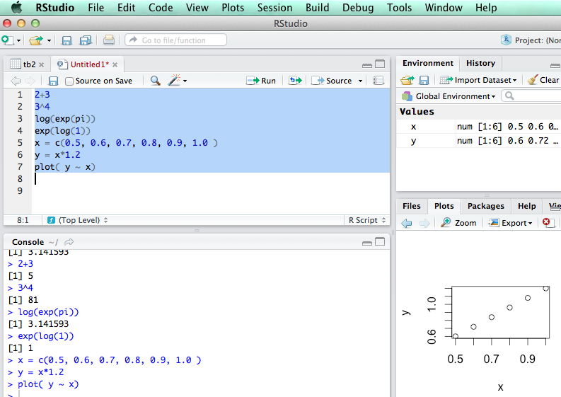
R is an interpretive language

Slide 4
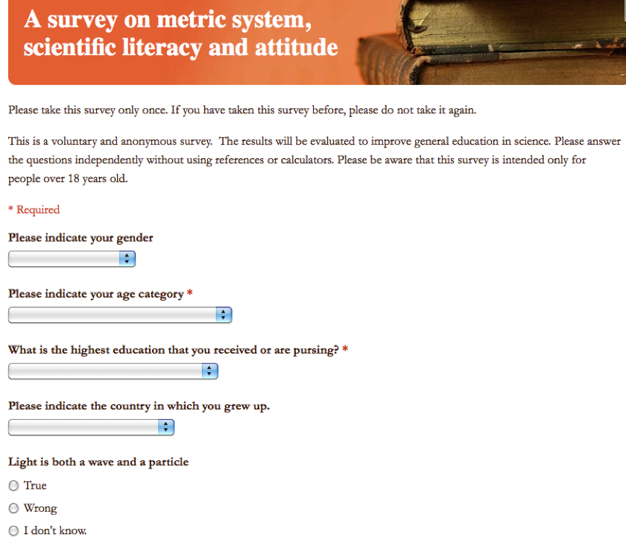
Learning R using an example
R Code: ‘metric.R’
Link to the online Survey

Slide 5
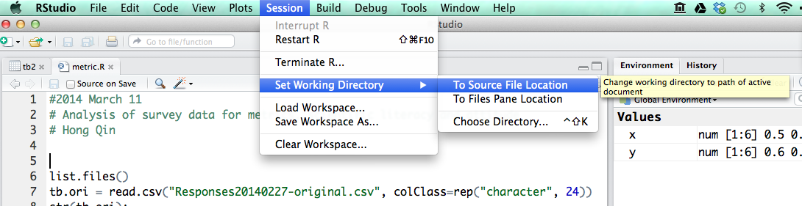
Load data into R
First, change working directory
Then, read.csv()

Slide 6
Explore the data
str()
head()
View()
Change long names to short names.

Slide 7
Table is a dataframe
A dataframe is like a spreadsheet in Excel.
tb[ 1:4, 2:7] #1-4 rows, 2-7 columns

Slide 8
Brackets and parentheses
# barackets are often for variable-access
x[i,j]
y[1];
z[[1]];
# parentheses are often for functions
t.test(x,y)
If (x <0 ) { x = -x; }
#curly parentheses are for other things

Slide 9
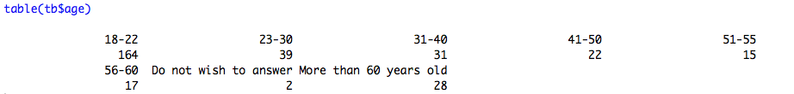


Explore the data

Slide 10
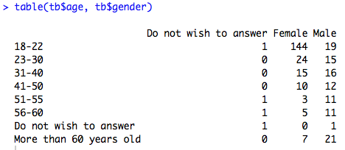
Explore the data

Slide 11
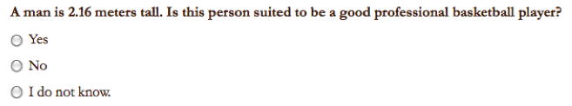
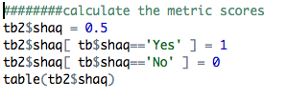

Convert answers to numerical scores

Slide 12
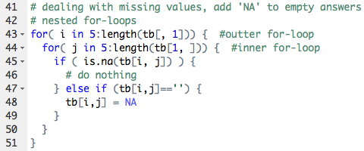
Loops in R

Slide 13
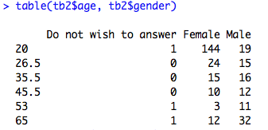
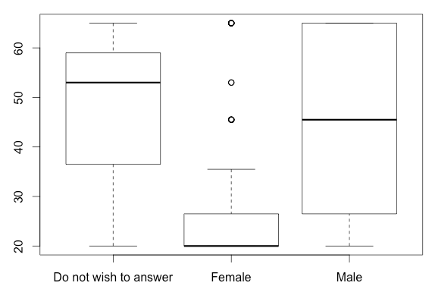

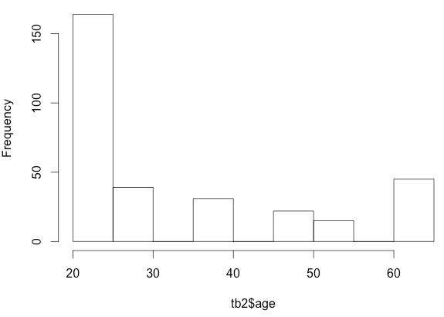
Plotting the data

Slide 14
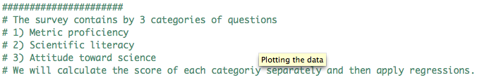
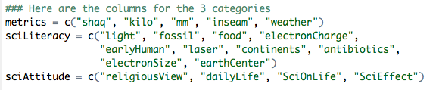
Three categories of questions

Slide 15
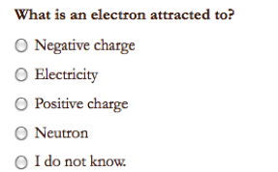
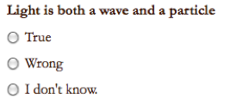
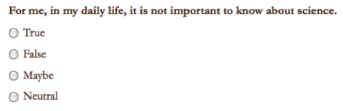
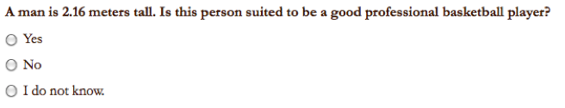
Sample Questions

Slide 16

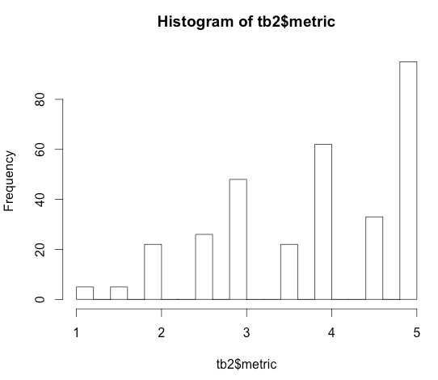

Score for Metric Proficiency

Slide 17
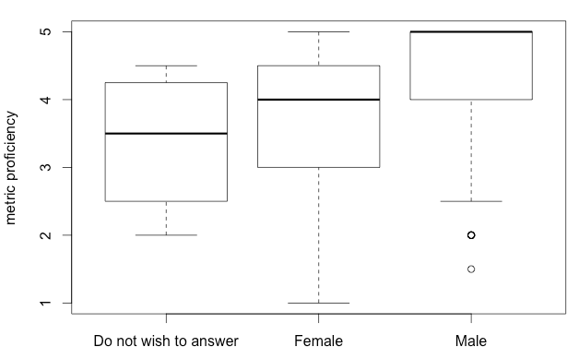
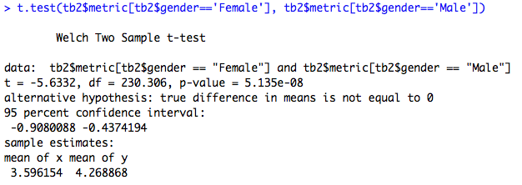
Do females tend to be less proficient in metric usage?

Slide 18
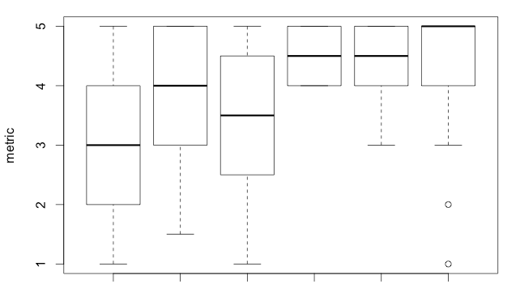
Education is a confounding factor.
BA BS HS MD MS PhD

Slide 19
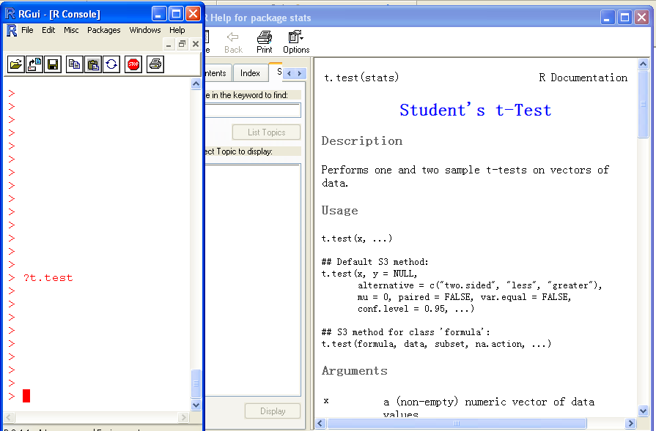
Help!

Slide 20
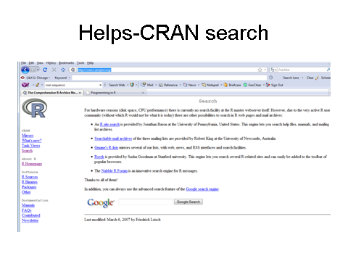
The R card

Slide 21
Assignment
Use the 2014 survey data for student assignment.

Slide 22
Todo
Add linear regression demo.

