Slide 1

R Data Wrangling through the metric proficiency survey case study
Hong Qin
Notes:
Part of materials are based on Ken Rice and Thomas Lumley’s lecture on R

Slide 2
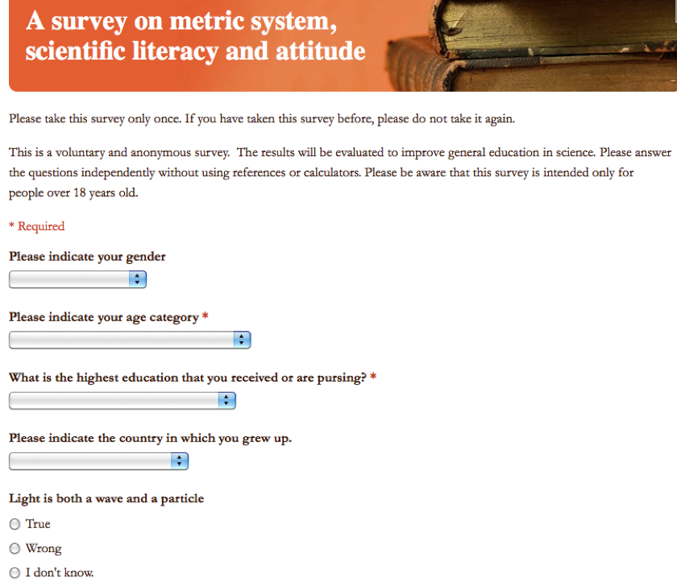
Learning R using an example
R Code: ‘metric.R’
Link to the online Survey

Slide 3
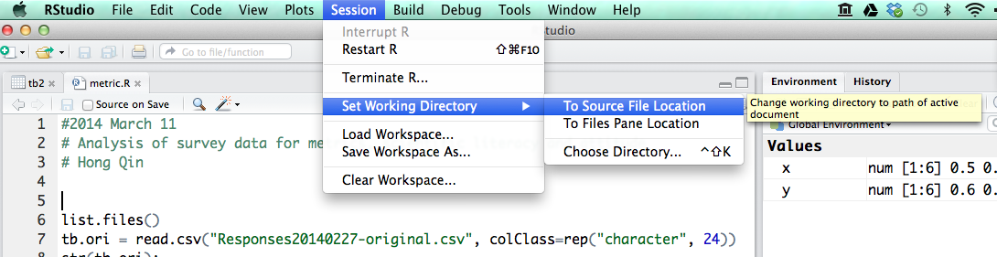
Load data into R
First, change working directory
Then, read.csv()

Slide 4
Explore the data
str()
head()
View()
Change long names to short names.

Slide 5
Table is a dataframe
A dataframe is like a spreadsheet in Excel.
tb[ 1:4, 2:7] #1-4 rows, 2-7 columns

Slide 6
Brackets and parentheses
# barackets are often for variable-access
x[i,j]
y[1];
z[[1]];
# parentheses are often for functions
t.test(x,y)
If (x <0 ) { x = -x; }
#curly parentheses are for other things

Slide 7
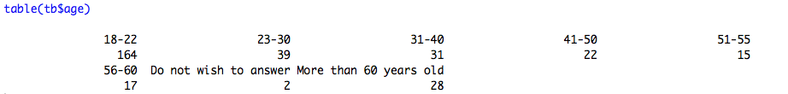


Explore the data

Slide 8
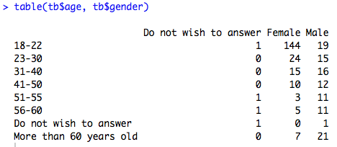
Explore the data

Slide 9
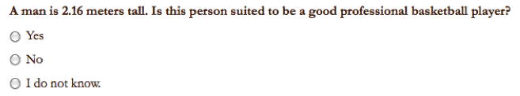
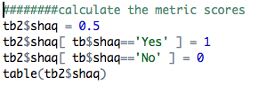

Convert answers to numerical scores

Slide 10
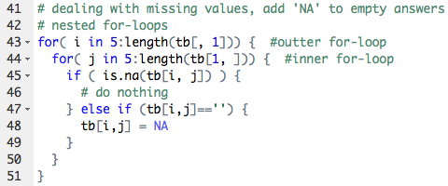
Loops in R

Slide 11
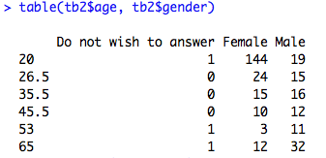
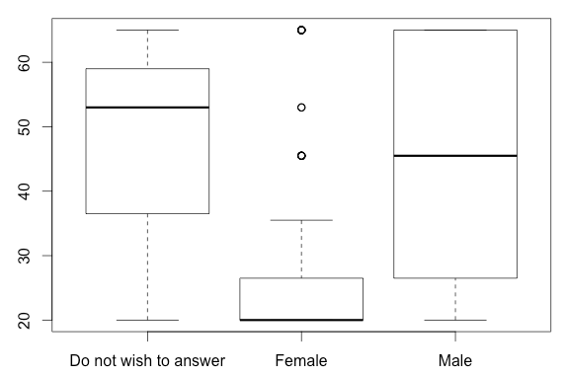

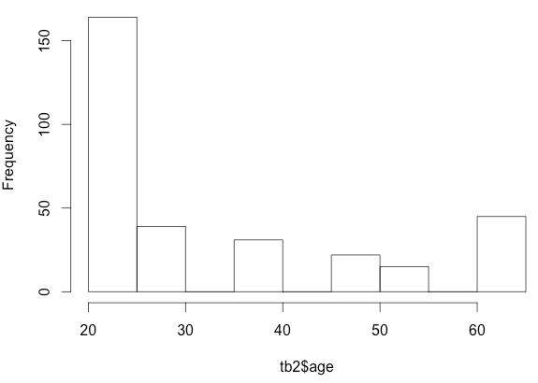
Plotting the data

Slide 12
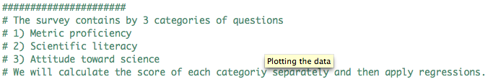
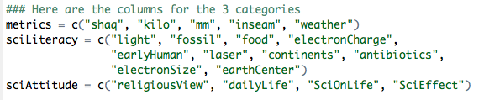
Three categories of questions

Slide 13
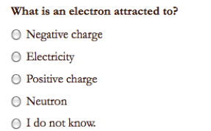
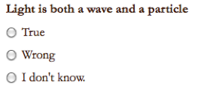
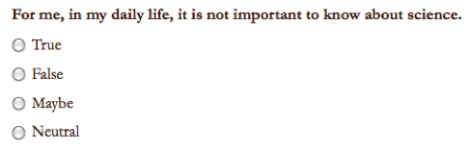
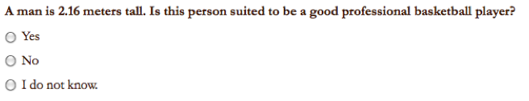
Sample Questions

Slide 14

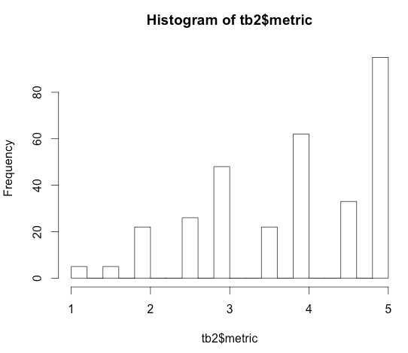

Score for Metric Proficiency

Slide 15
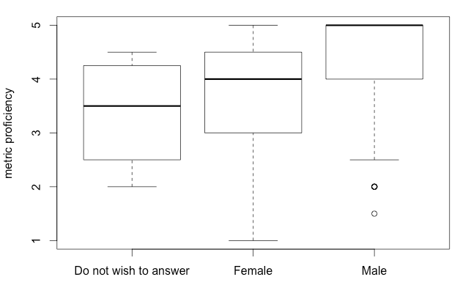
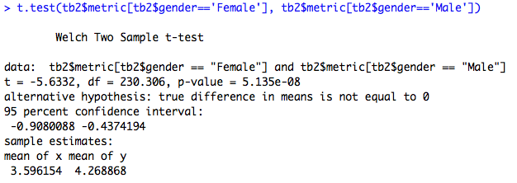
Do females tend to be less proficient in metric usage?

Slide 16
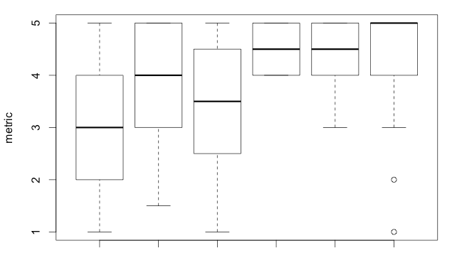
Education is a confounding factor.
BA BS HS MD MS PhD

Slide 17
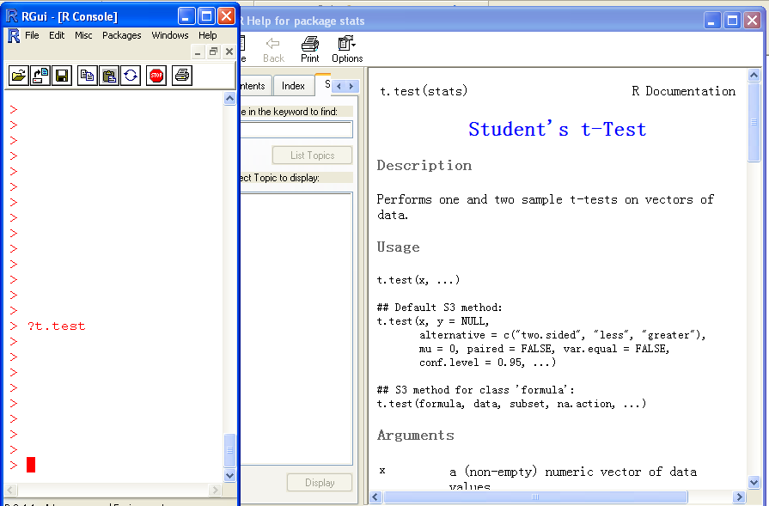
Help!

Slide 18
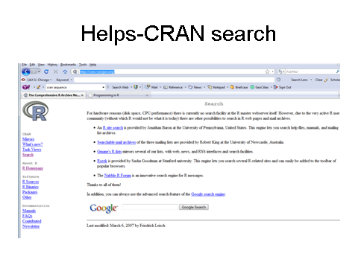
The R card

Slide 19
Assignment
Use the 2014 survey data for student assignment.

