Slide 1
Main Injector Slow Spill
Plan for optimizing beam quality
Status Update
December 13, 2013
Denton Morris
AD/MI

Slide 2
Main Injector Slow Spill Status Update
Three main areas being addressed in Main Injector:
Efficiency –
Current extraction efficiency is >80%
Low frequency spill structure –
Addressing 360Hz and 60Hz spill structure
53MHz duty factor –
Currently 10% to 30+%, need >40% minimum
Fourth of the three areas being addressed –
Hot bunches

Slide 3
Main Injector Slow Spill Status Update
Efficiency issues:
Current extraction efficiency is >80%. This includes extraction AND
approximately 1 ¼ miles of beam line.
Running 1e13 we need extraction efficiencies (excluding beam lines)
>95% to minimize activation of extraction components.
AD/Instrumentation is working on a new digitizer board to integrate spill intensity
signals from resonant beam position monitors. This will give us the ability to measure
the extraction efficiency and the efficiencies of transmission through the beam lines.
Expected date:
Proto-type is installed and sampling real data. First operational units
will be installed for MI extraction in approximately one month (plus the holidays so
late January).

Slide 4
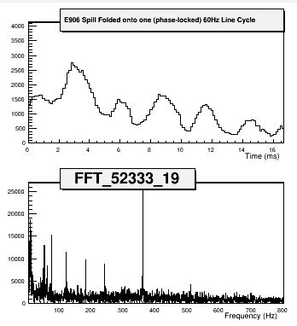
Main Injector Slow Spill Status Update
Low frequency spill structure
Combination of 60 Hz and 360 Hz
Investigating multiple potential causes
Main dipole/quad power supplies
Quad correction elements
Harmonic Quad circuits
Improving QXR and Bucker algorithms
Increasing the strength of the Bucker

Slide 5
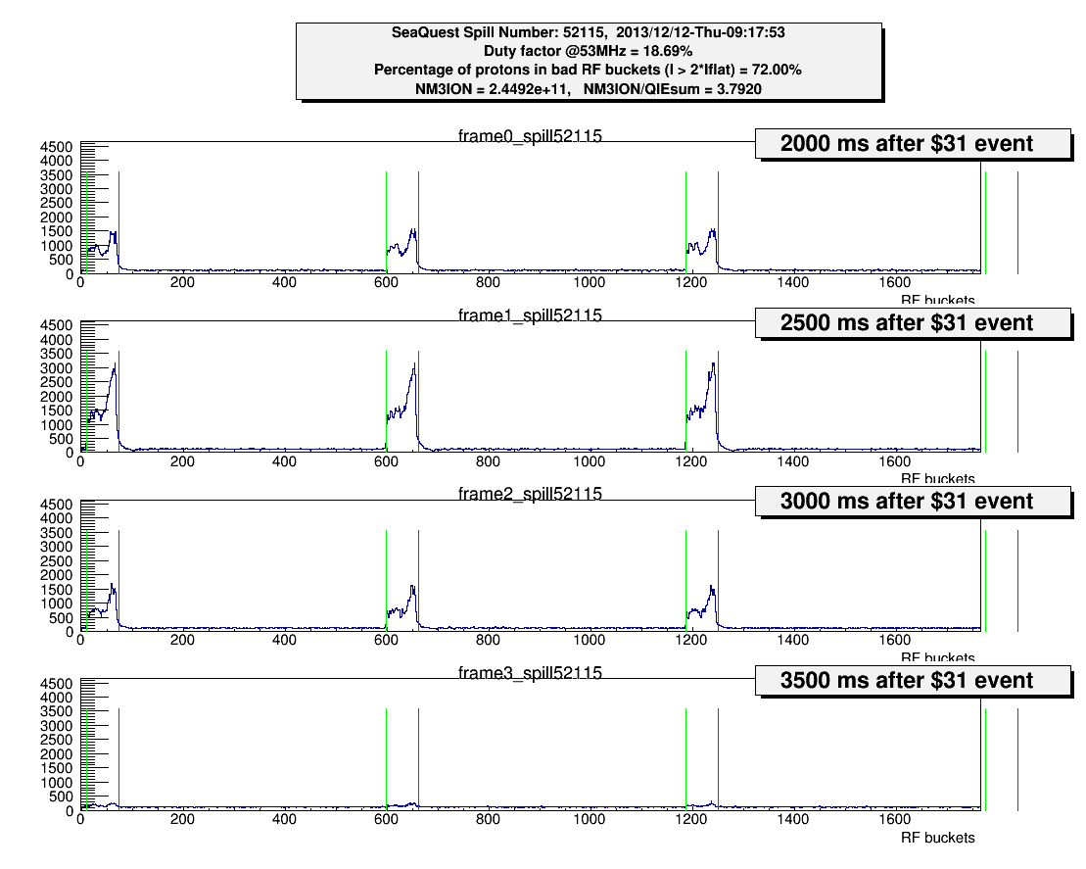
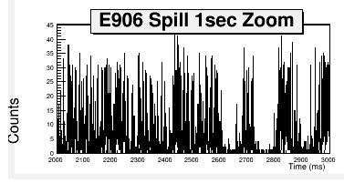
Main Injector Slow Spill Status Update
53MHz duty factor
Originally 10% - 20%
(de)Tuned up 20% - 30%
Currently 30+%

Slide 6
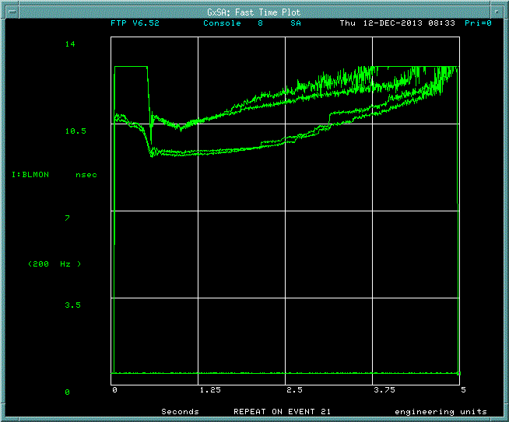
Main Injector Slow Spill Status Update
Detuning injection:
Turning off injection phase damping
and intentionally mistuning the
injection phase to more uniformly
distribute beam in each bunch
increased the 53MHz duty factor
from 10% - 15% up to 20% - 30+%.
We are re-installing a TeV era
longitudinal quad damper to
Increase the longitudinal emittence
of the bunches at high field.
Expect installation and testing by
middle of next week, fully
operational by next year.

Slide 7
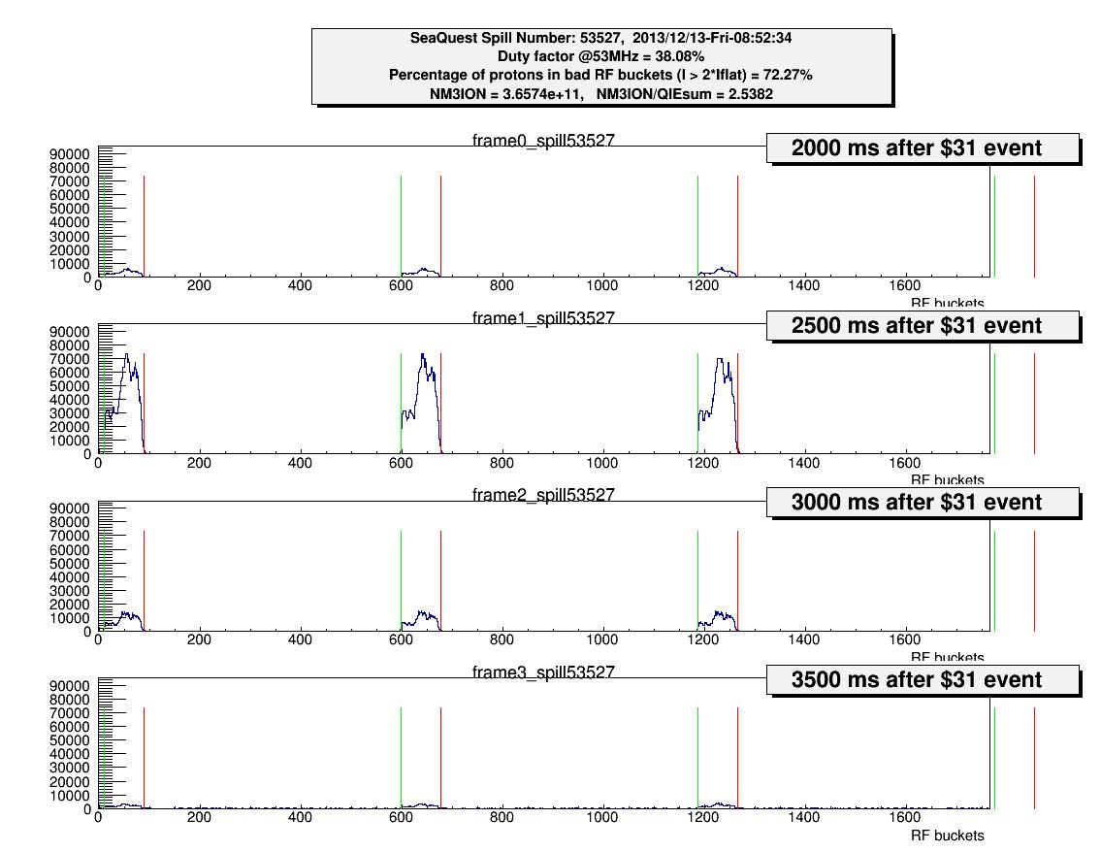
Main Injector Slow Spill Status Update
53MHz duty factor

Slide 8
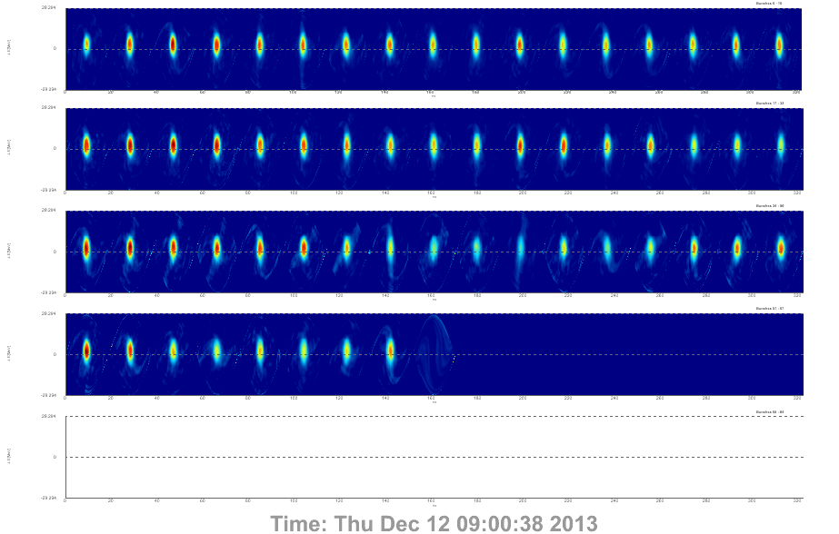
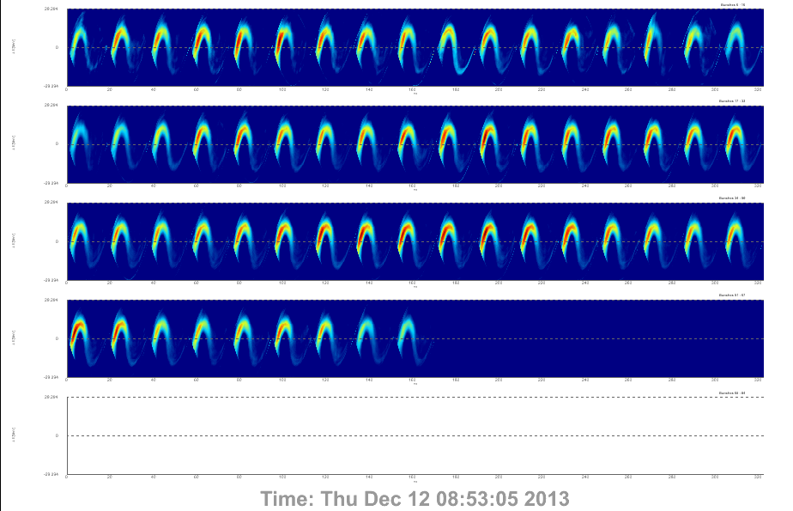
Main Injector Slow Spill Status Update

Slide 9
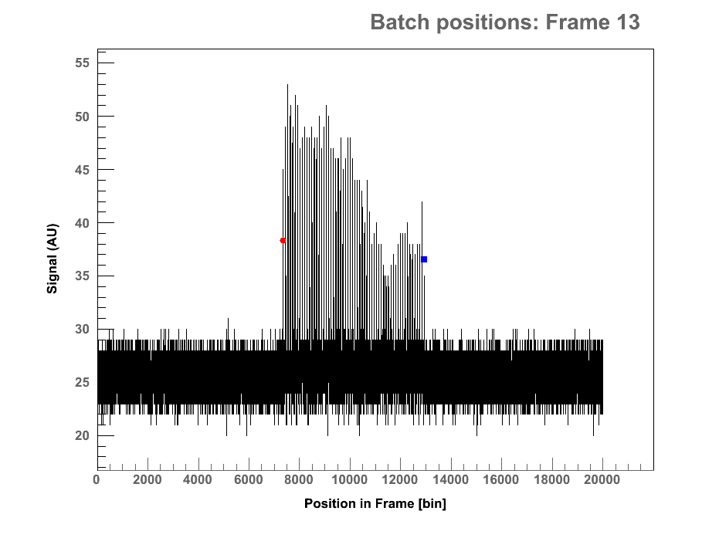
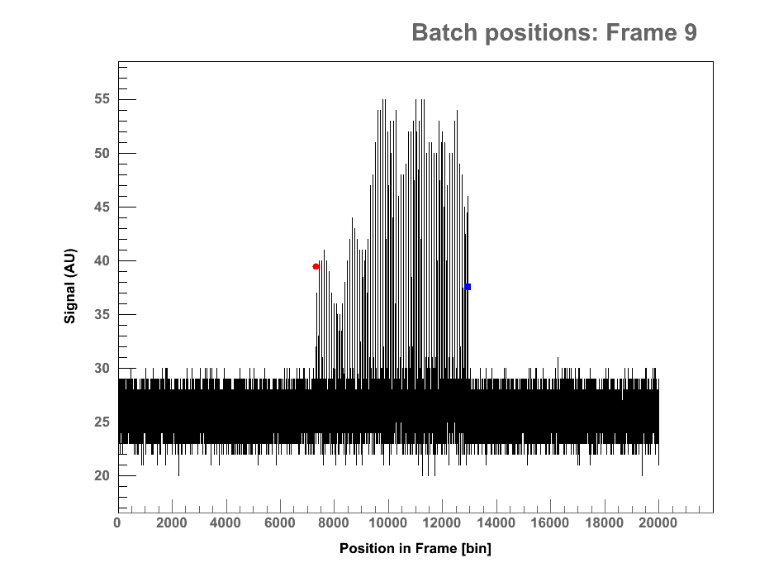
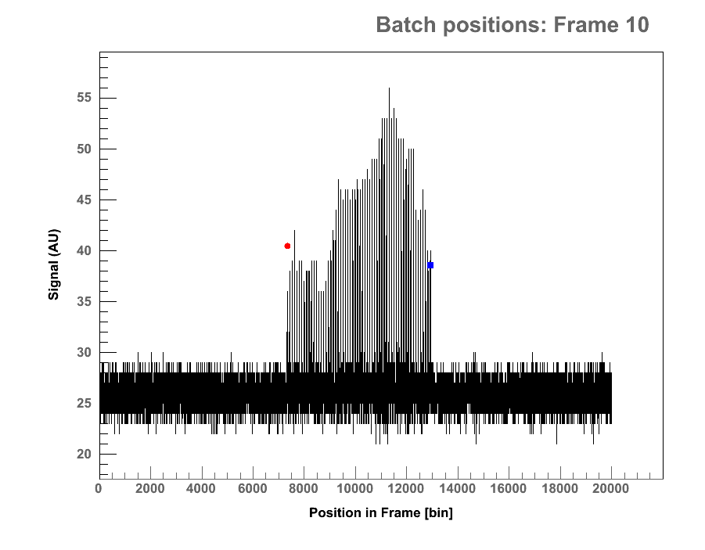
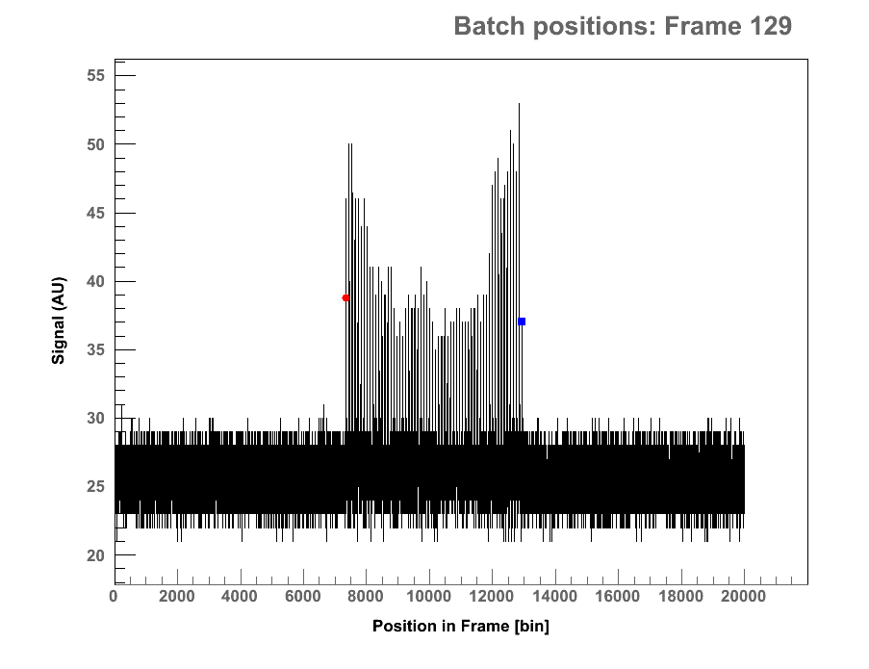
Main Injector Slow Spill Status Update
Booster is assisting with
implementation of longitudinal
dipole mode dampers

Slide 10
Main Injector Slow Spill Status Update
Three main areas being addressed in Main Injector:
Efficiency –
New intensity monitors installed mid-January
Low frequency spill structure –
Investigation underway
53MHz duty factor –
Longitudinal quad damper installed next week for commissioning
Fourth of the three areas being addressed –
Configuring Booster longitudinal dipole mode damper

