Slide 1
E-906/SeaQuest: EMG Briefing Beam Issues 12-13-13

Slide 2
What we asked for:
Ultimate goal from MOU
“The experiment requires a slow spill with a maximum rate of 2×10¹² protons/s with a macroscopic duty factor greater than 8% (one 5 s spill per minute) for a total of 7×10¹⁸ protons in a period of two years from the beginning of the experiment. (This number includes a factor of 1.3 to account for experimental efficiency and downtime)
Specifically, E-906 requires an average duty factor of greater than 60% for the run. Spills with a duty factor of less than 25% (a cut used in E-866) are not counted as protons delivered to the experiment. E-906 recognizes that this may be difficult to achieve as high-intensity, slow-spill fixed-target beam has not been extracted from the Main Injector yet.”
This implies 6 booster batches of 84 buckets per batch = 86% duty factor
Duty factor is defined as <I> * <I> / (< I*I>/N) where <A> =
Where we are now: Typically 3e11 ppp with TRN13=2 or 3 BNCH13~60 NBSYD=1 in a 4 second spill, ~ 2e4 protons in a filled rf bucket
Instantaneous rate in one rf bucket corresponds to 3 e 12 ppp in fully filled MI

Slide 3
Beam related Issues
We confirmed position of the beam on target with a film exposure
Beam current measuring devices not yet calibrated. In a typical spill
G2SEM= 2.11e11, NM2ION=3.50e11, NM3Ion=3.09e11
Mike Geelhoed believes G2SEM but uncertainty remains in what is the transmission
Accelerator Duty Factor helps produce very noisy events in our detector and fools our trigger. Dimuon trigger is sensitive to random coincidences as at least N**2
Low Frequency 360 and 60 Hz
High Frequency rf bunch to rf bunch
Mi injector group does not yet have instrumentation to understand losses in slow extraction. Therefore they do not want to put more than ~1e12 in MI until this is understood.
Radiation at NM3 berm and NM4 is higher than last year. Our intensity is limited to 8 e11 by this radiation limit.

Slide 4
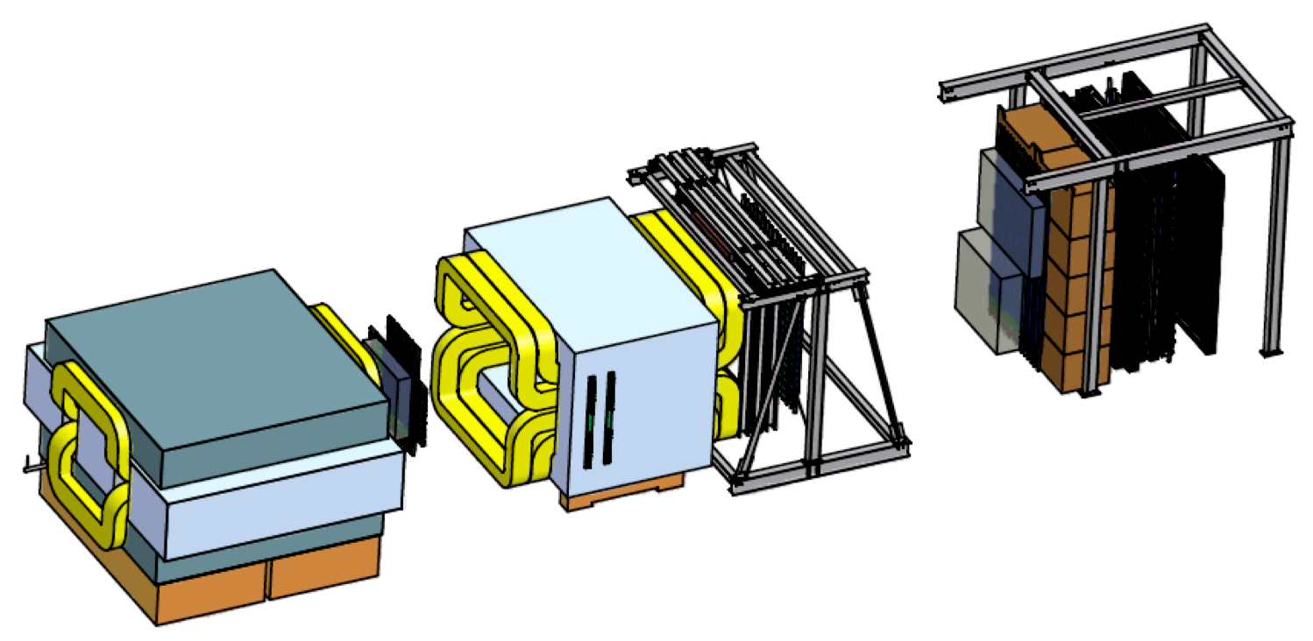
Duty factor at 7.5 kHz
We read out a single muon trigger (X1234) counting the coincidence rate in 4 scintillator planes every 7.5 kHz but at most 1 count per rf bucket.
Typical rate 75 kHz implies 11 counts per 133 microseconds
Display results on a web page for each spill and calculate Fourier transform and duty factor.

Slide 5
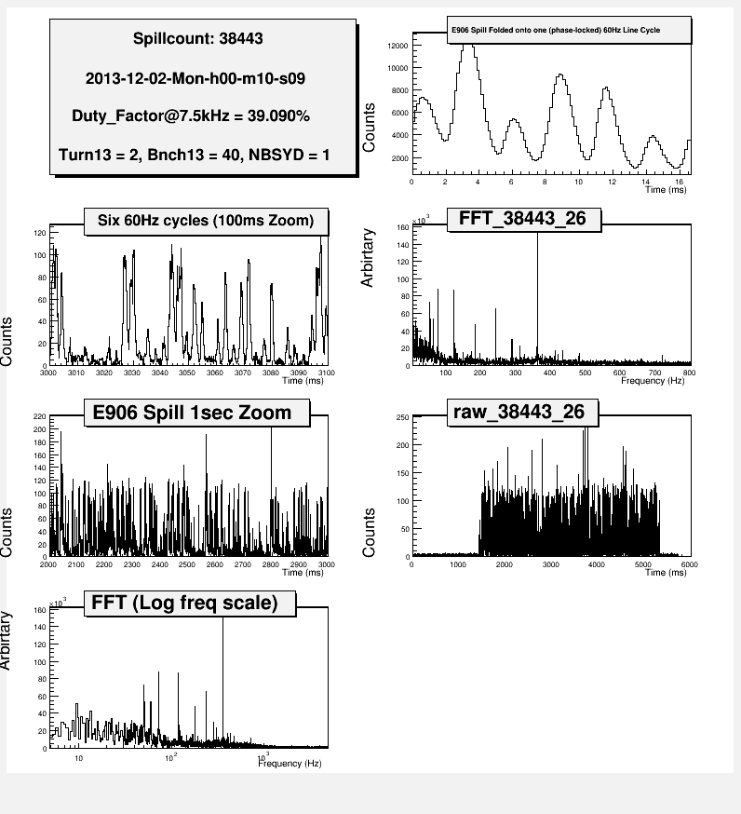
Results for 7.5 KHz Monitor
http://e906-gat3.fnal.gov:8081/seaquestacc/
Fourier Transform has
strong 360 Hz locked to
the 60 Hz phase
Note ~11 counts would be a uniform beam

Slide 6
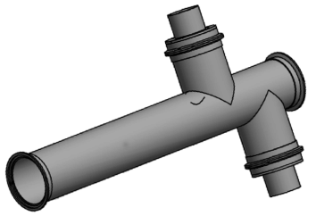
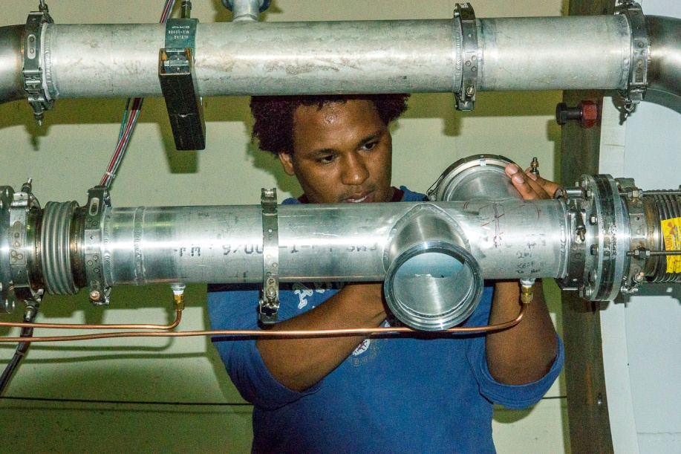
53 MHz Beam Intensity Monitor
Argon Cerenkov Counter upstream of the targets. Three functions:
Instantaneous Luminosity—Event readout
Duty Factor
Spill readout
At end of spill, output entire spill record + total intensity, intensity while DAQ dead, record of splat block. Feedback for MCC (used to produce FFT)
“Splat block”
Compute circular sum of beam intensity
Inhibit triggers if sum>threshold
Readout
Digitization by a QIE-10
Still takes longer than 55 seconds to read and process 212e6 buckets of data.
Currently one network board
Debugging 3 network board as we speak
Calculations are “about right” with occasion inhibits of the beam being too long.

Slide 7
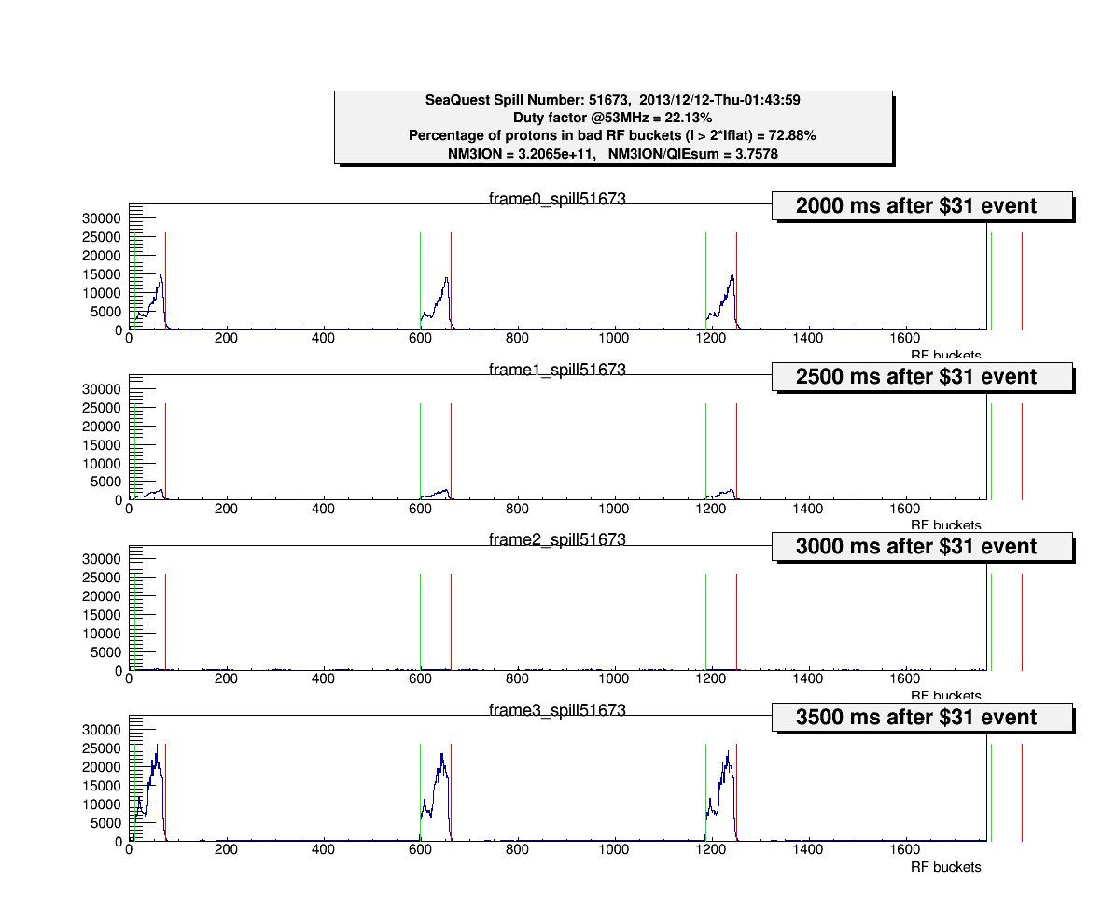
Results from the Beam Cerenkov
http://e906-gat3.fnal.gov:8081/seaquestacc/

Slide 8
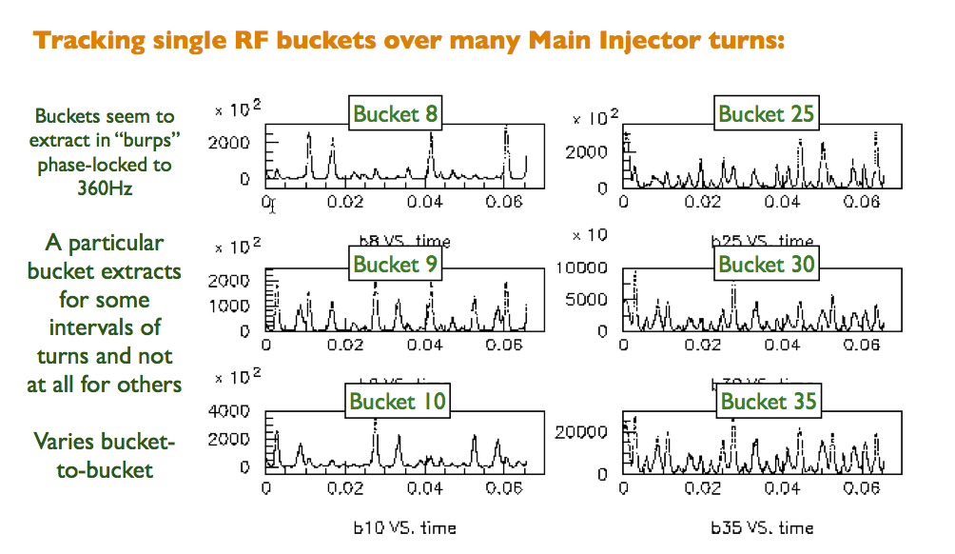
Now we can look in much more detail

Slide 9
We had a meeting with ~8 people from AD Monday
Suggested solution for rf bucket to rf bucket variation
Use rf to anti-damp, increasing longitudinal emmitance of every bucket. Perhaps this will make each bucket look similar and extract smoothly. Has worked in the past.
This will increase energy and time spread of our beam. They do not think that will be a big effect on the 1-2 ns time scale.
Simple tests now. Hardware is still there. Probably 1-2 weeks to do reconfigure
Suggested solution for low frequency 360 and 60 Hz
Rather than trying to find the source of the ripple and eliminating it, force 360 Hz amplitude with arbitrary phase on a few extraction elements to try to cancel oscillation.
They could sample loss monitor and feedback to QXR.
They want better instrumentation to monitor SY. Working on resonant BPM’s. Have prototype electronics board. Expect in ~2 months
They do not understand extraction losses in slow spill. It is not well simulated or measured. They need precision intensity monitors in MI and SY. First reliable intensity monitor is ¾ mile away. At this time they do not want to put more than 1e12 in MI.

Slide 10
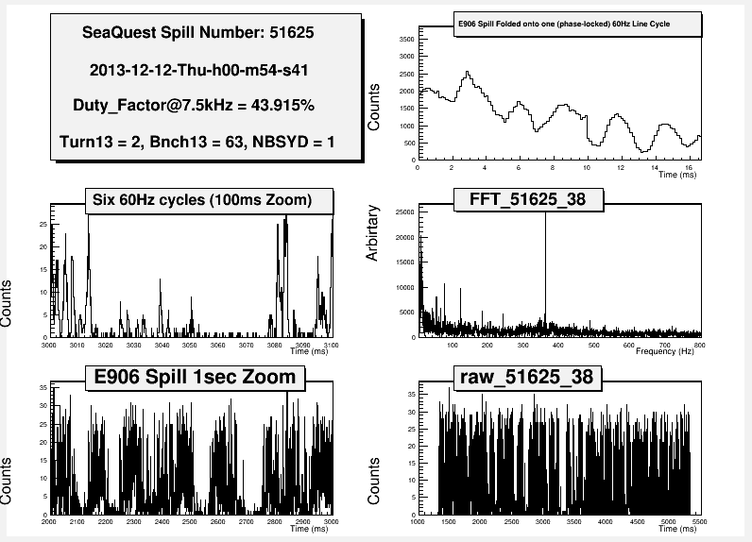
Results of 7.5 kHz monitor yesterday
Average 11

Slide 11
Radiation LEVELS at NM3 Berm and in NM4
Only new element is beam Cerenkov. 0.2% interaction length compared to a number of 0.056% devices like box swics.
Windows 0.054%, Ar-CO2 0.12% , Black paper .01-.04%, mylar ~.02%
Would like to remove and replace with vacuum for a test to prove it is the culprit. Cannot leave out permanently because it is integral to both our diagnostics and trigger.
Investigating move to NM2, 200’ upstream of current location, which puts 50’ of steel shielding between it and the Hall.
Other option is putting it right upstream of target.
For the Cerenkov to be incorporated as trigger veto from NM2 requires 400’ of hard line to location. We are about ready to make that purchase. Not ideal in terms of beam phase space.

Slide 12
Beam Summary
The apparatus is handling instantaneous rate equivalent to 2.5e12 ppp.
Detectors could be sensitive to higher average rates. We will see.
Improving the beam duty factor is essential for meeting our science goals. Otherwise we have to veto lots of the time the beam is on.
Ideas for doing this on time scale of a few weeks.
Longest lead time may be AD getting the diagnostics it wants to ensure it understands slow spill.
If Beam Cerenkov is the radiation source, investigate moving and local shielding.

