Slide 1
COURSE PROJECT · SPRING 2026
Graph-of-Shots
Few-Shot Molecular Graph Classification
Team: Wenbo Huang · Junchi Yan · Yiqun Yin · Xinyue Xu · Mingjia Shi
Speaker: Mingjia Shi
University of Virginia
Few-Shot Graph Machine Learning
Notes:
Opening. 15 minutes + 2–3 min Q&A.

Slide 2
MOTIVATION
Why Few-Shot Molecular Learning Matters
● Molecular property prediction is bottlenecked by label scarcity
– bioassays typically have only 10² – 10³ labeled molecules, many missing.
● Standard supervised GNNs overfit on small data
– and fail to generalize across new assays.
● Biology itself is inherently few-shot
– novel drug targets and emerging toxicity endpoints have a handful of tested compounds.
● Our goal:
– given K labeled molecules for a brand-new assay, classify the unlabeled rest.
TYPICAL ASSAY SIZE
10² – 10³
labeled molecules per target
MANY MISSING LABELS
Multi-task MoleculeNet assays are sparsely labeled — the few-shot setting is the rule, not the exception.
Graph-of-Shots · Few-Shot Molecular Graph Classification
2 / 13

Slide 3
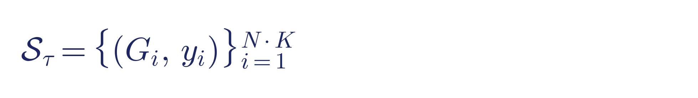
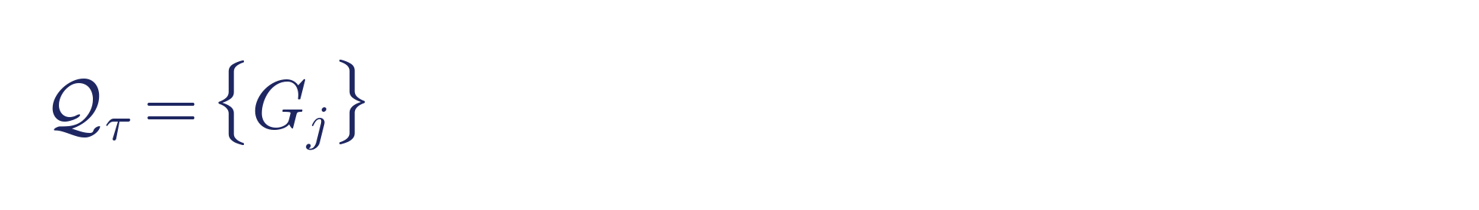
APPROACH
Problem — Episodic Few-Shot Classification
● Meta-learning: train across many small tasks that simulate few-shot test conditions.
● Split at the TASK level, strict label disjointness.
● Episode τ draws N classes × K support molecules + query set.
● Configs: 5-way 1-shot · 5-way 5-shot · 10-way 5-shot.
MERGED TASK POOL
Tox21
12
ToxCast
617
MUV
17
SIDER
27
—
—
Total
673
Split
405 / 134 / 134
Graph-of-Shots · Few-Shot Molecular Graph Classification
3 / 13

Slide 4
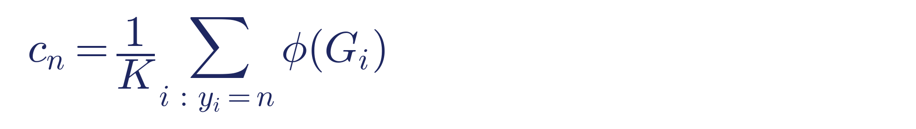
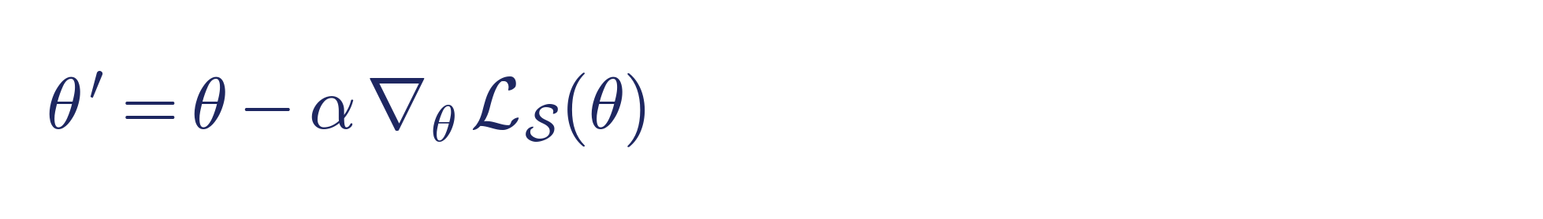
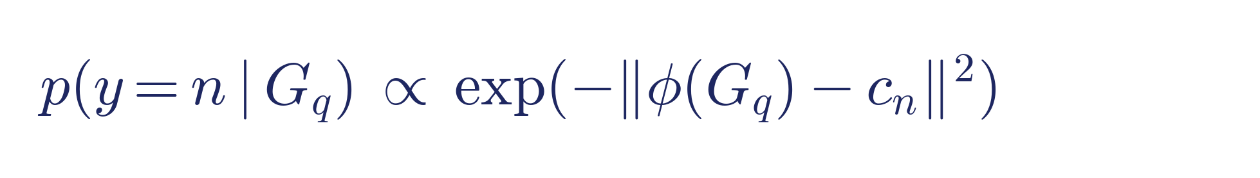
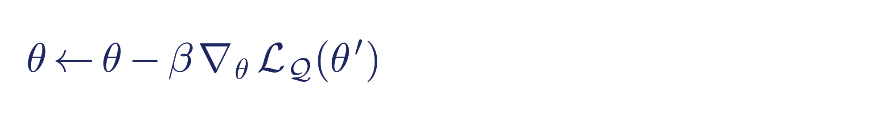
APPROACH
Baselines — ProtoNet & FOMAML
Prototypical Network (metric-based)
FOMAML (adaptation-based)
● Prototype = mean support embedding per class.
● Classify query by nearest prototype.
● No persistent per-class parameters.
● Learn init θ that adapts in a few SGD steps.
● First-order; detach inner loop (PyG-stable).
● Meta-gradient from query pass on original θ.
Graph-of-Shots · Few-Shot Molecular Graph Classification
4 / 13

Slide 5


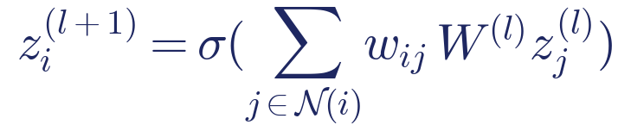

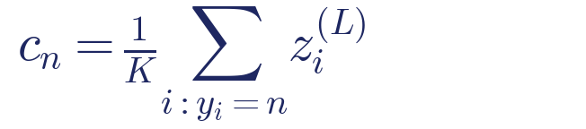


APPROACH · v1
GoS v1 — Pipeline with Dimensions
M = N·K + Q, d = 128 (example: N=5, K=5, Q=16 ⇒ M=41)
Episode input
① Encoder φ
② Affinity
③ kNN sparsify
④ Inject labels
⑤ Meta-GNN
N·K support + Q query molecules
2-layer weighted GCN
[atoms, 9] [bonds, 3]
h_s [N·K,128] h_q [Q,128]
W [M,M] M=N·K+Q
edge_index [2, 2·M·k]
z⁽⁰⁾ [M, d+N] [41, 133]
z⁽ᴸ⁾ [M, 128] → z_s, z_q
⑥ Prototype head
Query probs
p(y|G_q) ∈ R^N shape [Q, N]
All modules trained end-to-end with cross-entropy on query labels. No per-class parameters anywhere.
Graph-of-Shots · Few-Shot Molecular Graph Classification
5 / 13
Notes:
GoS v1 stage by stage with tensor shapes. Input: an episode of N·K support plus Q query molecules. Stage 1, the MPNN encoder produces h_s of shape [N·K, 128] and h_q of [Q, 128]. Stage 2, pairwise affinity gives W of shape [M, M] where M = N·K + Q. Stage 3, kNN keeps top-k edges per node, producing edge_index of shape [2, 2·M·k]. Stage 4, labels are injected: support nodes get [h; one-hot(y)], queries get [h; 0], so z^(0) has shape [M, d + N]. Stage 5, a 2-layer weighted GCN produces z^(L) of [M, 128]. Stage 6, the prototype head: scatter-mean support by class to get [N, 128] prototypes, classify queries by negative Euclidean distance giving logits of [Q, N], softmax to probabilities. End-to-end cross-entropy on query labels.

Slide 6
APPROACH · v1
GoS v1 — Why It Fell Short
THREE OBSERVATIONS CONVERGE ON THE SAME ROOT CAUSE
ROOT CAUSE
The meta-GNN replaces the encoder embedding at prototype time; 2-layer GCN over-smoothing destroys the class separability that was already there.
● Obs. 1 — kNN k = 3 > 5 > 10 > 100 (dense)
– sparsifying the meta-graph helps; classic GCN over-smoothing signature.
● Obs. 2 — ProtoNet 0.716 > GoS v1 0.572 at 5w5s
– the meta-GNN hurts a representation ProtoNet already classifies well.
● Obs. 3 — cosine ≈ bilinear ≈ attention (Δ < 2 pp)
– affinity-function expressivity is NOT the bottleneck.
Diagnosis → the checklist for v2: protect the encoder signal, prevent over-smoothing structurally, strengthen the encoder itself.
Graph-of-Shots · Few-Shot Molecular Graph Classification
6 / 13

Slide 7


APPROACH · v2
GoS v2 — Five Modifications with Motivations
M5 · SSL pretrain (before episodic training)
+2.2 pp (largest single lever)
motivation: baseline already 0.71 → encoder is the bottleneck
Episode input
① Encoder φ
② Affinity+kNN
③ M3 · Bipartite
④ M2 · 1-layer GAT
Refined z⁽ᴸ⁾
N·K support + Q query
SSL-init from M5
Q-sent msg = noise
softmax: no over-smoothing
[M, 128]
[atoms,9] [bonds,3]
h [M, 128]
W [M, M]
E_full [2, 2·M·k]
E_kept [2, 2·N·K·k]
c⁽ᵉⁿᶜ⁾_n (from φ)
c⁽ᵍⁿⁿ⁾_n (meta-GNN)
M1 · Residual prototype
Classify
M4 · Total loss
replace z⁽ᴸ⁾ with h [N, 128]
uses z⁽ᴸ⁾ [N, 128]
α learnable ∈ [0,1] α → 1 ⇒ ProtoNet (safety net)
λ = 0.1 optimal InfoNCE on S–Q
Red = v2 modifications. M1 lower-bounds v2 by ProtoNet. Composed v2 + SSL beats ProtoNet by +1.2 – 1.7 pp.
Graph-of-Shots · Few-Shot Molecular Graph Classification
7 / 13
Notes:
v2 is five targeted modifications. M5 up top: MolCLR-style SSL pretrain the encoder before episodic training; motivation is that at 0.71 ProtoNet, the encoder is the bottleneck. +2.2 pp. M3 in the middle: drop all edges originating from query nodes since queries have no labels and their messages are pure noise. M2 next to it: one GAT layer replaces two GCN layers because attention's softmax bounds message mass and prevents over-smoothing. M1 on the bottom — the safety net: compute two prototype sets, one from raw encoder, one from meta-GNN, mix with learnable alpha. At alpha equals 1, v2 recovers ProtoNet exactly, so v2 cannot do worse than ProtoNet. Finally M4: a small auxiliary InfoNCE contrastive loss on support-query pairs, λ=0.1, which directly shapes embedding geometry.

Slide 8
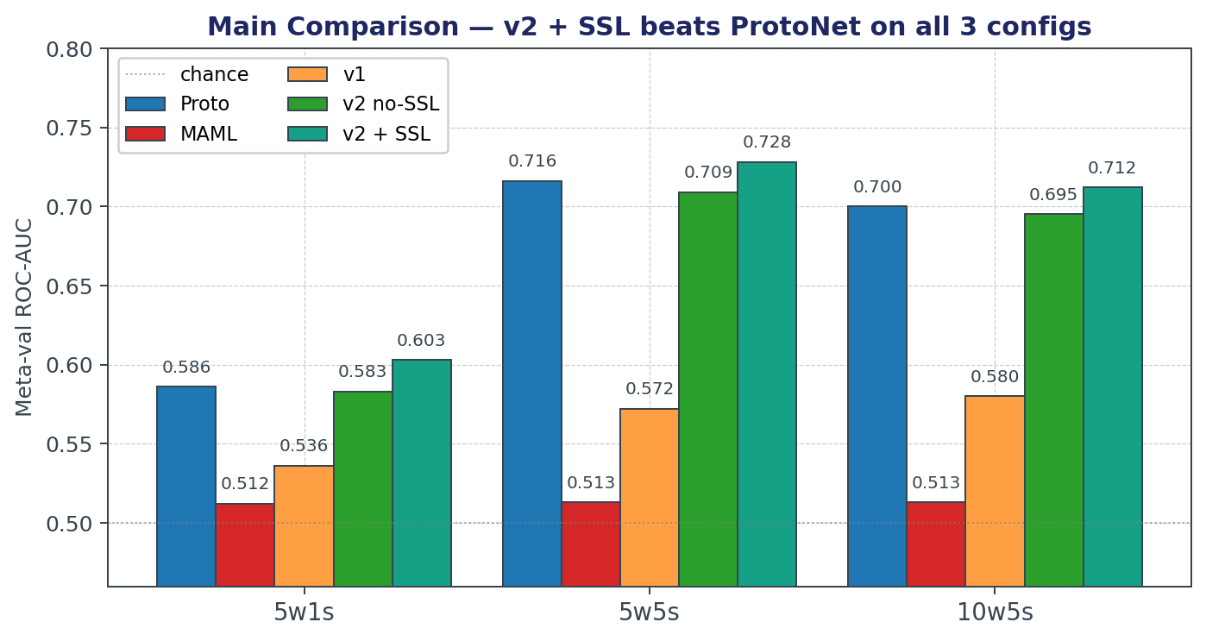
RESULTS
Main Comparison — v2 + SSL beats ProtoNet
TAKEAWAYS
● v2 + SSL beats ProtoNet on every config.
– 5w1s: 0.603 vs 0.586 (+1.7 pp)
– 5w5s: 0.728 vs 0.716 (+1.2 pp)
– 10w5s: 0.712 vs 0.700 (+1.2 pp)
● SSL alone: +2.2 pp on v2.
● MAML stays near chance.
Merged pool (673 tasks, 405 / 134 / 134 split). Meta-val AUC at best checkpoint.
Graph-of-Shots · Few-Shot Molecular Graph Classification
8 / 13

Slide 9
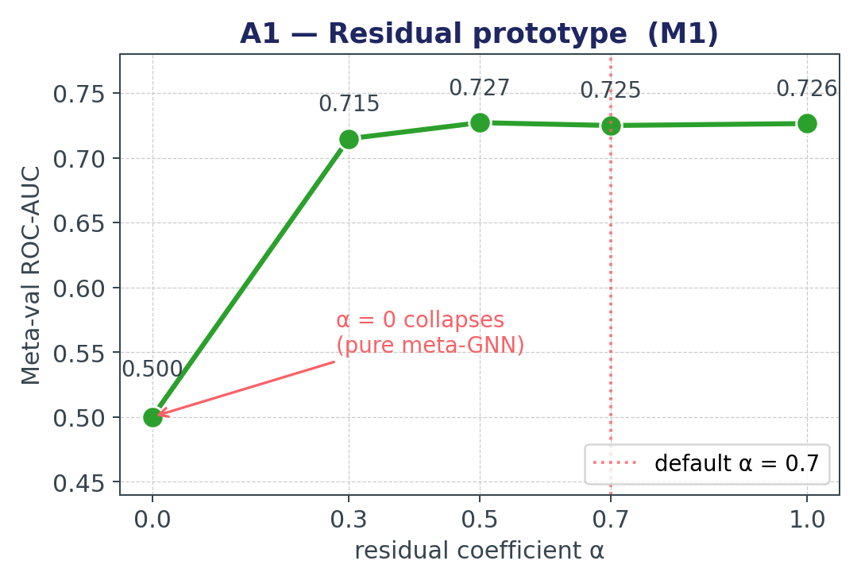
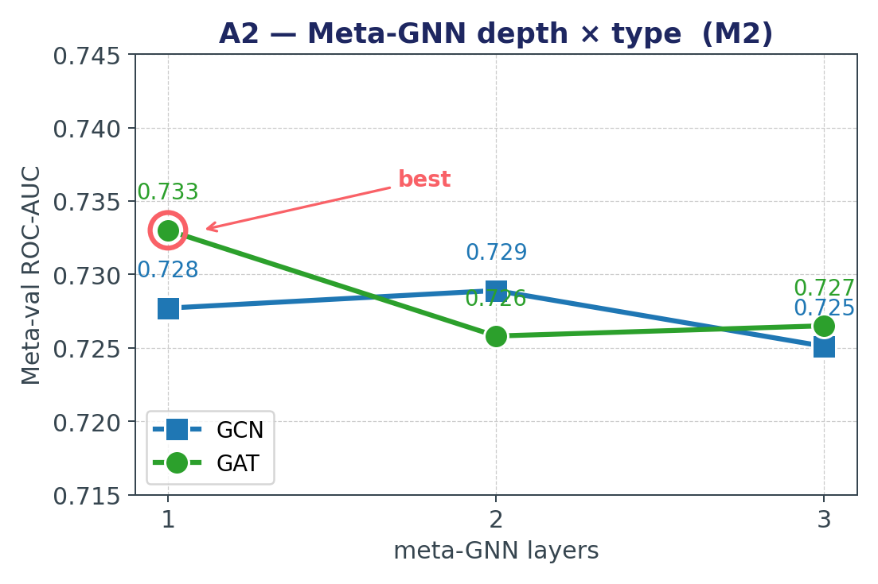
RESULTS
Ablations A1 & A2 — Residual + Depth × Type
KEY FINDINGS
A1: α = 0 collapses to 0.500 — residual is essential; any α ≥ 0.3 works. A2: GAT L = 1 wins — confirms the over-smoothing diagnosis.
Graph-of-Shots · Few-Shot Molecular Graph Classification
9 / 13

Slide 10
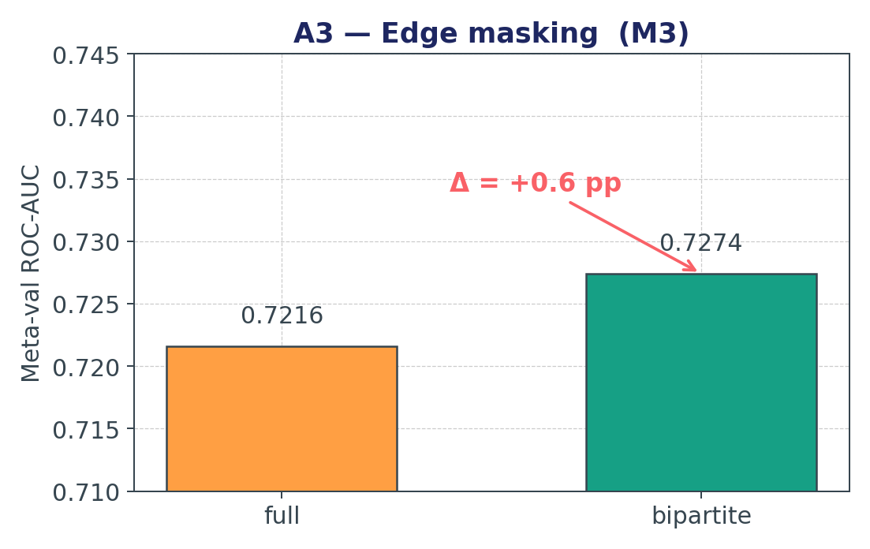
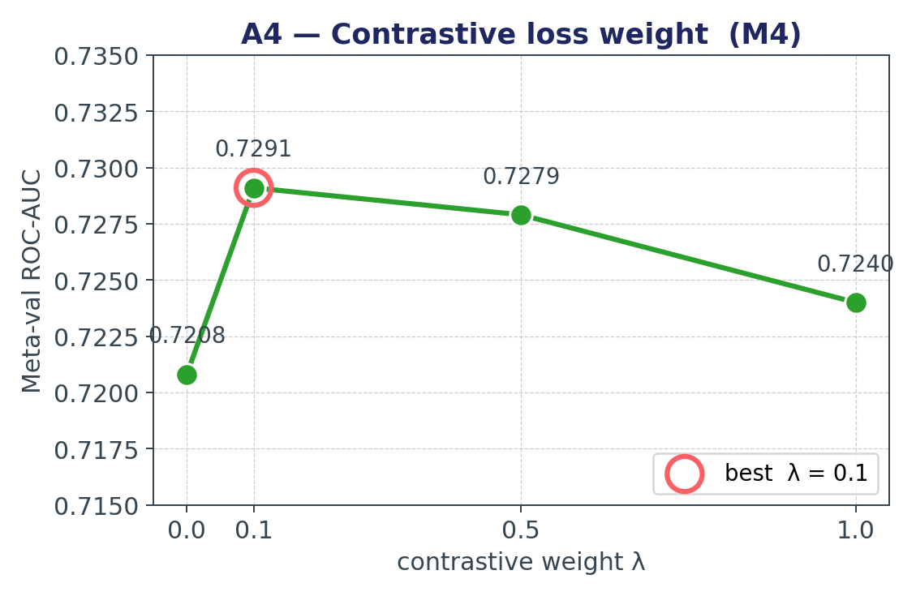
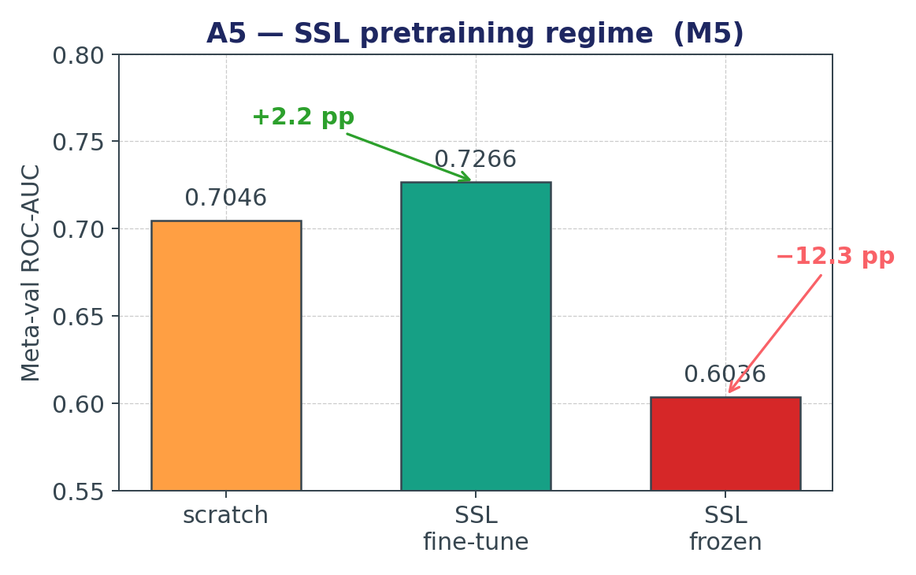
RESULTS
Ablations A3 · A4 · A5 — Masking, λ, SSL
KEY FINDINGS
A3: bipartite masking +0.6 pp. A4: a tiny λ = 0.1 contrastive loss is enough. A5: SSL fine-tune +2.2 pp, but freezing the encoder is catastrophic (−10 pp).
Graph-of-Shots · Few-Shot Molecular Graph Classification
10 / 13

Slide 11
WRAP-UP
Takeaways & Future Work
● Few-shot molecular classification has real motivation (label scarcity in bioassays).
● ProtoNet is a surprisingly strong baseline — starting from a clean metric method saves a lot of pain.
● GoS v1 beat MAML but lost to ProtoNet; GCN over-smoothing was the root cause.
● GoS v2 (residual prototype + 1-layer GAT + bipartite masking + contrastive loss + SSL)
– beats ProtoNet on 5w1s / 5w5s / 10w5s by +1.2 to +1.7 pp.
● Biggest two levers: M1 residual prototype (safety net) and M5 SSL pretraining (+2.2 pp).
● Transferable lessons:
– sparsification > affinity expressivity for meta-graphs,
– shared classifier heads collapse under episodic training,
– when your baseline is already 0.70, the bottleneck is usually the encoder.
● Future work: contrastive-only objective, text-augmented encoder, cross-assay meta-transfer.
Graph-of-Shots · Few-Shot Molecular Graph Classification
11 / 13

Slide 12
Thank you.
Questions?
Code: github.com/BDeMo/proj-mol
Team: Wenbo Huang · Junchi Yan · Yiqun Yin · Xinyue Xu · Mingjia Shi
Mingjia Shi · University of Virginia

Slide 13
REFERENCES
References
Snell et al., NeurIPS 2017
Prototypical Networks for Few-Shot Learning
Finn et al., ICML 2017
Model-Agnostic Meta-Learning for Fast Adaptation of Deep Networks
Hu et al., ICLR 2020
Strategies for Pre-training Graph Neural Networks (GIN, GINE)
Wu et al., Chem. Sci. 2018
MoleculeNet: A Benchmark for Molecular Machine Learning
Wang et al., Nature MI 2022
Molecular Contrastive Learning of Representations via GNNs (MolCLR)
Veličković et al., ICLR 2018
Graph Attention Networks (GAT)
van den Oord et al., 2018
Representation Learning with Contrastive Predictive Coding (InfoNCE)
Graph-of-Shots · Few-Shot Molecular Graph Classification
13 / 13

