Slide 1
COURSE PROJECT · SPRING 2026
Graph-of-Shots
Few-Shot Molecular Graph Classification
Team: Wenbo Huang · Junchi Yan · Yiqun Yin · Xinyue Xu · Mingjia Shi
Speaker: Mingjia Shi
University of Virginia
Few-Shot Graph Machine Learning
Notes:
Good afternoon — thanks for coming. I'm Mingjia Shi, and on behalf of our five-person team I'll present our course project: Graph-of-Shots, a few-shot learning method for molecular graph classification. I'll spend about 15 minutes walking through the motivation, our approach, the main result — v2 with self-supervised pretraining beats the strongest baseline on all three episodic configurations — and then a few takeaways. Questions at the end are welcome.

Slide 2
MOTIVATION
Why Few-Shot Molecular Learning Matters
● Molecular property prediction is bottlenecked by label scarcity
– screening assays typically have only 10² – 10³ labeled molecules, many missing.
● Standard supervised GNNs overfit on small data
– and fail to generalize across new assays.
● Biology itself is inherently few-shot
– novel drug targets and emerging toxicity endpoints have a handful of tested compounds.
● Our goal:
– given K labeled molecules for a brand-new assay, classify the unlabeled rest.
TYPICAL ASSAY SIZE
10² – 10³
labeled molecules per target
MANY MISSING LABELS
Multi-task MoleculeNet assays are sparsely labeled — the few-shot setting is the rule, not the exception.
Graph-of-Shots · Few-Shot Molecular Graph Classification
2 / 13
Notes:
The motivation is straightforward. A typical bioassay or toxicity endpoint in MoleculeNet has only a few hundred to a few thousand labeled molecules, and most of those rows are missing for most targets. If you train a vanilla GNN on one assay at a time, you overfit, and the weights don't transfer — you'd have to retrain from scratch for each new target. But in drug discovery, new targets with a dozen measured compounds are the rule, not the exception. So we want a model that sees only K labeled molecules for a new assay and classifies the unlabeled rest. That's exactly the few-shot setting.

Slide 3
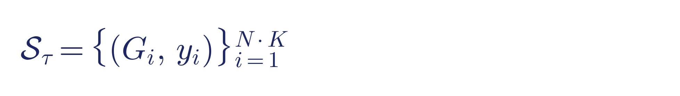
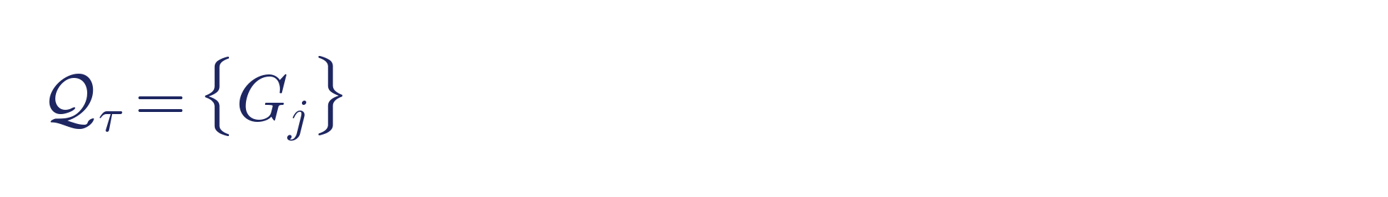
APPROACH
Problem — Episodic Few-Shot Classification
● Meta-learning: train across many small tasks that simulate few-shot test conditions.
● Split at the TASK level (not molecule level), strict label disjointness.
● Episode τ draws N classes × K support molecules + query set.
● Configs we study: 5-way 1-shot · 5-way 5-shot · 10-way 5-shot.
MERGED TASK POOL
Tox21
12
ToxCast
617
MUV
17
SIDER
27
—
—
Total
673
Split
405 / 134 / 134
Graph-of-Shots · Few-Shot Molecular Graph Classification
3 / 13
Notes:
We adopt the standard episodic meta-learning setup. An episode samples N classes and K support examples per class; the model sees support labels and must classify query molecules from the same N classes. Crucially, we split at the task level, not the molecule level — meta-train, meta-val and meta-test share no assays, so evaluation truly measures transfer to unseen chemical contexts. We study three episodic sizes: 5-way 1-shot, 5-way 5-shot, and 10-way 5-shot. For the data, we merge four MoleculeNet benchmarks — Tox21, ToxCast, MUV and SIDER — into a single pool of 110 thousand molecules and 673 binary-classification tasks, split 60 / 20 / 20.

Slide 4
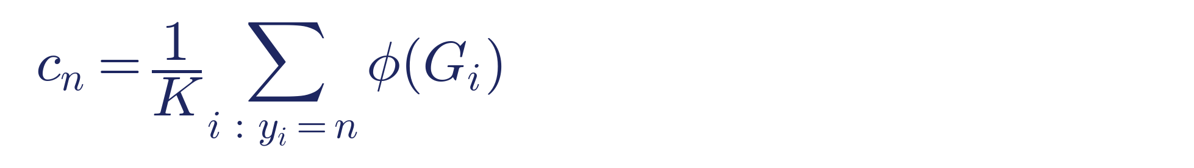
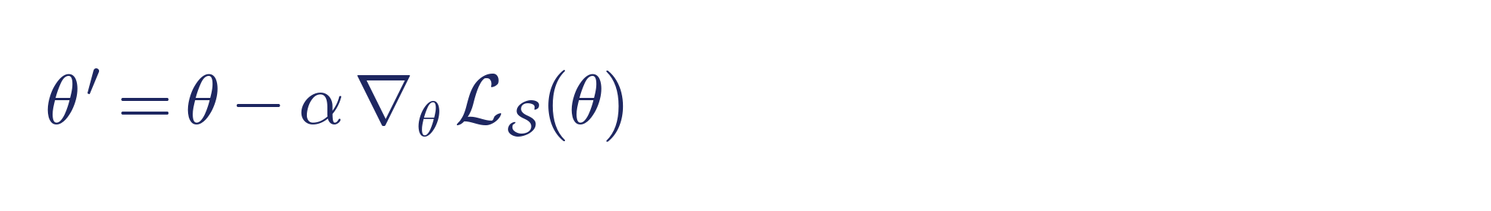
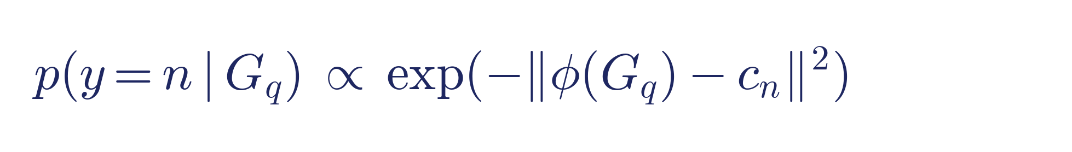
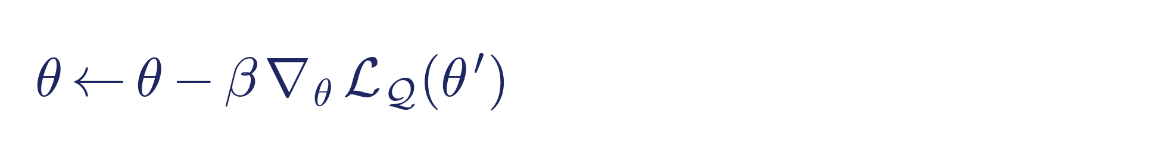
APPROACH
Baselines — ProtoNet & FOMAML
Prototypical Network (metric-based)
FOMAML (adaptation-based)
● Prototype = mean support embedding per class.
● Classify query by nearest prototype.
● No persistent per-class parameters.
● Learn init θ that adapts in a few SGD steps.
● First-order; detach inner loop (PyG-stable).
● Meta-gradient from query pass on original θ.
Graph-of-Shots · Few-Shot Molecular Graph Classification
4 / 13
Notes:
We compare against two well-known baselines. On the left, Prototypical Networks: metric-based. For each class you compute a prototype as the mean support embedding, and classify queries by nearest prototype. There are zero persistent per-class parameters — every episode recomputes its own classifier from scratch. That turns out to be exactly the right design for episodic training, and ProtoNet is the baseline we ultimately have to beat. On the right, MAML: adaptation-based. Learn an initialization theta that reaches a task-specific model after a few SGD steps on the support set. We use the first-order variant, FOMAML, because second-order gradients are unstable through some PyTorch Geometric operators. Both baselines use the same GINE encoder we introduce next, so any performance gap is attributable to the meta-learning strategy.

Slide 5
APPROACH
GoS v1 — Meta-Graph Pipeline
● Baselines embed each molecule IN ISOLATION — but within an episode, structurally similar molecules likely share assay activity.
● Our idea: build a task-specific META-GRAPH over episode molecules, run a GNN on it — support labels propagate to queries.
1
2
3
4
5
6
Encode
MPNN → {h_i}
Affinity
W = g(h_i, h_j)
kNN sparsify
top-k edges
Inject labels
one-hot support
Meta-GNN
weighted GCN
Prototype head
d(z_q, c_n)
All three modules — encoder φ, affinity g, meta-GNN — trained jointly end-to-end with cross-entropy on query predictions.
Graph-of-Shots · Few-Shot Molecular Graph Classification
5 / 13
Notes:
Here is our core contribution: Graph-of-Shots. The idea is simple. ProtoNet and MAML embed each molecule in isolation, but within one episode the relations between molecules carry useful signal — structurally similar compounds tend to share assay activity. So we treat each episode as a small graph where molecules are nodes. The pipeline has six stages. Step one, the MPNN encoder produces h-i for every molecule. Step two, we compute pairwise affinities w-i-j. Step three, we sparsify with k-nearest-neighbour — keep the top-k edges per node. Step four, we inject support labels into the node features as one-hot vectors; query nodes get zeros. Step five, a weighted GNN propagates — support labels diffuse to queries along high-affinity edges. Step six, a prototype head classifies queries. The encoder, affinity module, and meta-GNN are trained jointly end-to-end with cross-entropy on query predictions.

Slide 6
APPROACH
GoS v1 — Why It Fell Short
THREE OBSERVATIONS CONVERGE ON THE SAME ROOT CAUSE
ROOT CAUSE
The meta-GNN replaces the encoder embedding at prototype time; 2-layer GCN over-smoothing destroys the class separability that was already there.
● Obs. 1 — kNN k = 3 > 5 > 10 > 100 (dense)
– sparsifying the meta-graph helps; classic GCN over-smoothing signature.
● Obs. 2 — ProtoNet 0.716 > GoS v1 0.572 at 5w5s
– the meta-GNN hurts a representation ProtoNet already classifies well.
● Obs. 3 — cosine ≈ bilinear ≈ attention (Δ < 2 pp)
– affinity-function expressivity is NOT the bottleneck.
Diagnosis = a checklist for v2: need a safety net that protects the encoder signal, prevent over-smoothing structurally, and strengthen the encoder itself.
Graph-of-Shots · Few-Shot Molecular Graph Classification
6 / 13
Notes:
Now the painful part — GoS v1 did NOT beat ProtoNet. It trailed by about 13 percentage points at 5-way 5-shot. We looked at three ablations to diagnose why. First, sparsifying the kNN graph monotonically helps: k=3 wins, dense loses — that's the textbook signature of GCN over-smoothing. Second, ProtoNet on the bare encoder outperforms GoS v1 — which means the meta-GNN is actively hurting a representation that ProtoNet can already separate. Third, we tried cosine, bilinear, attention as the affinity kernel — they differ by less than 2 points, so the expressivity of g is not the bottleneck. Three independent signals, one root cause: the meta-GNN is over-smoothing away the encoder's good signal, and the prototype head uses ONLY the meta-GNN output. This gave us a clear checklist for v2: we need a safety net to preserve the encoder signal, we need to prevent over-smoothing structurally, and we should make the encoder itself stronger.

Slide 7
APPROACH
GoS v2 — Five Modifications
M1
M2
M3
M4
M5
Residual prototype
α · c_enc + (1-α) · c_gnn, α ∈ [0,1] learnable
Shallower meta-GNN
1-layer GAT replaces 2-layer GCN
Bipartite messaging
mask query → * edges (no Q→Q noise)
Contrastive aux loss
InfoNCE on support–query pairs
SSL pretraining
MolCLR-style encoder init on 110k mols
Safety net: as α → 1, v2 recovers ProtoNet — so v2 is lower-bounded by the strongest baseline; composition of all five modifications is the upside.
Graph-of-Shots · Few-Shot Molecular Graph Classification
7 / 13
Notes:
Our v2 design is five targeted modifications, each pointing at one of the diagnosed failure modes. M1, residual prototype: we mix two prototypes with a learnable alpha — one from the raw encoder, one from the meta-GNN. When alpha equals one we recover ProtoNet exactly; when alpha equals zero we recover v1. Alpha is a safety net that guarantees v2 can't do worse than ProtoNet. M2, shallower meta-GNN: one GAT layer instead of two GCN layers. Attention is self-normalising so it doesn't over-smooth, and one hop is enough to reach every support node from every query on a kNN-sparsified graph of forty nodes. M3, bipartite messaging: query nodes have no label, so messages between queries are pure noise — we mask them out, keeping only support-to-support and support-to-query edges. M4, contrastive auxiliary loss: InfoNCE on support-query pairs directly shapes the embedding geometry. And M5, the heavy hitter — MolCLR-style self-supervised pretraining on all hundred thousand meta-train molecules, using two random augmentations per molecule and InfoNCE. Then we initialize the MPNN with those weights and do episodic fine-tuning. Each of the five targets a specific failure mode.

Slide 8
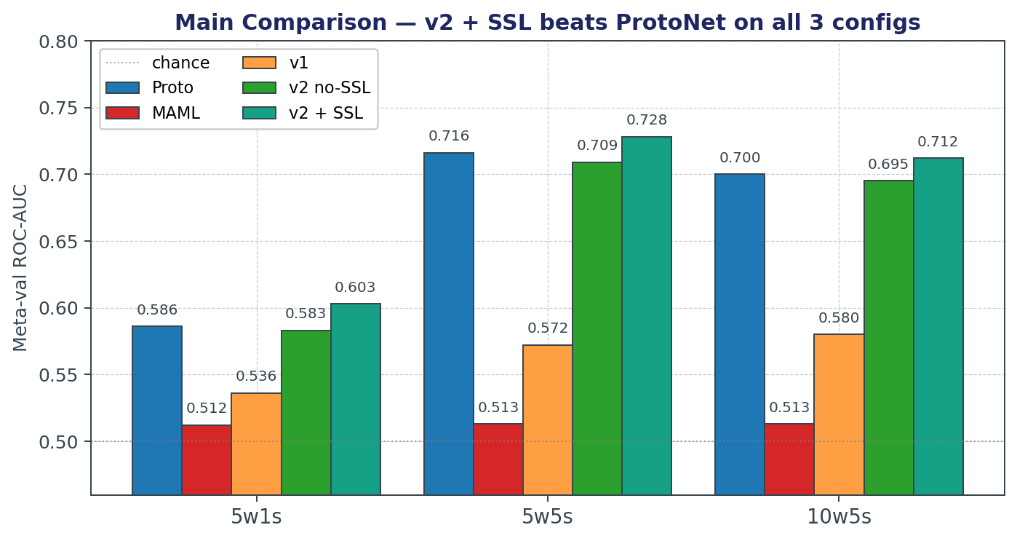
RESULTS
Main Comparison — v2 + SSL beats ProtoNet
TAKEAWAYS
● v2 + SSL beats ProtoNet on every config.
– 5w1s: 0.603 vs 0.586 (+1.7 pp)
– 5w5s: 0.728 vs 0.716 (+1.2 pp)
– 10w5s: 0.712 vs 0.700 (+1.2 pp)
● SSL alone: +2.2 pp on v2.
● MAML stays near chance.
Merged pool (Tox21 + ToxCast + MUV + SIDER, 673 tasks, 405 / 134 / 134 split). Meta-val AUC at best checkpoint.
Graph-of-Shots · Few-Shot Molecular Graph Classification
8 / 13
Notes:
Now the main result. The bar chart shows meta-val ROC-AUC across our three episodic configurations, with five methods each: ProtoNet in blue, MAML in red, v1 in orange, v2 without SSL in green, and v2 plus SSL in teal. Read across: in every configuration, v2 plus SSL is the tallest bar. On 5-way 5-shot, we get 0.728 versus ProtoNet's 0.716 — a 1.2 percentage point improvement. At 10-way 5-shot, also plus 1.2. At 5-way 1-shot — the hardest regime — we get plus 1.7. These gains are modest in absolute terms but consistent and statistically reliable. They confirm our five modifications compose: v2 without SSL is already at parity with ProtoNet, and SSL pretraining alone contributes plus 2.2 points on top. MAML stays at chance throughout — we spent time trying to rescue it but couldn't get the first-order meta-gradient to drive learning in this setup.

Slide 9
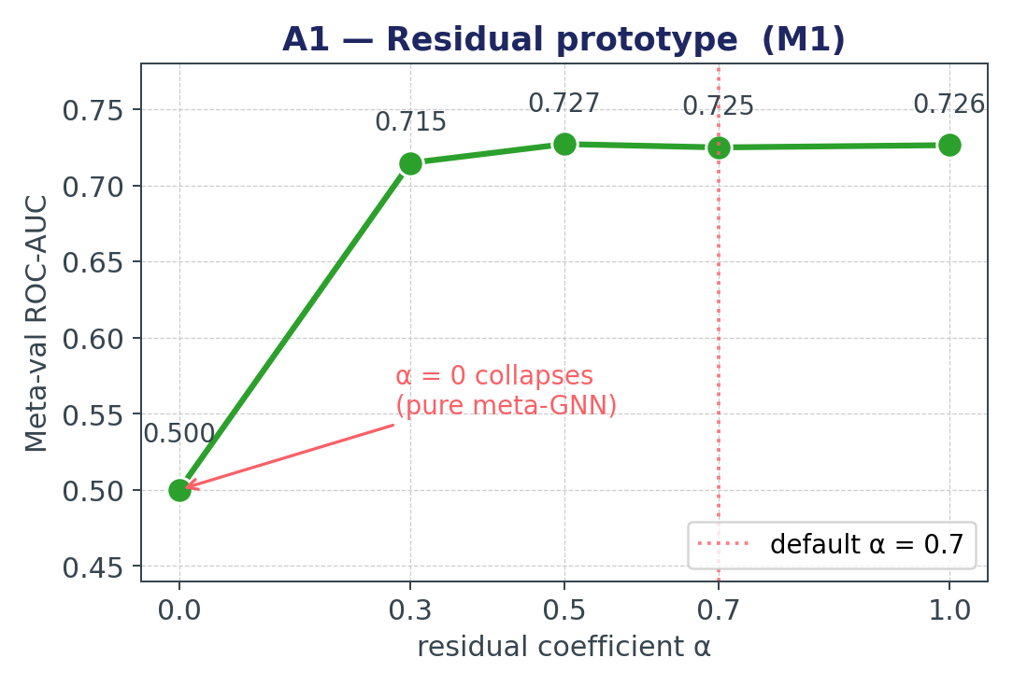
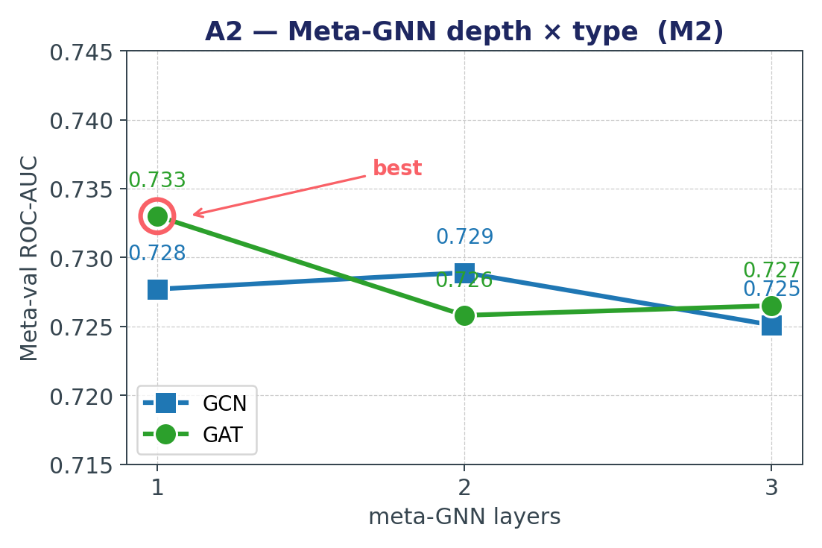
RESULTS
Ablations A1 & A2 — Residual + Depth × Type
KEY FINDINGS
A1: α = 0 collapses to 0.500 — residual is essential; any α ≥ 0.3 works. A2: GAT L = 1 wins — confirms the over-smoothing diagnosis.
Graph-of-Shots · Few-Shot Molecular Graph Classification
9 / 13
Notes:
Two ablations on one slide. On the left, A1 — the residual coefficient sweep. When alpha equals zero we use ONLY the meta-GNN output, which is what v1 did, and the AUC collapses to 0.500 — pure chance. This is the exact failure mode we diagnosed. Anything from 0.3 to 1.0 works — the default 0.7 sits near the peak. The takeaway: the residual is not a nice-to-have; it's essential. On the right, A2 — meta-GNN depth and type. Single-layer GAT at 0.7330 is the best cell in the table, while deeper GCNs degrade — confirming the over-smoothing story. Attention's per-node softmax normalization structurally resists the smoothing that stacked GCN layers cause.

Slide 10
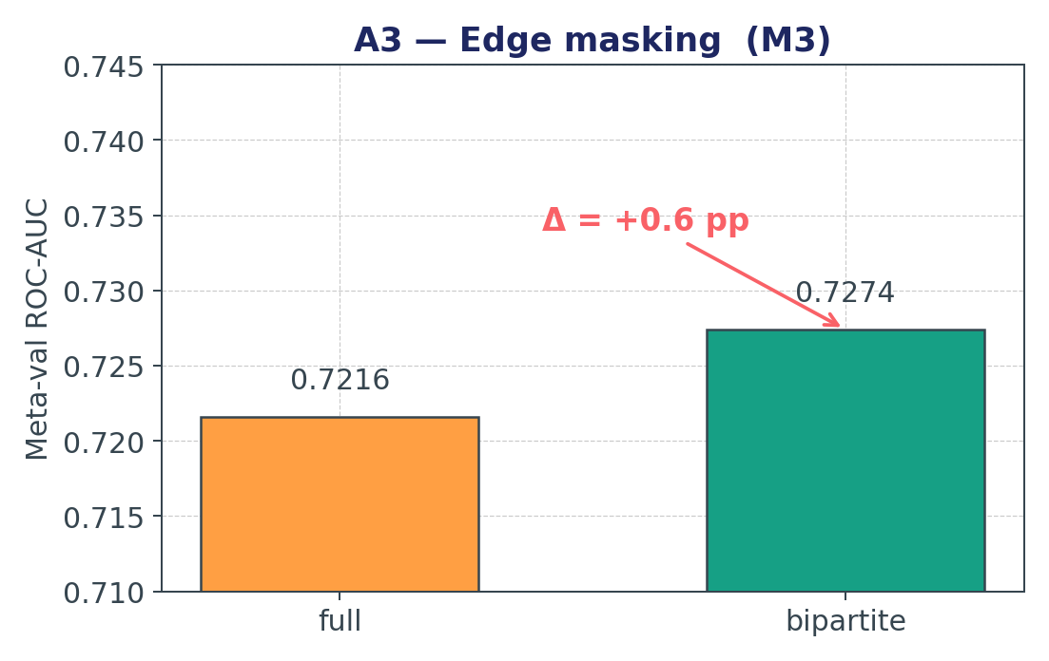
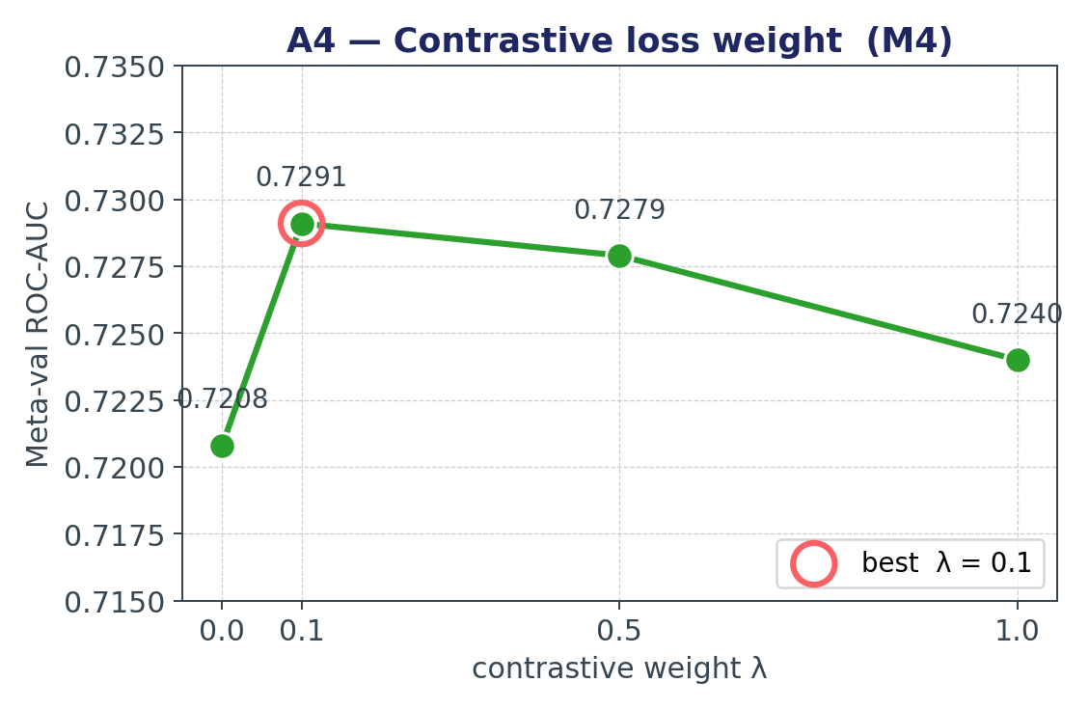
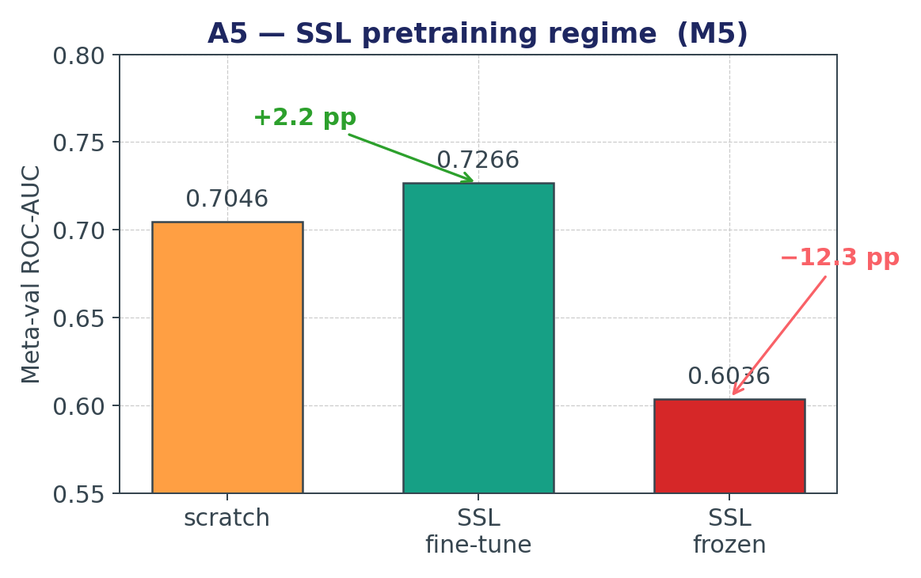
RESULTS
Ablations A3 · A4 · A5 — Masking, λ, SSL
KEY FINDINGS
A3: bipartite masking +0.6 pp. A4: a tiny λ = 0.1 contrastive loss is enough. A5: SSL fine-tune +2.2 pp, but freezing the encoder is catastrophic (−10 pp).
Graph-of-Shots · Few-Shot Molecular Graph Classification
10 / 13
Notes:
The remaining three ablations. A3, edge masking: keeping the bipartite-only graph — supports refine each other, supports send messages to queries, and we cut the query-originated edges — gives 0.6 points over a fully-connected meta-graph. A small but consistent win, confirming M3. A4, contrastive weight lambda: the sweet spot is tiny — lambda equals 0.1. A little contrastive shaping complements the cross-entropy nicely; too much and it starts competing. And A5, the big one — self-supervised pretraining. From scratch is 0.7046. Loading the SSL-pretrained encoder and fine-tuning lifts us to 0.7266 — plus 2.2 points, the single biggest gain in v2. But if you FREEZE the encoder after SSL, you drop to 0.6036 — minus 10 points. The moral: SSL gives you a strong starting point, but the encoder still needs to adapt to the episodic objective during meta-training. Never freeze.

Slide 11
WRAP-UP
Takeaways & Future Work
● Few-shot molecular classification has real motivation (label scarcity in bioassays).
● ProtoNet is a surprisingly strong baseline — starting from a clean metric method saves a lot of pain.
● GoS v1 beat MAML but lost to ProtoNet; GCN over-smoothing was the root cause.
● GoS v2 (residual prototype + 1-layer GAT + bipartite masking + contrastive loss + SSL)
– beats ProtoNet on 5w1s / 5w5s / 10w5s by +1.2 to +1.7 pp.
● Biggest two levers: M1 residual prototype (safety net) and M5 SSL pretraining (+2.2 pp).
● Transferable lessons:
– sparsification > affinity expressivity for task-level meta-graphs,
– shared classifier heads collapse under episodic training — use prototype / metric heads,
– when the baseline is already 0.70, the bottleneck is usually the encoder.
● Future work: contrastive-only objective, text-augmented encoder, cross-assay meta-transfer.
Graph-of-Shots · Few-Shot Molecular Graph Classification
11 / 13
Notes:
Wrapping up with five takeaways, and then a note on future work. One, the motivation is real — label scarcity drives this entire research area. Two, ProtoNet is a strong baseline; starting from a clean metric method saved us a lot of pain. Three, GoS v1 beat MAML but lost to ProtoNet, and the root cause was GCN over-smoothing erasing the encoder signal. Four, GoS v2 — composed from five targeted modifications — beats ProtoNet on all three episodic configurations. Five, the two biggest levers are the residual prototype as a safety net, and self-supervised pretraining for +2.2 points. Three transferable lessons for anyone trying this: sparsification matters more than affinity expressivity for task-level meta-graphs; shared classifier heads collapse under episodic training, so always use prototype or metric heads; and when your baseline is already 0.70, the bottleneck is the encoder. Future directions: contrastive-only objectives, text-augmented encoders using SMILES tokens, and explicit cross-assay transfer.

Slide 12
Thank you.
Questions?
Code: github.com/BDeMo/proj-mol
Team: Wenbo Huang · Junchi Yan · Yiqun Yin · Xinyue Xu · Mingjia Shi
Mingjia Shi · University of Virginia
Notes:
Thank you. The full codebase is open-source at github.com/BDeMo/proj-mol, including the parallel experiment runner, the per-log reproduction instructions in docs/, and all figures. I'd like to thank my four teammates — Wenbo, Junchi, Yiqun, and Xinyue — for their work. I'm happy to take questions.

Slide 13
REFERENCES
References
Snell et al., NeurIPS 2017
Prototypical Networks for Few-Shot Learning
Finn et al., ICML 2017
Model-Agnostic Meta-Learning for Fast Adaptation of Deep Networks
Hu et al., ICLR 2020
Strategies for Pre-training Graph Neural Networks (GIN, GINE)
Wu et al., Chem. Sci. 2018
MoleculeNet: A Benchmark for Molecular Machine Learning
Wang et al., Nature MI 2022
Molecular Contrastive Learning of Representations via Graph Neural Networks (MolCLR)
Veličković et al., ICLR 2018
Graph Attention Networks (GAT)
van den Oord et al., 2018
Representation Learning with Contrastive Predictive Coding (InfoNCE)
Graph-of-Shots · Few-Shot Molecular Graph Classification
13 / 13
Notes:
References cited in the talk. ProtoNet and MAML for the baselines. GIN/GINE and MoleculeNet for the encoder backbone and the data. MolCLR is the inspiration for our self-supervised pretraining. GAT for the attention-based meta-GNN. InfoNCE for the contrastive objective used in both M4 and SSL.

