Slide 1
The Hall of Fame
A Statistical Analysis of Baseball

Slide 2
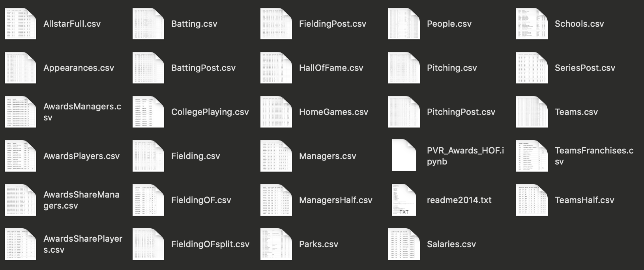
The Data ”The Starting Point”
Sean Lahman’s Baseball Database
CSV database that houses complete batting and pitching statistics from 1871 to 2018
In mid-1990’s he created the first online baseball archive. It later was reborn as baseball-reference.com

Slide 3
Hall of Fame “Selecting a Sample”
As of 2019, the Baseball Hall of Fame is comprised of 329 elected members
267 former players:
232 Major League Players
35 Negro League Players
The leftover 62 members consisted of:
Managers
Executives
Umpires
However, we need to eliminate some data points

Slide 4

Creating Data Limitations
232 Major League Baseball players fall into two camps:
Pitcher
Position Player (or Batter)
As we looked through the data of former players, we wanted to see what makes a “Hall of Fame” batter in the Modern Age of Baseball – 1950 and beyond
Therefore we eliminated players whose primary position was pitcher and those who played pre-1950.
79 Major League Position Players

Slide 5
Creating Data Limitations
Negro League Players had limited historical data for their playing careers, thus skewing the results
Some only had 1 or 2 Major League years recorded, but played 10+ years in the Negro League which was not recorded
Pitcher’s data was convoluted due to limited at-bats and the usage of a ”designated hitter” in the American League.
Baseball has two leagues – National and American
Pitchers must hit in the National League.
Pitchers in the American League have a “designated hitter”
Pre-1950s was known as the Golden Age of Baseball – which relied on trial and error of equipment, rules, and so forth.

Slide 6
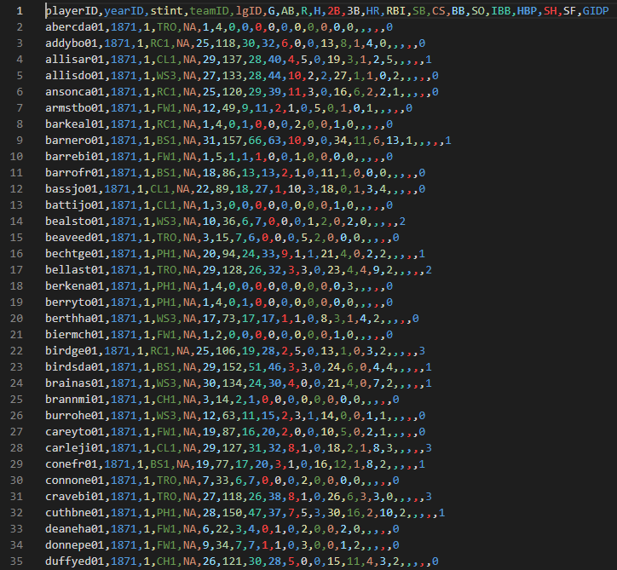
Data Munging Player Batting Data

Slide 7
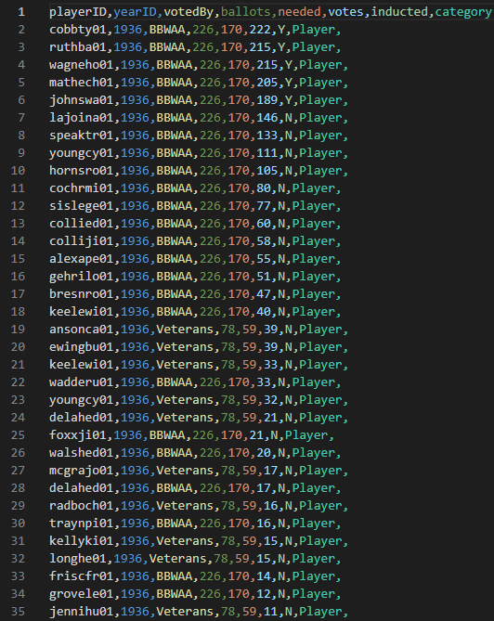
Data Munging Hall of Fame Induction Data

Slide 8
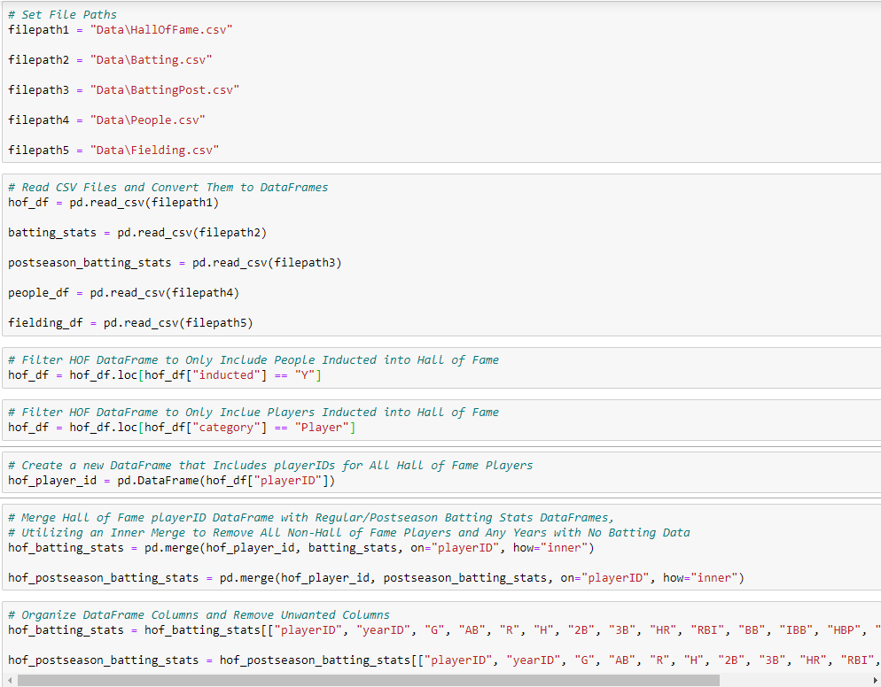
Pulling in CSV files
Converting CSV files to
Data Frames
Filtering Players Inducted & Creating Data Frame
Merging Player Stats to Hall of Fame Players
Filtering Unwanted Data

Slide 9
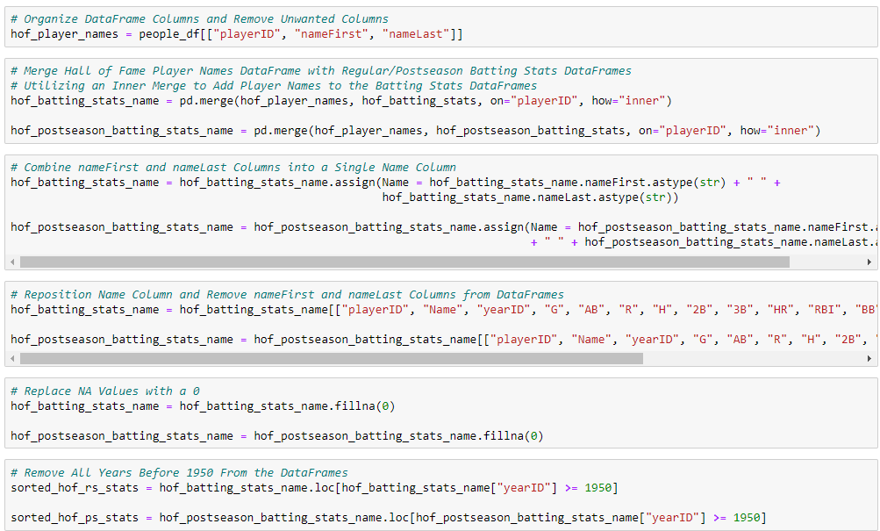
Grab Players from People DF & Merging to HOF
Creating Name Column from Separate Columns
Reorder/Removing Unwanted Fields
Removing NAs
Filtering to 1950+ Data

Slide 10
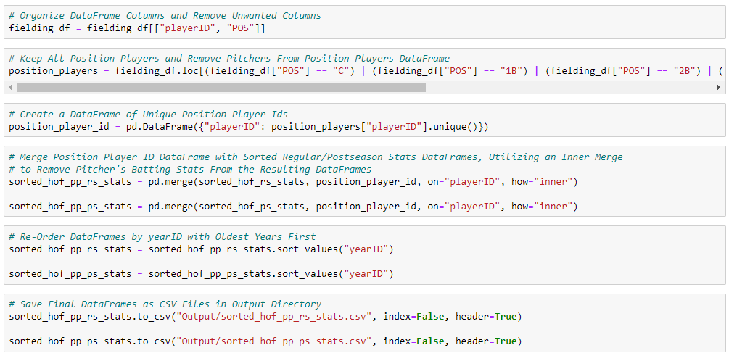
Removing Unwanted Columns
Removing Pitchers Using Fielding IDs
Creating New Data Frame for Player IDs
Merging Position Player IDs with Batting Data Frame
Sorting Final Data Frame by Year ID

Slide 11
Final Data Format

Slide 12
Winning Awards
”Does Winning Awards Contribute to Being Inducted in the Hall of Fame?”

Slide 13
Baseball Awards
ALCS MVP
Baseball Magazine All-Star
TSN All-Star
NLCS MVP
World Series MVP
All-Star Game MVP
Comeback Player of the Year
TSN Fireman of the Year
TSN Guide MVP
Babe Ruth Award
Pitching Triple Crown
Branch Rickey Award
Hutch Award
Cy Young Award
Most Valuable Player
Rolaids Relief Man Award
Gold Glove
All-Star Game MVP
Roberto Clemente Award
Silver Slugger
TSN Reliever of the Year
Hank Aaron Award
TSN Player of the Year
Rookie of the Year
Lou Gehrig Memorial Award
Triple Crown
TSN Pitcher of the Year

Slide 14
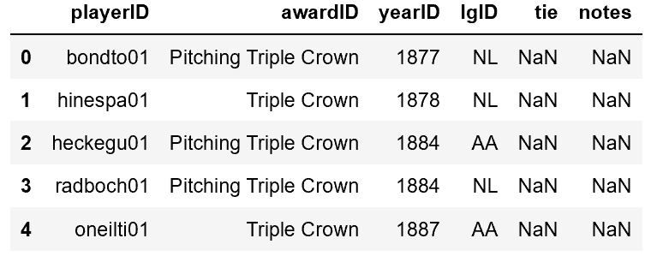
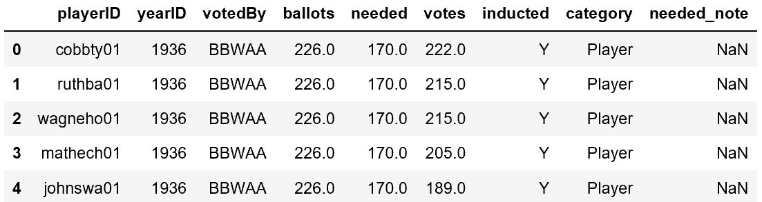
Merging Awards Data
Awards.Csv
Halloffame.csv

Slide 15
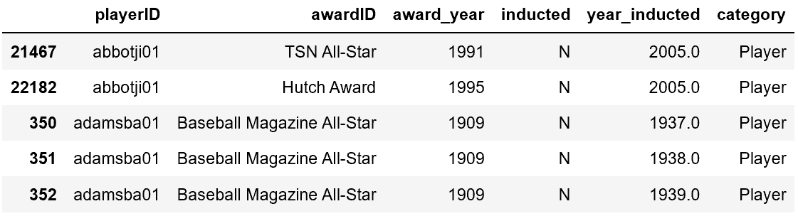
Merging Awards Data
merged_df = pd.merge(awards_df, hof_df, on='playerID', how="left")
results = merged_df.loc[merged_df.category == "Player",("playerID","awardID
awardsummary = results.sort_values(['inducted','category', 'playerID','award_year','awardID’])

Slide 16
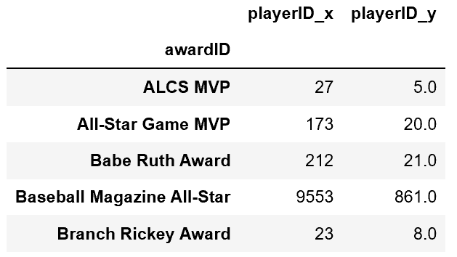
Merging Awards Data
groupbyawardID = awardsummary.groupby("awardID")["playerID"].count()
groupby2 = hofawards0.groupby("awardID")["playerID"].count()
final1 = pd.merge(allplayers, hofawards1, on='playerID', how="left")
final1 = final1.rename(columns={"awardID_x":"Total_player_awards", "awardID_y":"HOF_awards"})

Slide 17
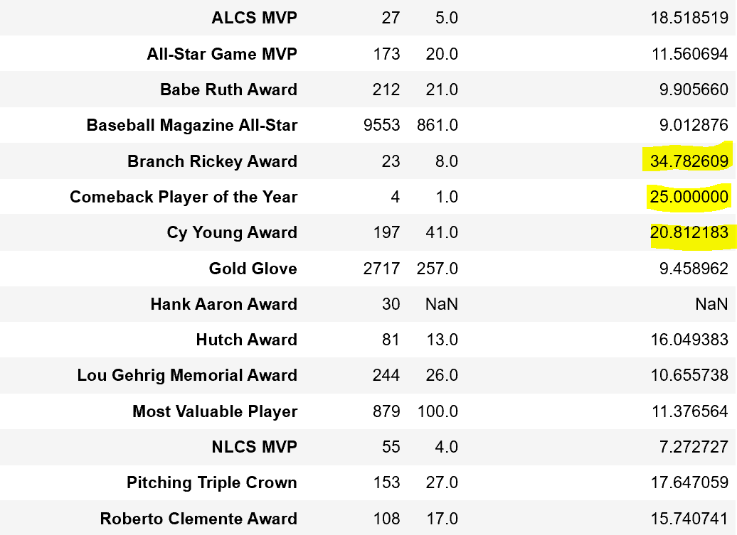
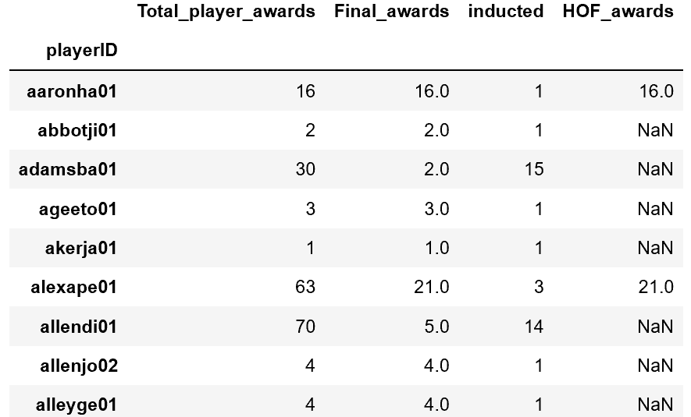
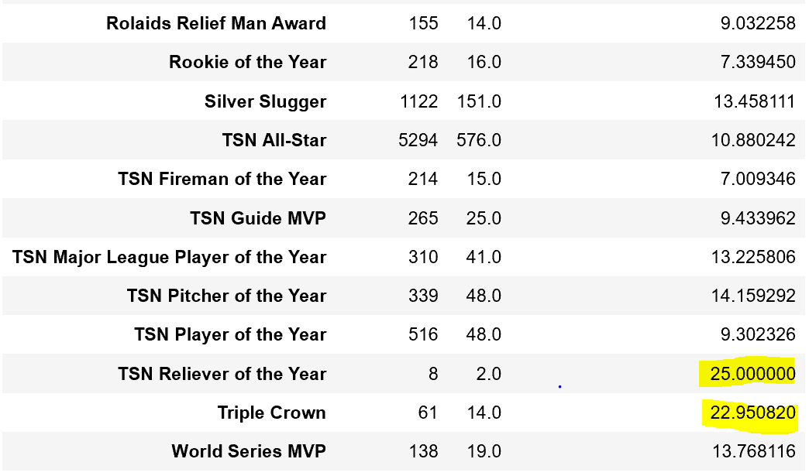
final = pd.merge(allawards, hofawards, on='awardID', how="left")
final = final.rename(columns={"playerID_x":"all_players", "playerID_y":"HOF"},)
final['HOF_percentage_of_all_players'] = final["HOF"]/final["all_players"]*100
All Players .groupby(“playerID)[“awardID].count()
HOF .groupby(“playerID)[“awardID].count()
Merge and then add column HOF_awards

Slide 18
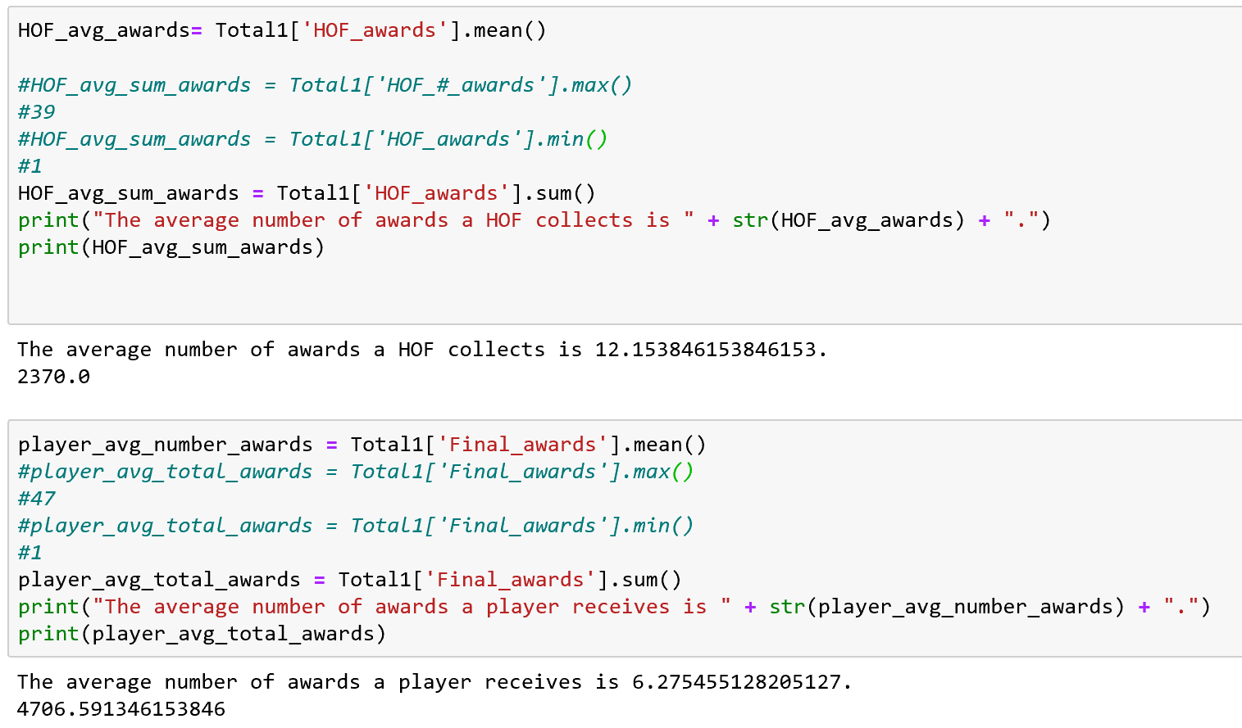
Awards Outcome
Hall of Famer:
12 Awards
Average Player:
6 Awards

Slide 19
Hall of Famers Across Decades
“Does Specific Performance Dictate Induction?”
“Is There A Statistical Formula for Being a Hall of Famer?”
“Does This Formula Change by Decade?”

Slide 20
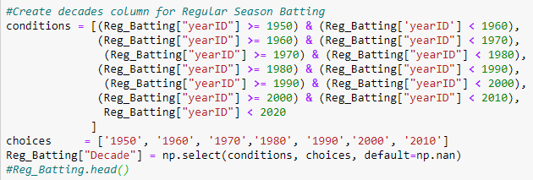
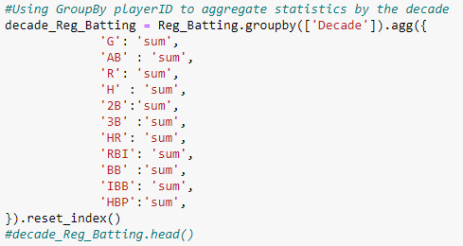
Creating Decade Buckets
Aggregating Player ID and Cumulative Stats

Slide 21
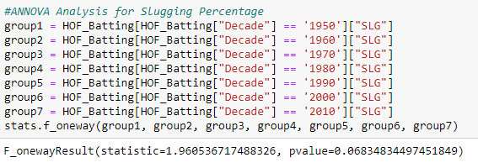
Do Key Statistics for Hall of Famers Differ Across Decade?
One-Way ANOVA Test on Slugging Percentage

Slide 22
Any Significant Stats Across Decade?
Batting Average? Homeruns? On Base Percentage?

Slide 23
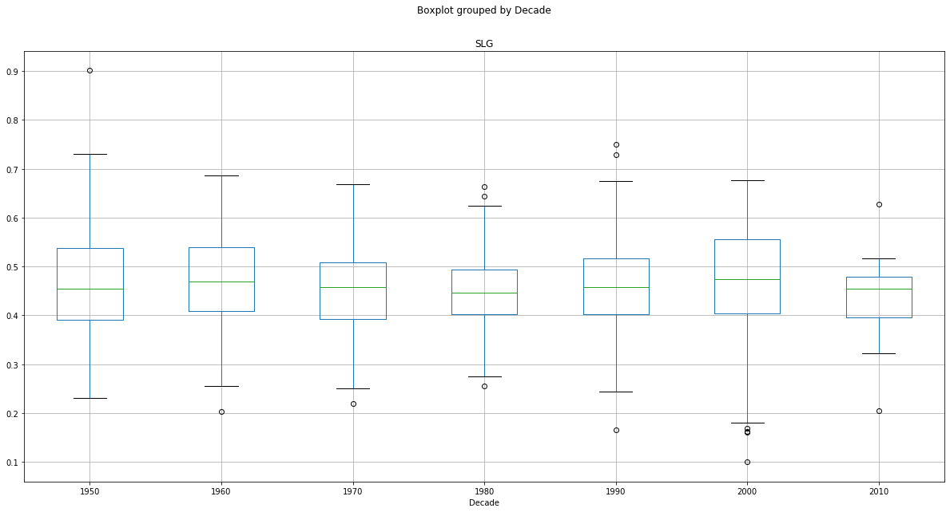
Slugging P-Value:
0.0683

Slide 24
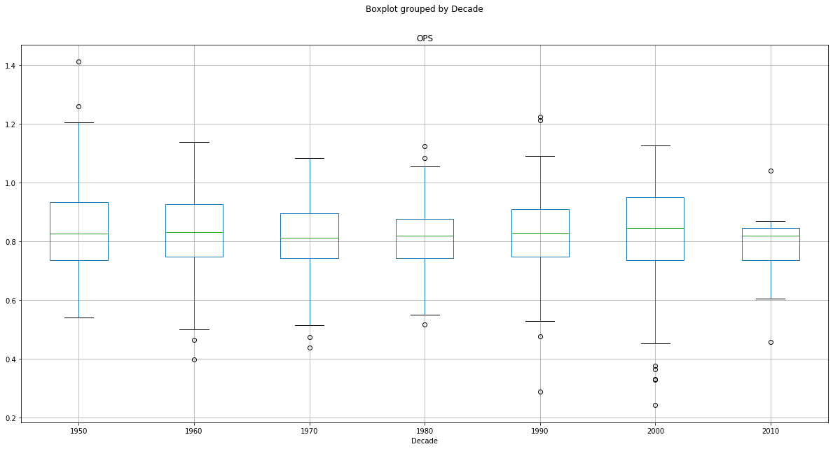
OPS P-Value:
0.0683

Slide 25
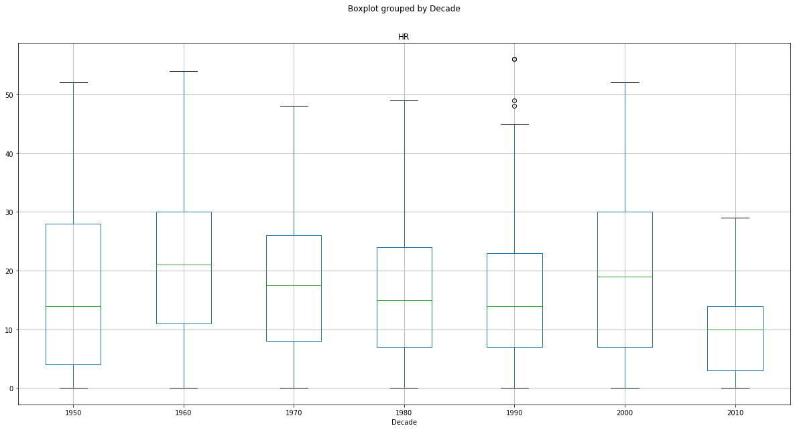
Homerun P-Value:
2.2474e-5

Slide 26
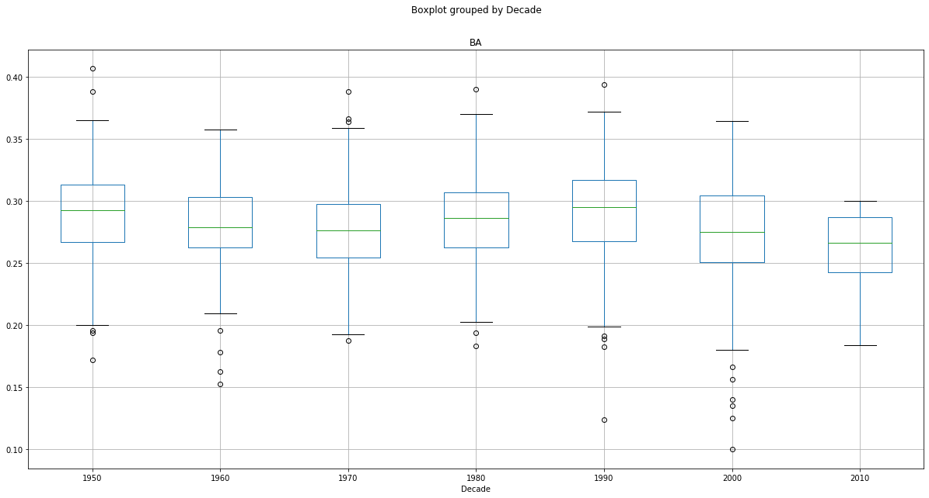
Batting Avg. P-Value:
6.4768e-8

Slide 27
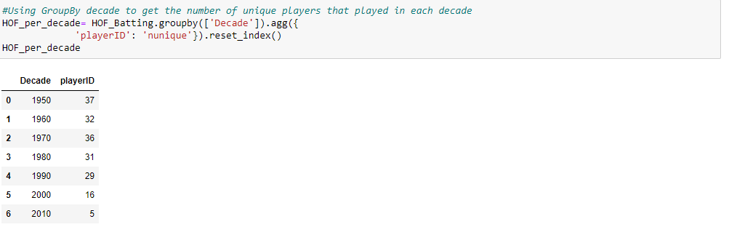
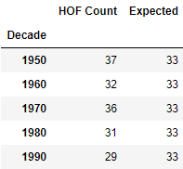
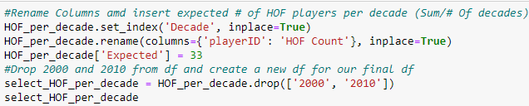
Is Each Decade Proportionally Represented by Hall of Fame Players?

Slide 28
Do Hall of Fame Players Increase Performance in Playoff Situations?
How about compared to average players?

Slide 29
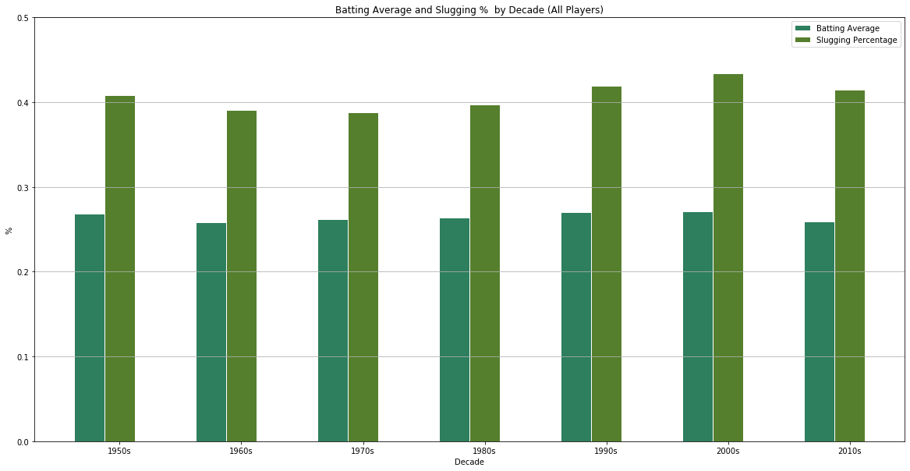
All Player Stats

Slide 30
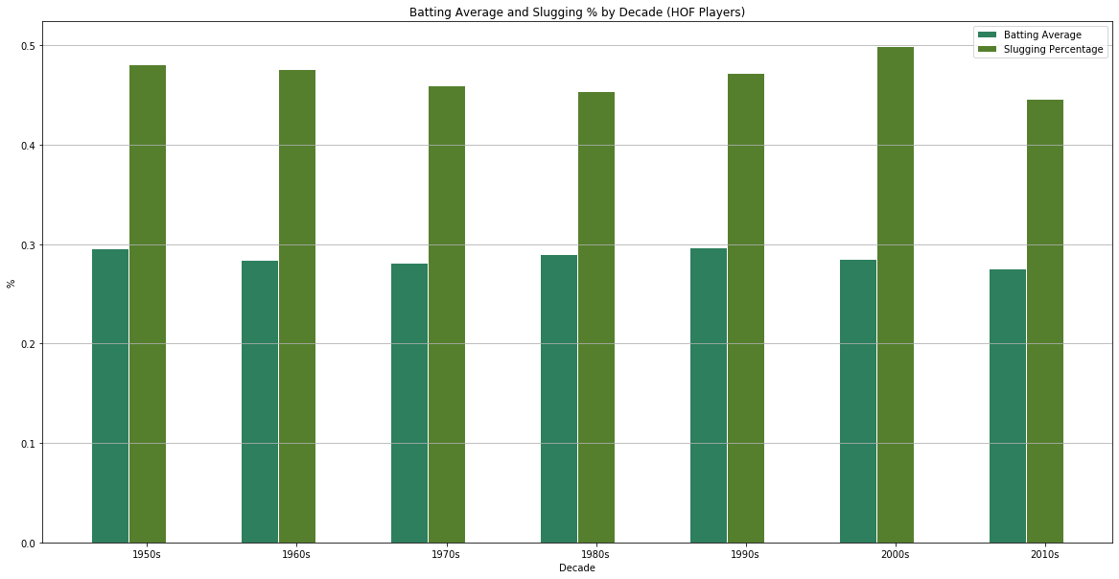
Hall of Fame Player Stats

Slide 31
T-Testing for Performance
All Regular Season Batting Average vs Post-Season Batting Average:
p-value = 6.0586e-25
All Regular Season Slugging % vs Post-Season Slugging %:
p-value = 5.2081 e-11
HOF Regular Season Batting Average vs Post-Season Batting Average:
p-value = 0.0045
HOF Regular Season Slugging % vs Post-Season Slugging %:
p-value = 0.0076

Slide 32
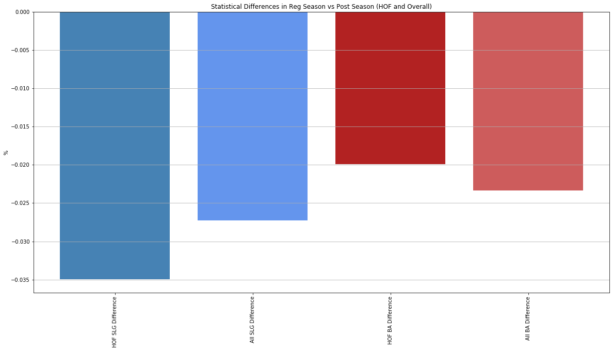
HOF vs. All Players
Slugging Percentage
HOF vs. All Players
Batting Average

Slide 33
Conclusion “Postmortem”
Difficulties with Data:
Database organization – CSVs were difficult to merge/adjust
Only had access to a singular free database
Current HOF does not take into account players still playing and accruing awards
Parsing our specific inputs (pitchers playing the field)
Git Hub

Slide 34
Questions
?

