Slide 1

Projekt Strojového Učenia
Presented BY:
Cherie Mosher, Taber Webb, Bryan Domogalla

Slide 2
Young People Survey
Students in the Social Sciences department of a Slovakian university were asked to get their friends to participate in a survey in 2013.
All participants were between the ages of 15-30.
The data file consists of 1,010 responses.
The original questionnaire was in Slovak language and was later translated into English.
Questions were based on 8 groups:
Music preferences (19)
Movie preferences (12)
Hobbies & interests (32)
Phobias (10)
Health habits (3)
Personality traits, views on life, & opinions (57)
Spending habits (7)
Demographics (10)

Slide 3
The three of us started playing around with the data to develop questions.
Can we make spurious correlations among seemingly unrelated categories using machine learning?
Can one category (i.e. personality traits/opinions) predict the response to another (i.e. phobias)?

Slide 4
Young People Survey
Students in the Social Sciences department of a Slovakian university were asked to get their friends to participate in a survey in 2013.
All participants were between the ages of 15-30.
The data file consists of 1,010 responses.
The original questionnaire was in Slovak language and was later translated into English.
Questions were based on 8 groups:
Music preferences (19)
Movie preferences (12)
Hobbies & interests (32)
Phobias (10)
Health habits (3)
Personality traits, views on life, & opinions (57)
Spending habits (7)
Demographics (10)

Slide 5
Settled on 5 targets
Gender
Education Level
Fear of Snakes
Fear of Spiders
Fear of Heights

Slide 6
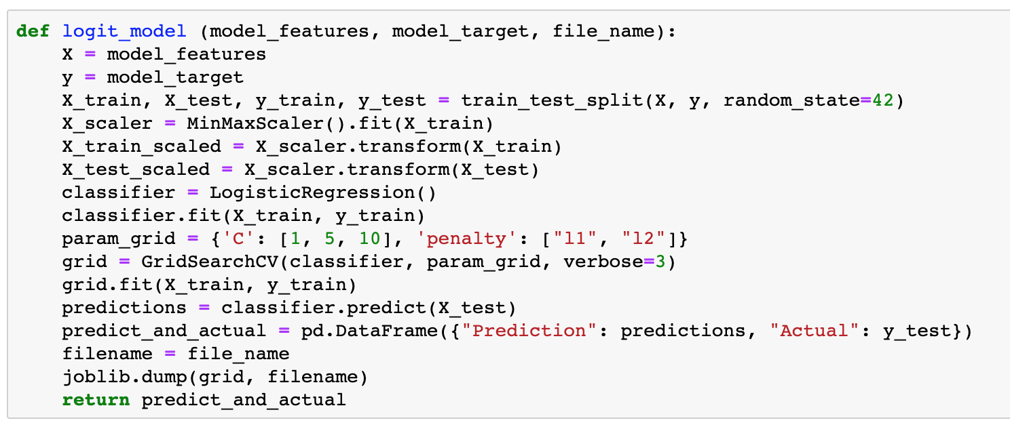
Initial Data Filtering
Removed rows with
null values
Ran logistic regression
models
Reduced the scale from 5 responses to 3.
Realized we want to see the coefficients and p-values for features in the models.

Slide 7
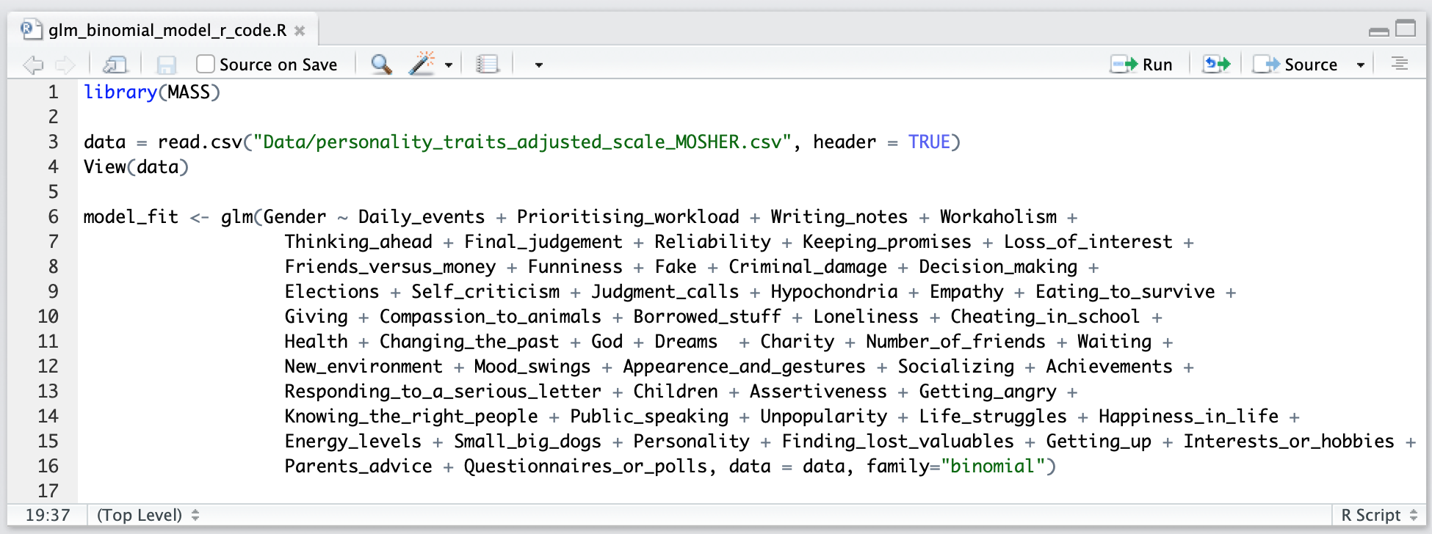
Logistic regression
Initial Data Filtering
Y’all remember this one.

Slide 9
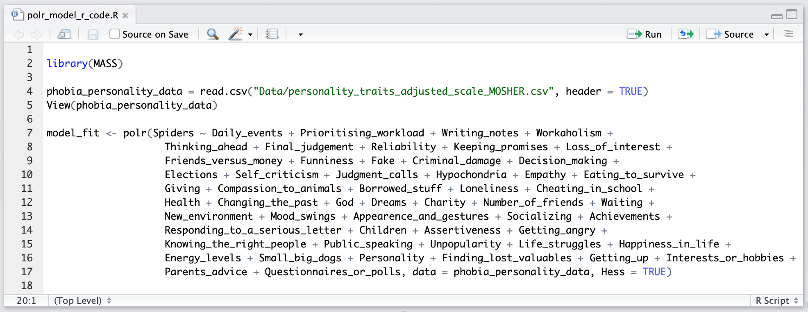
Proportional odds logistic regression
Initial Data Filtering
For a target of ordered responses and the distance between each response may not be equal.
Afraid
Neutral
Not Afraid

Slide 11
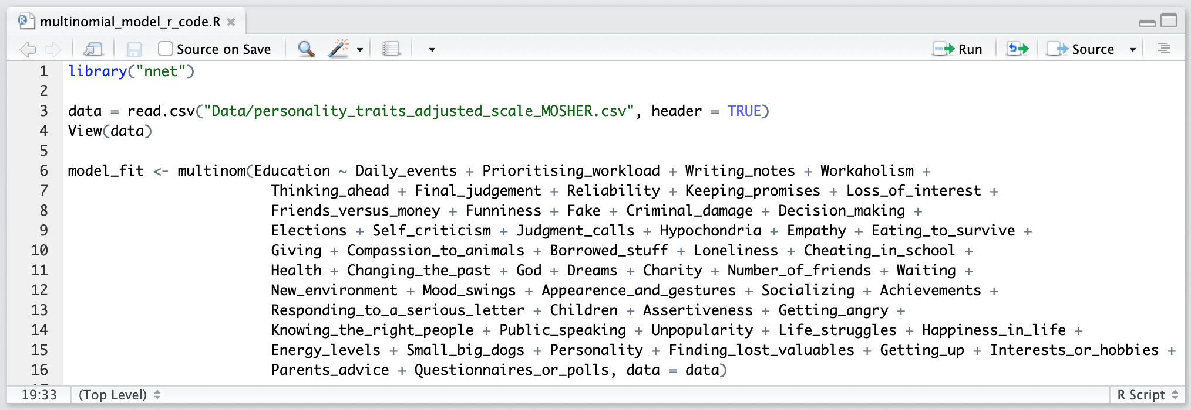
Multinomial logistic regression
Initial Data Filtering
Extends logistic regression to multiple classes in the target.

Slide 13

Gender
15 Predictive Features
I try to do tasks as soon as possible and not leave them until last minute.
I always make a list so I don't forget anything.
I am reliable at work and always complete all tasks given to me.
I always keep my promises.
I always try to be the funniest one.
I damaged things in the past when angry.
I don't like seeing animals suffering.
I am empathetic person.
I try to give as much as I can to other people at Christmas.
I eat because I have to. I don't enjoy food and eat as fast as I can.
My moods change quickly.
I enjoy meeting new people.
I cry when I feel down or things don't go the right way.
I have many different hobbies and interests.
I enjoy taking part in surveys.
Survey Responses
Female | 402
Male | 272
Model Accuracy
Neural Net | 74.0%
*K Nearest Neighbors | 84.6%
Logistic Regression | 72.6%
Improvement over Random Chance | 34.6%

Slide 14

Education
7 Predictive Features
If I find something the doesn't belong to me I will hand it in.
I believe all my personality traits are positive.
I am 100% happy with my life.
I believe in God.
I used to cheat at school.
I look after things I have borrowed from others.
I always try to vote in elections.
Survey Responses
College | 140
In Primary School | 2
Doctorate | 3
Masters | 52
Primary | 53
Secondary | 524
Model Accuracy
Neural Net | 63.3%
*K Nearest Neighbors | 63.3%
Logistic Regression | 62.0%
Improvement over Random Chance | 46.6%

Slide 15

Fear of Snakes
7 Predictive Features (p-values =< 0.1)
“Thinking Ahead”
“Health”
“God”
“Number of Friends”
“Children”
“Getting Angry”
“Public Speaking”
Survey Responses
Not Afraid | 272
Neutral | 139
Afraid | 263
Model Accuracy
*Neural Net | 52.7%
K Nearest Neighbors | 52.1%
Logistic Regression | 49.9%
Improvement over Random Chance | 19.4%

Slide 16
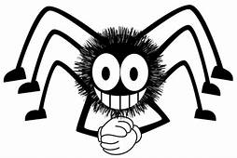
Fear of Spiders
10 Predictive Features (p-values =< 0.1)
“Number of Friends”
“Appearance and Gestures”
“Children”
“Getting Angry”
“Public Speaking”
“Unpopularity”
“Life Struggles”
“Happiness in Life”
“Getting Up”
“Questionnaires or Polls”
Survey Responses
Not Afraid | 247
Neutral | 99
Afraid | 328
Model Accuracy
Neural Net | 50.9%
K Nearest Neighbors | 55.0%
*Logistic Regression | 55.6%
Improvement over Random Chance | 22.3%

Slide 17
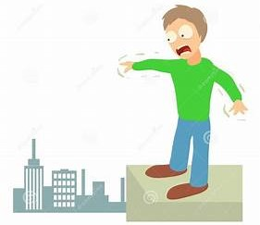
Fear of Heights
10 Predictive Features (p-values =< 0.1)
“Funniness”
“Self Criticism”
“Eating to Survive”
“Loneliness”
“Health”
“Waiting”
“Appearance and Gestures”
“Knowing the Right People”
“Life Struggles”
“Energy Levels”
Survey Responses
Not Afraid | 173
Neutral | 144
Afraid | 357
Model Accuracy
Neural Net | 50.9%
*K Nearest Neighbors | 55.0%
Logistic Regression | 53.1%
Improvement over Random Chance | 21.7%

Slide 18
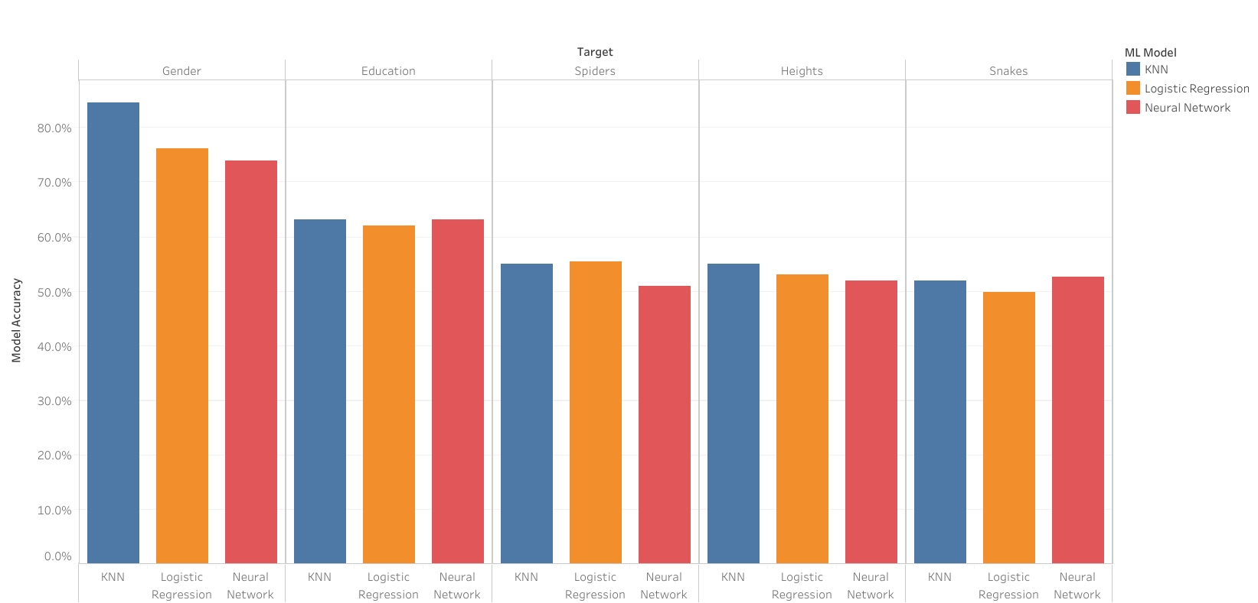

Slide 19
Challenges
Overfitting with Deep Learning
Variance in Accuracy of Neural Network models
Sampling (Size and Representativity)

Slide 20
Can we predict you by your responses?
Recognizing that we are using a dataset from a Slovakian university with participants between the ages of 15-30.
Let's find out!

Slide 21
Class Predictions Results
Gender: 11 Female, 11 Male
Education: 17 Secondary School (High School), 5 College/Bachelor Degree
Phobia of Snakes: 17 Afraid, 5 Not Afraid, 0 Neutral
Phobia of Spiders: 0 Afraid, 22 Not Afraid, 0 Neutral
Phobia of Heights: 7 Afraid, 13 Not Afraid, 2 Neutral

