Slide 1

Projekt Strojového Učenia
Presented by: Cherie mosher, bryan domogalla & taber webb

Slide 2
Young People Survey
Students in the Social Sciences department of a Slovakian university were asked to get their friends to participate in a survey in 2013.
All participants were between the ages of 15-30.
The data file consists of 1,010 responses.
The original questionnaire was in Slovak language and was later translated into English.
Questions were based on 8 groups:
Music preferences (19)
Movie preferences (12)
Hobbies & interests (32)
Phobias (10)
Health habits (3)
Personality traits, views on life, & opinions (57)
Spending habits (7)
Demographics (10)

Slide 3
The three of us started playing around with the data to develop questions.
Can we make spurious correlations among seemingly unrelated categories using machine learning?
Can one category (i.e. personality traits/opinions) predict the response to another (i.e. phobias)?

Slide 4
Young People Survey
Students in the Social Sciences department of a Slovakian university were asked to get their friends to participate in a survey in 2013.
All participants were between the ages of 15-30.
The data file consists of 1,010 responses.
The original questionnaire was in Slovak language and was later translated into English.
Questions were based on 8 groups:
Music preferences (19)
Movie preferences (12)
Hobbies & interests (32)
Phobias (10)
Health habits (3)
Personality traits, views on life, & opinions (57)
Spending habits (7)
Demographics (10)

Slide 5
Settled on 5 targets
Gender
Education Level
Fear of Snakes
Fear of Spiders
Fear of Heights

Slide 6
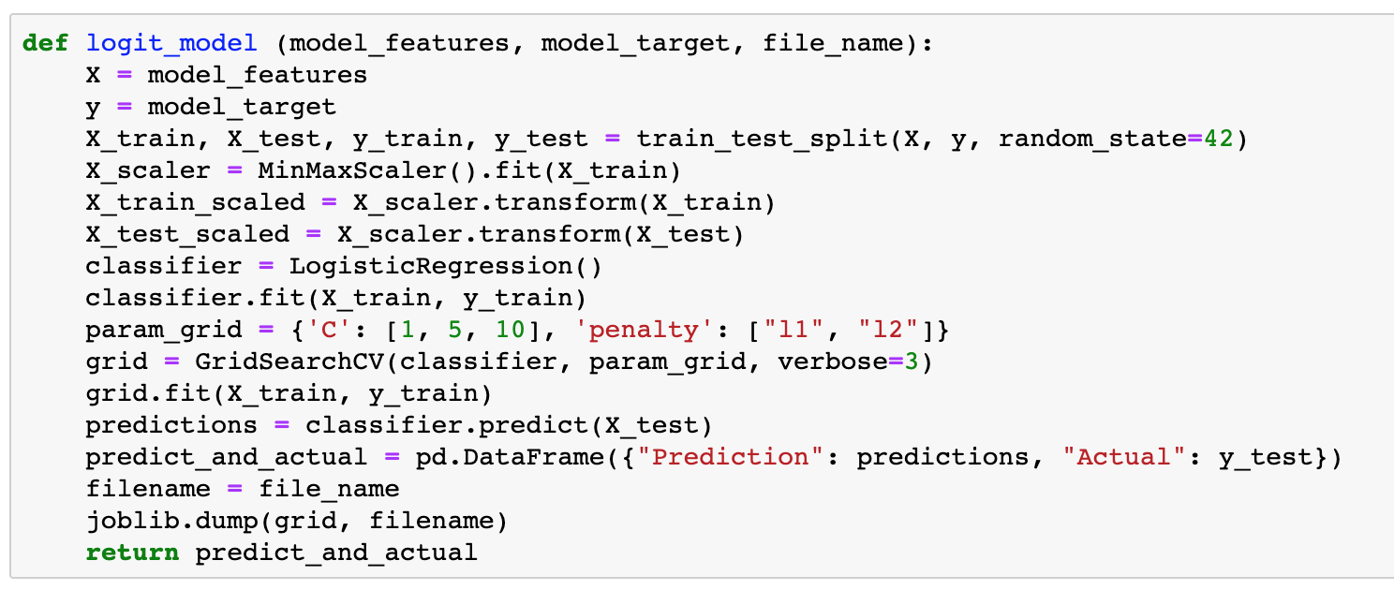
Initial Data Filtering
Removed rows with
null values
Ran logistic regression
models
Reduced the scale from 5 responses to 3.
Realized we want to see the coefficients and p-values for features in the models.

Slide 7
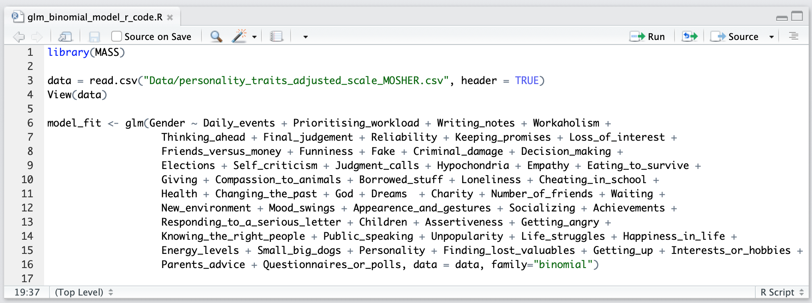
Logistic regression
Initial Data Filtering
Y’all remember this one.

Slide 9
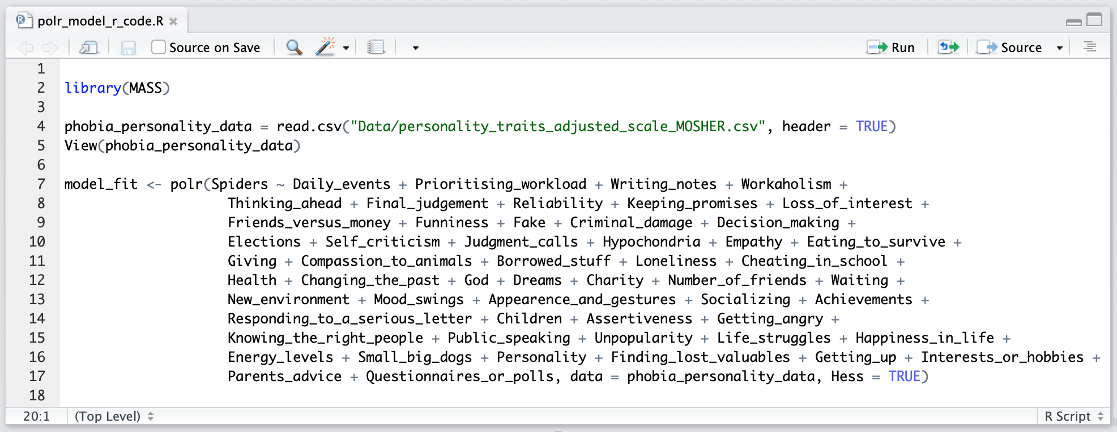
Proportional odds logistic regression
Initial Data Filtering
For a target of ordered responses and the distance between each response may not be equal.
Afraid
Neutral
Not Afraid

Slide 11
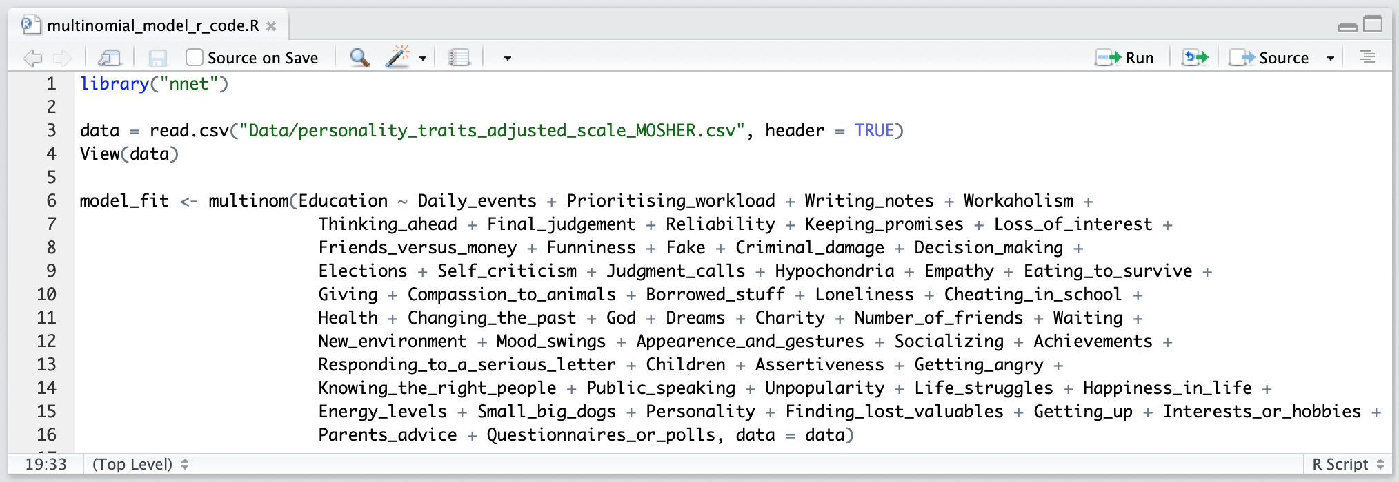
Multinomial logistic regression
Initial Data Filtering
Extends logistic regression to multiple classes in the target.

Slide 13
Can we predict you by your responses?
Recognizing that we are using a dataset from a Slovakian university with participants between the ages of 15-30.
Let's find out!

Slide 14

Fear of Snakes
7 Features (p-values =< 0.1)
“Thinking Ahead”
“Health”
“God”
“Number of Friends”
“Children”
“Getting Angry”
“Public Speaking”
Survey Responses
Not Afraid | 272
Neutral | 139
Afraid | 263
Model Accuracy
Neural Net | 0.527
K Nearest Neighbors | 0.521
Logistic Regression | 0.499

Slide 15
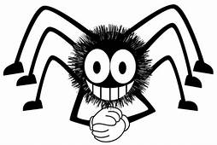
Fear of Spiders
10 Features (p-values =< 0.1)
“Number of Friends”
“Appearance and Gestures”
“Children”
“Getting Angry”
“Public Speaking”
“Unpopularity”
“Life Struggles”
“Happiness in Life”
“Getting Up”
“Questionnaires or Polls”
Survey Responses
Not Afraid | 247
Neutral | 99
Afraid | 328
Model Accuracy
Neural Net | 0.509
K Nearest Neighbors | 0.550
Logistic Regression | 0.556

Slide 16
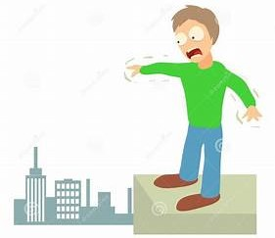
Fear of Heights
10 Features (p-values =< 0.1)
“Funniness”
“Self Criticism”
“Eating to Survive”
“Loneliness”
“Health”
“Waiting”
“Appearance and Gestures”
“Knowing the Right People”
“Life Struggles”
“Energy Levels”
Survey Responses
Not Afraid | 173
Neutral | 144
Afraid | 357
Model Accuracy
Neural Net | 0.509
K Nearest Neighbors | 0.550
Logistic Regression | 0.531

