Slide 1
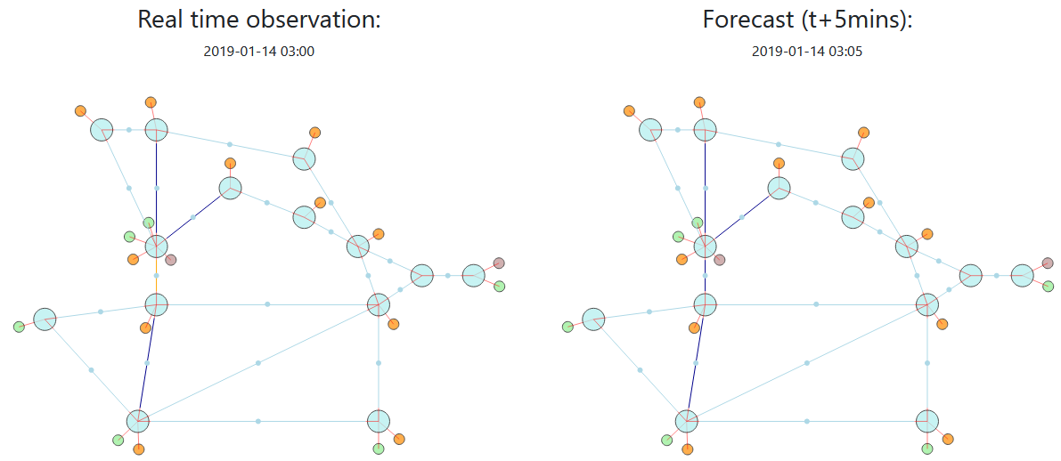

Slide 7
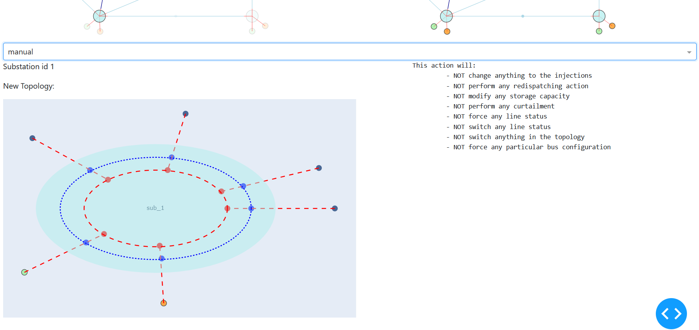

Slide 8
Bus 2
Bus 1

Slide 9
Line 1_2_1
Gen_1_0
Load_1_0

