Slide 1
Run Dot Run!
Beyza Tuğçe BİLGİÇ
Gökalp KÖKSAL
Gökçe ÖZKAN
Emine Ayşe SUNAR

Slide 2
State of Development
Most of the parts of the game, which are promised to be finished in the first iteration are completed except for some details.
What couldn't be done:
  As one of the main features, the curvy letters couldn't be added to the game because of the implementation problems.
  There is no music playing on the background of the game, which was also said to be added in the analysis report.
  Levels are not separated. For now, we have the 3rd level, which already includes the properties of the previous levels.

Slide 3
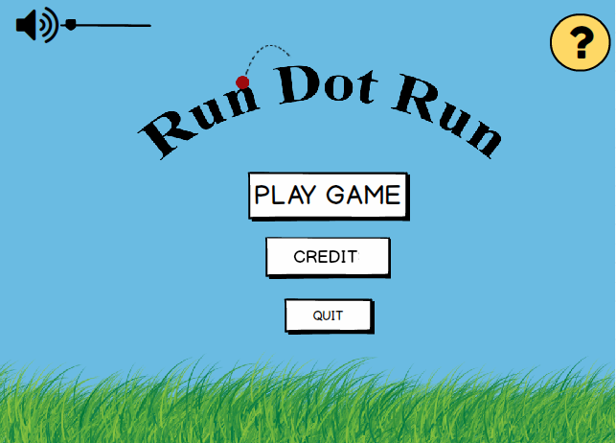
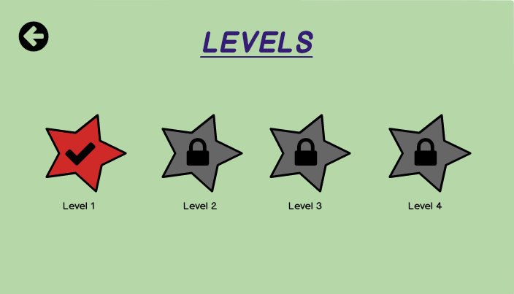
MainMenuPanel, LevelsPanel and LevelImageLoader are implemented.
What have been done:

Slide 4
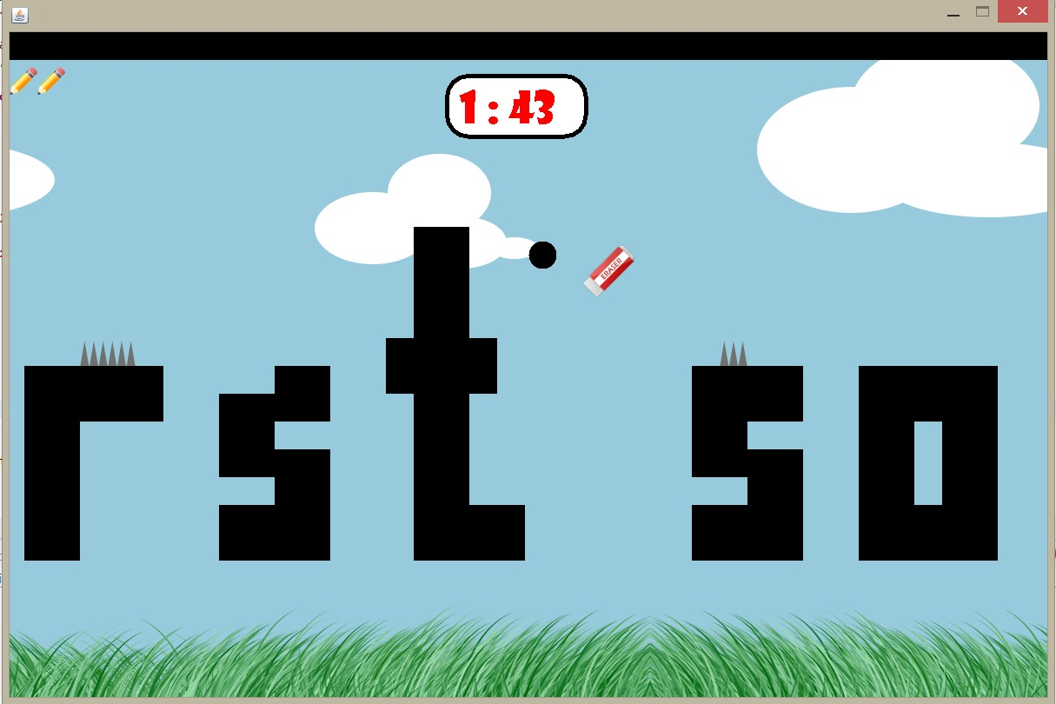
GameObjects (Dot, Spike, Eraser, FadingLetterBoxetc.), Camera, CollisionDetection, GameManager, ObjectId classes are implemented. Timer is added in the game as promised. In addition to the analysis report, "lives" property for dot is added to the game.

Slide 5
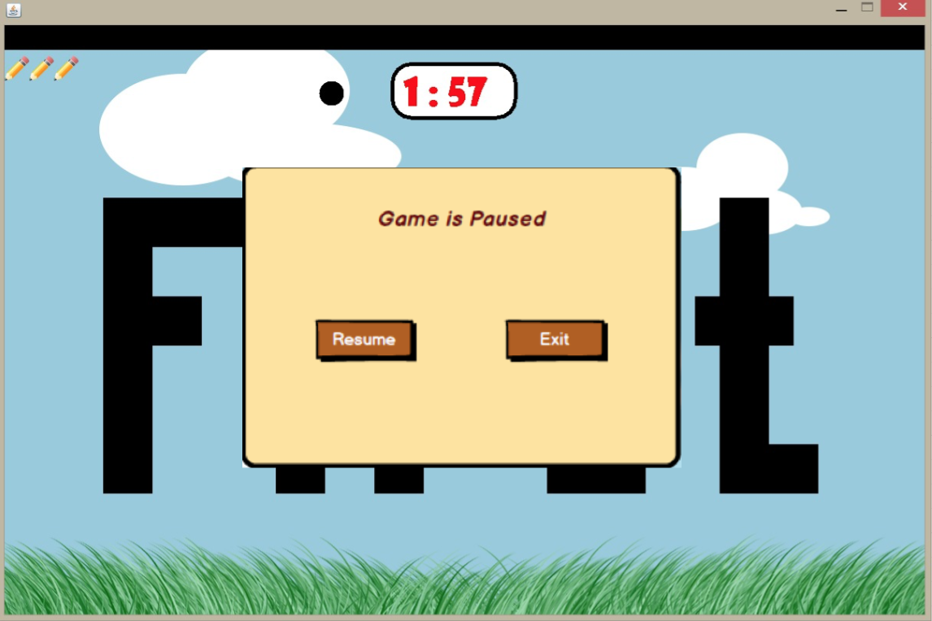
PausePanel is implemented.

Slide 6
Lessons about teamwork
Because the groups are randomly created, it helps to understand a real job team work. Teamwork in this project has taught:
How to arrange the responsibilities (eg. each group member has more responsibility in the parts which they have better skills than the others, which leads to a result closer to the best)
Everyone should be responsible in every part and check each other to reach the most correct result
How to improve communication skills

