Slide 1
Test plan
Fan Feng
ffeng@tamu.edu
Advisor: Zheng O’Neill
Date:9/15/2022

Slide 2
Lux 1. No. 17
Lux 2: No.18
Lux 3. No. 23
Lux 4. No. 22
Lux 6.(On the floor) No. 20
Lux 7. (On the ceiling). No.19
Lux 5. :No.9 (Fell on the floor)
10/19: Lux5 No
Lux 5
Desk
Lux 1
Lux 2
Lux 4
Lux 3
Lux 3

Slide 3
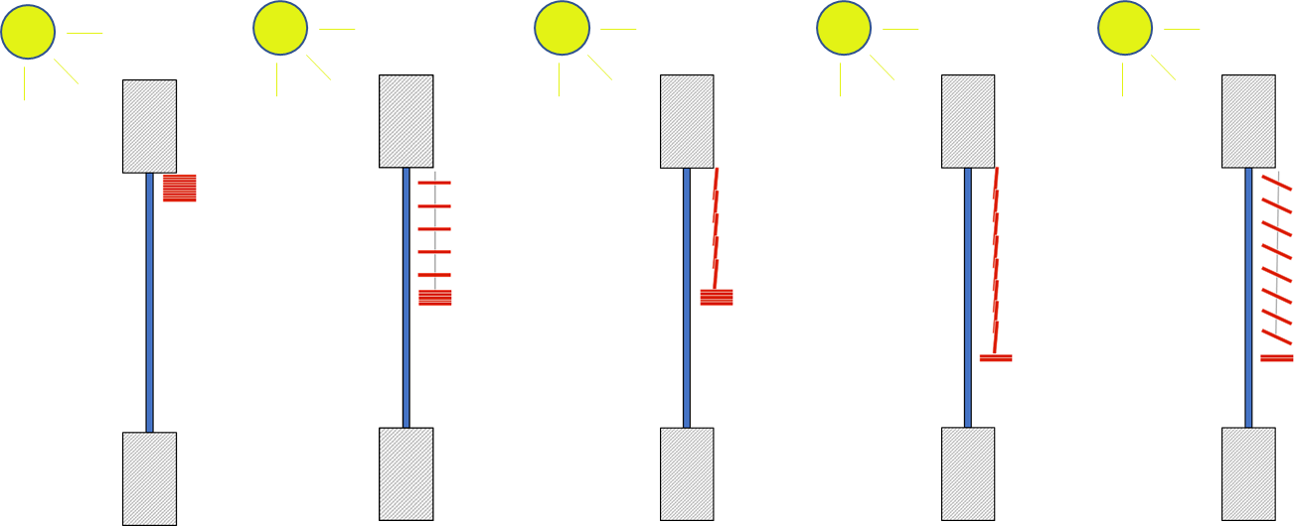
From 09/21 17:00:00
To 09/26 15:50:00
(a) Blind 0%,
slat angle 0º

Slide 4
From 09/26 15:50:00
To 09/30
(b) Blind 50%,
slat angle 0º

Slide 5
From 10/01
To 10/04 14:45:00
(c) Blind 50%,
slat angle 90º

Slide 6
From 10/04 15:00:00
To 10/13 14:45:00
(d) Blind 75%,
slat angle 90º

Slide 7
From 10/19 10:30:00
To 10/22 17:50:00
(e) Blind 75%,
slat angle 25º

