Slide 1
The Journey of Crafting a 6-DOF Robotic Arm with ESP32
Dexterous

Slide 2

Contents
Section 1: Introduction to Dexterous
Section 2: Literature Survey
Section 3: Objectives
Section 4: Block Diagram and Working Model
Section 5: Industrial Application Diagram
Section 6: Hardware and Software Specifications
Section 7: References
Section 8: Thanks

Slide 3

Section 1: Introduction to Dexterous
Challenge and Innovation
Crafting a 6-DOF Robotic Arm: The project involves the creation of a 6-DOF robotic arm using ESP32 and Raspberry Pi 3, presenting a thrilling challenge and opportunity for innovation.
Skill Development: The project offers opportunities to hone mechanical, electronic, and coding skills, providing practical knowledge in cutting-edge technology.
Future Automation Insight
Insight into Future Automation: The project offers deep insight into future automation with ESP32 and Raspberry Pi 3, positioning participants as contributors to future advancements in the field.
Transformative Experience: Creating a 6-DOF robotic arm isn't just a project; it's a transformative experience propelling individuals into the realm of advanced technology.

Slide 4

Section 2: Literature Survey
Key Trends and Findings
Common Control Technologies: ESP32 and Raspberry Pi 3 are common for control, showcasing synergy in the field of robotics.
Affordability and Flexibility: 3D printing is vital for cost-effective 6-DOF fabrication, highlighting affordability and flexibility in a 6-DOF context.
Integration of Locomotion: There is a trend towards integrating 6-DOF arms with locomotion, showcasing advancements in the field.
Advances and Trends: The literature survey concludes that there are advances in 6-DOF arms with locomotion, using ESP32 and Raspberry Pi 3. It also highlights future research opportunities in refining controls and expanding applications.

Slide 5
Objectives
Project Objectives
Precise Control: Ensure smooth and accurate movement using ESP32 and servo motors.
Wireless Communication: Utilize ESP32 for wireless control via Wi-Fi or Bluetooth, supporting various interfaces.
Modular Design: Enable future upgrades with a modular platform for additional sensors, tools, or attachments.

Slide 6


Additional Objectives
1. Locomotion Integration: Develop and implement a robust system for the robotic arm to move effectively and efficiently, allowing it to perform tasks with precision and accuracy.
2. End-Effector Customization: Create a flexible system that enables the customization of end-effectors to cater to specific tasks and applications. This will allow for seamless adaptation to various scenarios and requirements.
3. Safety Measures: Incorporate advanced safety features such as obstacle detection and secure operation protocols to ensure the robotic arm operates in a safe and controlled manner, minimizing potential hazards and risks.

Slide 7
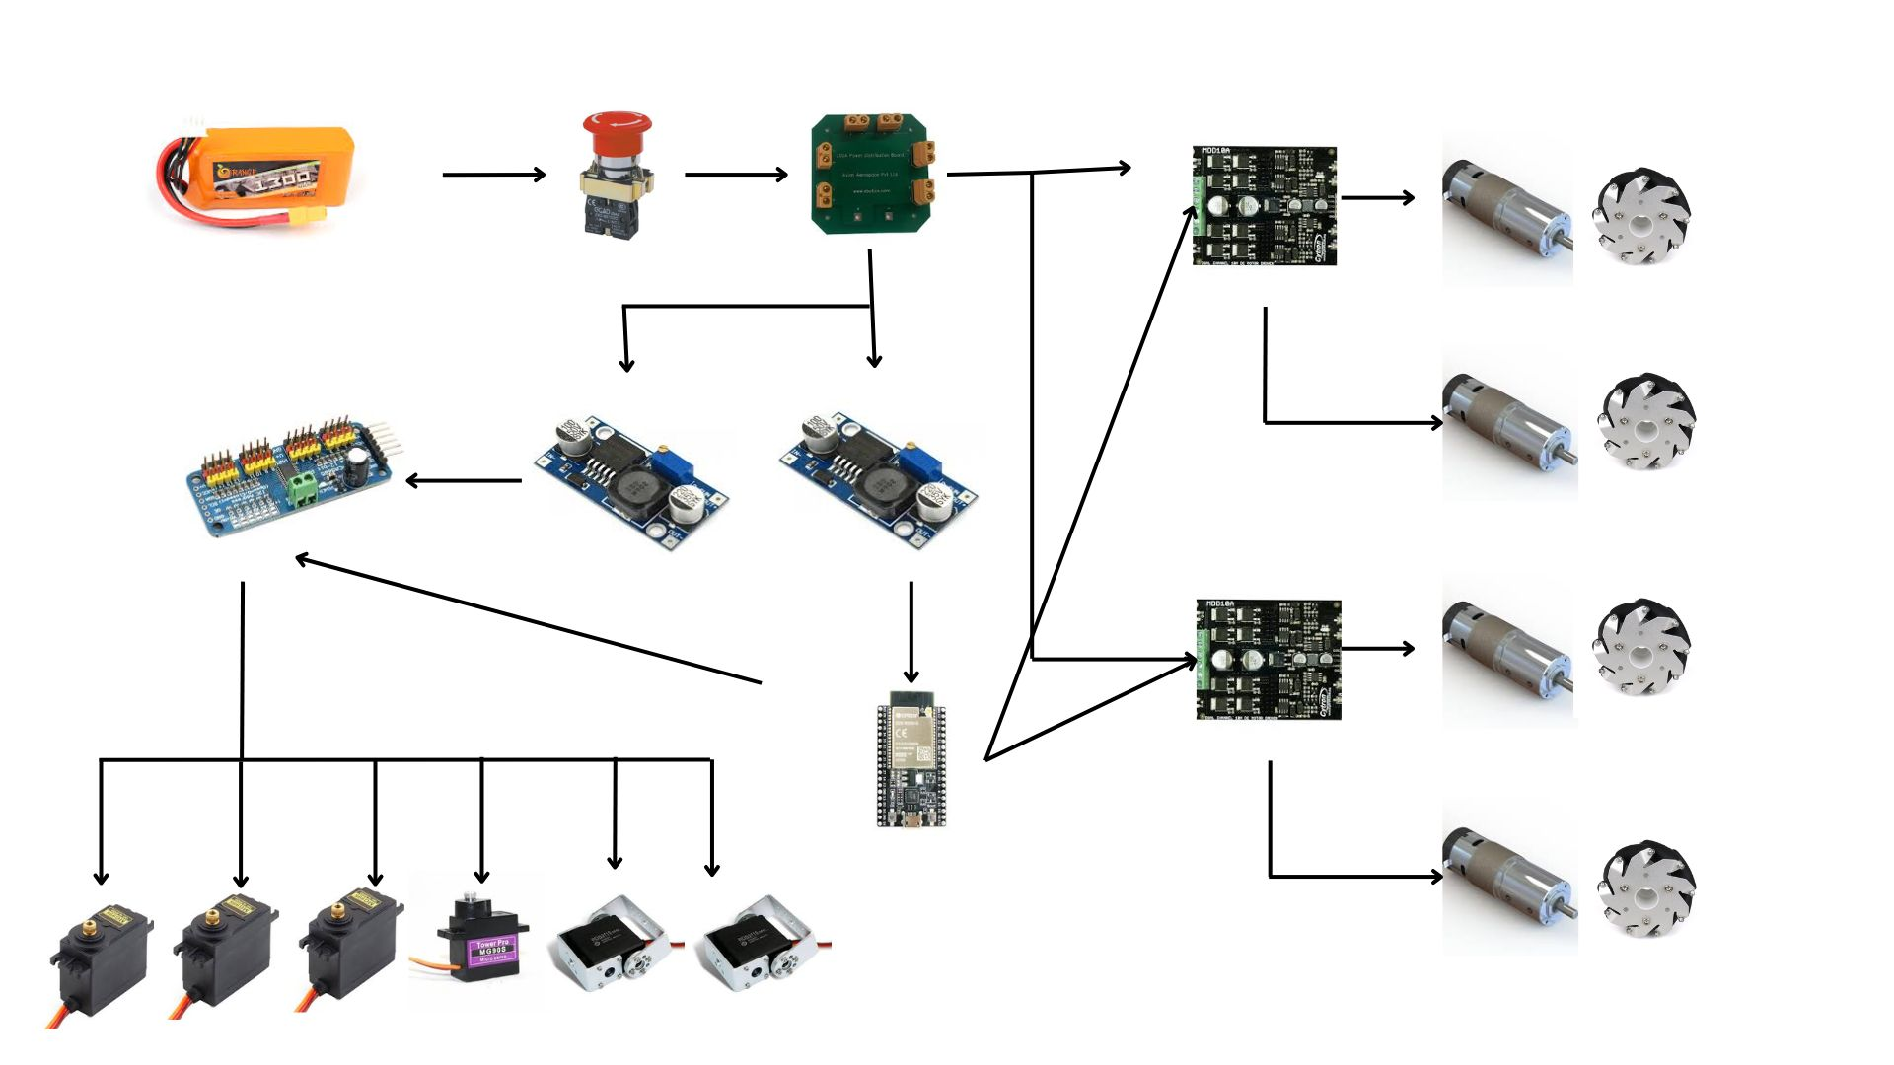
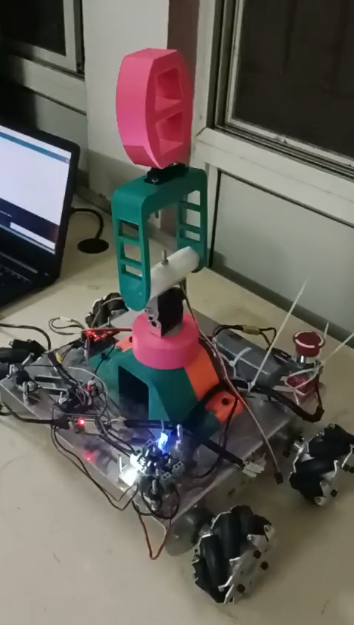
Circuit Diagram and Working Model

Slide 8
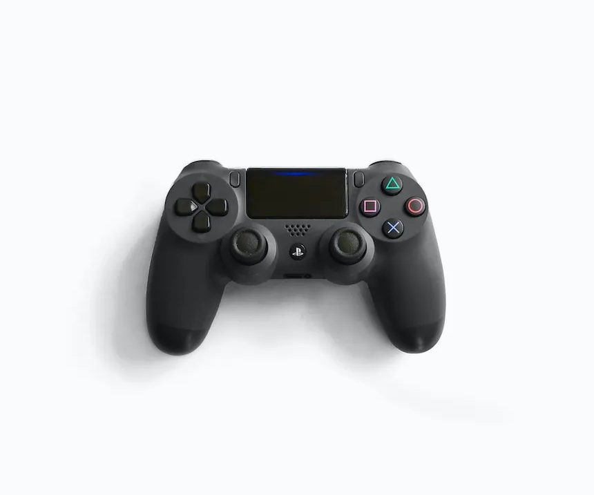
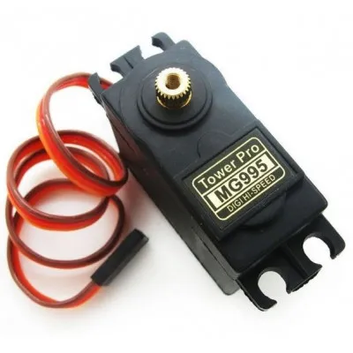
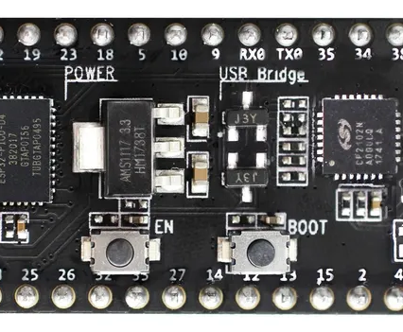
Hardware and Software Specifications
Hardware Specifications:
1) Kill Switch
2) Battery 12V LiPo Battery 3 Cells
3) PCA 9685 module Servo Driver
4) ESP32 microcontroller
5) Jumper Cables (Male to Female and Female to Female)
6) Wires
7) PDB Board for Power Distribution
8) LEDs and Resistors and switches

Slide 9
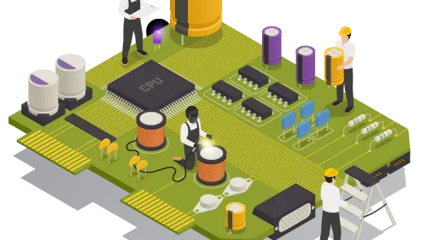
Hardware and Software Specifications
9) Cytron Motor Drivers MDD10A
10) IG 42 motors x4
11) MG995 Servos ×3
12) DS3115 Servo ×2
13) SG90 Servo x1
14) Buck Converters x2

Slide 10

Hardware and Software Specifications
Software specifications:
KiCAD
Arduino IDE 2.2.1
Fusion 360

Slide 11
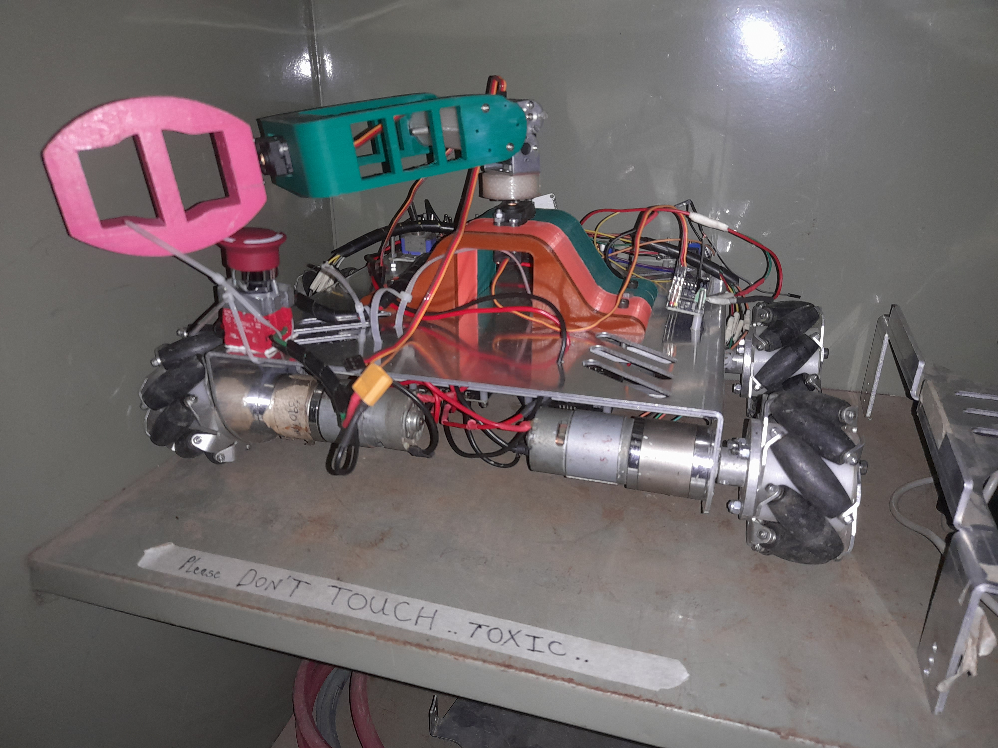
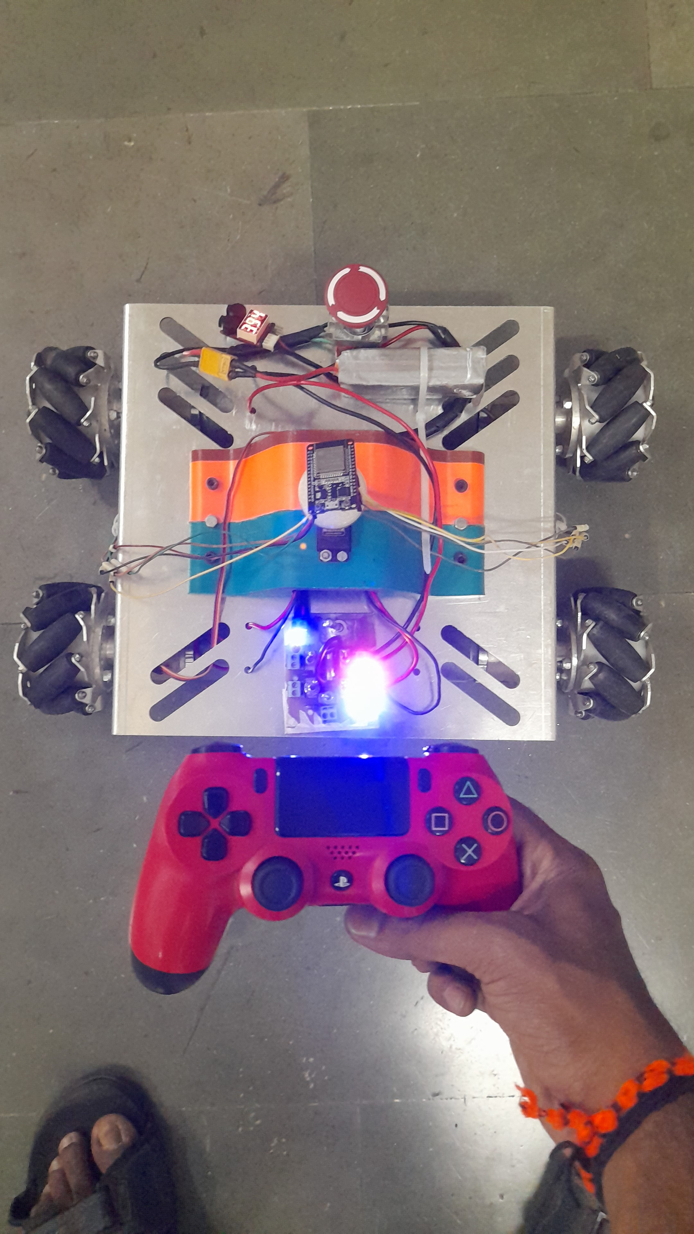
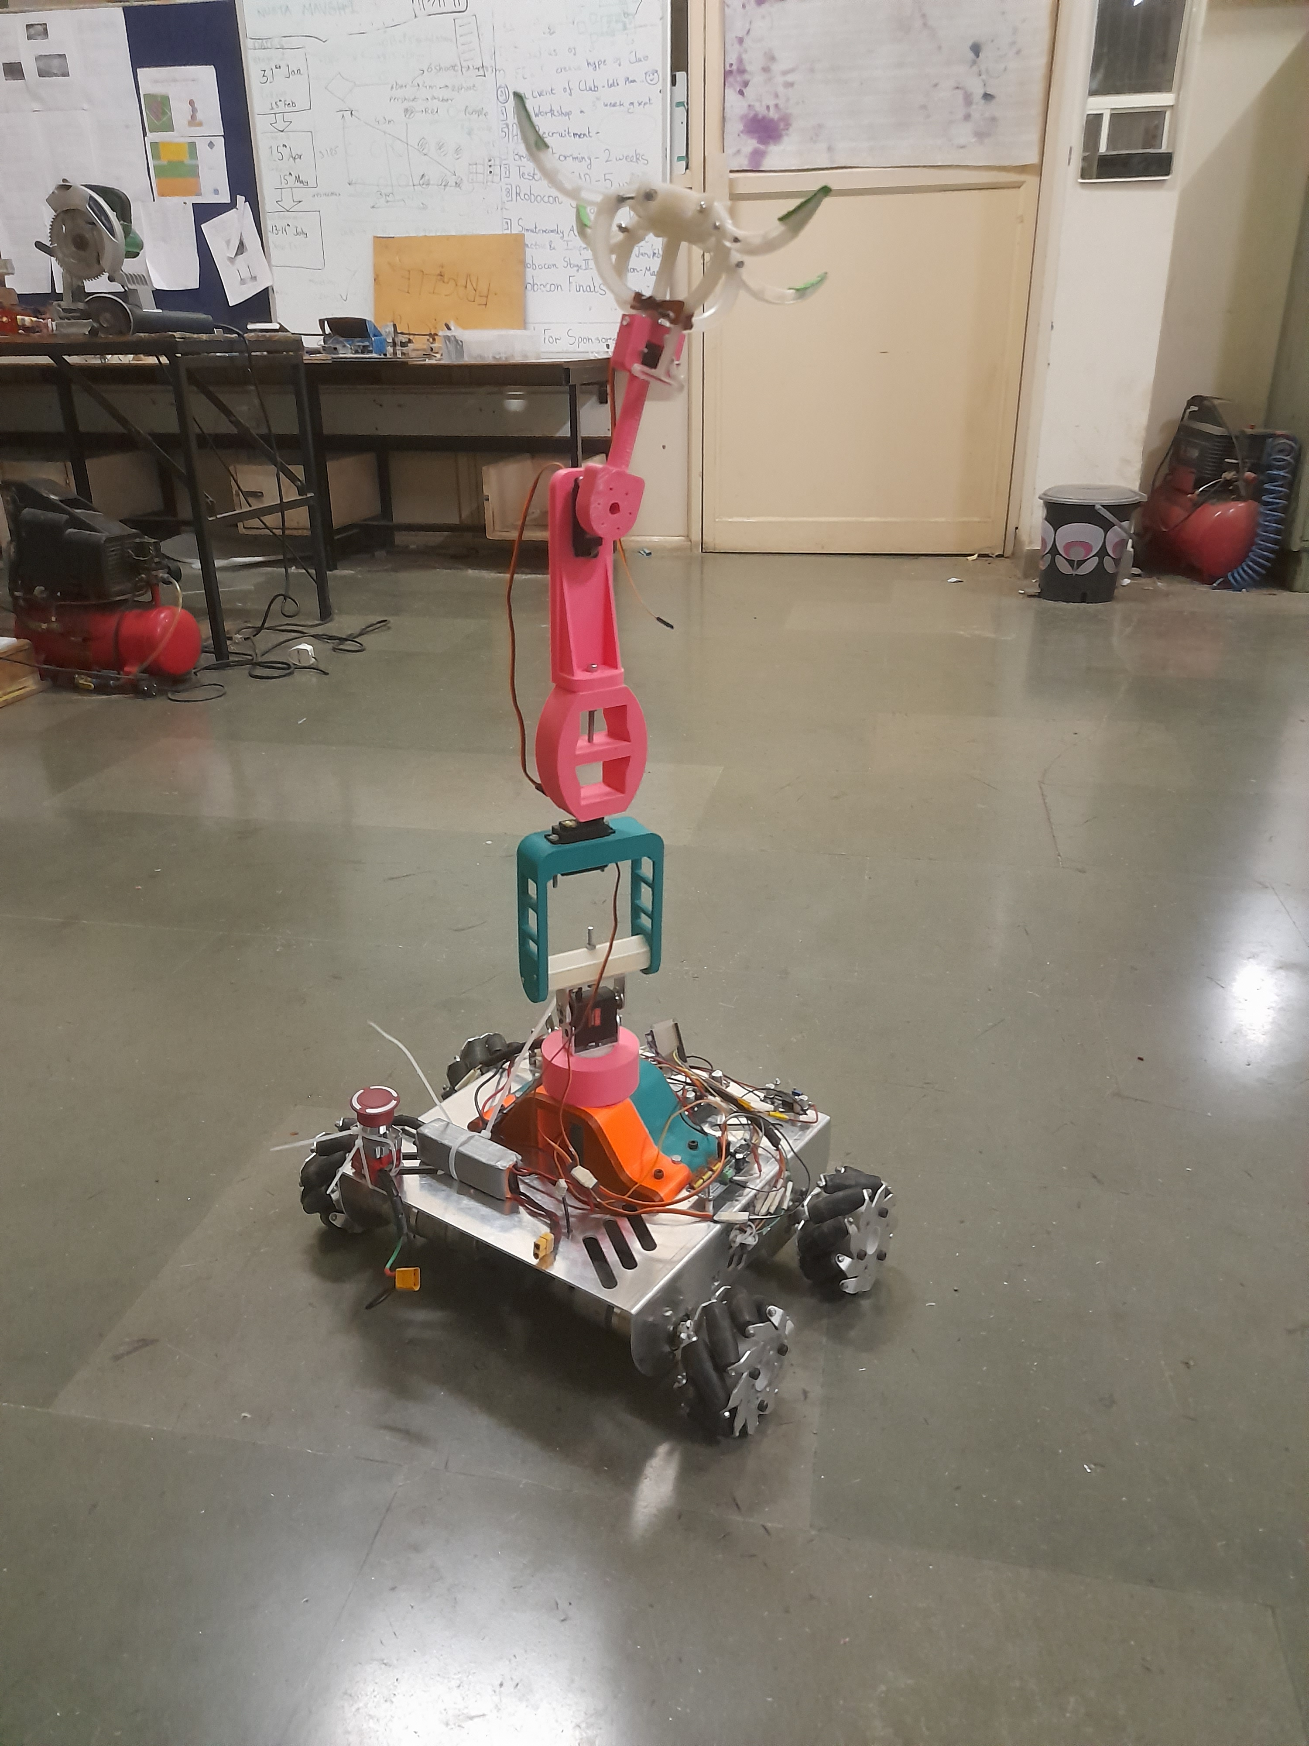
IMplementation

Slide 12

REferences
Mohd Ashiq Kamaril Yusoff's, Reza Ezuan Samin, Babul Salam Ksm Kader Ibrahim, “Wireless Mobile Robotic Arm”, ELSEVIER, ResearchGate, December 2012, 1072-1078.
https://iotdesignpro.com/articles/iot-based-robotic-arm-controlling-using-esp32
https://www.academia.edu/50180450/Design_and_implement_of_robotic_arm_and_control_of_moving_via_IoT_with_Arduino_ESP32
https://ozrobotics.com/shop/hiwonder-maxarm-robot-arm-powered-by-esp32-support-python-and-arduino-programming-standard-kit/
https://www.researchgate.net/publication/333886109_A_Cost-Efficient_Multipurpose_Service_Robot_using_Raspberry_Pi_and_6_DOF_Robotic_Arm
https://grabcad.com/library/robot-arm-83
https://docs.google.com/spreadsheets/d/1wXcu2AezT9oymwPx0rUag4GGjRIw_IFt9GSfBZX83_Y/edit#gid=0

Slide 13
Thank YOu

