Slide 1

Analysis of Twitter Reactions
to Government Policies.
Vivekanand Education Society’s Institute Of Technology
Department Of Computer Engineering
Project Review 1
Group Members (D17A)) Mentor:
1. Anagha Karmarkar (D17A,38.) Name: Mrs.Vidya Zope
2. Vinit Pawar (D17A,60.) Designation: Asst. Professor
3. Mansi Shivani (D17A,72.)
4. Kanchan Tewani (D17A,74.)

Slide 2
Index
Modular Diagram
Flow Chart
Graphs
Conclusion
Future Scope
References
Introduction
Motivation
Problem Definition
Literature Survey
SVM and Naive Bayes
Block Diagram

Slide 3
Introduction
Vivekanand Education Society’s Institute Of Technology
Department Of Computer Engineering

Slide 4
Introduction
For a sitting government, the deciding factor going into the next campaign is how their policies fared in the previous tenure.
With the advent of social media, it's never been easier to tap such large numbers of opinions with such great ease. A larger data set reflects better results than a customised one.
These insights into the public opinion further helps in targeted campaigning for all involved which has proved to be a huge success in both India and the recent US Presidential elections.

Slide 5
Problem Definition
Vivekanand Education Society’s Institute Of Technology
Department Of Computer Engineering

Slide 6
Problem Definition
Twitter is a huge platform with an infinite number of opinions.
In general, there isn't a better place to find honest public reactions to various topics, especially government policies.
An analysis of such a public reaction can be invaluable to various parties like the government, the opposition and media houses.

Slide 7
Literature Survey
Vivekanand Education Society’s Institute Of Technology
Department Of Computer Engineering

Slide 8
Literature Survey
TITLE | DATASET | TECHNOLOGY | PROS | CONS
Preprocessing Boosting Twitter Sentiment Analysis? (http://ieeexplore.ieee.org/document/7463812) | Stanford Twitter Sentiment Test dataset | Replacing negations,URL,stopword removal,removing numbers,prior polarity score model | Removing all features that make data unstructured | Fluctuation in performance when applied to different classifiers

Slide 9
Literature Survey
TITLE | DATASET | TECHNOLOGY | PROS | CONS
Sentiment Analysis on Twitter Data:Case Study on Digital India (http://ieeexplore.ieee.org/document/7857607/) | Manual collection of tweets using API | Dictionary Method | Provided information about various tools for sentiment analysis Visualization using pie-chart | No negation handling,credibility of reviews not considered
Opinion Mining and Sentiment Polarity on Twitter and Correlation Between Events and Sentiment (http://ieeexplore.ieee.org/document/7474355/) | Tweets are collected using Twitter’s Streaming API using various hashtags for FIFA 2014 World Cup, and manually labelled | Bayesian Logistic Regression | Compares relation between events and sentiments using pearson correlation coefficient | The model works with static data. It does not work with streaming feed.

Slide 10
Literature Survey
TITLE | DATASET | TECHNOLOGY | PROS | CONS
Text Sentiment Analysis Based on Long Short-Term Memory (http://ieeexplore.ieee.org/document/7778967/) | Manually classified dataset from JD.com comprising of english and chinese texts | RNN model using LSTM cell | Performs better in case of structures with conjunctions. | Only slight improvement than conventional RNN. Can be improved by adding the concept of ‘attention’
Deep Learning Approach for Sentiment Analysis of Short Texts (http://ieeexplore.ieee.org/document/7942788/) | Stanford Sentiment Treebank Dataset that consists of reviews from Rotten Tomatoes and IMDB Sentiment Analysis Dataset | ConvLstm (Convolution with recurrent laters) | Utilizes both convolution and recurrent layers. Reduces the number of layers required to capture long term dependencies | A proper combination of hyper-parameters has to be found.

Slide 11
Literature Survey
TITLE | DATASET | TECHNOLOGY | PROS | CONS
Sentiment classification using Comprehensive Attention Recurrent models (http://ieeexplore.ieee.org/document/7727384/) | IMDB Large Movie Review Dataset (IMDB) dataset [4] and Stanford Sentiment Treebank (SST) dataset | Comprehensive Attention Recurrent Neural Networks (CA-RNN) | It can be trained end-to-end without any human intervention. Human feature engineering is no longer needed. | The training procedure of this model can be time-consuming.
Semi-supervised Dual Recurrent Neural Network for Sentiment Analysis (http://ieeexplore.ieee.org/document/6844403/) | IMDB Movie Review dataset and MPQA Opinion corpus. | SDRNN (Semi-supervised Dual Recurrent Neural Network) | Abundant data as it uses both labeled and unlabeled. | Uncertainity whether back propagation through time optimization algorithm can really improve the effectiveness of recurrent neural network.

Slide 12
SVM and Naive Bayes
Vivekanand Education Society’s Institute Of Technology
Department Of Computer Engineering

Slide 13
Stats
1.Take csv file
2.split into id,label,tweet
3.Analyze tweet
extract unigrams and create frequency distribution
extract bigrams and create frequency distribution
4.Store as pickle files
5.Use top N words for classification

Slide 14
SVM
1.Get top N unigram,bigram
2.For batches:
apply tfidf
3.Train the data using linearSVC setting c as default
4.Use fit function in SVC lib to test the data

Slide 15
Naive Bayes
1.Take top N unigrams, top N bigrams
2.Process tweets:
split tweet_id, sentiment,tweet
fv=get feature vector
tweets.append((tweet_id, sentiment, feature_vector))
3.clf = MultinomialNB()
4.for batches:
apply tfidf
perform partial fit

Slide 16
Block Diagram
Vivekanand Education Society’s Institute Of Technology
Department Of Computer Engineering

Slide 17
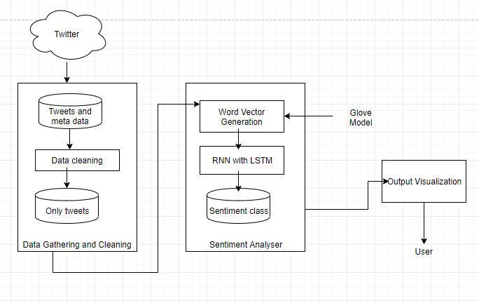
Block Diagram

Slide 18
Modular Diagram
Vivekanand Education Society’s Institute Of Technology
Department Of Computer Engineering

Slide 19
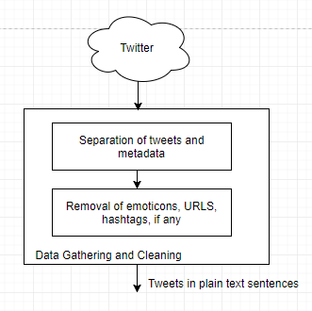

Slide 20
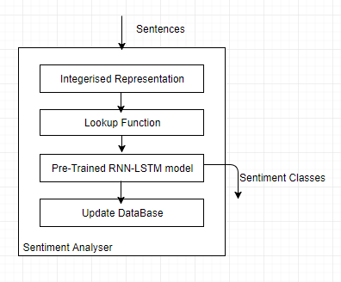

Slide 21
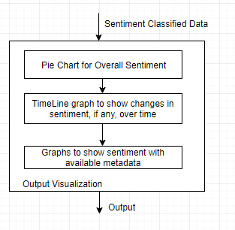

Slide 22
Flow Chart
Vivekanand Education Society’s Institute Of Technology
Department Of Computer Engineering

Slide 23
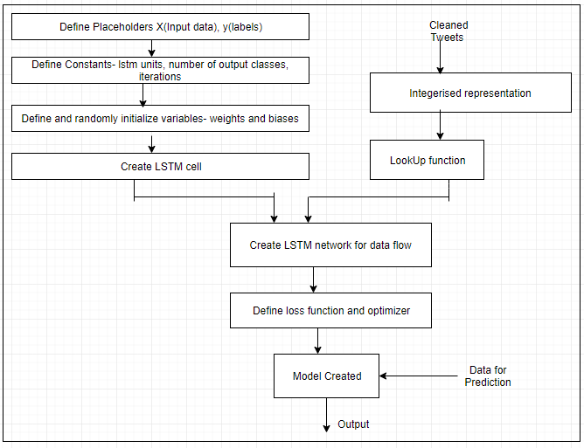
Flowchart

Slide 24
RNN- LSTM
1- Extract historical data using twitterScrapper
2- Preprocessing data to remove urls, user mentions, punctuation
3- Create a separate url list for further processing
4- Download pretrained word embedding model Glove(4,00,000 x 100)
5- Split the cleaned tweets to tokens and get the dimension vector for each word. Repeat this for all the tweets to get a final input 3D matrix
6- Specify parameters of the network, unroll the lstm cells to create the final graph
7- Adjust weights to minimize loss and predicts whether sentiment is positive or negative and calculate accuracy.

Slide 25
Graphs
Vivekanand Education Society’s Institute Of Technology
Department Of Computer Engineering

Slide 26
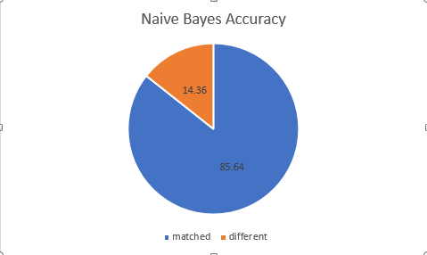
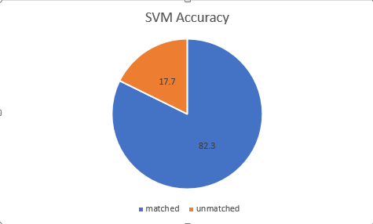
Analysis

Slide 27
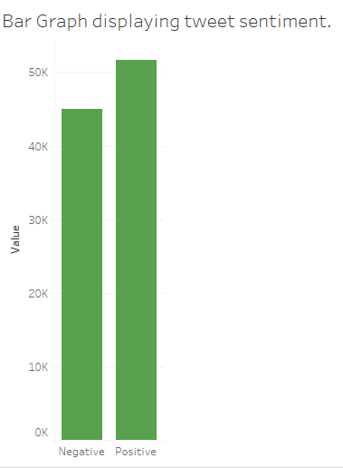
Visualization

Slide 28
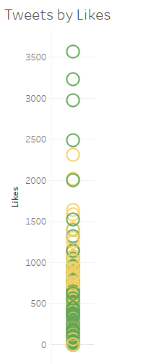
Likes

Slide 29
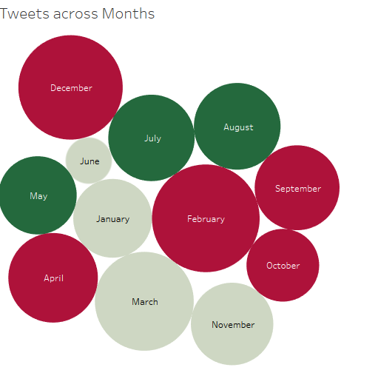
Across months

Slide 30
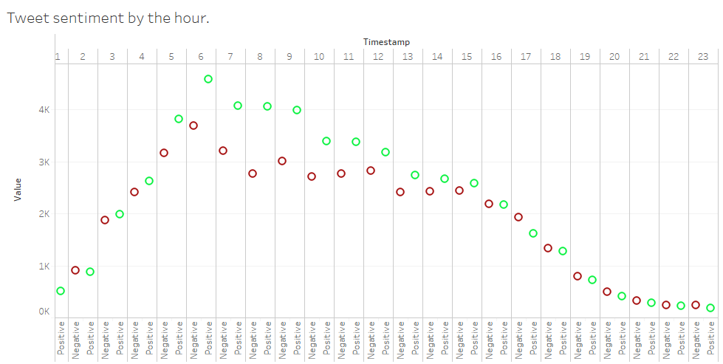
Across time

Slide 31
Conclusions
Vivekanand Education Society’s Institute Of Technology
Department Of Computer Engineering

Slide 32
Conclusions
We have made an attempt to provide in depth and unbiased analysis of Twitter reaction to various government policies.
We have compared two approaches. RNN-LSTM perform slightly better than algorithms like SVM and Naive Bayes
The major limitations are grammatical errors and that the system considers only tweets in English

Slide 33
Future Scope
We have created a list of Urls tweeted by users. Articles and blog posts have been scraped from these urls. We further plan to analyze these articles to get a more in-depth understanding of the sentiment the user wishes to convey.

Slide 34
References
Vivekanand Education Society’s Institute Of Technology
Department Of Computer Engineering

Slide 35
References
[1] Zhao Jianqiang,Xi’an, Shaanxi , “ Preprocessing Boosting Twitter Sentiment Analysis” published in 2015 IEEE International Conference on Smart City/SocialCom/SustainCom
[2]Prerna Mishra ,Dr. Ranjana Rajnish ,Dr.Pankaj Kumar , “Sentiment Analysis on Twitter Data:Case Study on Digital India, published in, 2016 International Conference on Information Technology
[3]Peiman Barnaghi, John G. Breslin, Parsa Ghaffari, “Opinion Mining and Sentiment Polarity on Twitter and Correlation Between Events and Sentiment”, published in 2016 IEEE Second International Conference on Big Data Computing Service and Applications
[4] Dan Li, Jiang Qian, “Text Sentiment Analysis Based on Long Short-Term Memory”, published in 2016 First IEEE International Conference on Computer Communication and the Internet
[5]Ski-Kit learn documentation-http://scikit-learn.org/stable/modules

Slide 36
Thank You
Vivekanand Education Society’s Institute Of Technology
Department Of Computer Engineering

