Slide 1

Sinhgad Technical Education Society’s
Sinhgad College of Engineering, Pune-41
Department of Electronics And Telecommunication
A Project On
“Remote Diagnosis System”
Presented By:
404235 Sanjana Sarkar 404237 Samruddhi Sevekar 404264 Snehal Yelkar
Guide:
Prof. V. G. Raut

Slide 2
Contents
Abstract
Introduction
Literature Review
Objectives
Block Diagram
Features
Future Scope

Slide 3
Abstract
A Remote Diagnosis System includes a central controller which acts as an interface between the patients and medics.
The purpose of this project is to design and implement a biomedical wireless pulse sensor system.
The system will acquire data and process it, and send it wirelessly. The medic can diagnose it with the help of a medical report prepared by the software.
It also includes monitoring app that graphs your pulse in real time.

Slide 4
Introduction
In this project, the nadi diagnosis system (a technique used in Ayurvedic science) is designed which is PC based and portable.
Nadi Pariksha is the technique of feeling the palpations of adjoining three points of the radial artery, a few millimeters below the starting point of the base of the thumb.
This method of sensing the pressure pulses is used for the diagnosis of the diseases. But Nadi parikshan requires expertise who has long experience and skill of reading the pulses for any disease diagnosis.

Slide 5
Literature Review
“Nadi pariksha system for health diagnosis” IEEE paper published in 2017 describes the use of Nadi Pariksha technique in diagnosis of diseases.
“Health Monitoring System Based on Wearable Sensors and Cloud Platform”, IEEE paper published in 2016 portrays an experimental model designed for monitoring and checking the health condition of the patients.The framework depends on e-health sensor shield associated witha cloud platform which gathers the data from the sensors.

Slide 6
Objectives
This project intends to realize a device that can read the human pulse rate from a fingertip.
A system can be designed to help physicians or common man who is not trained on Nadi pareeksha for diagnosis of common disorders.
To implement a portable and less expensive health monitoring system for all common disorders which can be easily diagnosed.

Slide 7
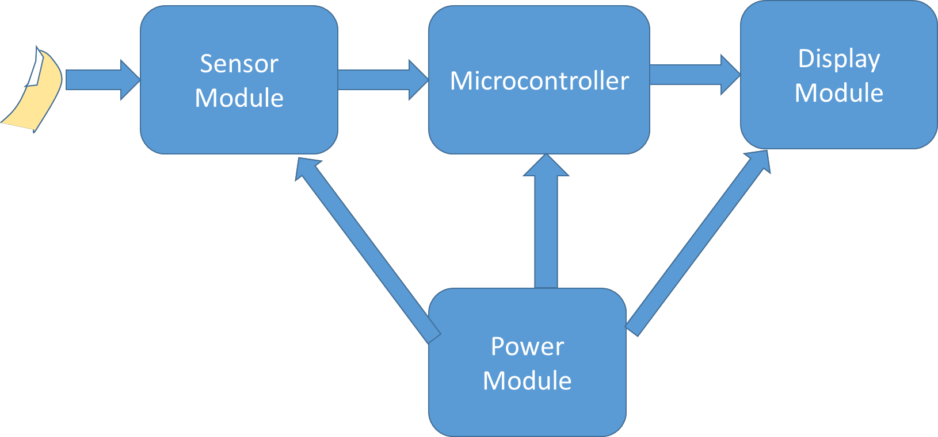
Block Diagram

Slide 8
Features
Portable system for real time diagnosis.
Easy assessing and monitoring of diagnostic test via a mobile application.
Transmission of vital health and other important characteristics through wireless communication.
Easy access of data stored from test results.
Flexibility due to remote access.
Quick results extracted by analysing previously stored data.

Slide 9
Future Scope
Variety of data, as per required for the diagnosis, can be collected from the patient for more detailed test results.
Storage of data can be done on cloud platform instead of traditional database.
Design of continuous health monitoring bands, which can be used to detect any small problems in the patient’s health at an early stage, thus preventing them from becoming bigger, costlier problems.

Slide 10
THANK YOU...

