Slide 1
Few-Shot Industrial Visual Anomaly Detection
AIAA3201 Project 2 — Intermediate Progress
Students
Qidan Zheng · 50027125
Sibei Lyu · 50026860
Detect and localize unseen product defects using only a few normal reference images.
Normal References
Test Image
Anomaly Score + Heatmap
AIAA3201 Project 2 — Intermediate Progress 0:00–0:20
1/11
Notes:
[Slide 1 · 0:00–0:20 · Speaker 1] Industrial anomaly detection must identify defective products and localize their defects, even when defect examples are unavailable. We study this problem on six VisA categories using only one, two, four, or eight normal reference images. Our system produces an image-level anomaly score, an OK-or-NG decision, and a pixel-level heatmap.

Slide 2
Part 1 — Template Difference Baseline
Normal references
Align images
Closest-template
difference map
Smooth map
Score + heatmap
Normal images only
1 / 2 / 4 / 8 references
Top-1% mean = image score
95th-percentile threshold
Calibration — 20 held-out normal images per category set the 95th-percentile threshold.
AIAA3201 Project 2 — Intermediate Progress 0:20–1:05
2/11
Notes:
[Slide 2 · 0:20–1:05 · Speaker 1] We first implement a classical template-difference baseline. Every test and reference image is resized and center-cropped to 448 pixels. We compare the test image with each normal reference using a weighted combination of absolute intensity difference and structural-similarity difference, and retain the closest template. After Gaussian smoothing, the mean of the top one percent of map values becomes the image-level anomaly score, while the full difference map provides localization. For the OK-or-NG threshold, the first twenty sorted normal training images of each category are reserved for calibration and excluded from the reference pool. The threshold is the ninety-fifth percentile of their scores.

Slide 3
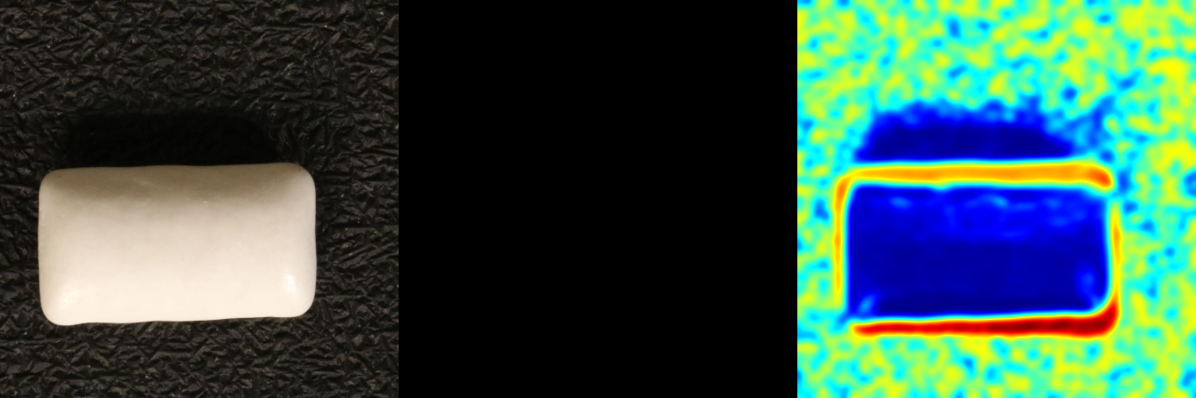
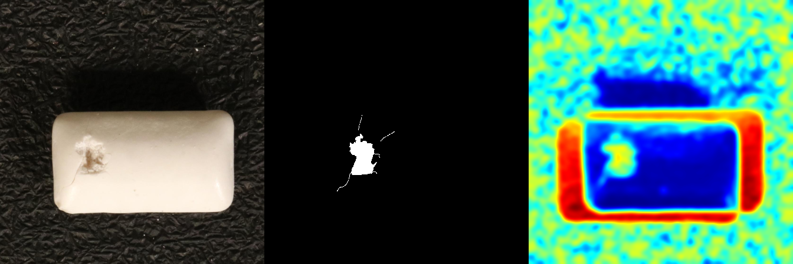
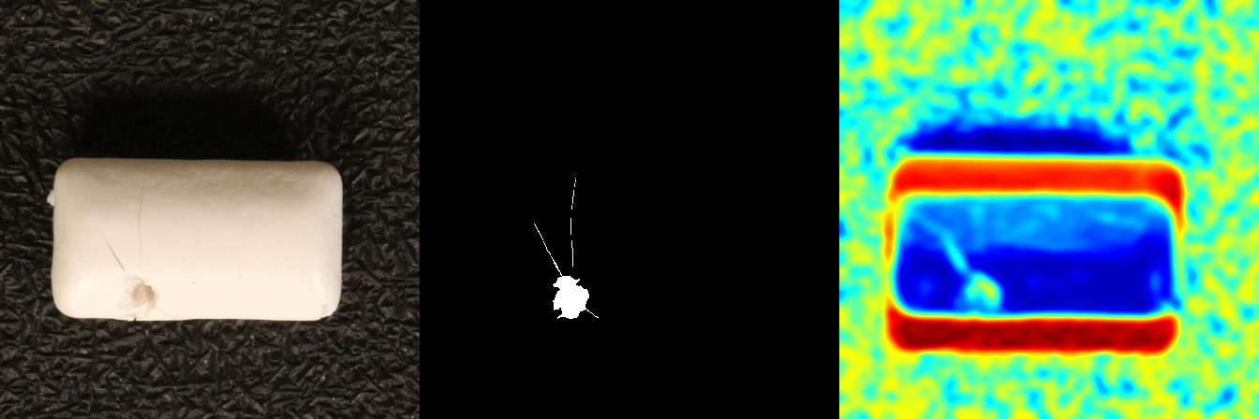
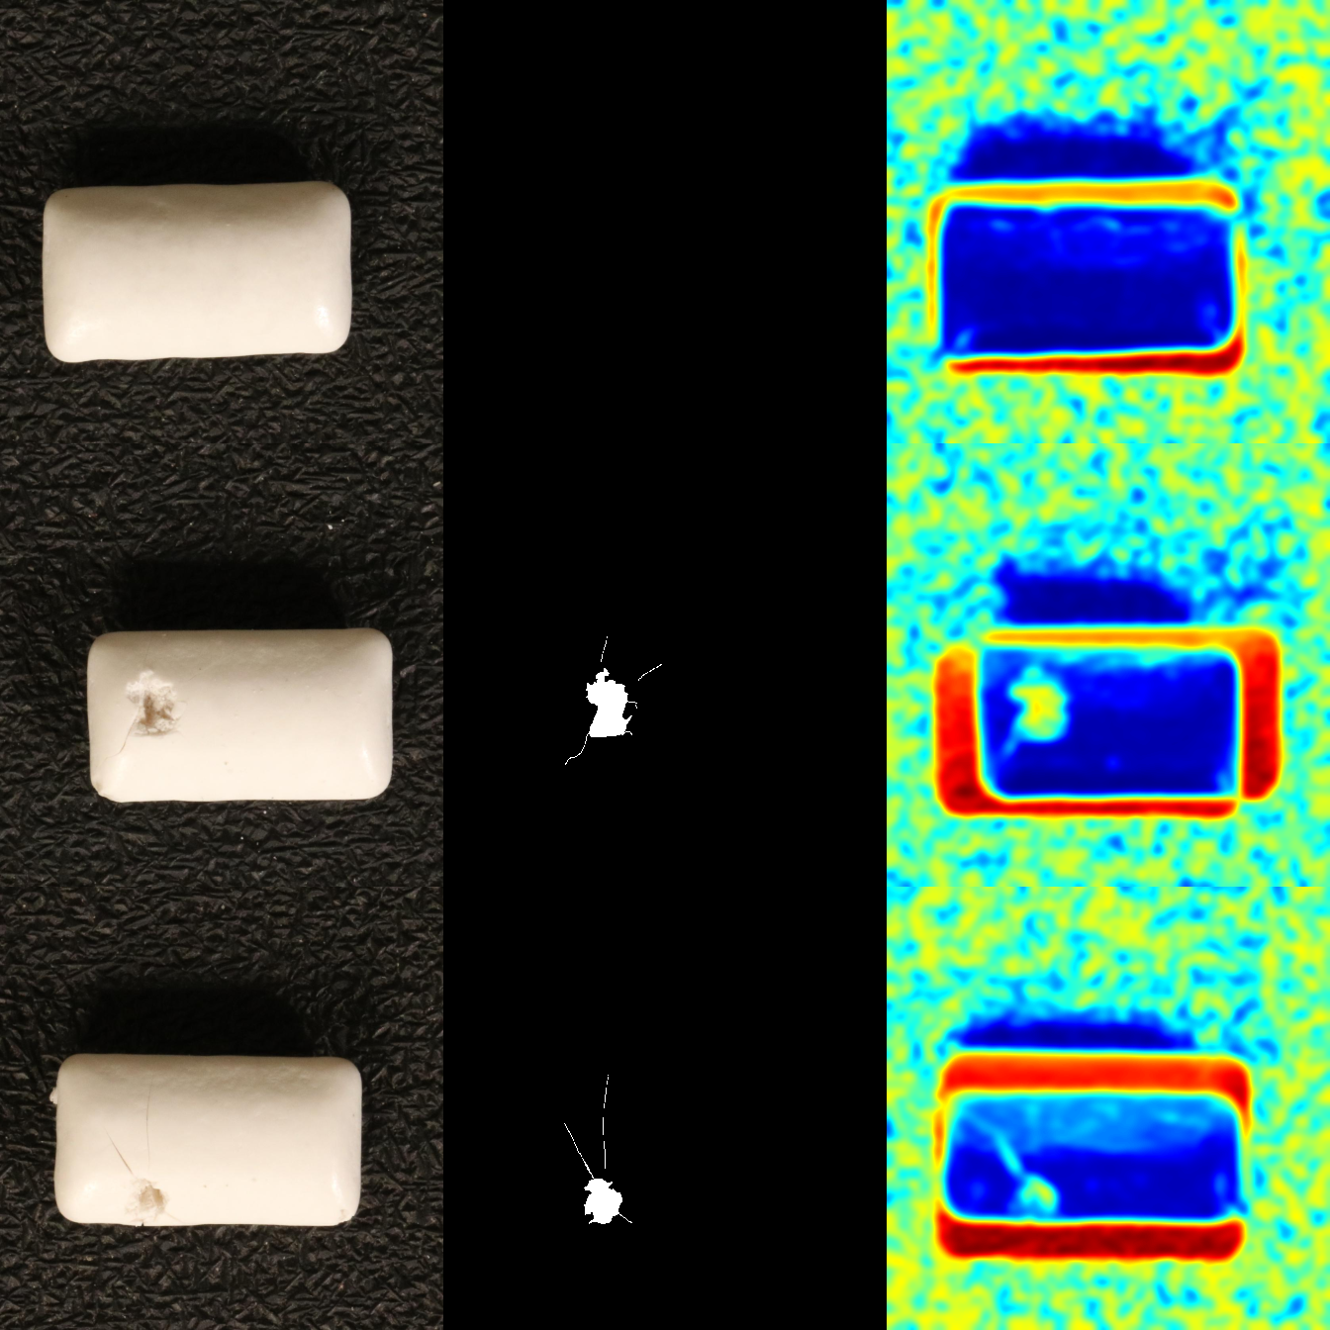
More References Help, but Pixel Differences Remain Fragile
Input
Ground Truth
Template Difference
Shots | Image AUROC | Pixel AUROC
1 | 52.0 | 65.1
2 | 54.1 | 64.9
4 | 55.4 | 65.5
8 | 58.0 | 66.1
False response from pose and background mismatch
Normal
Obvious
defect
Mean over six categories and three seeds (%)
Sensitive to pose, background, illumination, and alignment.
Subtle
defect
Boundary responses can overwhelm the defect.
AIAA3201 Project 2 — Intermediate Progress 1:05–1:40
3/11
Notes:
[Slide 3 · 1:05–1:40 · Speaker 1] Across six categories and three seeds, image AUROC rises from fifty-two percent with one reference to fifty-eight percent with eight. Pixel AUROC remains around sixty-five to sixty-six percent. The qualitative example explains the limited performance: strong responses frequently appear around the product boundary, including on normal images. Small changes in position, scale, illumination, and background texture can dominate the true defect. This motivates replacing raw pixel comparison with more robust learned features.

Slide 4
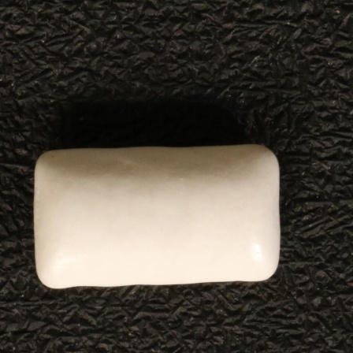
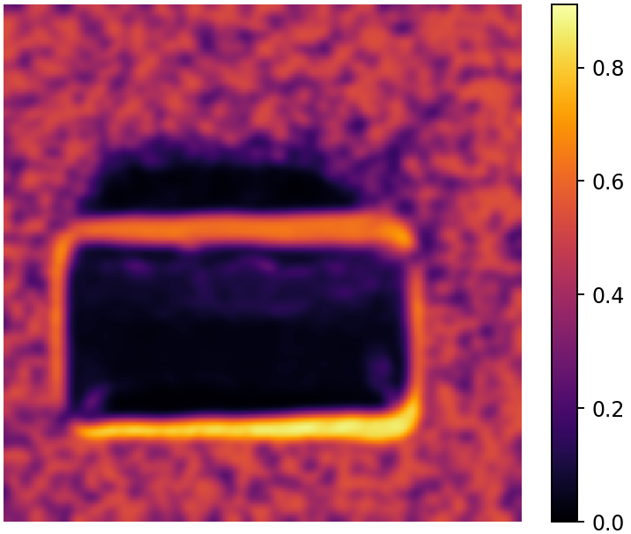
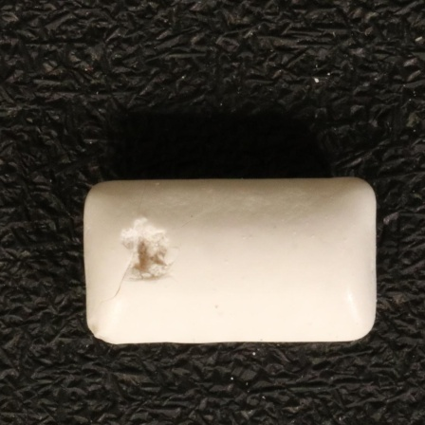
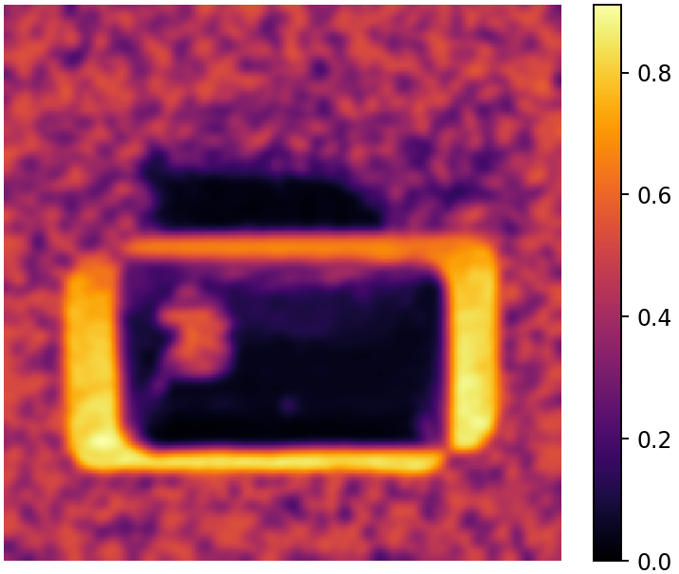
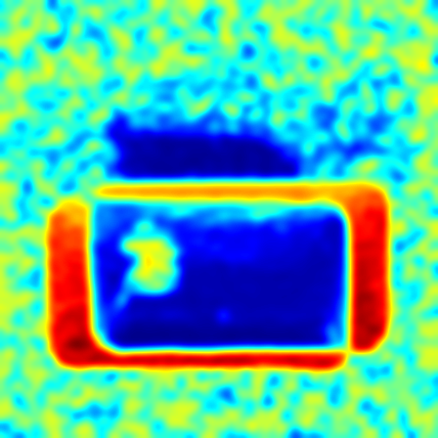

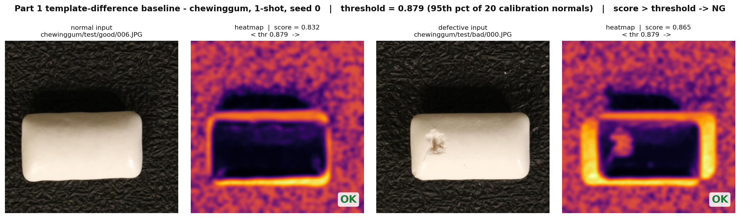
Part 1 — Real OK/NG Decision Demo
Decision rule: score > threshold → NG • chewinggum · 1-shot · seed 0 • threshold = 95th percentile of 20 held-out calibration normals • image score = mean of top 1% of the anomaly map
Normal input
Difference map
Defective input
Difference map
Sample | Ground truth | Image score | Decision
test/good/006.JPG | normal | 0.831698 | OK
test/bad/000.JPG | defective | 0.864918 | OK — missed
Threshold = 0.879422
Both scores sit below it.
The defective sample is missed because its score remains below the calibration threshold.
Samples are the first normal and first defective test images in deterministic filename order, chosen independently of score. This deterministic example reflects the low 47.28% Image AUROC for 1-shot chewinggum.
AIAA3201 Project 2 — Intermediate Progress 1:40–2:00
4/11
Notes:
[Slide 4 · 1:40–2:00 · Speaker 1] This is a real Part 1 decision on two chewinggum test images, one shot, seed zero. The calibration threshold is the ninety-fifth percentile of twenty held-out normals, 0.879422. The normal image scores 0.831698 and is correctly accepted as OK. The defective image scores 0.864918, still below the threshold, so it is also predicted OK: a genuine false negative, not a staged example. The two images are the first normal and first defective files in deterministic filename order, selected independently of score. This behaviour is consistent with the 47.28 percent image AUROC that Part 1 reaches on one-shot chewinggum.

Slide 5
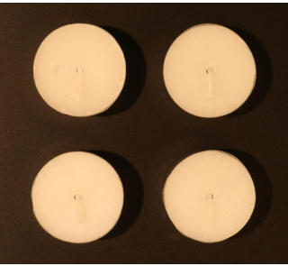
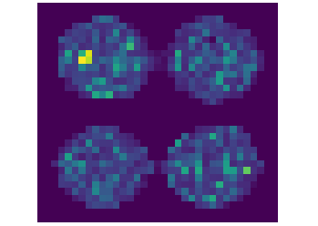
Part 2 — AnomalyDINO with Frozen DINOv2 Features
Reference images
Frozen DINOv2
Normal feature bank
Nearest-neighbor
distances
Score + heatmap
No defect examples
No fine-tuning
Test image
Patch distances (1-NN)
Heatmaps illustrate localization only.
AIAA3201 Project 2 — Intermediate Progress 2:00–2:50
5/11
Notes:
[Slide 5 · 2:00–2:50 · Speaker 2] We therefore reproduce AnomalyDINO using frozen DINOv2 patch features. AnomalyDINO needs only normal reference images and no defect examples. Each reference is processed by a frozen DINOv2 Vision Transformer at 448-pixel resolution. Its patch-level features form a memory bank of normal appearance. For every patch in a test image, we find the nearest feature in this memory bank. The nearest-neighbor distance becomes the patch anomaly score. Pooling the top one percent of distances produces the image-level score, while upsampling the patch-distance map gives the pixel-level heatmap. This feature-based comparison is much less sensitive to raw pixel alignment than Part One.

Slide 6
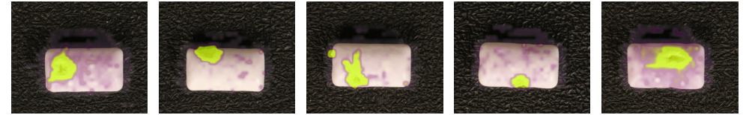
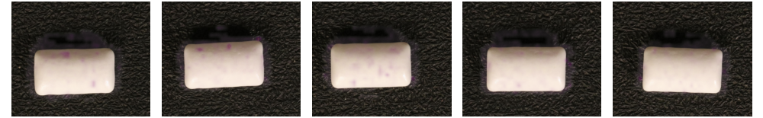
Official AnomalyDINO Results Across Three Seeds
Complete: 1, 2, 4, 8 shots × seeds 0, 1, 2
Shots | Image AUROC | Pixel AUROC
1 | 94.61 ± 0.84 | 98.08 ± 0.05
2 | 95.33 ± 0.46 | 98.22 ± 0.07
4 | 96.15 ± 0.40 | 98.36 ± 0.03
8 | 96.62 ± 0.57 | 98.47 ± 0.01
Defective test samples
Normal test samples
Official patch-distance overlays, 8-shot, seed 1, chewinggum.
AUROC (%), mean ± SD over seeds 0, 1, 2.
AIAA3201 Project 2 — Intermediate Progress 2:50–3:15
6/11
Notes:
[Slide 6 · 2:50–3:15 · Speaker 2] In the complete official evaluation across seeds zero, one and two, image AUROC rises from ninety-four point six one percent at one shot to ninety-six point six two at eight shots. Pixel AUROC stays between ninety-eight point zero eight and ninety-eight point four seven, with standard deviations below one percentage point.

Slide 7
Part 3 Plan — Multi-Layer Feature Fusion
PLAN ONLY — NO FINAL EXPERIMENTAL CONCLUSION
Planned experiment. No Part 3 results yet.
Intermediate layers
fine local texture
Normalize each layer
Fused score
Final layer
semantic stability
Motivation: reduce false boundary response.
Controlled comparison
Same VisA split, reference files, and evaluator
Report: Image/Pixel AUROC
Runtime and GPU memory
AIAA3201 Project 2 — Intermediate Progress 3:15–3:40
7/11
Notes:
[Slide 7 · 3:15–3:40 · Speaker 2] For Part Three, we plan to improve sensitivity to small texture defects through multi-layer DINOv2 feature fusion. Intermediate transformer layers preserve finer local texture, while the final layer provides stronger semantic stability. We will combine normalized distances from these layers and compare the result with unchanged AnomalyDINO using identical VisA data, reference filenames, shots, seeds, and evaluation code. We will report image AUROC, pixel AUROC, runtime, and peak GPU memory. This is our planned experiment, not yet a conclusion.

Slide 8
Current Status and Next Steps
Completed
In Progress
Planned
Part 1 evaluation
Part 2: 4 shots × 3 seeds
Align official and cached scores
Test feature fusion
Measure speed and memory
Part 2 is complete. Part 3 tests multi-layer features under the same protocol.
AIAA3201 Project 2 — Intermediate Progress 3:40–4:00
8/11
Notes:
[Slide 8 · 3:40–4:00 · Speaker 1] In summary, Part 1 is fully evaluated and Part 2 now has a complete three-seed official baseline. Next we will reconcile the official and cached scoring, then test multi-layer feature fusion under the same protocol, reporting image and pixel AUROC together with runtime and peak GPU memory.
DISCUSSANT QUESTION (not narrated in the 4-minute main line)
Main: How would you distinguish a true small defect from a normal pose or illumination change when both produce high patch distances?
Backup: Why might intermediate DINOv2 layers help localize tiny defects better than the final layer alone?

Slide 9
Appendix A — Per-category Part 2 Results
Appendix — not narrated in the 4-minute main line
Category | n | 1-shot | 2-shot | 4-shot | 8-shot
candle | 200 | 90.0 ± 2.6 | 91.9 ± 1.0 | 92.8 ± 0.9 | 93.5 ± 0.3
capsules | 160 | 97.7 ± 0.8 | 97.8 ± 0.6 | 98.1 ± 0.6 | 98.1 ± 0.7
cashew | 150 | 93.6 ± 0.5 | 93.4 ± 0.2 | 93.3 ± 1.1 | 94.6 ± 0.6
chewinggum | 150 | 98.5 ± 0.4 | 98.6 ± 0.2 | 99.0 ± 0.2 | 98.9 ± 0.3
fryum | 150 | 95.7 ± 1.3 | 97.0 ± 0.8 | 97.4 ± 0.8 | 98.1 ± 0.9
pipe_fryum | 150 | 92.1 ± 2.3 | 93.3 ± 1.8 | 96.4 ± 1.3 | 96.5 ± 1.7
All (macro) | 960 | 94.6 ± 0.8 | 95.3 ± 0.5 | 96.2 ± 0.4 | 96.6 ± 0.6
Image AUROC (%), mean ± SD over seeds 0, 1, 2.
Source: results/part2/summary_all_shots_seeds.json.
Per-category image results only.
Pixel AUROC is available in the same result file.
AIAA3201 Project 2 — Intermediate Progress Appendix
9/11
Notes:
Slide 9 · APPENDIX A — not narrated in the 4-minute main line. Show only if asked about per-category behaviour. Every cell is the mean over seeds 0/1/2 of the official AnomalyDINO image AUROC for that category, taken from results/summary_all_shots_seeds.json. The macro row reproduces the headline values on the results slide (94.61 / 95.33 / 96.15 / 96.62), which confirms the headline is the unweighted mean over the six categories.

Slide 10
Appendix B — Evaluation Protocol
Appendix — not narrated in the 4-minute main line
VisA: six categories, 448 × 448, agnostic.
Hold out 20 normal images per category for the 95th-percentile threshold.
Image score: top-1% map mean. Pixel map: resize to 448 px, Gaussian σ = 4.
AUPRO is not reported because of the shared-machine memory limit.
Sources: README_FOR_QWEN.md, results/part2_README.md, results/summary_all_shots_seeds.json.
AIAA3201 Project 2 — Intermediate Progress Appendix
10/11
Notes:
Slide 10 · APPENDIX B — not narrated in the 4-minute main line. Show if the protocol or the fairness of the comparison is questioned. Every bullet is taken from the supplied material package; nothing here is an estimate. The skipped AUPRO evaluation is stated as a limitation rather than hidden.

Slide 11
Appendix C — Efficiency and Part 3 Status
Appendix — not narrated in the 4-minute main line
Not measured
Runtime and peak GPU memory
Open item
Official/cached score alignment
Part 3
Planned only
Efficiency metric | Value
Runtime | not reported
Peak GPU memory | not reported
Discussant questions
Main: How can we distinguish a tiny defect from normal pose or lighting change?
Backup: Why could intermediate DINOv2 layers help localize tiny defects?
AIAA3201 Project 2 — Intermediate Progress Appendix
11/11
Notes:
Slide 11 · APPENDIX C — not narrated in the 4-minute main line. Show if asked about efficiency, about what is still missing, or when the discussant round begins. Runtime and peak GPU memory are deliberately left unreported: they have not been measured in the runs that back this deck. Cached-grid numbers are not comparable to the official path and are not used as Part 3 evidence.

