Slide 1
ECHOPIN · UPDATE v0.4
EchoPin grew up.
Real accounts, sealed emergency records, a central console, and a security review that tested itself.
Still serverless
Optional server
Tested for real
November 2026
Notes:
Good morning, everyone. The last time I stood here, I showed you EchoPin: an app that keeps a group together without GPS, without servers and without accounts. Today I want to tell you how EchoPin grew up, and why it is now safer, not less safe, even though it can talk to a server. Three things changed: real accounts, sealed emergency records, and a central console. And then we spent a lot of time trying to break all of it.

Slide 2
WHERE WE STARTED · V0.3
Three promises we kept
Relative, not absolute
No servers needed
Encrypted and signed
No coordinates exist anywhere. Distance comes from Bluetooth signal strength, measured on your own phone.
Phones talk directly over Bluetooth and Wi-Fi. Works on a mountain with no signal.
Every message sealed with XChaCha20-Poly1305 and signed with a per-session Ed25519 key.
None of this changed. Everything new sits on top.
Notes:
First, what did not change. ▶ EchoPin still never knows where you are. There is no latitude or longitude anywhere in the code. Distance comes from Bluetooth signal strength, measured on your own phone. Phones still talk directly to each other, so it works on a mountain with no signal. And every message is still encrypted and signed. ▶ None of that changed. Everything I'm about to show you sits on top of it.

Slide 3
THE BRIEF
What we were asked to build
1
2
3
4
Real accounts
Emergency history
Reports
Backups
Not IMEI numbers or serials
For the right people, when it matters
And diagnostics from every phone, in one place
So nothing is lost
“More security than using the system's IMEI… and a report system that shows user reports across all systems.”
Notes:
So why change anything? Because we were asked for four things. ▶ Real user accounts, with more security than identifying phones by their IMEI number. A history of sessions that the right people can check in an emergency. Reports and diagnostics from every phone in one place. And backups. ▶ In the words of the brief: more security than the system's IMEI, and reports across all systems.

Slide 4
THE BIG IDEA
An optional central server
Phones
Outbox
Server
Console
talk to each other
exactly as before
stores & forwards
when there's signal
accounts, records,
audit, backups
responders &
admins
No server address built into the app? It runs exactly like v0.3: local, offline, no account.
Notes:
Here's how we did it. ▶ Phones still talk to each other exactly as before. When there's signal, an outbox on the phone forwards things to a central server: accounts, sealed session records, reports and diagnostics. Responders and admins see that in a console. The outbox is the clever bit: if you're offline, nothing is lost. It waits, and sends when it can. ▶ And the server is optional. If an organisation doesn't set one up, the app runs exactly like before: local, offline, no account.

Slide 5
IDENTITY
A device key, not an IMEI
IMEI / serial
EchoPin device key
Readable by other apps?
Yes
No
Can be copied and replayed?
Yes
No
Available on modern phones?
Rarely
Always
Can be revoked?
No
Yes, per device
Sign-in proves the key: an Ed25519 signature over “purpose | email | time”, checked within 5 minutes. A stolen refresh token is useless without the phone.
Notes:
Now, the IMEI question. Why not just identify phones by their IMEI? ▶ Because other apps can read it. ▶ Anyone who reads it can copy and replay it. ▶ Modern Android and iPhones mostly don't let apps see it at all. ▶ And you can't revoke it. Instead, every install makes its own device key. The private half never leaves the phone. ▶ When you sign in, the phone signs a short statement with that key, and the server checks it within five minutes. So if someone steals your refresh token, it's useless without your actual phone.

Slide 6
SEALED EMERGENCY RECORDS
Two locks, two different people
OUTER LOCK · server's escrow key
Server alone?
INNER LOCK · custodian key (responders only)
Opens only its own layer. Can't read the record.
The record
who, when, SOS, check-ins
never coordinates
Stolen database + keys?
Still sealed: the custodian key isn't there.
Responder in an emergency?
Server peels its layer (audited), console opens the rest.
Notes:
The most sensitive thing we store is the emergency record of a session. ▶ The record says who was there, when someone pressed SOS, who checked in. Never coordinates. ▶ It's sealed inside a lock that only responders can open, using a custodian key that lives on their devices, never on the server. ▶ And that's sealed again inside a lock only the server can open. ▶ So the server on its own can't read a record. Someone who steals the database and the server's keys still can't read one. A responder in a real emergency can: the server opens its layer, and the console opens the rest.

Slide 7
BREAK-GLASS
Opening a record leaves a trail
1
2
3
4
Give a reason
Audit first
Admins alerted
Opened locally
10+ characters, plus a
case number if there is one
grant written before
anything is decrypted
every admin gets an
email straight away
custodian key on the
responder's own device
Staff accounts must have two-step sign-in before the console answers them.
Notes:
Opening a record is what we call break-glass, like the fire alarm. ▶ You must give a reason. ▶ The server writes that reason into the audit log before it decrypts anything, so there's no way to read a record without leaving a trace. ▶ Every admin gets an email straight away. ▶ Then the responder's own device opens the inner lock. ▶ And staff accounts must turn on two-step sign-in before the console will even answer them.

Slide 8
WE ATTACKED OUR OWN CODE
Two security reviews, then live testing
10
11
5
faults found and fixed in the first review
remaining risks closed in the second pass
bugs only real, end-to-end testing caught
None of them let anyone read a sealed record.
Notes:
Then we tried to break it. ▶ The first security review found ten faults and fixed every one. ▶ A second pass closed the eleven risks we had first accepted. ▶ And then testing the real app against a live server found five more bugs that no automated test had caught. ▶ The important part: none of them let anyone read a sealed record.

Slide 9
HIGHLIGHTS
What we fixed, in plain words
Spoofed IP addresses
Account pre-hijacking
Lockout used as a weapon
Read from the header the host overwrites, never the one the client writes
Confirming an email needs the code and the sign-up password
Your own registered phones skip the lock; strangers can't keep you out
Who has an account?
Breached passwords
Rewriting the audit log
Same answer and same timing for every email address
Checked against Have I Been Pwned; only 5 hash characters leave
Keyed HMAC chain plus an anchor stored with every backup
Notes:
A few highlights, in plain words. ▶ The server used to trust an IP address the client could simply make up, which let attackers dodge rate limits and fake the audit log. Fixed. Someone could register your email just after you did and have you activate their password. Fixed: confirming now needs your password too. Anyone could lock you out by typing wrong passwords. Now your own phones skip that lock. ▶ The server no longer reveals who has an account, not even through timing. Passwords that appear in public data breaches are refused, and only five characters of a hash leave the server to check. And the audit log is now signed with a secret key, so even someone with full database access can't rewrite history.

Slide 10
TESTED FOR REAL
Not just unit tests
30/30
213
62
6
live server checks
app tests
server tests
protocol tests
How: a real compiled server and database, a client signing genuine device proofs, and the real app clicked through on a hidden virtual display.
Notes:
How do we know it works? ▶ Thirty out of thirty checks against a real running server, plus over two hundred and eighty automated tests across the app, the server and the shared protocol. ▶ And we didn't stop at unit tests: a real compiled server, a real database, and the real app, clicked through on a hidden screen.

Slide 11
FOUND BY REAL TESTING
Five bugs the test suites missed
The two-step setup dialog crashed on every platform
BUG
FIXED
The console crashed right after a record was opened
BUG
FIXED
One SOS showed up as three
BUG
FIXED
A real member could be branded a fake on a tie
BUG
FIXED
Test runs wrote into the app's real data folder
BUG
FIXED
Notes:
That last step paid off. Five bugs. ▶ The two-step setup dialog crashed on every platform. ▶ The console crashed right after a responder opened a record. ▶ One SOS was being counted three times, once per phone that saw it. ▶ With exactly one real member and one outsider, the membership check could brand the real member as the fake. ▶ And our own test runs were writing into the app's real data folder. Every one is fixed, and every one now has a test.

Slide 12
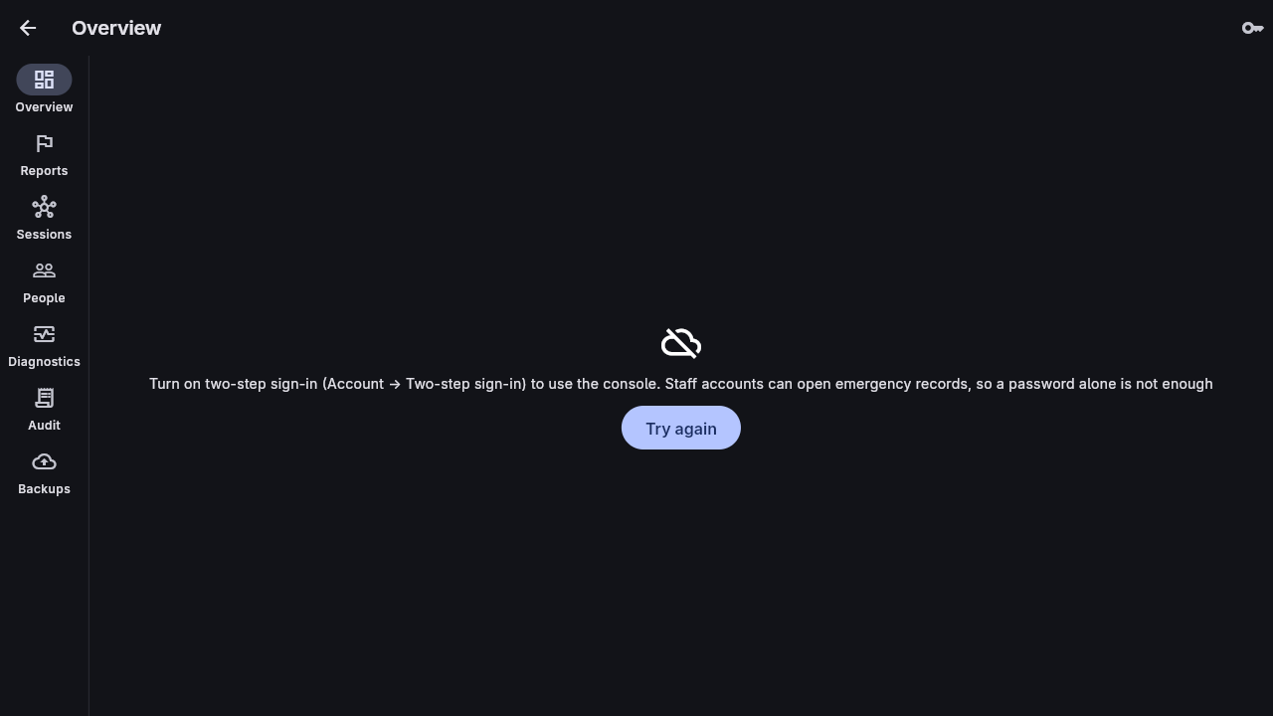
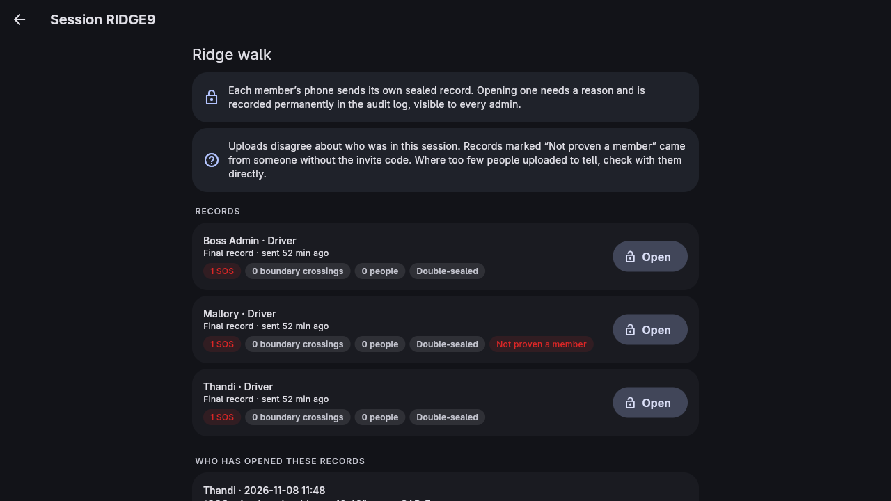
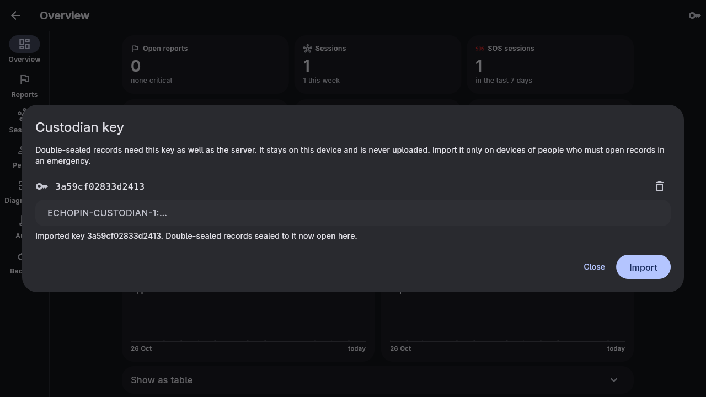
SEE IT
The real app, against the live server
Staff need two-step first
Uploads from non-members are flagged
The custodian key stays on the device
Screenshots from the end-to-end test run, unedited.
Notes:
Here's the real app. ▶ An admin without two-step is turned away. ▶ A session where someone uploaded a record without being in it: flagged, "not proven a member". ▶ And the custodian key, imported on a responder's device and never uploaded. ▶ These are straight from the test run.

Slide 13
RUNNING IT
Hosted for free
GitHub
Render
Supabase
Brevo
code + keep-awake
ping every 10 min
the server, Docker,
Frankfurt
PostgreSQL +
encrypted backups
sign-in codes
by email
Keys never in the code
Data location
One secret, ECHOPIN_KEYS, kept in a password manager. The server refuses to start without it.
Frankfurt today. The same image runs in a South African region if POPIA requires it.
Notes:
Running it costs nothing. ▶ GitHub holds the code and keeps the server awake. Render runs the server. Supabase holds the database and the encrypted backups. Brevo sends the sign-in codes. ▶ The keys never go in the code; the server refuses to start without them. And the data sits in Frankfurt today, but the same image runs in a South African region if POPIA needs it.

Slide 14
HONEST ABOUT WHAT'S LEFT
Limits and next steps
Still on us
Next
• Create the custodian key before real use
• Two-step on every hosting account
• Test Bluetooth between real phones
• Decide where the data lives
• “Verified account” badges in sessions
• Deploy to the free hosting stack
• Field trial with a real group
• Tune retention with the organisation
Notes:
I want to be honest about what's left. ▶ Before real use, we need to create the custodian key, turn on two-step for every account around the server, test Bluetooth between real phones, and decide where the data lives. ▶ Next, we'd like verified-account badges inside sessions, a real deployment, and a field trial with a real group.

Slide 15
Thank you
Questions? I can show any line of code behind any of this.
Notes:
EchoPin still doesn't know where you are. Now it can also help the right people find out what happened, and only them, and only with a reason everyone can see. Thank you. I'm happy to take questions, including about any line of code behind this.

