Slide 1
Hamster Pictures- Which is
cutest?
By BlueHamsfer

Slide 2

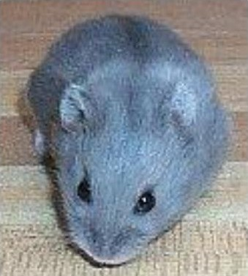
This one is ue

Slide 3
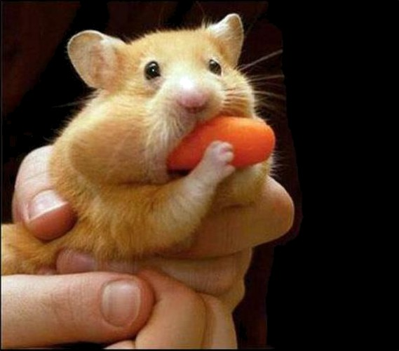
This is a cute one

Slide 4
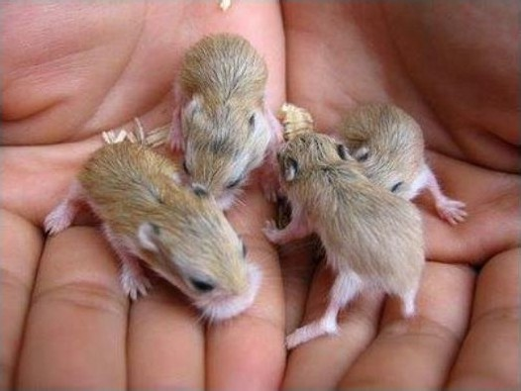
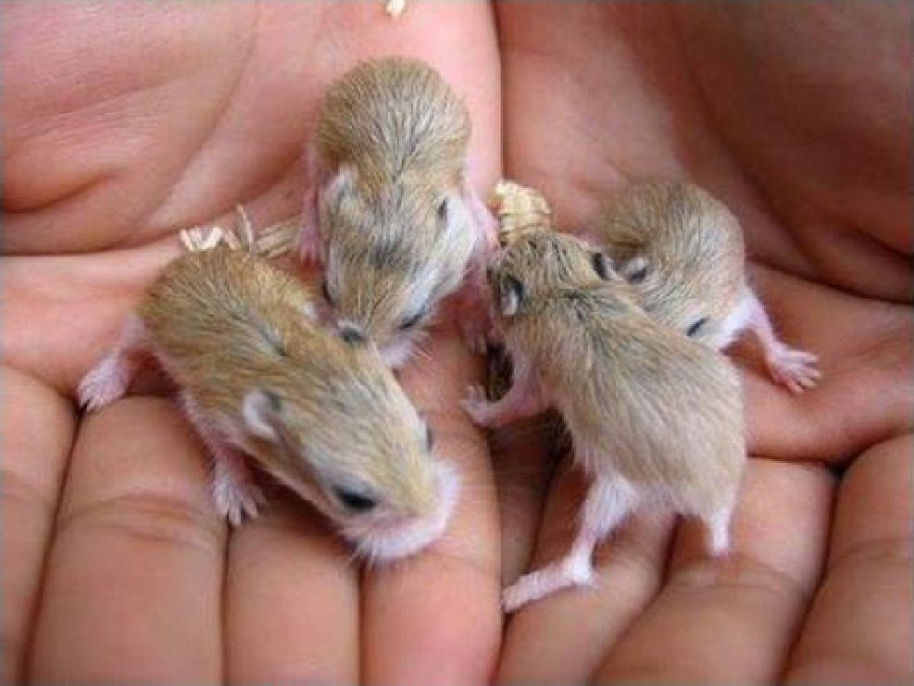
Baby Hamsters!!!!

Slide 5
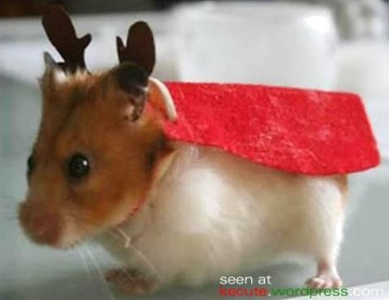
Christmas Hamster

Slide 6
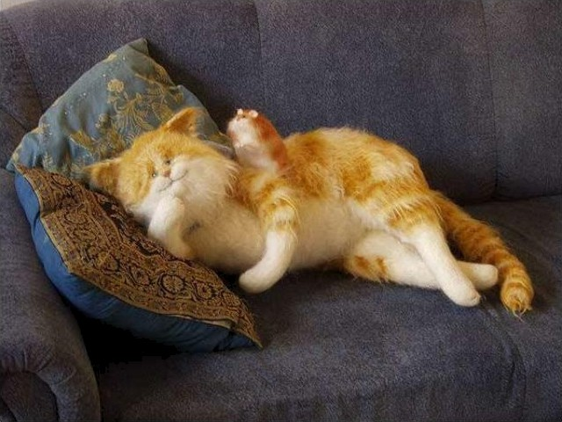
is at home!!!!
Don't try

Slide 7
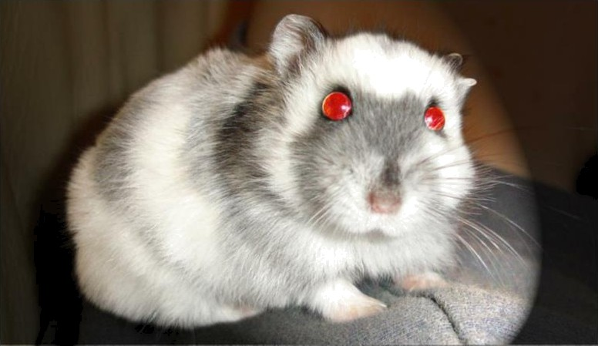
Beware-Creepy Hamster

Slide 8
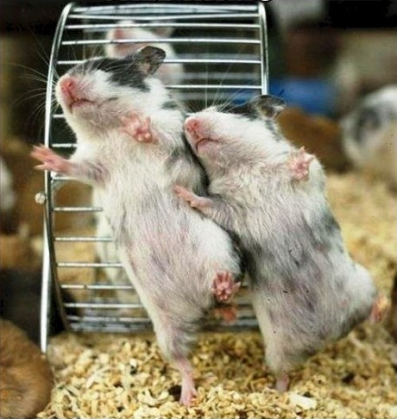
Hamsters
dansing

Slide 9
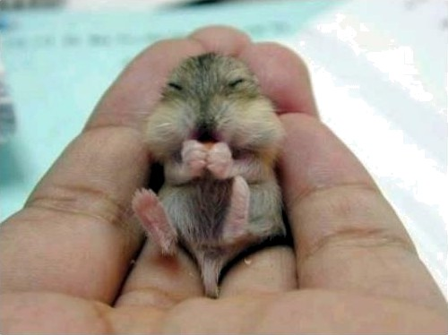
Tiny Hamster

Slide 10
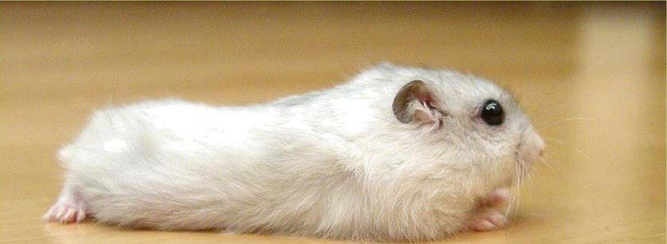
Super Spy

Slide 11
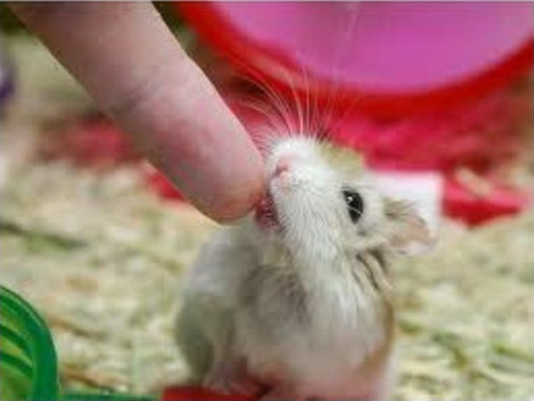
Do not stick you fingers in this cage- I
bite

Slide 12
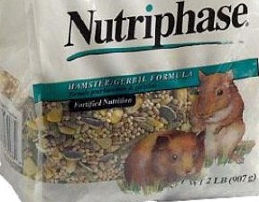
Just so you know- this is not a
hamster- it is hamster food

Slide 13
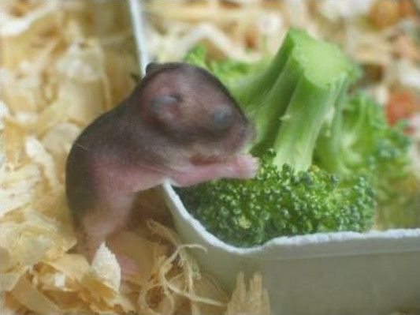
Hamster with a side of vegetables

