Slide 1
ELECTRONIC HEALTH RECORD MANAGEMENT SYSTEM {EHRMS}
Blockchain is a distributed ledger system that can record transactions between two parties efficiently. Each transaction is stored on a record, then these records, called blocks, are connected through cryptography to form a list or a Blockchain.
Blockchain creates a ledger system that is immutable and allows the transactions to take place in a decentralized manner. The three main features of Blockchain technology: - Security, Decentralization, and Transparency make any application built using it secure and not accessible by unauthorized parties. The manipulation of data is almost impossible to do in a Blockchain network.

Slide 2
To implement this system, we used a Blockchain-based framework Hyperledger Fabric and Composer tool to implement the project. Hyperledger composer is an open source tools for building a Blockchain business network. The workspace environment is set up to work with the Hyperledger fabric and Hyperledger composer.
By including Hyperledger Fabric, we can provide an industrial standard in the field of healthcare. The entire patient record can be tracked from the start to the end. The overall standard of the healthcare industry can be increased.

Slide 3
The Blockchain network is divided into three main components: Participants, Assets, and Transactions. In the implementation of an EHRM system using Blockchain, EHRMS consists of three main participants: - i. Patients ii. Doctors
iii. Admin Patients play an important role as a participant in the EHRM system. They own their health records that are being created and added to the Blockchain.
Doctors are the care providers who will collect medical data of patients through diagnoses, prescriptions. Admin is the one who deploys the Blockchain network, implements various contracts in the network, generates the key and handles the encryption-decryption of the transaction data. Overall system manipulations.

Slide 4
When a medical record of a patient is generated and tested, it can be added on to the Blockchain network, which offers patients with the perfect assurance that the record cannot be altered. These personalized health records could be encrypted and kept on the Blockchain network with a private key, which allows only verified users to access the health records in crucial time, thereby ensuring the privacy of the patient’s medical records and thus making the EHRMS patient-centered since medical records are patients’ assets, created medical records.

Slide 5
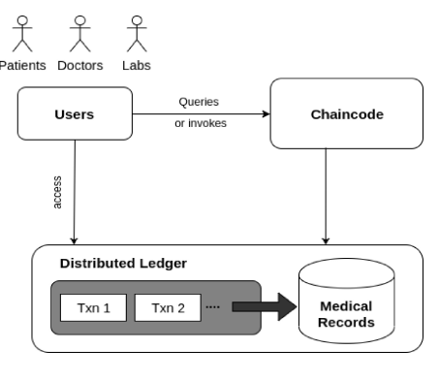
Essentially, a Blockchain is a distributed database solution which stores a continually increasing set of data verified and confirmed by participants.
The architecture of EHRMS.

Slide 6
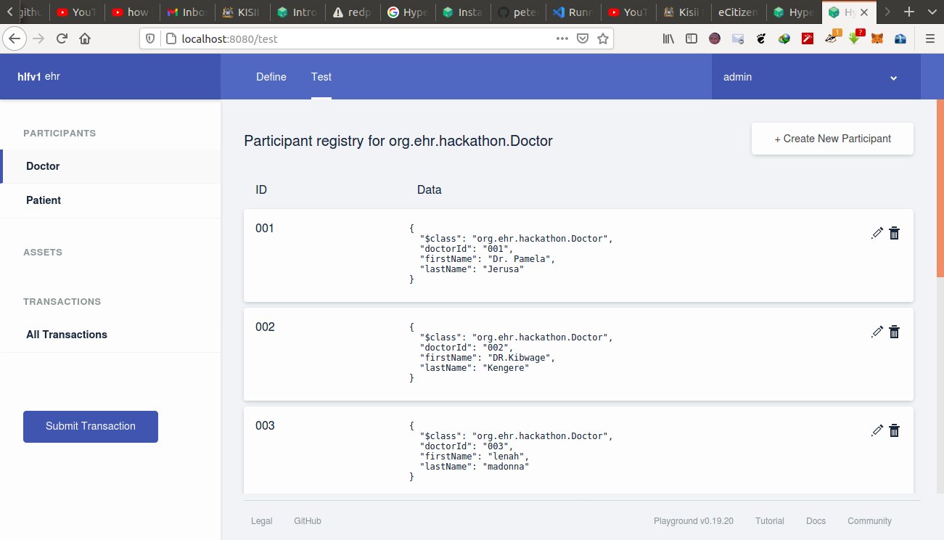
Following transactions are executed in the system:
AddParticipant - Whenever a new node will be added to the system this transaction will get executed.
Doctor: -

Slide 7
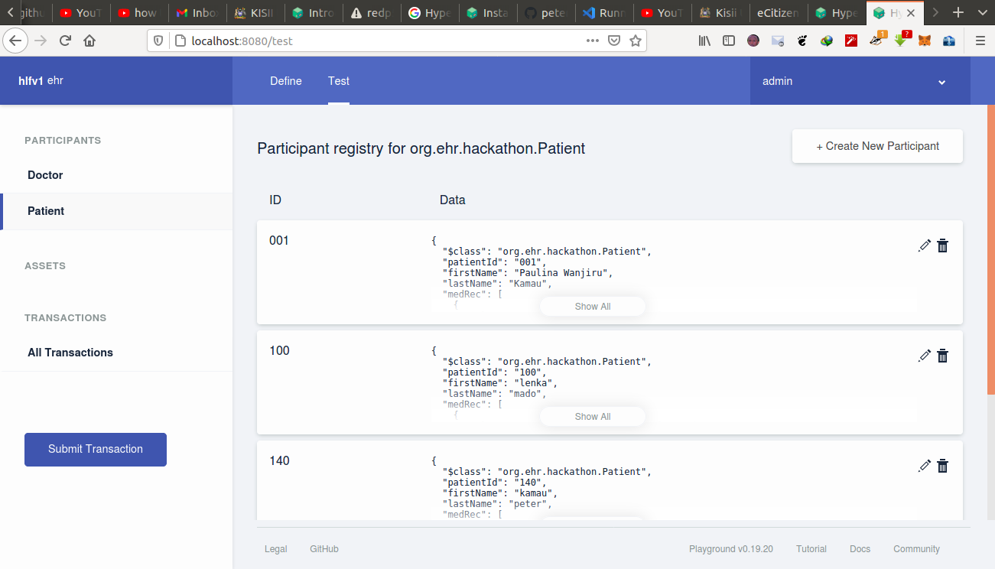
Patient: -

Slide 8
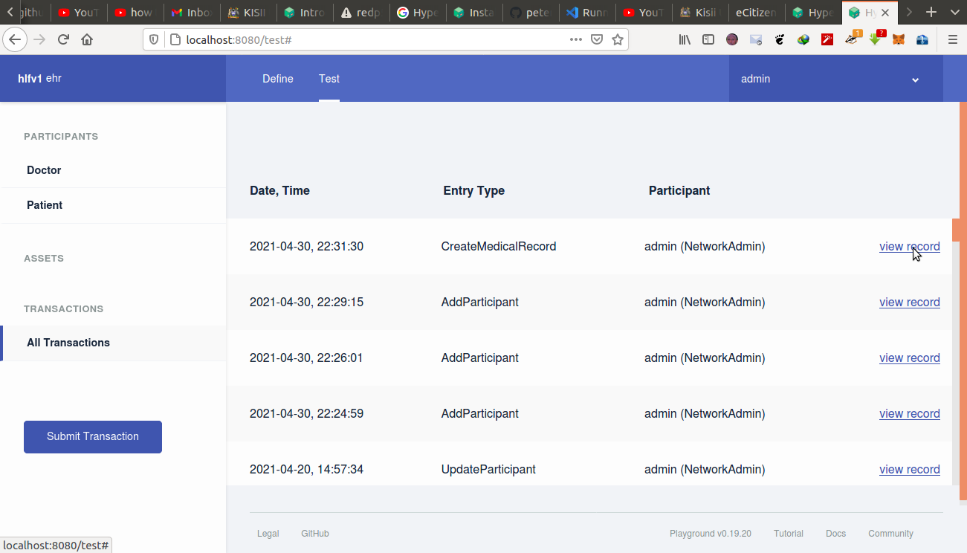
2. CreateMedicalRecord - This transaction would create records in the network. It contains fields like recordID, owner, and list of authorized patients. It contains fields that store medical information of the patients like medical history & diagnosis. The ID generated for the record is unique to the record and is used to identify that specific record in the collection.

Slide 9
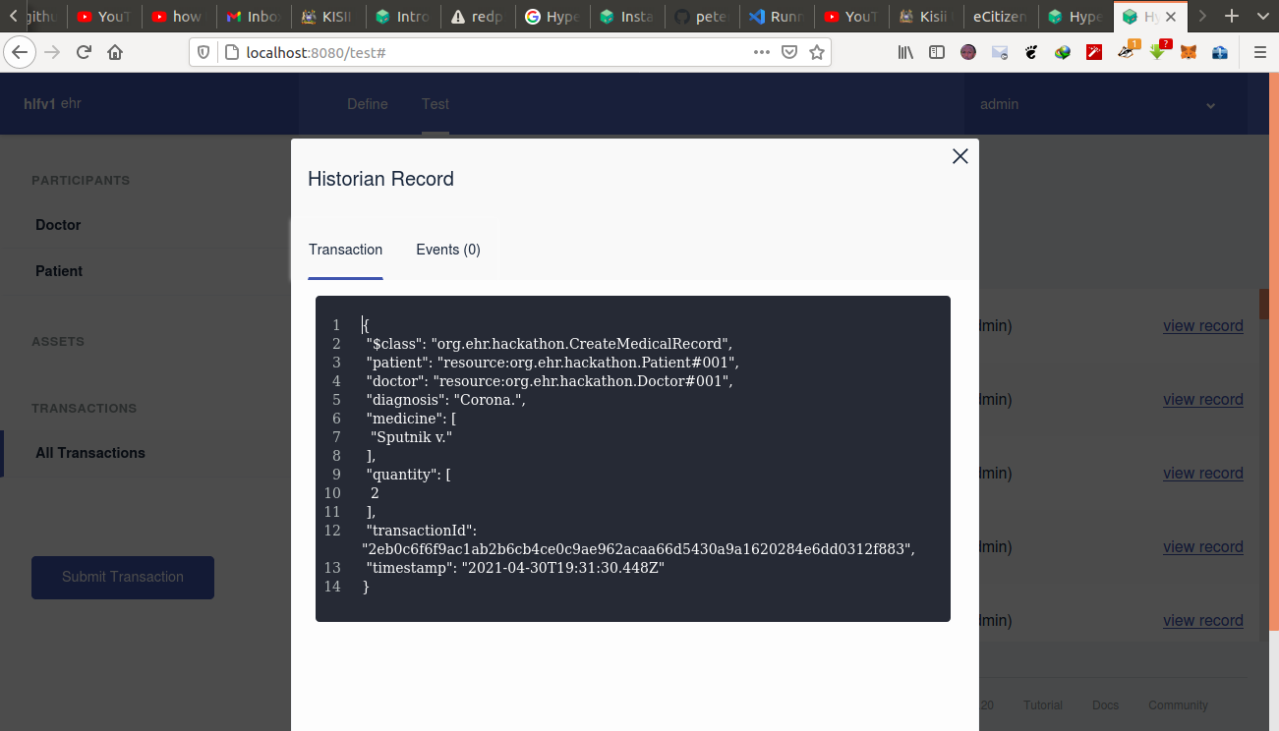
Medical record created with both Doctors’ & Patients’ unique ID: -

Slide 10
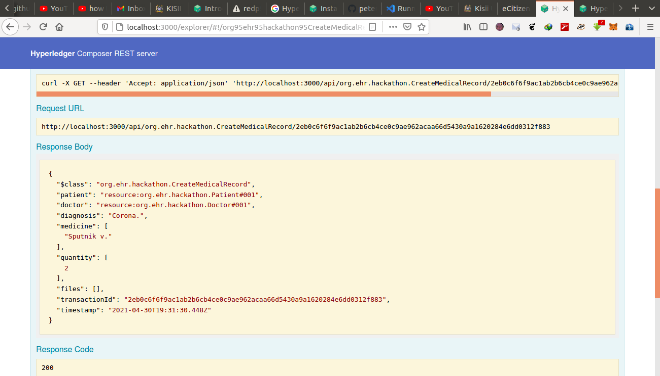
Proof of existence of the created medical record in the Hyperledger Composer REST Server: -

