Slide 1


INTRODUCTION TO INFERENCE AND INTERPRETATION
TEAM-6

Slide 2


Team Members
P. Siri Charana -306
B. Meghana -303
V. Chandana -305
B . Binduja -307

Slide 3
Contents
R programming
Features of R
Installation of R
Installation of Rstudio
Operators and Types
Objects
Data types and its Types
Functions
9. Data Files
10. Packages
11. Sub setting

Slide 4
R Programming
R is a free and open source scripting language.
It was developed by Ross Ihaka and Robert Gentleman in 1993.
R is a Programming Language that is mostly used for machine learning, data analysis, and statistical computing.
It is an interpreted language and is platform independent that means it can be used on platforms like Windows, Linux, and macOS.

Slide 5
Features of R Programming :
R is a well-developed, simple and effective programming language which includes conditionals, loops , user defined recursive functions and input and output facilities.
R has an effective data handling and storage facility,
R provides a suite of operators for calculations on arrays, lists, vectors and matrices.
R provides a large, coherent and integrated collection of tools for data analysis.
R provides graphical facilities for data analysis and display either directly at the computer or printing at the papers.

Slide 6
Installation of R :
Go to the CRAN website.
Click on "Download R for Windows".
Click on "install R for the first time" link to download the R executable (.exe) file.
Run the R executable file to start installation, and allow the app to make changes to your device.
Select the installation language.
Read the licence agreement and click Next.

Slide 7
7. Select the components you wish to install . Click Next.
8.Enter the folder/path you wish to install R into and then confirm by clicking Next.
9. Select additional tasks like creating desktop shortcuts etc, then click Next.
10. Wait for the installation process to complete.
11. Click on "Finish" to exit the installation setup.

Slide 8
Installation of R Studio :-
1. With R base installed lets move on to installation of Rstudio . To begin go to download RStudio and click on download button for RStudio desktop.
2. Click on the link for the windows version of RStudio and save the .exe file.
3. Run the .exe and follow the installation instructions.
4. Click Next on the welcome windows.
5. Enter the path to the installation folder and click Next to proceed.
6. Select the folder for the start menu shortcut or click on do not create shortcuts and then click Next.
7. Wait for installation process to complete.
8. Click Finish to end the installation.

Slide 9
Operators :
Operators are used to perform operations on variables and values.
R divides the operators in the following groups:
Arithmetic operators
Assignment operators
Comparison operators
Logical operators
Miscellaneous operators

Slide 10
Arithmetic operators
Arithmetic operators are used with numeric values to perform common mathematical operations
Operator | Name | Example
+ | Addition | x + y
- | Subtraction | x - y
* | Multiplication | x * y
/ | Division | x / y
^ | Exponent | x ^ y
%% | Modulus (Remainder from division) | x %% y
%/% | Integer Division | x%/%y

Slide 11
Assignment Operators
Assignment operators are used to assign values to variables.
Operator | Name | Example
== | Equal | x == y
!= | Not equal | x != y
> | Greater than | x > y
< | Less than | x < y
>= | Greater than or equal to | x >= y
<= | Less than or equal to | x <= y

Slide 12
Logical Operators
Logical operators are used to combine conditional statements
Operator | Description
& | Element-wise Logical AND operator. It returns TRUE if both elements are TRUE
&& | Logical AND operator - Returns TRUE if both statements are TRUE
| | Elementwise- Logical OR operator. It returns TRUE if one of the statement is TRUE
|| | Logical OR operator. It returns TRUE if one of the statement is TRUE.
! | Logical NOT - returns FALSE if statement is TRUE

Slide 13
Miscellaneous Operators
Miscellaneous operators are used to manipulate data.
Operator | Description | Example
: | Creates a series of numbers in a sequence | x <- 1:10
%in% | Find out if an element belongs to a vector | x %in% y
%*% | Matrix Multiplication | x <- Matrix1 %*% Matrix2

Slide 14
Objects:
R stores information as an object with a name. Later objects can be referred by the name. Object names are case sensitive. Objects may have different types of values.

Slide 15
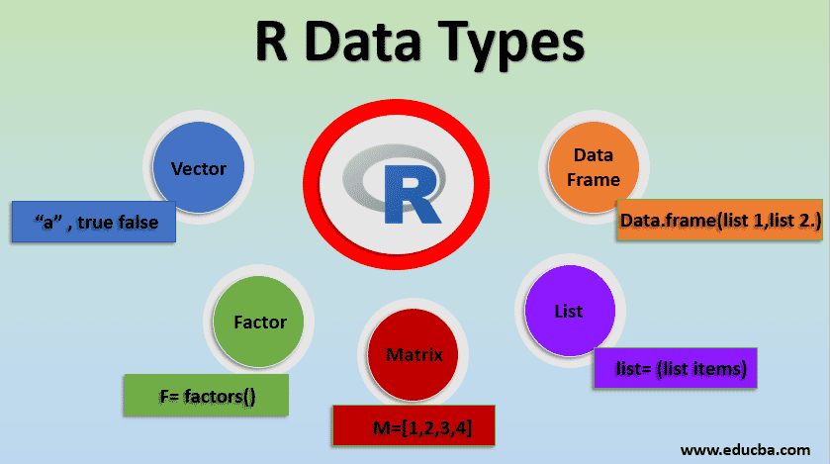
Data Types
R data types are the basic features of R language that are used to accept and store various types of data.

Slide 16
Vectors
A vector is a basic data structure which plays an important role in R programming.
In R, a sequence of elements which share the same data type is known as vector.
A vector supports logical, integer, double, character, complex, or raw data type.
The elements which are contained in vector known as components of the vector. We can check the type of vector with the help of the typeof( ) function.
x=c (3,6,1,2) x>2

Slide 17
Factors
The factor adds numeric codes along with the character level.
it defines categorical data with ordered and unordered sets. They are defined using function factor ().
Storing data in a factor helps to store data efficiently in statistical modeling.
f = factor (c(1, 6,2,4,7,1,6,7,8) print (f)

Slide 18
Matrix
A matrix is a two-dimensional rectangular data set. It can be created using a vector input to the matrix function.
Syntax : variable <- matrix(vector, n rows, n columns, split by row or column)
M = matrix( c('a','a','b','c','b','a'), nrow = 2, ncol = 3, byrow = TRUE)
print(M)

Slide 19
Lists
A list is an R-object which can contain many different types of elements inside it like vectors, functions and even another list inside it.
Syntax : variable <- list (list items)
list1 <- list(c(2,5,3),21.3,sin)
print(list1)

Slide 20
Data Frame
Data frames are two-dimensional with a group of vectors by an equal length. It’s a special kind of list with a rectangular format list.
The key factor is to store data tables. They are created using function data. the frame ().
Syntax : variable <- data.frame ( list 1, list 2… list N)
BMI <- data.frame( gender = c("Male", "Male","Female"),
height = c(152, 171.5, 165),
weight = c(81,93, 78),
Age = c(42,38,26) )
print(BMI)

Slide 21
Functions
Functions are useful when you want to perform a certain task multiple times.
A function accepts input arguments and produces the output by executing valid R commands that are inside the function.
Syntax for function :
function_name<- function(arg_1, arg_2, ...) { Function body }
Types of functions :
1. Built-in Function 2.User-defined Function

Slide 22
Built-in Function: Built function R is seq(), mean(), max(), sum(), mean(), median(), range(),abs(), these function are directly call in the program by users.
User-defined Function: R language allow us to write our own functions
Syntax:
function_name<- function(arguments) {
function_body
return(return)
}

Slide 23
Build in functions
c()
Seq()
Sort()
Rbind()
Cbind()
Math Function
Sqrt()
Exp()
Cos(), Sin(), Tan()
Max(), Min()
runif()
Floor()
Statistical Functions
Median()
Mode()
read_data()
dim()
nrow(),ncol()
Head()
summary()
table()

Slide 24
Data Files
Data files contain data that is stored on externally on secondary storage devices.
we use consider two types of data files called CSV and RData.
For saving or loading we need to specify the directory (folder).
We can use ‘getwd()’ and ‘setwd()’ functions.
getwd(): The getwd() method is used to gather information about the current working pathname or default working directory. This function has no arguments.
setwd(): This method is used to set the specified pathname as the current working space directory of the R console.

Slide 25
CSV Files
Comma-separated values
Represent tabular data.
Conceptually similar to a Microsoft Excel or Google spreadsheet.
Each observation is separated by line breaks and each field within the observation is separated by a comma, tab, or some other character or string.
Loading CSV files: To read a CSV file the function read.csv() can be used.
Saving Data Frame to a CSV file: Use write.csv() function by specifying the object name and the file name.

Slide 26
RData Files
Represent a collection of R objects including data sets.
Can contain multiple R objects of different kinds.
They are useful for saving intermediate results from R code as data files
we can load or save using mouse by clicking the respective icons.
Saving R objects: ls() function display the objects available(workspace) in the environment.
To save the workspace use the function save.image() or save(). Use the file extension .RData at the end of the file name. objects will be stored in the current working directory unless the path is given.
Loading a R Data file: load(“RData_file_name”).

Slide 27
Packages
Packages in R Programming language are a set of R functions, compiled code, and sample data. These are stored under a directory called “library” within the R environment.
A repository is a place where packages are located and stored so you can install packages from it.
Some of the most popular repositories for R packages are:
CRAN: Comprehensive R Archive Network(CRAN)
Bioconductor
Github

Slide 28
Syntax for :
Install Packages : install.packages("package name")
Remove Packages : Remove.packages(“package name”)
In R we are having many packages. Let us discuss some packages which we used in our programs :
Gplots
Ggplot2 . xts
CausalImpact
Swirl
haven
readr
dplyr
tidyr

Slide 29
Subsetting
It allows us to access elements of an object or to be specific allows us to access requested parts of a data set.
There are 4 methods of subsetting in R which have their own functionalities depending upon the type of object/data set we need to extract data form.

Slide 30
Subsetting can be done in 4 ways
Subsetting using the [] operator Using the [] operator, we can access elements of vectors or observations from data frames. To neglect some of the elements of the data frame, ‘-‘operator can also be used.
Subsetting using the [[]] operator [[]] operator can also be used to subset data in R. It is mainly used to subset lists and is different from the [] operator such that it can only select one element while the [] operator can select more than 1 field in a single command
Subsetting using the $ function Similar to the [[]] operator, the ‘$’operator can only select one field at a time. It can be used to access an element in a list or to access a single column in a data frame/set.
Subsetting using the subset() function Arguably the most efficient and user-friendly way to subset data in R, the subset() function allows us to subset elements from data according to the required condition. The syntax of subset() function is given as: subset(dataset/object,subset_condition,select)

Slide 31


