Slide 1
Store sales Prediction
Benay – Soledad – Marcelo
18th April 2026

Slide 2
01
Exploration and Data Analysis
EDA

Slide 3
EDA
DATA SET OVERVIEW
555,000
Training rows
70,000
Test rows (to predict)
9
Input features
1
Target variable
Input features
Store_ID store identifier
Promotion 0 or 1
Date → month, year, day
Day_of_week 1 to 7
State_holiday public holiday
Open 1 = open
Nb_customers_on_day customers that day
School_holiday 0 or 1
— Target — Sales
Goal: predict the sales column for the 70,000 unseen rows in the test set.

Slide 4
EDA
DATA CLEANING
Four transformations to prepare the data for modelling
1
Removed closed stores
2
Decomposed date column
When open = 0, sales are always 0 by definition. Keeping them would mislead the model.
Converted date to datetime, then extracted month, year and day into separate numeric features.
3
Encoded state_holiday
4
Checked for missing values
The column had letters (a, b, c) for holiday types. We replaced them with 1 (holiday) and kept 0 (no holiday).
Ran isna().sum() — no NaN values were found, so no imputation was needed.
Result: a clean numeric dataset with extracted time features, ready for modelling.

Slide 5
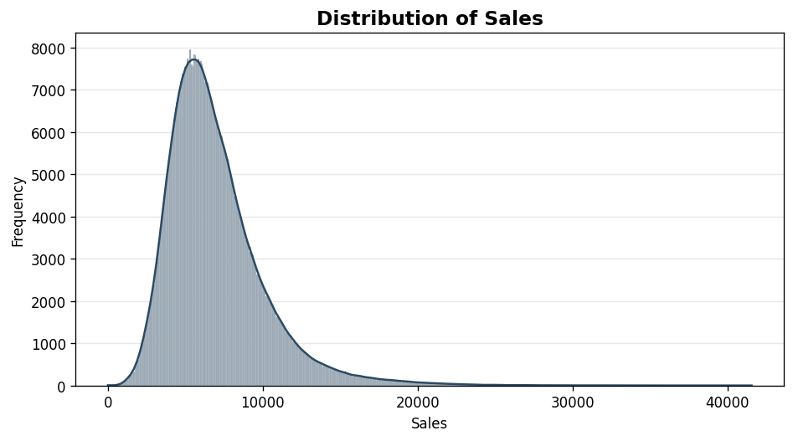
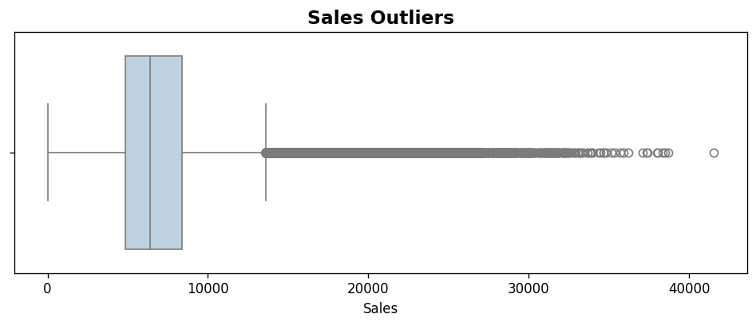
DATA INSIGHTS
Sales distribution and outliers
Key findings
• Right-skewed distribution (skewness = 1.60) — most sales are concentrated at low values
• Significant outliers present, reaching above 40,000 in sales
• Linear and distance-based models (KNN) will struggle — tree-based models are expected to perform better

Slide 6
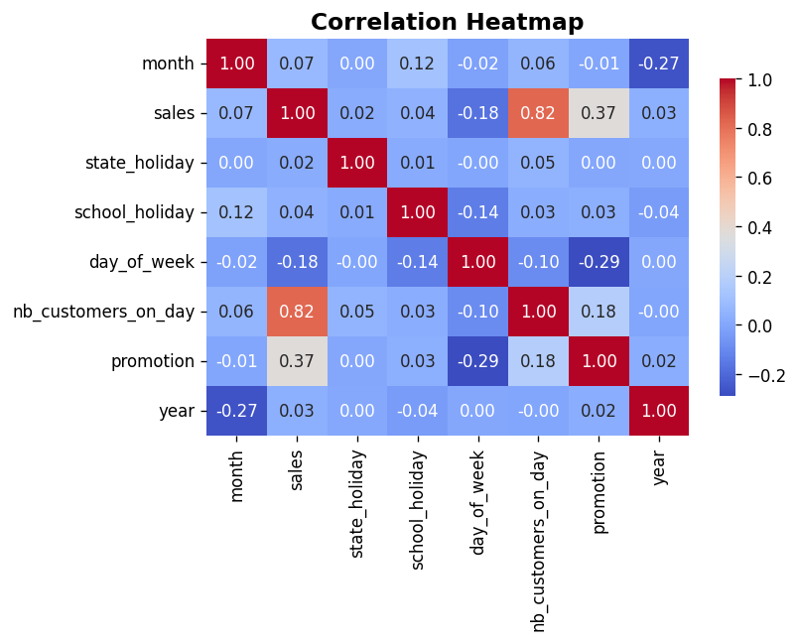
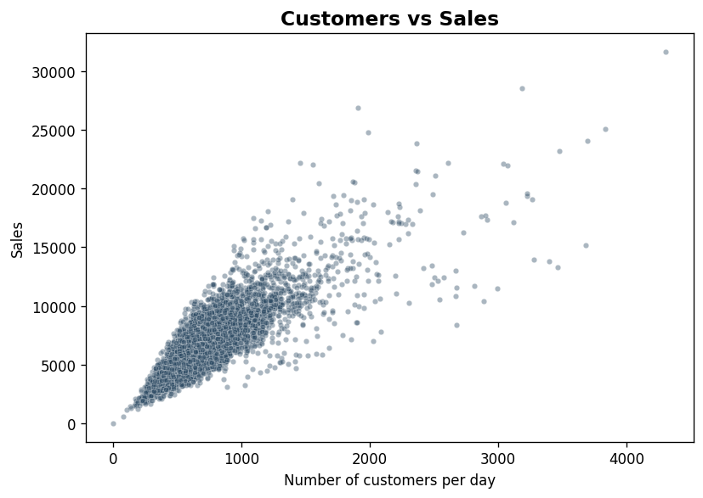
DATA INSIGHTS
Feature correlations and key drivers
0.82
Customers × Sales
0.37
Promotion × Sales
Number of customers is by far the strongest predictor. Promotions have moderate impact. Holidays and calendar features show weak direct correlation.

Slide 7
FEATURE ENGINEERING & TRAIN/VALIDATION SPLIT
Preparing the data for modelling
Features used for prediction
• day_of_week — 1 to 7
• nb_customers_on_day — Main predictor
• promotion — 0 or 1
• state_holiday — Encoded a/b/c → 1
• school_holiday — 0 or 1
• month, year, day — Extracted from date
Target variable: sales
Train / Validation split
We split the labelled data 80/20:
Training — 80%
Val 20%
~425,000 training rows | ~106,000 validation rows
Why this matters
The validation set gives an honest evaluation of how the model performs on unseen data, helping us detect overfitting and compare models fairly.
Key takeaway: skewness, outliers and non-linear relationships point us toward tree-based models as the most promising approach.

Slide 8
02
Models and Methodology

Slide 9
4 SUPERVISED MODELS WERE APPLIED TO SELECT BEST PREDICTION TECHNIQUE TO USE ON REAL DATA
Models
Supervised models reviewed
K NEAREST NEIGHBOURS
LINEAR REGRESSION
Ols
Ridge
Lasso
Decision
Tree
Random
Forest
Non-parametric baseline
Predicts by averaging the K most similar training example
Scales needed
OLS Methodology
Ridge (L2) and Lasso (L1) applied to test whether overfitting exists
Scaling required for L2 and L1
Non-linear, interpretable splits.
Handles outliers and categorical logic naturally
No scaling needed
Ensemble of decision trees
Reduces risks of overfitting by averaging predictions

Slide 10
MODEL PERFORMANCE COMPARISON AND HYPERPARAMETERS SELECTION
Model Performance comparison & hyperparameter selection
R²
KNN
OLS
RIDGE
LASSO
Decision Tree
Random Forest
K in [5,10, 25]
N.a.
Alpha = 1
Alpha = 0.01
max_depths = [5, 10]
min_splits = [2, 5]
min_leafs = [2, 5]
max_depths = [5, 10]
min_splits = [2, 5]
min_leafs = [2, 5]
KNN Model performs best at k= 10 but when we scale, it performs best at K=25 Overfitting with k=3 ("val") values drop significantly vs. the train data
KNN presents better results with k=10 (R2 test (val) = 78%)
Overfitting with k=3 ("val") values drop significantly vs. the train data
Promotion and state holiday are the most impactful features based on coeff. Results (at least ~5x times bigger than remaining coefficients)
OLS, Lasso and Ridge delivered the same results:
Lasso, Ridge only make a difference when the model is overfitting – not the case
The gap is ~0 🡪 nothing to regularize
The Decision Tree was able to capture non-linear relationships in the dataset
Compared
to simpler models like Linear Regression, it performed better due to its flexibility.
Random Forest outperformed Decision Tree
This is because ensemble methods reduce overfitting and improve prediction stability

Slide 11
03
Outputs and Conclusions

Slide 12
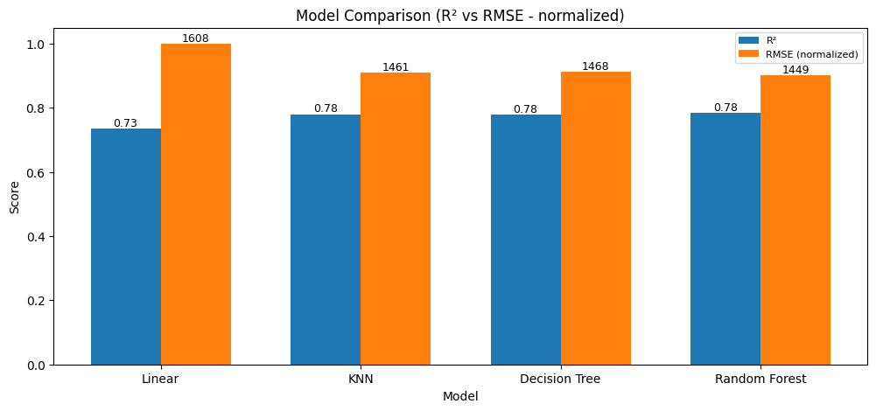
BASED ON EMPIRICAL VALIDATION RESULTS, THE PREDICTED SALES DATA IS EXPECTED TO ACHIEVE ~78% ACCURACY VS. REAL VALUES

Slide 13
FOR THE REAL SALE DATA, BASED ON EMPIRICAL SCIENTIFIC EVIDENCE, THE REAL_SALES DATA WILL HAVE ~81% ACCURACY
Best Model: Random Forest
Key Output
Real_Data.csv + Sales Prediction
R² Score = 0.78
RMSE = 1,442
Real_Data.csv + Sales Prediction
70+ rows with predicted sales values generatyed by Random Forest
The model explains 78% of the variance in daily store sales
N.a.

Slide 14
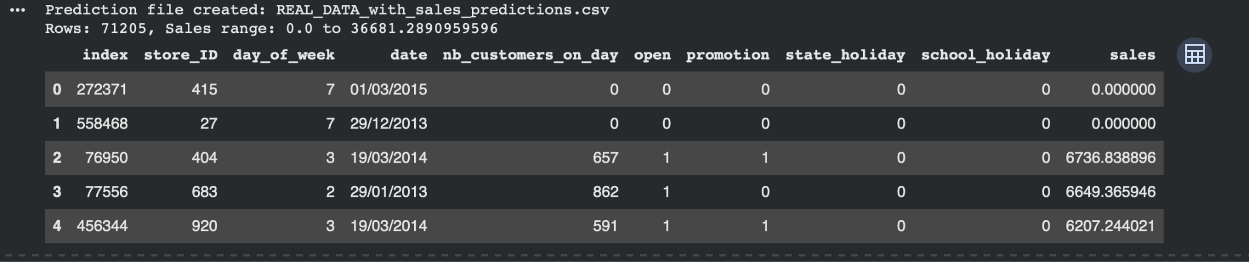
Final Output

