Slide 1
Contextual Verification and scoring of a webpage
Aditya Muralidharan , RA2212704010012
Akash Chaitanya , RA2212704010021
Akshaay CB , RA2212704010022

Slide 2
Introduction
The project titled "Contextual Verification of Webpage Content" is developed using the MERN Stack (MongoDB, Express, React, Node.js).
The application fetches and analyzes webpage details like Meta Title, Meta Keywords, Meta Description, and Page Content.
It calculates scores and identifies missing keywords to evaluate content relevance.
MongoDB is integrated to store fetched data, enabling future analysis and historical tracking.
The UI with React offers a more interactive and user-friendly experience.

Slide 3
Problem Statement
Webpages often suffer from incomplete or poorly structured metadata, which negatively impacts SEO performance and search visibility. Manually verifying these elements can be time-consuming and error-prone. This project addresses this issue by automating the extraction, analysis, and scoring of webpage metadata, including meta titles, descriptions, and keywords. By identifying missing keywords and assessing content quality, the project helps developers and content creators enhance their webpage structure for improved SEO optimization.

Slide 4
Objectives
To develop a React-based UI for seamless webpage content analysis.
To implement an Express.js backend for efficient data handling and API integration.
To integrate MongoDB for storing fetched metadata and analysis results.
To automate the extraction of meta titles, meta descriptions, and keywords.
To provide a score-based evaluation system for assessing content relevance.
To ensure the solution is user-friendly, scalable, and efficient for content verification.

Slide 5
System Architecture
USER
REACT FRONTEND
EXPRESS.JS BACKEND
TARGET WEBPAGE
WEB SCRAPER
MONGODB DATABASE

Slide 6
Features & Functionalities
1. Webpage Metadata Extraction:
Extracts Meta Title, Meta Description, and Meta Keywords from any given URL.
2. Content Analysis and Scoring:
Evaluates web page content by calculating a relevance score and highlighting missing keywords.
3. MongoDB Integration:
Stores fetched metadata and analysis results for future reference and data tracking.
4. Interactive React UI:
Provides a user-friendly interface for entering URLs, displaying results, and enhancing the user experience.
5. Real-Time Feedback System (Planned):
Implement a feature to provide live content improvement suggestions for better SEO.
6. User Authentication (Planned):
Add login/logout functionality to enable personalized data tracking and improved security.

Slide 7
Current Progress
A simple UI design (React.js)
2. Fetching details (Node.js with Express.js and webscaper module like Cheerio)
3. Storing in the Database (Mongodb)

Slide 8
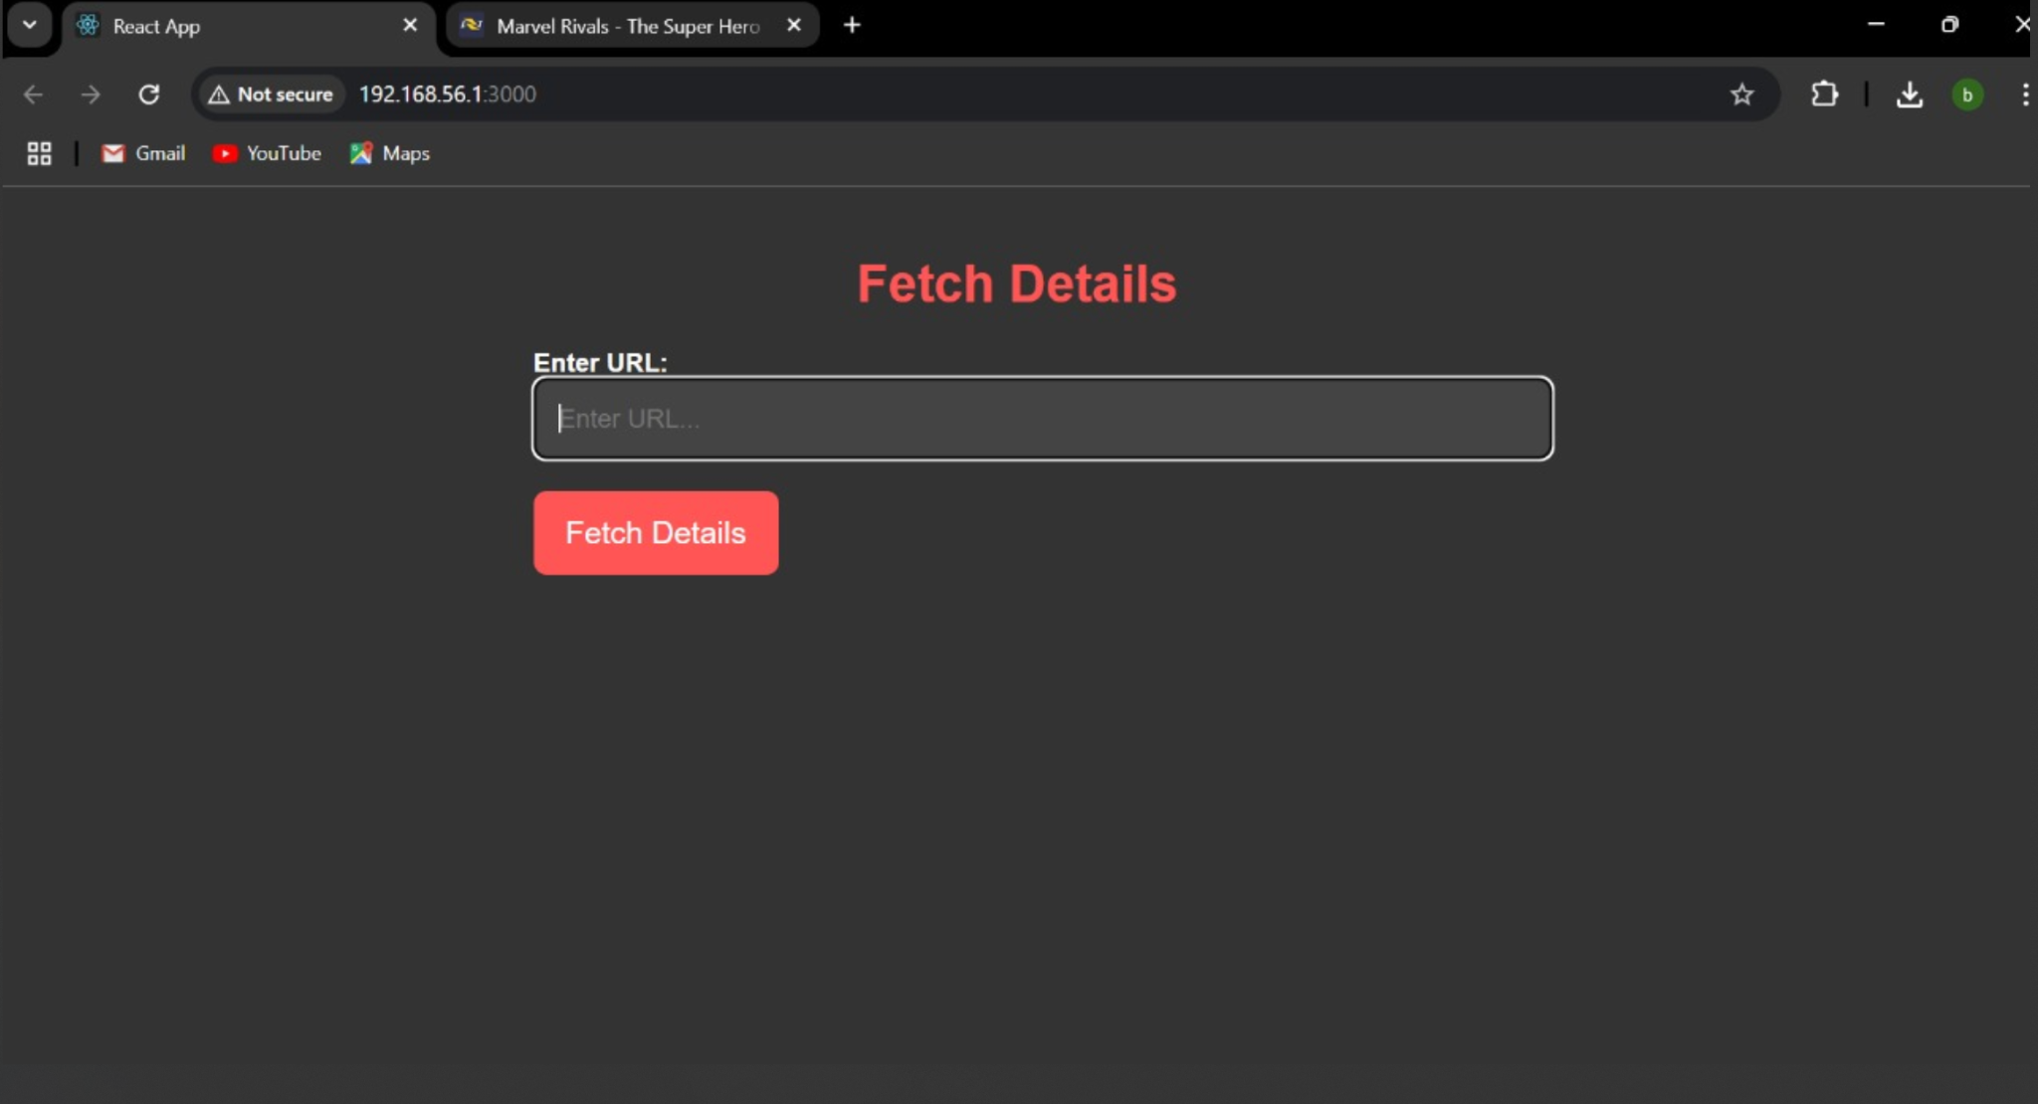

Slide 9
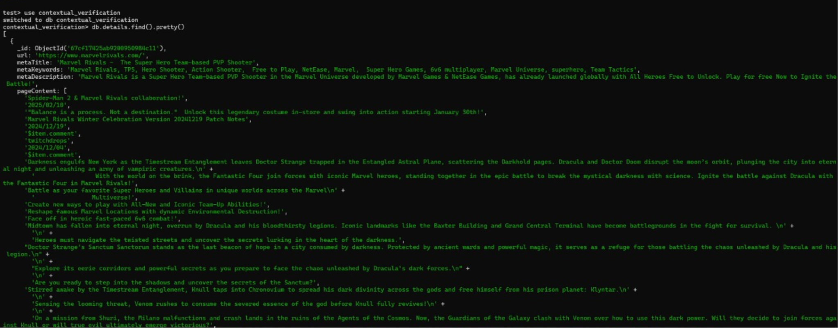

Slide 10
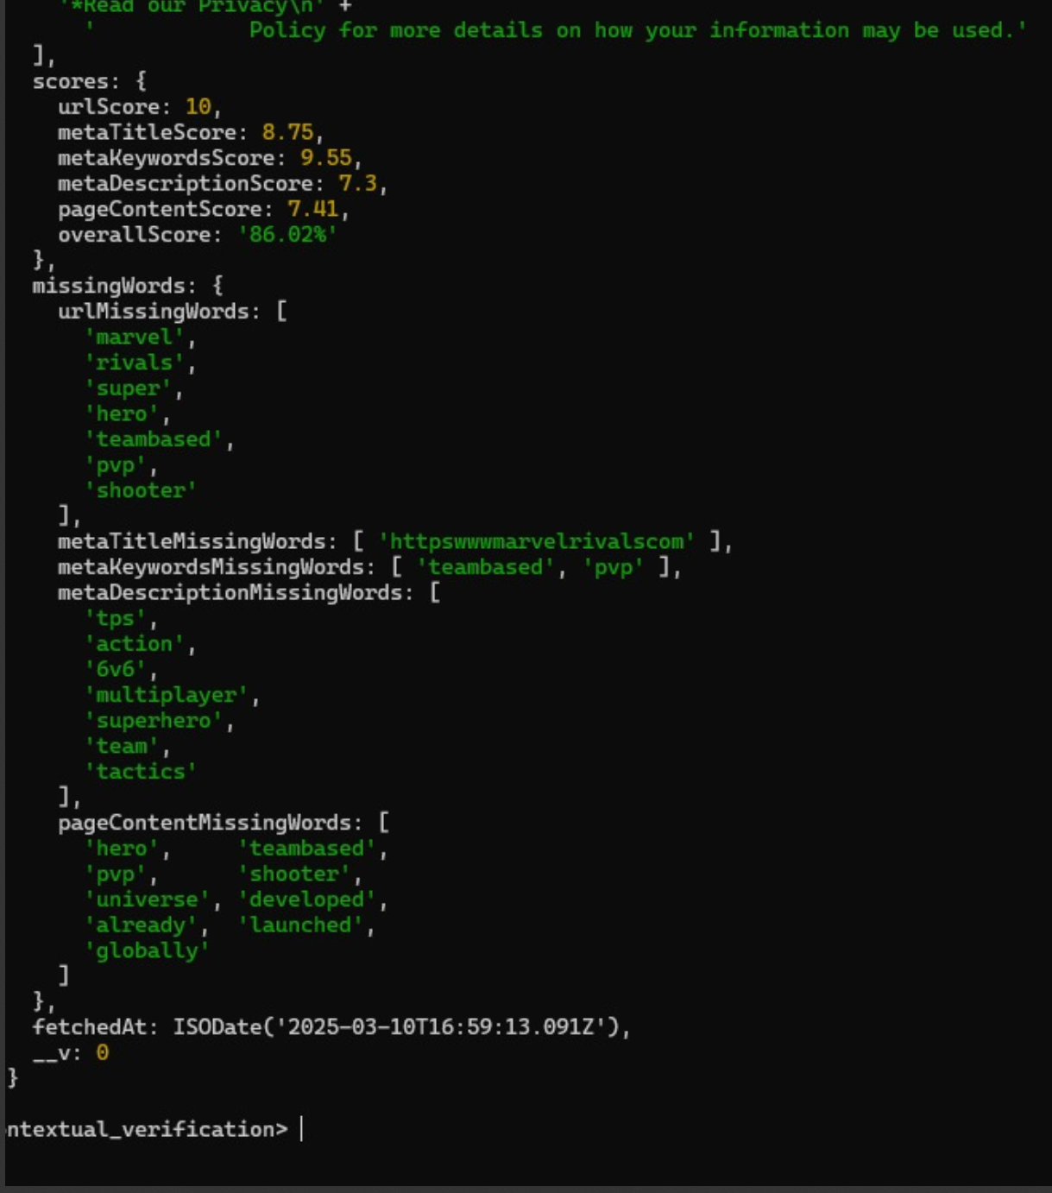

Slide 11
Thank You

