Slide 1
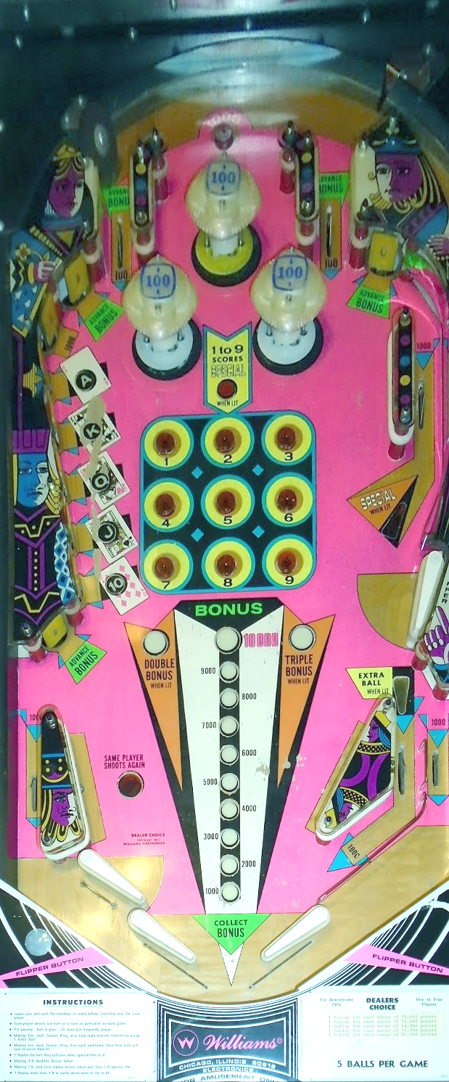
2
2
2
2
2
2
2
2
2
2
2
2
2
1
2
2
2
2
2
1
2
2
1
1
2
2
1
2
2
2
2
2
2
2
2
1
2
2
2
2
2
2
1
2
2
1
2
1
2
1
2
1
1
1
1
1
1
1
1
1
1
1
1
1
1
1
1
1
L
Light
1
L
LED
1
S
Switch
C
Coil
1
1
1
1
1
1
1
1

