Slide 1

DAR ES SALAAM INSTITUTE OF TECHNOLOGY (DIT)
DEPARTMENT OF COMPUTER STUDIES
BACHELOR OF ENGINEERING IN COMPUTER ENGINEERING
PROJECT TITLE | : | PATIENT’S HEALTH STATUS MONITORING SYSTEM USING IoT
PROJECT TYPE | : | PROBLEM SOLVING
NAME OF CANDIDATE | : | STANLEY JUSTINE MAHENGE
ADMISSION NO. | : | 180230220303

Slide 2
PRESENTATION CONTENTS
01
02
03
04
05
06
07
Introduction
Problem Statement
Objectives
Significance
System Analysis
Design
Development

Slide 3
INTRODUCTION
01

Slide 4
Background Information
According to World Health(WHO), the Doctor to patient ratio in Tanzania is around 1:20000 where the average ratio is 1:300 that is one doctor has to attend a around 98% more than the average. To this date there are highly technological systems that are used for monitor patients in Hospitals. Systems such as ECG for heart rate monitoring, EEG for monitoring brain activities etc. these system are quite expensive. Thus, this proposed study comes with minimal designed and cost-effective system for the doctors to be able to effectively and instantly trace multiple patient healthy status that is their temperature and pressure within the hospital ward during his work session.

Slide 5
PROBLEM STATEMENT
02

Slide 6
Problem Statement
Due to smaller Doctor to Patient ratio there is a heavy burden on the doctors and healthcare giver to follow up the Healthy status of each individual patient admitted in ward. Large Distance between patient and physicians lower the quality of healthy services :- Since this is the matter of death and life

Slide 7
OBJECTIVES
03

Slide 8
Main Objective
To develop a low cost effective and flexible patient status health monitoring system using using Internet of thing and artificial intelligence. The system shall help the healthcare giver to get the time to time temperature and Heart rate of patients admitted in the wards.

Slide 9
Specific Objectives
To develop gadget of temperature and Heart rate sensors which will be as close as possible to the patient to mine the require patient datas.
To develop physician terminal and attending healthcare giver terminals where patients data shall be processed to be sent to the Hospital data pool.
To build a web artificial intelligent portal were patients data shall be analysed and evaluated
To build an alerting subsystem via SMS where there is a critical condition alert for critical conditions shall be defined.

Slide 10
SIGNIFICANCE
04

Slide 11
Significance of the Study
The proposed system shall be able to provide the real time remote monitoring of the heartbeat and temperature with the integration of a way to notify the nurse about patient’s condition and SMS to a doctor to notify him/her about abnormal condition of the patient.
The appropriately proposed system shall be useful to regional hospitals (or any other medical service center) where a lot of patients are admitted.
The system shall aim at reducing the distance between the patient and his attending physician by allowing the healthcare giver to have the analysed temperature and pressure of patient at their fingertips.

Slide 12
SYSTEM ANALYSIS
05

Slide 13
Software Analysis
The proposed system software part aims at handling the analysis of data that is mined by sensors and stored to the database.
The proposed system software consist of Functional and Nonfunctional requirement
The main Functional requirements for this proposed web portal shall be to all viewing each patient’s temperature and heart rate through a web browser. To offer the evaluation of the data available by an IA module.
The non-functional requirement of the web portal is to have :
Having a database( sqlite for development and mysql for production ) to store both personal and medical details of patients.
Having page for the System Guide to the Health caregivers
The system to be able to determine critical condition and alerting the health case give as soon as possible

Slide 14
Software Analysis
The proposed system development Language shall be:
Python 3.9.0 Using Flask 2.1 Web Framework.
Bootstrap 4 as customized responsive CSS and HTML 5 template.
Jinja2 - Template engine for integrated python and web services.
Sqlite -as development Database.
MYSQL for production Database.
Github for repository and other tools such as vs Code as a text Editor.
Why python over other programming Language, Concept such as Cloud Computing, Machine Learning, and Big Data helps lots of organizations to transform and improve their processes and workflows and python plays as data friendly programming language from its creation.
And For bootstrap, as the Framework support JavaScript plugins, making it even more flexible and has a lot of components, a good grid system, styling for many HTML elements ranging from typography to buttons.

Slide 15
Software Analysis
Ward system use case.
As health caregiver enrolls a patient who is to be monitor the following details shall be feed to the system.
Patient
Personal info
Health caregiver
admits
Ward |Bed No
Patient Record
Doctor incharge
Patient Status

Slide 16
Software Analysis
Temperature and Heart rate record and relationships
For the database schema for the proposed system the relationship shall be one to many since each single patient under monitoring process shall have multiple both temperature and heart rate sensor reading
Temperature Records
Patient
Heart rate Records

Slide 17
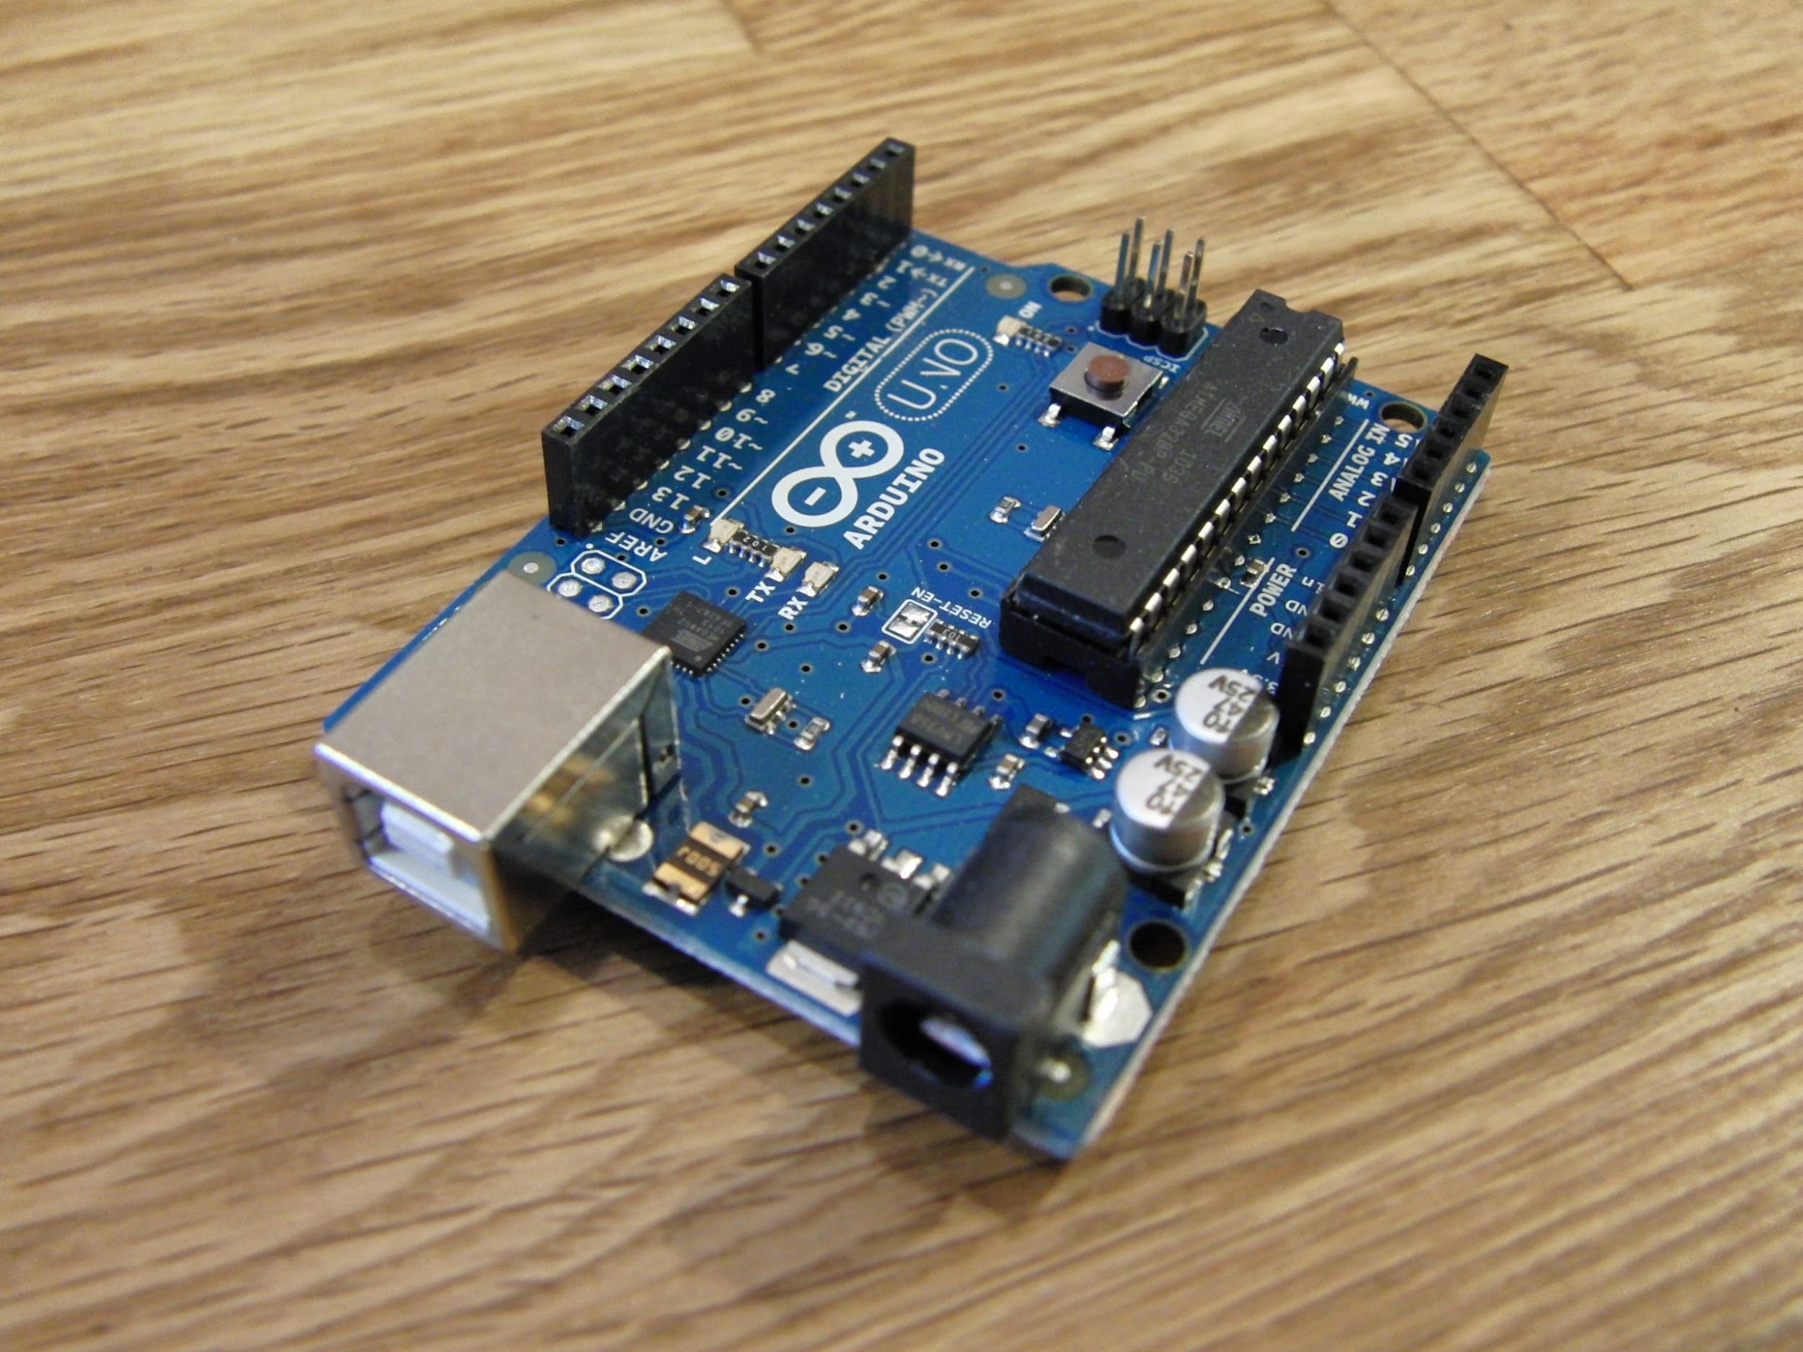
Hardware Analysis
The proposed system hardware shall consist of the following tools:
Arduino UNO microcontroller, DS18B20 is 1-Wire digital temperature sensor, Heart rate sensor , LCD i2c 16x2 display, ESP 8066 as for wifi module send sensor data to the web server , resistor for voltage control and jumper wires for connection.
Arduino UNO is a low-cost, flexible, and easy-to-use programmable open-source microcontroller board that can be integrated into a variety of electronic projects. This board can be interfaced with other Arduino boards, Arduino shields, Raspberry Pi boards and can control relays, LEDs, servos, and motors as an output.

Slide 18
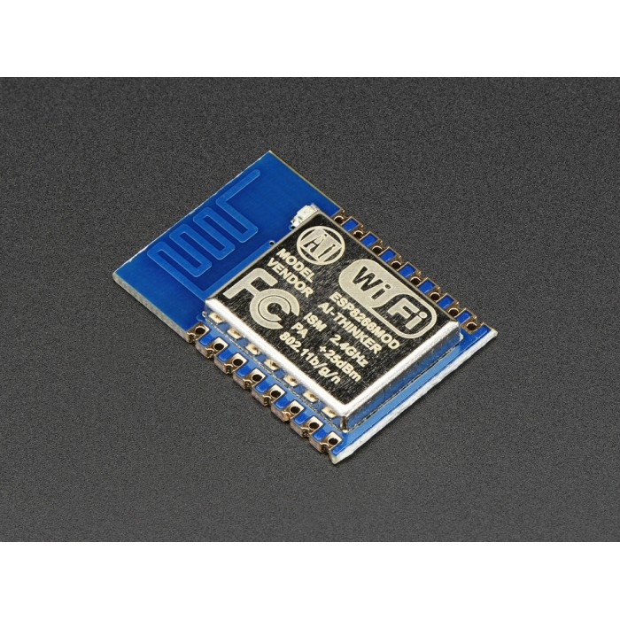
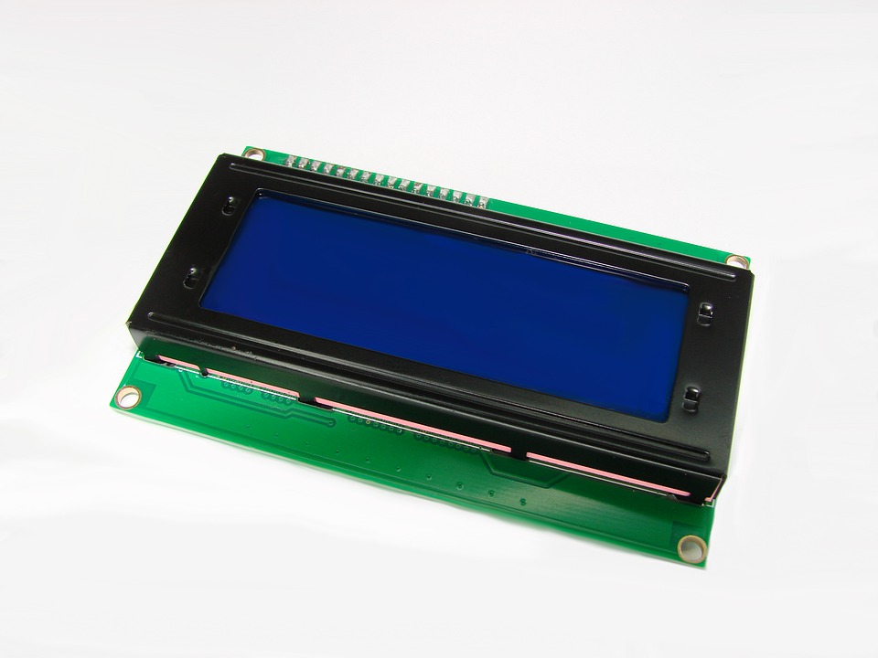
Hardware Analysis
The proposed system shall use I2C 16x2 Arduino LCD Screen since it only needs 4 pins for the LCD display: VCC, GND, SDA, SCL. It will save at least 4 digital/analog pins on Arduino. All connectors are standard XH2.54 (Breadboard type).It connects with the jumper wire directly.
ESP 8066 - low-cost Wifi microchip, with built-in TCP/IP networking software, and microcontroller capability.

Slide 19
Hardware Analysis
According to the components that are listed above, all are using only the same level of voltage. 5V DC voltage power supply for control unit, switching unit, sensing unit and display unit.
Selection of power supply
The selected power source is battery which is 12VDC. The aim of power supply is to convert 12V DC into 5V DC. The voltage regulator (L7805CV Positive Voltage Regulator) will take 12VDC from Battery and give Output of 5VDC.

Slide 20
SYSTEM DESIGN
06

Slide 21
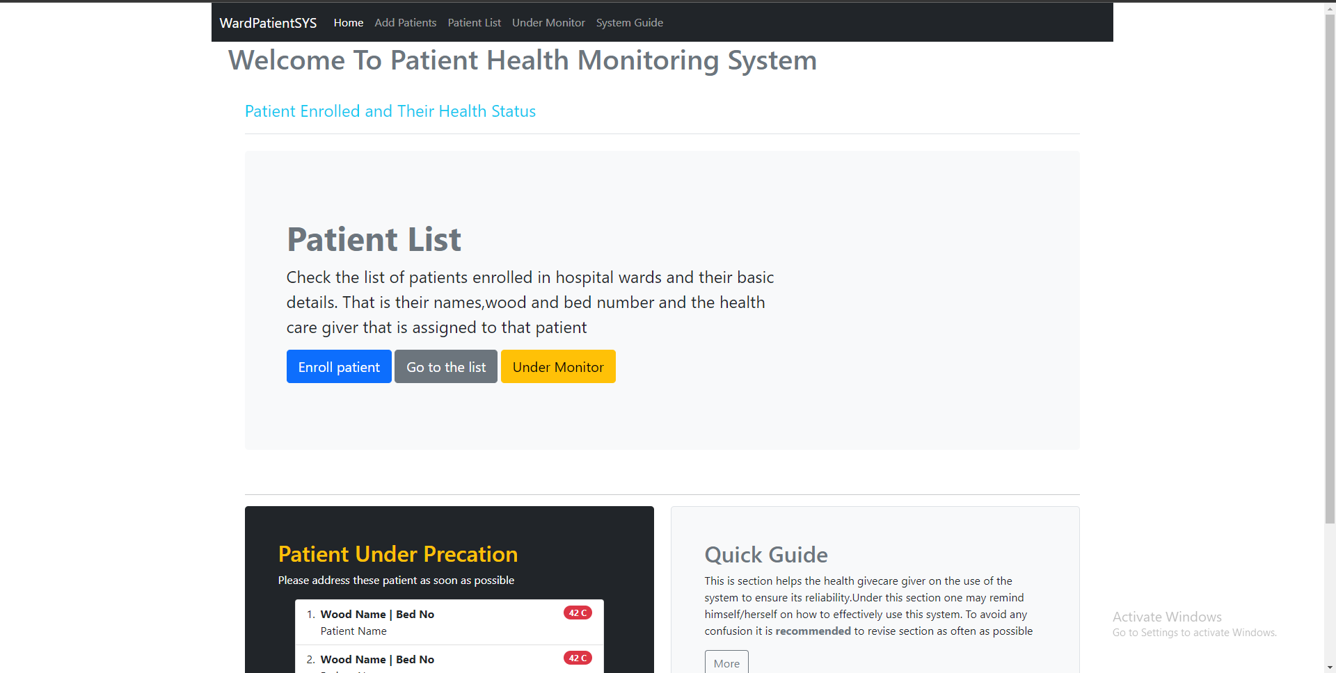
Web portal Designs
Home Page of the portal shall consist of form to add patient to the system to subject them to a monitoring action and the is a way to see patient list as well.

Slide 22
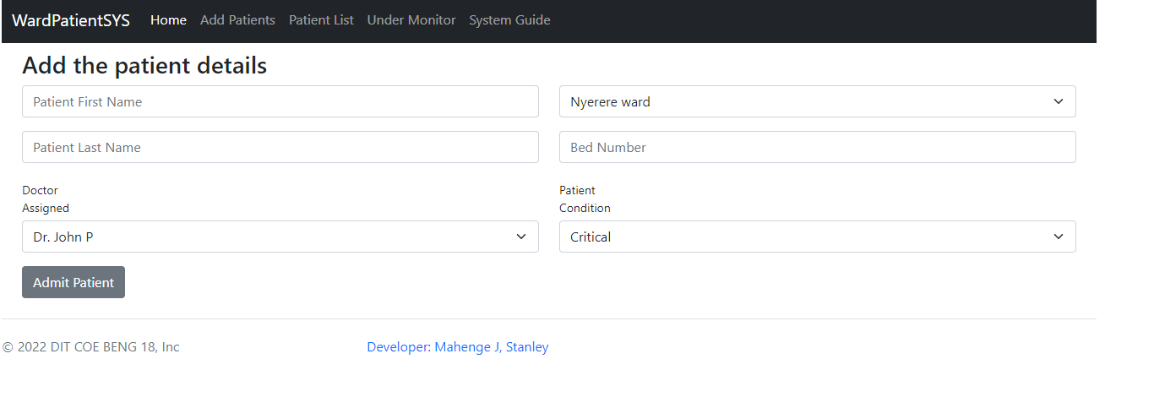
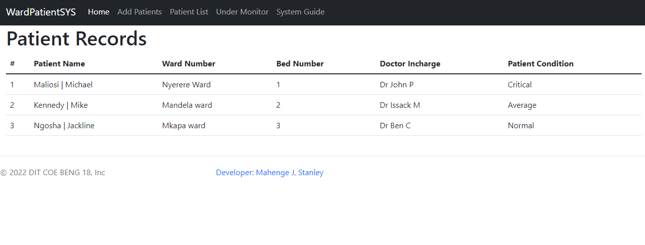
Web portal Designs
The web portal shall consist of form to add patient to the system to subject them to a monitoring action and the is a way to retrieve patient list and their details as well.

Slide 23
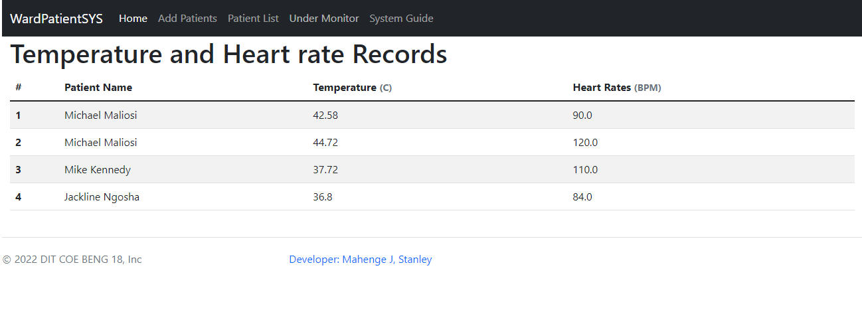
Web portal Designs
The web portal shall have the list of data of temperature and heart rate for each patient under monitoring process. As shown in the table below.

Slide 24
DEVELOPMENT
08

Slide 25
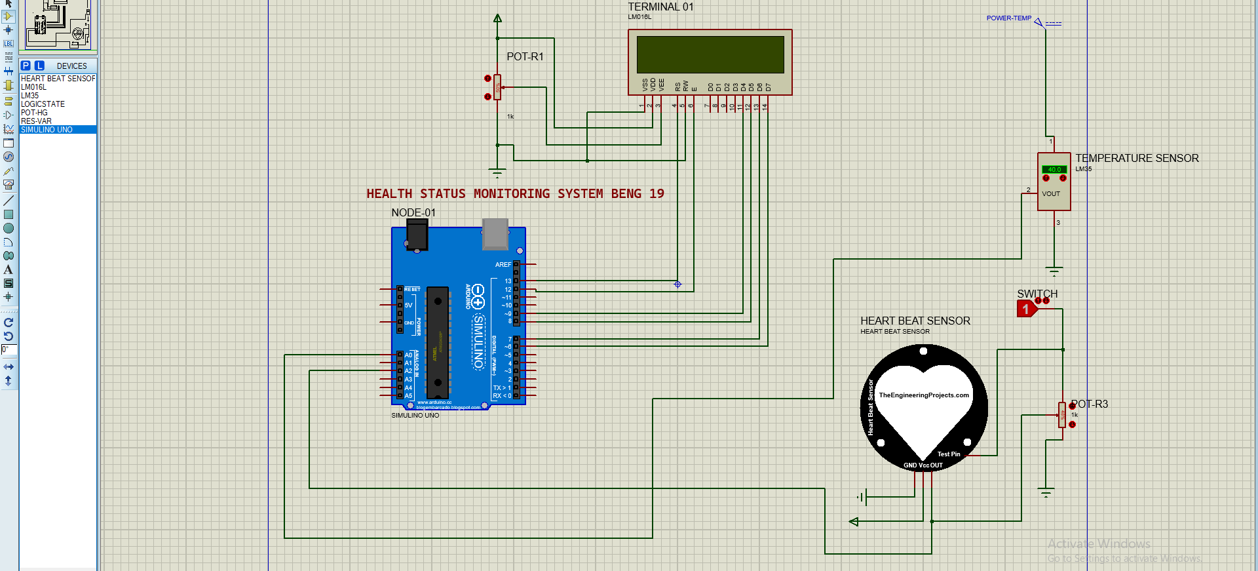
Temperature and Heart rate simulations
Tools used to simulate how the circuit for sensor will mine data from patient are :
Proteus 8 Professional where libraries for devices such as arduino UNO and heart rate had to be include in a program Library. Here is the circuit Design

Slide 26
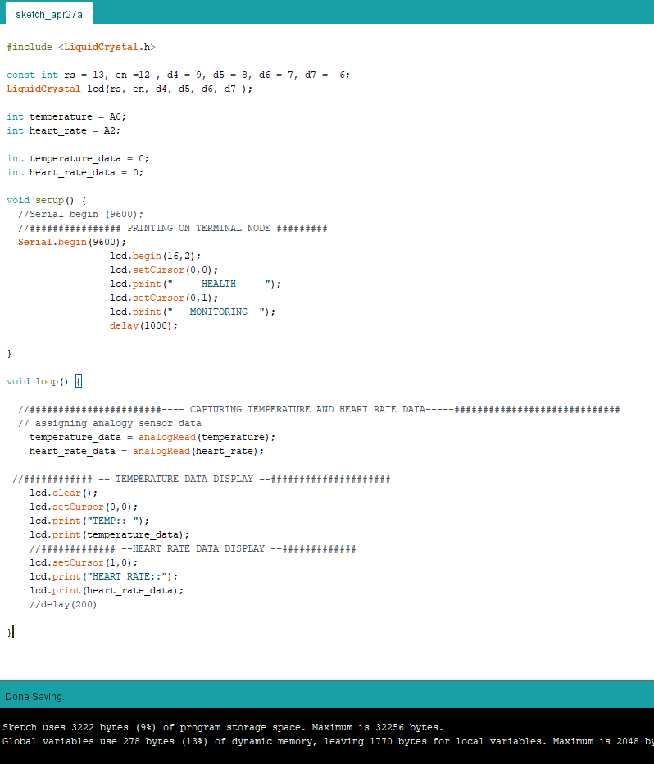
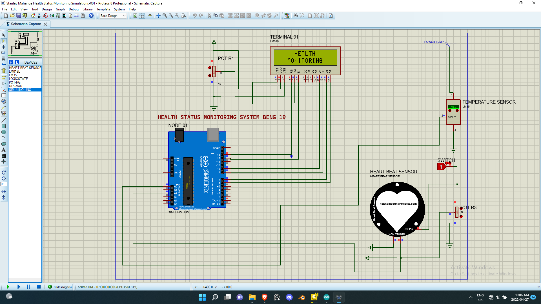
Temperature and Heart rate simulations
Using Proteus 8 professional simulation results here is the initial program plus the arduino code that allow the microcontroller to do its function.

Slide 27
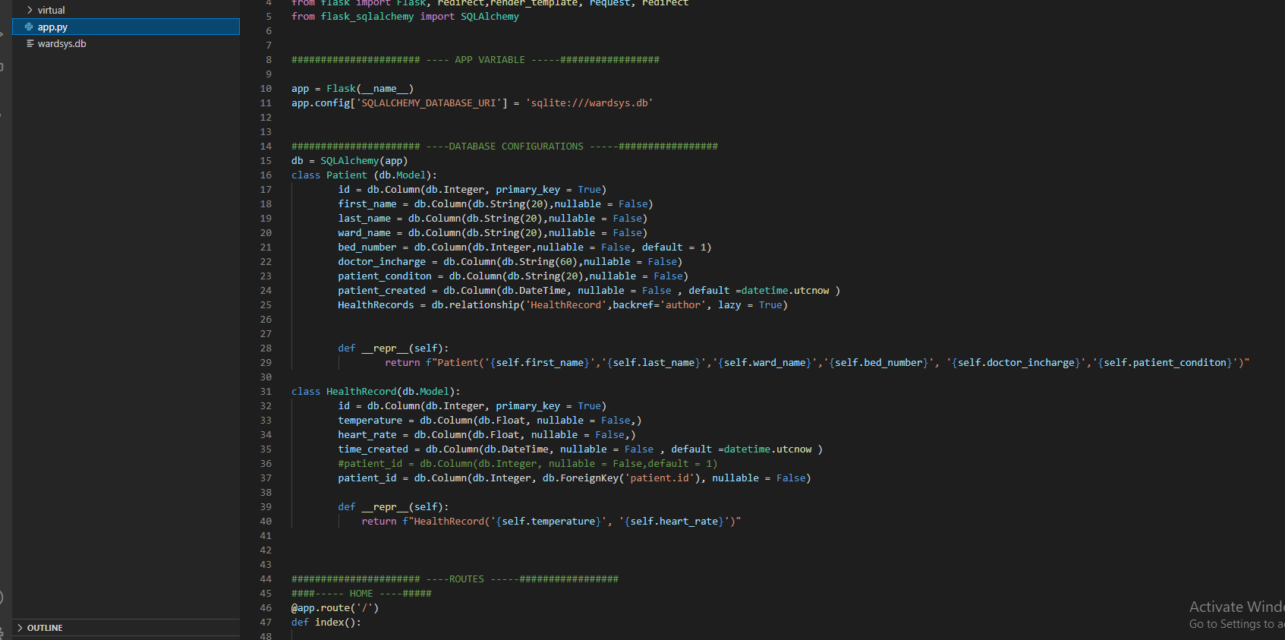
Database Schemas
Using Vs code to code the python for the flask to make an application that would run successful for the system. For the flask application here is the app file which is python file with all the app routes and logic - sqlAlchemy package to implement database schemas.

Slide 28
THANK YOU

