Slide 1

DAR ES SALAAM INSTITUTE OF TECHNOLOGY (DIT)
DEPARTMENT OF COMPUTER STUDIES
BACHELOR OF ENGINEERING IN COMPUTER ENGINEERING
PROJECT TITLE | : | PATIENT’S HEALTH STATUS MONITORING SYSTEM USING IoT
PROJECT TYPE | : | PROBLEM SOLVING
NAME OF CANDIDATE | : | STANLEY JUSTINE MAHENGE
ADMISSION NO. | : | 180230220303

Slide 2
PRESENTATION CONTENTS
01
02
03
04
06
07
08
05
Introduction
Problem Statement
Objectives
Significance
Literature Review
Data Analysis
Design Implementation
Testing

Slide 3
INTRODUCTION
01

Slide 4
Background Information
According to World Health(WHO), the Doctor to patient ratio in Tanzania is around 1:20000 where the average ratio is 1:300 that is one doctor has to attend a around 98% more than the average. To this date there are highly technological systems that are used for monitor patients in Hospitals. Systems such as ECG for heart rate monitoring, EEG for monitoring brain activities etc. these system are quite expensive. Thus, this proposed study comes with minimal designed and cost-effective system for the doctors to be able to effectively and instantly trace multiple patient healthy status that is their temperature and pressure within the hospital ward during his work session.

Slide 5
PROBLEM STATEMENT
02

Slide 6
Problem Statement
Due to smaller Doctor to Patient ratio there is a heavy burden on the doctors and healthcare giver to follow up the Healthy status of each individual patient admitted in ward. Large Distance between patient and physicians lower the quality of healthy services :- Since this is the matter of death and life

Slide 7
OBJECTIVES
03

Slide 8
Main Objective
To develop a low cost effective and flexible patient status health monitoring system using using Internet of thing. The system shall help the healthcare giver to get the time to time temperature and pressure of patients admitted in the wards.

Slide 9
Specific Objectives
To develop gadget of temperature and pressure sensors which will be as close as possible to the patient to mine the require patient datas.
To develop physician terminal and attending healthcare giver terminals where patients data shall be processed to be sent to the Hospital data pool.
To build a database driven web portal were patients data shall be stored, analysed and evaluated by healthcare giver for the effective follow up.

Slide 10
SIGNIFICANCE
04

Slide 11
Significance of the Study
The proposed system shall be able to provide the real time remote monitoring of the heartbeat and temperature with the integration of a way to notify the nurse about patient’s condition likewise to notify doctor incharge about abnormal condition of the patient.
The appropriately proposed system shall be useful to regional hospitals (or any other medical service center) where a lot of patients are admitted.
The system shall aim at reducing the distance between the patient and his attending physician by allowing the healthcare giver to have the analysed temperature and pressure of patient at their fingertips.

Slide 12
LITERATURE REVIEW
05

Slide 13
Reviews
The Internet of Things (IoT) is a newly emerging term for the new generation of the Internet which allows understanding between interconnected devices. IoT acts as an assistant in healthcare and plays an extremely important role in wide scopes of medicinal services observing applications. [1]
The exponentially growing healthcare costs coupled with the increasing interest of patients in receiving care in the comfort of their own homes have prompted a serious need to revolutionize healthcare systems. This has prompted active research in the development of solutions that enable healthcare providers to remotely monitor and evaluate the health of patients in the comfort of their residences. [2]
Clinical usefulness of existing measures might be demonstrated as clinical experience is broadened. At this time, however, it seems that new instruments, or adaptation of existing measures and scaling methods, are needed for individual-patient assessment and monitoring.[3]

Slide 14
Reviews
The significant challenges in the implementation of Internet of Things for healthcare applications is monitoring all patient's from various places. Thus Internet o Things in the medical field brings out the solution for effective patient monitoring at reduced cost and also reduces the trade-off between patient outcome and disease management.[4]
An elderly person should be monitored constantly, specifically if he or she is diagnosed for health-related problems before. In the proposed system, a patient's condition is monitored by using multimodal inputs, specifically, speech and video. Video cameras and microphones are installed in the smart homes; these sensors constantly capture video and speech of the patient, and transmit them to a dedicated cloud.[5]

Slide 15
Existing System
In general there are existing subsystem that are wearable things such as bracelets, caps, t-shirts (t-shirts), bands, glasses Wearable processes can be tailored to the "real body." These equipment has been used to contact the person who is to be monitored, personal health and the information gathered which has been sent to the central and internal research centre. Most of these involves monitoring the patient healthy by attending physician.
Wearable devices may provide natural statistics, including calories, steps, heart rate, blood pressure; time spent exercising, and so on. The effect on these devices is enormous and of course very strong, which has a good focus on monitoring the physical health of users.

Slide 16
Existing System
Considering various wearable devices such as Pulse Oximetry:-tests the oxygen saturation level of the human body and monitors the difference in the skin blood flow associated with the cardiac cycle. Electrocardiography (ECG):-waveform that monitors the heart continues to function and provides time information. Blood Pressure:-energy used by blood pumping into the blood vessels helps to quantify it. Glucose Monitoring:- transplant device for body sugar levels tracking. Implantable Neural Stimulators:- device for electrical stimulation trigger electric impulses to relieve chronic pain in the human spinal cord or brain.
All of these subsystems work at level that is not in a case where the physician has to attend and do a follow up on multiple patients. Far from that the efficiency of these subsystem are not guaranteed. Theres is no data evaluation and analysis.

Slide 17
Existing System
Data flow chart
Mode of patient health status management that is current used in regional hospitals is that
SENSORS
PROCESSOR CHIP
DISPLAY

Slide 18
Proposed System
IoT refer to the network of physical object-linked devices that allow remote devices to hear, analyze, and monitor. The computational mechanism for linking computer hardware to allow communication between sensors and smart sewing equipment. IoT implementations in IoT data processing rely heavily on the five layer which are perception layer-sensors as data minors, broadcasting layer -transportations and networking, middle layer - processing of data and application layer- analysis.
The role of 'IoT in healthcare' is to reduce maintenance burden, followed by an increase in the chance of healthcare. The addition individual and online health care network was great learning experience and anticipated that mobile information and general technology killing applications would lead to the development of cloud health services..

Slide 19
Proposed System
The proposed system sensors shall be used to mine patient details that is temperature and pressure. The physician can provide adequate guidance on health care. Increased monitoring is required for IoT devices commonly used for disabled patients. Monitoring strategies, through the assistance of the sensors, have been collected to maintain a constant material movement by the patients referred to there for physicians. In turn, this enhances care quality. In the end, this leads to care costs.
The proposed system shall have the wearable sensor to mining the patient's temperature and blood pressure. With help of wireless network the individual patient’s data shall be move to the Terminal such as attending Physician and nurse terminal in real time.
A hospital web portal shall be able to gather and store all admitted patient in all wards, any flacturation from normal human blood pressure and temperature will automatically results into alert system as shown in next flowchart.

Slide 20
Proposed System
Data flow and system model:
Wearable sensors
Sensor gateway
Processing Terminals
Hospitals
Patient data pools
Mobile services
Web interfaces
Emergency response management

Slide 21
DATA ANALYSIS
06

Slide 22
Data Analysis
Since the case study of the proposed system center itself within Jakaya Cardiac Institute with the following data:
General wards can be occupied by 33 patients while the rest of the wards has maximum capacity of 10 patients.
The average number of health care giver per shift per ward is 3 to 5 nurses and 2 doctors.
Hospital
7
Patient wards
4
General purpose
2
Intensive care
1
VIP

Slide 23
System Data Flow
The system data starts from the time a patient is admitted in the ward. The nurse incharge is obliged to record the necessary information of a patient as he or she is admitted in the given ward.
Patients records
Name and ID
Patient Record
Ward + Bed No.
Doctor in charge
Status Condition

Slide 24
System Data Flow
The system shall be able to provide the a mechanism for a nurse to register the sensors available in the given hospital wards. These sensor shall be identified by their special ID provided by the system which shall based on which ward the sensor is register and for which bed number.
Sensor registering
UniqueID
Sensor Node
Bed Number
Ward Name

Slide 25
System Data Flow
The system shall be able to provide the real time remote monitoring of the heartbeat and temperature with the help of sensors. Each sensors will have the records on the database / Hospital data pools.
Sensor Data -
Temperature
Sensor Record
Heart Rate
SensorID

Slide 26
Data Relationship
The system data relationships involve the integration of all data to ensure the full functionality of the system.
Any patient at a critical condition is assigned a given sensor. That sensor mined the data records of the given patient and stores in the database.
Relationship
critical condition
Assigned
Recorded
Patient
Sensor
Sensor data
Temperature
Heart Rate

Slide 27
IMPLEMENTATION
07

Slide 28
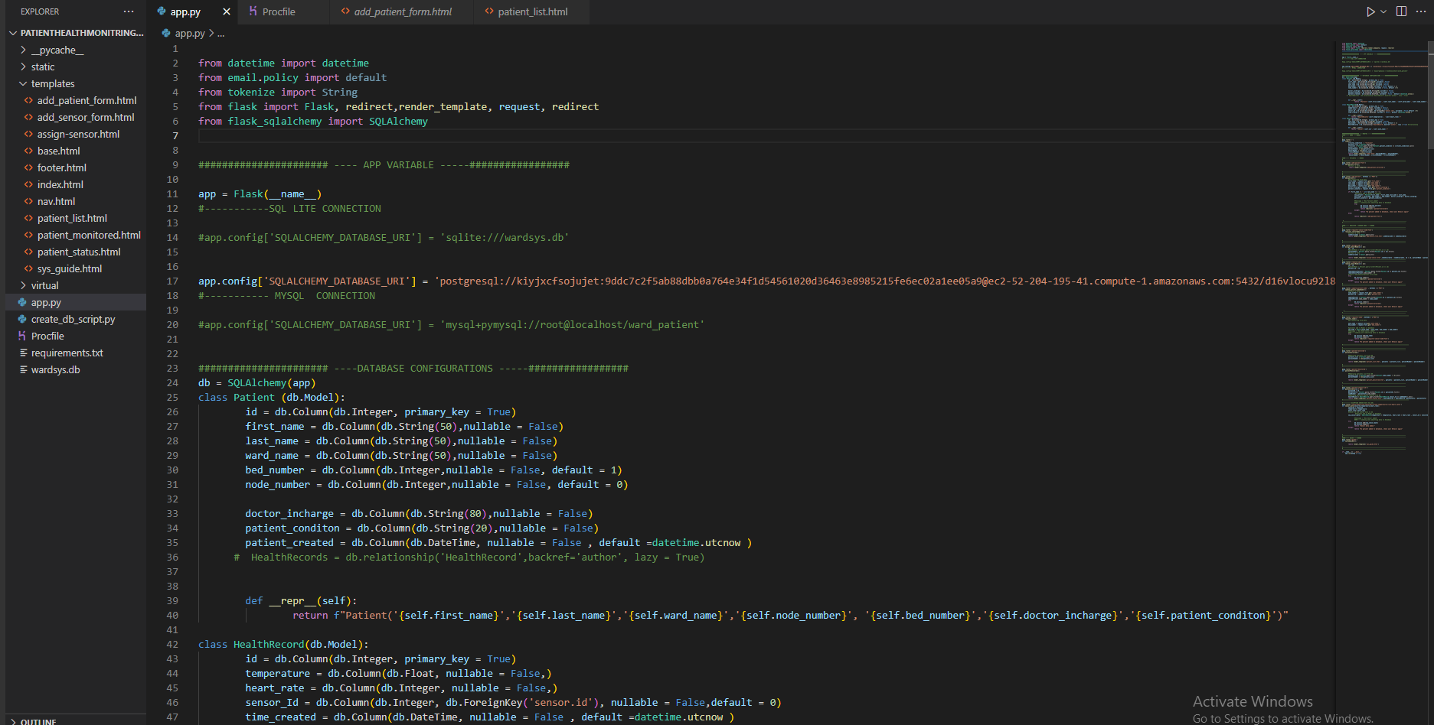
Development and Design
The system consist of Web portal that shall be used by health care giver to check the patient status and progress.
Web system Development and python Coding file using Flask Framework.

Slide 29
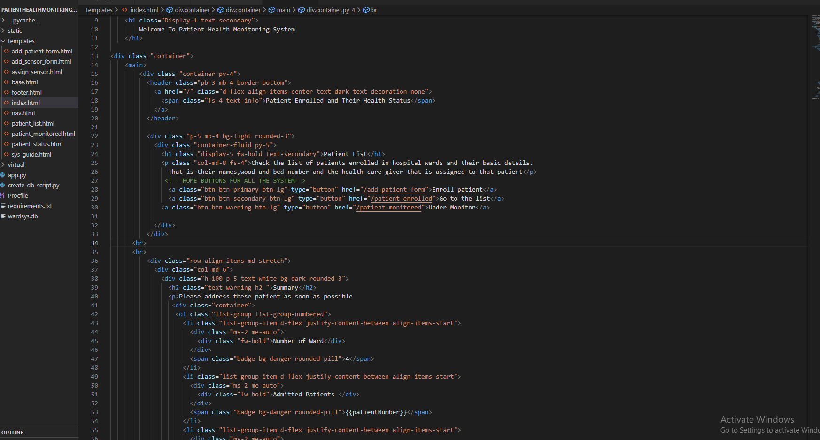
Development and Design
UI -User interface using HTML and bootstrap CSS to develop a robust and cleaner user experience where the healthy caregiver will be able to interact with system.

Slide 30
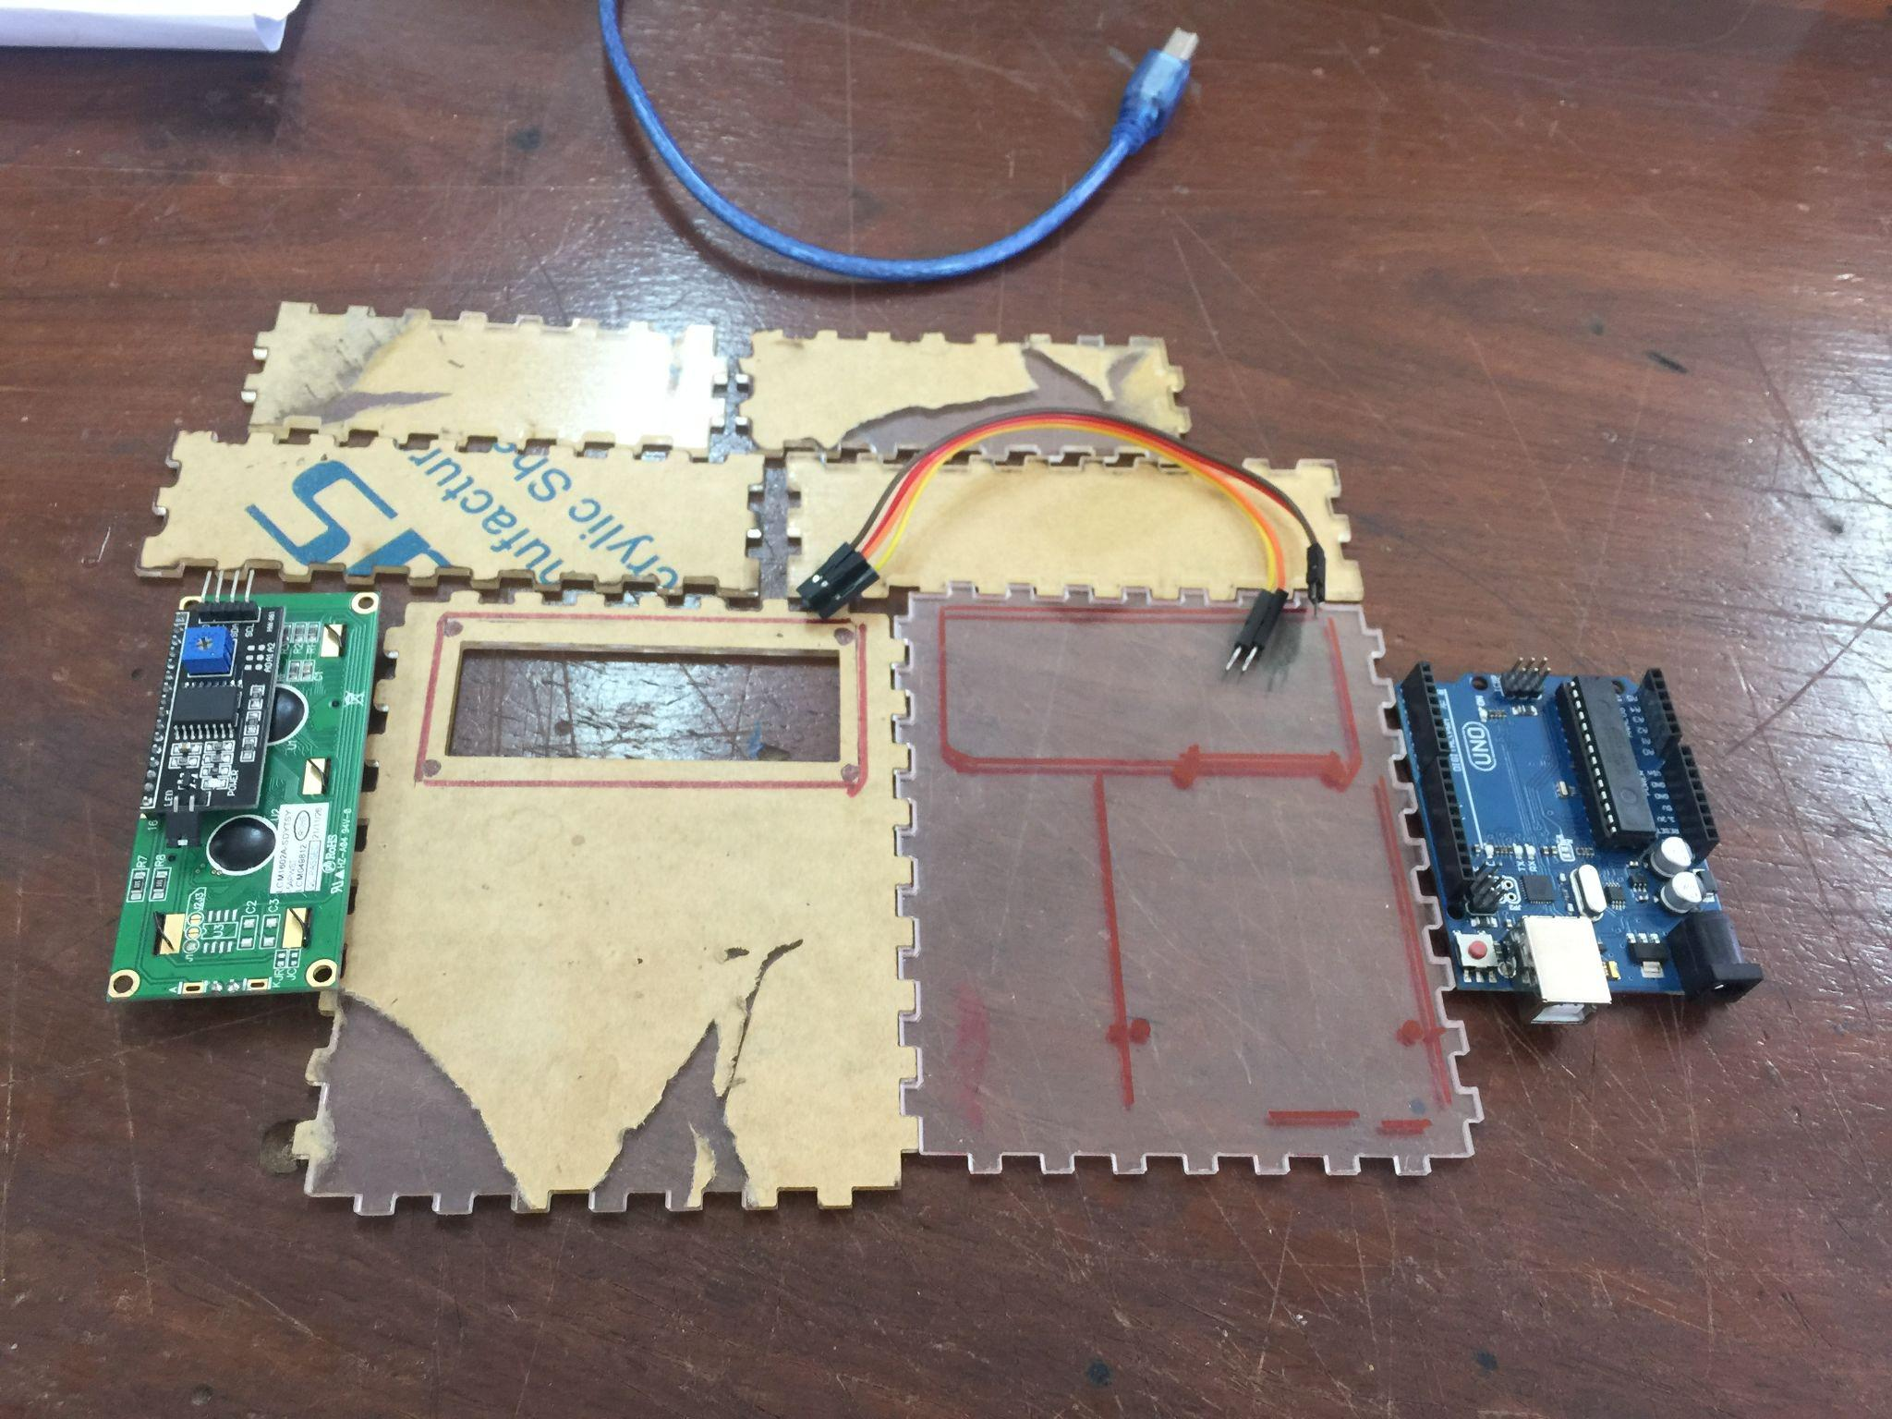
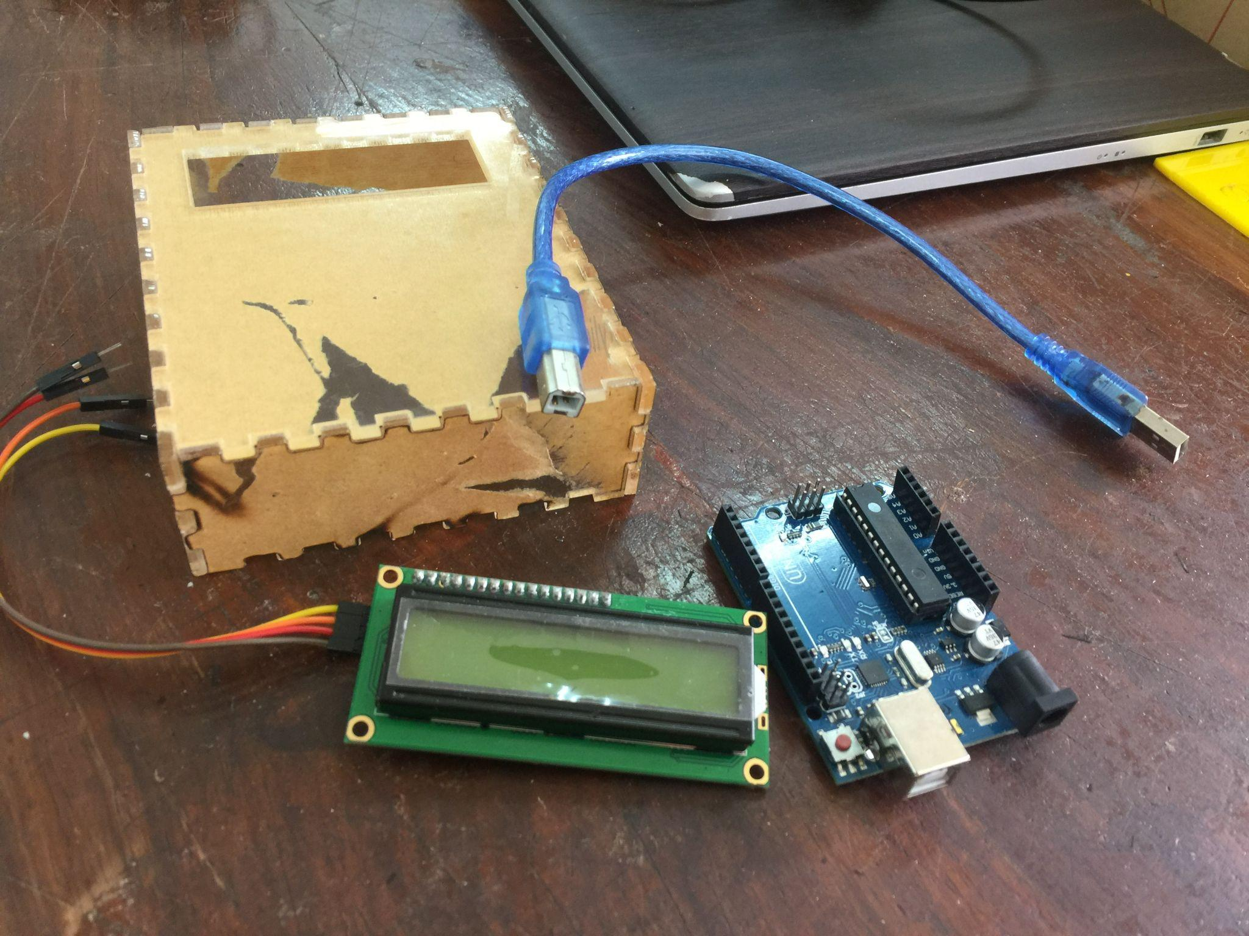
Hardware Design
Hardware design involves the process of gathering the required component for embedded system to work.
Design a enclosure case for microcontroller as first terminal for the health caregiver

Slide 31
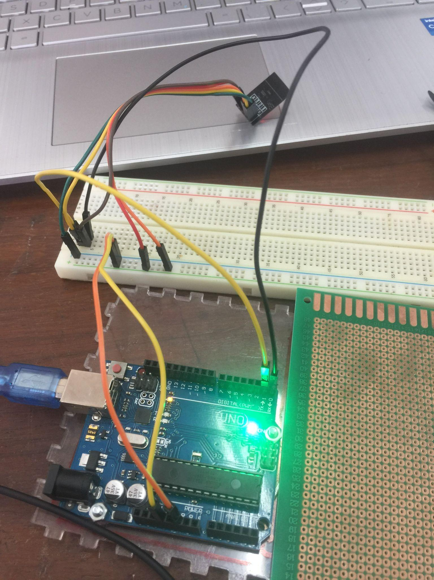
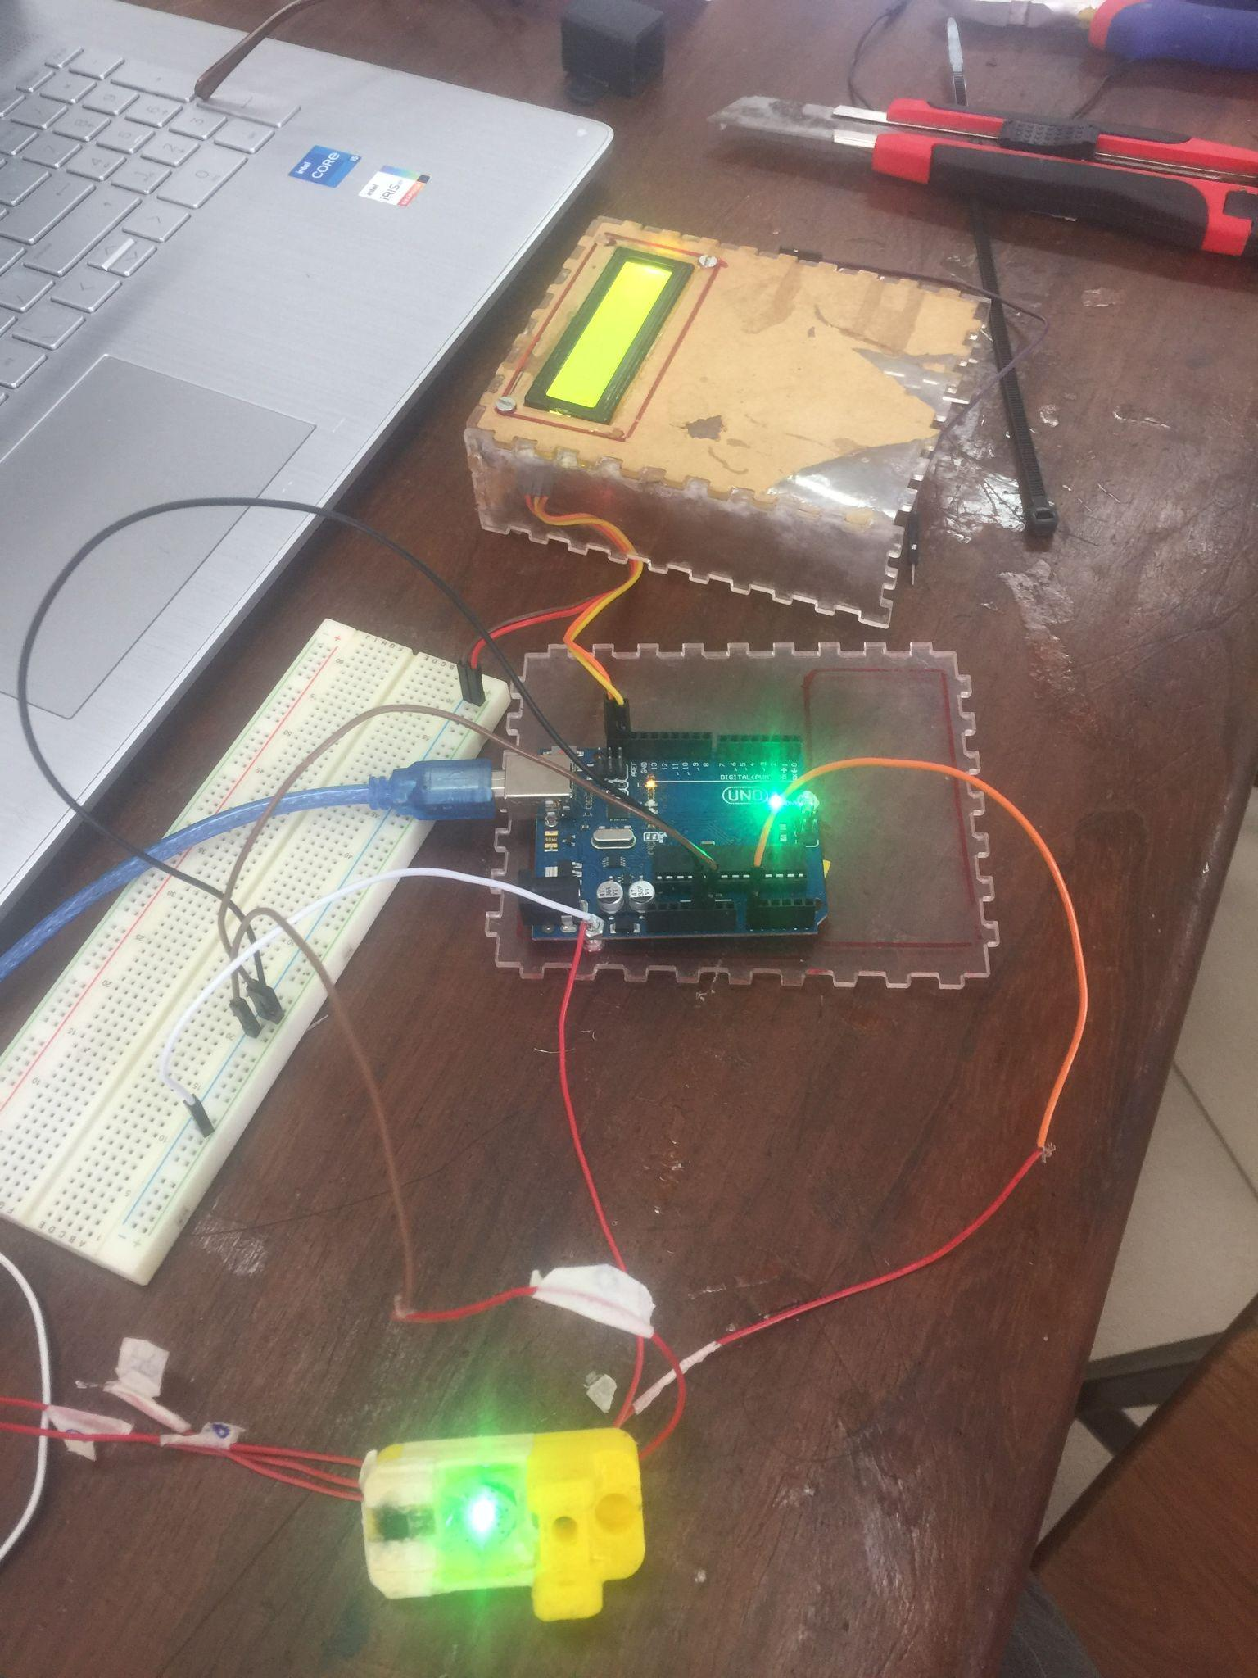
Hardware Design
Hardware design furthermore include configuring the hardware component to be able to communicate to one another. This involved arduino to Lcd Display and arduino to sensors

Slide 32
TESTING
08

Slide 33
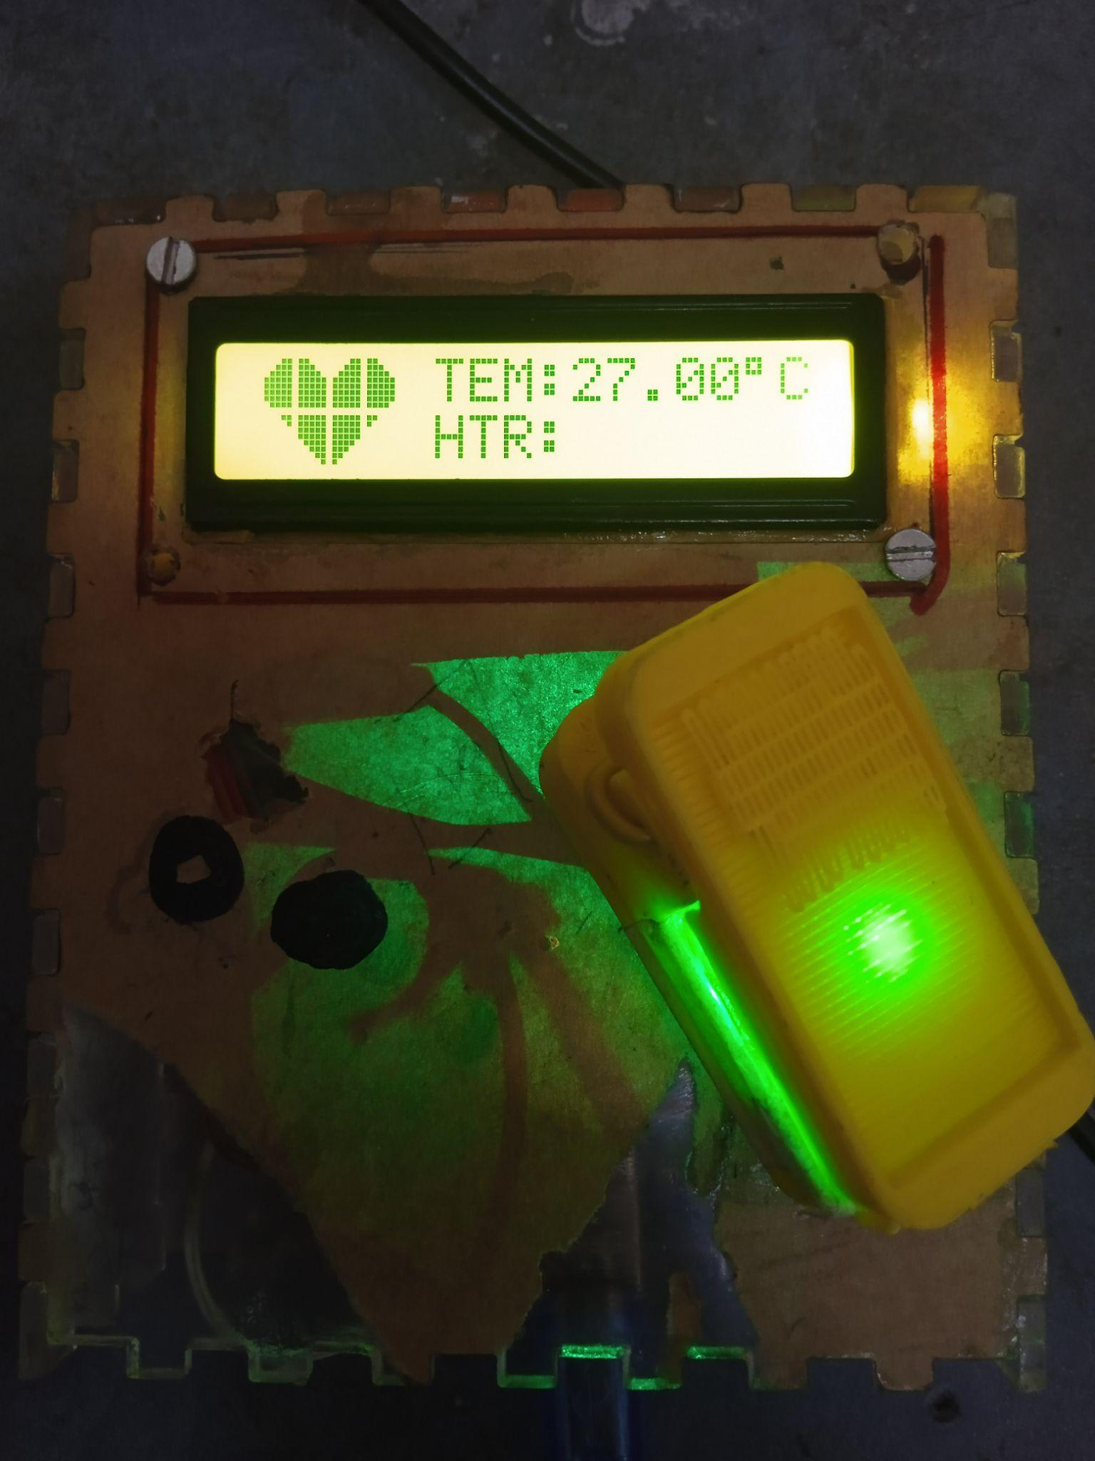
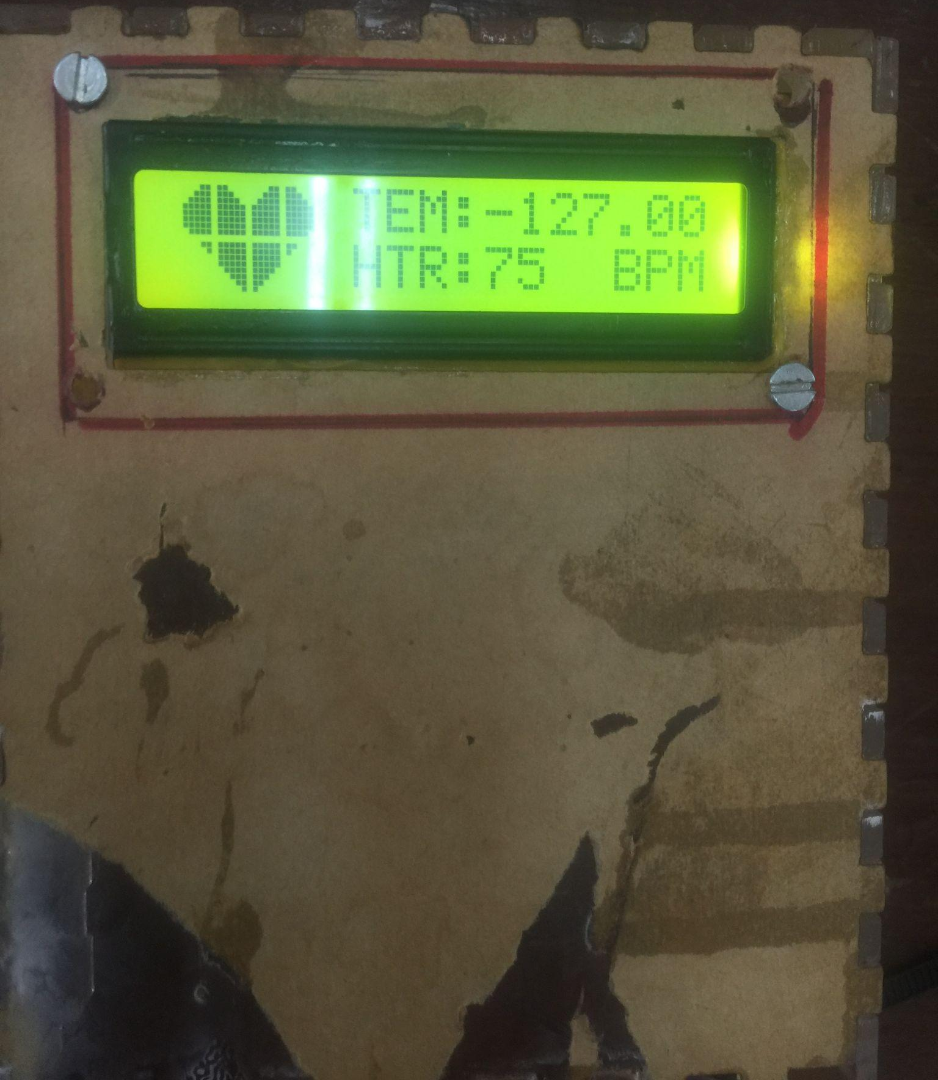
System Testing
The system should be able to mine the patient temperature and heart rate and send them to a web port database of a corresponding patient assigned to that given patient.
Unit testing and General testing of the system.

Slide 34
THANK YOU

