Slide 1

MASTER 1 · COMPUTER SCIENCE
Shortest Path in a Directed Weighted Graph
Teaching Dijkstra's Algorithm through Problem-Based Inductive Learning
PEDAGOGICAL SESSION PRESENTED FOR THE MCF AUDITION
Presented by Mr. BENHELAL Mehdi Salim
Page 1

Slide 2




ABOUT THIS SESSION
2 / 21
Session at a glance
AUDIENCE
LANGUAGE
DURATION
First-year Master students
English
1h30 teaching session
Computer Science
All material delivered in English
Single session, in-class
APPROACH
Problem-based inductive
Discovery → formalization
Dijkstra's Algorithm | Problem-Based Inductive Learning
Master's in Computer Science

Slide 3
SESSION OVERVIEW
4 / 21
Learning outcomes
By the end of the session, students will be able to:
1
Model a routing problem as a directed weighted graph G = (V, E)
2
Execute Dijkstra's algorithm step by step
3
Reconstruct the shortest path using the predecessor function π
4
Justify why the algorithm works for non-negative weights w(u,v)
5
Identify applications and limitations
Dijkstra's Algorithm | Problem-Based Inductive Learning
Master's in Computer Science

Slide 4

COURSE CONTEXT
5 / 21
Course context
Shortest Path in a Directed Weighted Graph
Expected prerequisites
Pedagogical adaptation
Students are expected to know:
The opening example is contextualized through connected-device routing to make the algorithm meaningful for IoT-oriented students.
directed graphs G = (V, E)
vertices, edges and positive integer weights w(u,v)
adjacency lists and adjacency matrices
basic graph traversal (BFS, DFS)
priority queues
IoT-oriented
Dijkstra's Algorithm | Problem-Based Inductive Learning
Master's in Computer Science

Slide 5
PEDAGOGICAL APPROACH
6 / 21
Pedagogical choice
Problem-based inductive approach
01
02
03
04
why a shortest-path algorithm is needed
why intuitive strategies may fail
how the formal algorithm solves the problem
how the method transfers to realistic routing contexts
Teaching sequence
1
2
3
4
5
6
Start from a concrete routing problem
Let students propose intuitive strategies
Compare strategies and identify limitations
Introduce the need for a systematic algorithm
Formalize Dijkstra's algorithm and validate it
Discuss applications and limitations
Dijkstra's Algorithm | Problem-Based Inductive Learning
Master's in Computer Science

Slide 6

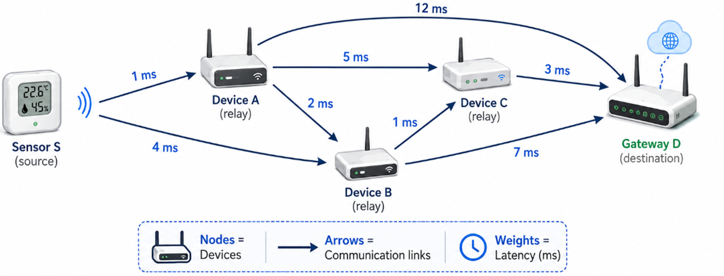
OPENING PROBLEM
7 / 21
Opening problem : Connected-device routing
A message must be sent from a source device S to a target gateway D. We want to minimize total latency.
Nodes
represent sensors, devices or gateways
Directed edges
represent communication links
Weights
represent latency (ms)
Goal
minimize total latency from S to D
Dijkstra's Algorithm | Problem-Based Inductive Learning
Master's in Computer Science

Slide 7

OPENING PROBLEM
8 / 21
Example and student activity
QUESTION TO STUDENTS
Which route should the message follow?
Path | Edges | Cost
S → A → D | 2 | 13
S → B → D | 2 | 11
S → A → C → D | 3 | 9
S → A → B → C → D | 4 | 7 ✓
EXPECTED TAKEAWAY
The 4-edge path is the cheapest. “Fewest hops” fails because edge weights matter.
Activity sequence: 1. Quick vote → 2. Pair discussion → 3. Cost comparison → 4. Name the failed intuition
Dijkstra's Algorithm | Problem-Based Inductive Learning
Master's in Computer Science

Slide 8

FROM INTUITION TO FORMALIZATION
9 / 21
From intuition to Dijkstra
The activity shows that students need to store:
Key concepts
the best known distance from S to each node
1
tentative distance
dist(v) — current best estimate
the predecessor of each node
2
edge relaxation
dist(v) ← dist(u) + w(u,v) if shorter
the next node to process
predecessor table
3
π(v) — used to rebuild the path
systematic distance updates
priority queue
4
extracts the node with minimum dist
Dijkstra's Algorithm | Problem-Based Inductive Learning
Master's in Computer Science

Slide 9
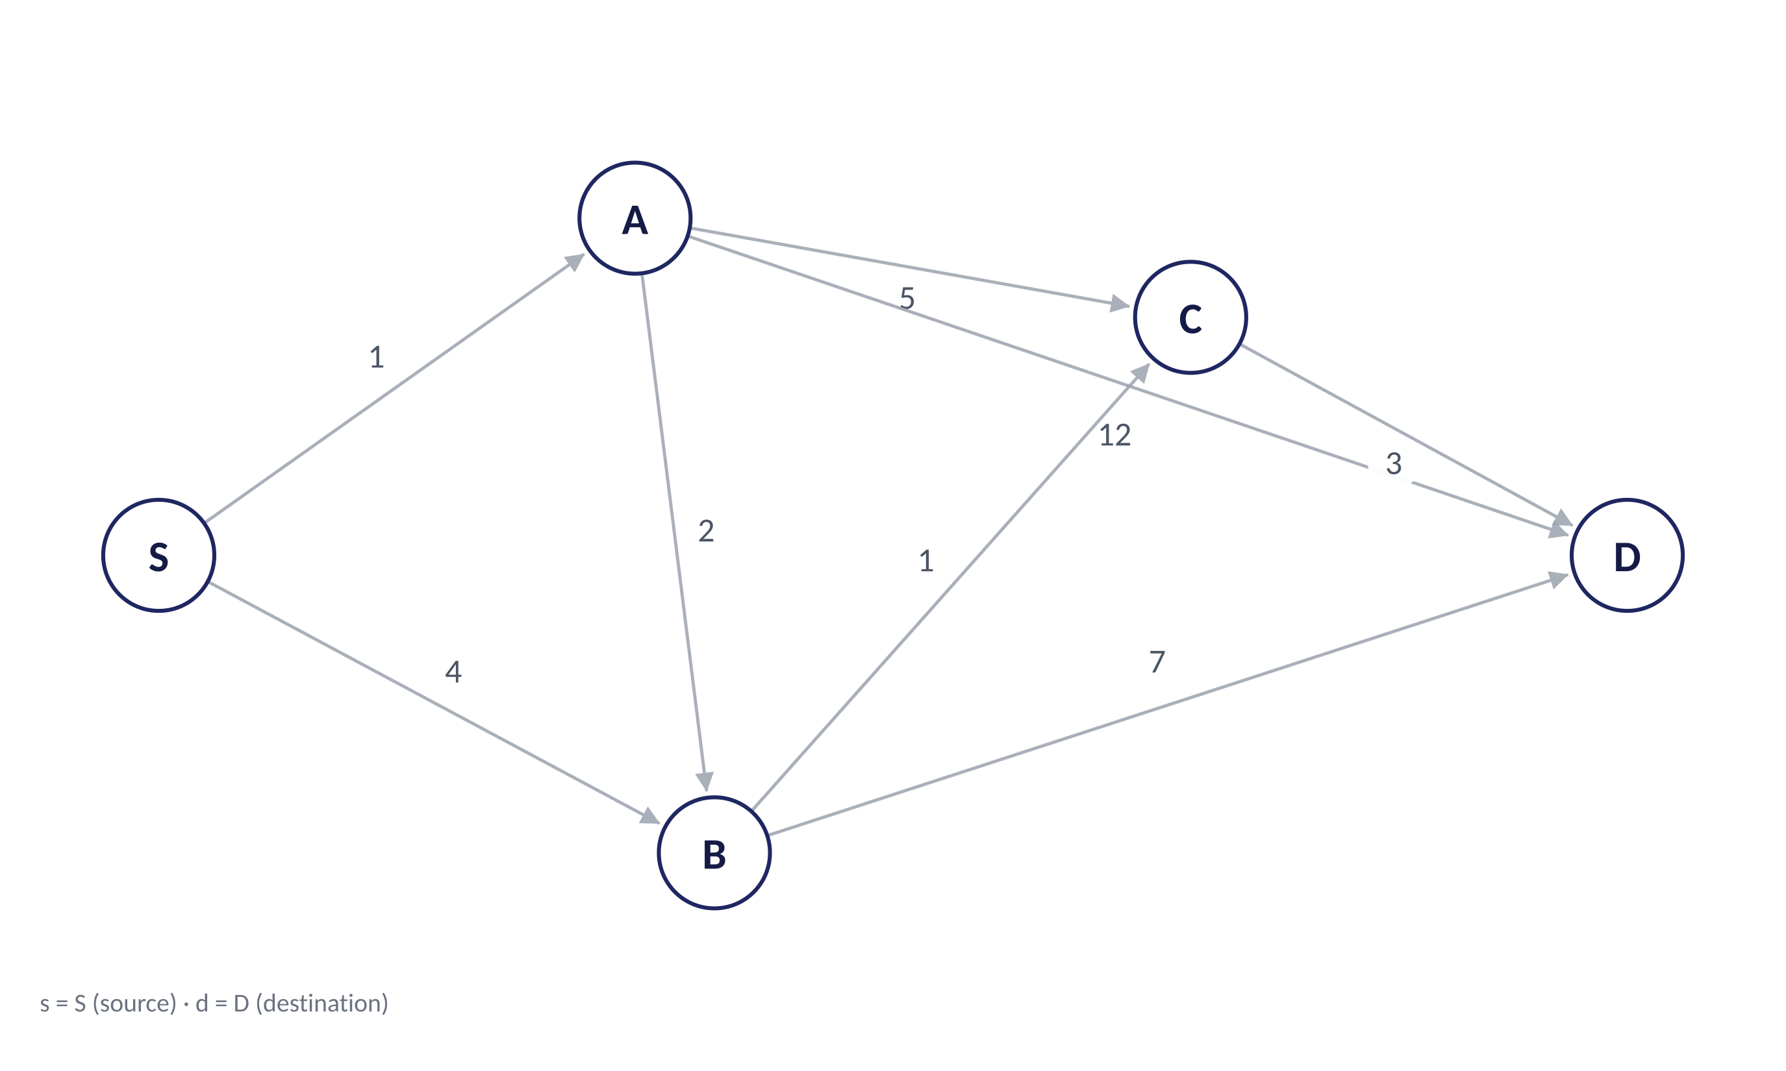


STEP-BY-STEP EXECUTION
10 / 21
Dijkstra — formal execution state
V = {S, A, B, C, D}; F = ∅; Q = V
Formal state
Initialization: dist(s)=0; ∀v ∈ V\{s}, dist(v) = ∞; π(v) = ⊥.
V = {S, A, B, C, D}
F = ∅
Q = V \ F = {S, A, B, C, D}
select: u = S (because dist(S) = 0)
Relaxation: if dist(u) + w(u,v) < dist(v), dist(v) ← dist(u) + w(u,v), π(v) ← u
Distance / predecessor functions
v | dist(v) | π(v) | v ∈ F
S | 0 | ⊥ | –
A | ∞ | ⊥ | –
B | ∞ | ⊥ | –
C | ∞ | ⊥ | –
D | ∞ | ⊥ | –
Step 0 / 6
Restart
Next step
Dijkstra's Algorithm | Problem-Based Inductive Learning
Master's in Computer Science

Slide 10
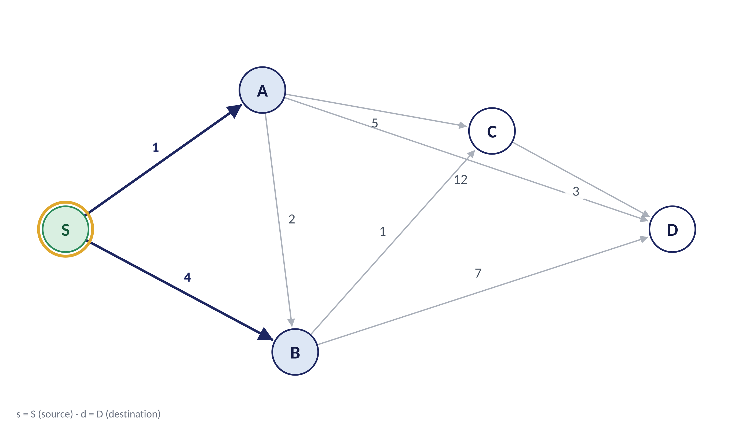

STEP-BY-STEP EXECUTION
11 / 21
Step 1 — select S
F = {S}; Q = {A, B, C, D}
Formal state
F ← F ∪ {S}; relax (S,A) and (S,B): dist(A) = 1, dist(B) = 4.
V = {S, A, B, C, D}
F = {S}
Q = V \ F = {A, B, C, D}
select: u = S (dist(S) = 0 is the minimum in Q)
Relaxation: if dist(u) + w(u,v) < dist(v), dist(v) ← dist(u) + w(u,v), π(v) ← u
Distance / predecessor functions
v | dist(v) | π(v) | v ∈ F
S | 0 | ⊥ | ✓
A | 1 | S | –
B | 4 | S | –
C | ∞ | ⊥ | –
D | ∞ | ⊥ | –
Step 1 / 6
Restart
Back
Next step
Dijkstra's Algorithm | Problem-Based Inductive Learning
Master's in Computer Science

Slide 11
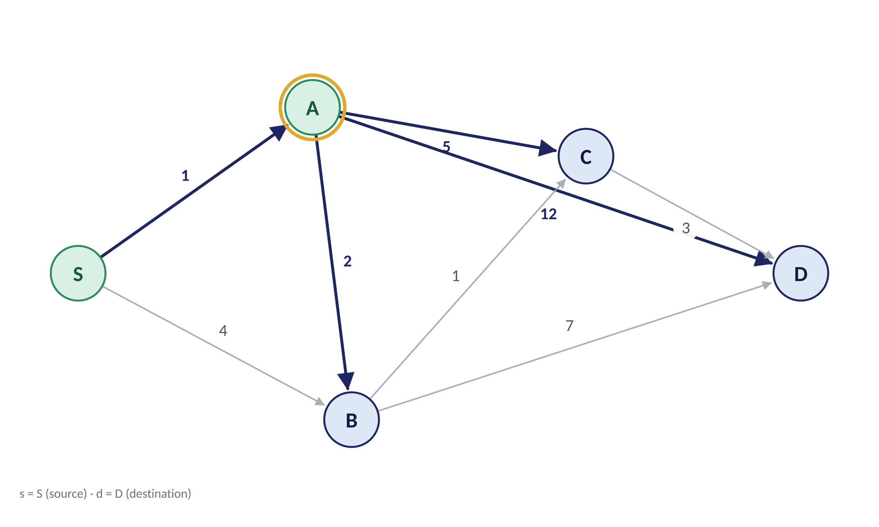
STEP-BY-STEP EXECUTION
12 / 21
Step 2 — select A
F = {S, A}; Q = {B, C, D}
Formal state
F ← F ∪ {A}; relax A→B, A→C, A→D. B improves: 4 → 3.
V = {S, A, B, C, D}
F = {S, A}
Q = V \ F = {B, C, D}
select: u = A (dist(A) = 1 is the minimum in Q)
Relaxation: if dist(u) + w(u,v) < dist(v), dist(v) ← dist(u) + w(u,v), π(v) ← u
Distance / predecessor functions
v | dist(v) | π(v) | v ∈ F
S | 0 | ⊥ | ✓
A | 1 | S | ✓
B | 3 | A | –
C | 6 | A | –
D | 13 | A | –
Step 2 / 6
Restart
Back
Next step
Dijkstra's Algorithm | Problem-Based Inductive Learning
Master's in Computer Science

Slide 12
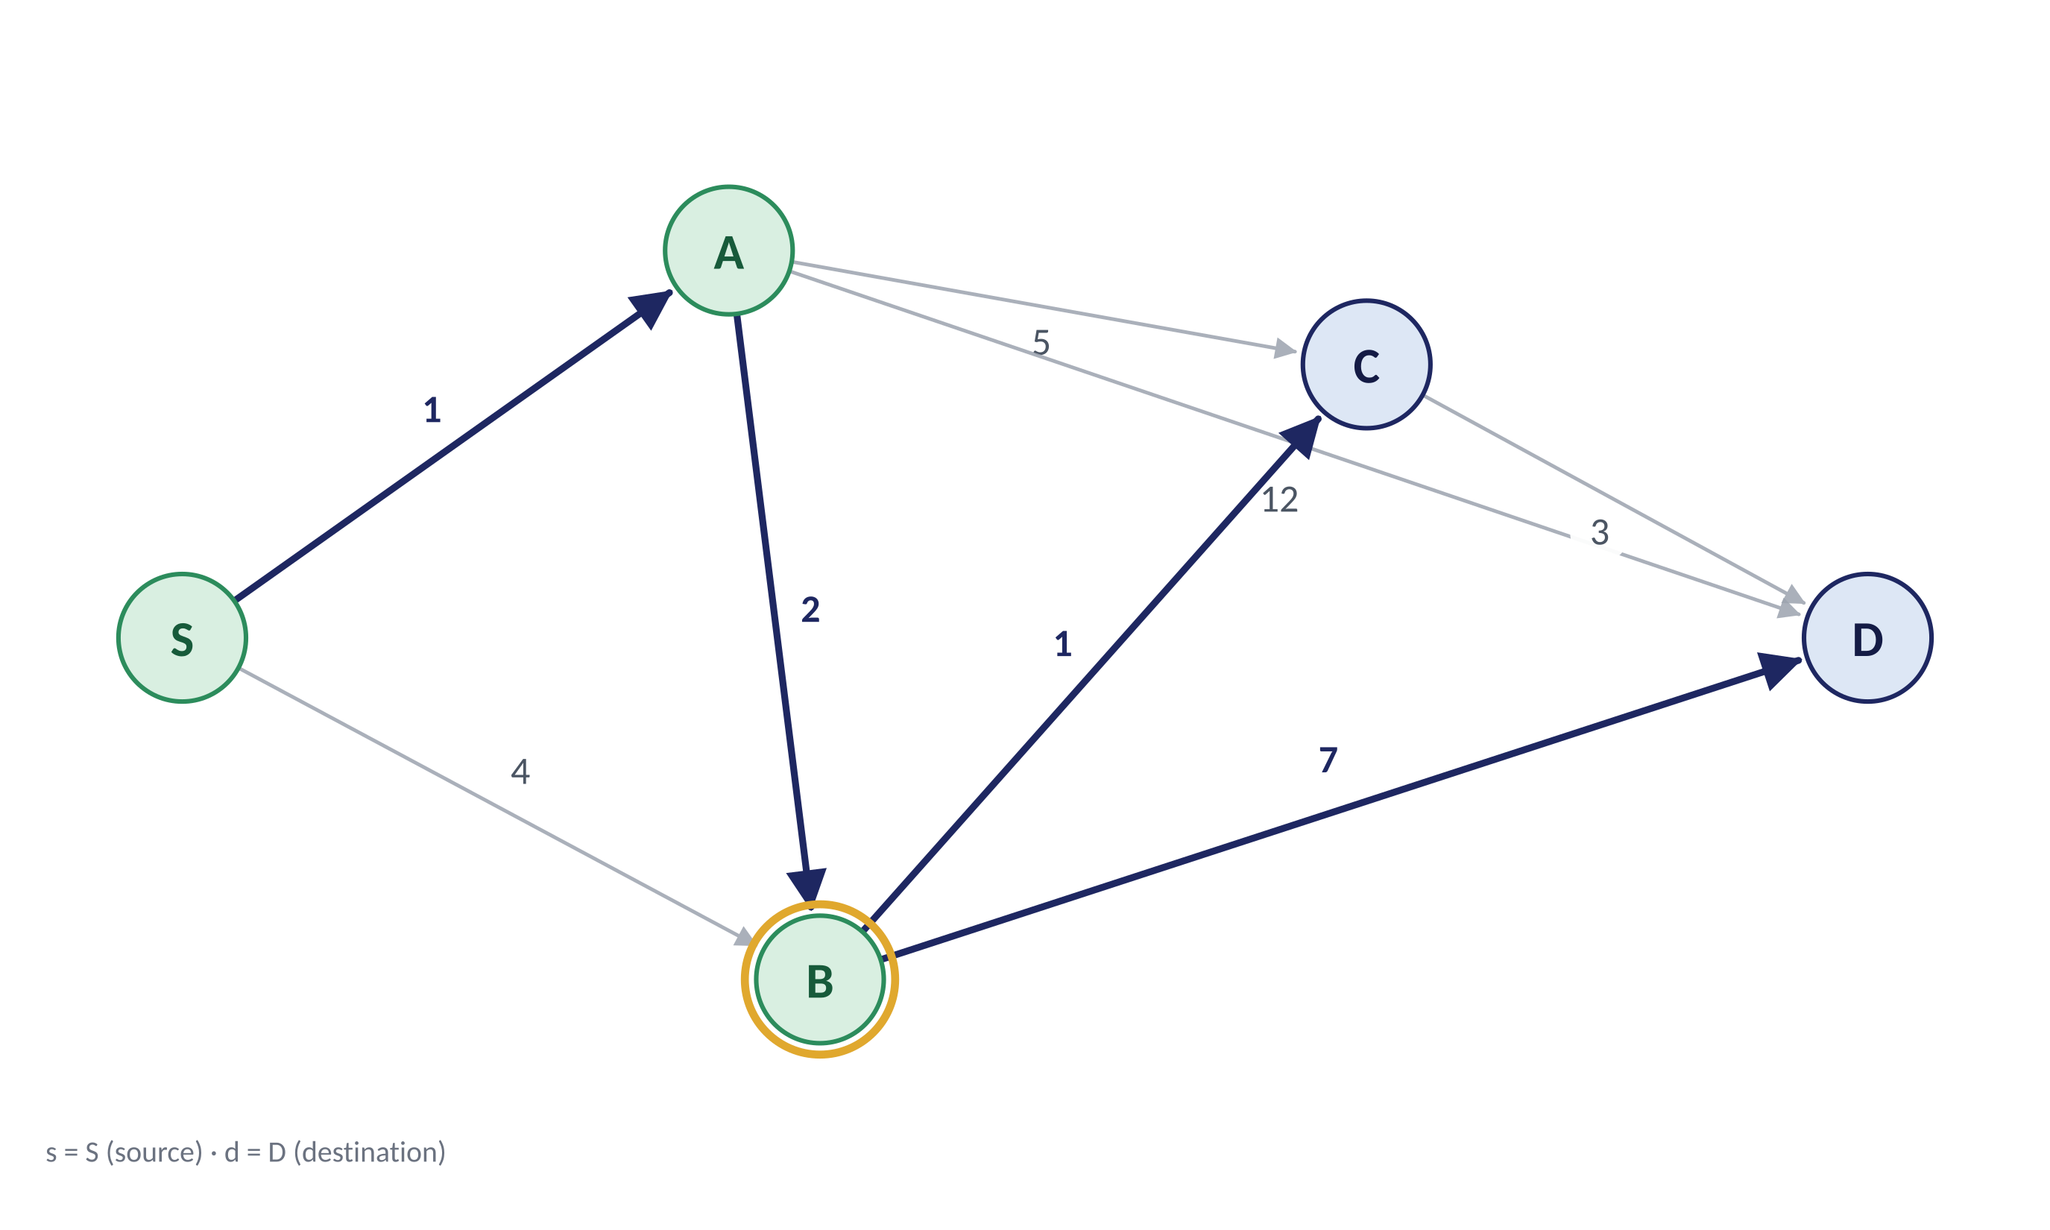
STEP-BY-STEP EXECUTION
13 / 21
Step 3 — select B
F = {S, A, B}; Q = {C, D}
Formal state
F ← F ∪ {B}; relax B→C and B→D. C improves: 6 → 4; D improves: 13 → 10.
V = {S, A, B, C, D}
F = {S, A, B}
Q = V \ F = {C, D}
select: u = B (dist(B) = 3 is the minimum in Q)
Relaxation: if dist(u) + w(u,v) < dist(v), dist(v) ← dist(u) + w(u,v), π(v) ← u
Distance / predecessor functions
v | dist(v) | π(v) | v ∈ F
S | 0 | ⊥ | ✓
A | 1 | S | ✓
B | 3 | A | ✓
C | 4 | B | –
D | 10 | B | –
Step 3 / 6
Restart
Back
Next step
Dijkstra's Algorithm | Problem-Based Inductive Learning
Master's in Computer Science

Slide 13
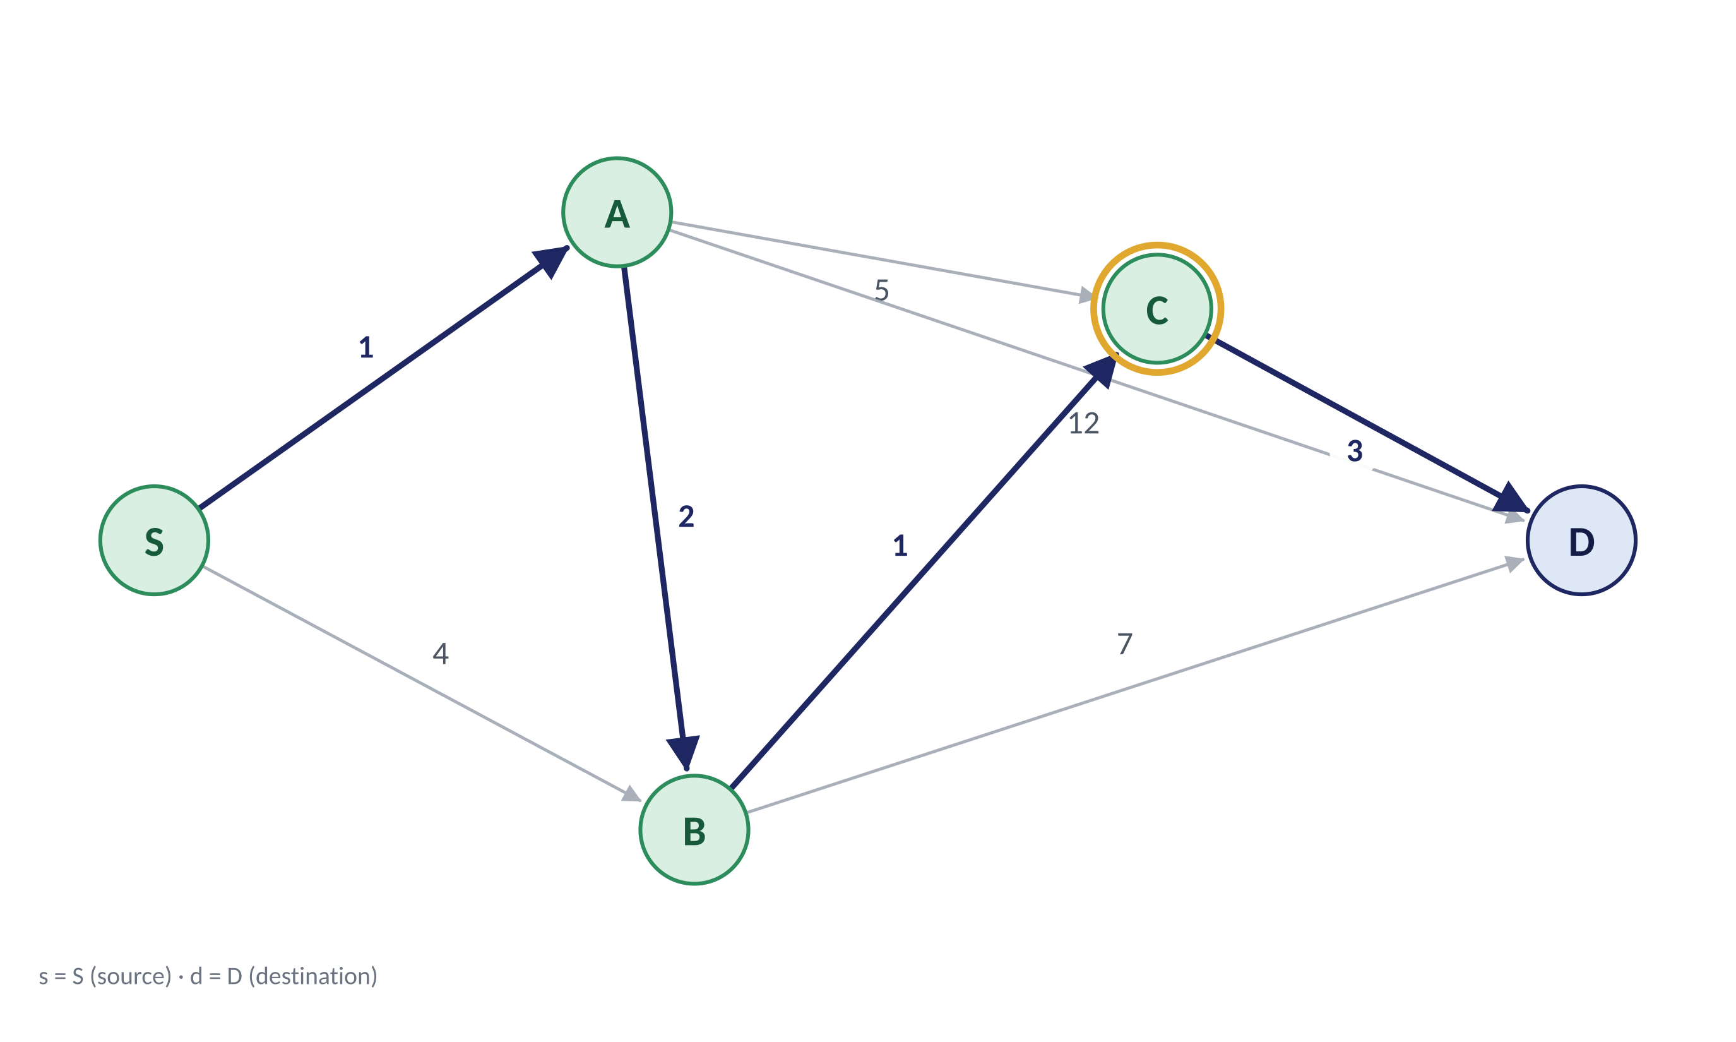
STEP-BY-STEP EXECUTION
14 / 21
Step 4 — select C
F = {S, A, B, C}; Q = {D}
Formal state
F ← F ∪ {C}; relax C→D. D improves: 10 → 7.
V = {S, A, B, C, D}
F = {S, A, B, C}
Q = V \ F = {D}
select: u = C (dist(C) = 4 is the minimum in Q)
Relaxation: if dist(u) + w(u,v) < dist(v), dist(v) ← dist(u) + w(u,v), π(v) ← u
Distance / predecessor functions
v | dist(v) | π(v) | v ∈ F
S | 0 | ⊥ | ✓
A | 1 | S | ✓
B | 3 | A | ✓
C | 4 | B | ✓
D | 7 | C | –
Step 4 / 6
Restart
Back
Next step
Dijkstra's Algorithm | Problem-Based Inductive Learning
Master's in Computer Science

Slide 14
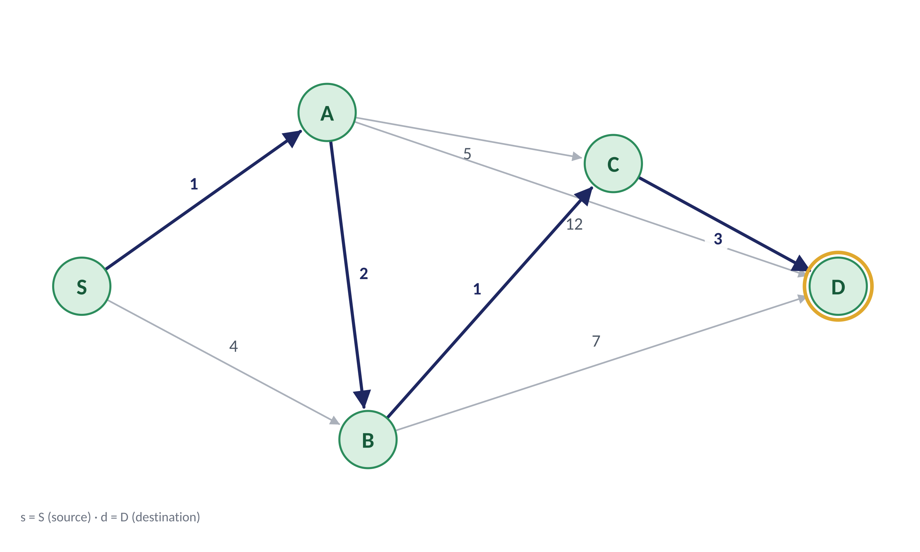
STEP-BY-STEP EXECUTION
15 / 21
Step 5 — select D
F = {S, A, B, C, D}; Q = ∅
Formal state
F ← F ∪ {D}; Q = ∅. Stop: the target is settled.
V = {S, A, B, C, D}
F = {S, A, B, C, D}
Q = V \ F = ∅
select: u = D (dist(D) = 7 is the minimum in Q)
Relaxation: if dist(u) + w(u,v) < dist(v), dist(v) ← dist(u) + w(u,v), π(v) ← u
Distance / predecessor functions
v | dist(v) | π(v) | v ∈ F
S | 0 | ⊥ | ✓
A | 1 | S | ✓
B | 3 | A | ✓
C | 4 | B | ✓
D | 7 | C | ✓
Step 5 / 6
Restart
Back
Next step
Dijkstra's Algorithm | Problem-Based Inductive Learning
Master's in Computer Science

Slide 15
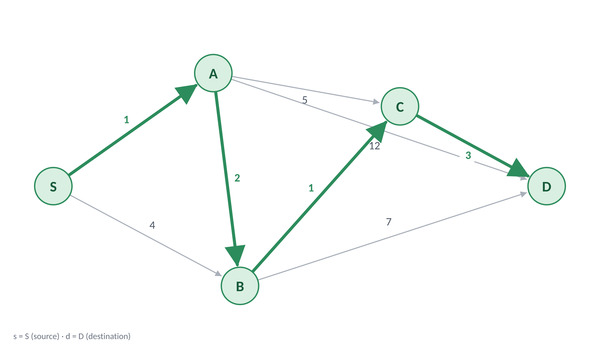

STEP-BY-STEP EXECUTION
16 / 21
Final result — reconstruct the path
Path P = ⟨S, A, B, C, D⟩; w(P) = 1 + 2 + 1 + 3 = 7
Formal state
Shortest path: S → A → B → C → D. Total cost: dist(D) = 7.
V = {S, A, B, C, D}
F = {S, A, B, C, D}
Q = V \ F = ∅
rebuild: π(D)=C, π(C)=B, π(B)=A, π(A)=S
Relaxation: if dist(u) + w(u,v) < dist(v), dist(v) ← dist(u) + w(u,v), π(v) ← u
Distance / predecessor functions
v | dist(v) | π(v) | v ∈ F
S | 0 | ⊥ | ✓
A | 1 | S | ✓
B | 3 | A | ✓
C | 4 | B | ✓
D | 7 | C | ✓
Step 6 / 6
Restart
Back
Finished
Dijkstra's Algorithm | Problem-Based Inductive Learning
Master's in Computer Science

Slide 16
ALGORITHM
17 / 21
Dijkstra's algorithm
PRINCIPLE
Dijkstra's algorithm computes shortest paths from a source node s in a graph with non-negative edge weights.
Pseudocode · Dijkstra(G, s, t)
Validity & complexity
for each v ∈ V:
dist(v) ← ∞
Validity
π(v) ← ⊥
dist(s) ← 0
Requires non-negative weights w(u,v) ≥ 0
Q ← min-priority queue(V, dist)
Time complexity
while Q is not empty:
u ← extract_min(Q)
O((|V| + |E|) log |V|)
if u = t: break
with adjacency list & binary heap
for each (u, v) ∈ E:
if dist(u) + w(u,v) < dist(v):
Space complexity
dist(v) ← dist(u) + w(u,v)
π(v) ← u
O(|V| + |E|)
decrease_key(Q, v)
Dijkstra's Algorithm | Problem-Based Inductive Learning
Master's in Computer Science

Slide 17






ASSESSMENT & APPLICATIONS
18 / 21
Understanding checks throughout the session
AT THE BEGINNING
DURING THE ACTIVITY
DURING FORMALIZATION
AT THE END
quick vote on the best route
students complete the Dijkstra execution table
guided questions on distance updates and finalized nodes
Exercise and quiz to verify the key concepts
Applications
Project-based extension
IoT routing
Network routing
GPS navigation
As a follow-up activity, students implement Dijkstra's algorithm and evaluate it on a real-world Wireless Sensor Network dataset.
Logistics optimization
Game AI
“WSN-MERLIN” — Multi-Metric Wireless Sensor Network Dataset for Environment sensing, Routing, Energy, and Anomaly Analysis.
Dijkstra's Algorithm | Problem-Based Inductive Learning
Master's in Computer Science

Slide 18
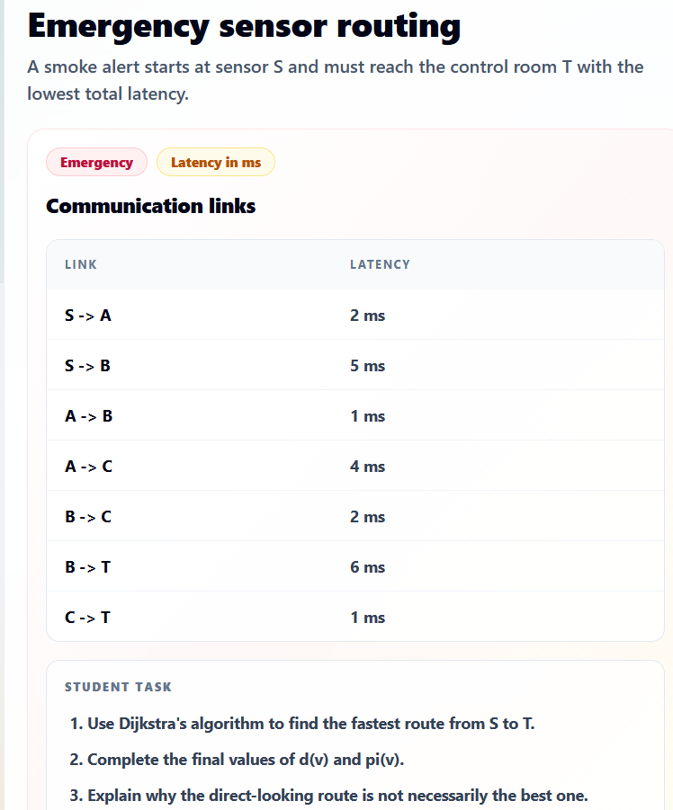
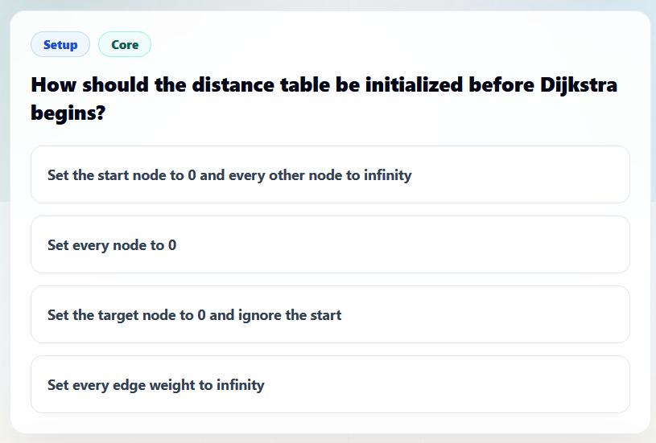
ASSESSMENT & APPLICATIONS
19 / 21
Quiz & Exercise
GUIDED DIJKSTRA EXERCISE
Check understanding through an interactive quiz and
a guided Dijkstra exercise.
INTERACTIVE QUIZ
Dijkstra's Algorithm | Problem-Based Inductive Learning
Master's in Computer Science

Slide 19
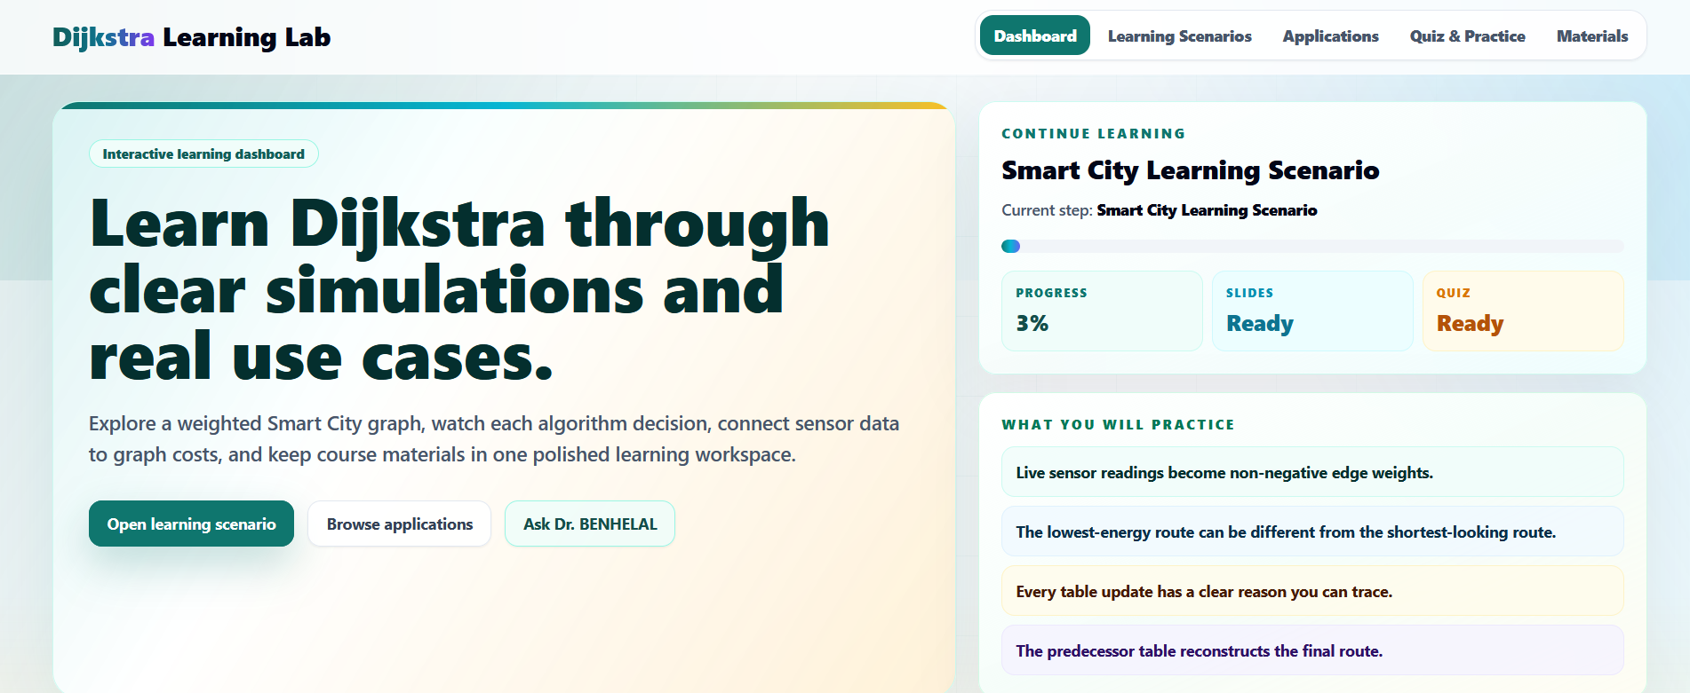
ASSESSMENT & APPLICATIONS
20 / 21
Website Showcase
A learning space for practice, feedback, and follow-up resources. Link: https://benhelal.github.io/Dijkstra/
Dijkstra's Algorithm | Problem-Based Inductive Learning
Master's in Computer Science

Slide 20
THANK YOU
Questions are very welcome.
Teaching Dijkstra's Algorithm through Problem-Based Inductive Learning
21 / 21 · Master's in Computer Science

