Slide 1


Prediction of CARDIOVASCULAR Disease

Slide 2
CONTENTS
1. Problem Statement
2. Project Objectives
3. Dataset Information
4. Dataset
5. Data exploration and Visualizations
7. Comparison of models
7. Challenges
Why Heart Diseases
8.References
6. Why Machine Learning ?

Slide 3
Why Cardiovascular Disease?
Cardiovascular disease which affects both the heart or any blood vessels is the No. 1 killer of men and women in the worldwide.
It’s vital that people learn to identify and manage Cardiovascular risk factors, such as heart-healthy eating, regular exercise, and seeing a doctor to measure blood pressure, cholesterol, and weight.
In Modern medicine cardiology has been at the forefront of technological innovation and quality improvement over the past 50 years
Goal - Find the significant features using different machine learning models in prediction of cardiovascular disease.
Plan – to predict conditions for cardiovascular disease and target medicinal procedure for the prevention of the cardiovascular diseases and curing it.

Slide 4
Problem statement
Identify the factors that can be cause for cardiovascular disease and build a model to predict the cardiovascular disease hidden or forthcoming in a patient and treat it at an early stage.

Slide 5
Project Objectives
Acknowledge the impact of distinct factors, predict accurately with few tests and attributes the presence of heart disease.
Classification methods to diagnose heart disease and measures the classification accuracy to evaluate the performance of characteristic selection methods.

Slide 6
Data set
Data Source : Kaggle
1.High volume of patient data about 70,000. 2. There are 3 types of input features: a) Objective: factual information; b). Examination: results of medical examination; c). Subjective: information given by the patient.

Slide 7

Demographic Study

Slide 8
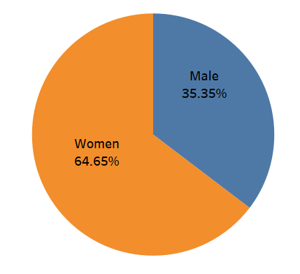
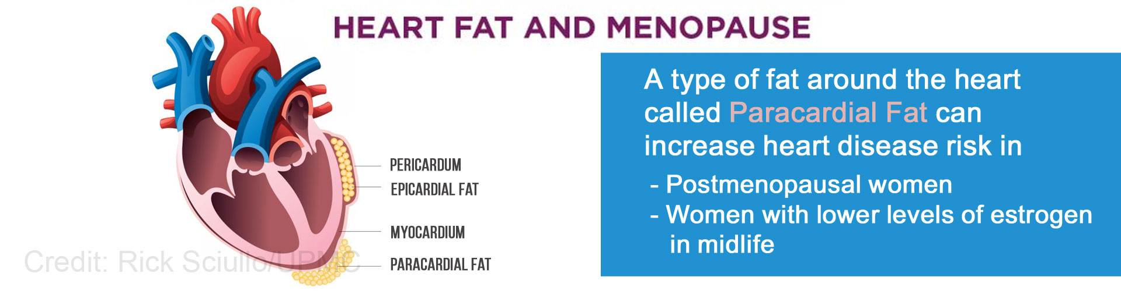
Gender most affected by cardiovascular disease

Slide 9
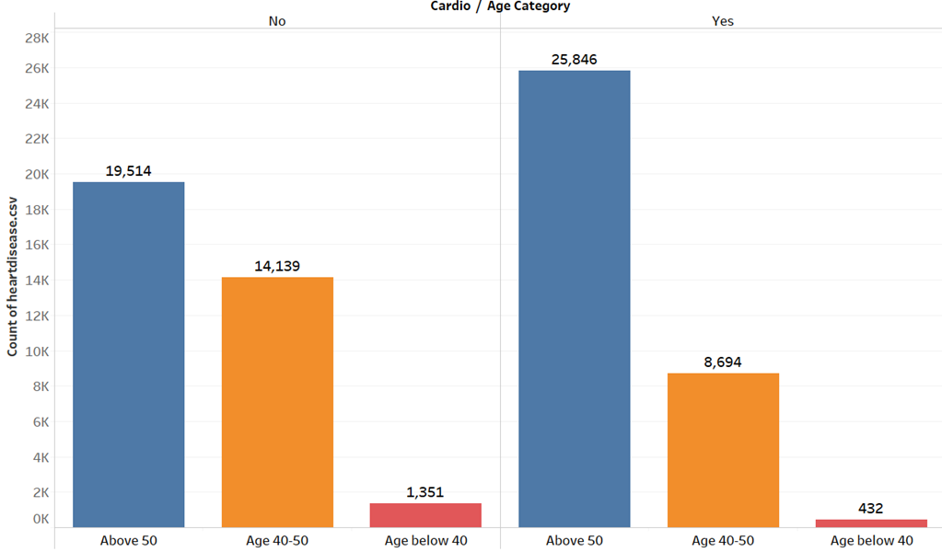
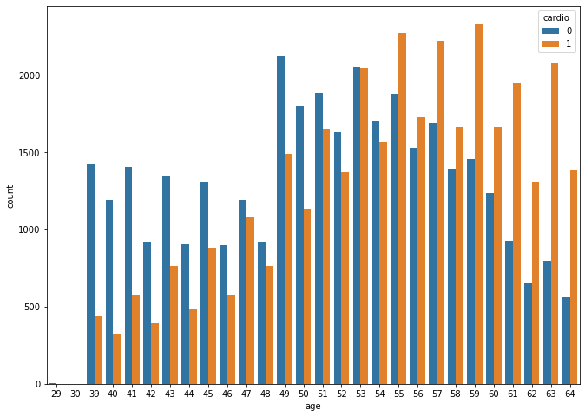
Effect of Age on CVD

Slide 10
Analysing the Risk Factors of CVD

Slide 11
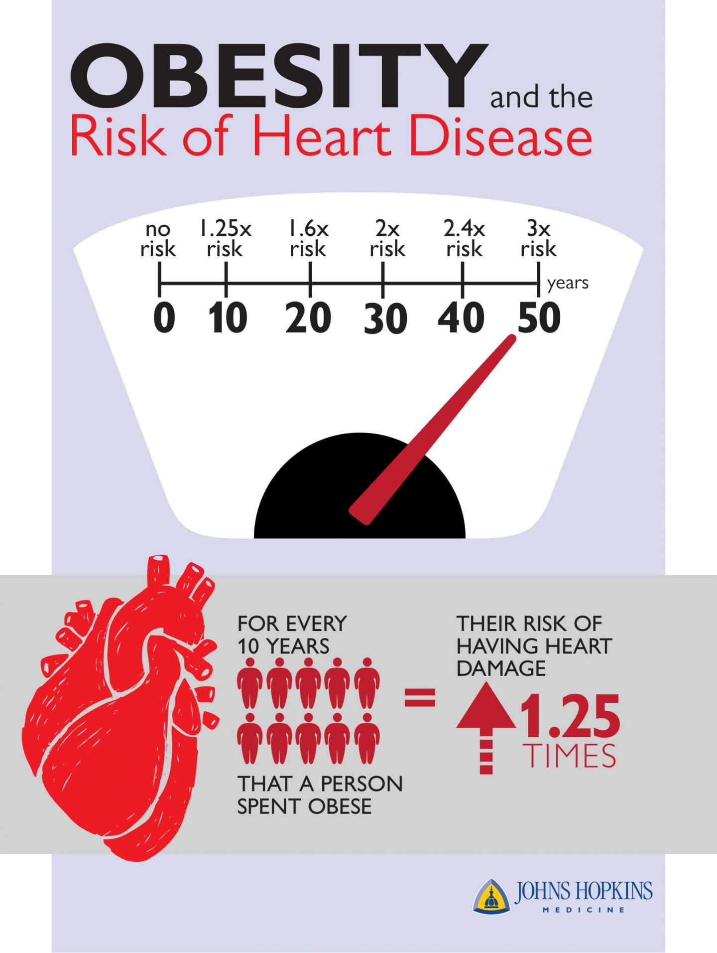
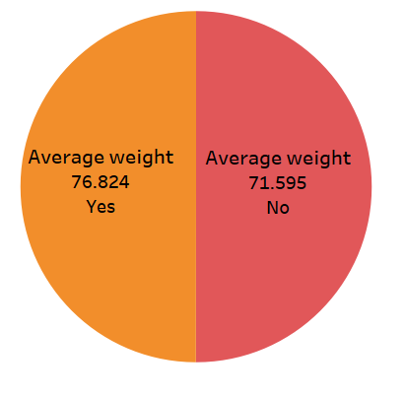
Effect of weight on CVD
.

Slide 12
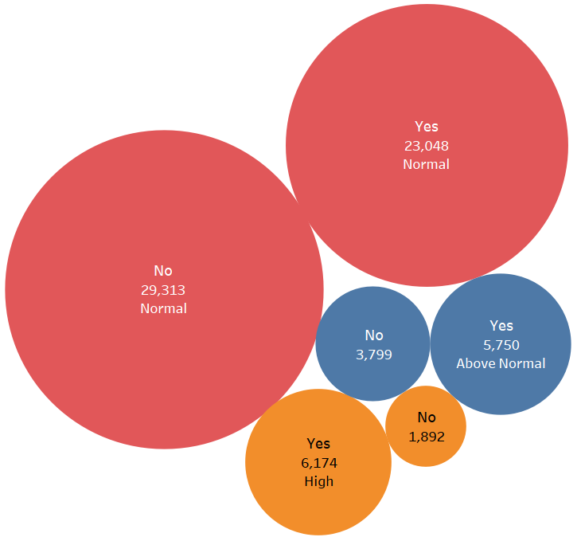
Effect of cholesterol on CVD

Slide 13
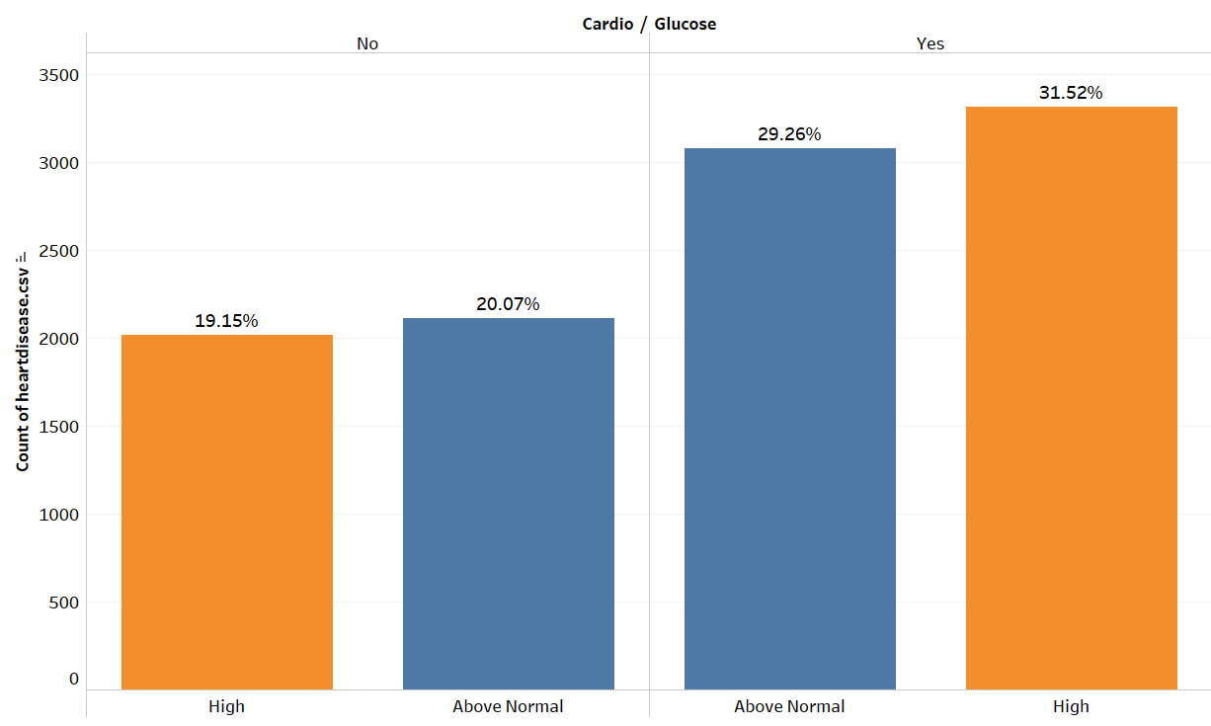
Effect of glucose on CVD
.

Slide 14
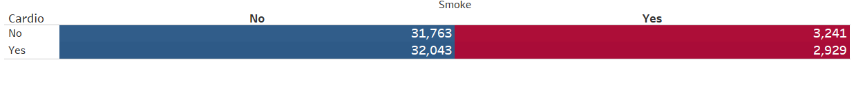
Effect of Smoke on heart disease

Slide 15
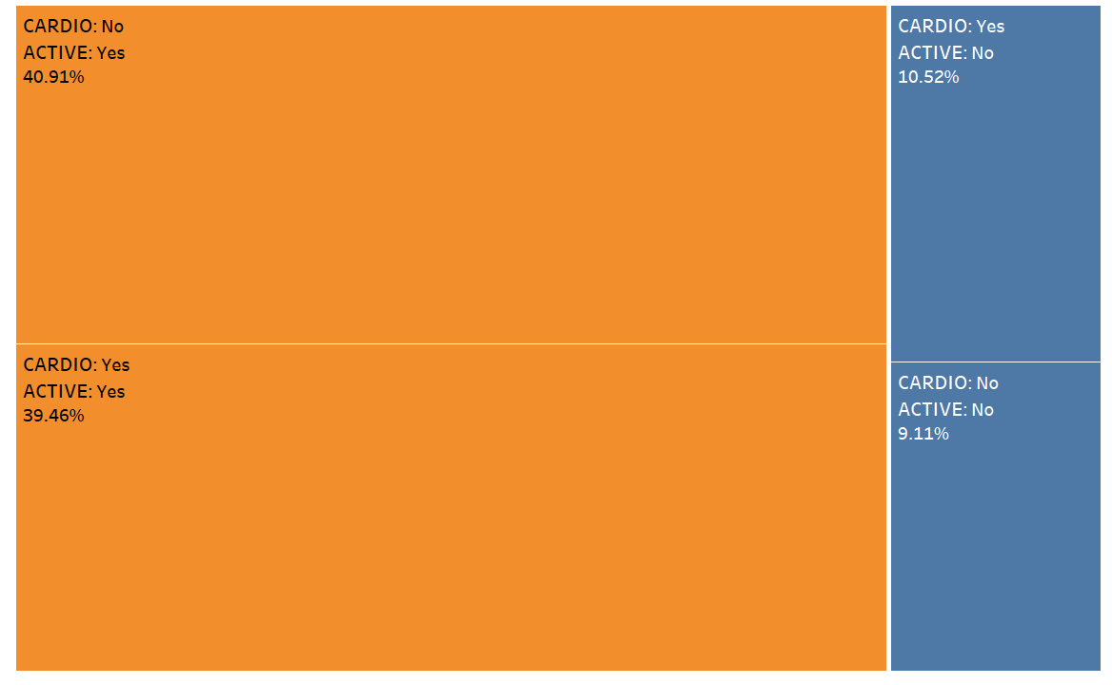
Effect of physical activity on CVD

Slide 16
Why machine learning approach? •
To examine the risk factors associated with Cardiovascular diseases and identifying the hidden factors.
To predict the presence cardiovascular diseases such as heart attack, heart failure, stroke in a better way

Slide 17

MODEL EVALUATION

Slide 18
Models Used For Prediction
XGBoost Classifier
Decision Tree
Linear Perceptron
Linear SVC
KNN
Random Forest
SVM-RBF

Slide 19
Accuracy of Various Models
XGBoost : 73.21%
Decision Tree: 63.31%
Linear Perceptron: 56.4%
Linear SVC: 64.56%
KNN: 60.56%
Random Forest: 63.2%
SVM-RBF: 59.89%

Slide 20
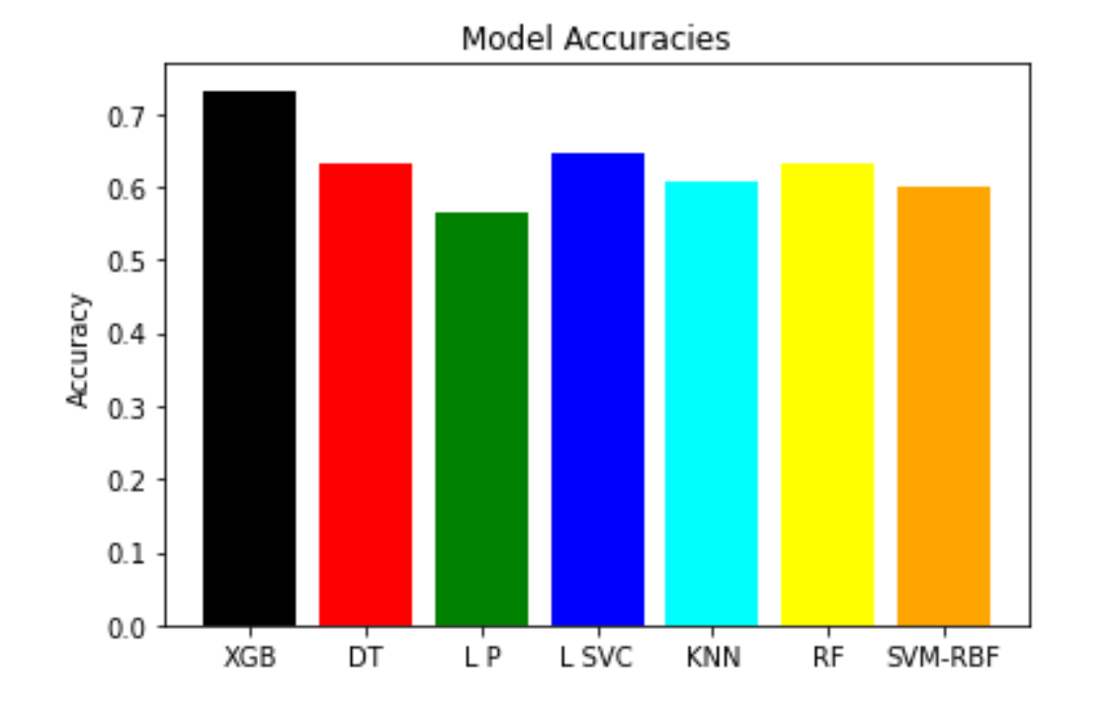

Slide 21
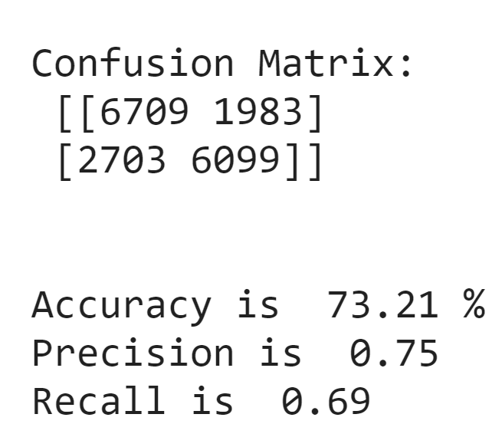
Performance metrics of XGBoost

Slide 22
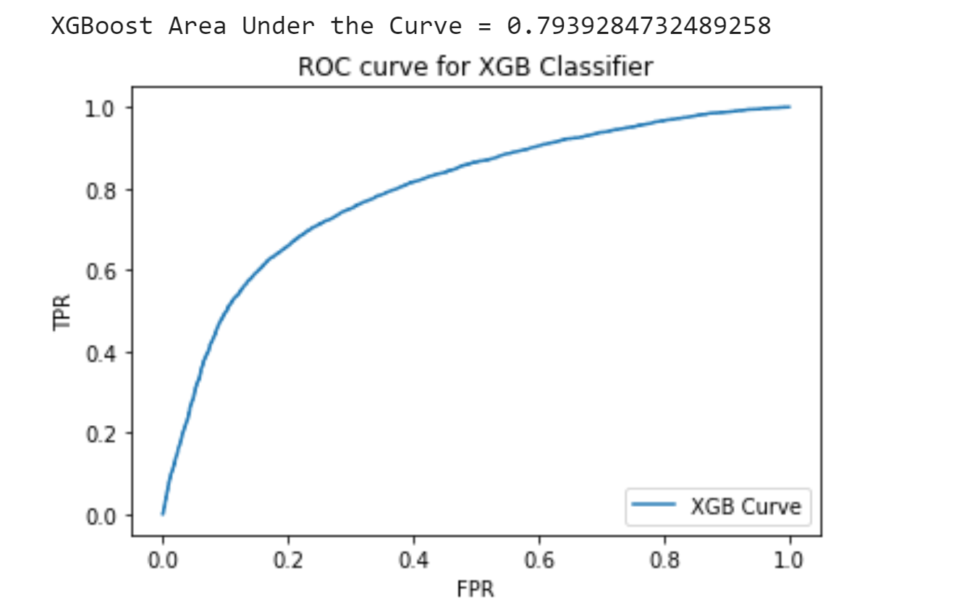
ROC curve for XGBoost Classifier

Slide 23
Challenges
Finding a proper dataset with considerable variable
Discovering and using a proper model for prediction
Lack of in person meeting

Slide 24


