Slide 1

GROUNDVALUE
AI property
valuation for
lending
Hero Housing Fintech Challenge
Problem Statement 1
Notes:
Competition brief: https://docs.google.com/presentation/d/1TRd67oaFJUE5jlbIFhi199VV2B7_E3q5/edit
Cover architectural illustration generated for GroundValue. Product concept: evidence-backed digital property valuation.

Slide 2
GROUNDVALUE / THE PROBLEM
The property valuation workflow
01
02
03
Collect property evidence
Reconcile differences
Assess collateral risk
Transaction records, listings, title context and local infrastructure arrive in different formats.
Area definitions, duplicate listings and stale observations can distort comparisons.
A lender needs a value range, its evidence and a clear reason to refer a case.
GroundValue brings the research and review into one property file.
02
Notes:
Hero Housing Fintech Challenge, Problem Statement 1. Requirements: https://docs.google.com/presentation/d/1TRd67oaFJUE5jlbIFhi199VV2B7_E3q5/edit
GroundValue application and source: https://github.com/BENi-Aditya/GroundValue
Screenshots captured from the working local application on 7 November 2026. Architecture and pilot stages describe the solution design. No measured model accuracy is asserted.

Slide 3
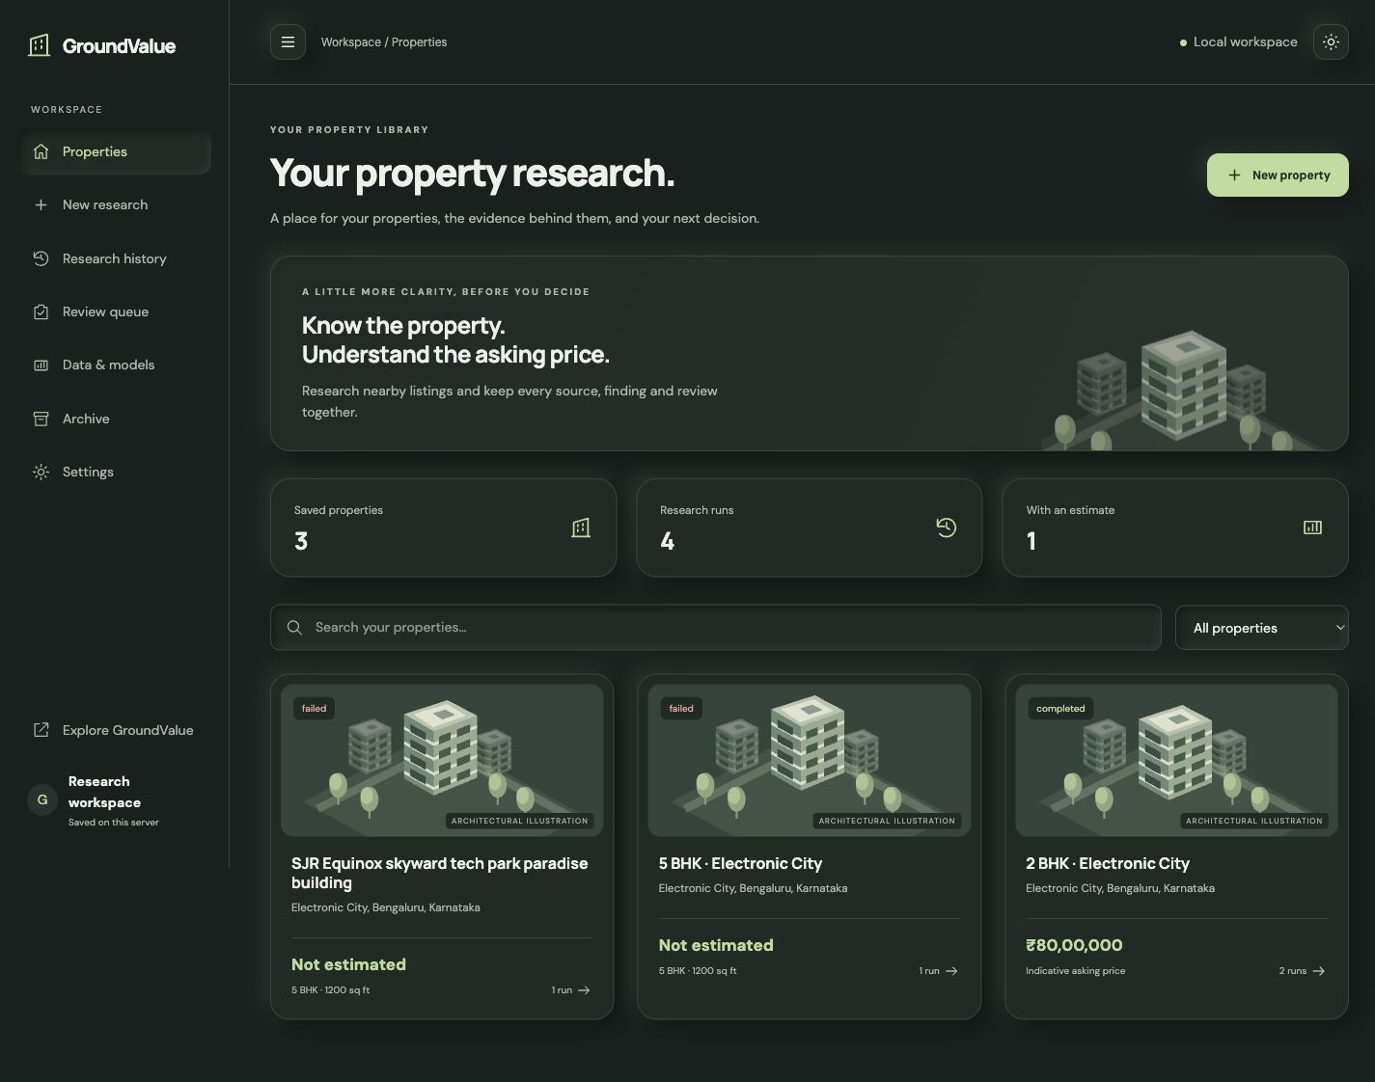
GROUNDVALUE / WORKING PRODUCT
A workspace for every property
Research
Create a property file and run source research.
Review
Open evidence, estimates and previous versions.
Retain
Keep the report and the reasoning together.
03
Notes:
Hero Housing Fintech Challenge, Problem Statement 1. Requirements: https://docs.google.com/presentation/d/1TRd67oaFJUE5jlbIFhi199VV2B7_E3q5/edit
GroundValue application and source: https://github.com/BENi-Aditya/GroundValue
Screenshots captured from the working local application on 7 November 2026. Architecture and pilot stages describe the solution design. No measured model accuracy is asserted.

Slide 4
GROUNDVALUE / SCOPE
India coverage, by city and property type
01
02
03
Bengaluru
Hyderabad, Pune, NCR
Wider India
Residential apartments as the first validation cohort.
Expand city models after local transaction and coverage checks.
Extend through regional data partnerships and city-specific validation.
Residential
Commercial
Area, age, configuration and neighbourhood
Office and retail, with rents, occupancy and yields
04
Notes:
Hero Housing Fintech Challenge, Problem Statement 1. Requirements: https://docs.google.com/presentation/d/1TRd67oaFJUE5jlbIFhi199VV2B7_E3q5/edit
GroundValue application and source: https://github.com/BENi-Aditya/GroundValue
Screenshots captured from the working local application on 7 November 2026. Architecture and pilot stages describe the solution design. No measured model accuracy is asserted.

Slide 5
GROUNDVALUE / DATA DESIGN
Data collection and property linkage
01
02
03
Source evidence
Clean and match
Versioned property file
Registered transactions
Government property records
Listings and market trends
Geospatial and satellite context
Standardise units and dates
Separate carpet and built-up area
Deduplicate buildings and listings
Link parcel, address and coordinates
Source URL and observation date
Access basis and extraction record
Quality flags and missing fields
Features linked to the original evidence
Unstructured documents and pages feed the same schema as structured records.
05
Notes:
Hero Housing Fintech Challenge, Problem Statement 1. Requirements: https://docs.google.com/presentation/d/1TRd67oaFJUE5jlbIFhi199VV2B7_E3q5/edit
GroundValue application and source: https://github.com/BENi-Aditya/GroundValue
Screenshots captured from the working local application on 7 November 2026. Architecture and pilot stages describe the solution design. No measured model accuracy is asserted.

Slide 6
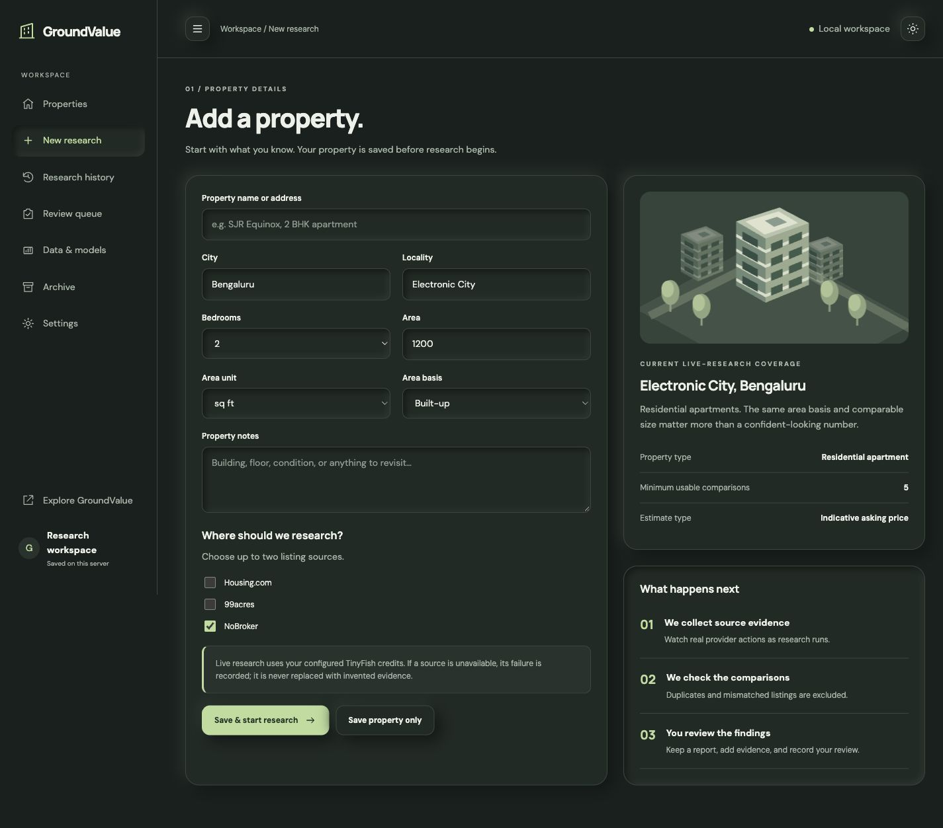
GROUNDVALUE / WORKING PRODUCT
Property details guide the research
One property identity
Location, configuration, area basis and property characteristics.
Source selection
Research follows the selected sources and keeps the original inputs.
Reproducible runs
A new run creates a new version of the property research.
06
Notes:
Hero Housing Fintech Challenge, Problem Statement 1. Requirements: https://docs.google.com/presentation/d/1TRd67oaFJUE5jlbIFhi199VV2B7_E3q5/edit
GroundValue application and source: https://github.com/BENi-Aditya/GroundValue
Screenshots captured from the working local application on 7 November 2026. Architecture and pilot stages describe the solution design. No measured model accuracy is asserted.

Slide 7
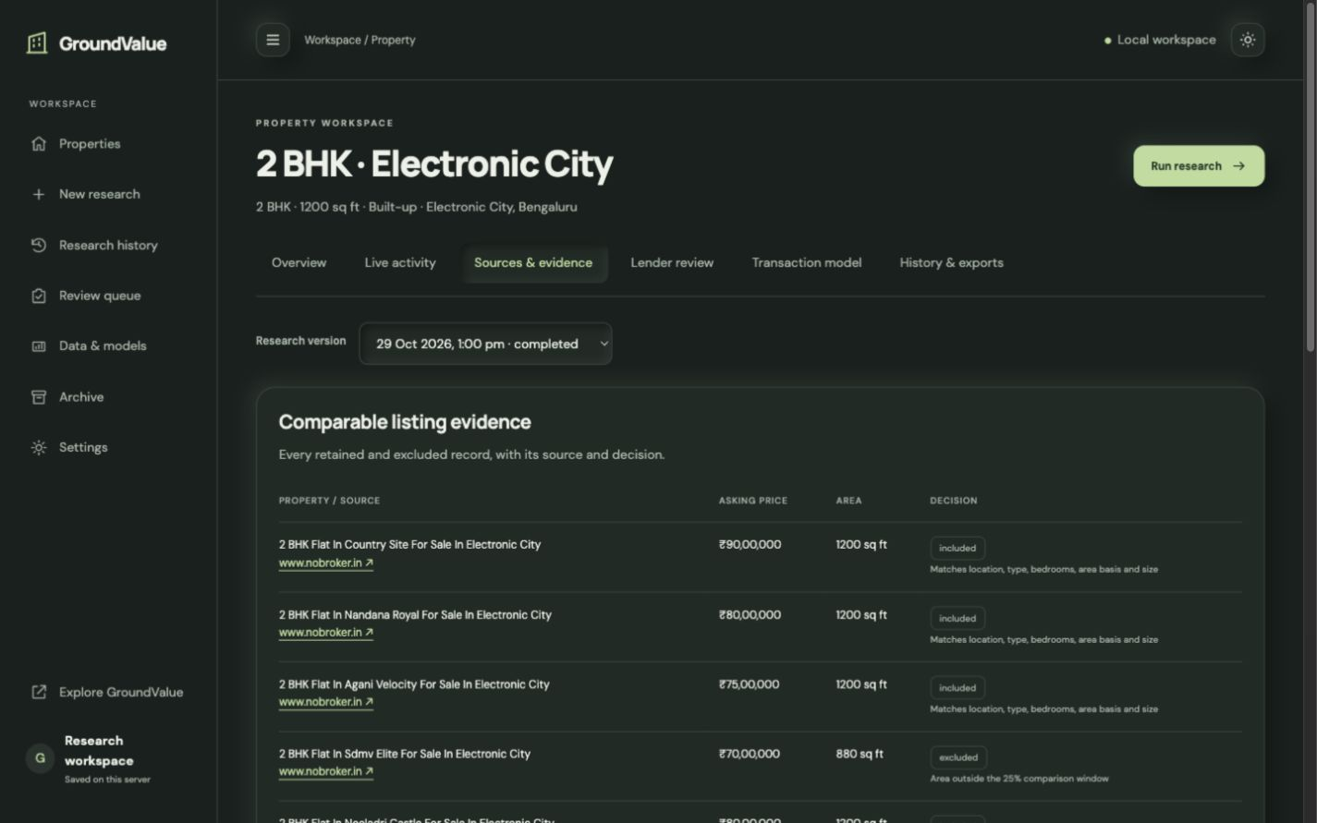
GROUNDVALUE / WORKING PRODUCT
Comparable evidence stays inspectable
Match quality
Location, property type, size and area basis.
Exclusions
Every rejected comparison keeps its reason.
Sources
Open the source behind each observation.
07
Notes:
Hero Housing Fintech Challenge, Problem Statement 1. Requirements: https://docs.google.com/presentation/d/1TRd67oaFJUE5jlbIFhi199VV2B7_E3q5/edit
GroundValue application and source: https://github.com/BENi-Aditya/GroundValue
Screenshots captured from the working local application on 7 November 2026. Architecture and pilot stages describe the solution design. No measured model accuracy is asserted.

Slide 8
GROUNDVALUE / ML DESIGN
The valuation model
INPUT
LEARN
OUTPUT
Property features
Transaction price
Value and uncertainty
Area, bedrooms, age, coordinates, metro distance, city, property type and area basis.
Log-price ridge regression provides an interpretable baseline. Gradient boosting is the challenger design.
A point estimate, calibrated interval and feature contributions, with an explicit coverage check.
Comparable market rates provide an independent benchmark for the model.
08
Notes:
Hero Housing Fintech Challenge, Problem Statement 1. Requirements: https://docs.google.com/presentation/d/1TRd67oaFJUE5jlbIFhi199VV2B7_E3q5/edit
GroundValue application and source: https://github.com/BENi-Aditya/GroundValue
Screenshots captured from the working local application on 7 November 2026. Architecture and pilot stages describe the solution design. No measured model accuracy is asserted.
Implementation reference: groundvalue_mvp/model_lab.py, NumPy ridge regression. Gradient boosting is a model development direction. The training target is sale_price_inr, not asking price. No trained accuracy claim is made.

Slide 9
GROUNDVALUE / VALIDATION
Accuracy measurement and model release
60%
20%
20%
Train
Calibrate
Test
Fit preprocessing and model parameters.
Estimate the residual interval.
Measure on untouched later records.
Time-ordered splits with separate buildings
MAE and RMSE in rupees. Median percentage error. R². Interval coverage.
Compare the same test records against the median-rate baseline and external AVMs where available.
09
Notes:
Hero Housing Fintech Challenge, Problem Statement 1. Requirements: https://docs.google.com/presentation/d/1TRd67oaFJUE5jlbIFhi199VV2B7_E3q5/edit
GroundValue application and source: https://github.com/BENi-Aditya/GroundValue
Screenshots captured from the working local application on 7 November 2026. Architecture and pilot stages describe the solution design. No measured model accuracy is asserted.
Protocol implemented in model_lab.py: 60/20/20 temporal split, remove buildings crossing partitions, train-only transformations, residual calibration. Percentages describe the split, not observed model performance. Promotion requires lower held-out error and acceptable segment coverage.

Slide 10
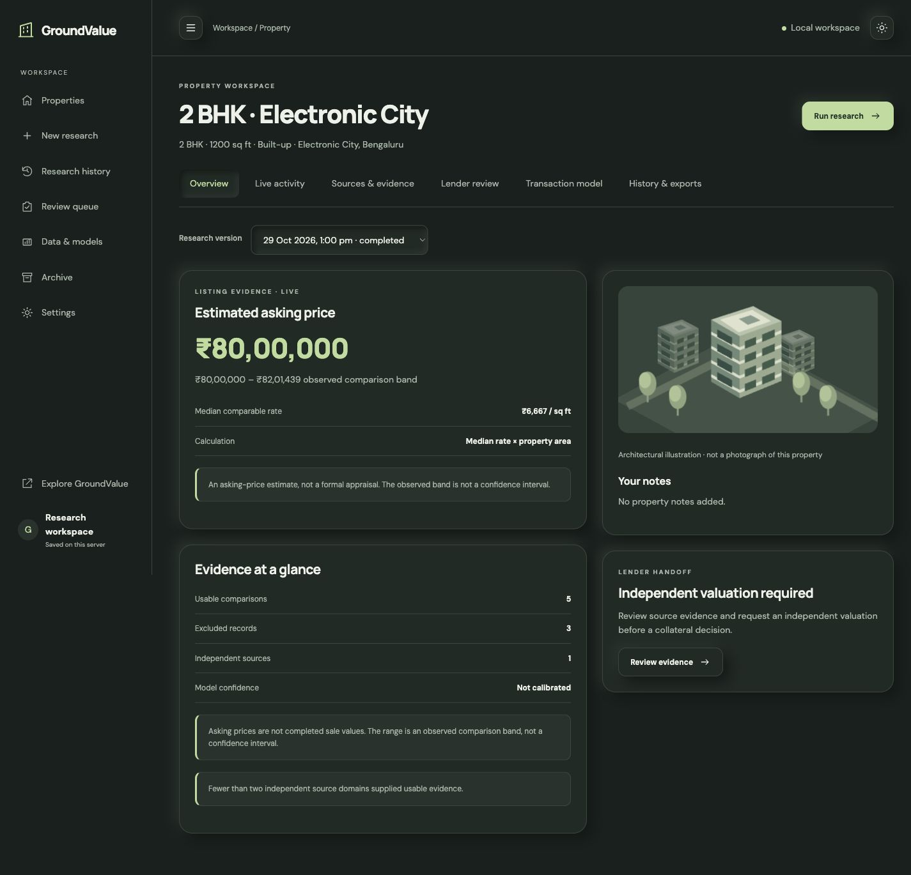
GROUNDVALUE / WORKING PRODUCT
A value estimate with its reasoning
Value range
Show the estimate and the comparison band.
Evidence behind it
Retain selected comparables, source counts and calculation method.
Clear distinctions
Separate asking-price research from a transaction-trained valuation.
10
Notes:
Hero Housing Fintech Challenge, Problem Statement 1. Requirements: https://docs.google.com/presentation/d/1TRd67oaFJUE5jlbIFhi199VV2B7_E3q5/edit
GroundValue application and source: https://github.com/BENi-Aditya/GroundValue
Screenshots captured from the working local application on 7 November 2026. Architecture and pilot stages describe the solution design. No measured model accuracy is asserted.

Slide 11
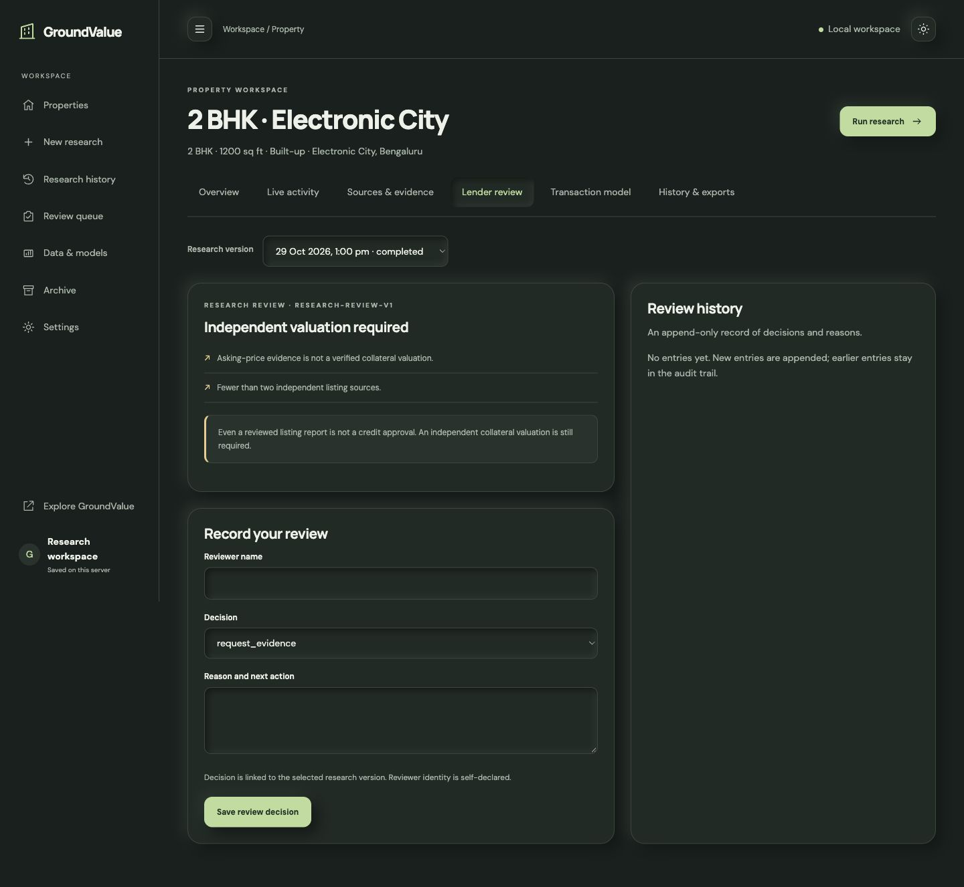
GROUNDVALUE / LENDING WORKFLOW
Lender review and escalation
Review the property file
Check source quality, uncertainty and missing evidence.
Choose the next action
Request evidence, refer an independent valuer or record the research review.
Keep the decision trail
Attach the reviewer’s reason to the exact research version.
11
Notes:
Hero Housing Fintech Challenge, Problem Statement 1. Requirements: https://docs.google.com/presentation/d/1TRd67oaFJUE5jlbIFhi199VV2B7_E3q5/edit
GroundValue application and source: https://github.com/BENi-Aditya/GroundValue
Screenshots captured from the working local application on 7 November 2026. Architecture and pilot stages describe the solution design. No measured model accuracy is asserted.
The lender retains credit authority. The prototype review is not a loan approval or a substitute for required independent valuation. Regulatory alignment is an integration objective, not a certification claim.

Slide 12
GROUNDVALUE / SCALE
Automation and deployment architecture
Browser workspace
Application API
Research service
Model service
Property intake and review
Validation and case state
Source collection jobs
Prediction and checks
Persistent research store
Operational controls
Property versions, evidence, job state and review history survive browser sessions.
Track failed jobs, source freshness, model versions and regional coverage. Route exceptions to review.
12
Notes:
Hero Housing Fintech Challenge, Problem Statement 1. Requirements: https://docs.google.com/presentation/d/1TRd67oaFJUE5jlbIFhi199VV2B7_E3q5/edit
GroundValue application and source: https://github.com/BENi-Aditya/GroundValue
Screenshots captured from the working local application on 7 November 2026. Architecture and pilot stages describe the solution design. No measured model accuracy is asserted.
This is the target deployment architecture. Serverless-compatible job persistence and private storage support the hosted workflow. Production tenancy, identity and access controls require lender-specific integration.

Slide 13
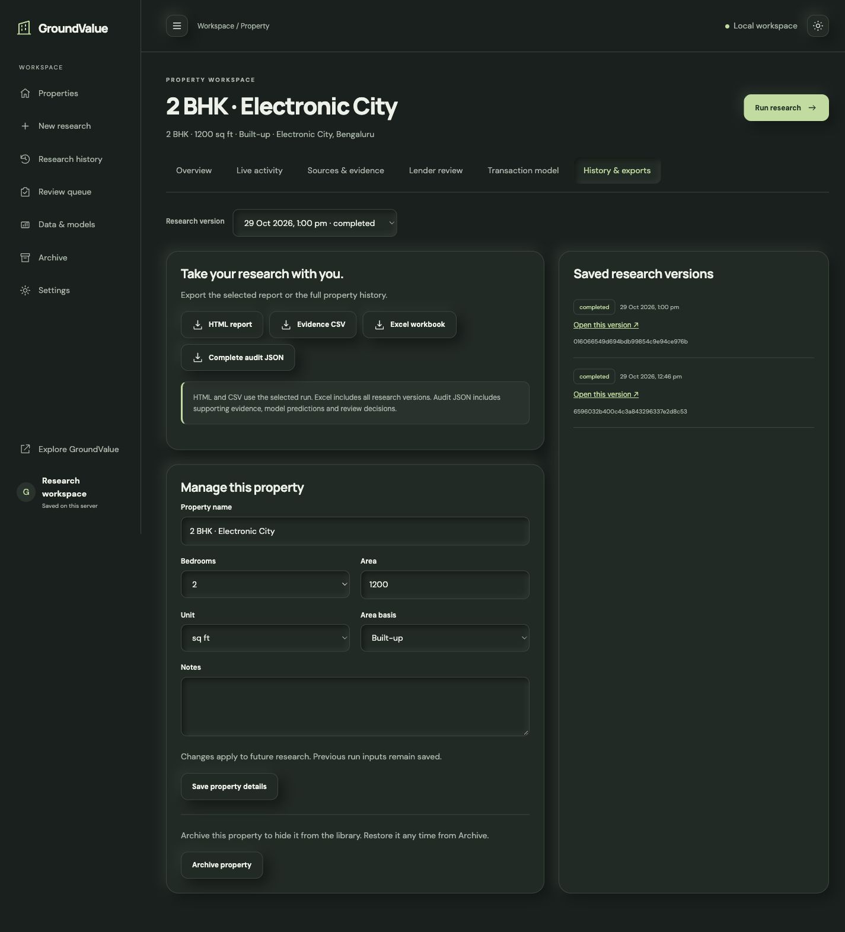
GROUNDVALUE / WORKING PRODUCT
Reports and audit history
Report handoff
HTML report, evidence CSV and Excel workbook.
Complete audit record
Export property history, evidence, predictions and reviews as JSON.
Version integrity
Property edits apply to future research while earlier run inputs remain saved.
13
Notes:
Hero Housing Fintech Challenge, Problem Statement 1. Requirements: https://docs.google.com/presentation/d/1TRd67oaFJUE5jlbIFhi199VV2B7_E3q5/edit
GroundValue application and source: https://github.com/BENi-Aditya/GroundValue
Screenshots captured from the working local application on 7 November 2026. Architecture and pilot stages describe the solution design. No measured model accuracy is asserted.

Slide 14
GROUNDVALUE / ADOPTION
Pilot with a housing finance partner
01
02
03
Validate on lender data
Measure the benefit
Expand by evidence
Use authorised transactions and independent valuations across property segments.
Compare valuation error, research turnaround, manual effort and exception rates.
Broaden city and commercial coverage after accuracy and audit acceptance.
Integration: a property case in the loan workflow, with an API response and reviewable report.
14
Notes:
Hero Housing Fintech Challenge, Problem Statement 1. Requirements: https://docs.google.com/presentation/d/1TRd67oaFJUE5jlbIFhi199VV2B7_E3q5/edit
GroundValue application and source: https://github.com/BENi-Aditya/GroundValue
Screenshots captured from the working local application on 7 November 2026. Architecture and pilot stages describe the solution design. No measured model accuracy is asserted.

Slide 15
GROUNDVALUE / DEMO & SUBMISSION
GroundValue for digital property valuation
Research the property.
Explain the estimate.
Keep the evidence.
Solution coverage
India rollout and property scope
Structured and unstructured data
ML training and evaluation
Explainability and confidence
Automation and exception review
Lender workflow integration
Live demo
groundvalue.vercel.app
Source code
github.com/BENi-Aditya/GroundValue
Hero Housing Fintech Challenge / Problem Statement 1
15
Notes:
Hero Housing Fintech Challenge, Problem Statement 1. Requirements: https://docs.google.com/presentation/d/1TRd67oaFJUE5jlbIFhi199VV2B7_E3q5/edit
GroundValue application and source: https://github.com/BENi-Aditya/GroundValue
Screenshots captured from the working local application on 7 November 2026. Architecture and pilot stages describe the solution design. No measured model accuracy is asserted.

