Slide 1
Next meetup…

Slide 2
For our next meetup(s)
… will be organized in Nov/Dec
… but we’re looking for a location
… and speakers

Slide 3
Other annoucements

Slide 4
Bepug.github.io

Slide 5
Bepug members twitter list
Add yourself to our twitter list!
Go to twitter repo
File an issue
Watch the magic

Slide 6
Bepug.github.io

Slide 7
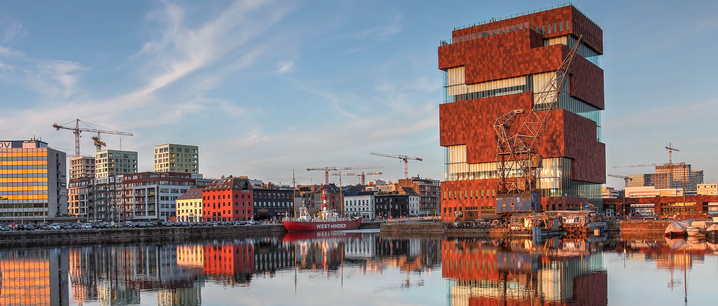
Beer raffle
Answer questions and win a beer

Slide 11
Thank you!

