Slide 1


BEPUG Meetup 11 March 2020
Notes:
Requires following files
# 15MinuteBreak.ps1
# chinese-gong-daniel_simon.wav
# http://soundbible.com/grab.php?id=2148&type=wav
Set path to 15MinuteBreak.ps1 in break slide action
sp HKCU:\Software\Microsoft\Office\16.0\PowerPoint\Security\ -Name RunPrograms -Value 1
https://support.office.com/en-us/article/-run-programs-custom-action-is-disabled-in-powerpoint-2016-7607b815-675b-470c-8099-823c66d3a367

Slide 2

Thanks to our sponsor!

Slide 3







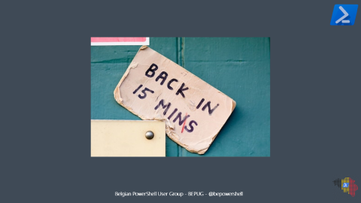

Agenda
19:30
20:30
18:30
20:15
21:15

Slide 4
Open floor peer-to-peer user group

Slide 5
Open floor peer-to-peer user group
Goal:
To learn from each other
Help each other develop PowerShell skills
How?
Bring your questions to the floor
Show us your code
Respect each other – listen, let others talk
There is no such thing as a stupid question!

Slide 6

Open floor peer-to-peer user group
The floor is yours

Slide 7
Modernizing PowerShell Scripts
- Matthias van den Elsacker

Slide 8


Slide 9
Git(Hub) 101
- Stijn & Merlijn

Slide 10


