Slide 1
Next meetup…

Slide 2
For our next meetup(s)
… will be organized in Sep/Oct
… but we’re looking for a location
… and speakers (you maybe?)

Slide 3
Other annoucements

Slide 4
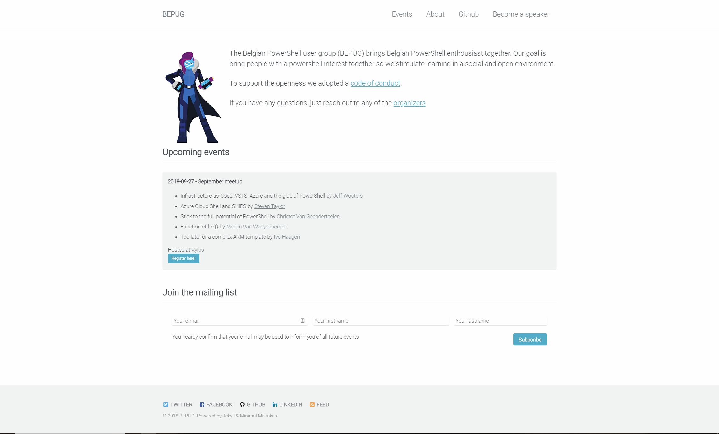
Bepug.github.io

Slide 5
Bepug members twitter list
Add yourself to our twitter list!
Go to twitter repo
File an issue
Watch the magic

Slide 6

Beer raffle
Answer questions and win a beer

Slide 7
How many releases of PowerShell Core do we have so far?
64

Slide 8
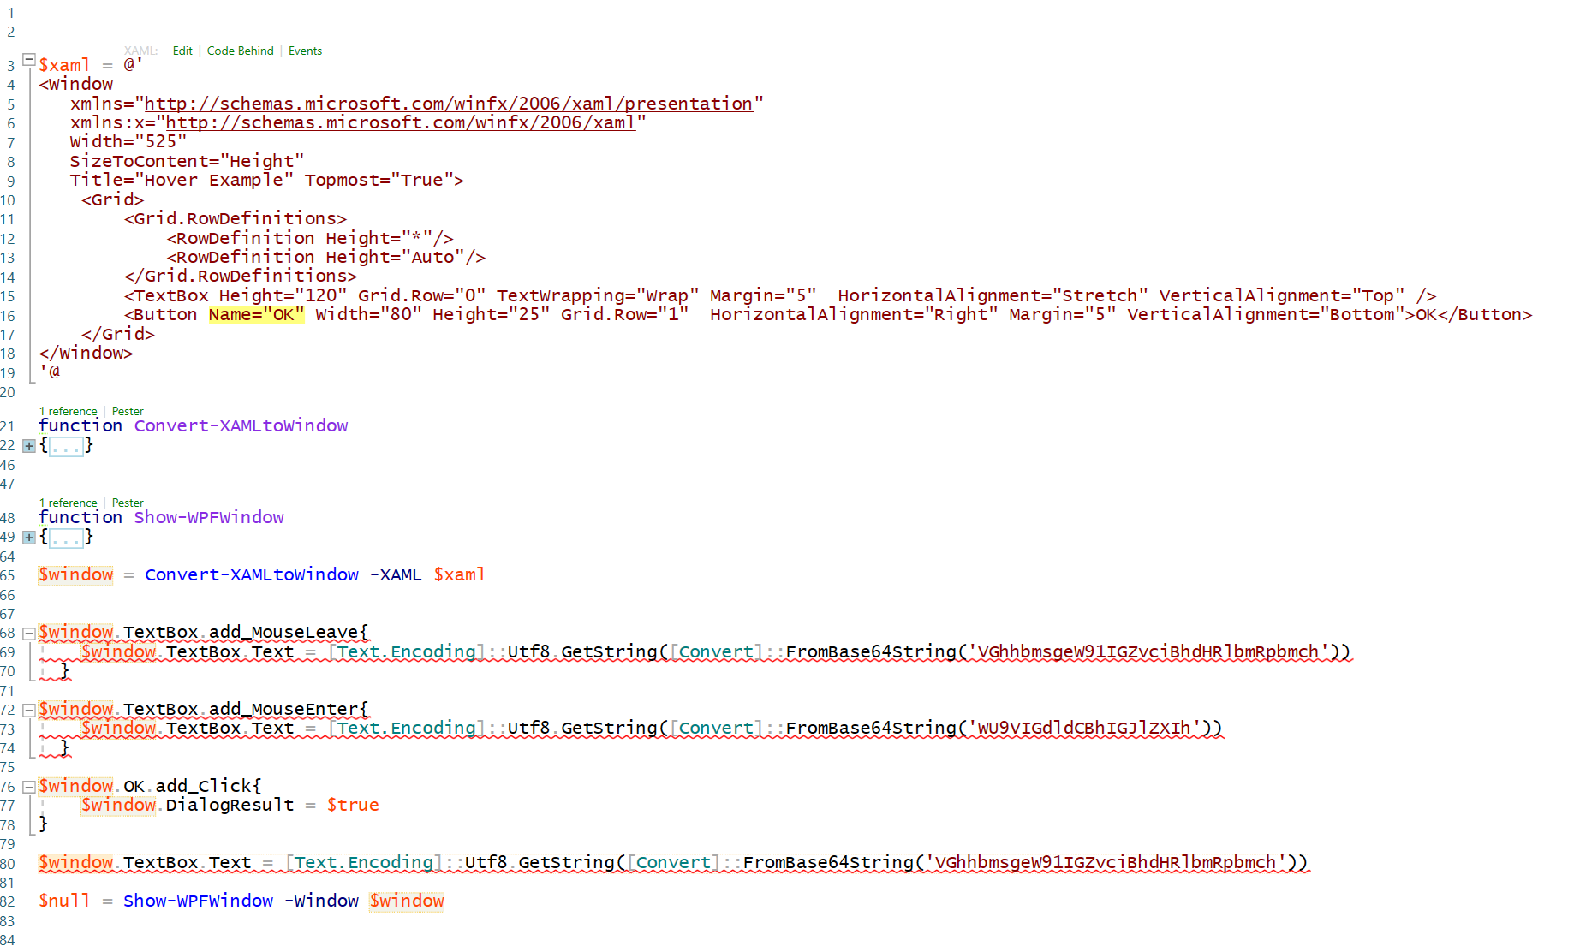
What’s wrong with my XAML?
Make sure every element has a Name or x:Name tag for event handlers!

Slide 9
Thank you Thomas and Cheops Aleksandar and all of you!

