Slide 1
Next meetup…

Slide 2
For our next meetup(s)
… will be organized in Nov/Dec
… but we’re looking for a location
… and speakers

Slide 3
Other annoucements

Slide 4
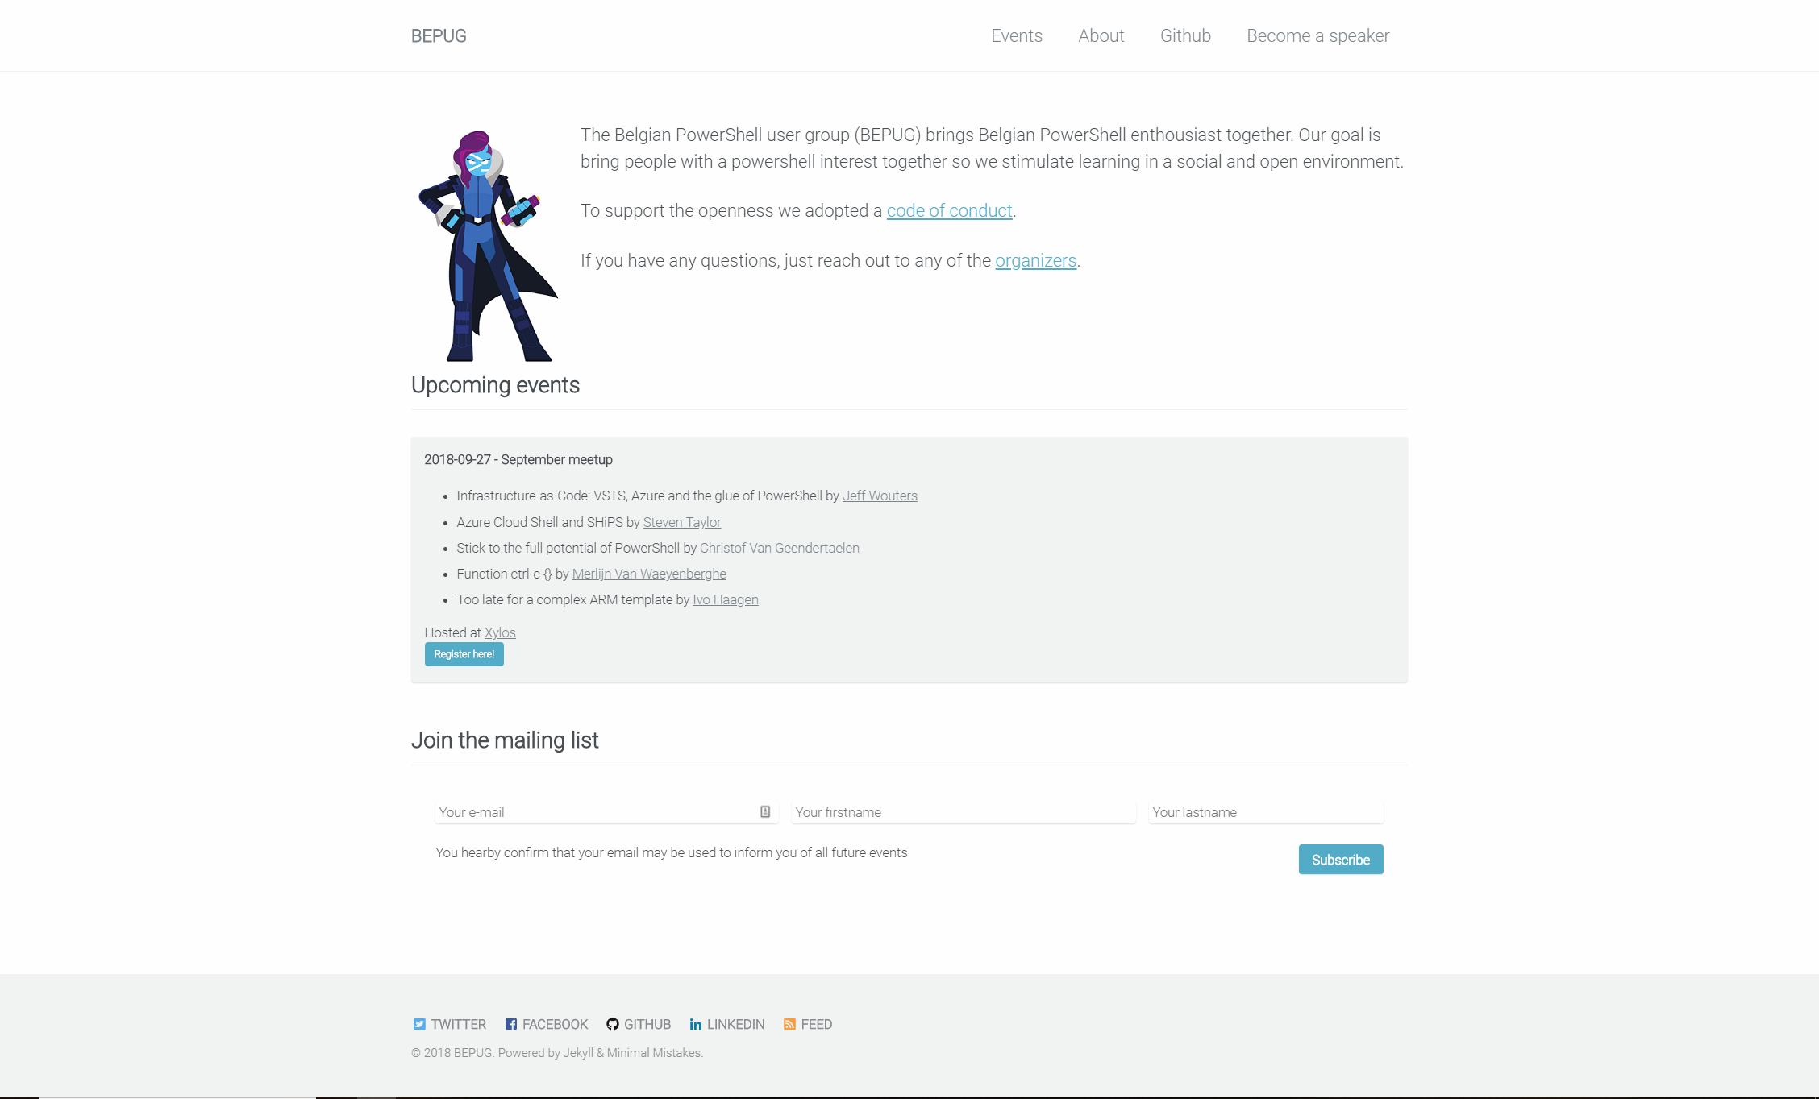
Bepug.github.io

Slide 5
Bepug members twitter list
Add yourself to our twitter list!
Go to twitter repo
File an issue
Watch the magic

Slide 6

Beer raffle
Answer questions and win a beer

Slide 7
How many functions are included in Chrissy’s massive dbatools module in the latest release (0.9.435)?
438

Slide 8
Why does enter-pssession | disconnect-pssession not work every time?
Disconnect-pssession does only work when you used new-pssession.

Slide 9
Give me the 3 cmdlets PowerShell is all about
Get-help, get-command, get-member

Slide 10
Give me 3 ways to acces cloudshell
Azure.com, docs.Microsoft.com (try me) and VSCode plugins

Slide 11
Thank you!

