Slide 1

SER + Ubezpieczenia SER + Insurance

Slide 2
Agenda
18.05-18.40 "Experience vs. Data" Markus Gesmann (Lloyd’s, London)
18.40-19.00 Pizza break
19.00-19.35 "Non life insurance in R" Emilia Kalarus (Triple A - Risk Finance)
19.35-20.10 "Stochastic mortality modelling" Adam Wróbel (NN)
20.30 – Afterparty @Kwadrat

Slide 3


Thanks to our Sponsors

Slide 4
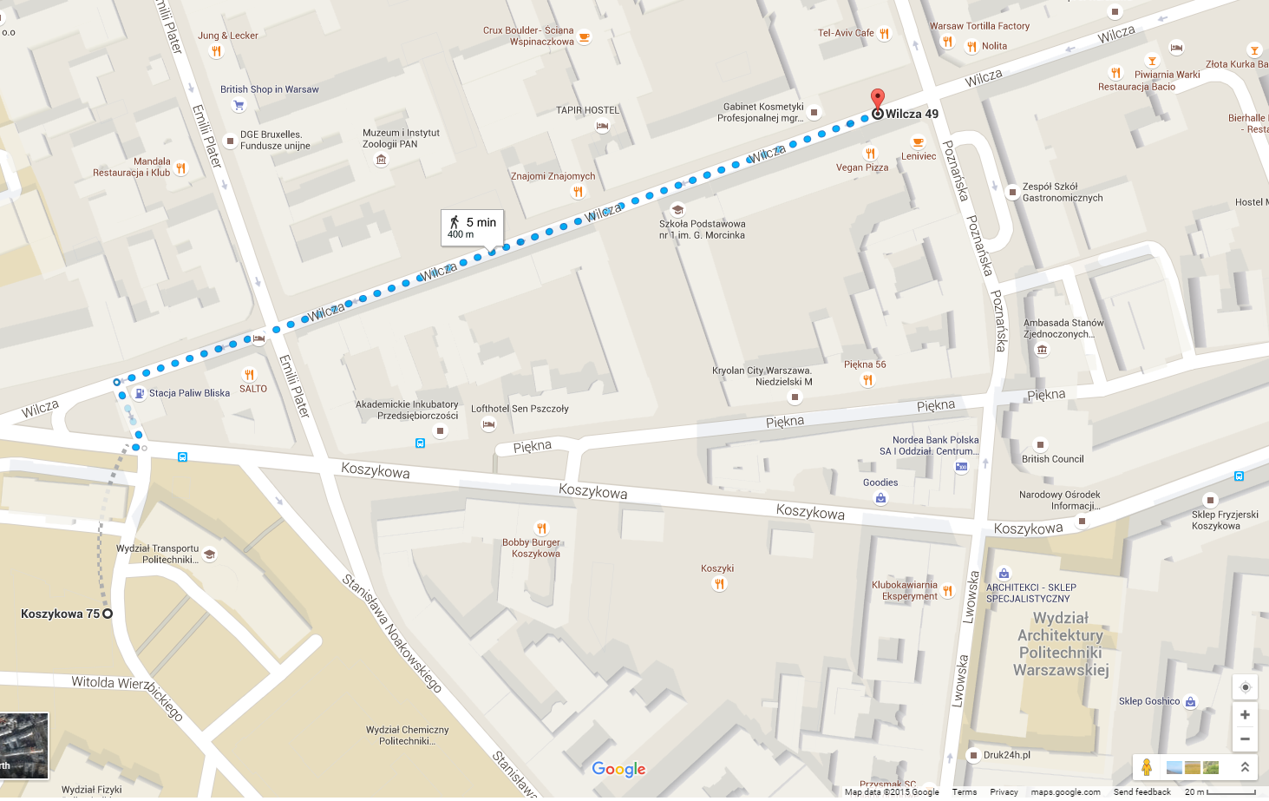
Afterparty location – Pub Kwadrat

