Slide 1
Introduction to Statistics for Ecology and Evolutionary Biology Gaussian Regression Models Week 06 02 March 2020

Slide 2
The Modeling-Prediction Workflow
Data
Raw observations
Model-Based Predictions
On same scale as raw data
Model Fitting
Use probability density or mass functions (i.e., dnorm) to define the likelihood. Define priors. Generate posterior distributions
Prediction Generation
Use random generation functions (i.e., rnorm) and posterior samples to, in a sense, run the model in reverse
Statistical Model
Inference about model parameters made by examining the posteriors and summarizing posterior samples
Notes:
Emphasize the posterior as the focal point of inference; samples from the posterior are simply a representation of the posterior that is often easier to work with
Observation uncertainty: uncertainty about outcomes even given fixed parameter values
Inherent in the use of random generation functions for prediction
Parameter uncertainty: uncertainty about what the true parameter values are
Only incorporated if we feed posterior uncertainty (i.e., posterior samples) into our prediction generation process

Slide 3
Gaussian Models
Attempt to learn about the mean and variance of some (continuous) measurement
A common extension of the basic Gaussian model is to make the mean value itself a function of an additive combination of other variables (i.e., “linear regression”)
This formulation in particular accounts for its broad use in ecology and evolution
Notes:
Statistical Rethinking: “This type of model is simple, flexible, and commonplace.”

Slide 4
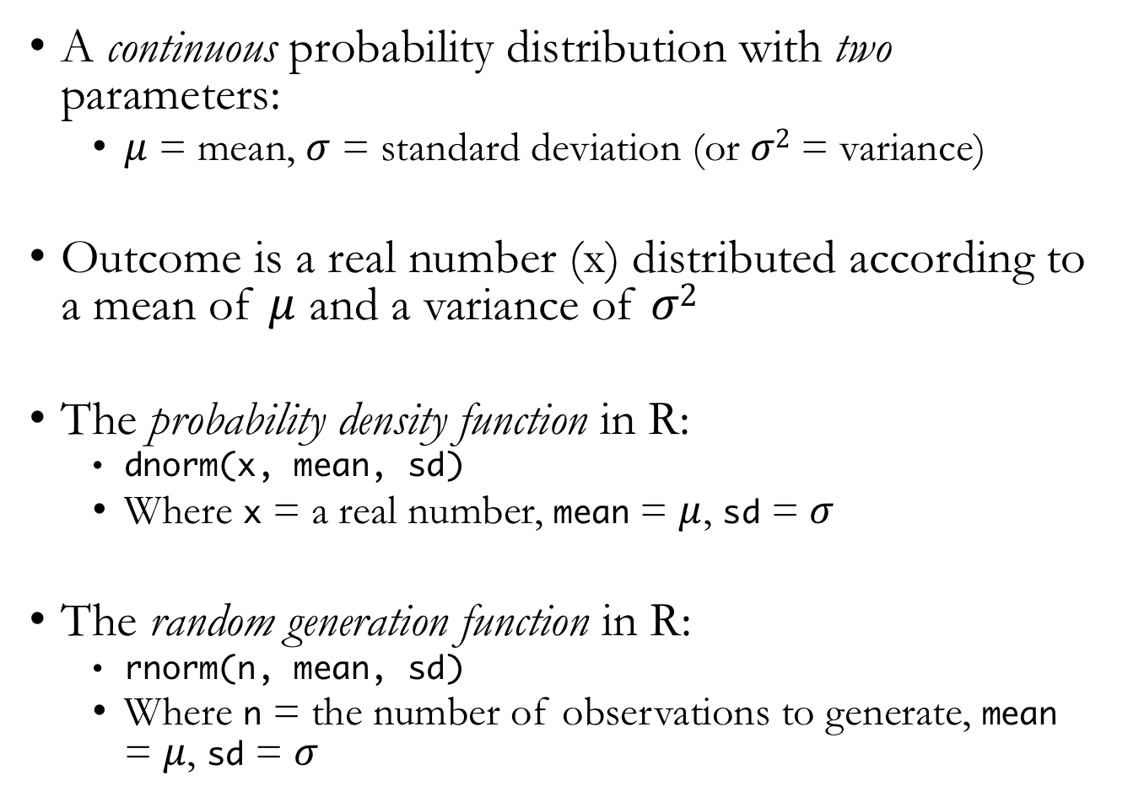
Normal Distribution
A continuous probability distribution with two parameters:
$μ$ = mean, $σ$ = standard deviation (or $σ2$ = variance)
Outcome is a real number (x) distributed according to a mean of $μ$ and a variance of $σ2$
The probability density function in R:
dnorm(x, mean, sd)
Where x = a real number, mean = $μ$, sd = $σ$
The random generation function in R:
rnorm(n, mean, sd)
Where n = the number of observations to generate, mean = $μ$, sd = $σ$
Notes:
Also called the Gaussian distribution
Greek letter “mu” for the mean parameter, “sigma” for the standard deviation parameter

Slide 5
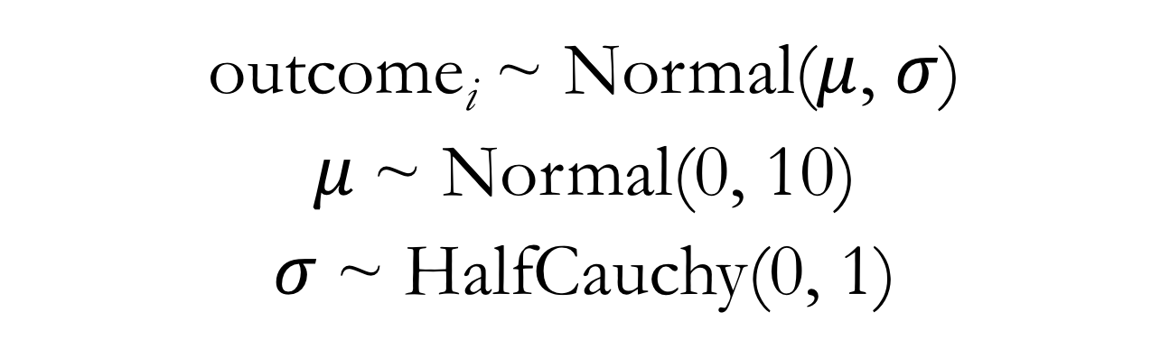
Models in Mathematical Language: Normal Distribution
outcome_{i} ~ Normal($μ$, $σ$)
$μ$~ Normal(0, 10)
$σ$~ HalfCauchy(0, 1)
Notes:
The first line of the model typically relates the outcome variable to the likelihood function
We also need to define prior distributions for all parameters
In later extensions of this approach, we will recognize predictor variables that themselves are used to define model parameters
The benefit of expressing models in mathematical language is it removes ambiguity about our modeling choices and makes bare all of our modeling assumptions
All lines here describe stochastic (rather than deterministic) relationships

Slide 6
Fitting Models Using map
A more practical tool than grid approximation for more complex models
But just another way to compute the posterior defined by our Bayesian statistical machinery
Note this is still an approximation of the posterior
Treats posterior parameter distributions as if they have quadratic shapes
Allows us to express our statistical models in something very close to the explicit mathematical language

Slide 7
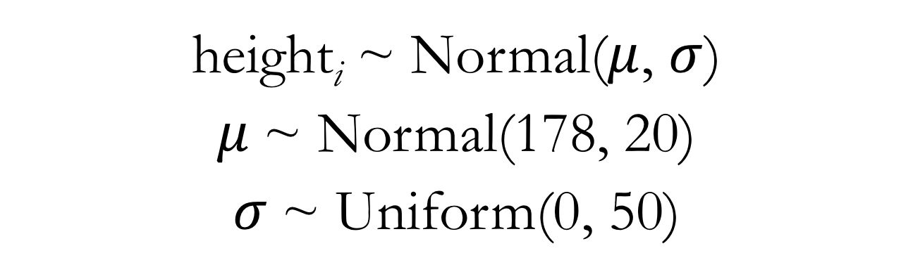
Gaussian Model for Height: Mathematical Language
height_{i} ~ Normal($μ$, $σ$)
$μ$~ Normal(178, 20)
$σ$~ Uniform(0, 50)
Notes:
The height data we’re using was collected by anthropologist/sociologist Nancy Howell within the !Kung San human population

Slide 8
Gaussian Model for Height: map Code
m4.1 <- map(
data = d2, # specify data to fit
alist(
# define statistical model
height ~ dnorm(mu, sigma), # likelihood
mu ~ dnorm(178, 20) , # prior for the mean parameter
sigma ~ dunif(0, 50) # prior for the sd parameter
)
)
Notes:
Show lecture code

Slide 9
Linear Regression Terminology
This term is typically used when we have a predictor variable included to model the mean parameter
Also sometimes called a “linear model”
Generalized linear models – specify a different type of outcome distribution (coming relatively soon)
Generalized linear mixed models – a particular modeling strategy using varying (aka random) effects (coming later)
Just note that unless otherwise specified, a “linear regression” or “linear model” usually refers to a statistical modeling strategy with a Gaussian (normal) outcome distribution
Notes:
Critically, including predictor variables allows us to quantify the strength of association between predictors and the mean of the outcome

Slide 10
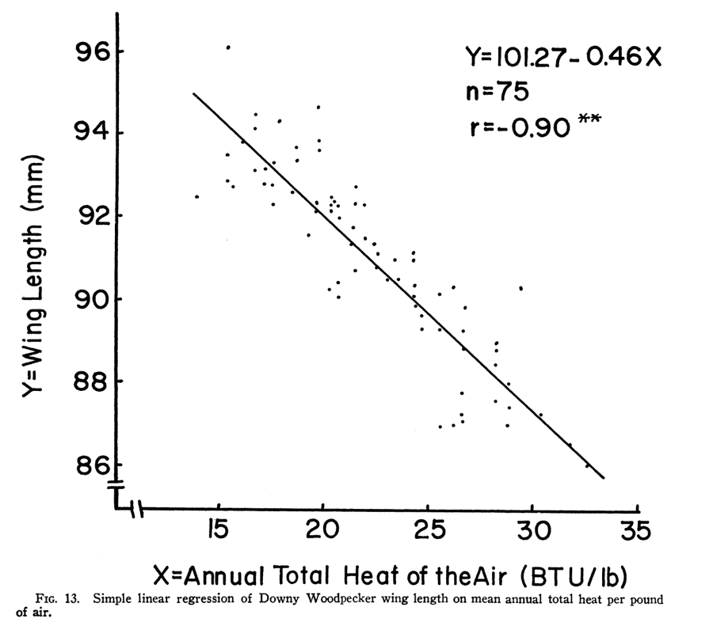
Linear Regression in Ecology and Evolution
Mathematizing Nature’s Messiness: Graphical Representations of Variation in Ecology, 1930-present
by
Laura J. Martin
James 1970, Ecology
Notes:
In ecology and evolution, linear regression is often used to relate environment drivers to some biological variable (e.g., an organismal, population, or community trait)
Martin 2015:
“Today linear regression is arguably the most widespread practice in ecology.”
“Linear regression was a means of considering variation in an organismal variable and an environmental variable simultaneously.”
“Ecologists… used linear regression… to determine whether there was a relationship among two or more variables.”

Slide 11
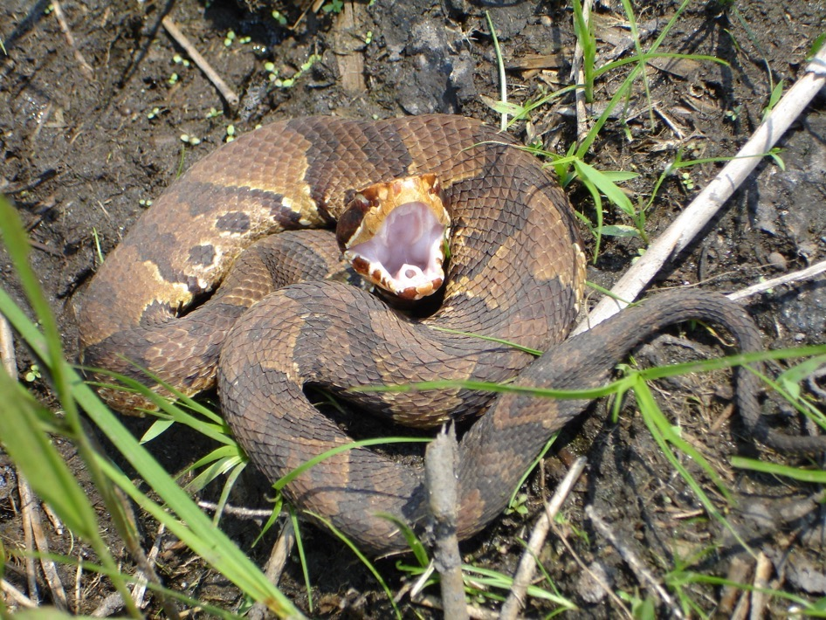
Linear Regression in Ecology and Evolution
Eskew et al. 2009, Journal of Zoology

Slide 12
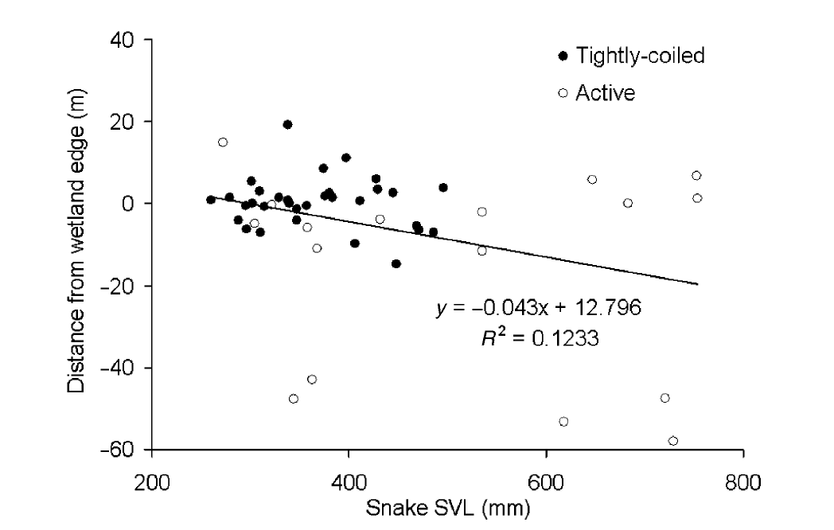
Linear Regression in Ecology and Evolution
Eskew et al. 2009, Journal of Zoology

Slide 13
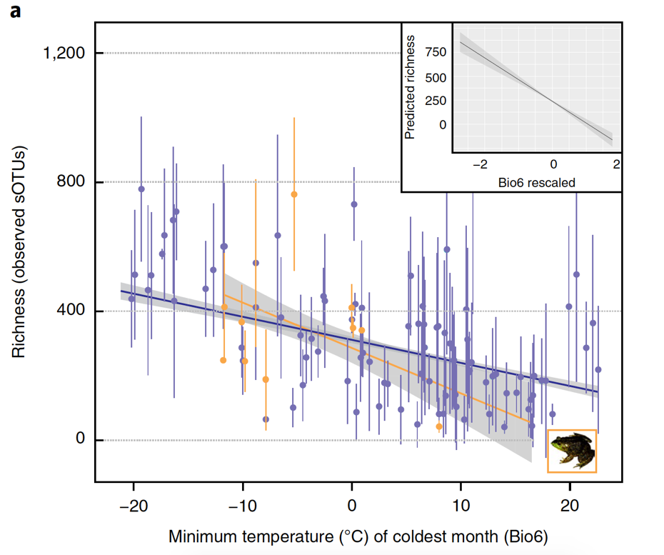
Linear Regression in Ecology and Evolution
Kueneman et al. 2019, Nature Ecology & Evolution

Slide 14
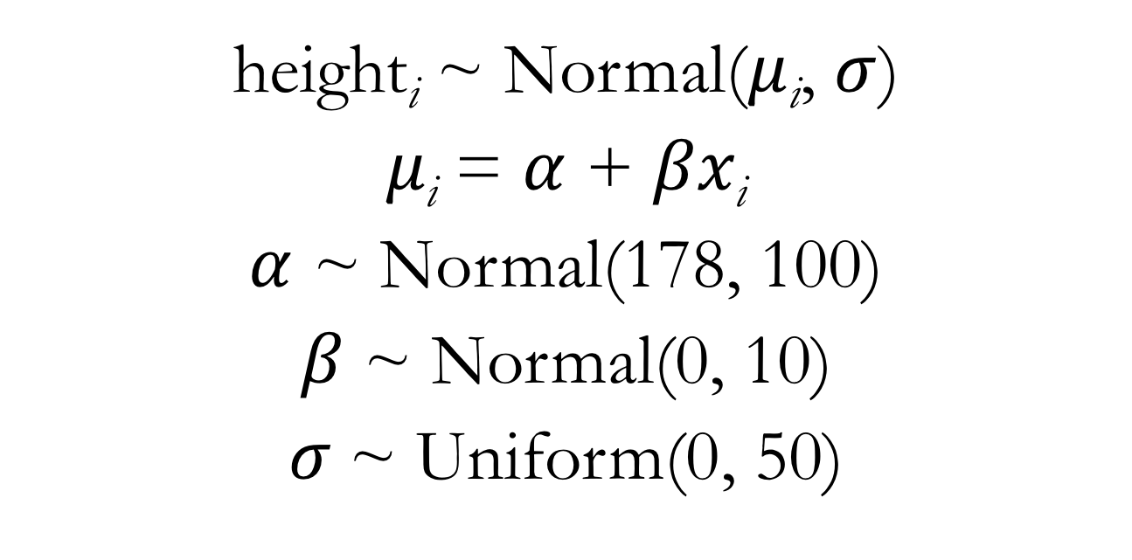
Gaussian Model for Height: Adding a Weight Predictor
height_{i} ~ Normal($μ$_{i}, $σ$)
$μ\text{i}$ = $α$ + $βx\text{i}$
$α$ ~ Normal(178, 100)
$β$ ~ Normal(0, 10)
$σ$~ Uniform(0, 50)
Notes:
This model includes a deterministic node in addition to stochastic nodes

Slide 15
Gaussian Model for Height: Adding a Weight Predictor
m4.3 <- map(
data = d2, # specify data to fit
alist(
# define statistical model
height ~ dnorm(mu, sigma), # likelihood
mu <- a + b*weight, # model mu using a linear formula
a ~ dnorm(178, 100), # prior for the intercept parameter
b ~ dnorm(0, 10), # prior for the slope parameter
sigma ~ dunif(0, 50) # prior for the sd parameter
)
)
Notes:
Point out how mu is not being directly modeled now
Discuss interpretation of alpha and beta parameters
Alpha, the intercept, is the expected mean of the outcome when the predictor has a value of 0
Beta, the slope, is the expected increase in the mean of the outcome for each one unit increase in the predictor

Slide 16
Interpretation of Slope Parameters
Slope parameters are often the major focus in interpretation of linear regression models
The slope parameter quantifies the strength of a predictor’s influence on the outcome
Significant posterior mass above 0 indicates a positive effect, significant posterior mass below 0 indicates a negative effect, significant posterior mass overlapping 0 indicates lack of an effect
Given this interpretation of slope parameters, it often makes sense to employ a prior for slope parameters that is centered at 0
Notes:
Show lecture code

Slide 17
Centering Predictor Variables
Subtract the raw variable mean from each value of the raw variable
Interpretation: a value of 0 for a centered variable corresponds to the mean value of the raw variable
Benefits:
Can improve model fitting
Can improve interpretability of the intercept parameter

Slide 18
Standardizing Predictor Variables
Subtract the raw variable mean from each value of the raw variable and divide by the raw variable’s standard deviation
Or the R function scale() will do this for you
Interpretation: a value of 0 for a standardized variable corresponds to the mean value of the raw variable, and an increase in 1 unit of the standardized variable corresponds to a 1 standard deviation increase in the raw variable
Benefits:
Can improve model fitting
Can improve interpretability of the intercept parameter
Allows easier comparison among predictors in a regression model with multiple predictors (i.e., multiple regression)

