Slide 1
Navigating Twists & Turns in Biological Research
Yihan Wang
Lianfeng Wu lab
School of Life Sciences, Westlake University
wangyihan@westlake.edu.cn

Slide 2
Hypothesis
Technical issue
Experiments
Trouble shooting:
Using the right controls
No technical issue
Results
Negative
Positive

Slide 3
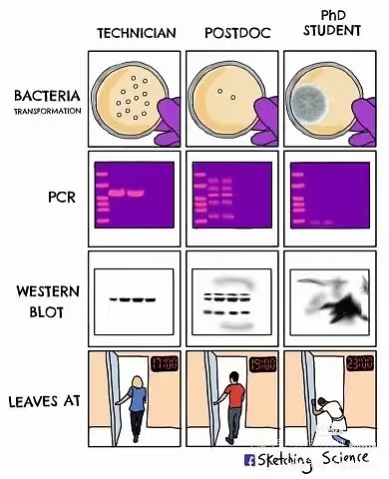
Technical Setbacks

Slide 4

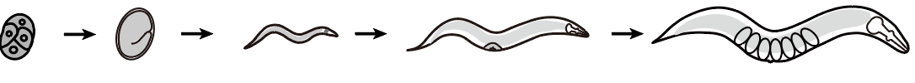
The question of my research: what happened in early life leaves a lasting mark on adult health and longevity
The model: C. elegans
2-3 weeks lifespan
Ease of genetic manipulations and screening
Conserved metabolic & aging pathways

Slide 5
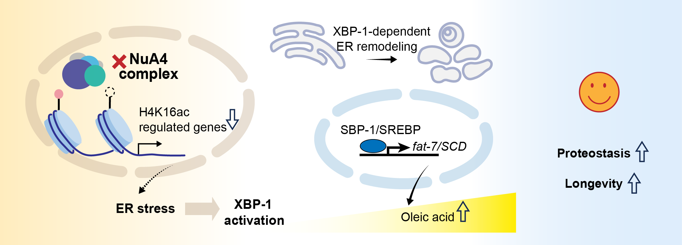
4
3
1
2
Epigenetic factor Stress response Lipid metabolism Aging
Wang et al., The EMBO Journal, 2026

Slide 6
A
Observation
Hypothesis
Testing
Unexpected Data
Model Refinement & Pivot
X
Y
Z
??
Phenotype

Slide 7
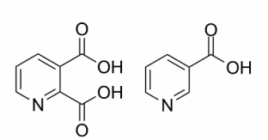
Don’t fall for your original hypothesis
QA
NA (Vitamin B3)
New Enzyme ?
NAPRT
NAD+
Animal growth
Zhu et al., Comm Bio, 2025

Slide 8
Things rarely go as planned in research. It is not a failure.
Technical setback is the road to reliable data
Negative data is the road to the true story of biology

Slide 9
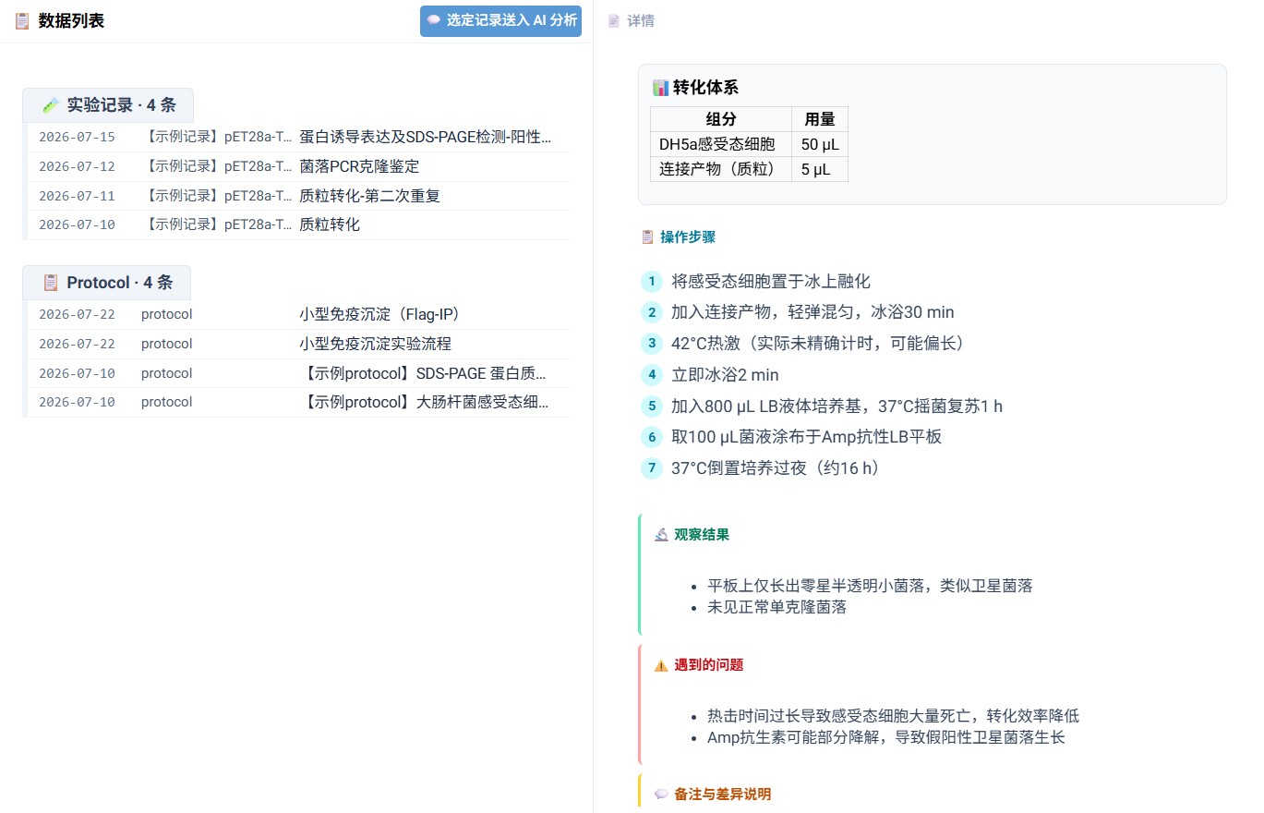
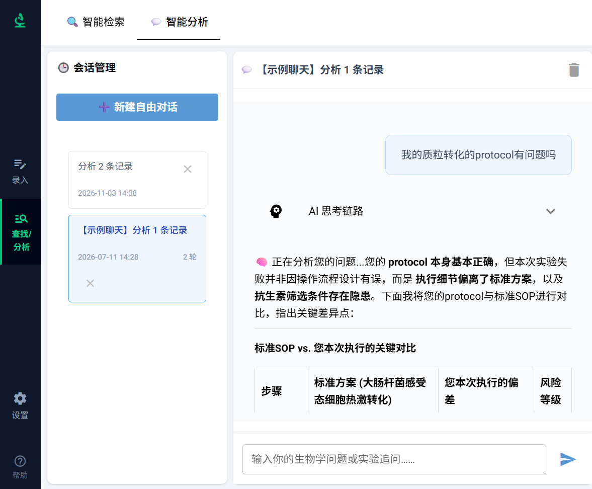
Using AI to mine the hidden value of negative experiments
© 2026 AI实验秘书

