Slide 1
Household and dwelling information
Information | 2013 | 2021 | Change
Household size | q_1_1_sq1 | ncomp_mfr | Retained, 2021 top-coded
Member age | cletad_1 ... cletad_12 | eta_mfr1 ... eta_mfr5 | Changed age bands, fewer members
Education | titstu_1 ... titstu_12 | istr_mfr1 ... istr_mfr5 | Retained, categories aggregated
Dwelling type | q_2_1 | v1_1 | Retained, categories changed
Construction year / floor area | q_2_4_ric / q_2_7_class | v1_2_new / v1_7_mfr | Retained in classes
Geography / survey weight | reg / rip / coef_red | REGIO / RIP / PESO | Retained
Notes:
Sources: ISTAT 2013 ECH_Tracciato_Anno 2013.html and ISTAT_MFR_ECH_Tracciato_2021_DELIMITED.html in repository METADATI directories; respective classification HTML and questionnaires. Availability refers to released microdata, not absence of the physical equipment.

Slide 2
Heating and cooling information
Information | 2013 | 2021 | Change
Main heating system | q_3_0 | v3_0 | Retained
Heating frequency / hours | q_3_10 / q_3_11A-C | v3_7 / v3_8a-c | Retained, three time bands
Air-conditioning inventory | q_2_37A-F | v2_11a-e | Retained, types regrouped
Main cooling system | q_5_0 | v5_0 | Retained
Cooling frequency / hours | q_5_7 / q_5_8A-C | v5_6 / v5_7a-c | Retained, three time bands
Heating / cooling equipment age | q_3_7_ric / q_5_4_ric | v3_5_mfr / v5_4_mfr | Retained in classes
Notes:
Sources: ISTAT 2013 ECH_Tracciato_Anno 2013.html and ISTAT_MFR_ECH_Tracciato_2021_DELIMITED.html in repository METADATI directories; respective classification HTML and questionnaires. Availability refers to released microdata, not absence of the physical equipment.

Slide 3
Insulation and windows
Information | 2013 | 2021 | Change
Thermal insulation rating | q_3_17 | Absent | Removed from released microdata
Wall insulation / insulation system | q_2_26 / q_2_27_1-3,9 | Absent | Removed from released microdata
Insulation / window improvements | q_3_19_7 / q_3_19_8 | v3_14gh_new | Merged into one indicator
Parent investment question | q_3_18 | v3_13 | Retained, preceding five years
Window-frame materials | q_2_10 / q_2_14 / q_2_18 | v1_10 / v1_13 / v1_16 | Retained
Double glazing | q_2_12 / q_2_16 / q_2_20 | v1_12_mfr / v1_15_mfr / v1_18_mfr | Retained, coding changed
Notes:
Sources: ISTAT 2013 ECH_Tracciato_Anno 2013.html and ISTAT_MFR_ECH_Tracciato_2021_DELIMITED.html in repository METADATI directories; respective classification HTML and questionnaires. Availability refers to released microdata, not absence of the physical equipment.

Slide 4
Appliance ownership and use
Information | 2013 | 2021 | Change
Lighting counts | q_7_1 / q_7_3 | v7_1a / v7_1b | Retained, two bulb types
Fridge / separate freezer | q_8_1 / q_8_7 | v7_5 / v7_8 | Ownership retained
Washer / dryer / dishwasher | q_8_10 / q_8_18 / q_8_23 | v7_10 / v7_16 / v7_19 | Ownership retained
Weekly appliance cycles | q_8_14 / q_8_22 / q_8_26 | v7_12a / v7_18a / v7_21a | Retained
Washing-temperature bands | q_8_15A-C | v7_13a-c | Retained, three bands
TV / computer count and hours | q_8_40,42 / q_8_44,46 | v7_33,35 / v7_37,39 | Retained, computer scope changed
Notes:
Sources: ISTAT 2013 ECH_Tracciato_Anno 2013.html and ISTAT_MFR_ECH_Tracciato_2021_DELIMITED.html in repository METADATI directories; respective classification HTML and questionnaires. Availability refers to released microdata, not absence of the physical equipment.

Slide 5
Information no longer released separately
Information | 2013 | 2021 | Change
Lighting operating-time bands | q_7_2A-C / q_7_4A-C | Absent | No household lighting hours
Fridge count / size | q_8_2 / q_8_5 | Absent | Ownership and age remain
Washer / dryer / oven size | q_8_13 / q_8_21 / q_8_37 | Absent | No corresponding size fields
Small-appliance inventory | q_8_28A-D / q_8_38A-M | Absent | No equivalent detailed inventory
TV counts by technology | q_8_41A-D | v7_34 | Primary TV type, not counts by type
Computer counts by type | q_8_45A-B | v7_38 | Primary type, not counts by type
Notes:
Sources: ISTAT 2013 ECH_Tracciato_Anno 2013.html and ISTAT_MFR_ECH_Tracciato_2021_DELIMITED.html in repository METADATI directories; respective classification HTML and questionnaires. Availability refers to released microdata, not absence of the physical equipment.

Slide 6
More detail in 2021
Information | 2013 | 2021 | Change
Window configuration counts | q_2_11_class / 15_class / 19_class | v1_11a-e_mfr / 14a-e_mfr / 17a-e_mfr | Window / door-window, one / two leaves
Auxiliary heating hours | q_3_16 | v3_12a-c | Daily total becomes three time bands
Auxiliary cooling hours | q_5_13 | v5_10a-c | Daily total becomes three time bands
Infrequent appliance use | q_8_14 / q_8_22 / q_8_26 | v7_12b / v7_18b / v7_21b | Explicit 1-2 times/month or less
Electricity spending | q_9_1_ric | elettricita_eu_mfr | Classes become reported euros
Wood / pellet quantity and spending | q_6_5_ric,9_ric,13_ric,15_ric | v6_6_mfr,9_mfr,12_mfr,14_mfr | Classes become point values
Notes:
Sources: ISTAT 2013 ECH_Tracciato_Anno 2013.html and ISTAT_MFR_ECH_Tracciato_2021_DELIMITED.html in repository METADATI directories; respective classification HTML and questionnaires. Availability refers to released microdata, not absence of the physical equipment.

Slide 7
New explicit fields in 2021
Information | 2013 | 2021 | Change
Interview mode / sample | Absent | TECNICA / CAMPIONE | CATI / CAWI collection fields
Hybrid solar system | No separate hybrid field | v2_14e | Photovoltaic plus thermal
Gas barbecue | No separate gas-barbecue field | v7_27 | Dedicated ownership field
Powered gardening equipment | No equivalent dedicated fields | v7_41 / v7_42a-c | Ownership and energy source
Computer scope | Desktop / portable computers | v7_36-39 | Computers and similar devices, tablets included
Notes:
Sources: ISTAT 2013 ECH_Tracciato_Anno 2013.html and ISTAT_MFR_ECH_Tracciato_2021_DELIMITED.html in repository METADATI directories; respective classification HTML and questionnaires. Availability refers to released microdata, not absence of the physical equipment.

Slide 8
Comparison definitions
Information | 2013 | 2021 | Change
Source of values | Published article, 2013 survey | Latest 2021 manuscript | Different analysis specifications
PCA and archetypes | Published 2013 estimates | Frozen revised 2013 training basis | Not a newly fitted 2021 PCA
Heating boxplot colors | Current subjective insulation rating | Improvements in preceding five years | Different measures, unknowns excluded
Electricity boxplot colors | Cooling system used / not used | Cooling equipment present / absent | Different definitions
Geographical map | Municipal climate zones and legal limits | Regional mean reported heating hours | Different quantities
Appliance electricity | Published model-derived kWh | Model-derived kWh, explicit assumptions | Neither column is metered appliance use
Notes:
Sources: ISTAT 2013 ECH_Tracciato_Anno 2013.html and ISTAT_MFR_ECH_Tracciato_2021_DELIMITED.html in repository METADATI directories; respective classification HTML and questionnaires. Availability refers to released microdata, not absence of the physical equipment. https://www.research.unipd.it/retrieve/01d67fde-fa74-4d70-b216-26ba79c542bd/1-s2.0-S0378778825006541-main.pdf; output/pdf/italian_user_archetypes_corrected_2021.pdf. Comparative differences are not a causal or pure temporal estimate.

Slide 9
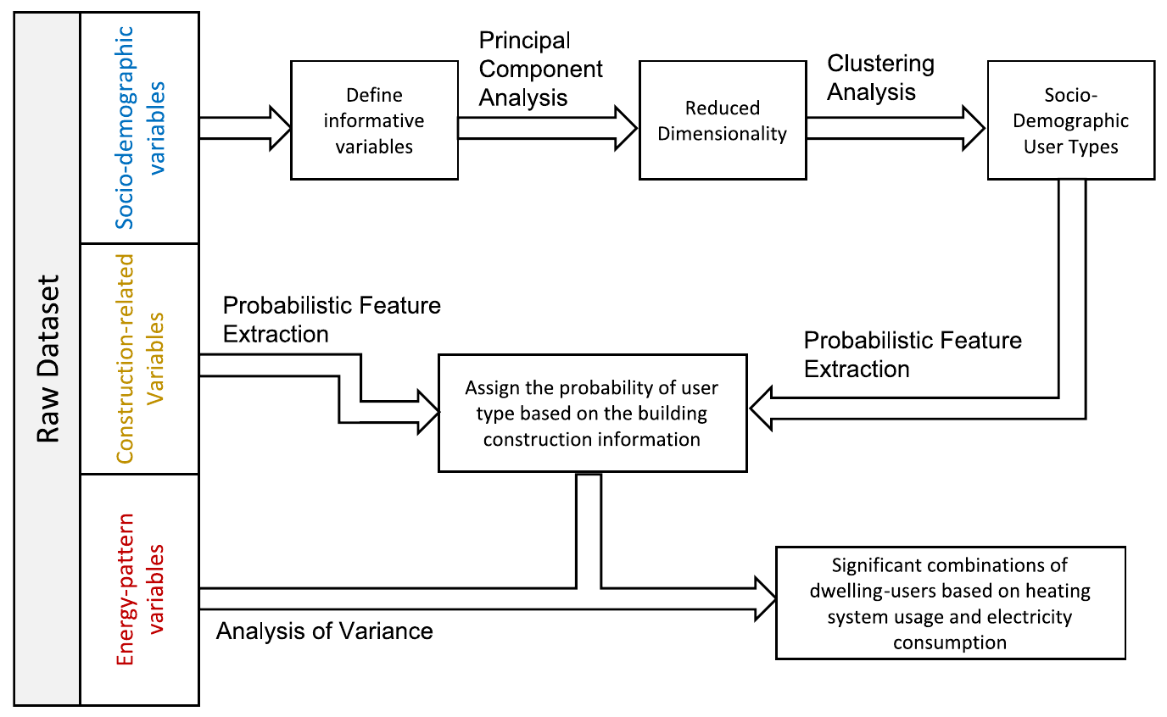
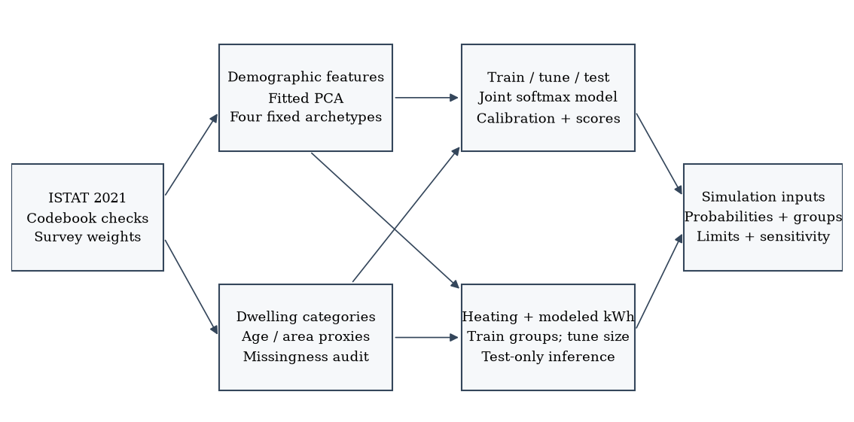
2013
2021
Notes:
2013: Khajedehi, Vivian and Zarrella (2025), Energy & Buildings 344, 115924, f1, PDF page 4. https://www.research.unipd.it/retrieve/01d67fde-fa74-4d70-b216-26ba79c542bd/1-s2.0-S0378778825006541-main.pdf CC BY 4.0. Original published visual, cropped without changing values. 2021: repository output/pdf/italian_user_archetypes_corrected_2021.pdf and revised_paper_outputs/2021/figures. Counterpart from revised 2021 analysis. Definitions and methods differ as stated in the opening comparison.

Slide 10
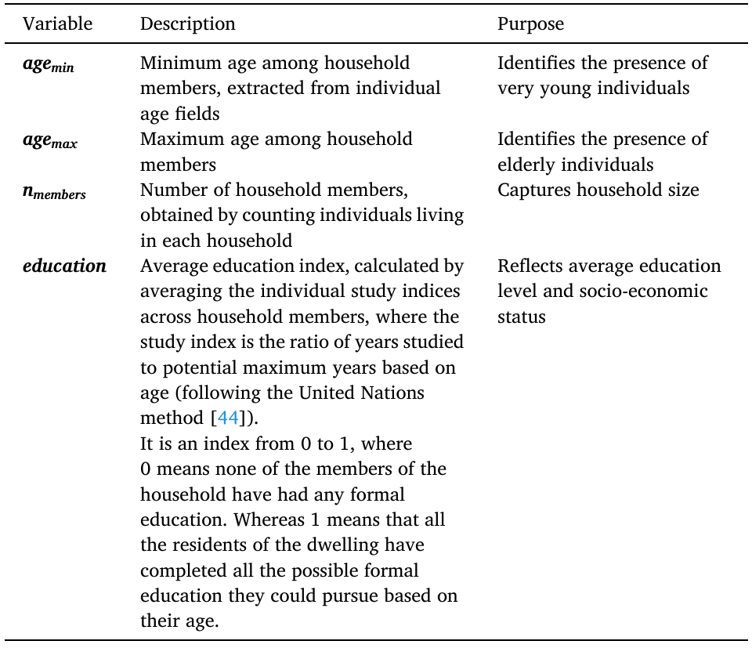
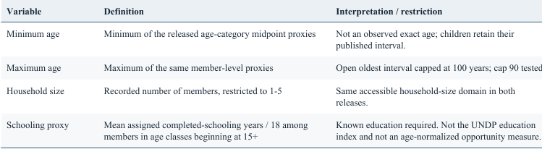
2013
2021
Notes:
2013: Khajedehi, Vivian and Zarrella (2025), Energy & Buildings 344, 115924, t1, PDF page 4. https://www.research.unipd.it/retrieve/01d67fde-fa74-4d70-b216-26ba79c542bd/1-s2.0-S0378778825006541-main.pdf CC BY 4.0. Original published visual, cropped without changing values. 2021: repository output/pdf/italian_user_archetypes_corrected_2021.pdf and revised_paper_outputs/2021/figures. Counterpart from revised 2021 analysis. Definitions and methods differ as stated in the opening comparison.

Slide 11
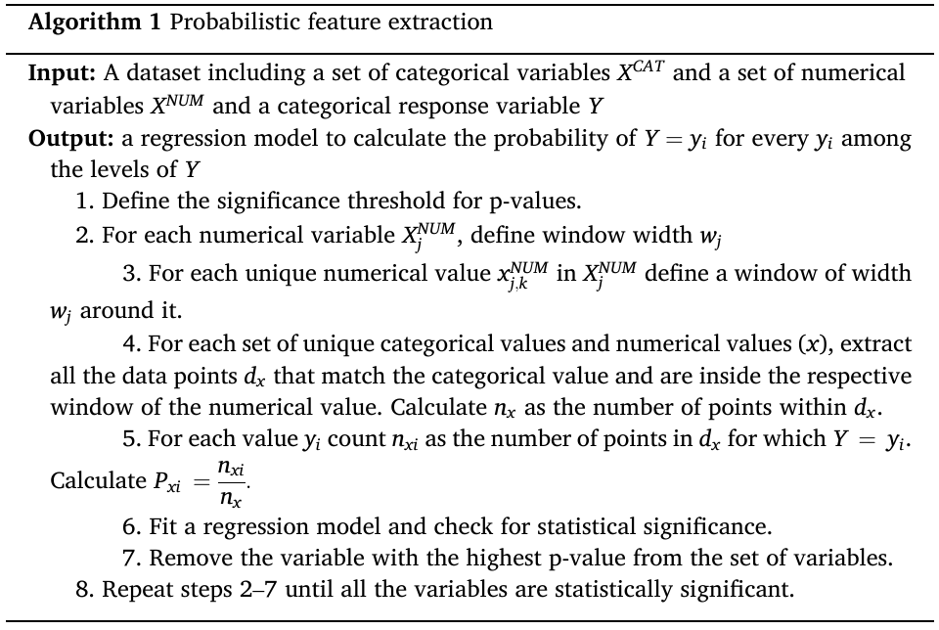
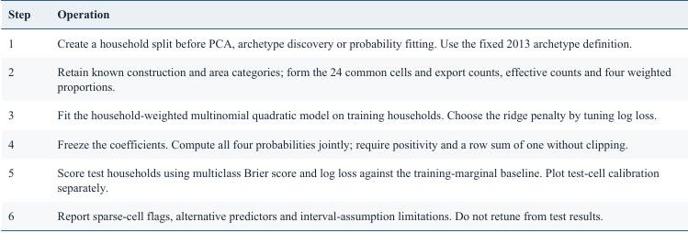
2013
2021
Notes:
2013: Khajedehi, Vivian and Zarrella (2025), Energy & Buildings 344, 115924, a1, PDF page 5. https://www.research.unipd.it/retrieve/01d67fde-fa74-4d70-b216-26ba79c542bd/1-s2.0-S0378778825006541-main.pdf CC BY 4.0. Original published visual, cropped without changing values. 2021: repository output/pdf/italian_user_archetypes_corrected_2021.pdf and revised_paper_outputs/2021/figures. Counterpart from revised 2021 analysis. Definitions and methods differ as stated in the opening comparison.

Slide 12
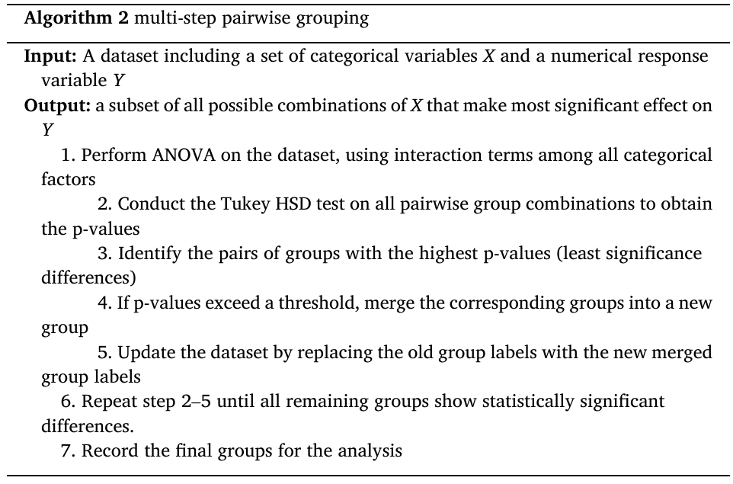
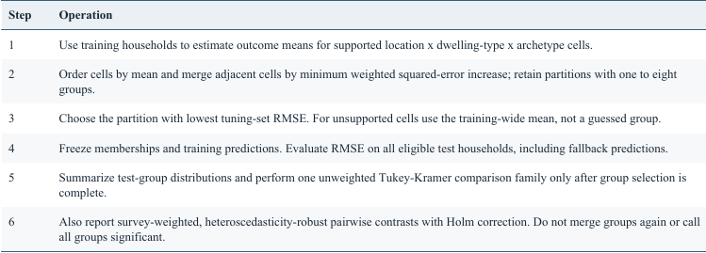
2013
2021
Notes:
2013: Khajedehi, Vivian and Zarrella (2025), Energy & Buildings 344, 115924, a2, PDF page 5. https://www.research.unipd.it/retrieve/01d67fde-fa74-4d70-b216-26ba79c542bd/1-s2.0-S0378778825006541-main.pdf CC BY 4.0. Original published visual, cropped without changing values. 2021: repository output/pdf/italian_user_archetypes_corrected_2021.pdf and revised_paper_outputs/2021/figures. Counterpart from revised 2021 analysis. Definitions and methods differ as stated in the opening comparison.

Slide 13
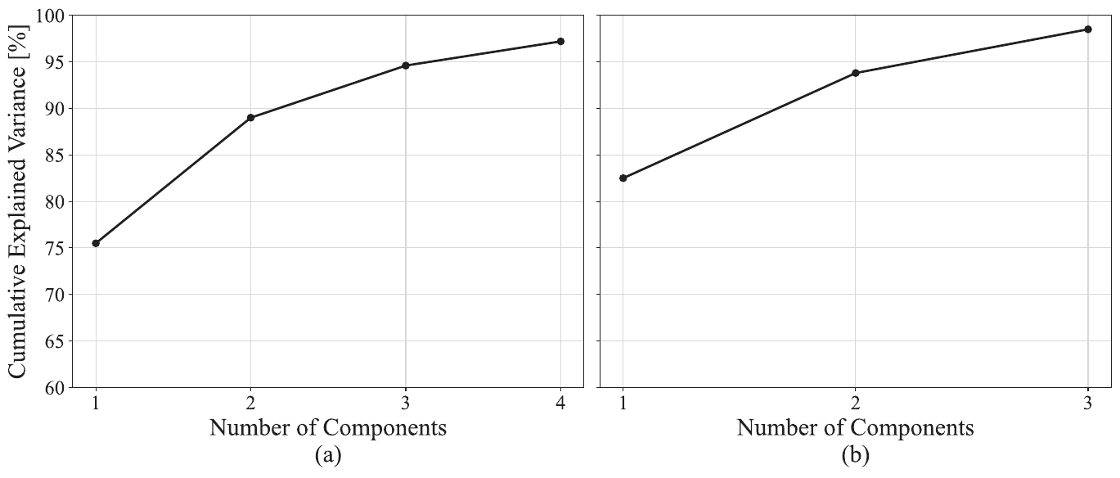
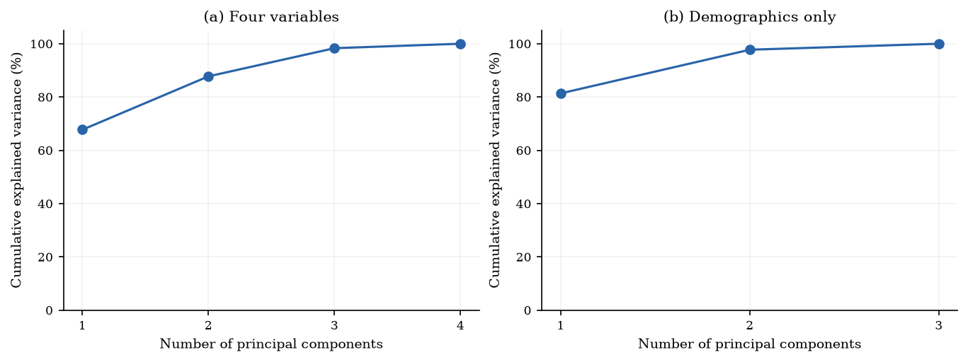
2013
2021
Notes:
2013: Khajedehi, Vivian and Zarrella (2025), Energy & Buildings 344, 115924, f2, PDF page 6. https://www.research.unipd.it/retrieve/01d67fde-fa74-4d70-b216-26ba79c542bd/1-s2.0-S0378778825006541-main.pdf CC BY 4.0. Original published visual, cropped without changing values. 2021: repository output/pdf/italian_user_archetypes_corrected_2021.pdf and revised_paper_outputs/2021/figures. Counterpart from revised 2021 analysis. Definitions and methods differ as stated in the opening comparison.

Slide 14
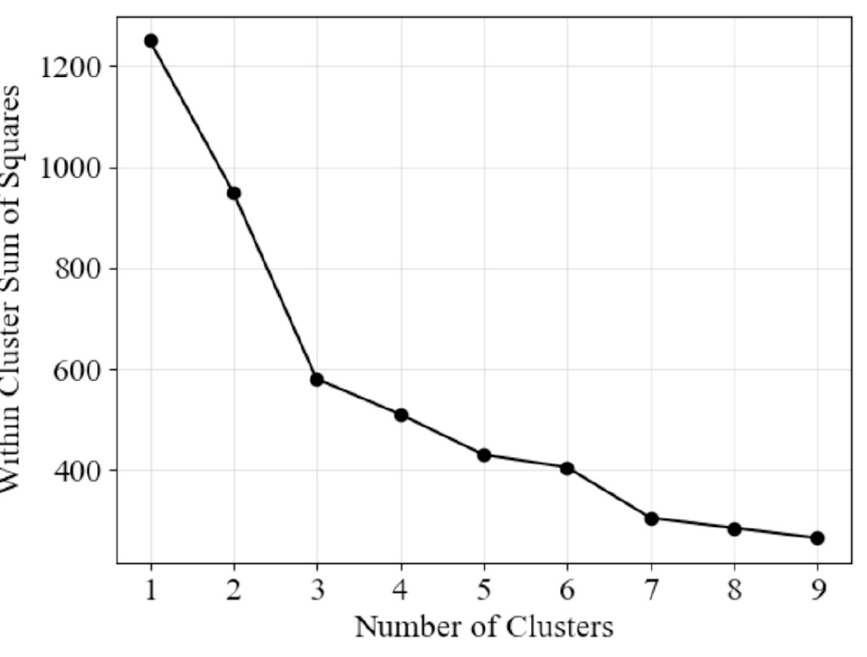
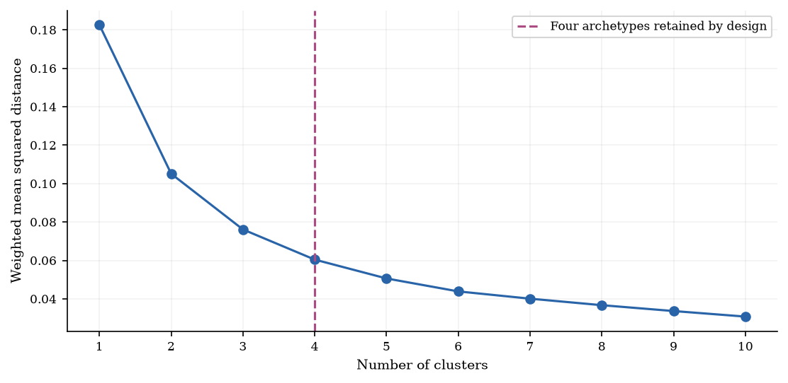
2013
2021
Notes:
2013: Khajedehi, Vivian and Zarrella (2025), Energy & Buildings 344, 115924, f3, PDF page 6. https://www.research.unipd.it/retrieve/01d67fde-fa74-4d70-b216-26ba79c542bd/1-s2.0-S0378778825006541-main.pdf CC BY 4.0. Original published visual, cropped without changing values. 2021: repository output/pdf/italian_user_archetypes_corrected_2021.pdf and revised_paper_outputs/2021/figures. Counterpart from revised 2021 analysis. Definitions and methods differ as stated in the opening comparison.

Slide 15
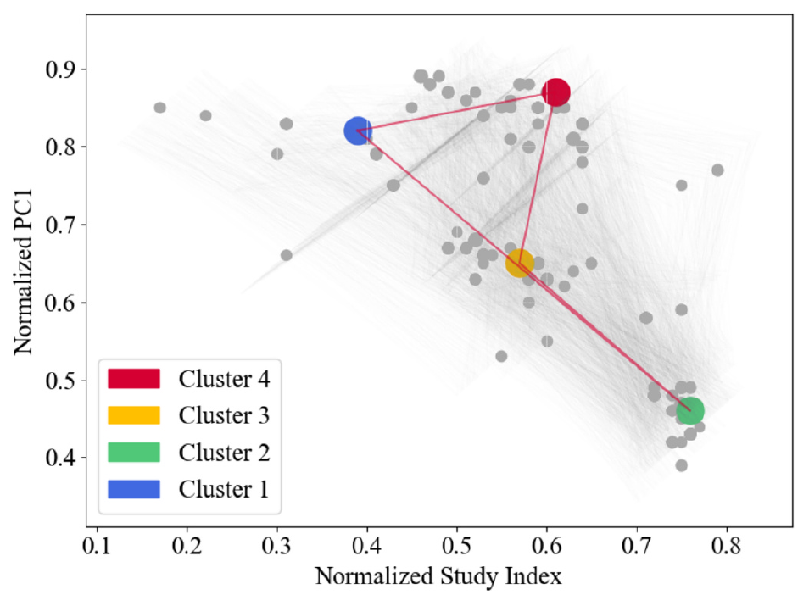
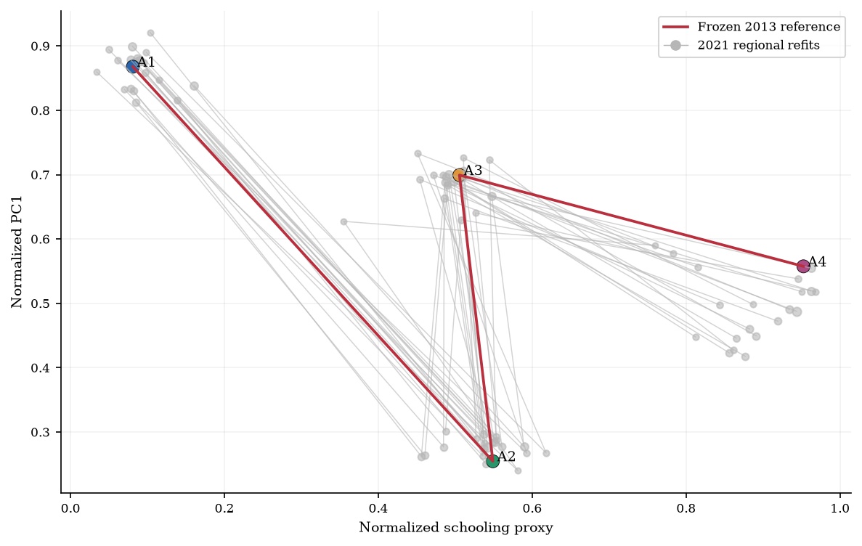
2013
2021
Notes:
2013: Khajedehi, Vivian and Zarrella (2025), Energy & Buildings 344, 115924, f4, PDF page 6. https://www.research.unipd.it/retrieve/01d67fde-fa74-4d70-b216-26ba79c542bd/1-s2.0-S0378778825006541-main.pdf CC BY 4.0. Original published visual, cropped without changing values. 2021: repository output/pdf/italian_user_archetypes_corrected_2021.pdf and revised_paper_outputs/2021/figures. Counterpart from revised 2021 analysis. Definitions and methods differ as stated in the opening comparison.

Slide 16
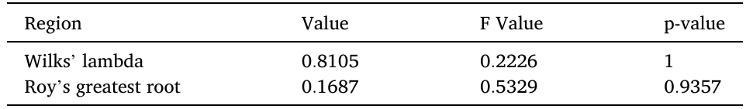

2013
2021
Notes:
2013: Khajedehi, Vivian and Zarrella (2025), Energy & Buildings 344, 115924, t2, PDF page 6. https://www.research.unipd.it/retrieve/01d67fde-fa74-4d70-b216-26ba79c542bd/1-s2.0-S0378778825006541-main.pdf CC BY 4.0. Original published visual, cropped without changing values. 2021: repository output/pdf/italian_user_archetypes_corrected_2021.pdf and revised_paper_outputs/2021/figures. Counterpart from revised 2021 analysis. Definitions and methods differ as stated in the opening comparison.

Slide 17
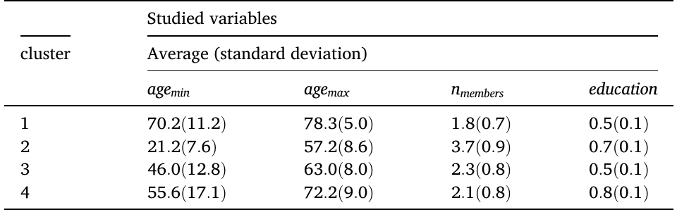
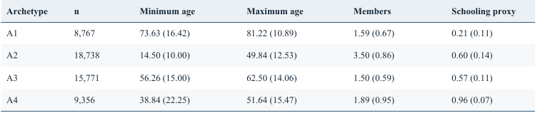
2013
2021
Notes:
2013: Khajedehi, Vivian and Zarrella (2025), Energy & Buildings 344, 115924, t3, PDF page 7. https://www.research.unipd.it/retrieve/01d67fde-fa74-4d70-b216-26ba79c542bd/1-s2.0-S0378778825006541-main.pdf CC BY 4.0. Original published visual, cropped without changing values. 2021: repository output/pdf/italian_user_archetypes_corrected_2021.pdf and revised_paper_outputs/2021/figures. Counterpart from revised 2021 analysis. Definitions and methods differ as stated in the opening comparison.

Slide 18
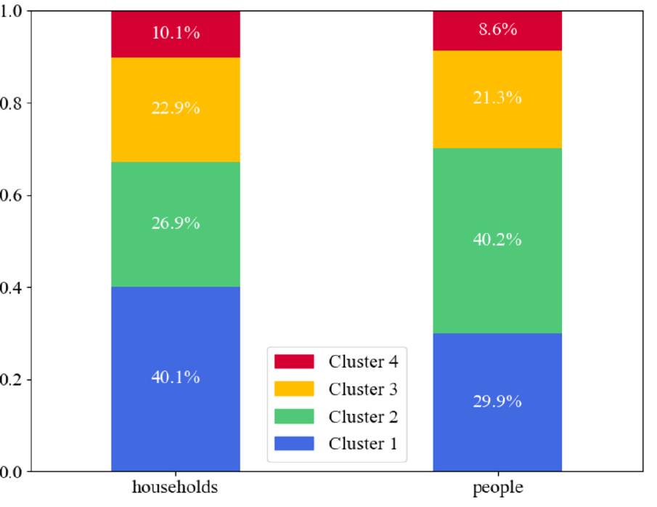
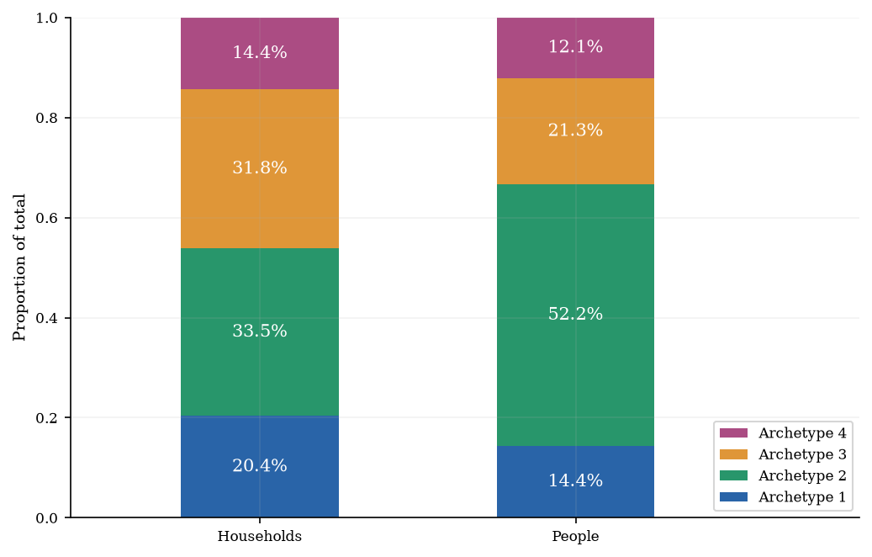
2013
2021
Notes:
2013: Khajedehi, Vivian and Zarrella (2025), Energy & Buildings 344, 115924, f5, PDF page 7. https://www.research.unipd.it/retrieve/01d67fde-fa74-4d70-b216-26ba79c542bd/1-s2.0-S0378778825006541-main.pdf CC BY 4.0. Original published visual, cropped without changing values. 2021: repository output/pdf/italian_user_archetypes_corrected_2021.pdf and revised_paper_outputs/2021/figures. Counterpart from revised 2021 analysis. Definitions and methods differ as stated in the opening comparison.

Slide 19
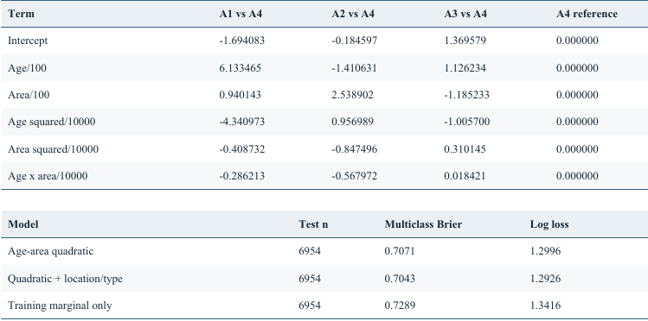
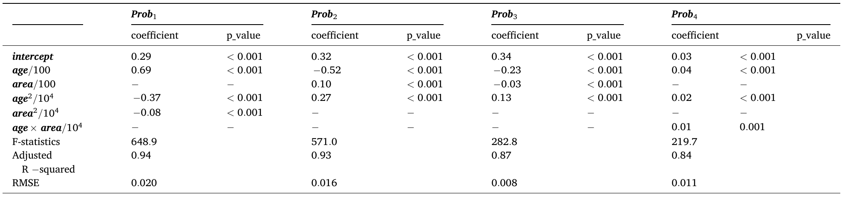
2013
2021
Notes:
2013: Khajedehi, Vivian and Zarrella (2025), Energy & Buildings 344, 115924, t4, PDF page 8. https://www.research.unipd.it/retrieve/01d67fde-fa74-4d70-b216-26ba79c542bd/1-s2.0-S0378778825006541-main.pdf CC BY 4.0. Original published visual, cropped without changing values. 2021: repository output/pdf/italian_user_archetypes_corrected_2021.pdf and revised_paper_outputs/2021/figures. Counterpart from revised 2021 analysis. Definitions and methods differ as stated in the opening comparison.

Slide 20
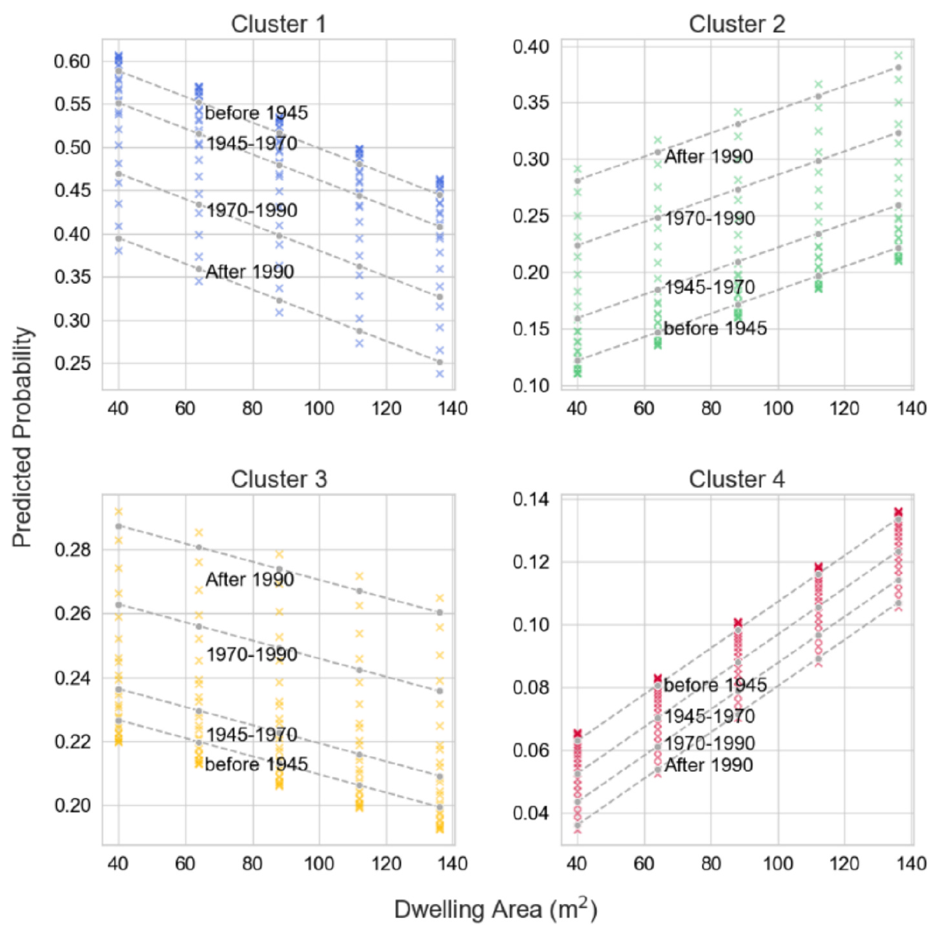
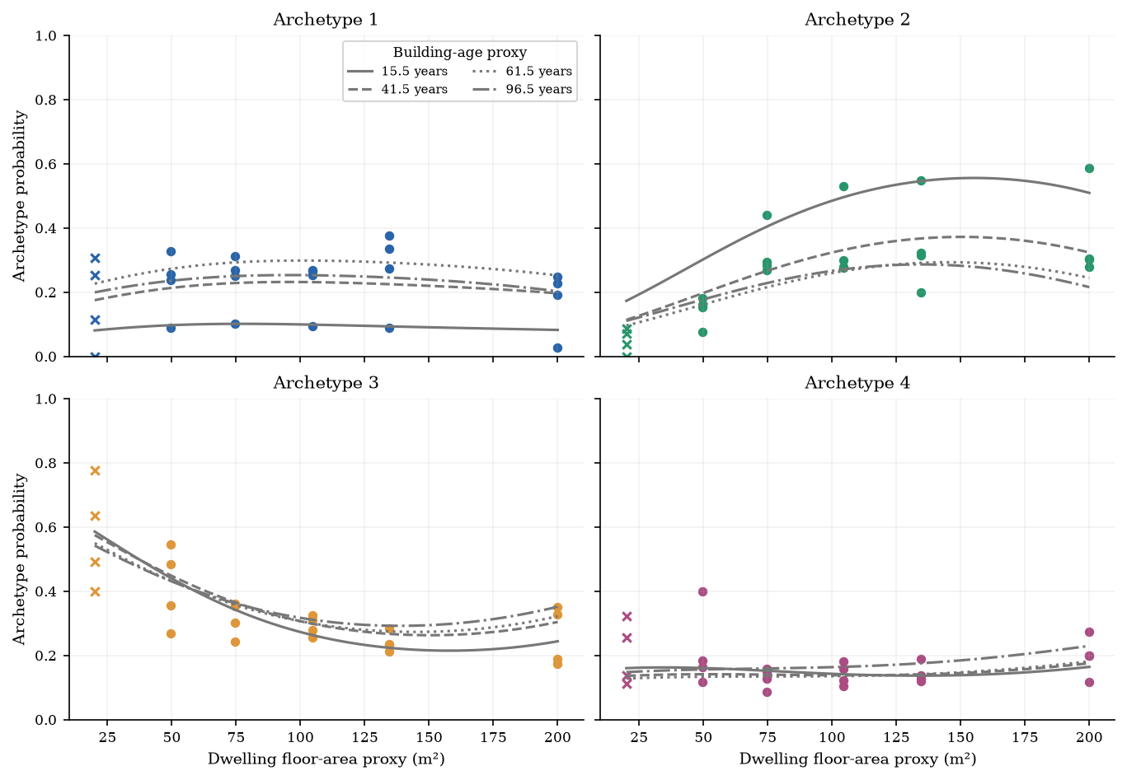
2013
2021
Notes:
2013: Khajedehi, Vivian and Zarrella (2025), Energy & Buildings 344, 115924, f6, PDF page 8. https://www.research.unipd.it/retrieve/01d67fde-fa74-4d70-b216-26ba79c542bd/1-s2.0-S0378778825006541-main.pdf CC BY 4.0. Original published visual, cropped without changing values. 2021: repository output/pdf/italian_user_archetypes_corrected_2021.pdf and revised_paper_outputs/2021/figures. Counterpart from revised 2021 analysis. Definitions and methods differ as stated in the opening comparison.

Slide 21
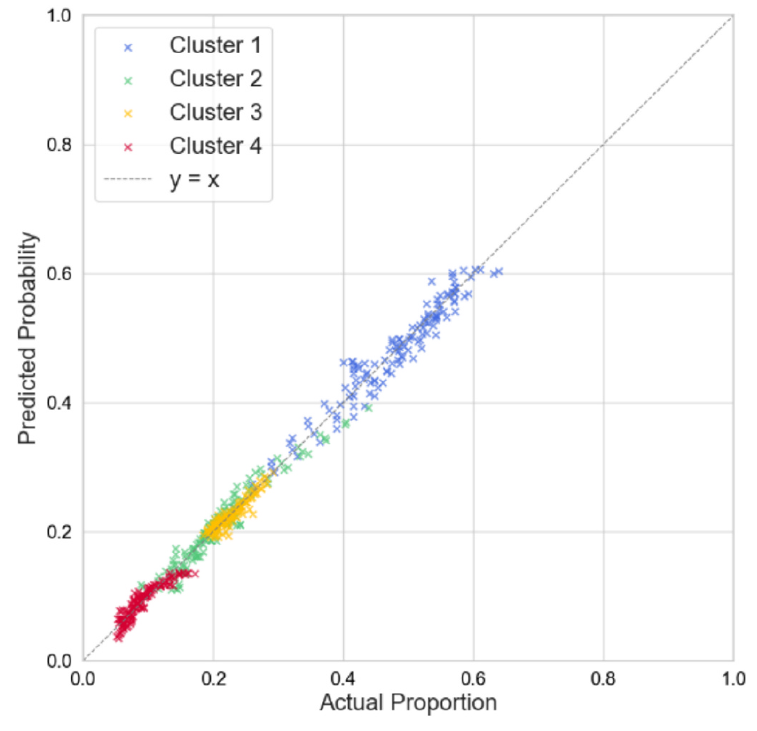
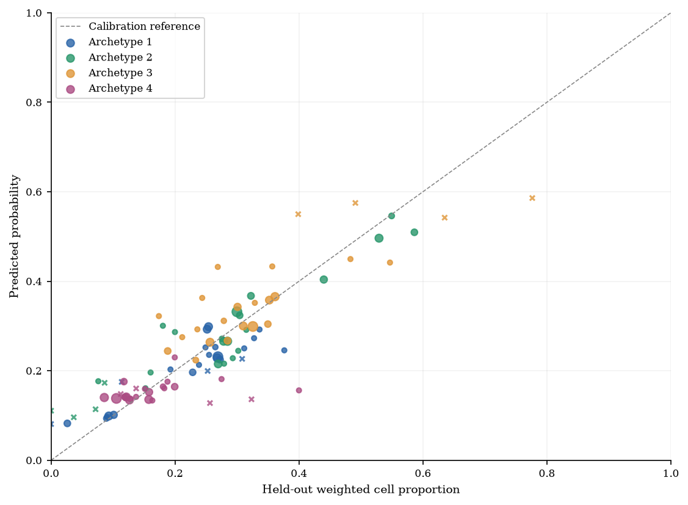
2013
2021
Notes:
2013: Khajedehi, Vivian and Zarrella (2025), Energy & Buildings 344, 115924, f7, PDF page 9. https://www.research.unipd.it/retrieve/01d67fde-fa74-4d70-b216-26ba79c542bd/1-s2.0-S0378778825006541-main.pdf CC BY 4.0. Original published visual, cropped without changing values. 2021: repository output/pdf/italian_user_archetypes_corrected_2021.pdf and revised_paper_outputs/2021/figures. Counterpart from revised 2021 analysis. Definitions and methods differ as stated in the opening comparison.

Slide 22
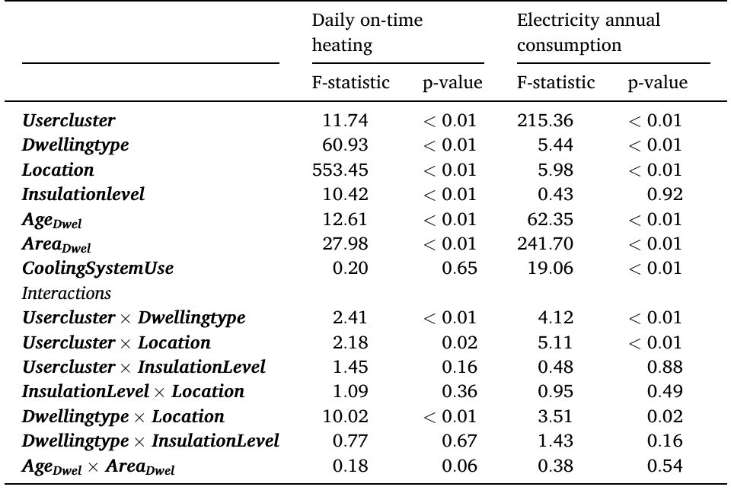
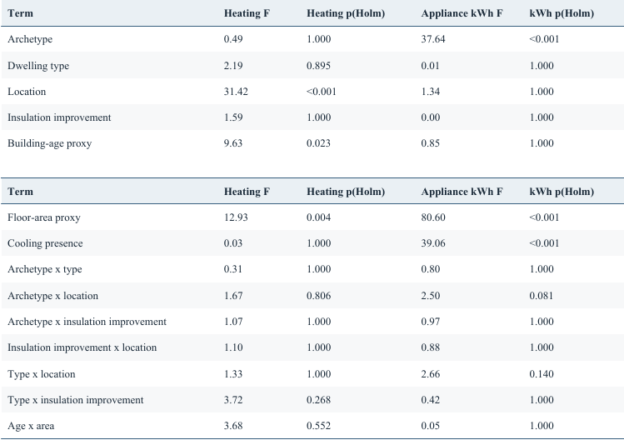
2013
2021
Notes:
2013: Khajedehi, Vivian and Zarrella (2025), Energy & Buildings 344, 115924, t5, PDF page 9. https://www.research.unipd.it/retrieve/01d67fde-fa74-4d70-b216-26ba79c542bd/1-s2.0-S0378778825006541-main.pdf CC BY 4.0. Original published visual, cropped without changing values. 2021: repository output/pdf/italian_user_archetypes_corrected_2021.pdf and revised_paper_outputs/2021/figures. Counterpart from revised 2021 analysis. Definitions and methods differ as stated in the opening comparison.

Slide 23
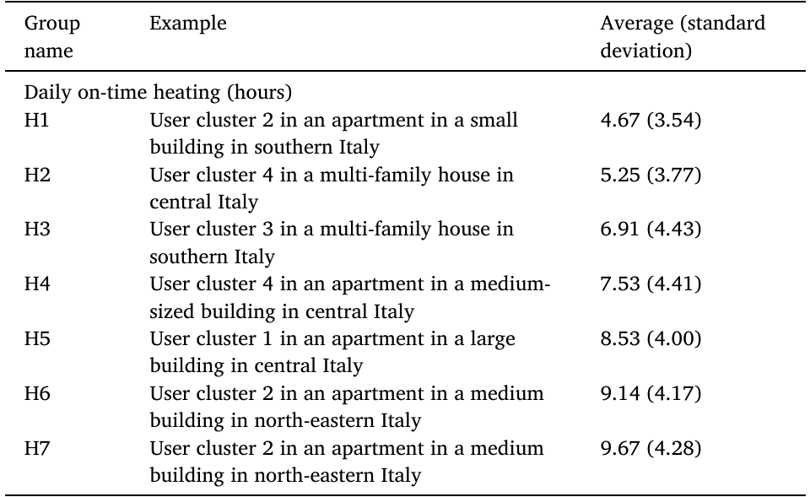
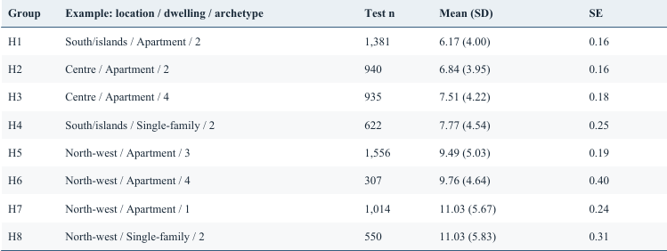
2013
2021
Notes:
2013: Khajedehi, Vivian and Zarrella (2025), Energy & Buildings 344, 115924, t6a, PDF page 10. https://www.research.unipd.it/retrieve/01d67fde-fa74-4d70-b216-26ba79c542bd/1-s2.0-S0378778825006541-main.pdf CC BY 4.0. Original published visual, cropped without changing values. 2021: repository output/pdf/italian_user_archetypes_corrected_2021.pdf and revised_paper_outputs/2021/figures. Counterpart from revised 2021 analysis. Definitions and methods differ as stated in the opening comparison.

Slide 24
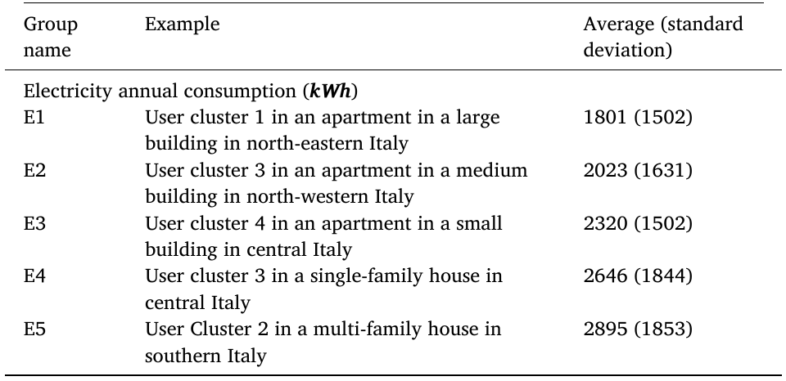
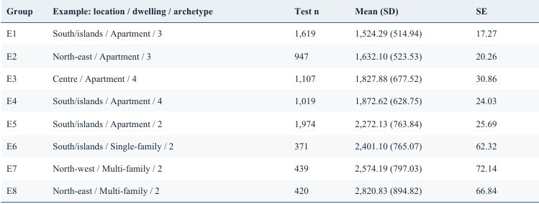
2013
2021
Notes:
2013: Khajedehi, Vivian and Zarrella (2025), Energy & Buildings 344, 115924, t6b, PDF page 10. https://www.research.unipd.it/retrieve/01d67fde-fa74-4d70-b216-26ba79c542bd/1-s2.0-S0378778825006541-main.pdf CC BY 4.0. Original published visual, cropped without changing values. 2021: repository output/pdf/italian_user_archetypes_corrected_2021.pdf and revised_paper_outputs/2021/figures. Counterpart from revised 2021 analysis. Definitions and methods differ as stated in the opening comparison.

Slide 25
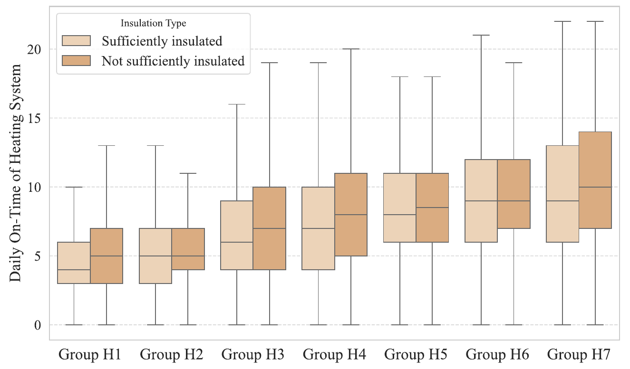
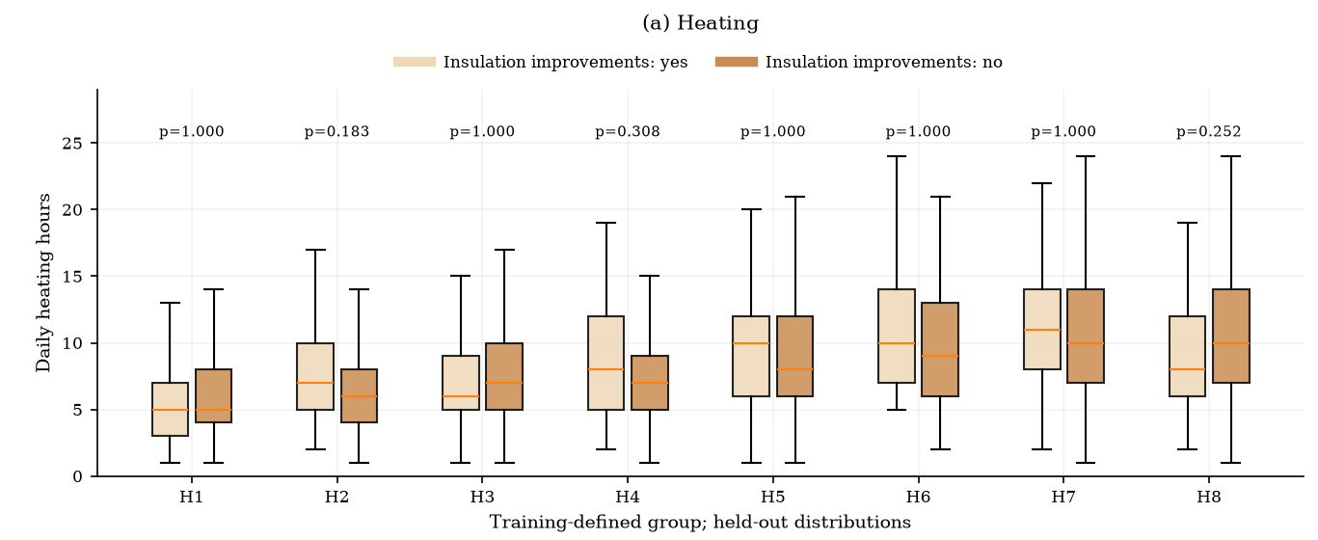
2013
2021
Notes:
2013: Khajedehi, Vivian and Zarrella (2025), Energy & Buildings 344, 115924, f8a, PDF page 11. https://www.research.unipd.it/retrieve/01d67fde-fa74-4d70-b216-26ba79c542bd/1-s2.0-S0378778825006541-main.pdf CC BY 4.0. Original published visual, cropped without changing values. 2021: repository output/pdf/italian_user_archetypes_corrected_2021.pdf and revised_paper_outputs/2021/figures. Counterpart from revised 2021 analysis. Definitions and methods differ as stated in the opening comparison.

Slide 26
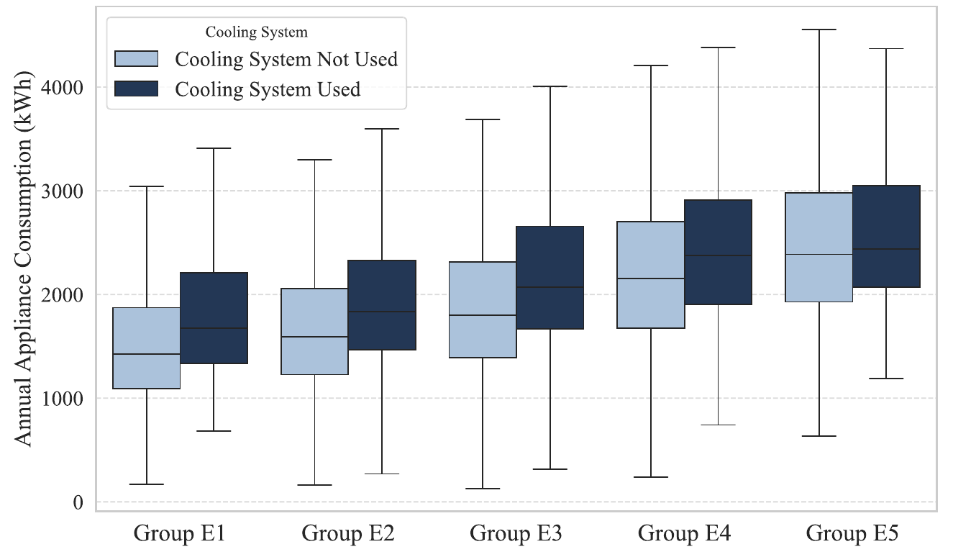
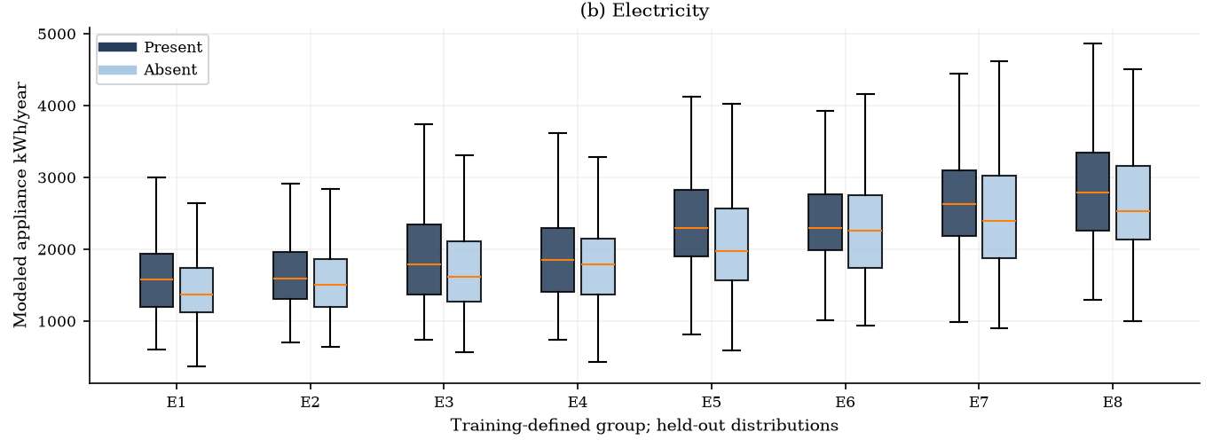
2013
2021
Notes:
2013: Khajedehi, Vivian and Zarrella (2025), Energy & Buildings 344, 115924, f8b, PDF page 11. https://www.research.unipd.it/retrieve/01d67fde-fa74-4d70-b216-26ba79c542bd/1-s2.0-S0378778825006541-main.pdf CC BY 4.0. Original published visual, cropped without changing values. 2021: repository output/pdf/italian_user_archetypes_corrected_2021.pdf and revised_paper_outputs/2021/figures. Counterpart from revised 2021 analysis. Definitions and methods differ as stated in the opening comparison.

Slide 27
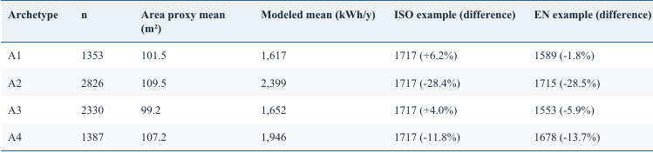
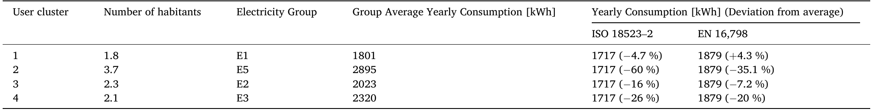
2013
2021
Notes:
2013: Khajedehi, Vivian and Zarrella (2025), Energy & Buildings 344, 115924, t7, PDF page 12. https://www.research.unipd.it/retrieve/01d67fde-fa74-4d70-b216-26ba79c542bd/1-s2.0-S0378778825006541-main.pdf CC BY 4.0. Original published visual, cropped without changing values. 2021: repository output/pdf/italian_user_archetypes_corrected_2021.pdf and revised_paper_outputs/2021/figures. Counterpart from revised 2021 analysis. Definitions and methods differ as stated in the opening comparison.

Slide 28
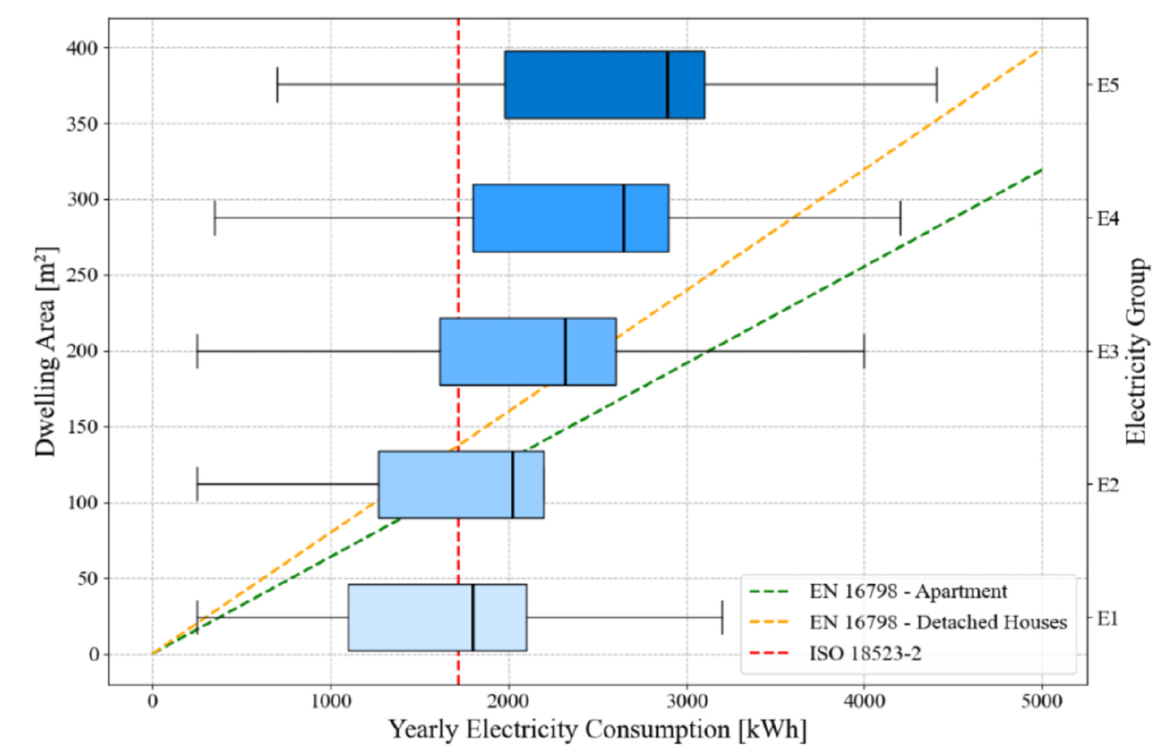
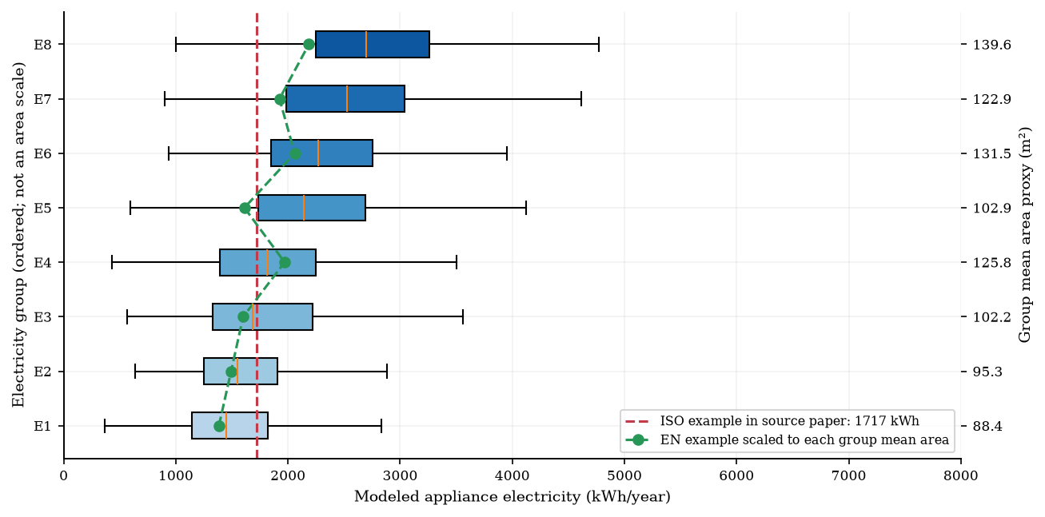
2013
2021
Notes:
2013: Khajedehi, Vivian and Zarrella (2025), Energy & Buildings 344, 115924, f9, PDF page 12. https://www.research.unipd.it/retrieve/01d67fde-fa74-4d70-b216-26ba79c542bd/1-s2.0-S0378778825006541-main.pdf CC BY 4.0. Original published visual, cropped without changing values. 2021: repository output/pdf/italian_user_archetypes_corrected_2021.pdf and revised_paper_outputs/2021/figures. Counterpart from revised 2021 analysis. Definitions and methods differ as stated in the opening comparison.

Slide 29
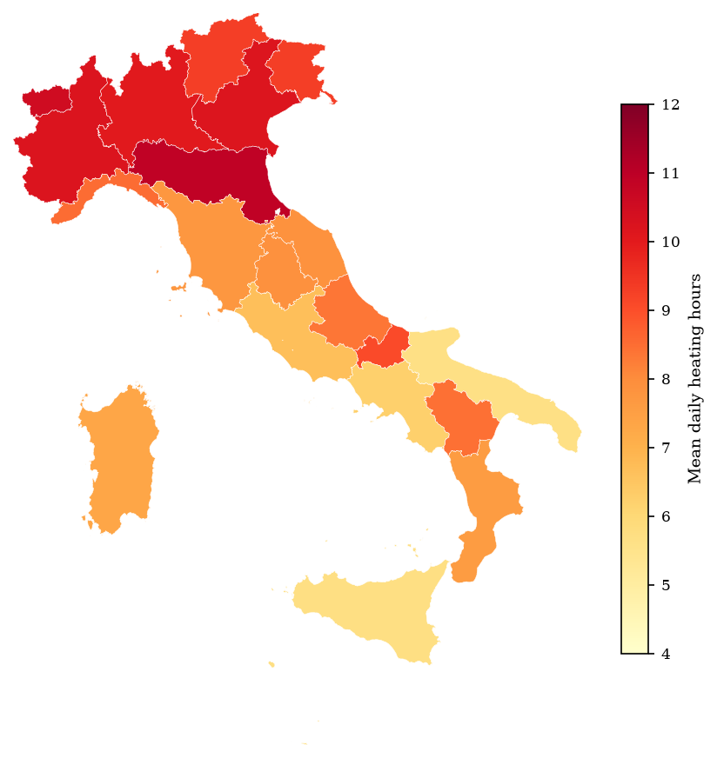
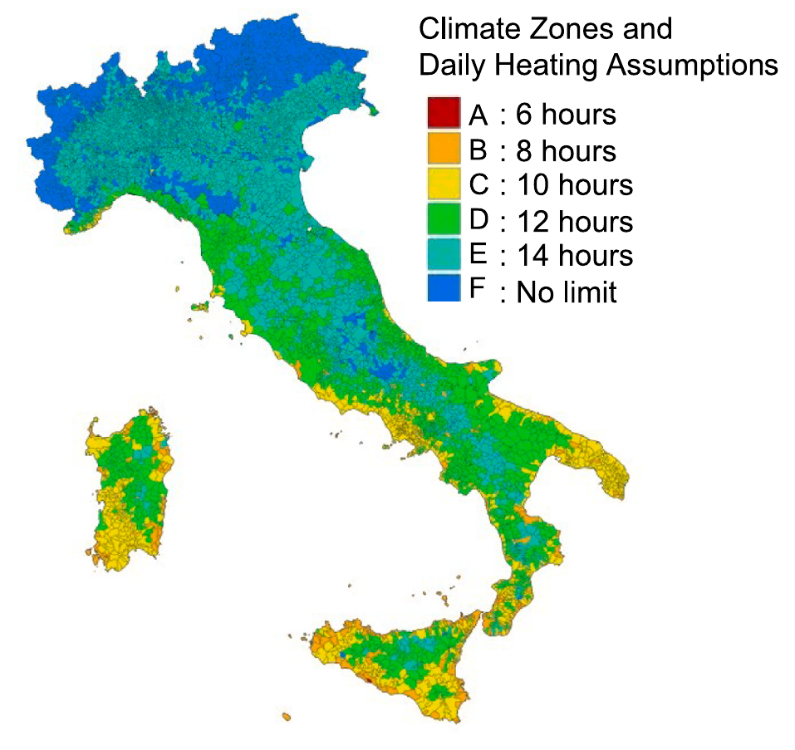
2013
2021
Notes:
2013: Khajedehi, Vivian and Zarrella (2025), Energy & Buildings 344, 115924, f10, PDF page 13. https://www.research.unipd.it/retrieve/01d67fde-fa74-4d70-b216-26ba79c542bd/1-s2.0-S0378778825006541-main.pdf CC BY 4.0. Original published visual, cropped without changing values. 2021: repository output/pdf/italian_user_archetypes_corrected_2021.pdf and revised_paper_outputs/2021/figures. Counterpart from revised 2021 analysis. Definitions and methods differ as stated in the opening comparison.

Slide 30
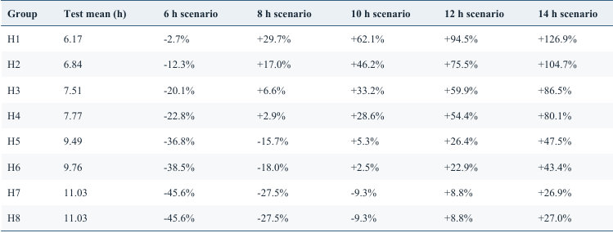
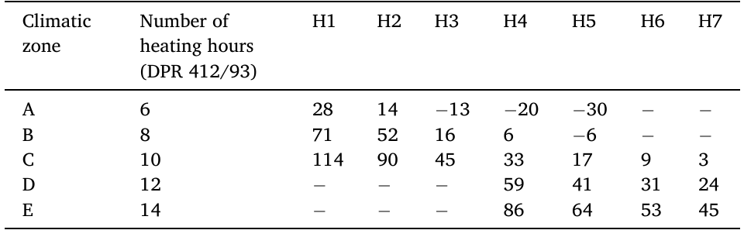
2013
2021
Notes:
2013: Khajedehi, Vivian and Zarrella (2025), Energy & Buildings 344, 115924, t8, PDF page 13. https://www.research.unipd.it/retrieve/01d67fde-fa74-4d70-b216-26ba79c542bd/1-s2.0-S0378778825006541-main.pdf CC BY 4.0. Original published visual, cropped without changing values. 2021: repository output/pdf/italian_user_archetypes_corrected_2021.pdf and revised_paper_outputs/2021/figures. Counterpart from revised 2021 analysis. Definitions and methods differ as stated in the opening comparison.

Slide 31
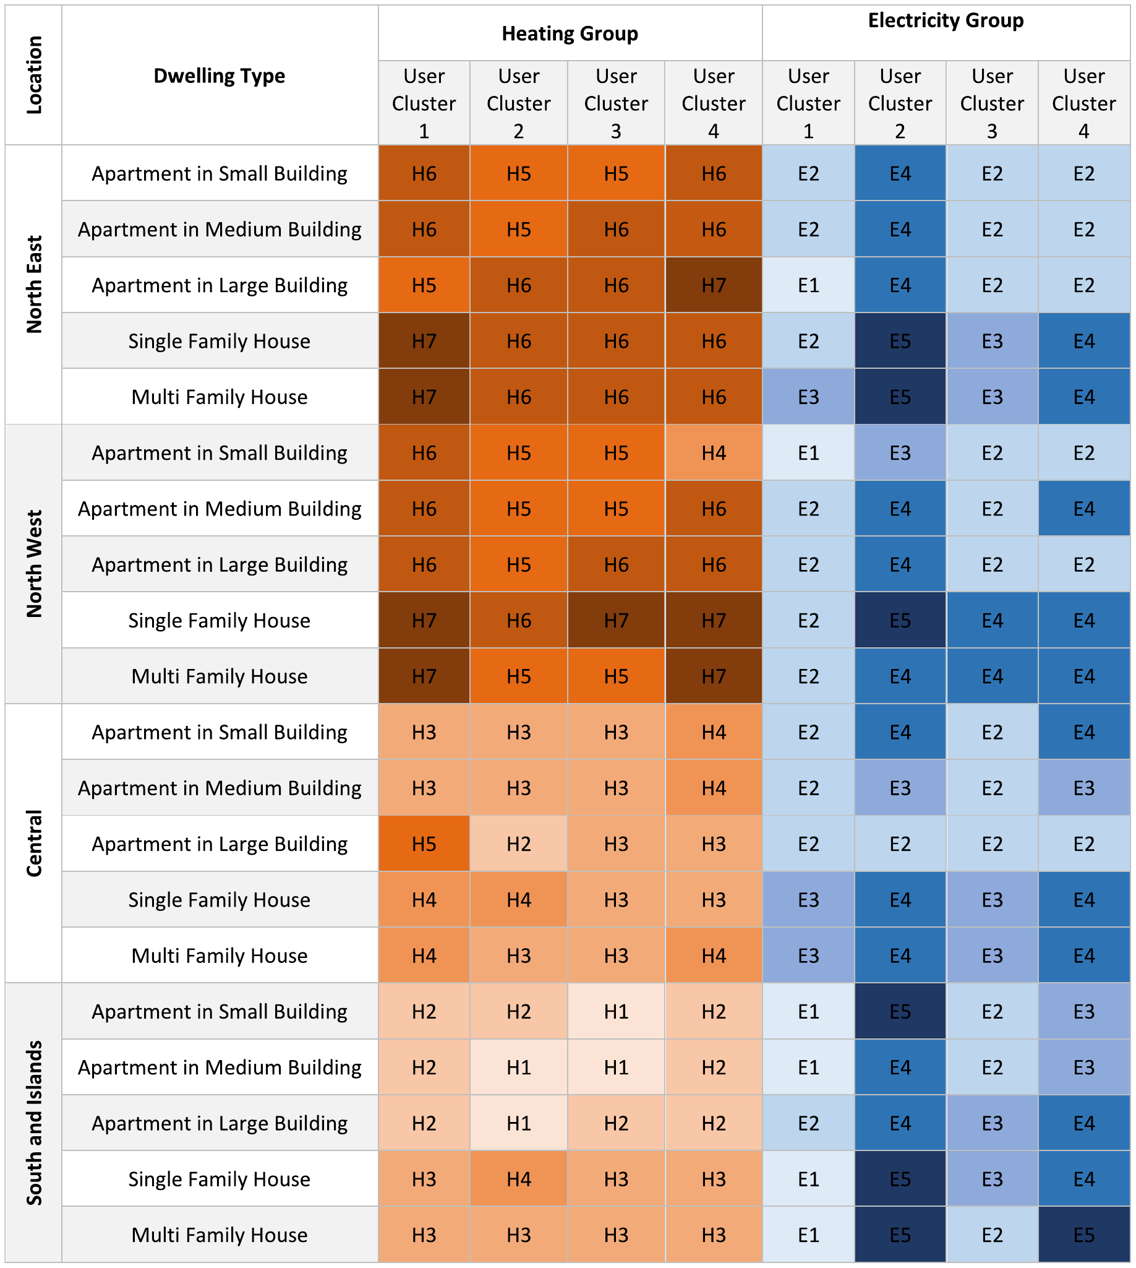
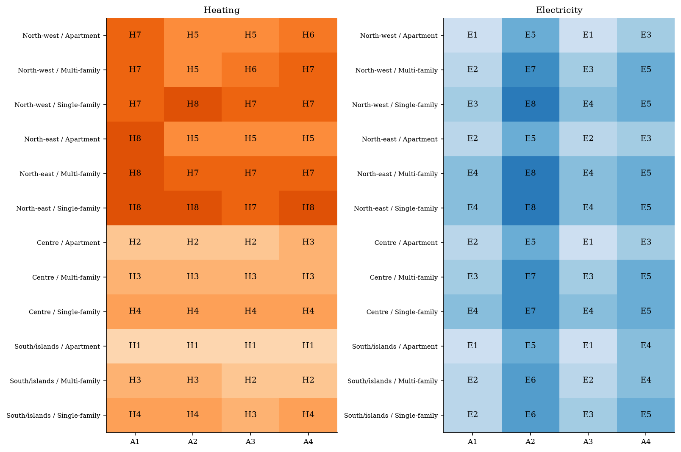
2013
2021
Notes:
2013: Khajedehi, Vivian and Zarrella (2025), Energy & Buildings 344, 115924, fa1, PDF page 14. https://www.research.unipd.it/retrieve/01d67fde-fa74-4d70-b216-26ba79c542bd/1-s2.0-S0378778825006541-main.pdf CC BY 4.0. Original published visual, cropped without changing values. 2021: repository output/pdf/italian_user_archetypes_corrected_2021.pdf and revised_paper_outputs/2021/figures. Counterpart from revised 2021 analysis. Definitions and methods differ as stated in the opening comparison.

