Slide 1
Household and dwelling information
Information | 2013 | 2021 | Change
Household size | q_1_1_sq1 | ncomp_mfr | Retained, 2021 top-coded
Member age | cletad_1 ... cletad_12 | eta_mfr1 ... eta_mfr5 | Changed age bands, fewer members
Education | titstu_1 ... titstu_12 | istr_mfr1 ... istr_mfr5 | Retained, categories aggregated
Dwelling type | q_2_1 | v1_1 | Retained, categories changed
Construction year / floor area | q_2_4_ric / q_2_7_class | v1_2_new / v1_7_mfr | Retained in classes
Geography / survey weight | reg / rip / coef_red | REGIO / RIP / PESO | Retained

Slide 2
Heating and cooling information
Information | 2013 | 2021 | Change
Main heating system | q_3_0 | v3_0 | Retained
Heating frequency / hours | q_3_10 / q_3_11A-C | v3_7 / v3_8a-c | Retained, three time bands
Air-conditioning inventory | q_2_37A-F | v2_11a-e | Retained, types regrouped
Main cooling system | q_5_0 | v5_0 | Retained
Cooling frequency / hours | q_5_7 / q_5_8A-C | v5_6 / v5_7a-c | Retained, three time bands
Heating / cooling equipment age | q_3_7_ric / q_5_4_ric | v3_5_mfr / v5_4_mfr | Retained in classes

Slide 3
Insulation and windows
Information | 2013 | 2021 | Change
Thermal insulation rating | q_3_17 | Absent | Removed from released microdata
Wall insulation / insulation system | q_2_26 / q_2_27_1-3,9 | Absent | Removed from released microdata
Insulation / window improvements | q_3_19_7 / q_3_19_8 | v3_14gh_new | Merged into one indicator
Parent investment question | q_3_18 | v3_13 | Retained, preceding five years
Window-frame materials | q_2_10 / q_2_14 / q_2_18 | v1_10 / v1_13 / v1_16 | Retained
Double glazing | q_2_12 / q_2_16 / q_2_20 | v1_12_mfr / v1_15_mfr / v1_18_mfr | Retained, coding changed

Slide 4
Appliance ownership and use
Information | 2013 | 2021 | Change
Lighting counts | q_7_1 / q_7_3 | v7_1a / v7_1b | Retained, two bulb types
Fridge / separate freezer | q_8_1 / q_8_7 | v7_5 / v7_8 | Ownership retained
Washer / dryer / dishwasher | q_8_10 / q_8_18 / q_8_23 | v7_10 / v7_16 / v7_19 | Ownership retained
Weekly appliance cycles | q_8_14 / q_8_22 / q_8_26 | v7_12a / v7_18a / v7_21a | Retained
Washing-temperature bands | q_8_15A-C | v7_13a-c | Retained, three bands
TV / computer count and hours | q_8_40,42 / q_8_44,46 | v7_33,35 / v7_37,39 | Retained, computer scope changed

Slide 5
Information no longer released separately
Information | 2013 | 2021 | Change
Lighting operating-time bands | q_7_2A-C / q_7_4A-C | Absent | No household lighting hours
Fridge count / size | q_8_2 / q_8_5 | Absent | Ownership and age remain
Washer / dryer / oven size | q_8_13 / q_8_21 / q_8_37 | Absent | No corresponding size fields
Small-appliance inventory | q_8_28A-D / q_8_38A-M | Absent | No equivalent detailed inventory
TV counts by technology | q_8_41A-D | v7_34 | Primary TV type, not counts by type
Computer counts by type | q_8_45A-B | v7_38 | Primary type, not counts by type

Slide 6
More detail in 2021
Information | 2013 | 2021 | Change
Window configuration counts | q_2_11_class / 15_class / 19_class | v1_11a-e_mfr / 14a-e_mfr / 17a-e_mfr | Window / door-window, one / two leaves
Auxiliary heating hours | q_3_16 | v3_12a-c | Daily total becomes three time bands
Auxiliary cooling hours | q_5_13 | v5_10a-c | Daily total becomes three time bands
Infrequent appliance use | q_8_14 / q_8_22 / q_8_26 | v7_12b / v7_18b / v7_21b | Explicit 1-2 times/month or less
Electricity spending | q_9_1_ric | elettricita_eu_mfr | Classes become reported euros
Wood / pellet quantity and spending | q_6_5_ric,9_ric,13_ric,15_ric | v6_6_mfr,9_mfr,12_mfr,14_mfr | Classes become point values

Slide 7
New explicit fields in 2021
Information | 2013 | 2021 | Change
Interview mode / sample | Absent | TECNICA / CAMPIONE | CATI / CAWI collection fields
Hybrid solar system | No separate hybrid field | v2_14e | Photovoltaic plus thermal
Gas barbecue | No separate gas-barbecue field | v7_27 | Dedicated ownership field
Powered gardening equipment | No equivalent dedicated fields | v7_41 / v7_42a-c | Ownership and energy source
Computer scope | Desktop / portable computers | v7_36-39 | Computers and similar devices, tablets included

Slide 8
Comparison definitions
Information | 2013 | 2021 | Change
Source of values | Published article, 2013 survey | 2021 analysis; four H / five E groups | Different analysis specifications
PCA and archetypes | Published 2013 estimates | Frozen revised 2013 training basis | Not a newly fitted 2021 PCA
Heating boxplot colors | Current subjective insulation rating | Insulation/window improvements in preceding five years | Not current insulation status; excluded from current models
Electricity boxplot colors | Cooling system used / not used | Cooling equipment present / absent | Different definitions
Geographical map | Municipal climate zones and legal limits | Regional mean reported heating hours | Different quantities
Appliance electricity | Published model-derived kWh | Model-derived kWh, explicit assumptions | Neither column is metered appliance use

Slide 9
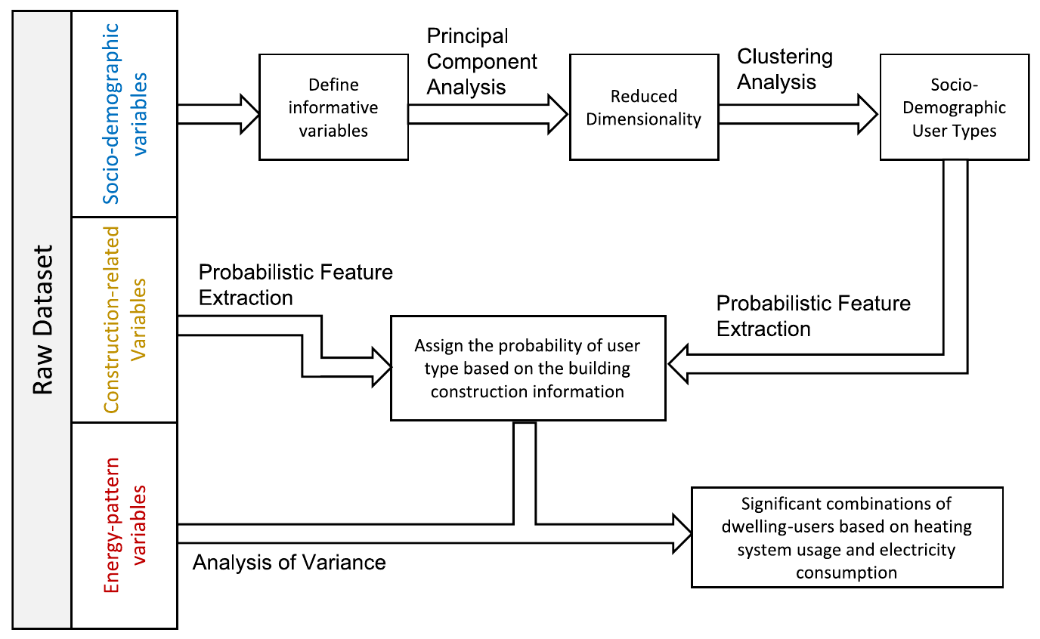
2013
2021
Demographic
variables
Reference PCA
Fixed centers
Harmonized
household
variables
Frozen
PCA
coordinates
Four fixed
user
archetypes
Construction
variables
Probabilistic feature extraction
Joint archetype probabilities
by dwelling age and area
Energy-use
variables
Training-defined heating and
appliance-electricity groups
Held-out distributions and tests
Split-sample grouping

Slide 10
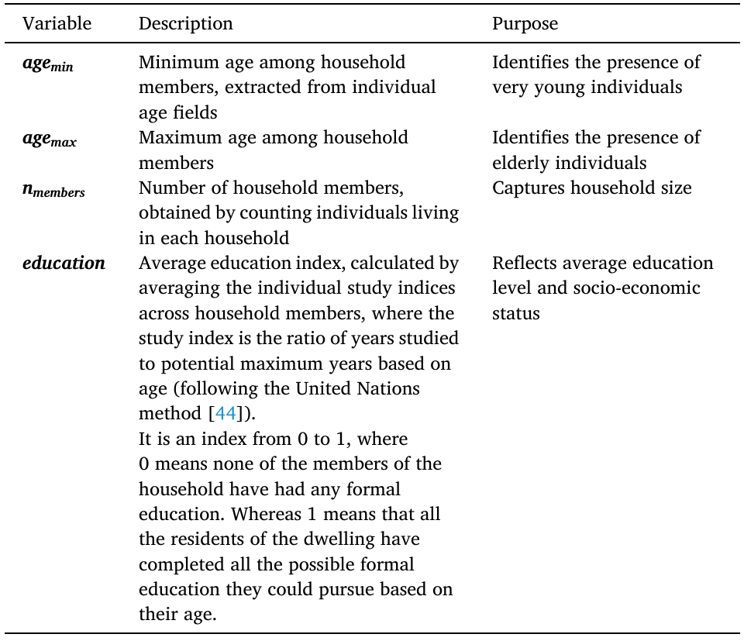
2013
2021
Variable | Operational definition
Minimum age | Minimum of the released age-category midpoint proxies Not an observed exact age; children retain their published interval.
Maximum age | Maximum of the same member-level proxies Open oldest interval capped at 100 years; cap 90 tested.
Household size | Recorded number of members, restricted to 1-5 Same accessible household-size domain in both releases.
Schooling proxy | Mean assigned completed-schooling years / 18 among members in age classes beginning at 15+ Known education required. Not the UNDP education index and not an age-normalized opportunity measure.

Slide 11
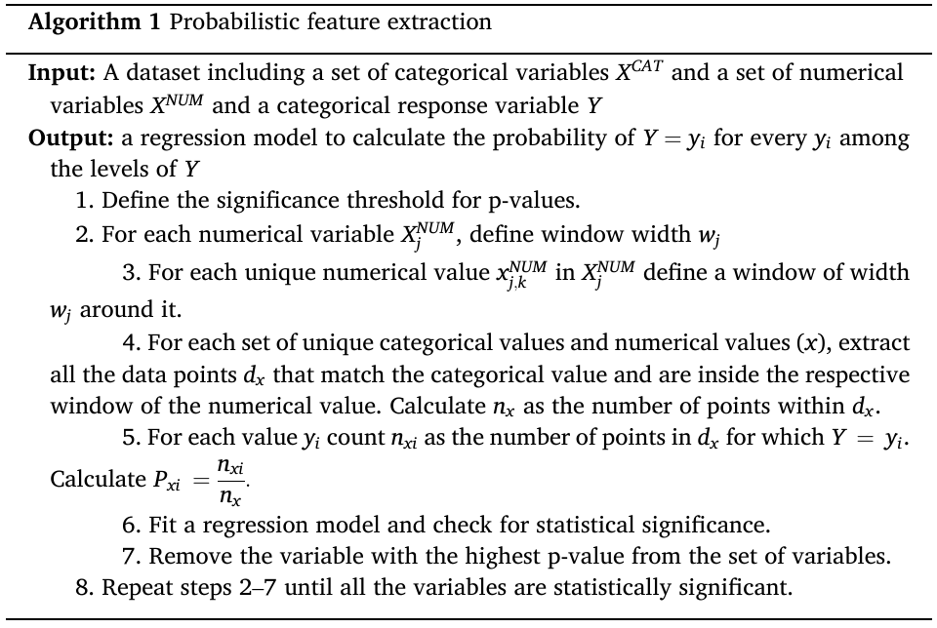
2013
2021
Step | Operation
1 | Split households before fitting; retain the fixed reference archetypes.
2 | Create 24 age–area cells; calculate counts, effective counts and weighted proportions.
3 | Fit a weighted multinomial quadratic model; tune the ridge penalty.
4 | Freeze coefficients; compute four positive probabilities summing to one.
5 | Evaluate held-out log loss, Brier score and cell calibration.
6 | Flag sparse cells and report sensitivity to interval assumptions.

Slide 12
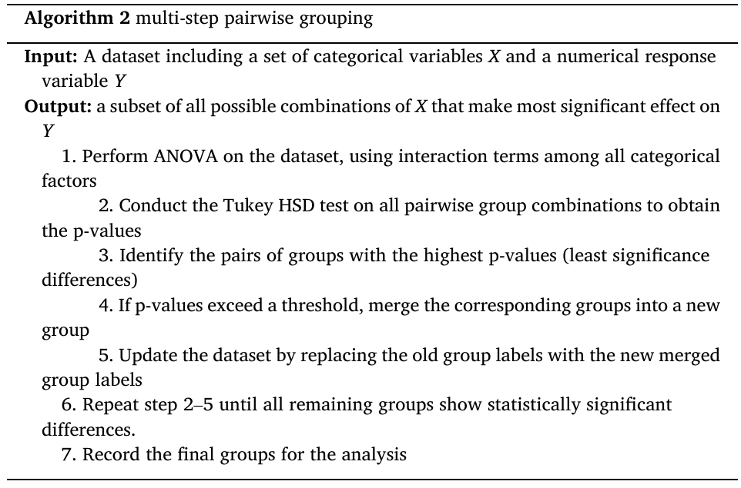
2013
2021
Step | Operation
1 | Calculate training weighted means for location × dwelling type × archetype cells.
2 | Cluster cell means using exact one-dimensional weighted k-means.
3 | Inspect WCSS and marginal gains across group counts; check tuning RMSE.
4 | Use four heating groups and five electricity groups for this comparison.
5 | Freeze cell assignments; summarize held-out households.
6 | Exclude insulation from models; retain cooling presence in electricity boxplots.

Slide 13
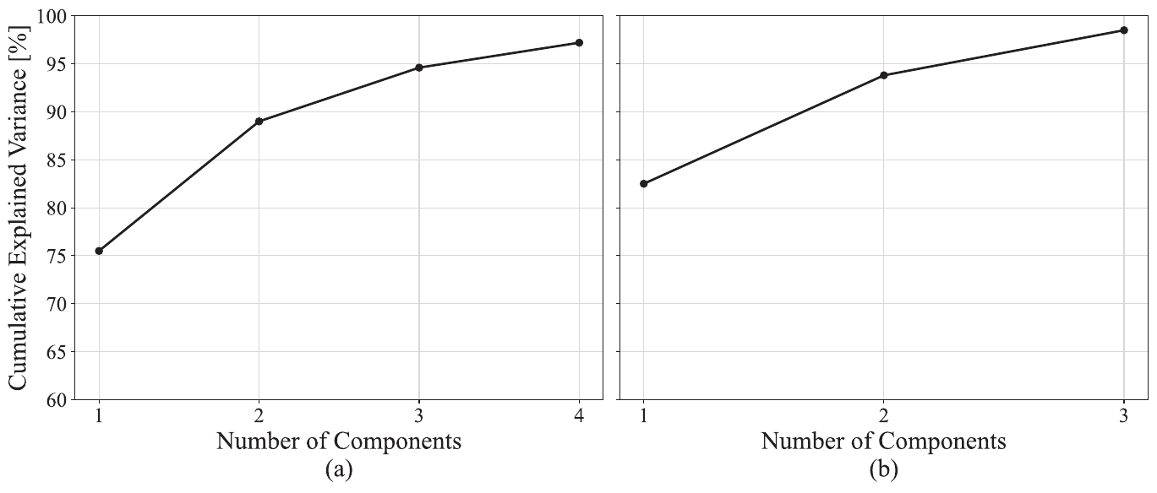
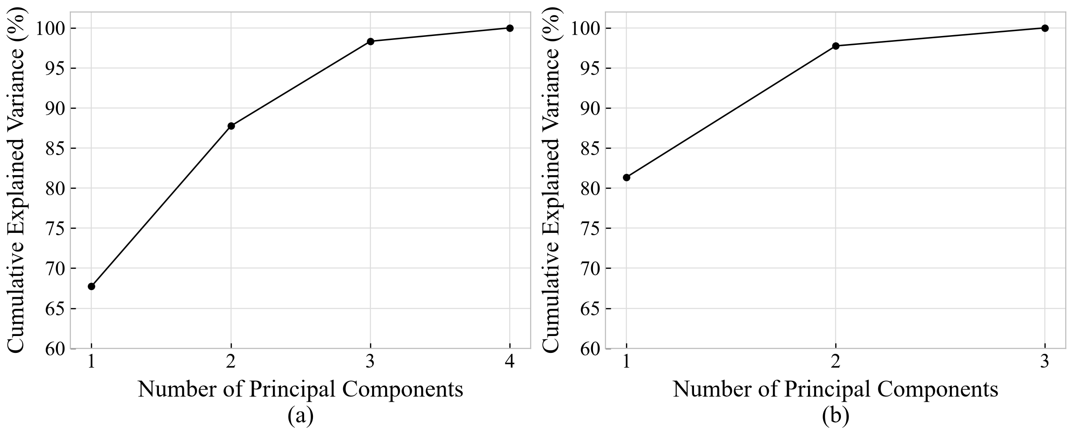
2013
2021

Slide 14
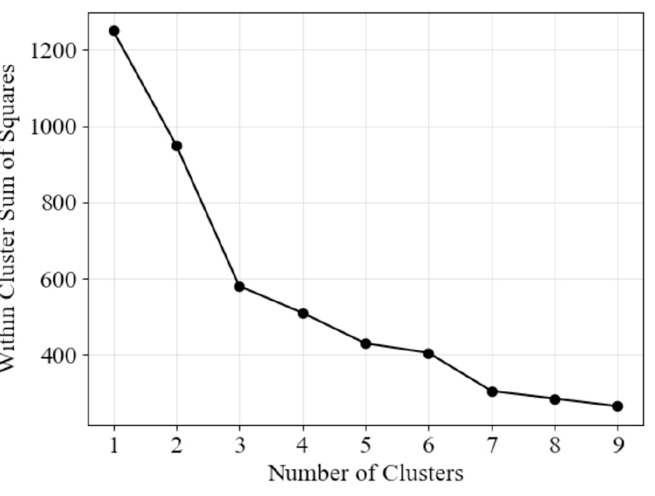
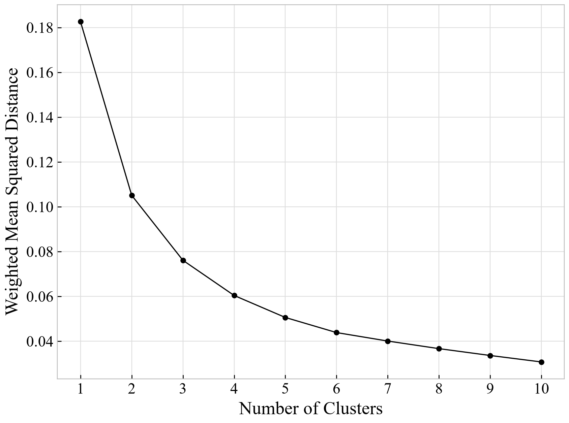
2013
2021

Slide 15
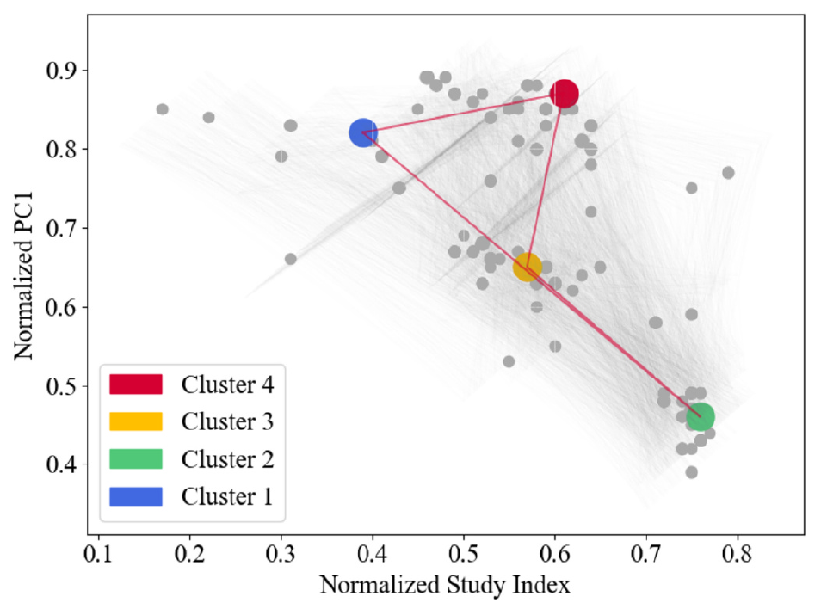
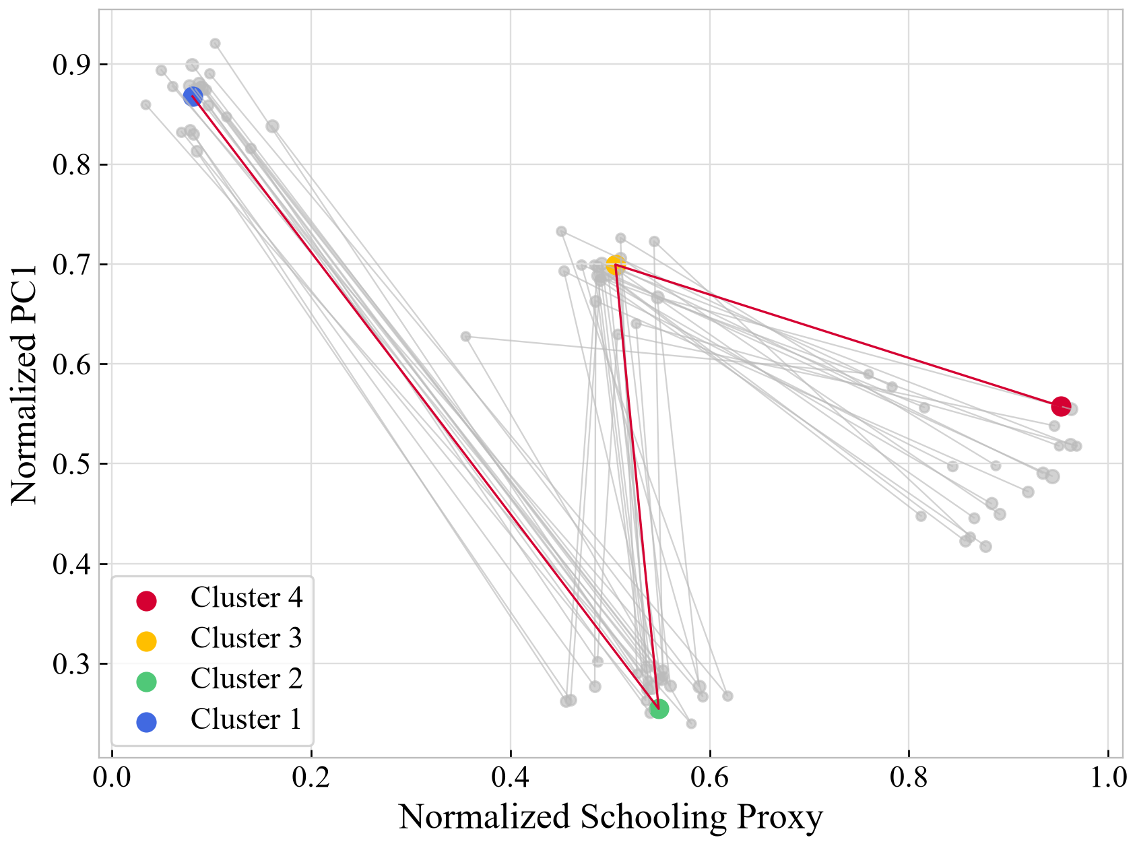
2013
2021

Slide 16
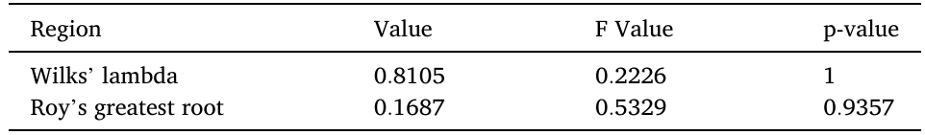
2013
2021
Statistic | Value | F | Numerator df | Denominator df | p
Wilks' lambda | 0.9692 | 4.346 | 57 | 23,479 | <0.001
Roy's greatest root | 0.0169 | 7.019 | 19 | 7,876 | <0.001

Slide 17
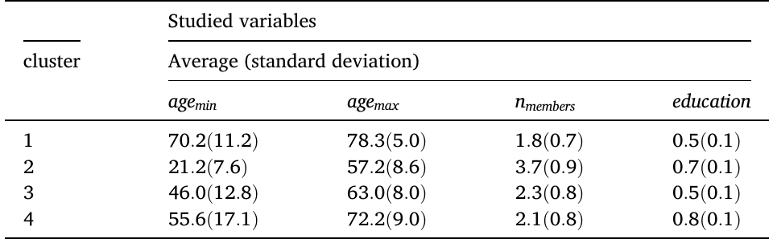
2013
2021
Cluster | Minimum age | Maximum age | Members | Schooling proxy
A1 | 73.63 (16.42) | 81.22 (10.89) | 1.59 (0.67) | 0.21 (0.11)
A2 | 14.50 (10.00) | 49.84 (12.53) | 3.50 (0.86) | 0.60 (0.14)
A3 | 56.26 (15.00) | 62.50 (14.06) | 1.50 (0.59) | 0.57 (0.11)
A4 | 38.84 (22.25) | 51.64 (15.47) | 1.89 (0.95) | 0.96 (0.07)

Slide 18
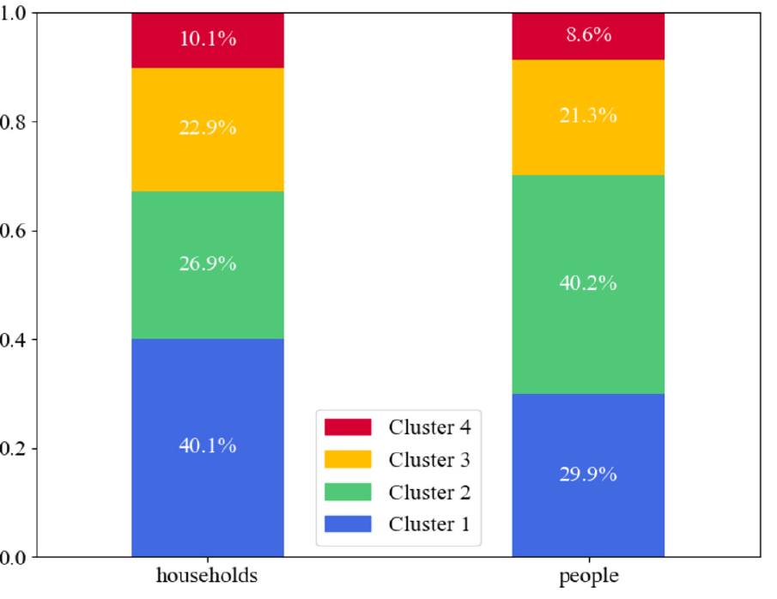
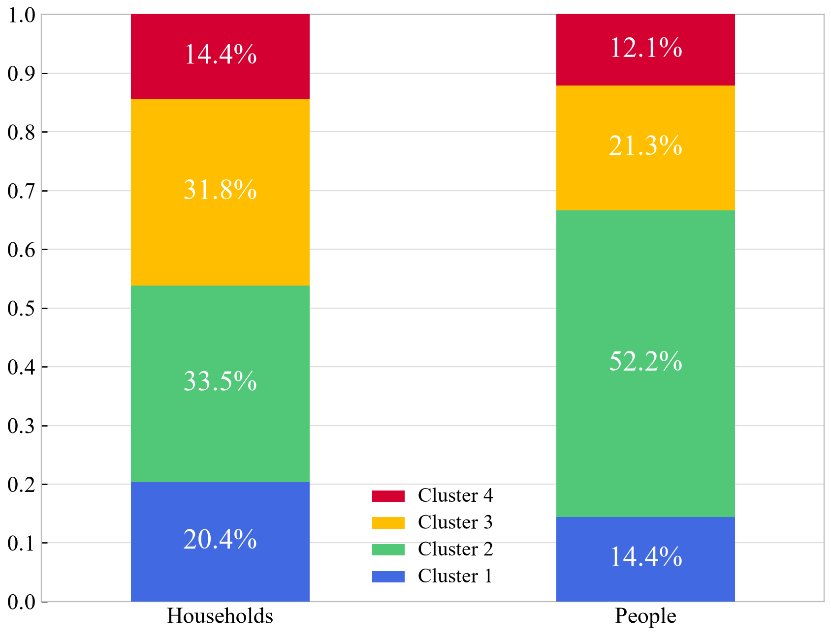
2013
2021

Slide 19
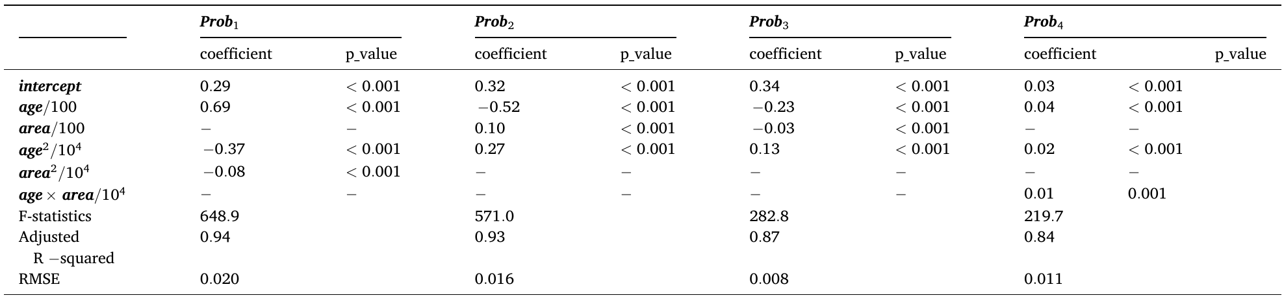
2013
2021
Term | A1 vs A4 | A2 vs A4 | A3 vs A4 | A4 reference
Intercept | -1.694083 | -0.184597 | 1.369579 | 0.000000
Age/100 | 6.133465 | -1.410631 | 1.126234 | 0.000000
Area/100 | 0.940143 | 2.538902 | -1.185233 | 0.000000
Age squared/10000 | -4.340973 | 0.956989 | -1.005700 | 0.000000
Area squared/10000 | -0.408732 | -0.847496 | 0.310145 | 0.000000
Age x area/10000 | -0.286213 | -0.567972 | 0.018421 | 0.000000
Model | Test n | Multiclass Brier | Log loss
Age-area quadratic | 6954 | 0.7071 | 1.2996
Quadratic + location/type | 6954 | 0.7043 | 1.2926
Training marginal only | 6954 | 0.7289 | 1.3416

Slide 20
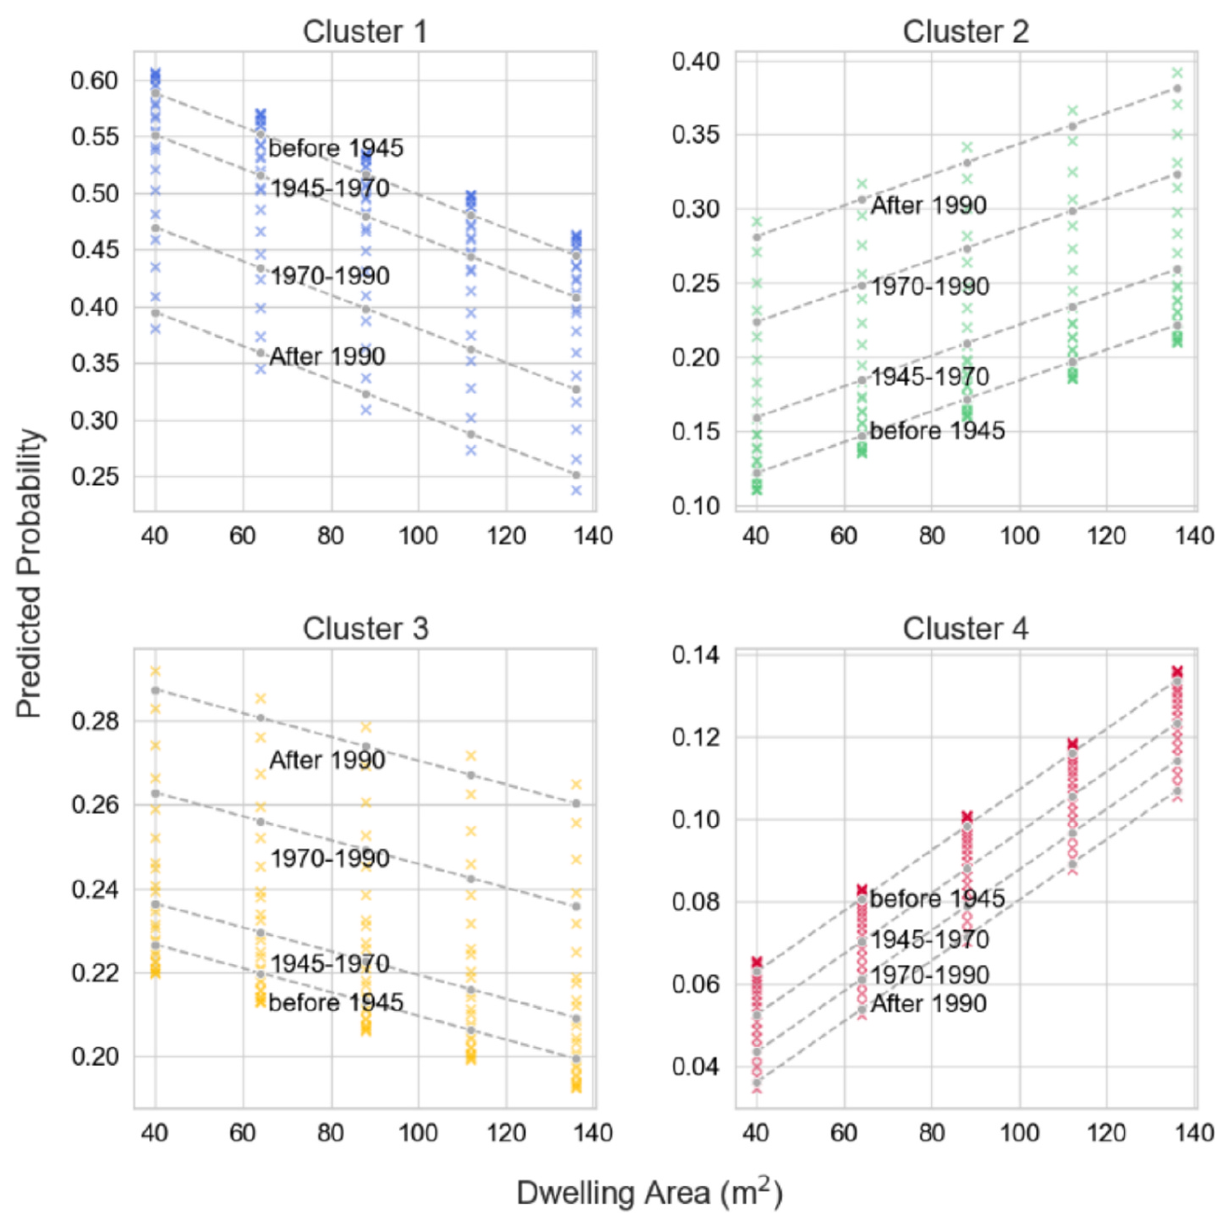
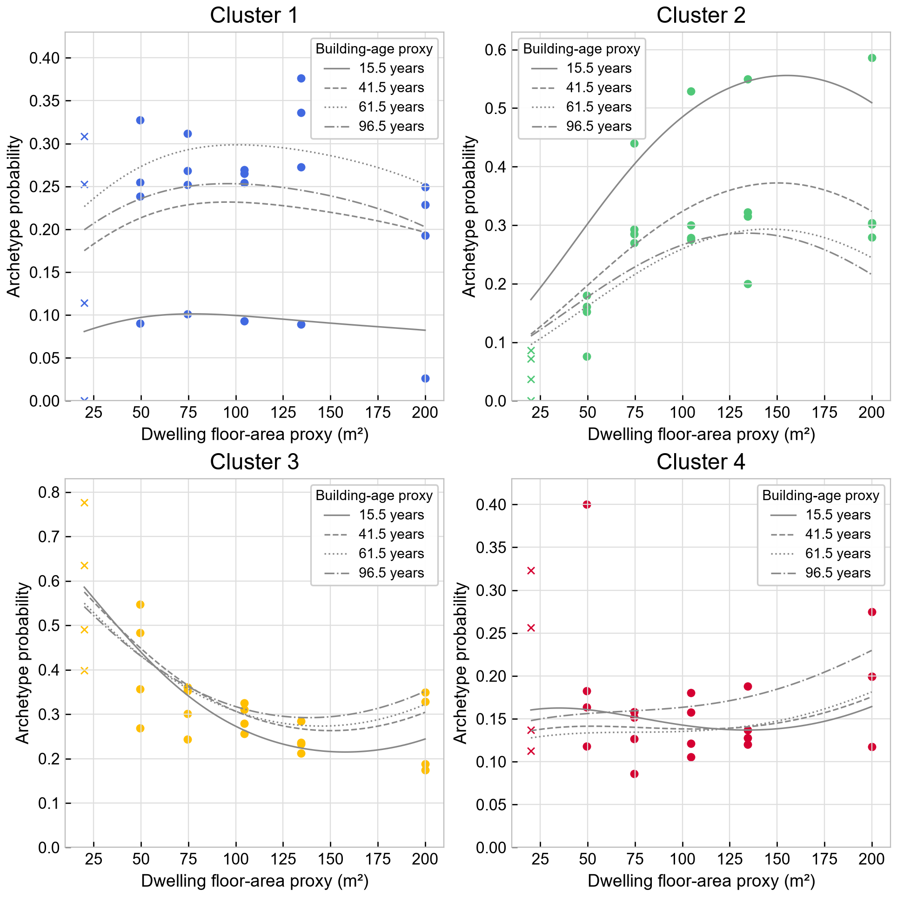
2013
2021

Slide 21
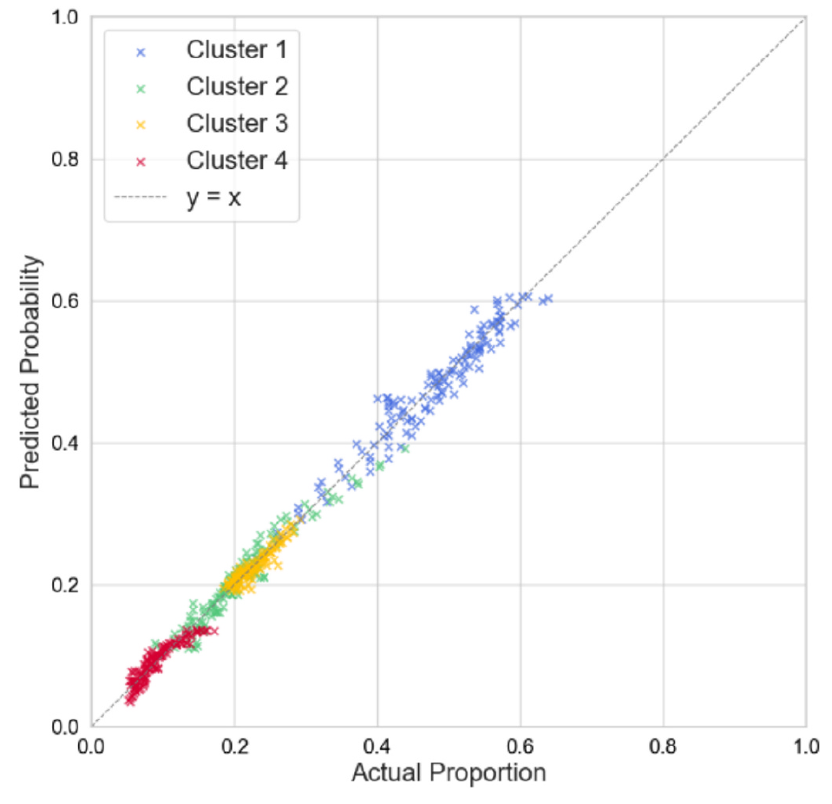
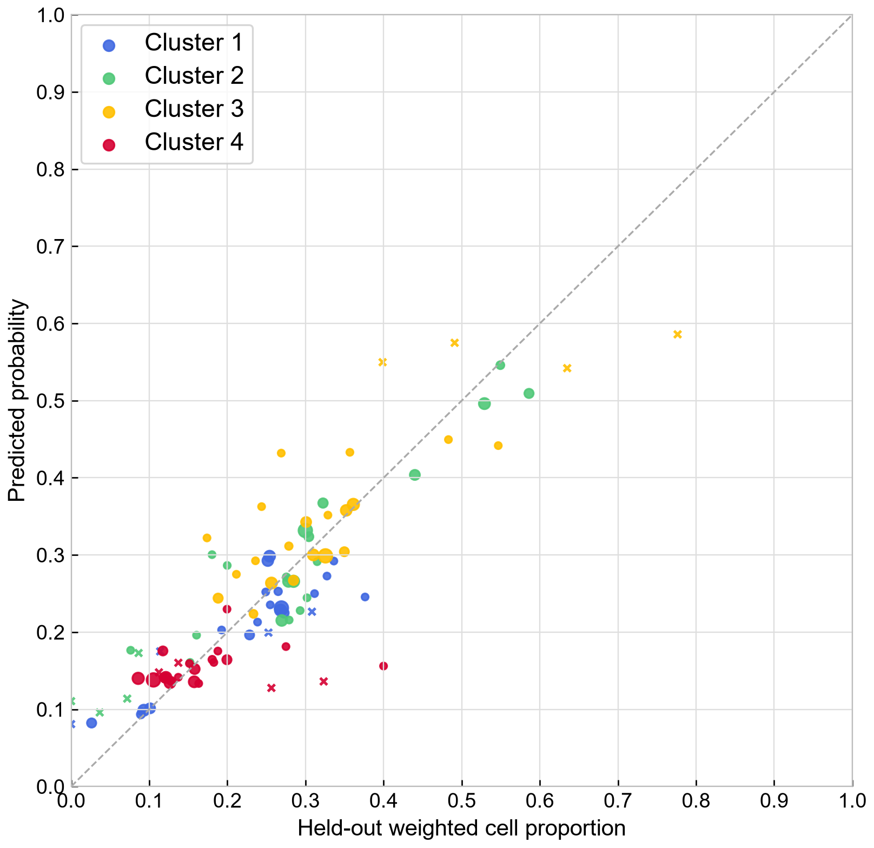
2013
2021

Slide 22
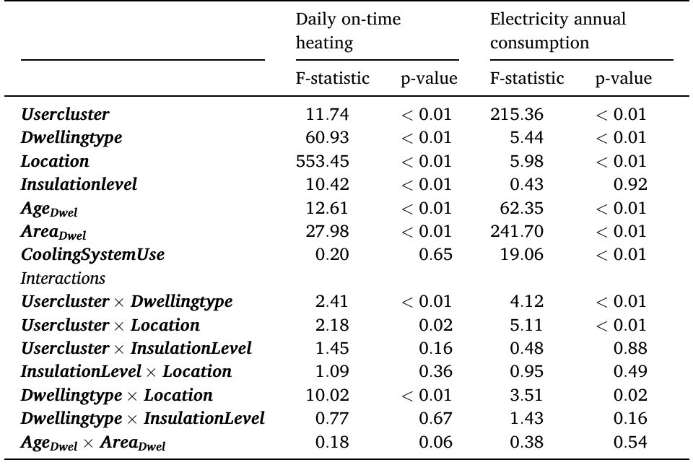
2013
2021
Term | Heating F | Heating p (Holm) | Electricity F | Electricity p (Holm)
Archetype | 0.39 | 1.000 | 38.68 | <0.001
Dwelling type | 2.25 | 0.529 | 0.02 | 1.000
Location | 31.79 | <0.001 | 1.34 | 1.000
Building-age proxy | 9.78 | 0.014 | 0.57 | 1.000
Floor-area proxy | 13.10 | 0.003 | 82.96 | <0.001
Cooling presence | 0.05 | 1.000 | 41.97 | <0.001
Archetype x type | 0.28 | 1.000 | 0.83 | 1.000
Archetype x location | 1.70 | 0.502 | 2.31 | 0.085
Type x location | 1.35 | 0.930 | 2.72 | 0.085
Age x area | 3.75 | 0.369 | 0.10 | 1.000

Slide 23
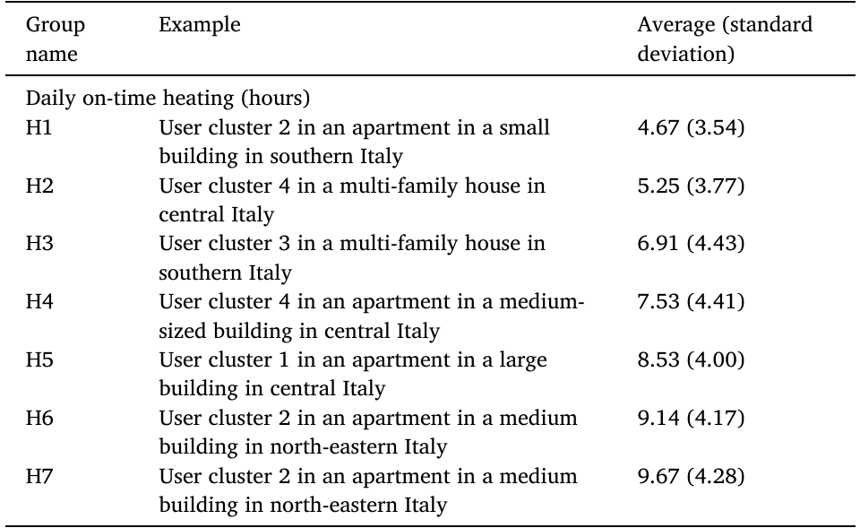
2013
2021
Group | Example | Average (standard deviation)
H1 | Cluster 2; Apartment; South/islands | 6.26 (3.95)
H2 | Cluster 3; Apartment; Centre | 7.27 (4.15)
H3 | Cluster 3; Apartment; North-west | 9.23 (4.96)
H4 | Cluster 1; Apartment; North-west | 10.95 (5.68)

Slide 24
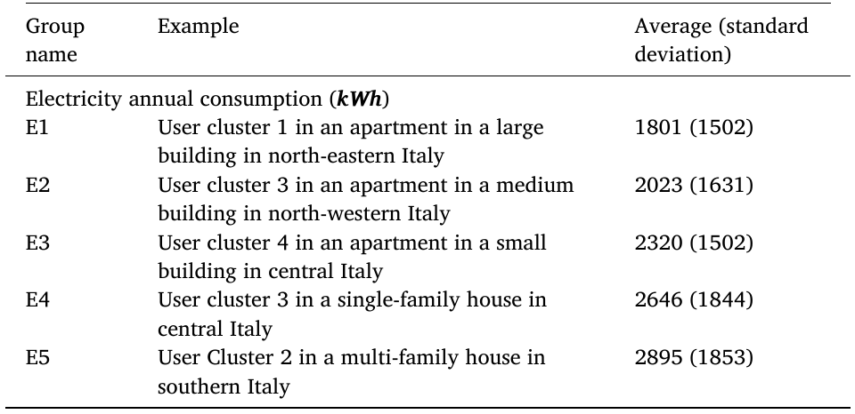
2013
2021
Group | Example | Average (standard deviation)
E1 | Cluster 3; Apartment; South/islands | 1,542.25 (514.07)
E2 | Cluster 4; Apartment; Centre | 1,792.30 (648.94)
E3 | Cluster 4; Apartment; South/islands | 1,872.62 (628.75)
E4 | Cluster 2; Apartment; South/islands | 2,290.62 (765.35)
E5 | Cluster 2; Multi-family; North-west | 2,691.04 (853.70)

Slide 25
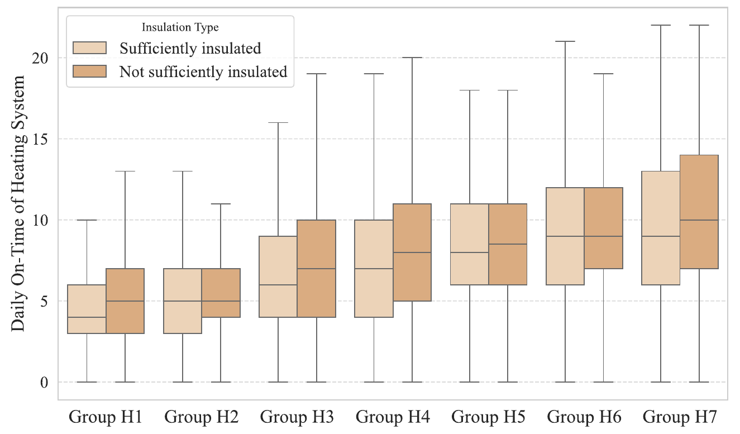
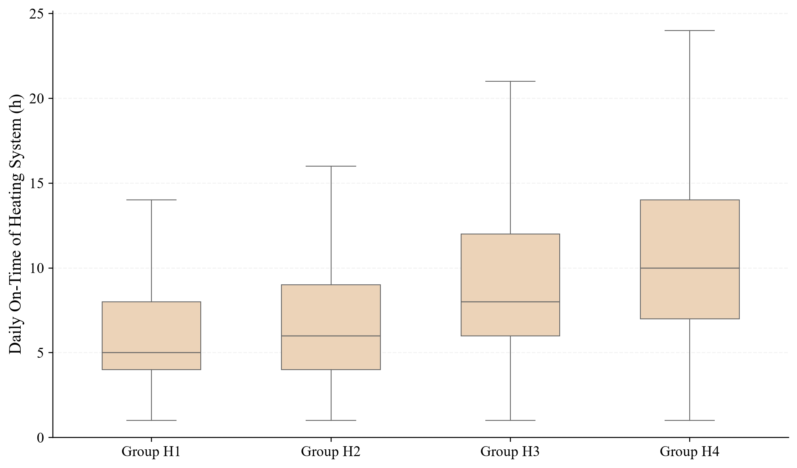
2013
2021

Slide 26
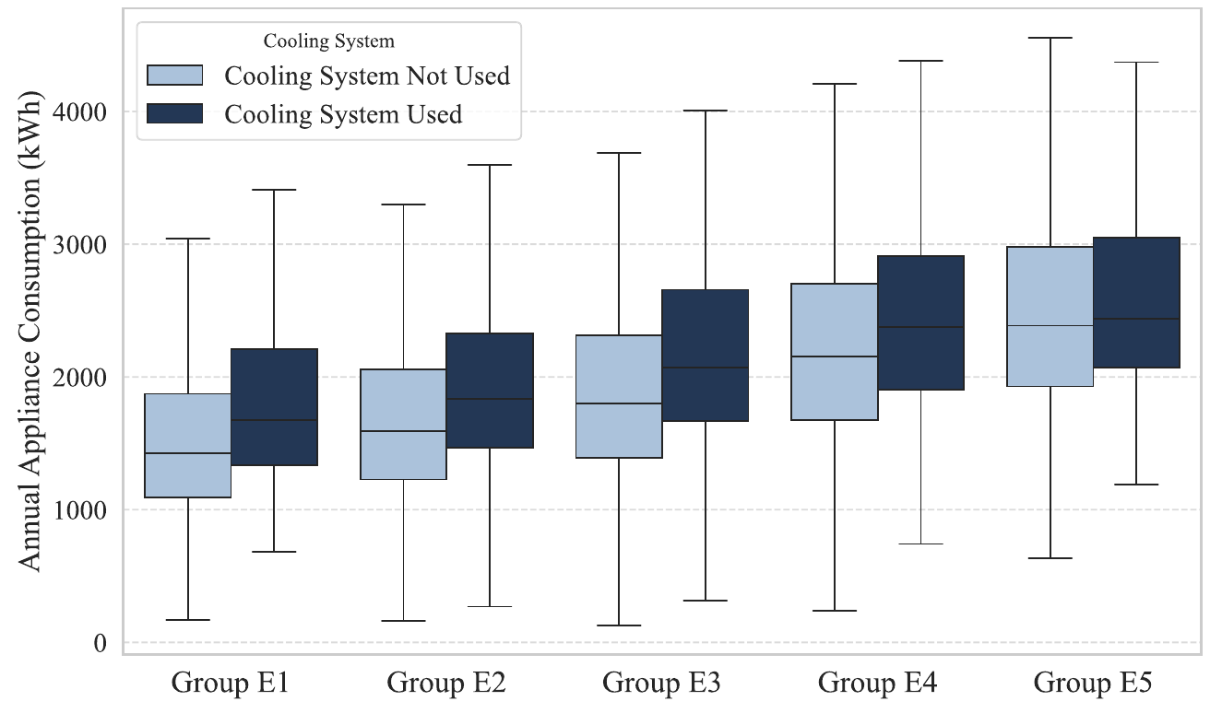
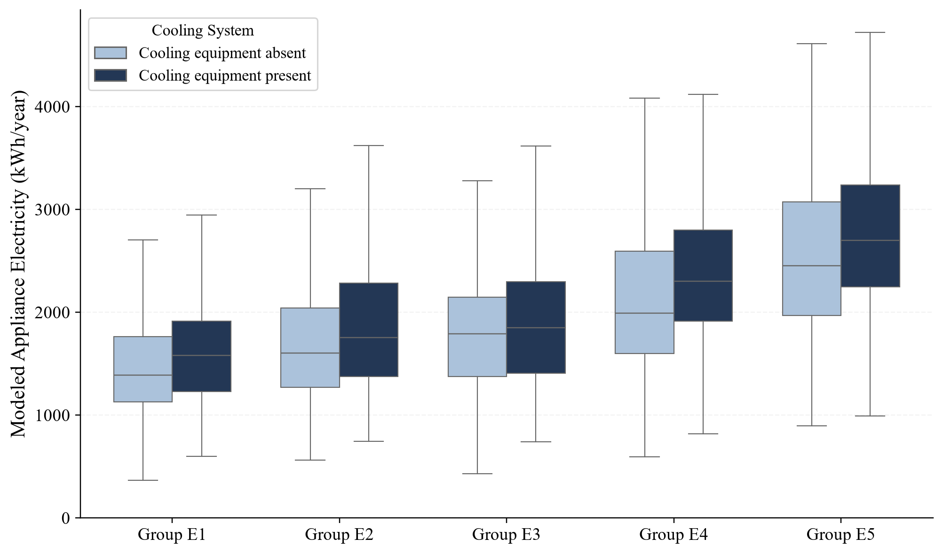
2013
2021

Slide 27
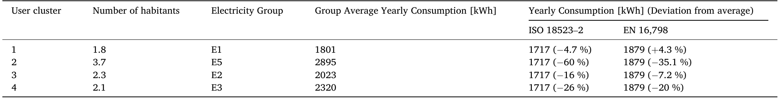
2013
2021
Cluster | Test n | Mean area (m²) | Modeled mean (kWh/y) | ISO example (difference) | EN example (difference)
A1 | 1353 | 101.5 | 1,617 | 1717 (+6.2%) | 1589 (-1.8%)
A2 | 2826 | 109.5 | 2,399 | 1717 (-28.4%) | 1715 (-28.5%)
A3 | 2330 | 99.2 | 1,652 | 1717 (+4.0%) | 1553 (-5.9%)
A4 | 1387 | 107.2 | 1,946 | 1717 (-11.8%) | 1678 (-13.7%)

Slide 28
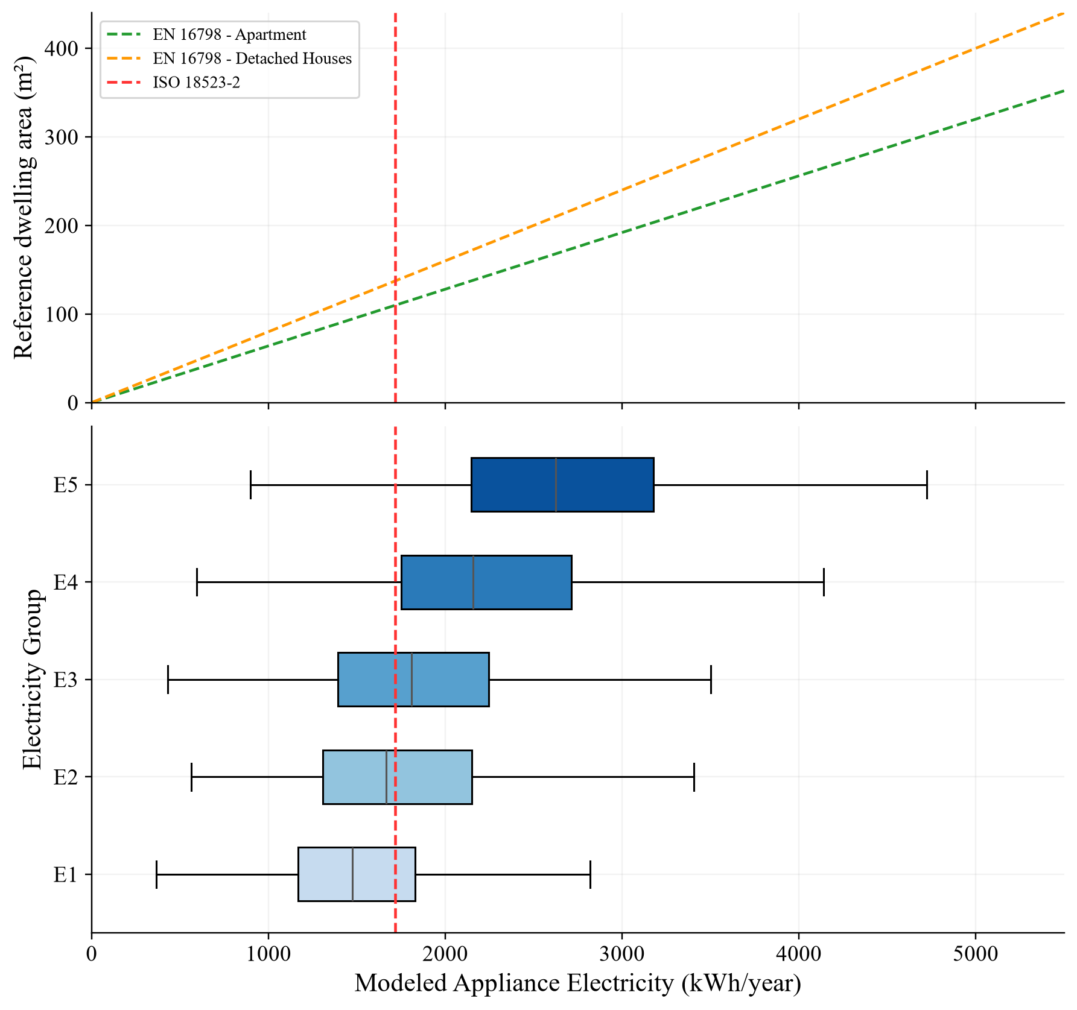
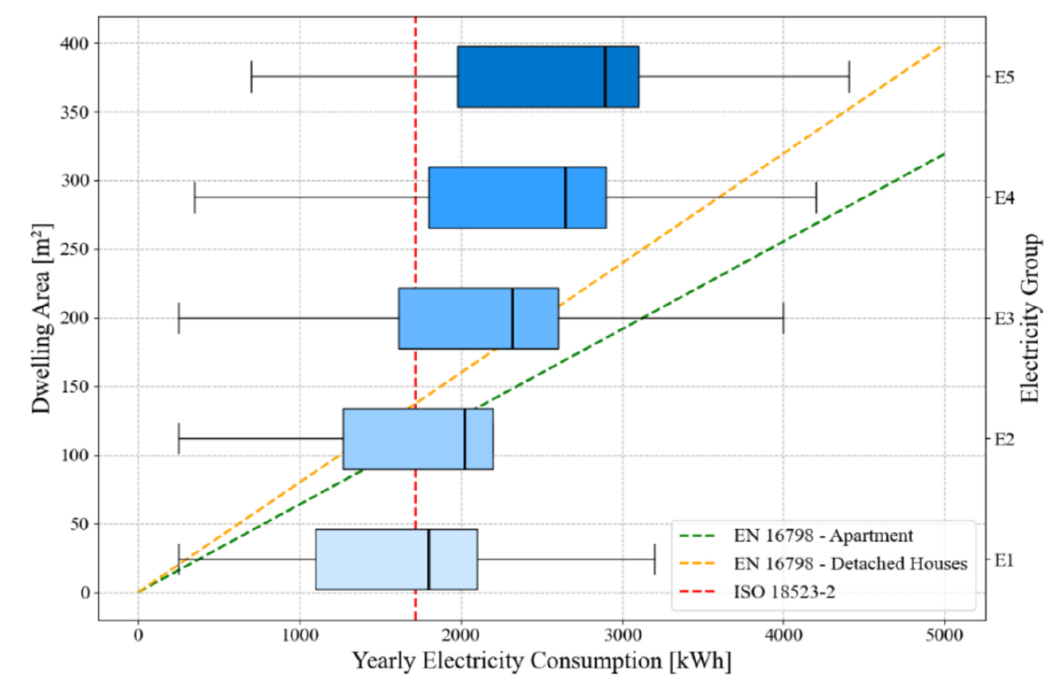
2013
2021

Slide 29
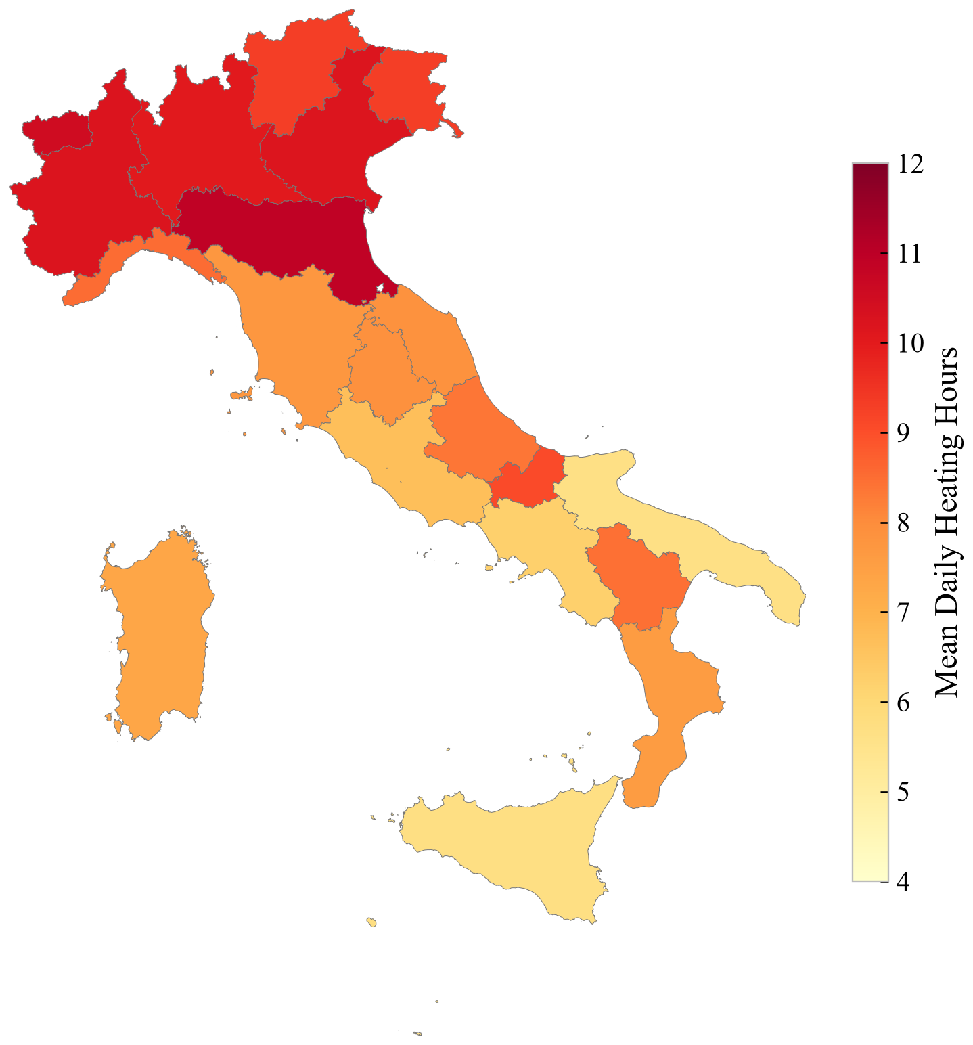
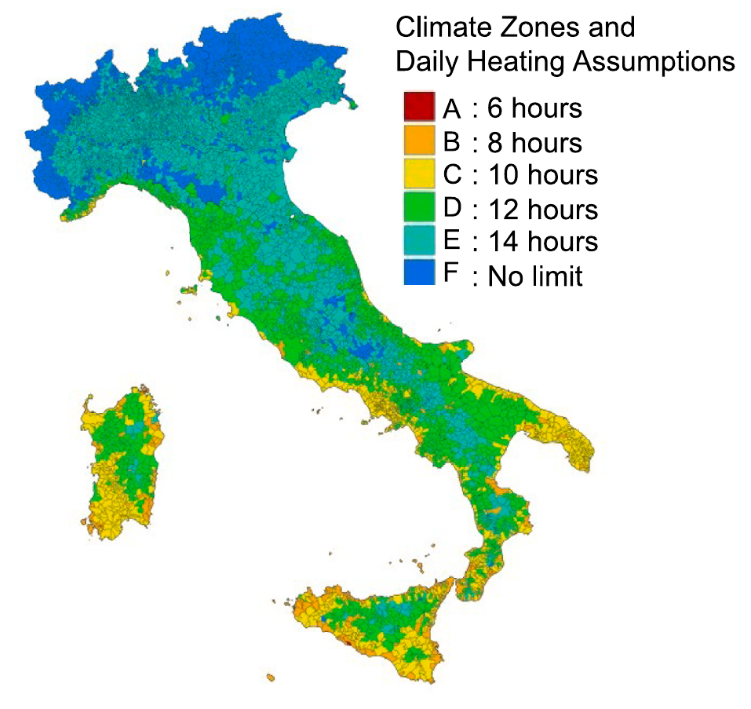
2013
2021

Slide 30
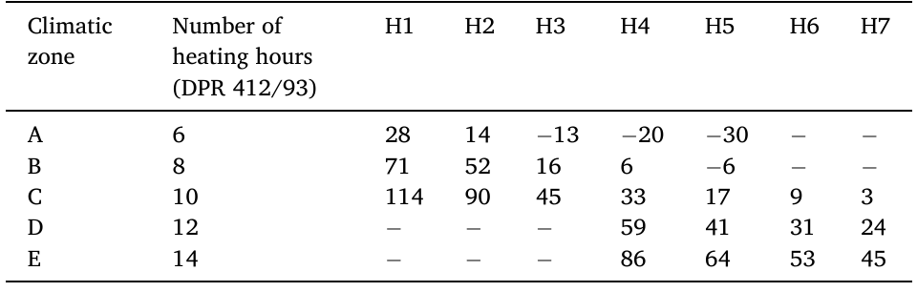
2013
2021
Schedule (h) Difference (%) | H1 | H2 | H3 | H4
6 | -4.2 | -17.4 | -35.0 | -45.2
8 | +27.8 | +10.1 | -13.3 | -26.9
10 | +59.7 | +37.6 | +8.4 | -8.6
12 | +91.6 | +65.2 | +30.0 | +9.6
14 | +123.6 | +92.7 | +51.7 | +27.9

Slide 31
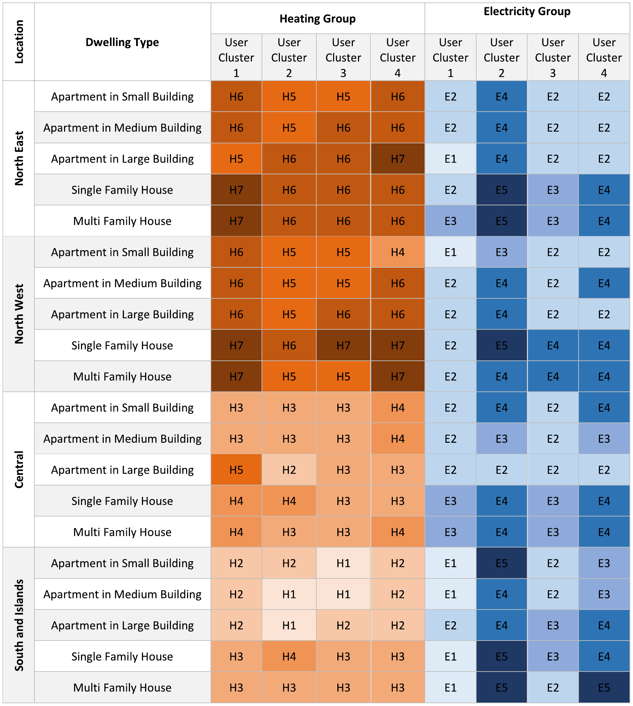
2013
2021
Location | Dwelling type | Heating Group |  |  |  | Electricity Group
 |  | A1 | A2 | A3 | A4 | A1 | A2 | A3 | A4
North- west | Apartment | H4 | H3 | H3 | H3 | E1 | E4 | E1 | E2
 | Multi-family | H4 | H3 | H4 | H4 | E2 | E5 | E2 | E4
 | Single-family | H4 | H4 | H4 | H4 | E2 | E5 | E3 | E4
North- east | Apartment | H4 | H3 | H3 | H3 | E1 | E4 | E1 | E2
 | Multi-family | H4 | H4 | H4 | H4 | E3 | E5 | E3 | E4
 | Single-family | H4 | H4 | H4 | H4 | E3 | E5 | E3 | E4
Centre | Apartment | H2 | H1 | H2 | H2 | E1 | E4 | E1 | E2
 | Multi-family | H2 | H2 | H2 | H2 | E2 | E5 | E2 | E4
 | Single-family | H3 | H2 | H3 | H3 | E3 | E5 | E3 | E4
South/ islands | Apartment | H1 | H1 | H1 | H1 | E1 | E4 | E1 | E3
 | Multi-family | H2 | H2 | H2 | H2 | E2 | E4 | E2 | E3
 | Single-family | H3 | H3 | H2 | H2 | E2 | E4 | E2 | E4

