Slide 1
Household and dwelling information
Information | 2013 | 2021 | Change
Household size | q_1_1_sq1 | ncomp_mfr | Retained, 2021 top-coded
Member age | cletad_1 ... cletad_12 | eta_mfr1 ... eta_mfr5 | Changed age bands, fewer members
Education | titstu_1 ... titstu_12 | istr_mfr1 ... istr_mfr5 | Retained, categories aggregated
Dwelling type | q_2_1 | v1_1 | Retained, categories changed
Construction year / floor area | q_2_4_ric / q_2_7_class | v1_2_new / v1_7_mfr | Retained in classes
Geography / survey weight | reg / rip / coef_red | REGIO / RIP / PESO | Retained
Notes:
Sources: ISTAT 2013 ECH_Tracciato_Anno 2013.html and ISTAT_MFR_ECH_Tracciato_2021_DELIMITED.html in repository METADATI directories; respective classification HTML and questionnaires. Availability refers to released microdata, not absence of the physical equipment.

Slide 2
Heating and cooling information
Information | 2013 | 2021 | Change
Main heating system | q_3_0 | v3_0 | Retained
Heating frequency / hours | q_3_10 / q_3_11A-C | v3_7 / v3_8a-c | Retained, three time bands
Air-conditioning inventory | q_2_37A-F | v2_11a-e | Retained, types regrouped
Main cooling system | q_5_0 | v5_0 | Retained
Cooling frequency / hours | q_5_7 / q_5_8A-C | v5_6 / v5_7a-c | Retained, three time bands
Heating / cooling equipment age | q_3_7_ric / q_5_4_ric | v3_5_mfr / v5_4_mfr | Retained in classes
Notes:
Sources: ISTAT 2013 ECH_Tracciato_Anno 2013.html and ISTAT_MFR_ECH_Tracciato_2021_DELIMITED.html in repository METADATI directories; respective classification HTML and questionnaires. Availability refers to released microdata, not absence of the physical equipment.

Slide 3
Insulation and windows
Information | 2013 | 2021 | Change
Thermal insulation rating | q_3_17 | Absent | Removed from released microdata
Wall insulation / insulation system | q_2_26 / q_2_27_1-3,9 | Absent | Removed from released microdata
Insulation / window improvements | q_3_19_7 / q_3_19_8 | v3_14gh_new | Merged into one indicator
Parent investment question | q_3_18 | v3_13 | Retained, preceding five years
Window-frame materials | q_2_10 / q_2_14 / q_2_18 | v1_10 / v1_13 / v1_16 | Retained
Double glazing | q_2_12 / q_2_16 / q_2_20 | v1_12_mfr / v1_15_mfr / v1_18_mfr | Retained, coding changed
Notes:
Sources: ISTAT 2013 ECH_Tracciato_Anno 2013.html and ISTAT_MFR_ECH_Tracciato_2021_DELIMITED.html in repository METADATI directories; respective classification HTML and questionnaires. Availability refers to released microdata, not absence of the physical equipment.

Slide 4
Appliance ownership and use
Information | 2013 | 2021 | Change
Lighting counts | q_7_1 / q_7_3 | v7_1a / v7_1b | Retained, two bulb types
Fridge / separate freezer | q_8_1 / q_8_7 | v7_5 / v7_8 | Ownership retained
Washer / dryer / dishwasher | q_8_10 / q_8_18 / q_8_23 | v7_10 / v7_16 / v7_19 | Ownership retained
Weekly appliance cycles | q_8_14 / q_8_22 / q_8_26 | v7_12a / v7_18a / v7_21a | Retained
Washing-temperature bands | q_8_15A-C | v7_13a-c | Retained, three bands
TV / computer count and hours | q_8_40,42 / q_8_44,46 | v7_33,35 / v7_37,39 | Retained, computer scope changed
Notes:
Sources: ISTAT 2013 ECH_Tracciato_Anno 2013.html and ISTAT_MFR_ECH_Tracciato_2021_DELIMITED.html in repository METADATI directories; respective classification HTML and questionnaires. Availability refers to released microdata, not absence of the physical equipment.

Slide 5
Information no longer released separately
Information | 2013 | 2021 | Change
Lighting operating-time bands | q_7_2A-C / q_7_4A-C | Absent | No household lighting hours
Fridge count / size | q_8_2 / q_8_5 | Absent | Ownership and age remain
Washer / dryer / oven size | q_8_13 / q_8_21 / q_8_37 | Absent | No corresponding size fields
Small-appliance inventory | q_8_28A-D / q_8_38A-M | Absent | No equivalent detailed inventory
TV counts by technology | q_8_41A-D | v7_34 | Primary TV type, not counts by type
Computer counts by type | q_8_45A-B | v7_38 | Primary type, not counts by type
Notes:
Sources: ISTAT 2013 ECH_Tracciato_Anno 2013.html and ISTAT_MFR_ECH_Tracciato_2021_DELIMITED.html in repository METADATI directories; respective classification HTML and questionnaires. Availability refers to released microdata, not absence of the physical equipment.

Slide 6
More detail in 2021
Information | 2013 | 2021 | Change
Window configuration counts | q_2_11_class / 15_class / 19_class | v1_11a-e_mfr / 14a-e_mfr / 17a-e_mfr | Window / door-window, one / two leaves
Auxiliary heating hours | q_3_16 | v3_12a-c | Daily total becomes three time bands
Auxiliary cooling hours | q_5_13 | v5_10a-c | Daily total becomes three time bands
Infrequent appliance use | q_8_14 / q_8_22 / q_8_26 | v7_12b / v7_18b / v7_21b | Explicit 1-2 times/month or less
Electricity spending | q_9_1_ric | elettricita_eu_mfr | Classes become reported euros
Wood / pellet quantity and spending | q_6_5_ric,9_ric,13_ric,15_ric | v6_6_mfr,9_mfr,12_mfr,14_mfr | Classes become point values
Notes:
Sources: ISTAT 2013 ECH_Tracciato_Anno 2013.html and ISTAT_MFR_ECH_Tracciato_2021_DELIMITED.html in repository METADATI directories; respective classification HTML and questionnaires. Availability refers to released microdata, not absence of the physical equipment.

Slide 7
New explicit fields in 2021
Information | 2013 | 2021 | Change
Interview mode / sample | Absent | TECNICA / CAMPIONE | CATI / CAWI collection fields
Hybrid solar system | No separate hybrid field | v2_14e | Photovoltaic plus thermal
Gas barbecue | No separate gas-barbecue field | v7_27 | Dedicated ownership field
Powered gardening equipment | No equivalent dedicated fields | v7_41 / v7_42a-c | Ownership and energy source
Computer scope | Desktop / portable computers | v7_36-39 | Computers and similar devices, tablets included
Notes:
Sources: ISTAT 2013 ECH_Tracciato_Anno 2013.html and ISTAT_MFR_ECH_Tracciato_2021_DELIMITED.html in repository METADATI directories; respective classification HTML and questionnaires. Availability refers to released microdata, not absence of the physical equipment.

Slide 8
Comparison definitions
Information | 2013 | 2021 | Change
Source of values | Published article, 2013 survey | 2021 analysis, audited improvement coding | Different analysis specifications
PCA and archetypes | Published 2013 estimates | Frozen revised 2013 training basis | Not a newly fitted 2021 PCA
Heating boxplot colors | Current subjective insulation rating | Insulation/window improvements in preceding five years | Not current insulation status; ambiguous responses excluded
Electricity boxplot colors | Cooling system used / not used | Cooling equipment present / absent | Different definitions
Geographical map | Municipal climate zones and legal limits | Regional mean reported heating hours | Different quantities
Appliance electricity | Published model-derived kWh | Model-derived kWh, explicit assumptions | Neither column is metered appliance use
Notes:
2021 audit: v3_13=1 and v3_14gh_new=1 => yes. v3_13=2 => no recent investment. If v3_13=1, a blank gh item is only treated as no when another released investment detail is observed. Both released detail items blank => ambiguous; exclude conservatively. 336 of 7,305 heating-test records excluded from this stratification. The release omits some other investment details, so these exclusions are ambiguous, not proven questionnaire nonresponse. No heating-hour discrepancies found. n=6,969 for stratified comparison; HC3 WLS, Holm over 8 fixed groups. No adjusted p<0.05. Higher hours are not higher heat consumption or a causal insulation effect. Published 2013 estimates and panels remain unchanged. Comparisons retain differences in measurement and model specification; cluster labels do not establish direct cluster equivalence.

Slide 9
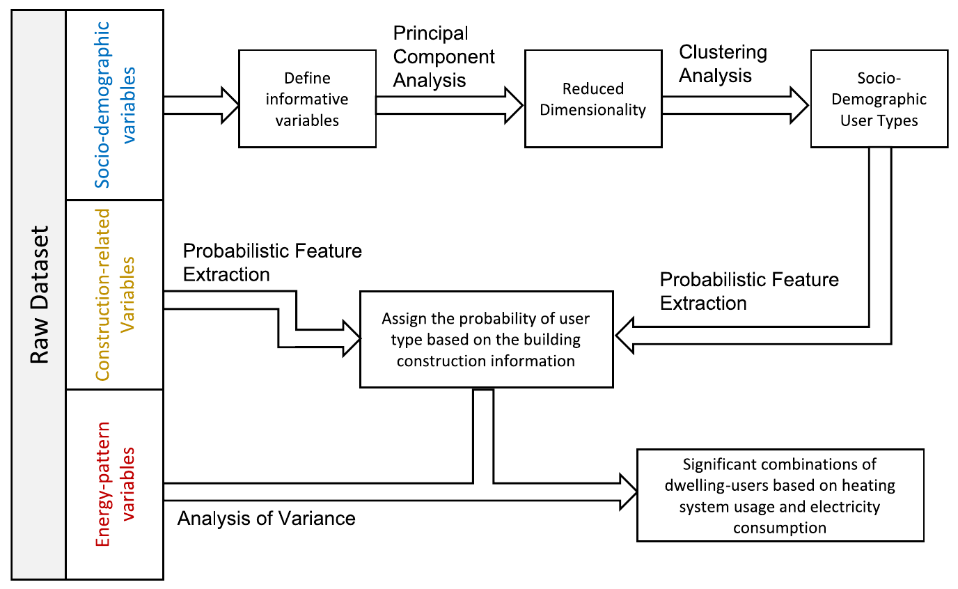
2013
2021
Demographic
variables
Reference PCA
Fixed centers
Harmonized
household
variables
Frozen
PCA
coordinates
Four fixed
user
archetypes
Construction
variables
Probabilistic feature extraction
Joint archetype probabilities
by dwelling age and area
Energy-use
variables
Training-defined heating and
appliance-electricity groups
Held-out distributions and tests
Split-sample grouping
Notes:
Published 2013 original: Khajedehi, Vivian and Zarrella (2025), Energy & Buildings 344, 115924; original PDF page 4; preserved image bytes. 2021: revised_paper_outputs/2021; restyled from source CSVs without changing analytical values except the audited investment-response exclusions in the stratified heating boxes and both ANOVA models. Style matching does not imply identical measures or models. Refer to slide 8. Scientific panels are high-resolution rendered plots as requested; all rebuilt tables and workflow are native editable objects.

Slide 10
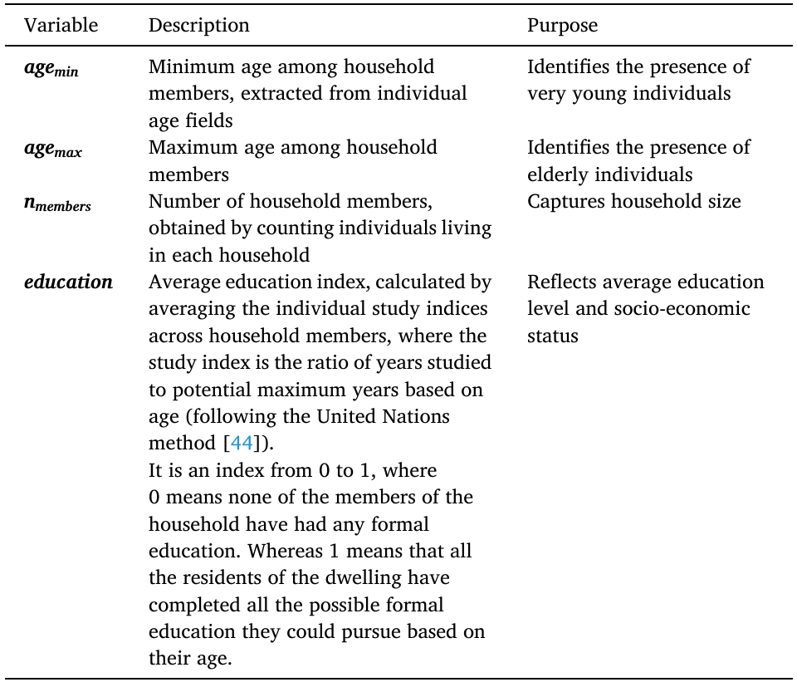
2013
2021
Variable | Operational definition
Minimum age | Minimum of the released age-category midpoint proxies Not an observed exact age; children retain their published interval.
Maximum age | Maximum of the same member-level proxies Open oldest interval capped at 100 years; cap 90 tested.
Household size | Recorded number of members, restricted to 1-5 Same accessible household-size domain in both releases.
Schooling proxy | Mean assigned completed-schooling years / 18 among members in age classes beginning at 15+ Known education required. Not the UNDP education index and not an age-normalized opportunity measure.
Notes:
Published 2013 original: Khajedehi, Vivian and Zarrella (2025), Energy & Buildings 344, 115924; original PDF page 4; preserved image bytes. 2021: revised_paper_outputs/2021; restyled from source CSVs without changing analytical values except the audited investment-response exclusions in the stratified heating boxes and both ANOVA models. Style matching does not imply identical measures or models. Refer to slide 8. Scientific panels are high-resolution rendered plots as requested; all rebuilt tables and workflow are native editable objects.

Slide 11
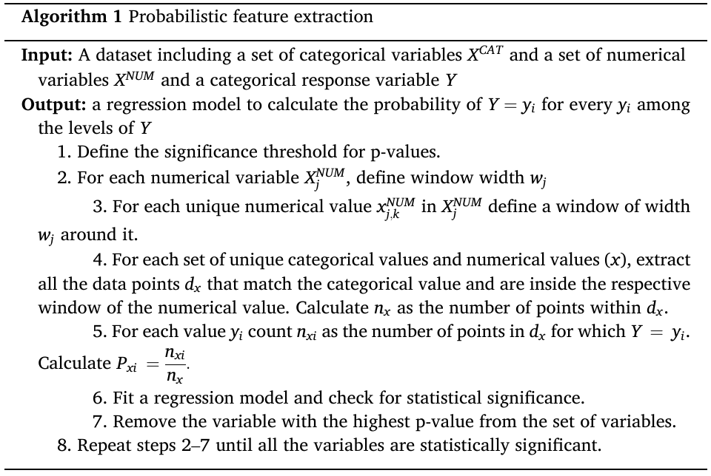
2013
2021
Step | Operation
1 | Split households before fitting; retain the fixed reference archetypes.
2 | Create 24 age–area cells; calculate counts, effective counts and weighted proportions.
3 | Fit a weighted multinomial quadratic model; tune the ridge penalty.
4 | Freeze coefficients; compute four positive probabilities summing to one.
5 | Evaluate held-out log loss, Brier score and cell calibration.
6 | Flag sparse cells and report sensitivity to interval assumptions.
Notes:
Published 2013 original: Khajedehi, Vivian and Zarrella (2025), Energy & Buildings 344, 115924; original PDF page 5; preserved image bytes. 2021: revised_paper_outputs/2021; restyled from source CSVs without changing analytical values except the audited investment-response exclusions in the stratified heating boxes and both ANOVA models. Style matching does not imply identical measures or models. Refer to slide 8. Scientific panels are high-resolution rendered plots as requested; all rebuilt tables and workflow are native editable objects.

Slide 12
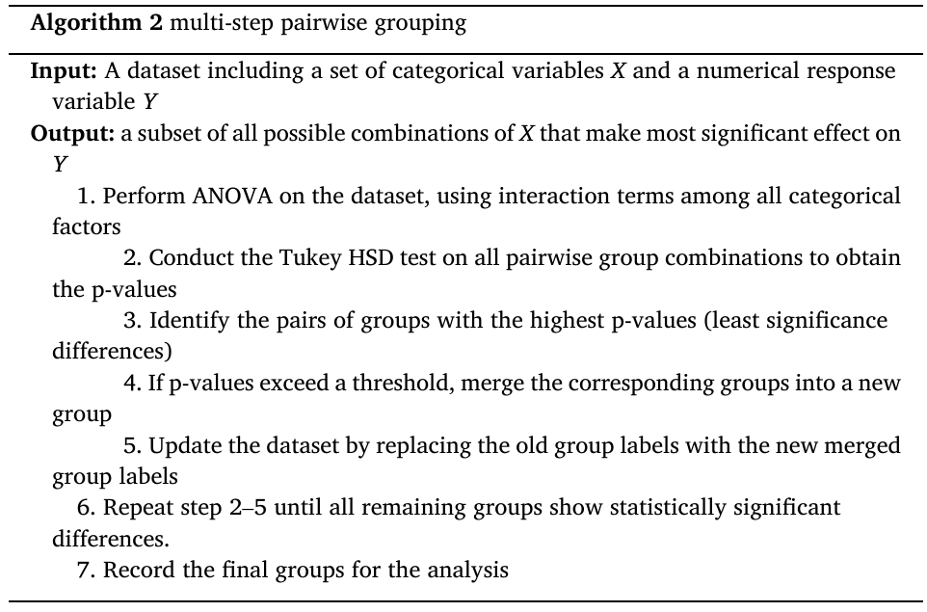
2013
2021
Step | Operation
1 | Estimate training means by location × dwelling type × archetype; require 30 records per cell.
2 | Order cells by mean; merge adjacent cells by minimum increase in weighted squared error.
3 | Select one to eight groups by tuning RMSE; use a training-mean fallback for unsupported cells.
4 | Freeze memberships and predictions; evaluate all eligible test households.
5 | Compare fixed test groups using one Tukey–Kramer family.
6 | Report weighted robust pairwise contrasts with Holm correction; do not merge again.
Notes:
Published 2013 original: Khajedehi, Vivian and Zarrella (2025), Energy & Buildings 344, 115924; original PDF page 5; preserved image bytes. 2021: revised_paper_outputs/2021; restyled from source CSVs without changing analytical values except the audited investment-response exclusions in the stratified heating boxes and both ANOVA models. Style matching does not imply identical measures or models. Refer to slide 8. Scientific panels are high-resolution rendered plots as requested; all rebuilt tables and workflow are native editable objects.

Slide 13
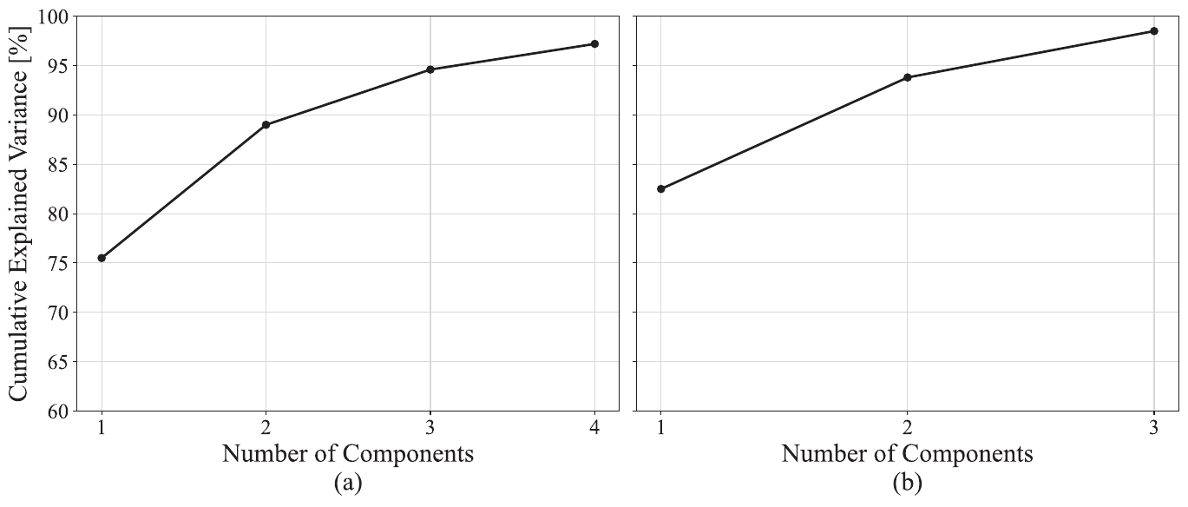
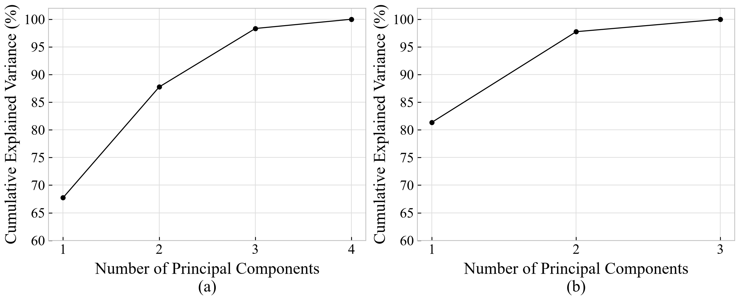
2013
2021
Notes:
Published 2013 original: Khajedehi, Vivian and Zarrella (2025), Energy & Buildings 344, 115924; original PDF page 6; preserved image bytes. 2021: revised_paper_outputs/2021; restyled from source CSVs without changing analytical values except the audited investment-response exclusions in the stratified heating boxes and both ANOVA models. Style matching does not imply identical measures or models. Refer to slide 8. Scientific panels are high-resolution rendered plots as requested; all rebuilt tables and workflow are native editable objects.

Slide 14
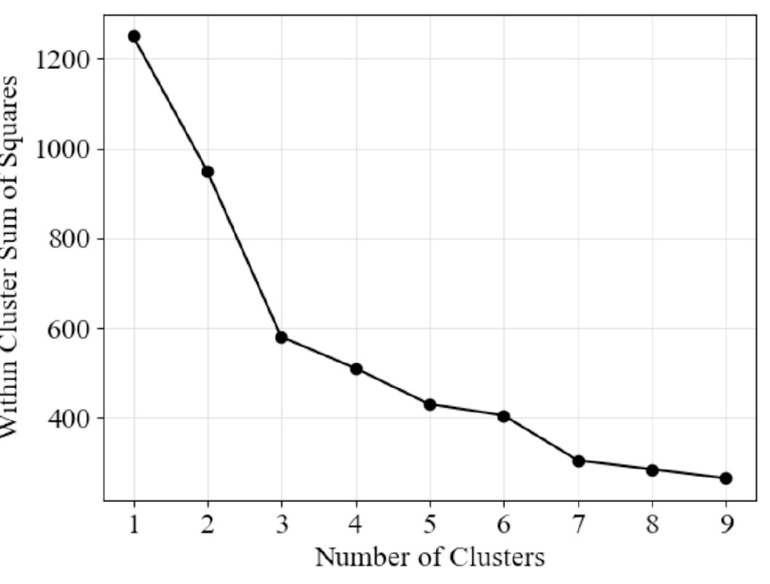
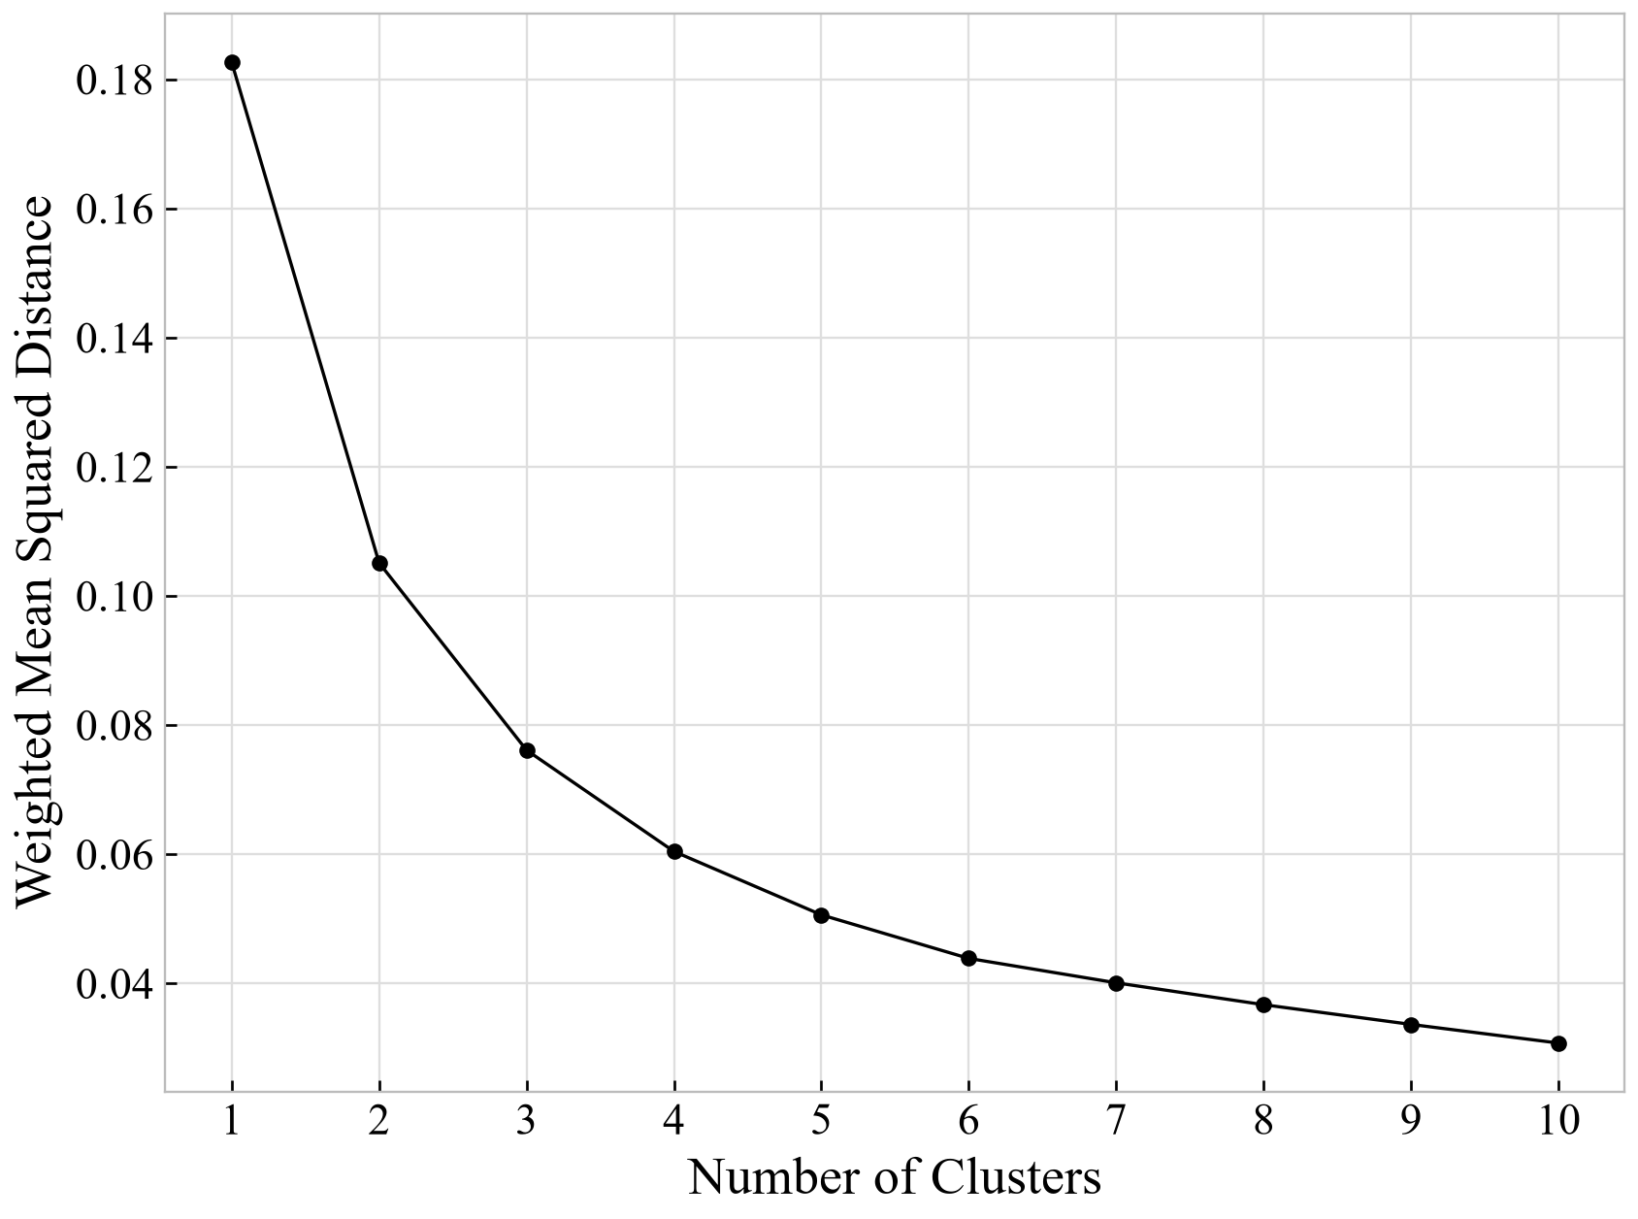
2013
2021
Notes:
Published 2013 original: Khajedehi, Vivian and Zarrella (2025), Energy & Buildings 344, 115924; original PDF page 6; preserved image bytes. 2021: revised_paper_outputs/2021; restyled from source CSVs without changing analytical values except the audited investment-response exclusions in the stratified heating boxes and both ANOVA models. Style matching does not imply identical measures or models. Refer to slide 8. Scientific panels are high-resolution rendered plots as requested; all rebuilt tables and workflow are native editable objects.

Slide 15
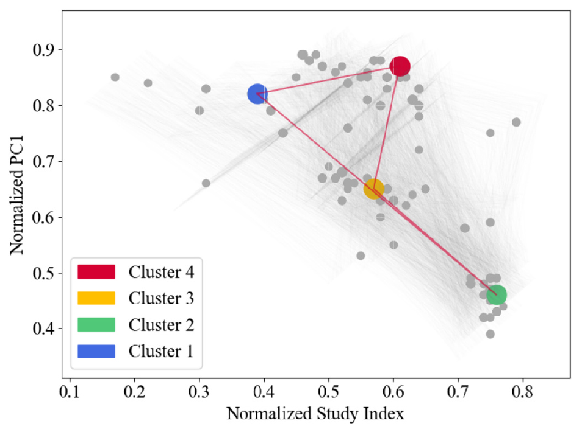
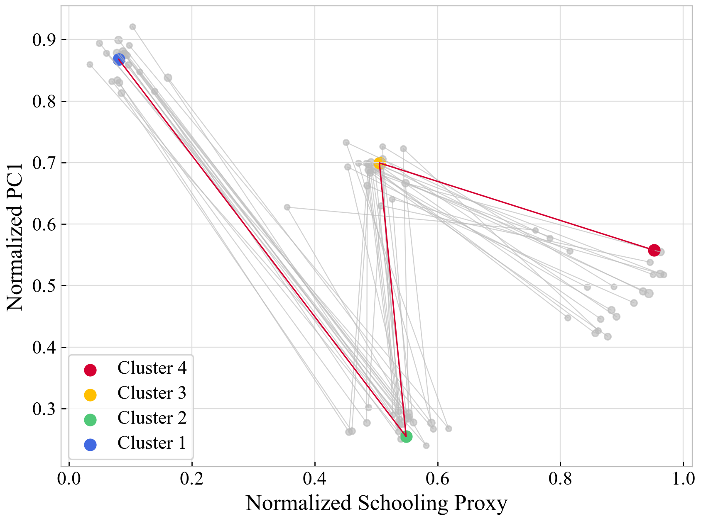
2013
2021
Notes:
Published 2013 original: Khajedehi, Vivian and Zarrella (2025), Energy & Buildings 344, 115924; original PDF page 6; preserved image bytes. 2021: revised_paper_outputs/2021; restyled from source CSVs without changing analytical values except the audited investment-response exclusions in the stratified heating boxes and both ANOVA models. Style matching does not imply identical measures or models. Refer to slide 8. Scientific panels are high-resolution rendered plots as requested; all rebuilt tables and workflow are native editable objects.

Slide 16
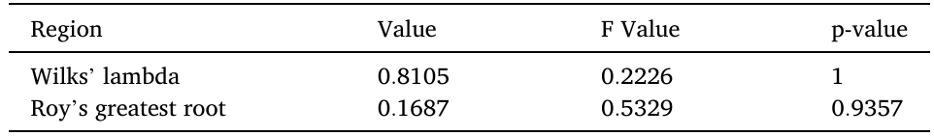
2013
2021
Statistic | Value | F | Numerator df | Denominator df | p
Wilks' lambda | 0.9692 | 4.346 | 57 | 23,479 | <0.001
Roy's greatest root | 0.0169 | 7.019 | 19 | 7,876 | <0.001
Notes:
Published 2013 original: Khajedehi, Vivian and Zarrella (2025), Energy & Buildings 344, 115924; original PDF page 6; preserved image bytes. 2021: revised_paper_outputs/2021; restyled from source CSVs without changing analytical values except the audited investment-response exclusions in the stratified heating boxes and both ANOVA models. Style matching does not imply identical measures or models. Refer to slide 8. Scientific panels are high-resolution rendered plots as requested; all rebuilt tables and workflow are native editable objects.

Slide 17
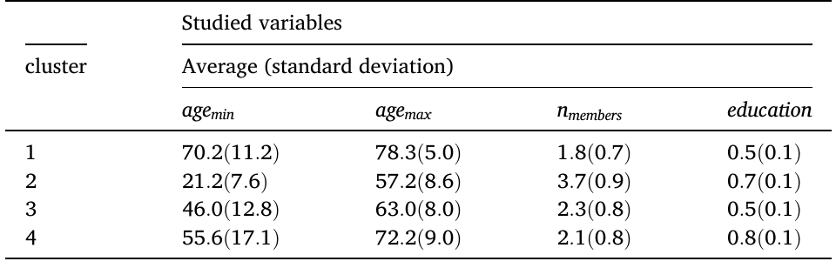
2013
2021
Cluster | Minimum age | Maximum age | Members | Schooling proxy
A1 | 73.63 (16.42) | 81.22 (10.89) | 1.59 (0.67) | 0.21 (0.11)
A2 | 14.50 (10.00) | 49.84 (12.53) | 3.50 (0.86) | 0.60 (0.14)
A3 | 56.26 (15.00) | 62.50 (14.06) | 1.50 (0.59) | 0.57 (0.11)
A4 | 38.84 (22.25) | 51.64 (15.47) | 1.89 (0.95) | 0.96 (0.07)
Notes:
Published 2013 original: Khajedehi, Vivian and Zarrella (2025), Energy & Buildings 344, 115924; original PDF page 7; preserved image bytes. 2021: revised_paper_outputs/2021; restyled from source CSVs without changing analytical values except the audited investment-response exclusions in the stratified heating boxes and both ANOVA models. Style matching does not imply identical measures or models. Refer to slide 8. Scientific panels are high-resolution rendered plots as requested; all rebuilt tables and workflow are native editable objects. Full tabulation, including sample counts and standard errors: {"name":"Table 3","caption":"Weighted demographic summaries by fixed-reference archetype. Entries are mean (population-weighted standard deviation); ages are category proxies.","header":["Archetype","n","Minimum age","Maximum age","Members","Schooling proxy"],"rows":[["A1","8,767","73.63 (16.42)","81.22 (10.89)","1.59 (0.67)","0.21 (0.11)"],["A2","18,738","14.50 (10.00)","49.84 (12.53)","3.50 (0.86)","0.60 (0.14)"],["A3","15,771","56.26 (15.00)","62.50 (14.06)","1.50 (0.59)","0.57 (0.11)"],["A4","9,356","38.84 (22.25)","51.64 (15.47)","1.89 (0.95)","0.96 (0.07)"]],"widths":[62,60,98,98,90,91.27559055118115]}

Slide 18
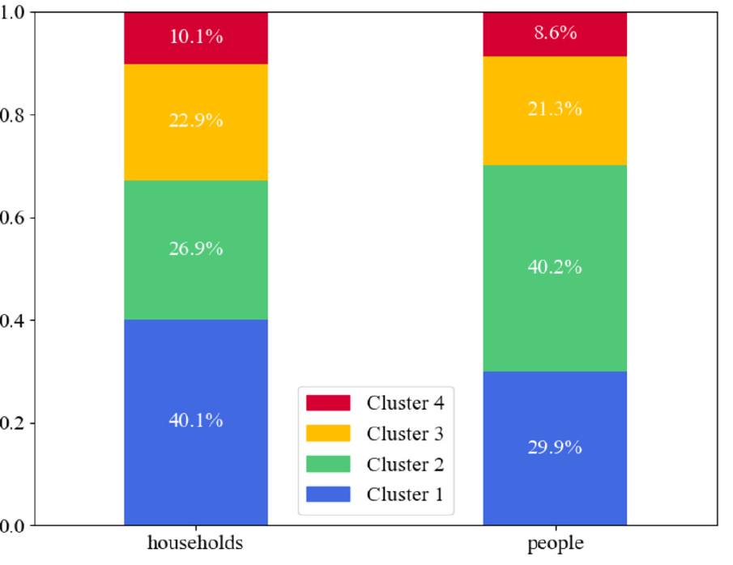
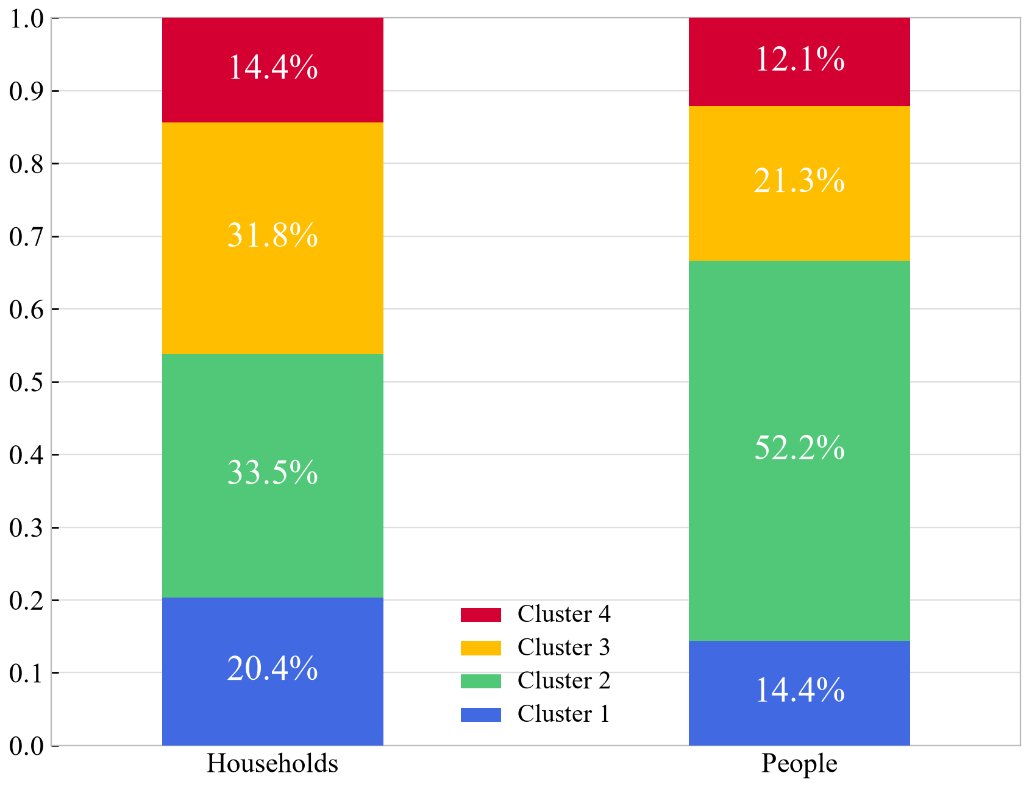
2013
2021
Notes:
Published 2013 original: Khajedehi, Vivian and Zarrella (2025), Energy & Buildings 344, 115924; original PDF page 7; preserved image bytes. 2021: revised_paper_outputs/2021; restyled from source CSVs without changing analytical values except the audited investment-response exclusions in the stratified heating boxes and both ANOVA models. Style matching does not imply identical measures or models. Refer to slide 8. Scientific panels are high-resolution rendered plots as requested; all rebuilt tables and workflow are native editable objects.

Slide 19
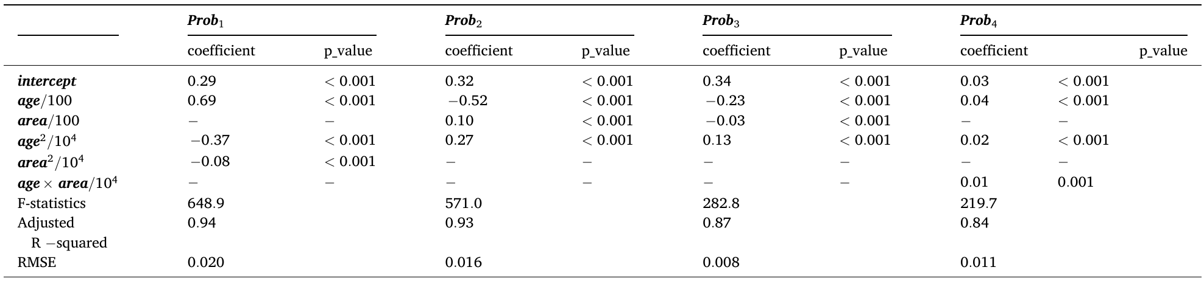
2013
2021
Term | A1 vs A4 | A2 vs A4 | A3 vs A4 | A4 reference
Intercept | -1.694083 | -0.184597 | 1.369579 | 0.000000
Age/100 | 6.133465 | -1.410631 | 1.126234 | 0.000000
Area/100 | 0.940143 | 2.538902 | -1.185233 | 0.000000
Age squared/10000 | -4.340973 | 0.956989 | -1.005700 | 0.000000
Area squared/10000 | -0.408732 | -0.847496 | 0.310145 | 0.000000
Age x area/10000 | -0.286213 | -0.567972 | 0.018421 | 0.000000
Model | Test n | Multiclass Brier | Log loss
Age-area quadratic | 6954 | 0.7071 | 1.2996
Quadratic + location/type | 6954 | 0.7043 | 1.2926
Training marginal only | 6954 | 0.7289 | 1.3416
Notes:
Published 2013 original: Khajedehi, Vivian and Zarrella (2025), Energy & Buildings 344, 115924; original PDF page 8; preserved image bytes. 2021: revised_paper_outputs/2021; restyled from source CSVs without changing analytical values except the audited investment-response exclusions in the stratified heating boxes and both ANOVA models. Style matching does not imply identical measures or models. Refer to slide 8. Scientific panels are high-resolution rendered plots as requested; all rebuilt tables and workflow are native editable objects.

Slide 20
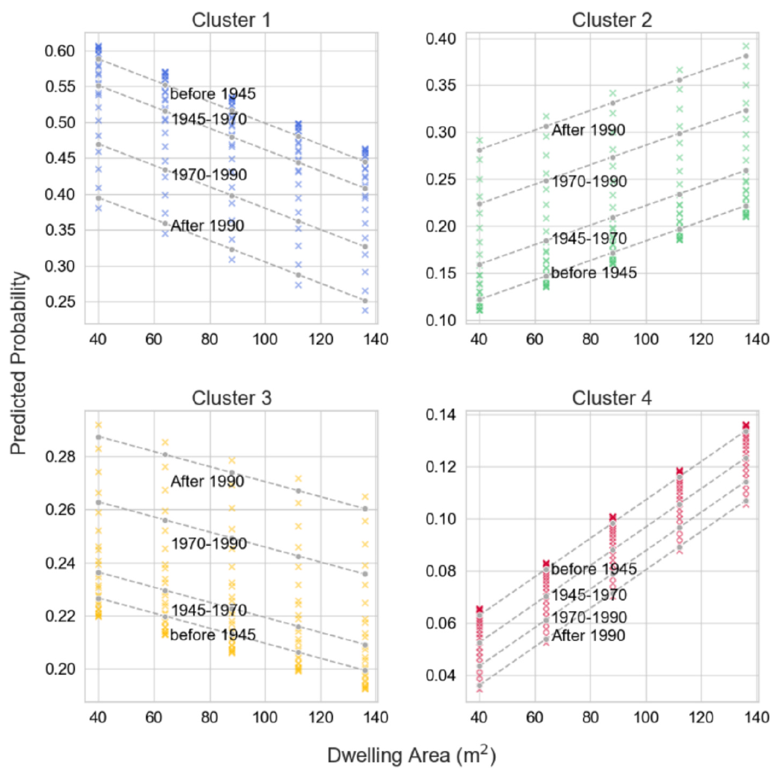
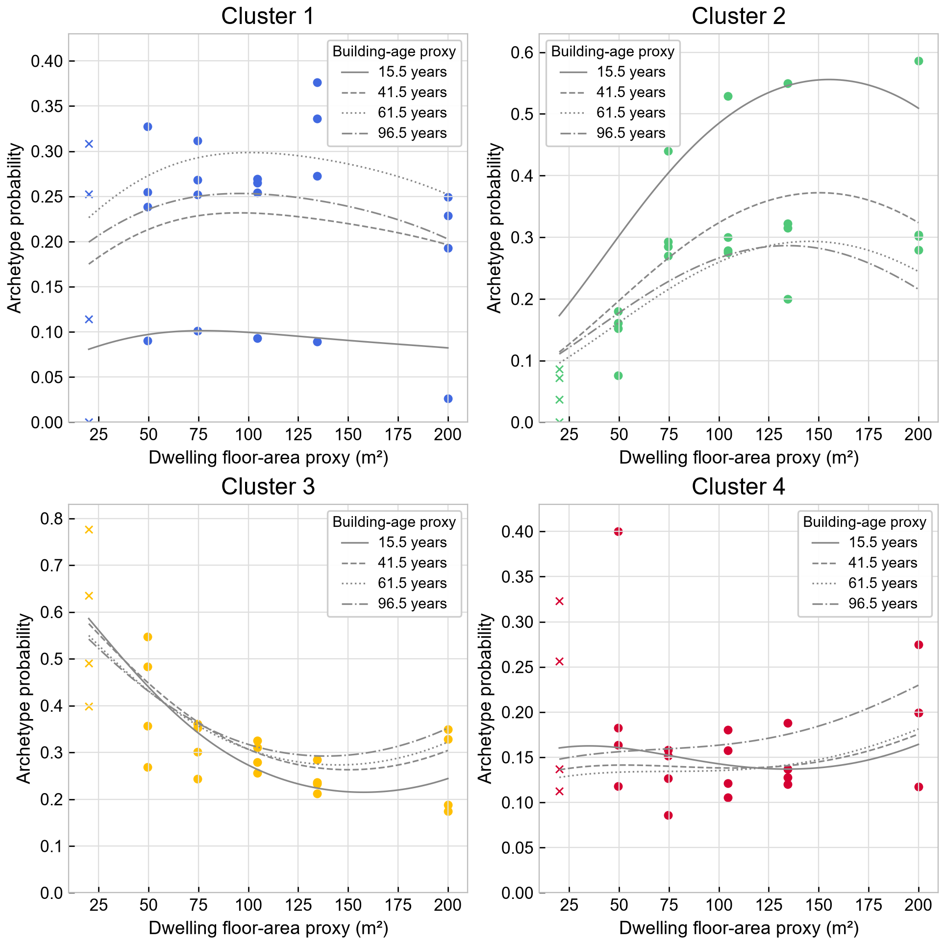
2013
2021
Notes:
Published 2013 original: Khajedehi, Vivian and Zarrella (2025), Energy & Buildings 344, 115924; original PDF page 8; preserved image bytes. 2021: revised_paper_outputs/2021; restyled from source CSVs without changing analytical values except the audited investment-response exclusions in the stratified heating boxes and both ANOVA models. Style matching does not imply identical measures or models. Refer to slide 8. Scientific panels are high-resolution rendered plots as requested; all rebuilt tables and workflow are native editable objects.

Slide 21
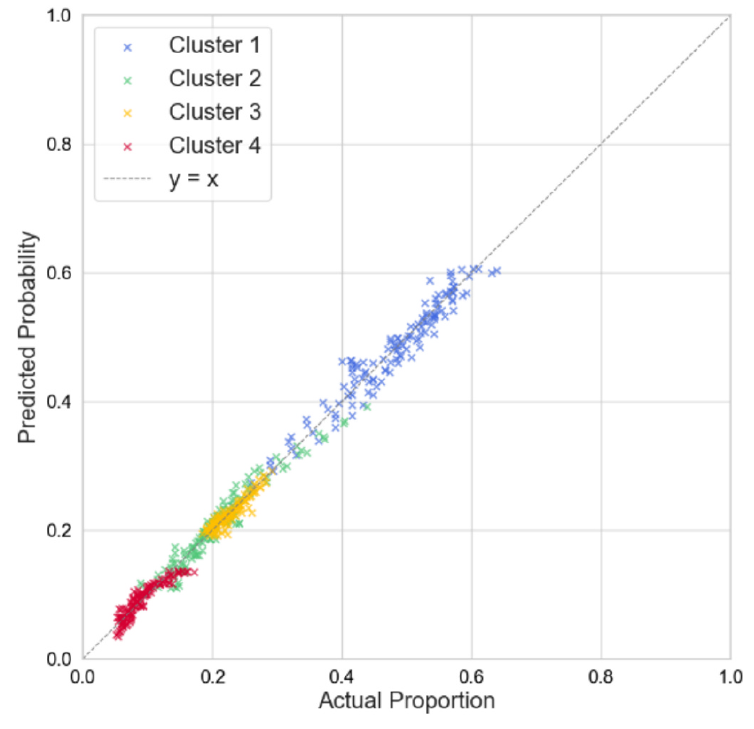
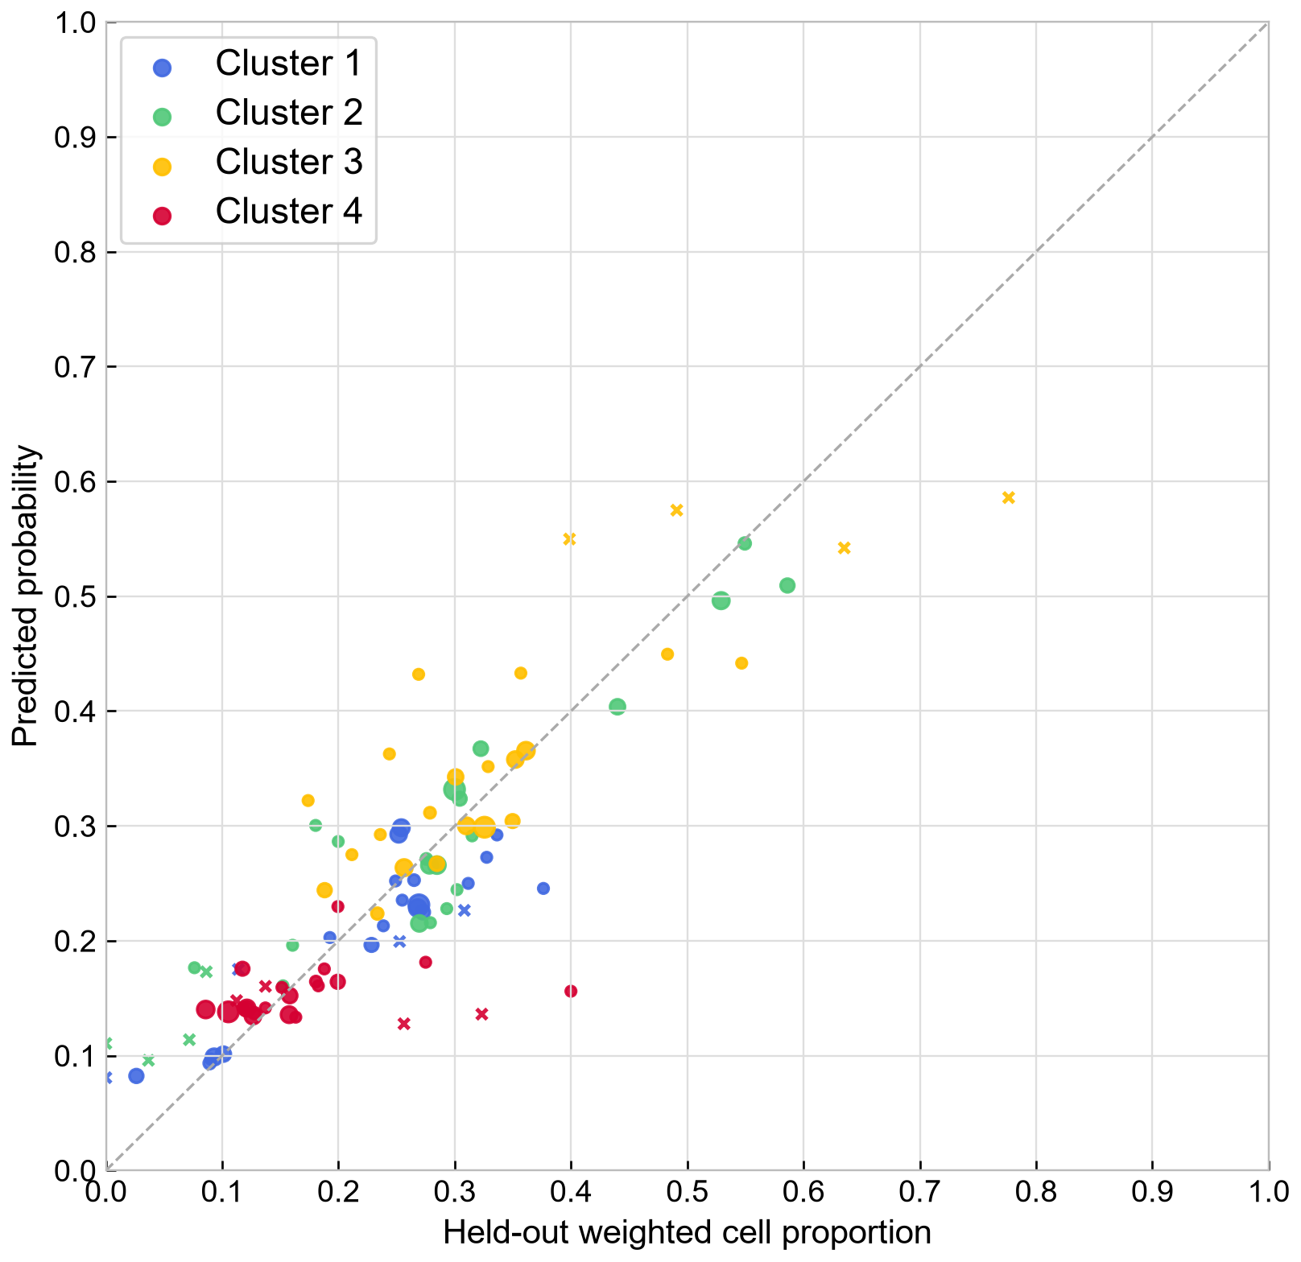
2013
2021
Notes:
Published 2013 original: Khajedehi, Vivian and Zarrella (2025), Energy & Buildings 344, 115924; original PDF page 9; preserved image bytes. 2021: revised_paper_outputs/2021; restyled from source CSVs without changing analytical values except the audited investment-response exclusions in the stratified heating boxes and both ANOVA models. Style matching does not imply identical measures or models. Refer to slide 8. Scientific panels are high-resolution rendered plots as requested; all rebuilt tables and workflow are native editable objects.

Slide 22
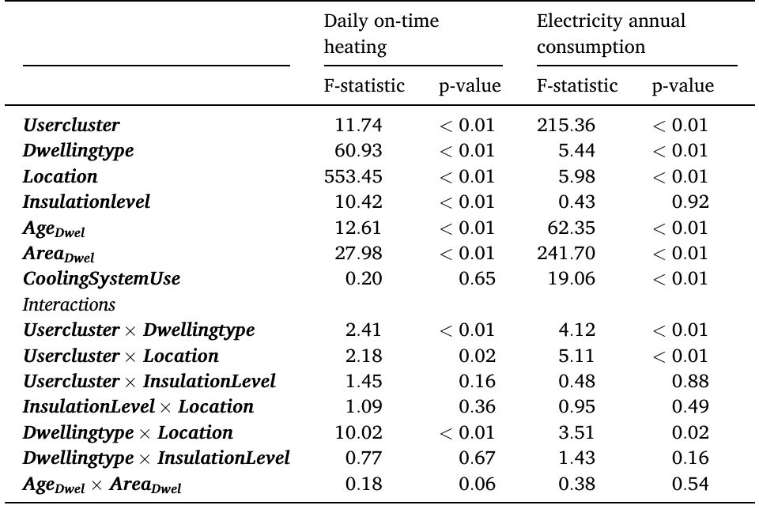
2013
2021
Term | Heating F | Heating p (Holm) | Electricity F | Electricity p (Holm)
Archetype | 0.39 | 1.000 | 34.85 | <0.001
Dwelling type | 2.38 | 0.847 | 0.07 | 1.000
Location | 29.78 | <0.001 | 1.62 | 1.000
Insulation improvement | 1.81 | 1.000 | 0.01 | 1.000
Building-age proxy | 8.04 | 0.055 | 1.00 | 1.000
Floor-area proxy | 11.18 | 0.011 | 75.95 | <0.001
Cooling presence | 0.00 | 1.000 | 33.16 | <0.001
Archetype x type | 0.39 | 1.000 | 0.72 | 1.000
Archetype x location | 1.53 | 1.000 | 2.84 | 0.027
Archetype x insulation improvement | 1.10 | 1.000 | 1.02 | 1.000
Insulation improvement x location | 1.25 | 1.000 | 0.97 | 1.000
Type x location | 1.45 | 1.000 | 2.72 | 0.121
Type x insulation improvement | 3.75 | 0.258 | 0.40 | 1.000
Age x area | 2.97 | 0.847 | 0.00 | 1.000
Notes:
Published 2013 original: Khajedehi, Vivian and Zarrella (2025), Energy & Buildings 344, 115924; original PDF page 9; preserved image bytes. 2021: revised_paper_outputs/2021; restyled from source CSVs without changing analytical values except the audited investment-response exclusions in the stratified heating boxes and both ANOVA models. 2021 audit: v3_13=1 and v3_14gh_new=1 => yes. v3_13=2 => no recent investment. If v3_13=1, a blank gh item is only treated as no when another released investment detail is observed. Both released detail items blank => ambiguous; exclude conservatively. 336 of 7,305 heating-test records excluded from this stratification. The release omits some other investment details, so these exclusions are ambiguous, not proven questionnaire nonresponse. No heating-hour discrepancies found. n=6,969 for stratified comparison; HC3 WLS, Holm over 8 fixed groups. No adjusted p<0.05. Higher hours are not higher heat consumption or a causal insulation effect. Style matching does not imply identical measures or models. Refer to slide 8. Scientific panels are high-resolution rendered plots as requested; all rebuilt tables and workflow are native editable objects.

Slide 23
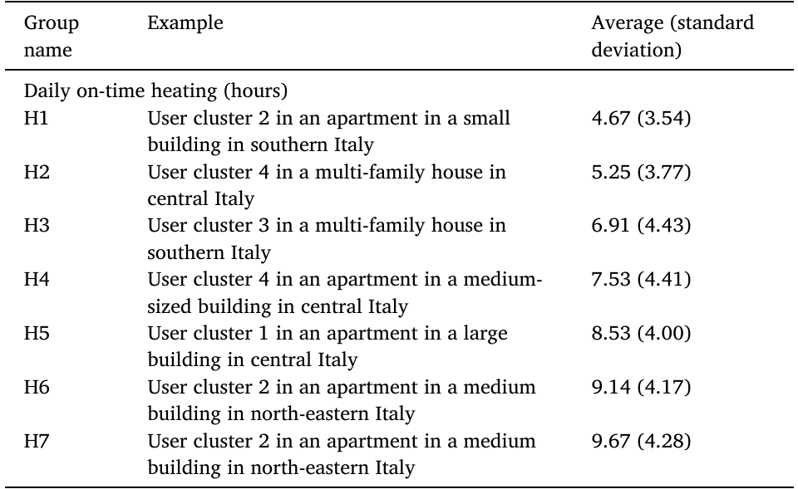
2013
2021
Group | Example | Average (standard deviation)
H1 | Cluster 2; Apartment; South/islands | 6.17 (4.00)
H2 | Cluster 2; Apartment; Centre | 6.84 (3.95)
H3 | Cluster 4; Apartment; Centre | 7.51 (4.22)
H4 | Cluster 2; Single-family; South/islands | 7.77 (4.54)
H5 | Cluster 3; Apartment; North-west | 9.49 (5.03)
H6 | Cluster 4; Apartment; North-west | 9.76 (4.64)
H7 | Cluster 1; Apartment; North-west | 11.03 (5.67)
H8 | Cluster 2; Single-family; North-west | 11.03 (5.83)
Notes:
Published 2013 original: Khajedehi, Vivian and Zarrella (2025), Energy & Buildings 344, 115924; original PDF page 10; preserved image bytes. 2021: revised_paper_outputs/2021; restyled from source CSVs without changing analytical values except the audited investment-response exclusions in the stratified heating boxes and both ANOVA models. Style matching does not imply identical measures or models. Refer to slide 8. Scientific panels are high-resolution rendered plots as requested; all rebuilt tables and workflow are native editable objects. Full tabulation, including sample counts and standard errors: {"name":"Table 6","caption":"(a) Training-defined heating groups, summarized on test households. Examples are the highest-count training cell assigned to each group, not duplicated illustrative scenarios.","header":["Group","Example: location / dwelling / archetype","Test n","Mean (SD)","SE"],"rows":[["H1","South/islands / Apartment / 2","1,381","6.17 (4.00)","0.16"],["H2","Centre / Apartment / 2","940","6.84 (3.95)","0.16"],["H3","Centre / Apartment / 4","935","7.51 (4.22)","0.18"],["H4","South/islands / Single-family / 2","622","7.77 (4.54)","0.25"],["H5","North-west / Apartment / 3","1,556","9.49 (5.03)","0.19"],["H6","North-west / Apartment / 4","307","9.76 (4.64)","0.40"],["H7","North-west / Apartment / 1","1,014","11.03 (5.67)","0.24"],["H8","North-west / Single-family / 2","550","11.03 (5.83)","0.31"]],"widths":[42,220,55,110,72.27559055118115]}

Slide 24
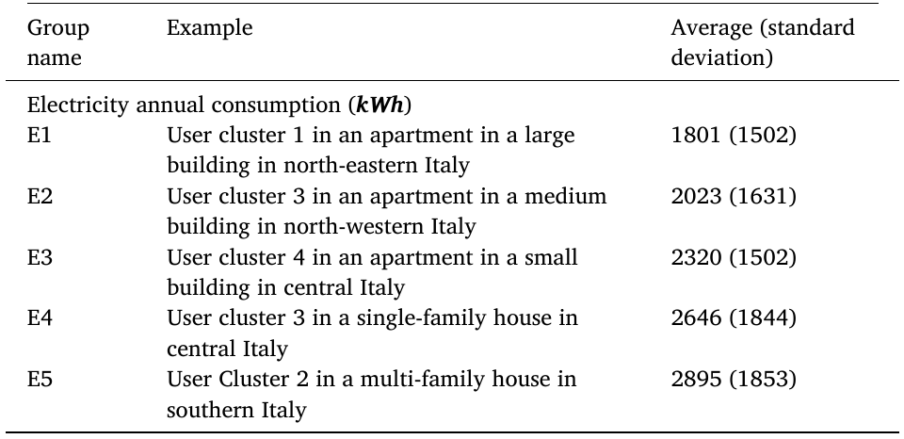
2013
2021
Group | Example | Average (standard deviation)
E1 | Cluster 3; Apartment; South/islands | 1,524.29 (514.94)
E2 | Cluster 3; Apartment; North-east | 1,632.10 (523.53)
E3 | Cluster 4; Apartment; Centre | 1,827.88 (677.52)
E4 | Cluster 4; Apartment; South/islands | 1,872.62 (628.75)
E5 | Cluster 2; Apartment; South/islands | 2,272.13 (763.84)
E6 | Cluster 2; Single-family; South/islands | 2,401.10 (765.07)
E7 | Cluster 2; Multi-family; North-west | 2,574.19 (797.03)
E8 | Cluster 2; Multi-family; North-east | 2,820.83 (894.82)
Notes:
Published 2013 original: Khajedehi, Vivian and Zarrella (2025), Energy & Buildings 344, 115924; original PDF page 10; preserved image bytes. 2021: revised_paper_outputs/2021; restyled from source CSVs without changing analytical values except the audited investment-response exclusions in the stratified heating boxes and both ANOVA models. Style matching does not imply identical measures or models. Refer to slide 8. Scientific panels are high-resolution rendered plots as requested; all rebuilt tables and workflow are native editable objects. Full tabulation, including sample counts and standard errors: {"name":"Table 6 (continued)","caption":"(b) Training-defined electricity groups, summarized on test households. Examples are the highest-count training cell assigned to each group, not duplicated illustrative scenarios.","header":["Group","Example: location / dwelling / archetype","Test n","Mean (SD)","SE"],"rows":[["E1","South/islands / Apartment / 3","1,619","1,524.29 (514.94)","17.27"],["E2","North-east / Apartment / 3","947","1,632.10 (523.53)","20.26"],["E3","Centre / Apartment / 4","1,107","1,827.88 (677.52)","30.86"],["E4","South/islands / Apartment / 4","1,019","1,872.62 (628.75)","24.03"],["E5","South/islands / Apartment / 2","1,974","2,272.13 (763.84)","25.69"],["E6","South/islands / Single-family / 2","371","2,401.10 (765.07)","62.32"],["E7","North-west / Multi-family / 2","439","2,574.19 (797.03)","72.14"],["E8","North-east / Multi-family / 2","420","2,820.83 (894.82)","66.84"]],"widths":[42,220,55,110,72.27559055118115]}

Slide 25
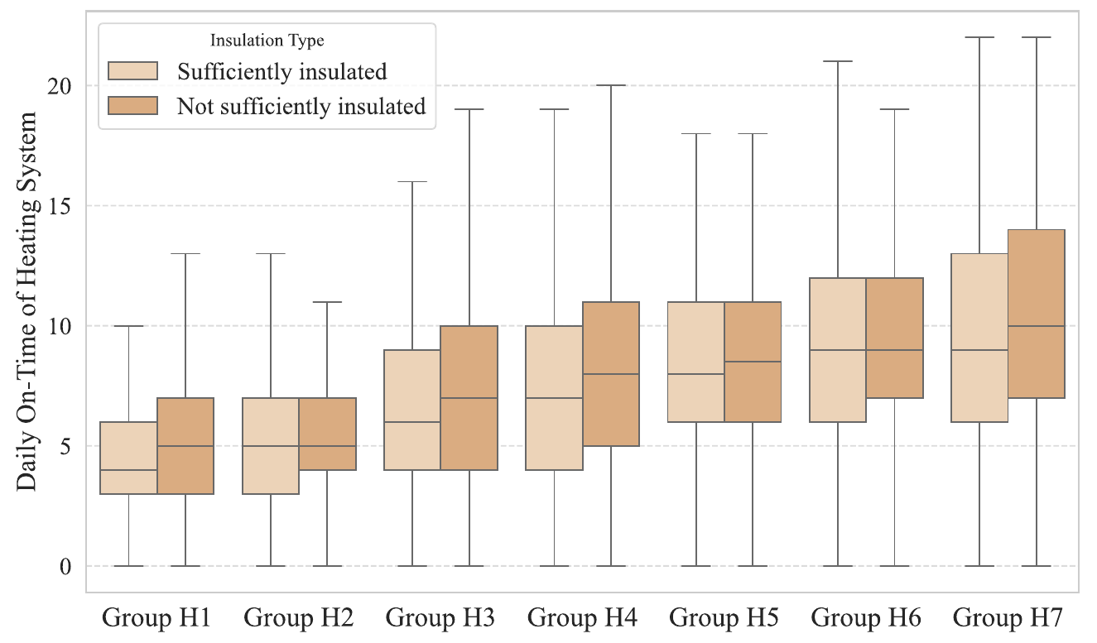
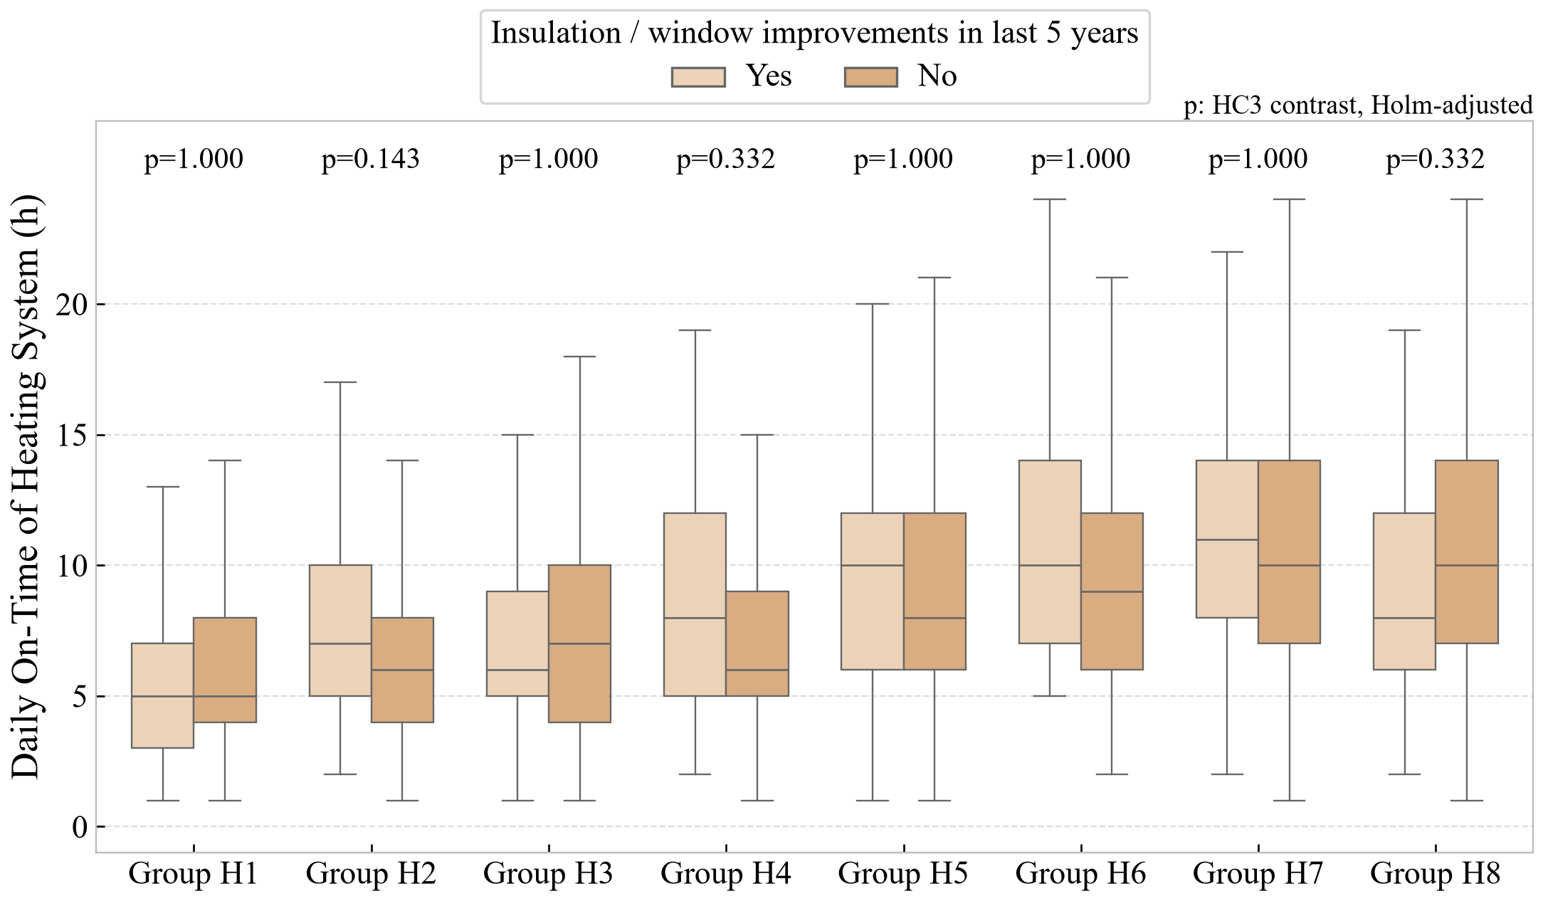
2013
2021
Notes:
Published 2013 original: Khajedehi, Vivian and Zarrella (2025), Energy & Buildings 344, 115924; original PDF page 11; preserved image bytes. 2021: revised_paper_outputs/2021; restyled from source CSVs without changing analytical values except the audited investment-response exclusions in the stratified heating boxes and both ANOVA models. 2021 audit: v3_13=1 and v3_14gh_new=1 => yes. v3_13=2 => no recent investment. If v3_13=1, a blank gh item is only treated as no when another released investment detail is observed. Both released detail items blank => ambiguous; exclude conservatively. 336 of 7,305 heating-test records excluded from this stratification. The release omits some other investment details, so these exclusions are ambiguous, not proven questionnaire nonresponse. No heating-hour discrepancies found. n=6,969 for stratified comparison; HC3 WLS, Holm over 8 fixed groups. No adjusted p<0.05. Higher hours are not higher heat consumption or a causal insulation effect. Style matching does not imply identical measures or models. Refer to slide 8. Scientific panels are high-resolution rendered plots as requested; all rebuilt tables and workflow are native editable objects.

Slide 26
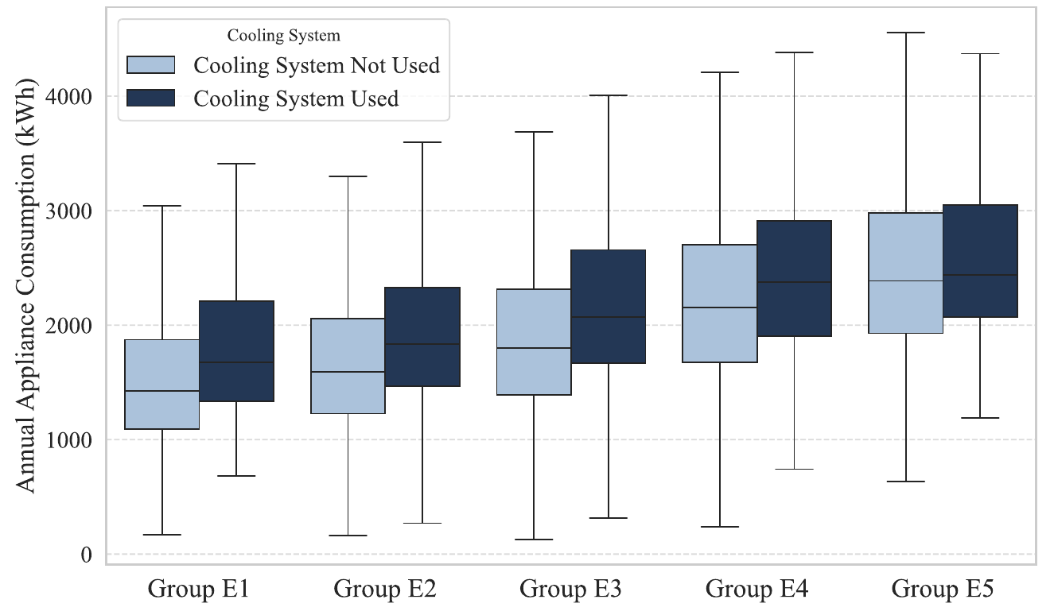
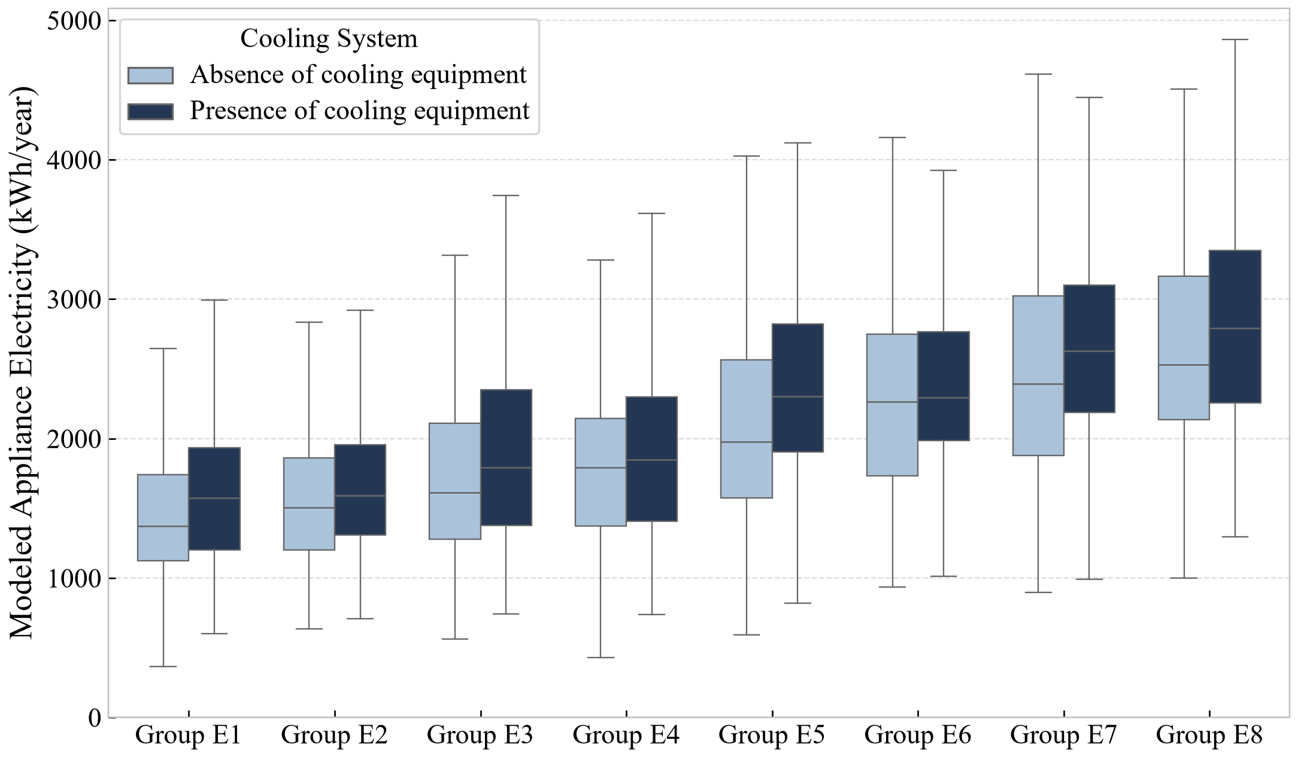
2013
2021
Notes:
Published 2013 original: Khajedehi, Vivian and Zarrella (2025), Energy & Buildings 344, 115924; original PDF page 11; preserved image bytes. 2021: revised_paper_outputs/2021; restyled from source CSVs without changing analytical values except the audited investment-response exclusions in the stratified heating boxes and both ANOVA models. Style matching does not imply identical measures or models. Refer to slide 8. Scientific panels are high-resolution rendered plots as requested; all rebuilt tables and workflow are native editable objects.

Slide 27
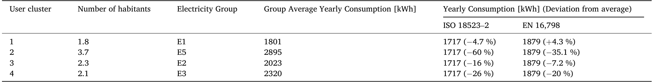
2013
2021
Cluster | Test n | Mean area (m²) | Modeled mean (kWh/y) | ISO example (difference) | EN example (difference)
A1 | 1353 | 101.5 | 1,617 | 1717 (+6.2%) | 1589 (-1.8%)
A2 | 2826 | 109.5 | 2,399 | 1717 (-28.4%) | 1715 (-28.5%)
A3 | 2330 | 99.2 | 1,652 | 1717 (+4.0%) | 1553 (-5.9%)
A4 | 1387 | 107.2 | 1,946 | 1717 (-11.8%) | 1678 (-13.7%)
Notes:
Published 2013 original: Khajedehi, Vivian and Zarrella (2025), Energy & Buildings 344, 115924; original PDF page 12; preserved image bytes. 2021: revised_paper_outputs/2021; restyled from source CSVs without changing analytical values except the audited investment-response exclusions in the stratified heating boxes and both ANOVA models. Style matching does not imply identical measures or models. Refer to slide 8. Scientific panels are high-resolution rendered plots as requested; all rebuilt tables and workflow are native editable objects.

Slide 28
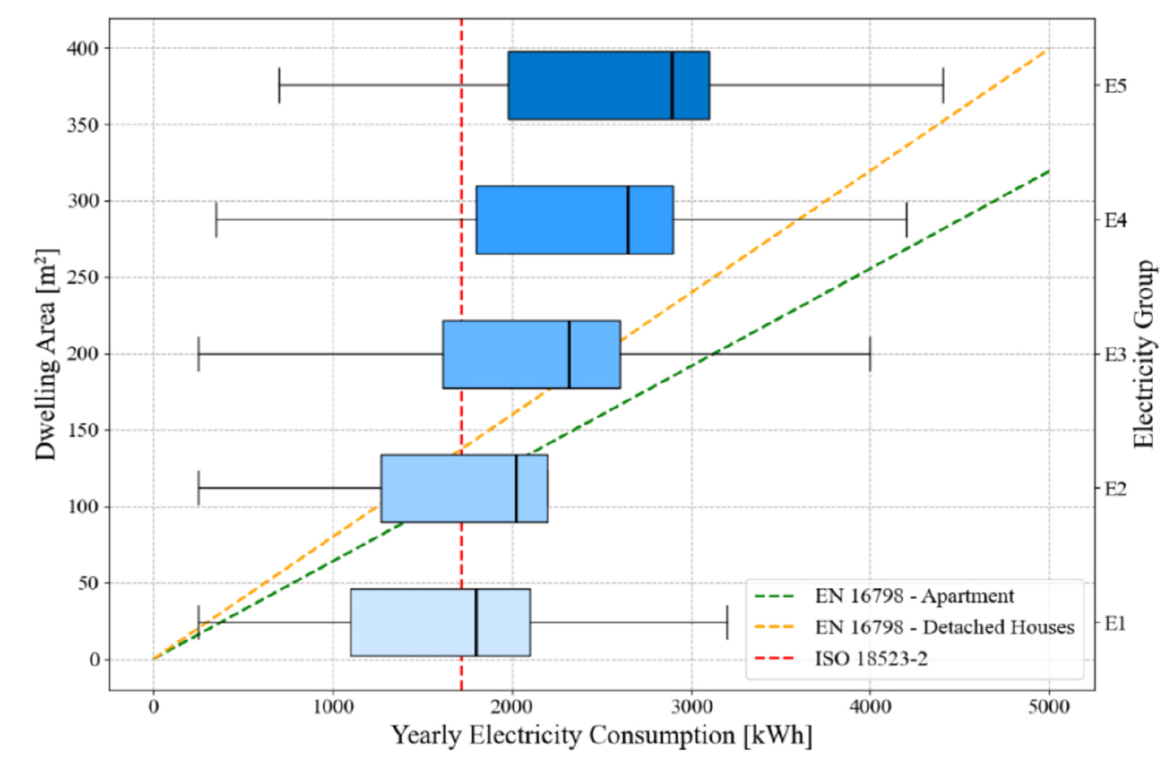
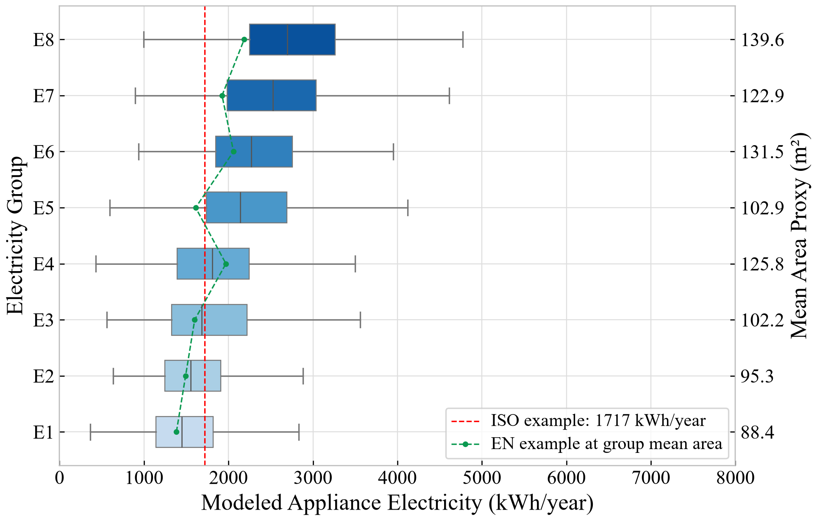
2013
2021
Notes:
Published 2013 original: Khajedehi, Vivian and Zarrella (2025), Energy & Buildings 344, 115924; original PDF page 12; preserved image bytes. 2021: revised_paper_outputs/2021; restyled from source CSVs without changing analytical values except the audited investment-response exclusions in the stratified heating boxes and both ANOVA models. Style matching does not imply identical measures or models. Refer to slide 8. Scientific panels are high-resolution rendered plots as requested; all rebuilt tables and workflow are native editable objects.

Slide 29
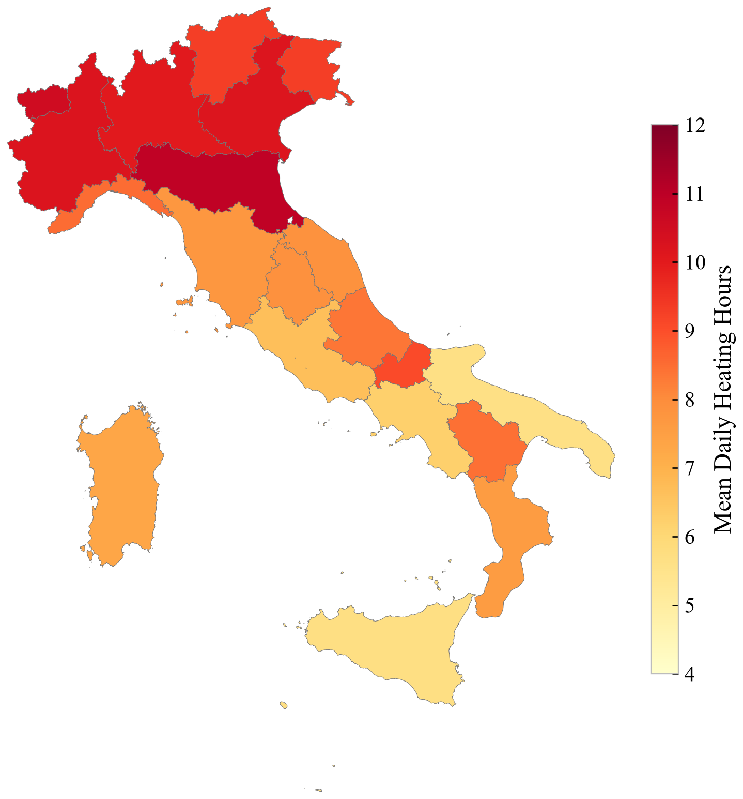
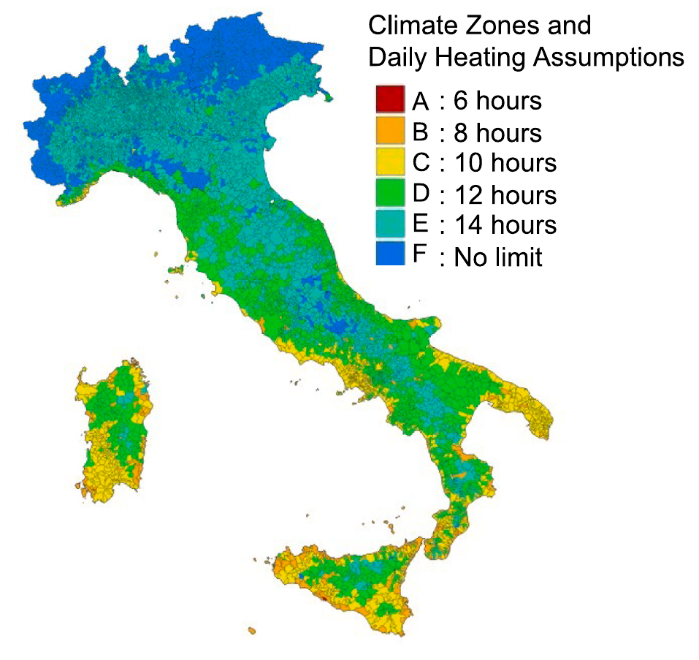
2013
2021
Notes:
Published 2013 original: Khajedehi, Vivian and Zarrella (2025), Energy & Buildings 344, 115924; original PDF page 13; preserved image bytes. 2021: revised_paper_outputs/2021; restyled from source CSVs without changing analytical values except the audited investment-response exclusions in the stratified heating boxes and both ANOVA models. Style matching does not imply identical measures or models. Refer to slide 8. Scientific panels are high-resolution rendered plots as requested; all rebuilt tables and workflow are native editable objects.

Slide 30
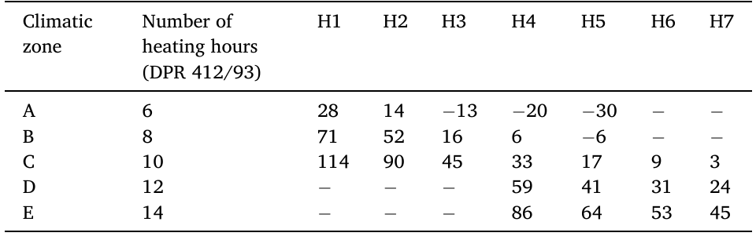
2013
2021
Schedule (h) Difference (%) | H1 | H2 | H3 | H4 | H5 | H6 | H7 | H8
6 | -2.7 | -12.3 | -20.1 | -22.8 | -36.8 | -38.5 | -45.6 | -45.6
8 | +29.7 | +17.0 | +6.6 | +2.9 | -15.7 | -18.0 | -27.5 | -27.5
10 | +62.1 | +46.2 | +33.2 | +28.6 | +5.3 | +2.5 | -9.3 | -9.3
12 | +94.5 | +75.5 | +59.9 | +54.4 | +26.4 | +22.9 | +8.8 | +8.8
14 | +126.9 | +104.7 | +86.5 | +80.1 | +47.5 | +43.4 | +26.9 | +27.0
Notes:
Published 2013 original: Khajedehi, Vivian and Zarrella (2025), Energy & Buildings 344, 115924; original PDF page 13; preserved image bytes. 2021: revised_paper_outputs/2021; restyled from source CSVs without changing analytical values except the audited investment-response exclusions in the stratified heating boxes and both ANOVA models. Style matching does not imply identical measures or models. Refer to slide 8. Scientific panels are high-resolution rendered plots as requested; all rebuilt tables and workflow are native editable objects.

Slide 31
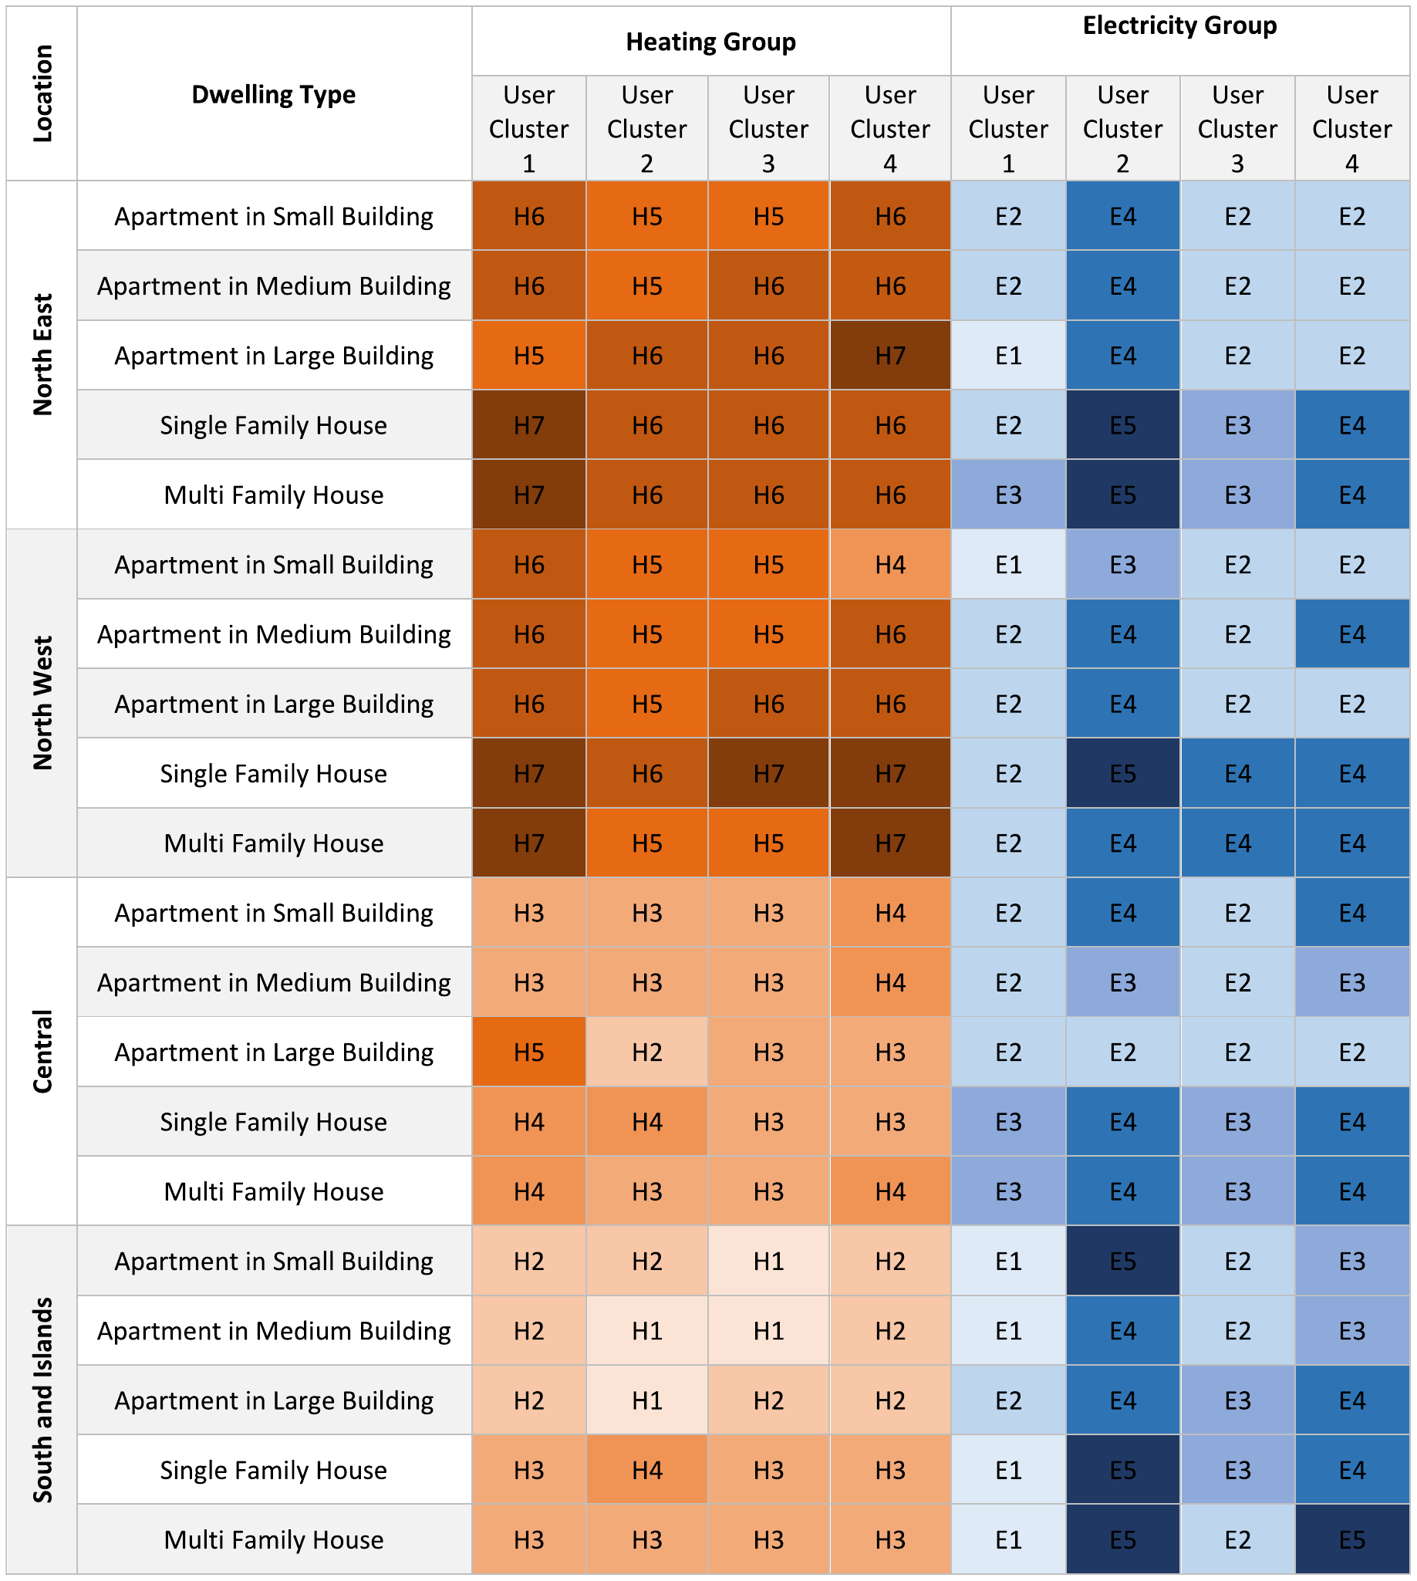
2013
2021
Location | Dwelling type | Heating Group |  |  |  | Electricity Group
 |  | A1 | A2 | A3 | A4 | A1 | A2 | A3 | A4
North- west | Apartment | H7 | H5 | H5 | H6 | E1 | E5 | E1 | E3
 | Multi-family | H7 | H5 | H6 | H7 | E2 | E7 | E3 | E5
 | Single-family | H7 | H8 | H7 | H7 | E3 | E8 | E4 | E5
North- east | Apartment | H8 | H5 | H5 | H5 | E2 | E5 | E2 | E3
 | Multi-family | H8 | H7 | H7 | H7 | E4 | E8 | E4 | E5
 | Single-family | H8 | H8 | H7 | H8 | E4 | E8 | E4 | E5
Centre | Apartment | H2 | H2 | H2 | H3 | E2 | E5 | E1 | E3
 | Multi-family | H3 | H3 | H3 | H3 | E3 | E7 | E3 | E5
 | Single-family | H4 | H4 | H4 | H4 | E4 | E7 | E4 | E5
South/ islands | Apartment | H1 | H1 | H1 | H1 | E1 | E5 | E1 | E4
 | Multi-family | H3 | H3 | H2 | H2 | E2 | E6 | E2 | E4
 | Single-family | H4 | H4 | H3 | H4 | E2 | E6 | E3 | E5
Notes:
Published 2013 original: Khajedehi, Vivian and Zarrella (2025), Energy & Buildings 344, 115924; original PDF page 14; preserved image bytes. 2021: revised_paper_outputs/2021; restyled from source CSVs without changing analytical values except the audited investment-response exclusions in the stratified heating boxes and both ANOVA models. Style matching does not imply identical measures or models. Refer to slide 8. Scientific panels are high-resolution rendered plots as requested; all rebuilt tables and workflow are native editable objects.

