Slide 1
NYC Taxi Time Prediction
Machine Learning Pipeline Review
23CSE301

Slide 2
Introduction
Objective: End-to-End machine learning pipeline to predict how many seconds a NYC Cab trip will last.
Target Variable: Time Taken in seconds

Slide 3
Dataset Characteristics
Volume : Around 300K records of various NYC Cab data spanning over six months.
Features: 10 raw features present in the dataset and one target variable, trip_duration

Slide 4
Motivation and objectives
Operational ETA: Estimate yellow-cab trip duration before the ride ends, using only pickup-time information (time, GPS, passengers, vendor). Dispatch and rider ETAs cannot wait for dropoff_datetime.
Congestion: Two trips of the same kilometres can differ by several minutes at rush hour. The notebook adds haversine/Manhattan distance, bearing, and calendar flags so models can learn that pattern.
Data integrity: Drop dropoff_datetime (target leakage) and id. Fit the scaler/encoder on the training split only. Score every algorithm on the same held-out trips.
Fair model comparison: Train all ten required regressors on one preprocessed table and report R², RMSE, MAE, and 5-fold CV R² against a mean baseline.
Interpretability: Linear coefficients, tree splits, and feature importances show why a trip is predicted as long or short, not only the score.

Slide 5
Approach: Preparation & Engineering
Data cleansing: Drop exact duplicates, drop id, and drop dropoff_datetime so duration cannot leak into the features.
Domain filters: Keep trips inside the NYC GPS box, passengers 1–6, and duration 60–7,200 s. No IQR wipe of long airport runs.
Pickup-only engineering: New columns use information known at pickup.
  Haversine and Manhattan distances (physical length of the trip).
  Bearing (direction: airports vs downtown).
  Hour, day of week, month, weekend, and rush-hour flags
After this step the table is 349,080 rows. Distance correlates ~0.7+ with duration; that is the signal the ten models train on.

Slide 6
Approach: Preprocessor Architecture
Partitioning: 80/20 split (random_state=42). Duration is cut into 10 quantile bins and used to stratify, so long trips appear in both train and test.
ColumnTransformer:
  StandardScaler on the 13 numeric columns (fit on train only).
  One-hot encoding of vendor_id and store_and_fwd_flag (names, not ordered numbers).
Shared matrix: The same 17-column processed arrays go to all ten models. Trees do not need scaling; SVR and KNN do scaling once keeps the comparison fair.
Shared test cap: Every model is scored on the same 50,000-row evaluation slice so SVR/KNN prediction stays tractable.
Train shape after this step: 279,264 × 17. Test scored: 50,000 × 17.

Slide 7
Approach: Predictive Modeling Suite
Evaluated ten required algorithms on the same preprocessed table and the same 50k test trips.
  Linear Regression: Unregularized parametric baseline; scaled coefficients show direction of each feature.
  Ridge: L2 shrinkage for collinear haversine and Manhattan distances.
  Lasso: L1 sparsity; some weights go exactly to zero.
  ElasticNet: Mix of L1 and L2 (l1_ratio=0.5).
  Polynomial Regression: Degree 1 vs 2, then linear — lets distance interact with hour.
  Decision Tree: Depth-capped splits plus feature importance.
  Random Forest: Bagged trees; later tuned with RandomizedSearch.
  Gradient Boosting: HistGradientBoostingRegressor (same family, runnable at this scale).
  SVR: RBF kernel with a scaled target; trained on 12k rows.
  KNN: Distance-weighted neighbours (k=15); trained on 40k rows.
Mean baseline is stored first (always predict the training average) so every model must beat R² ≈ 0.

Slide 8
Results: Evaluation Framework
Primary metrics: Test R², RMSE, and MAE (seconds). 5-fold CV R² on the training split for stability.
Rationale: R² ranks models against a mean baseline (R² ≈ 0). RMSE/MAE stay in seconds so “off by ~5 minutes” is easy to say. Macro-style class metrics do not apply here — the target is continuous.
Protocol: Same preprocessed matrix, same 50k test trips, random_state=42. Train rows is reported so SVR (12k) and KNN (40k) are not compared as if they saw the full split.
Key finding 1: Haversine distance is the dominant driver (correlation 0.77 with duration after cleaning).
Key finding 2: Tree ensembles beat linear models on the non-linear congestion pattern. Gradient Boosting leads (R² 0.80, RMSE 292 s ≈ 4.9 min); Random Forest is close (R² 0.79). Linear / Ridge sit at R² 0.62.

Slide 9
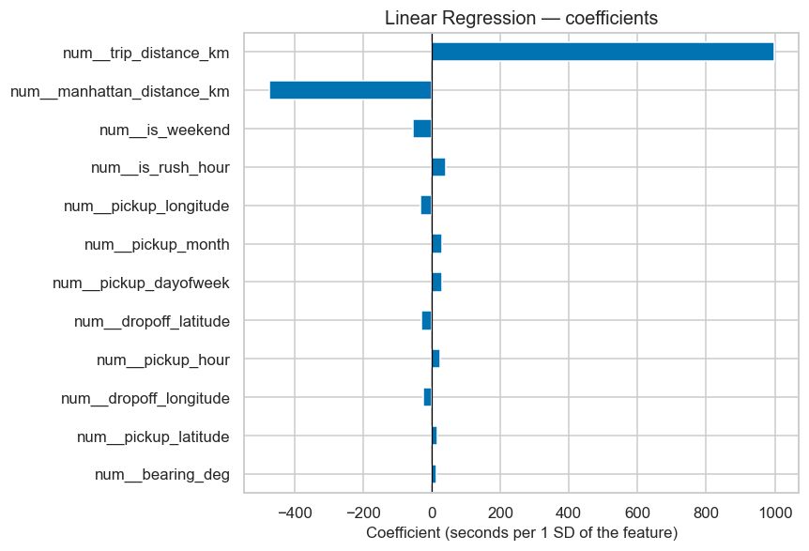
Results: Model 1 – Linear Regression

Slide 10

Results: model 2 – ridge regression

Slide 11
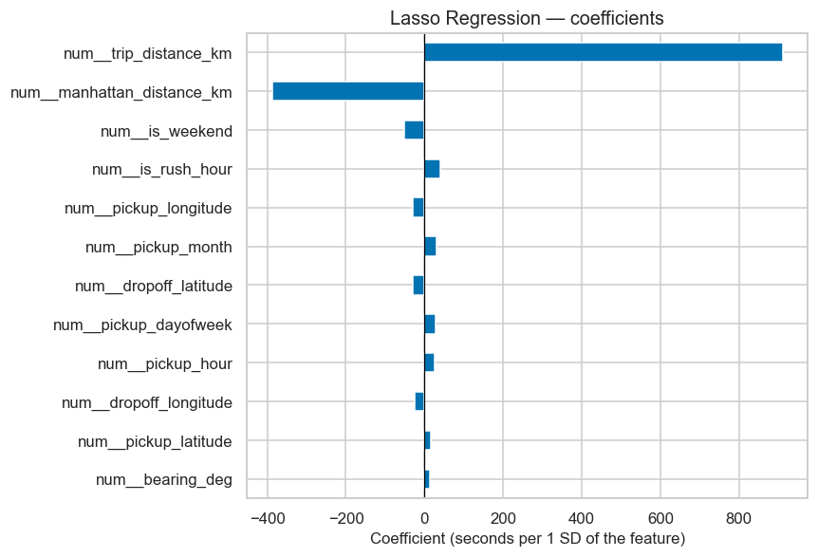
Results: model 3 – lasso regression

Slide 12
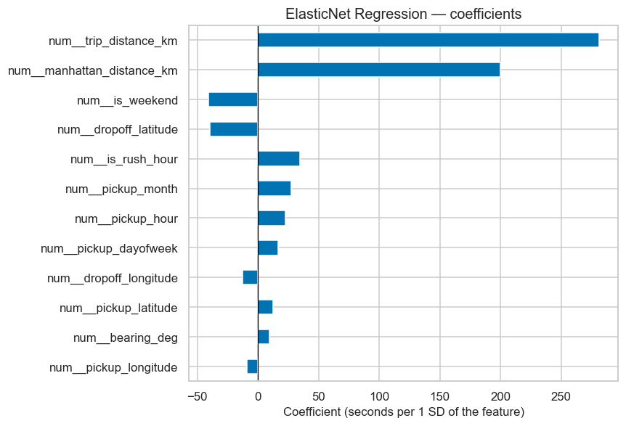
Results: model 4 – elasticnet regression

Slide 13
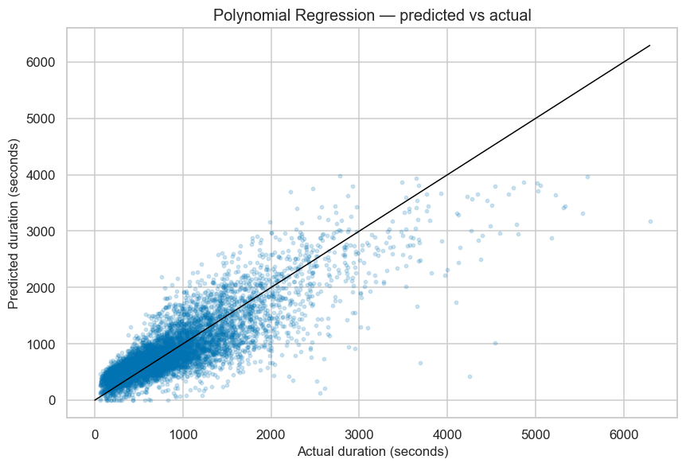
Results: model 5 – polynomial regression

Slide 14
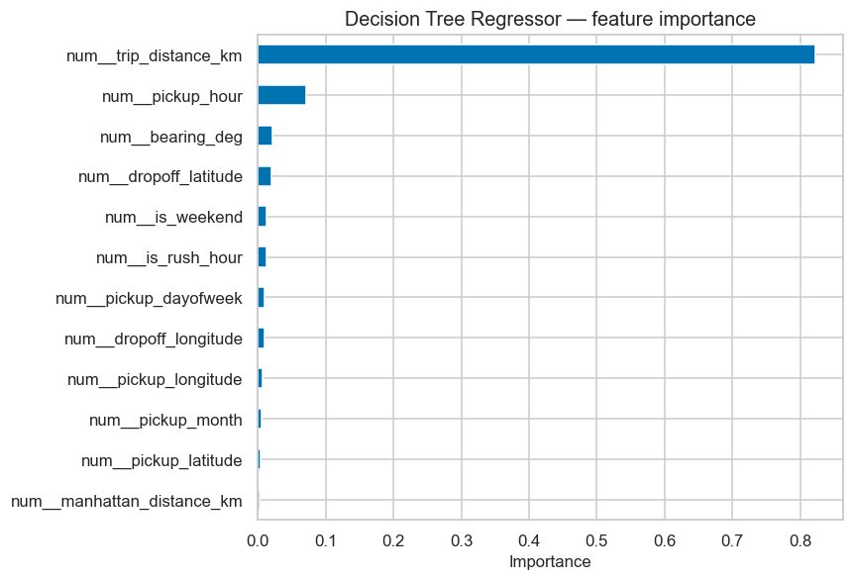
Results: model 6 – decision tree

Slide 15
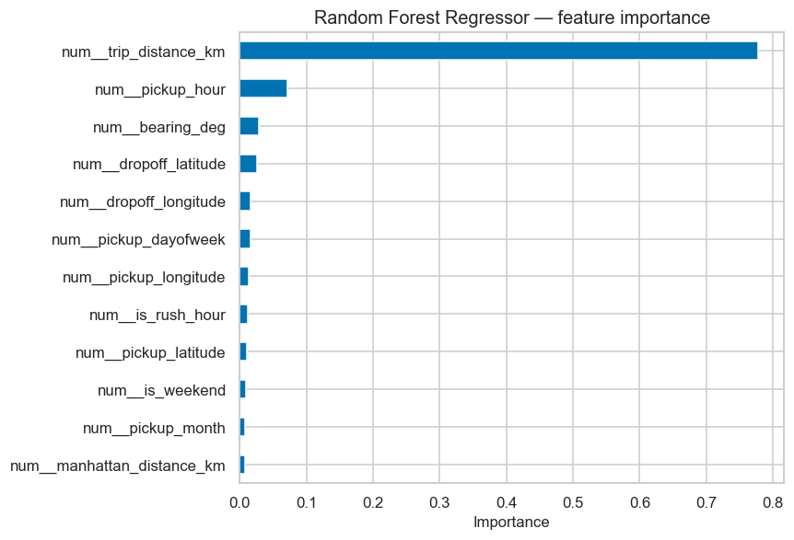
Results: model 7 – random forest regressor

Slide 16

Results: model 8 – gradient boosting regressor

Slide 17

Results: model 9 – support vector regressor

Slide 18

Results: model 10 – K Nearest neighbors Regressor

Slide 19
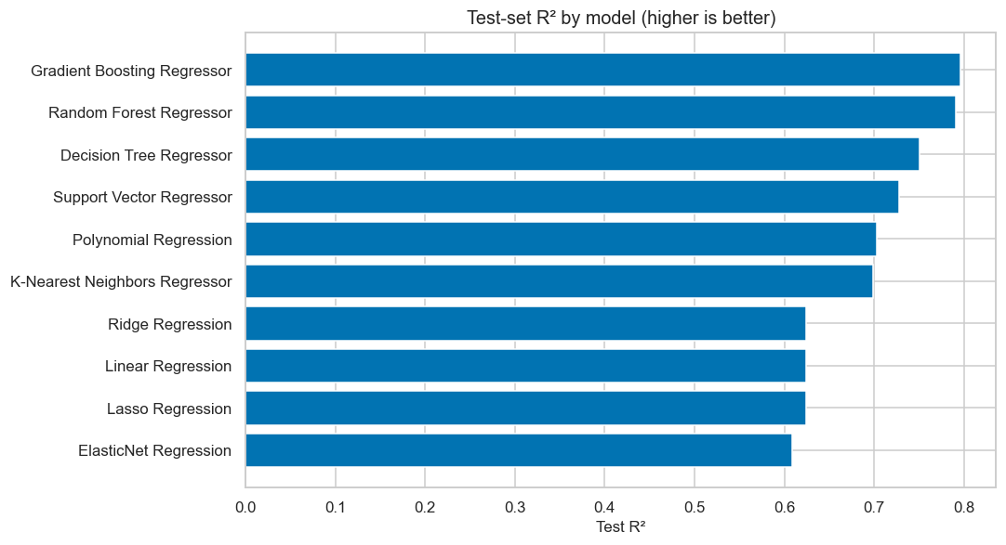
Results: model performance summary

Slide 20
Conclusion & Deployability
Best model: Gradient Boosting (R² ≈ 0.80, RMSE ≈ 5 min). Random Forest is close.
Main signal: trip distance; rush hour adds the congestion gap.
Deploy: use pickup-only features (no dropoff_datetime); return seconds at request time.
Ship with: train-only scaling, NYC GPS / duration filters, and GBM or Forest — not SVR/KNN on full data.

